Slide 1
Wind Energy Project Report (Data Mining and Feature Engineering)
Prepared by:
Adaiyibo Kio & Nitesh Kumar

Slide 2
Data preprocessing
Filtering of data for Turbine State, Power Limitation and Valid Data
Turbine State – 5
Power Limitation – 0
Data Valid – 1
The above filtering reduced the data set from 3.3M to 2.1M observations.

Slide 3
Timeline
Initial exploratory data analysis suggested that id19 – id25, id36, id37, id71 – id78, id84 – id87, and id111 might be important. These were later shown to be temperature measurements correlated to each other and/or ambient temperature.
Further exploratory data analysis suggested that id12 – id14, id26 – 28, id30, id31, id47, id61, id94 – id96, and id141 might be important. These were shown to be various measurements intrinsic to the generator and related to generator speed, power and temperature.
Removal of features that are correlated and similarly distributed with other features included in the model and keep only one of then.

Slide 4
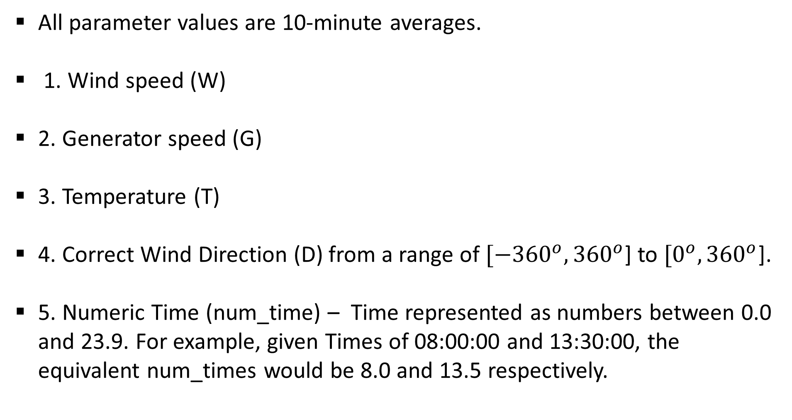
Feature Engineering – Modifying Features
All parameter values are 10-minute averages.
1. Wind speed (W)
2. Generator speed (G)
3. Temperature (T)
4. Correct Wind Direction (D) from a range of $[−{360}^{o}, {360}^{o}$] to $[0^{o}, {360}^{o}$].
5. Numeric Time (num_time) – Time represented as numbers between 0.0 and 23.9. For example, given Times of 08:00:00 and 13:30:00, the equivalent num_times would be 8.0 and 13.5 respectively.

Slide 5
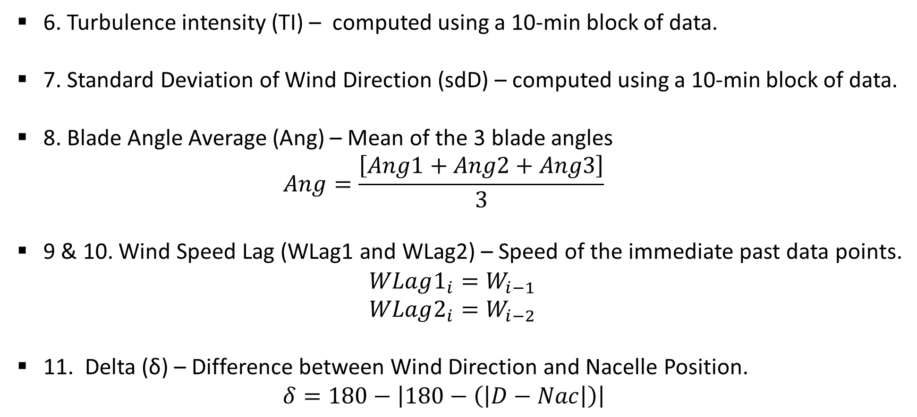
Feature Engineering – New Features
6. Turbulence intensity (TI) – computed using a 10-min block of data.
7. Standard Deviation of Wind Direction (sdD) – computed using a 10-min block of data.
8. Blade Angle Average (Ang) – Mean of the 3 blade angles
$$Ang=\frac{\left[Ang1+Ang2+Ang3\right]}{3}$$
9 & 10. Wind Speed Lag (WLag1 and WLag2) – Speed of the immediate past data points.
$$WLag1_{i}=W_{i−1}$$
$$WLag2_{i}=W_{i−2}$$
11. Delta (δ) – Difference between Wind Direction and Nacelle Position.
$$δ=180−\left|180−\left(\left|D−Nac\right|\right)\right|$$

Slide 6
Current Analysis
id5 and id17 are flagged as possibly important from previous analysis.
Two sets of models are built – one set containing id5 and id17, and the other set excluding id5 and id17.
Nacelle Position is excluded from the current analysis as a new feature incorporating the Nacelle Position is created.
Note that models in previous reports provided did not contain the following variables: id5, id17, sdD, WLag1, WLag2 and delta
Turbine 34 [2016 & 2018] and Turbine 61 [2018] are analyzed. KNN is used to build models and the models with the least RMSE are reported. Also reported are previous KNN and binning model results.

Slide 7
Results – Turbine 34 [2016]
With id5 and id17
 | With G and Ang | Without G and Ang
Current results | W + G + id5 + T RMSE = 1.597% | W + id5 + T RMSE = 2.502%
Without id5 and id17
 | With G and Ang | Without G and Ang
Current results | W + G + T + Ang + TI RMSE = 2.045% | W + T+ num_time RMSE = 3.095%
Previous results | W + G + T + Ang RMSE = 2.070% | W + T+ TI RMSE = 3.180%
Binning | RMSE = 3.930% | RMSE = 3.930%

Slide 8
Results – Turbine 34 [2018]
With id5 and id17
 | With G and Ang | Without G and Ang
Current results | W + id5 + G + T RMSE = 1.715% | W + id5 + T RMSE = 2.180%
Without id5 and id17
 | With G and Ang | Without G and Ang
Current results | W + T + G RMSE = 1.961% | W + T RMSE = 2.482%
Previous results | W + T + G RMSE = 1.980% | W + T RMSE = 2.500%
Binning | RMSE = 4.370% | RMSE = 4.370%

Slide 9
Results – Turbine 61 [2018]
With id5 and id17
Current Results | With G and Ang | Without G and Ang
Current Results | W + G + id5 + TI RMSE = 1.626% | W + id5 + id17 + T RMSE = 2.800%
Without id5 and id17
Previous Results | With G and Ang | Without G and Ang
Current Results | W + G + TI + T RMSE = 1.680% | W + T + num_time RMSE = 2.926%
Previous | W + G + TI + T RMSE = 1.700% | W + T+ TI RMSE = 2.930%
Binning | RMSE = 3.940% | RMSE = 3.940%

