Slide 1
TAMU-GoldWind Project2 Report 04-22-2019
Prepared By
Nitesh Kumar

Slide 2
Turbine State - 5
Roadmap:-
Data Exploration
Data Visualization
Data Modelling using Forward stepwise – 10 Fold Cross Validation for 6 and 4 candidates
4) Comparison of KNN – 10 minutes vs 1 minute average
5) Comparison of KNN – 10 minutes average vs 1 minute down sampled(10 min average)
Comparison of KNN with Binning method
Summary

Slide 3
Variable | Notation Used
Wind Speed | W
Wind Direction | D
Generator Speed | G
Ambient temperature | T
Nacelle Position | Nac
Blade Angle | Ang
Power Limitation | PL
Data Valid | DV
Note :–
Turbine blade angle is taken as the average of blade angle 1, 2 and 3
Results are presented in normalized state i.e (RMSE/Rated Power )*100
Group 1 – Power Limitation : 0 and Data Valid : 1
Group 2 - Power Limitation : 0 and Data Valid : 0
Group 3 - Power Limitation : 1 and Data Valid : 0
Model 1 – Include G and Ang , Model 2 – Exclude G and Ang

Slide 4
Turbine Number - 34
YEAR - 2016

Slide 5
Data Exploration
Data Distribution
Total observations – 2,326,809
 | PL- 0 | PL- 1
DV - 0 | 165,714 (7.12 %) | 16,136 (0.69) %
DV - 1 | 2,144,959 (92.18 %) | 0 (0 %)
Group 1
Group 2
Group 3
Total
Initial Observations | 2,144,959 (92.18 %) | 165,714 (7.12 %) | 16,136 (0.69 %) | 2,326,809
1 minute average | 248,825 (90.07 %) | 25,537 (9.24 %) | 1,895 (0.68 %) | 276,257
10 minutes average | 26,160 (81.25 %) | 5,777 (17.94 %) | 259 (0.80 %) | 32,196

Slide 6
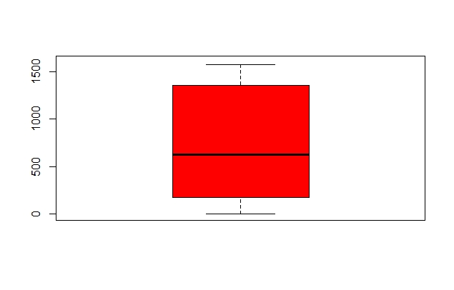
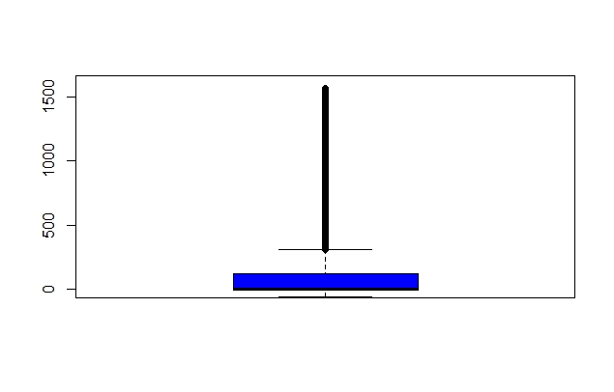
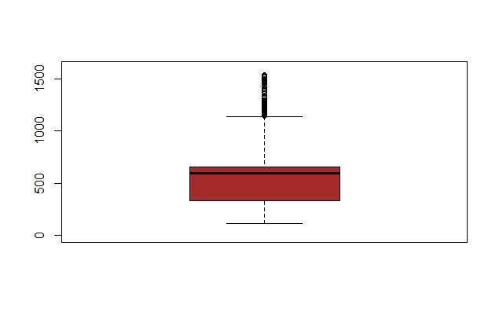
Data Visualization
Group - 1
Group - 2
Power
Power
(kW)
(kW)
Group - 3
Power
(kW)

Slide 7
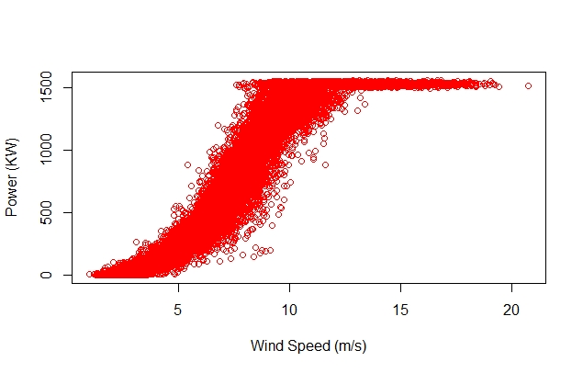
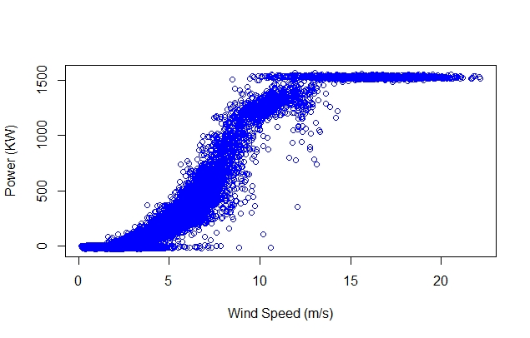
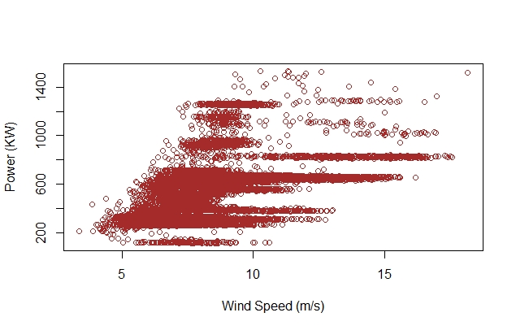
Group - 1
Group - 2
Power
Power
(kW)
(kW)
Wind Speed (m/s)
Wind Speed (m/s)
Group - 3
Power
(kW)
Wind Speed (m/s)

Slide 8
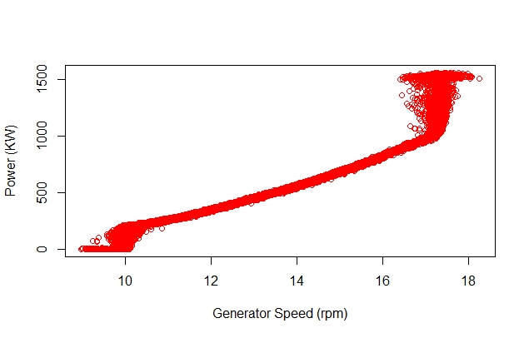
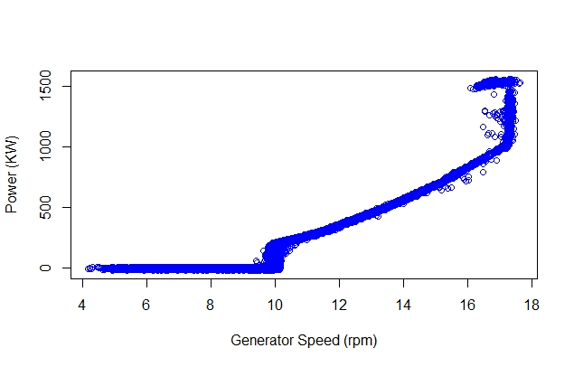
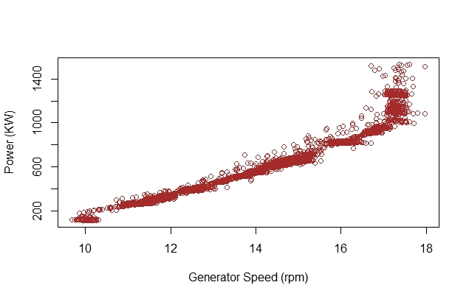
Data Visualization
Group - 1
Group - 2
Power
Power
(kW)
(kW)
Generator Speed (rpm)
Generator Speed (rpm)
Group - 3
Power
(KW)
Generator Speed (rpm)

Slide 9
KNN
Group - 1
Average – 10 minutes
Model 1: using G
Number of predictor | Best variables | RMSE | Error w.r.t rated power
1 | W | 59.33 | 3.95 %
2 | W+G | 38.24 | 2.54 %
3 | W+G+T | 31.45 | 2.09 %
4 | W+G+T+Ang | 31.05 | 2.07 %
5 | W+G+T+Ang+Nac | 35.39 | 2.35 %

Slide 10
KNN
Group - 1
Average – 10 minutes
Model 2: not using G
Number of predictor | Best variables | RMSE | Error w.r.t rated power
1 | W | 59.33 | 3.95 %
2 | W+T | 49.02 | 3.26 %
3 | W+T+Nac | 49.64 | 3.30 %
4 | W+T+Nac+Wd | 58.15 | 3.87 %

Slide 11
KNN
Group - 1
RMSE (%)
Number of Predictors
Note : -
Best model predictors for Model 1 – Wind Speed, Generator Speed, Ambient temperature and Turbine Blade Angle
Best model predictors for Model 2 – Wind Speed and Ambient temperature

Slide 12
KNN
Group - 1
Average – 1 minute
Model 1: using G
Number of predictor | Best variables | RMSE | Error w.r.t rated power
1 | W | 69.28 (72.78) | 4.61% (4.85 %)
2 | W+G | 41.41 (43.31) | 2.76 % (2.88 %)
3 | W+G+T | 33.93 (35.95) | 2.26% (2.39 %)
4 | W+G+T+Ang | 29.18 (31.63) | 1.94% (2.10 %)
5 | W+G+T+Ang+Nac | 29.45 (32.30) | 1.96% (2.15 %)
Values in the parenthesis: 1-min model predicts on 1-min test data.
Values outside the parenthesis: 1-min model predicts on 1-min resolution. The 1-min predictions are averaged every 10-min and compare with 10-min test data.

Slide 13
KNN
Group - 1
Average – 1 minute
Model 2: not using G
Number of predictor | Best variables | RMSE | Error w.r.t rated power
1 | W | 69.28 (72.78) | 4.61 % (4.85 %)
2 | W+T | 59.54 (63.40) | 3.96 % (4.22 %)
3 | W+T+Nac | 55.53 (60.00) | 3.70 % (4.00 %)
4 | W+T+Wd+Nac | 60.43 (64.85) | 4.02 % (4.32 %)
Values in the parenthesis: 1-min model predicts on 1-min test data.
Values outside the parenthesis: 1-min model predicts on 1-min resolution. The 1-min predictions are averaged every 10-min and compare with 10-min test data.

Slide 14
KNN
Group - 1
RMSE (%)
Number of Predictors
Note : -
Best model predictors for Model 1 – Wind Speed, Generator Speed, Ambient temperature and Turbine Blade Angle
Best model predictors for Model 2 – Wind Speed, Ambient temperature and Nacelle Position

Slide 15
Comparison – 10 mins vs 1 min(Average)
RMSE (%)
Number of Predictors

Slide 16
Comparison – 10 mins vs 1 min(Average)
RMSE (%)
Number of Predictors

Slide 17
KNN
Group - 1
Down sample – 1 minutes and average 10 mins
Model 1: using G
Number of predictor | Best variables | RMSE | Error w.r.t rated power
1 | W | 66.76 | 4.45 %
2 | W+G | 41.96 | 2.79 %
3 | W+G+T | 35.89 | 2.39 %
4 | W+G+T+Ang | 34.98 | 2.33 %
5 | W+G+T+Ang+Nac | 39.40 | 2.62 %

Slide 18
KNN
Group - 1
Down sample – 1 min and average 10 mins
Model 2: not using G
Number of predictor | Best variables | RMSE | Error w.r.t rated power
1 | W | 66.76 | 4.45 %
2 | W+T | 57.31 | 3.82 %
3 | W+T+Nac | 58.10 | 3.87 %
4 | W+T+Nac+Wd | 64.89 | 4.32 %

Slide 19
KNN
Group - 1
RMSE (%)
Number of Predictors
Note : -
Best model predictors for Model 1 – Wind Speed, Generator Speed, Ambient temperature and Turbine Blade Angle
Best model predictors for Model 2 – Wind Speed and Ambient temperature

Slide 20
Comparison – 10 mins average vs 10 mins average(down sample 1 min)
RMSE (%)
Number of Predictors

Slide 21
Comparison – 10 mins average vs 10 mins average(down sample 1 min)
RMSE (%)
Number of Predictors

Slide 22
Model Comparison
Group – 1 Data Only
Model 1: using G
Model 2: Not using G
Model | RMSE (kW) | RMSE (%)
KNN – 1 min (average) | 29.18 (31.63) | 1.94% (2.10%)
KNN – 10 mins (average) | 31.05 | 2.07%
KNN – 10 mins average (down sample 1 min) | 34.98 | 2.33%
BINNING – 10 mins (average) | 59.09 | 3.93%
Model | RMSE (kW) | RMSE (%)
KNN – 1 min (average) | 55.53 (60.00) | 3.70% (4.00%)
KNN – 10 mins (average) | 49.02 | 3.26%
KNN – 10 mins average (down sample 1 min) | 57.31 | 3.82%
BINNING – 10 mins (average) | 59.09 | 3.93%

Slide 23
SUMMARY
Power curve modelling : two phases – Data Cleaning and Data Modelling
Data Cleaning
Data Exploration and visualization laid the basis to filter important states of features. The three major ones are:
Turbine State – 5 2) Power Limitation – 0 3) Data Valid - 1
The above filtering reduced the data-set by approximately 33%.
Data Modelling
The analysis was carried out on 1 minute averaged data and 10 minutes averaged data using KNN.
1 minute: 1) 1 minute average data predicted the power produced with the best RMSE error of 2.10 % using generator speed and 4.00 % without using generator speed
2) 1 minute prediction and 10 minutes averaged test data predicted the power produced with the best RMSE error of 1.94 % using generator speed and 3.70 % without using generator speed
3) 1 minute down sample and 10 minutes averaged data predicted the power produced with the best RMSE error of 2.33 % using generator speed and 3.82 % without using generator speed
10 minutes: 1) 10 minutes average data predicted the power produced with the best RMSE error of 2.07 % using generator speed and 3.26 % without using generator speed

Slide 24
Turbine Number - 34
YEAR - 2018

Slide 25
Data Exploration
Data Distribution
Total observations – 2,283,148
 | PL- 0 | PL- 1
DV - 0 | 196,860 (8.62 %) | 39,434 (1.72) %
DV - 1 | 2,046,854 (89.65 %) | 0 (0 %)
Group 1
Group 2
Group 3
Total
Initial Observations | 2,046,854 (89.65 %) | 196,860 (8.62 %) | 39434 (1.72 %) | 2,283,148
1 minute average | 266,016 (86.81 %) | 34,407 (11.22 %) | 5,991 (1.95 %) | 306,414
10 minutes average | 28,646 (76.31 %) | 7,861 (20.94 %) | 1,028 (2.73 %) | 37,535

Slide 26
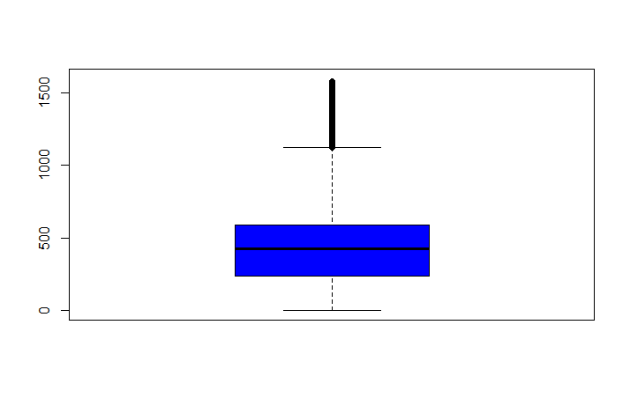
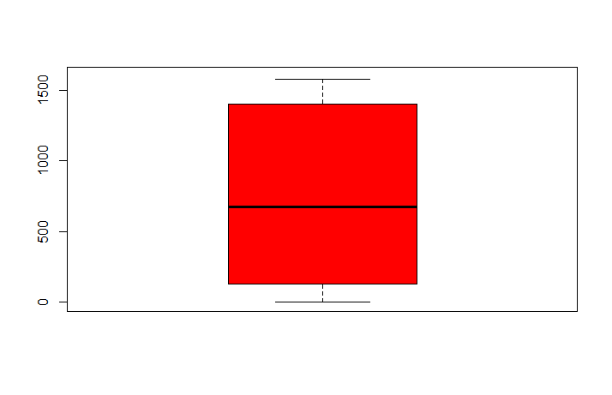
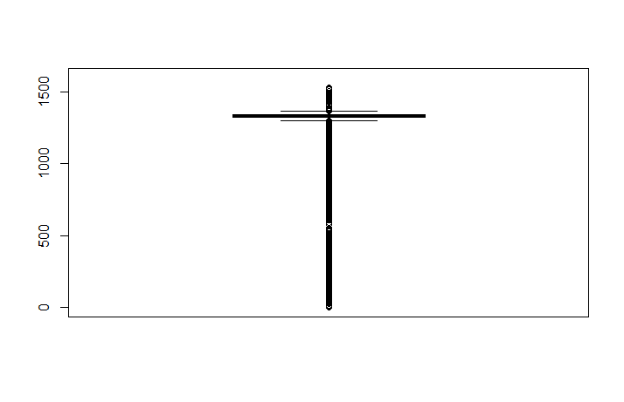
Data Visualization
Group - 1
Group - 2
Power
Power
(kW)
(kW)
Group - 3
Power
(kW)

Slide 27
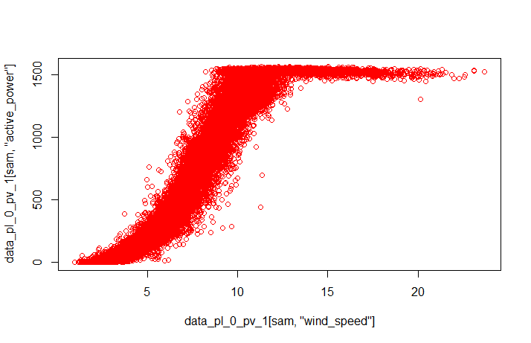
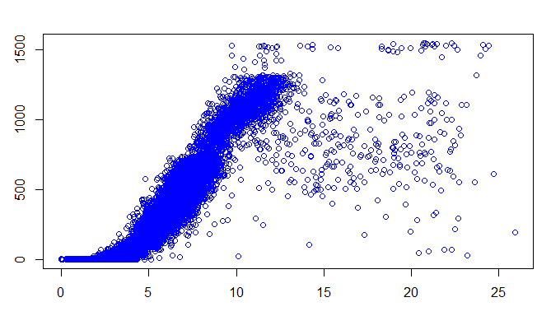
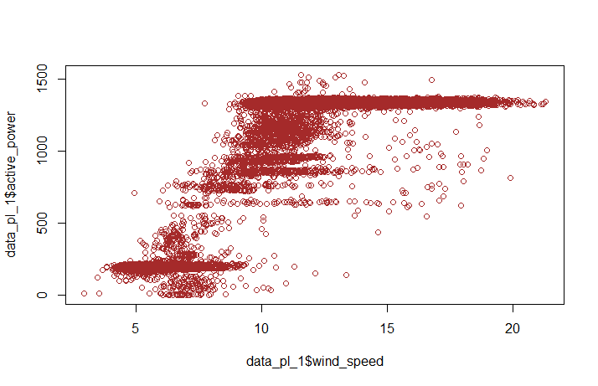
Group - 1
Group - 2
Power
Power
(kW)
(kW)
Wind Speed (m/s)
Wind Speed (m/s)
Group - 3
Power
(kW)
Wind Speed (m/s)

Slide 28
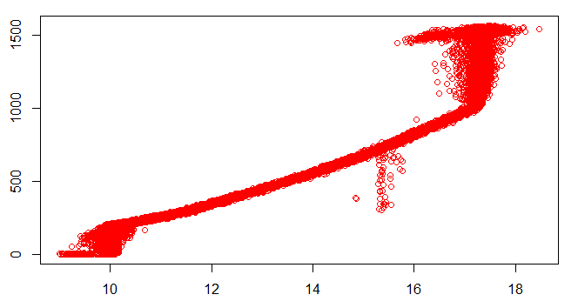
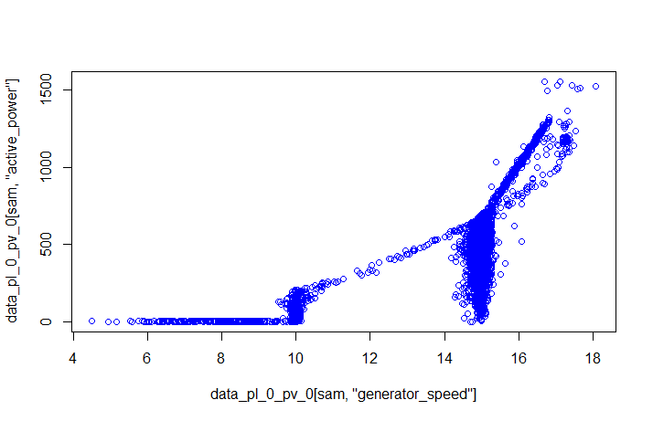
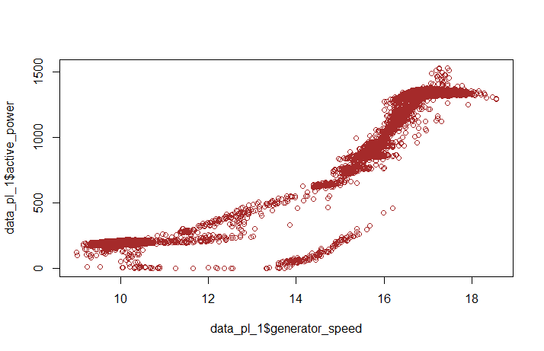
Data Visualization
Group - 1
Group - 2
Power
Power
(kW)
(kW)
Generator Speed (rpm)
Generator Speed (rpm)
Group - 3
Power
(kW)
Generator Speed (rpm)

Slide 29
KNN
Group - 1
Average – 10 minutes
Model 1: using G
Number of predictor | Best variables | RMSE | Error w.r.t rated power
1 | W | 66.41 | 4.42 %
2 | W+T | 37.63 | 2.50 %
3 | W+T+G | 29.81 | 1.98 %
4 | W+T+G+Nac | 30.95 | 2.06 %
5 | W+T+G+Nac+Ang | 36.57 | 2.43 %

Slide 30
KNN
Group - 1
Average – 10 minutes
Model 2: not using G
Number of predictor | Best variables | RMSE | Error w.r.t rated power
1 | W | 66.41 | 4.42 %
2 | W+T | 37.63 | 2.50 %
3 | W+T+Nac | 38.49 | 2.56 %
4 | W+T+Nac+Wd | 47.55 | 3.17 %

Slide 31
KNN
Group - 1
RMSE (%)
Number of Predictors
Note : -
Best model predictors for Model 1 – Wind Speed, Ambient Temperature and Generator Speed
Best model predictors for Model 2 – Wind Speed and Ambient temperature

Slide 32
KNN
Group - 1
Average – 1 minute
Model 1: using G
Number of predictor | Best variables | RMSE | Error w.r.t rated power
1 | W | 76.28 (79.16) | 5.08 % (5.27 %)
2 | W+G | 50.11 (52.27) | 3.34 % (3.48 %)
3 | W+G+T | 33.59 (35.83) | 2.23 % (2.38 %)
4 | W+G+T+Ang | 30.32 (32.70) | 2.02 % (2.18 %)
5 | W+G+T+Ang+Nac | 31.84 (34.56) | 2.12 % (2.30 %)
Values in the parenthesis: 1-min model predicts on 1-min test data.
Values outside the parenthesis: 1-min model predicts on 1-min resolution. The 1-min predictions are averaged every 10-min and compare with 10-min test data.

Slide 33
KNN
Group - 1
Average – 1 minute
Model 2: not using G
Number of predictor | Best variables | RMSE | Error w.r.t rated power
1 | W | 76.28 (79.16) | 5.08 % (5.27 %)
2 | W+T | 51.61 (55.47) | 3.44 % (3.69 %)
3 | W+T+Nac | 49.78 (53.93) | 3.31 % (3.59 %)
4 | W+T+Wd+Nac | 53.01 (56.96) | 3.53 % (3.79 %)
Values in the parenthesis: 1-min model predicts on 1-min test data.
Values outside the parenthesis: 1-min model predicts on 1-min resolution. The 1-min predictions are averaged every 10-min and compare with 10-min test data.

Slide 34
KNN
Group - 1
RMSE (%)
Number of Predictors
Note : -
Best model predictors for Model 1 – Wind Speed, Generator Speed, Ambient temperature and Turbine Blade Angle
Best model predictors for Model 2 – Wind Speed, Ambient temperature and Nacelle Position

Slide 35
Comparison – 10 mins vs 1 min(Average)
RMSE (%)
Number of Predictors

Slide 36
Comparison – 10 mins vs 1 min(Average)
RMSE (%)
Number of Predictors

Slide 37
KNN
Group - 1
Down sample – 1 minutes and average 10 mins
Model 1: using G
Number of predictor | Best variables | RMSE | Error w.r.t rated power
1 | W | 71.69 | 4.77 %
2 | W+T | 46.40 | 3.09 %
3 | W+T+G | 34.78 | 2.31 %
4 | W+T+G+Ang | 35.18 | 2.34 %
5 | W+T+G+Ang+Nac | 40.88 | 2.72 %

Slide 38
KNN
Group - 1
Down sample – 1 min and average 10 mins
Model 2: not using G
Number of predictor | Best variables | RMSE | Error w.r.t rated power
1 | W | 71.69 | 4.77 %
2 | W+T | 46.40 | 3.09 %
3 | W+T+Nac | 47.77 | 3.18 %
4 | W+T+Nac+Wd | 54.63 | 3.64 %

Slide 39
KNN
Group - 1
RMSE (%)
Number of Predictors
Note : -
Best model predictors for Model 1 – Wind Speed, Ambient Temperature and Generator Speed
Best model predictors for Model 2 – Wind Speed and Ambient temperature

Slide 40
Comparison – 10 mins average vs 10 mins average(down sample 1 min)
RMSE (%)
Number of Predictors

Slide 41
Comparison – 10 mins average vs 10 mins average(down sample 1 min)
RMSE (%)
Number of Predictors

Slide 42
Model Comparison
Group – 1 Data Only
Model 1: using G
Model 2: Not using G
Model | RMSE (kW) | RMSE (%)
KNN – 1 min (average) | 30.32 (32.70) | 2.02 % (2.18 %)
KNN – 10 mins (average) | 29.81 | 1.98 %
KNN – 10 mins average (down sample 1 min) | 34.78 | 2.31 %
BINNING – 10 mins (average) | 65.63 | 4.37%
Model | RMSE (kW) | RMSE (%)
KNN – 1 min (average) | 49.78 (53.93) | 3.31 % (3.59 %)
KNN – 10 mins (average) | 37.63 | 2.50 %
KNN – 10 mins average (down sample 1 min) | 46.40 | 3.09 %
BINNING – 10 mins (average) | 65.63 | 4.37 %

Slide 43
SUMMARY
Power curve modelling : two phases – Data Cleaning and Data Modelling
Data Cleaning
Data Exploration and visualization laid the basis to filter important states of features. The three major ones are:
Turbine State – 5 2) Power Limitation – 0 3) Data Valid - 1
The above filtering reduced the data-set by approximately 33%.
Data Modelling
The analysis was carried out on 1 minute average data and 10 minutes average data using KNN.
1 minute: 1) 1 minute average data predicted the power produced with the best RMSE error of 2.18 % using generator speed and 3.59 % without using generator speed
2) 1 minute prediction and 10 minutes averaged test data predicted the power produced with the best RMSE error of 2.02 % using generator speed and 3.31 % without using generator speed
3) 1 minute down sample and 10 minutes average data predicted the power produced with the best RMSE error of 2.31 % using generator speed and 3.09 % without using generator speed
10 minutes: 1) 10 minutes average data predicted the power produced with the best RMSE error of 1.98 % using generator speed and 2.50 % without using generator speed

Slide 44
Turbine Number - 61
YEAR - 2018

Slide 45
Data Exploration
Data Distribution
Total observations – 2,243,808
 | PL- 0 | PL- 1
DV - 0 | 71,084 (3.16 %) | 628 (0.02 %)
DV - 1 | 2,172,096 (96.80 %) | 0 (0 %)
Group 1
Group 2
Group 3
Total
Initial Observations | 2,172,096 (96.80 %) | 71,084 (3.16 %) | 628 (0.02 %) | 2,243,808
1 minute average | 282,705 (92.87 %) | 21,578 (7.08 %) | 104 (0.03 %) | 304,387
10 minutes average | 30,193 (78.04 %) | 8,464 (21.87 %) | 31 (0.08 %) | 38,688

Slide 46
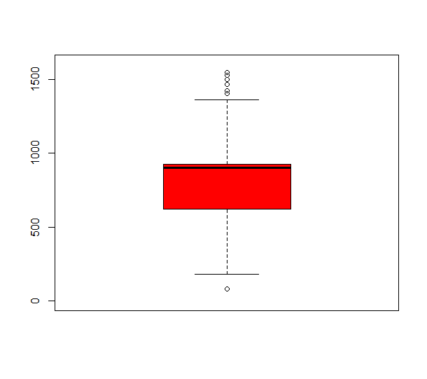
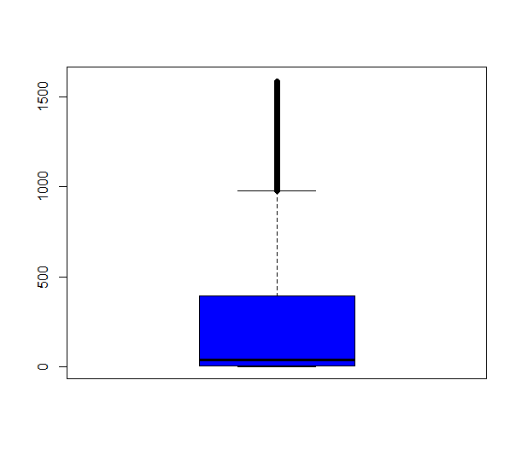
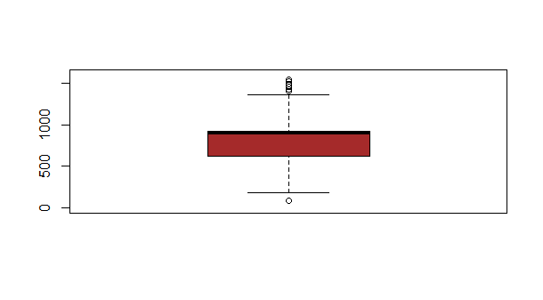
Data Visualization
Group - 1
Group - 2
Power
Power
(kW)
(kW)
Group - 3
Power
(kW)

Slide 47
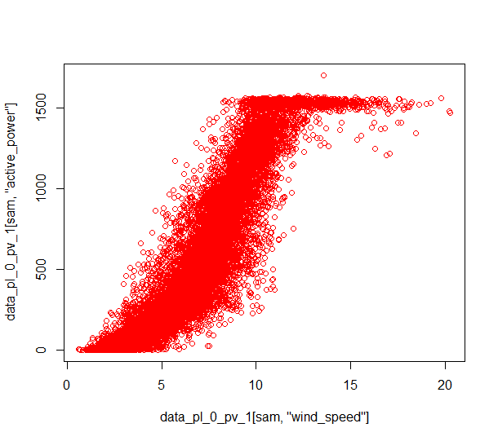
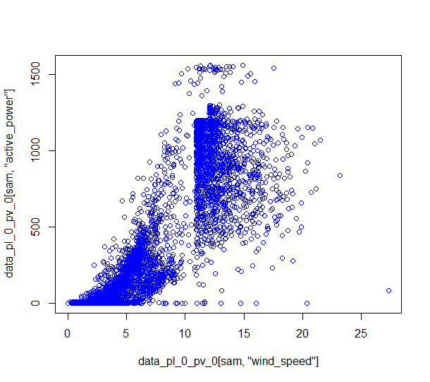
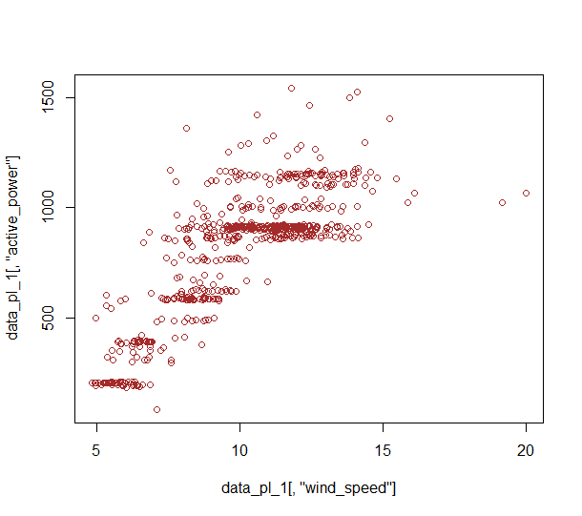
Group - 1
Group - 2
Power
Power
(kW)
(kW)
Wind Speed (m/s)
Wind Speed (m/s)
Group - 3
Power
(kW)
Wind Speed (m/s)

Slide 48
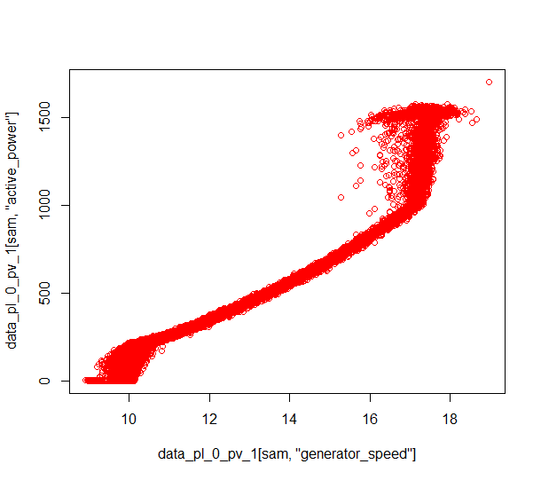
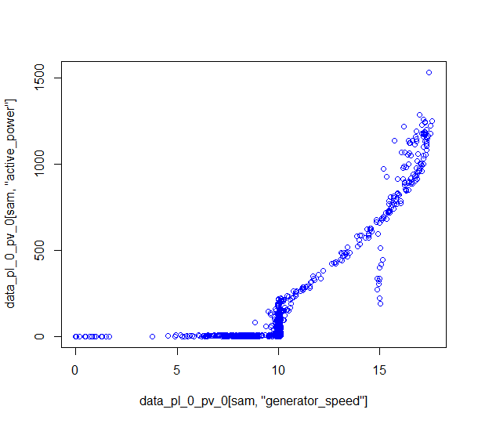
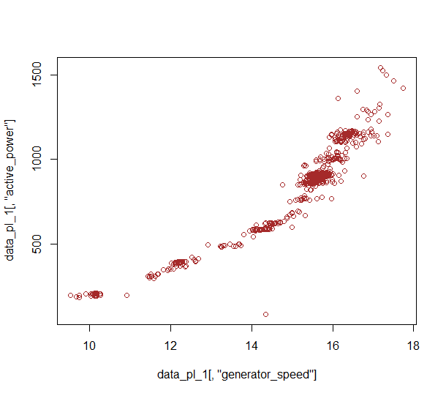
Data Visualization
Group - 1
Group - 2
Power
Power
(kW)
(kW)
Generator Speed (rpm)
Generator Speed (rpm)
Group - 3
Power
(kW)
Generator Speed (rpm)

Slide 49
KNN
Group - 1
Average – 10 minutes
Model 1: using G
Number of predictor | Best variables | RMSE | Error w.r.t rated power
1 | W | 59.51 | 3.96 %
2 | W+G | 32.64 | 2.17 %
3 | W+G+T | 29.29 | 1.95 %
4 | W+G+T+Ang | 31.22 | 2.08 %
5 | W+G+T+Ang+Nac | 37.22 | 2.48 %

Slide 50
KNN
Group - 1
Average – 10 minutes
Model 2: not using G
Number of predictor | Best variables | RMSE | Error w.r.t rated power
1 | W | 59.51 | 3.96 %
2 | W+T | 49.88 | 3.32 %
3 | W+T+Nac | 50.26 | 3.35 %
4 | W+T+Nac+Wd | 54.21 | 3.61 %

Slide 51
KNN
Group - 1
RMSE (%)
Number of Predictors
Note : -
Best model predictors for Model 1 – Wind Speed, Generator Speed, Ambient temperature
Best model predictors for Model 2 – Wind Speed and Ambient temperature

Slide 52
KNN
Group - 1
Average – 1 minute
Model 1: using G
Number of predictor | Best variables | RMSE | Error w.r.t rated power
1 | G | 71.09 (74.90) | 4.73 % (4.99 %)
2 | G+W | 36.91 (39.60) | 2.46 % (2.64 %)
3 | G+W+T | 32.70 (35.65) | 2.18 % (2.37 %)
4 | G+W+T+Ang | 31.48 (34.69) | 2.09 % (2.31 %)
5 | G+W+T+Ang+Nac | 34.07 (37.47) | 2.27 % (2.49 %)
Values in the parenthesis: 1-min model predicts on 1-min test data.
Values outside the parenthesis: 1-min model predicts on 1-min resolution. The 1-min predictions are averaged every 10-min and compare with 10-min test data.

Slide 53
KNN
Group - 1
Average – 1 minute
Model 2: not using G
Number of predictor | Best variables | RMSE | Error w.r.t rated power
1 | W | 77.25 (83.12) | 5.15 % (5.54 %)
2 | W+T | 68.24 (74.50) | 4.54 % (4.96 %)
3 | W+T+Nac | 67.09 (73.49) | 4.47 % (4.89 %)
4 | W+T+Wd+Nac | 69.16 (75.28) | 4.61 % (5.01 %)
Values in the parenthesis: 1-min model predicts on 1-min test data.
Values outside the parenthesis: 1-min model predicts on 1-min resolution. The 1-min predictions are averaged every 10-min and compare with 10-min test data.

Slide 54
KNN
Group - 1
RMSE (%)
Number of Predictors
Note : -
Best model predictors for Model 1 – Generator Speed, Wind Speed, Ambient temperature and Turbine Blade Angle
Best model predictors for Model 2 – Wind Speed, Ambient temperature and Nacelle Position

Slide 55
Comparison – 10 mins vs 1 min(Average)
RMSE (%)
Number of Predictors

Slide 56
Comparison – 10 mins vs 1 min(Average)
RMSE (%)
Number of Predictors

Slide 57
KNN
Group - 1
Down sample – 1 minutes and average 10 mins
Model 1: using G
Number of predictor | Best variables | RMSE | Error w.r.t rated power
1 | G | 65.97 | 4.39 %
2 | G+W | 38.81 | 2.58 %
3 | G+W+T | 36.33 | 2.42 %
4 | G+W+T+Ang | 38.49 | 2.56 %
5 | G+W+T+Ang+Nac | 43.85 | 2.92 %

Slide 58
KNN
Group - 1
Down sample – 1 min and average 10 mins
Model 2: not using G
Number of predictor | Best variables | RMSE | Error w.r.t rated power
1 | W | 72.45 | 4.83 %
2 | W+T | 64.27 | 4.28 %
3 | W+T+Nac | 65.18 | 4.34 %
4 | W+T+Nac+Wd | 68.47 | 4.56 %

Slide 59
KNN
Group - 1
RMSE (%)
Number of Predictors
Note : -
Best model predictors for Model 1 – Generator Speed, Wind Speed and Ambient temperature
Best model predictors for Model 2 – Wind Speed and Ambient temperature

Slide 60
Comparison – 10 mins average vs 10 mins average(down sample 1 min)
RMSE (%)
Number of Predictors

Slide 61
Comparison – 10 mins average vs 10 mins average(down sample 1 min)
RMSE (%)
Number of Predictors

Slide 62
Model Comparison
Group – 1 Data Only
Model 1: using G
Model 2: Not using G
Model | RMSE (kW) | RMSE (%)
KNN – 1 min (average) | 31.48 (34.69) | 2.09 % (2.31 %)
KNN – 10 mins (average) | 29.29 | 1.95 %
KNN – 10 mins average (down sample 1 min) | 36.33 | 2.42 %
BINNING – 10 mins (average) | 59.11 | 3.94 %
Model | RMSE (kW) | RMSE (%)
KNN – 1 min (average) | 67.09 (73.49) | 4.47 % (4.89 %)
KNN – 10 mins (average) | 49.88 | 3.32 %
KNN – 10 mins average (down sample 1 min) | 64.27 | 4.28 %
BINNING – 10 mins (average) | 59.11 | 3.94 %

Slide 63
SUMMARY
Power curve modelling : two phases – Data Cleaning and Data Modelling
Data Cleaning
Data Exploration and visualization laid the basis to filter important states of features. The three major ones are:
Turbine State – 5 2) Power Limitation – 0 3) Data Valid - 1
The above filtering reduced the data-set by approximately 33%.
Data Modelling
The analysis was carried out on 1 minute averaged data and 10 minutes averaged data using KNN.
1 minute: 1) 1 minute average data predicted the power produced with the best RMSE error of 2.31 % using generator speed and 4.89 % without using generator speed
2) 1 minute prediction and 10 minutes average test data predicted the power produced with the best RMSE error of 2.09 % using generator speed and 4.47 % without using generator speed
3) 1 minute down sample and 10 minutes average data predicted the power produced with the best RMSE error of 2.42 % using generator speed and 4.28 % without using generator speed
10 minutes: 1) 10 minutes average data predicted the power produced with the best RMSE error of 1.95 % using generator speed and 3.32 % without using generator speed

Slide 64
SUMMARY – Using G
Model | Turbine – 34(2016) RMSE(%) | Turbine – 34(2018) RMSE(%) | Turbine – 61(2018) RMSE(%)
KNN – 1 min (average) | 1.94% (2.10%) | 2.02 % (2.18 %) | 2.09 % (2.31 %)
KNN – 10 mins (average) | 2.07% | 1.98 % | 1.95 %
KNN – 10 mins average (down sample 1 min) | 2.33% | 2.31 % | 2.42 %
BINNING – 10 mins (average) | 3.93% | 4.37% | 3.94 %
The analysis gives a clear picture of 10 minute average data being consistent and best in terms of prediction
The 1 minute average data with RMSE calculated on 10 minute averaged test data does better than normal 1 minute data prediction and error calculation

Slide 65
SUMMARY – Not Using G
Model | Turbine – 34(2016) RMSE(%) | Turbine – 34(2018) RMSE(%) | Turbine – 61(2018) RMSE(%)
KNN – 1 min (average) | 3.70% (4.00%) | 3.31 % (3.59 %) | 4.47 % (4.89 %)
KNN – 10 mins (average) | 3.26% | 2.50 % | 3.32 %
KNN – 10 mins average (down sample 1 min) | 3.82% | 3.09 % | 4.28 %
BINNING – 10 mins (average) | 3.93% | 4.37 % | 3.94 %
Not using generator speed does lack in predictive capability and shows some variation in the results across different data
It seems that be it any case(using generator speed or not) 10 minute average data shows a better predictive capability.

