Slide 1
Wind Energy Project Report (Power curve modelling and performance evaluation)
Prepared By:
Nitesh Kumar & Adaiyibo Kio

Slide 2
Summary

Slide 3
Data and processing
Data Preprocessing
Data Exploration and visualization laid the basis to filter important states of features. The three major ones are:
Turbine State – 5 2) Power Limitation – 0 3) Data Valid – 1
The above filtering reduced the data-set by approximately 33%.
Modelling
The analysis was carried out on 1 minute averaged data and 10 minutes averaged data using KNN.
The set of input variables (predictors) are listed on the next slide.
Cross validation RMSE is used to select the best model. A forward selection strategy is used.

Slide 4
Variable | Notation Used
Wind Speed | W
Wind Direction | D
Generator Speed | G
Ambient temperature | T
Nacelle Position | Nac
Blade Angle | Ang
Power Limitation | PL
Data Valid | DV
Turbulence Intensity | I
New
addition
Note :–
Turbine blade angle is taken as the average of blade angle 1, 2 and 3
Results are presented in normalized state i.e (RMSE/Rated Power )*100
Group 1 – Power Limitation : 0 and Data Valid : 1
Group 2 - Power Limitation : 0 and Data Valid : 0
Group 3 - Power Limitation : 1 and Data Valid : 0
Model 1 – Include G and Ang , Model 2 – Exclude G and Ang

Slide 5
Model 1: Using G
Model | Turbine – 34(2016) RMSE(%) | Turbine – 34(2018) RMSE(%) | Turbine – 61(2018) RMSE(%)
KNN – 10 mins (average) | 2.07% | 1.98 % | 1.70 %
Gaussian – 10 mins (average) | 1.63% | 1.96% | 1.40%
BINNING – 10 mins (average) | 3.93% | 4.37% | 3.94 %
% reduction from Binning(KNN) | 47% | 55% | 57%
% reduction from Binning(Gaussian) | 58% | 55% | 64%
Best variable sets | W, G, T, Ang | W, T, G | W, T, G, I

Slide 6
Model 2: Not using G
Model | Turbine – 34(2016) RMSE(%) | Turbine – 34(2018) RMSE(%) | Turbine – 61(2018) RMSE(%)
KNN – 10 mins (average) | 3.18% | 2.50 % | 2.93 %
Gaussian – 10 mins (average) | 3.15% | 2.54% | 2.84%
BINNING – 10 mins (average) | 3.93% | 4.37 % | 3.94 %
% reduction from Binning(KNN) | 19% | 43% | 26%
% reduction from Binning(Gaussian) | 19% | 42% | 28%
Best variable set | W, T, I | W, T | W, T, I

Slide 7
Turbine Number - 34
YEAR - 2016
Bin-wise RMSE reduction

Slide 8
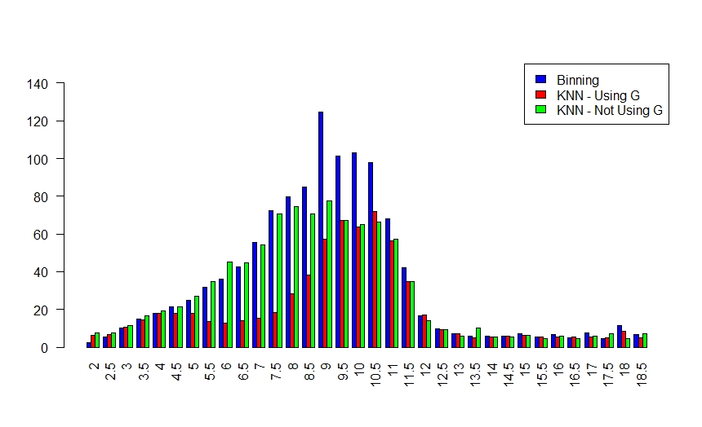
Binwise RMSE
RMSE
(kW)
Wind Speed (m/s)

Slide 9
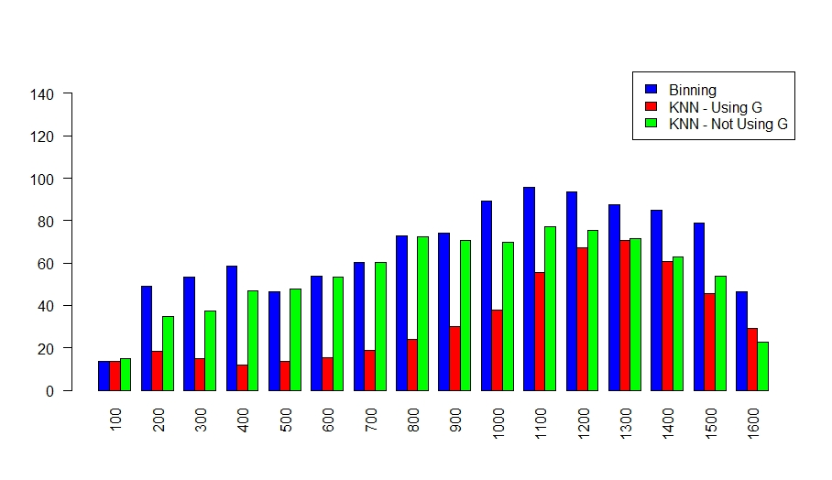
Binwise RMSE
RMSE
(kW)
Power (kW)

Slide 10
Turbine Number - 34
YEAR - 2018
Bin-wise RMSE reduction

Slide 11
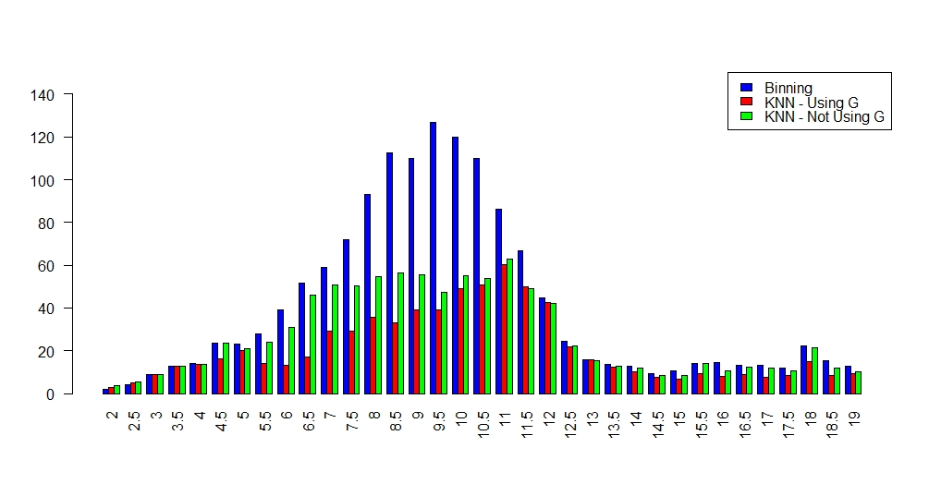
Binwise RMSE
RMSE
(kW)
Wind Speed (m/s)

Slide 12
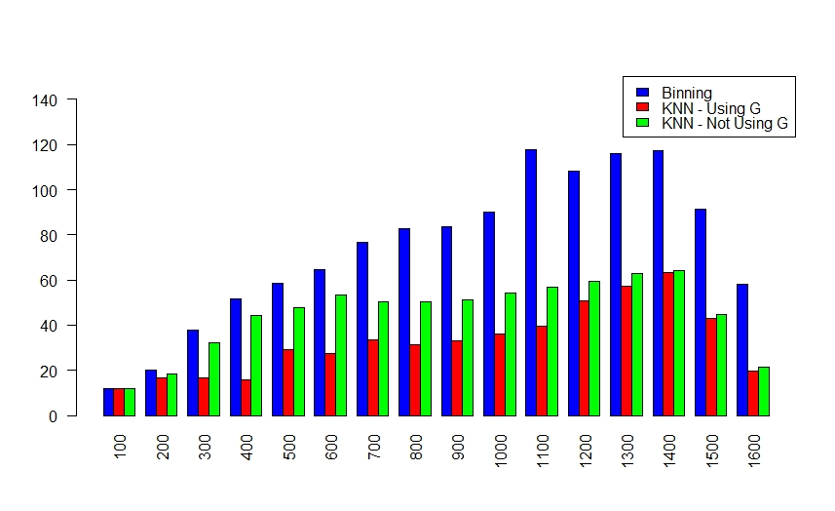
Binwise RMSE
RMSE
(kW)
Power (kW)

Slide 13
Turbine Number - 61
YEAR - 2018
Bin-wise RMSE reduction

Slide 14
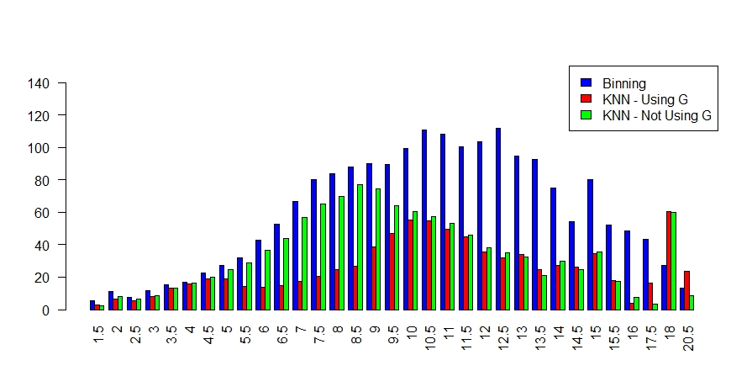
2016
RMSE
(kW)
Wind Speed (m/s)

Slide 15
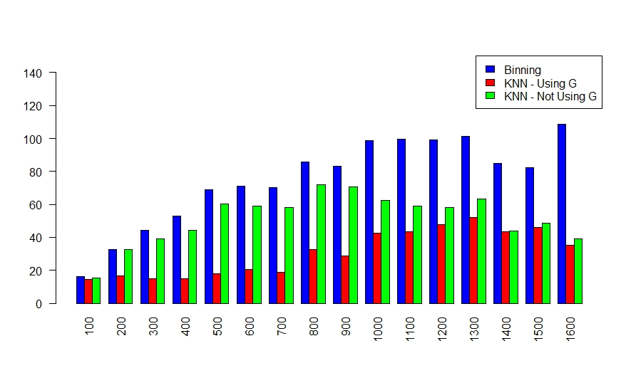
RMSE
(kW)
Power (kW)

