Slide 1
Wind Energy Project Report (Power curve modelling and performance evaluation) 06-16-2019
Prepared By:
Nitesh Kumar & Adaiyibo Kio

Slide 2
Gaussian Process

Slide 3
Introduction
What we did previously
Use the KNN method for power curve modelling and analysis of the followings:
- 10 minute average data
- 1 minute average data
- Down sample 1 minute and average 10 minute data
Two modeling options: using generator speed and without generator speed
The forward stepwise method along with 10 fold cross validation were employed to get the best covariates combination
Transition from KNN to Gaussian Process (GP) Model. Why do we need this?
Most of the data encountered on daily basis exhibit stochastic behavior and Gaussian process is based on stochastic principles.
Gaussian process can be used to quantify uncertainty in a model because it assumes a joint multivariate Gaussian distribution which has a defined probability distribution.
On the other hand, KNN can only be used for predicting/estimating the mean (average) value without uncertainty quantification.

Slide 4
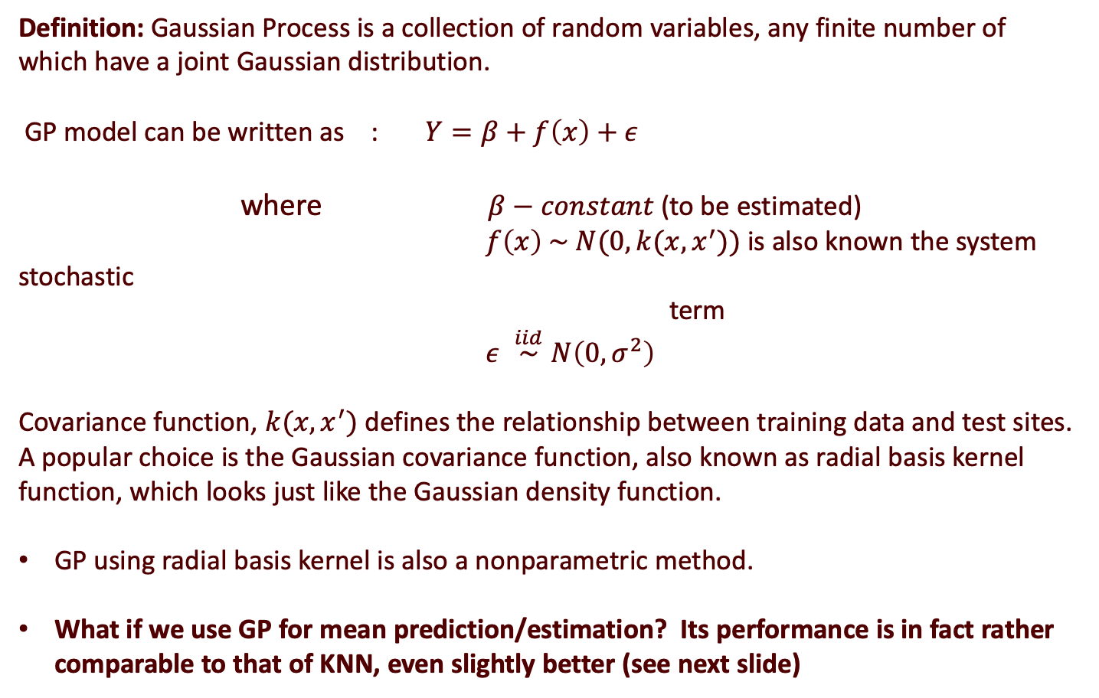
GP Model
Definition: Gaussian Process is a collection of random variables, any finite number of which have a joint Gaussian distribution.
GP model can be written as : $Y=β+f\left(x\right)+ε$
where $β−constant$ (to be estimated)
$f\left(x\right) \sim N(0,k(x,x^{′}))$ is also known the system stochastic term
$ε \overset{iid}{∼}N\left(0,σ^{2}\right)$
Covariance function, $k(x,x^{′})$ defines the relationship between training data and test sites. A popular choice is the Gaussian covariance function, also known as radial basis kernel function, which looks just like the Gaussian density function.
GP using radial basis kernel is also a nonparametric method.
What if we use GP for mean prediction/estimation? Its performance is in fact rather comparable to that of KNN, even slightly better (see next slide)

Slide 5
KNN vs GP Model (mean prediction)
Model | Turbine – 34 (2016) RMSE(%) | Turbine – 34 (2018) RMSE(%) | Turbine – 61 (2018) RMSE(%)
KNN – 10 mins (average) | 2.07% | 1.98 % | 1.70 %
GP – 10 mins (average) | 1.63% | 1.96% | 1.40%
BINNING – 10 mins (average) | 3.93% | 4.37% | 3.94 %
% reduction from Binning (KNN) | 47% | 55% | 57%
% reduction from Binning (GP) | 58% | 55% | 64%
Best variable sets | W, G, T, Ang | W, T, G | W, T, G, I

Slide 6
Introduction
What we do here
Use GP to do performance comparison either between two periods of the same turbine or two turbines over the same period.
The methodological background for doing this is hypothesis testing of two nonparametric functions.

Slide 7
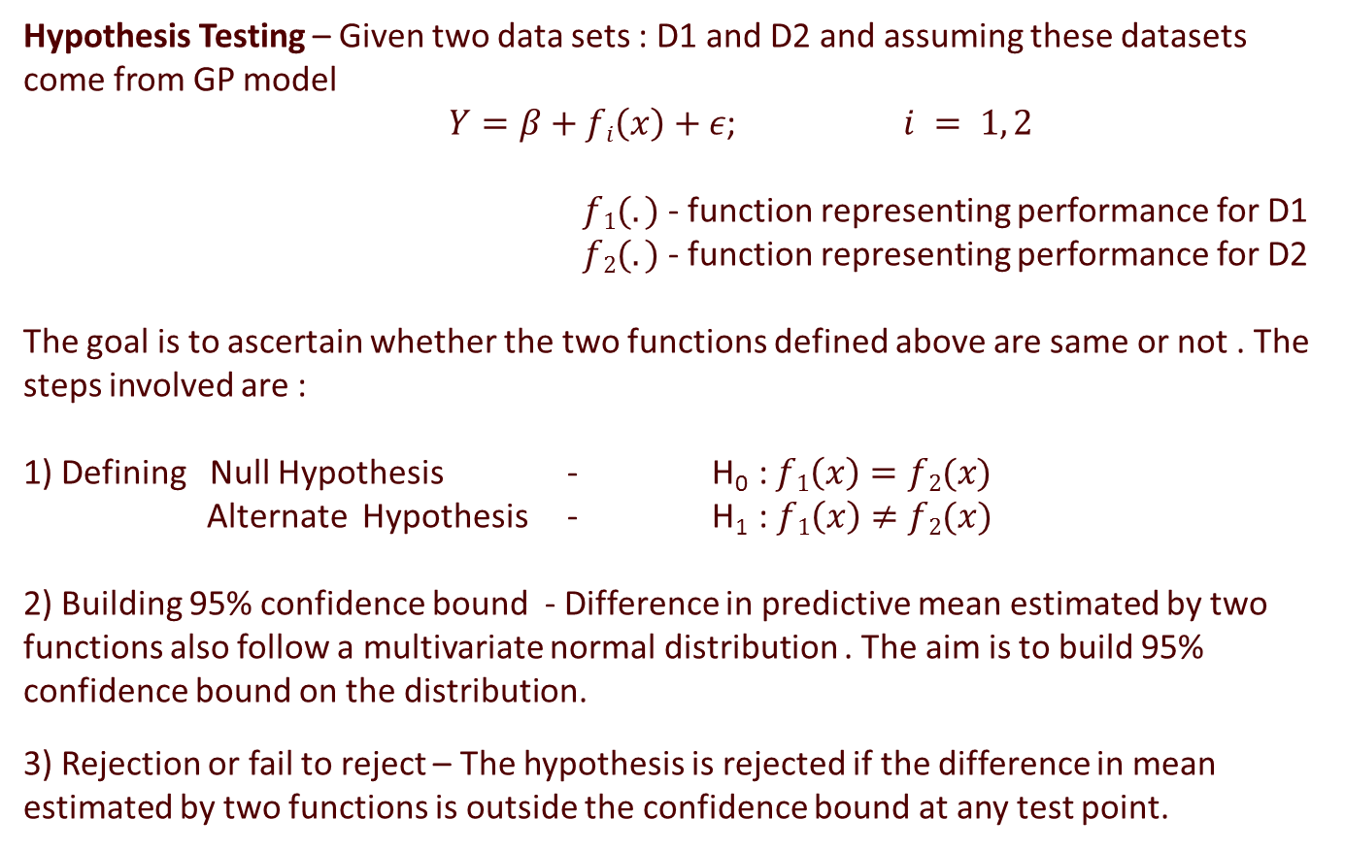
GP Model - Statistical Inference
Hypothesis Testing – Given two data sets : D1 and D2 and assuming these datasets come from GP model
$Y=β+fi\left(x\right)+ε$; $i = 1, 2$
$f1(.)$ - function representing performance for D1
$f2(.)$ - function representing performance for D2
The goal is to ascertain whether the two functions defined above are same or not . The steps involved are :
1) Defining Null Hypothesis - H₀ : $f1\left(x\right)=f2(x)$
Alternate Hypothesis - H₁ : $f1\left(x\right)≠f2(x)$
2) Building 95% confidence bound - Difference in predictive mean estimated by two functions also follow a multivariate normal distribution . The aim is to build 95% confidence bound on the distribution.
3) Rejection or fail to reject – The hypothesis is rejected if the difference in mean estimated by two functions is outside the confidence bound at any test point.

Slide 8
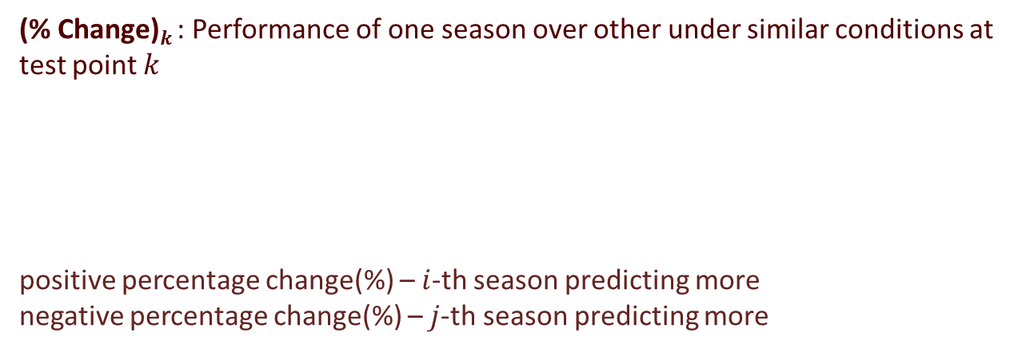
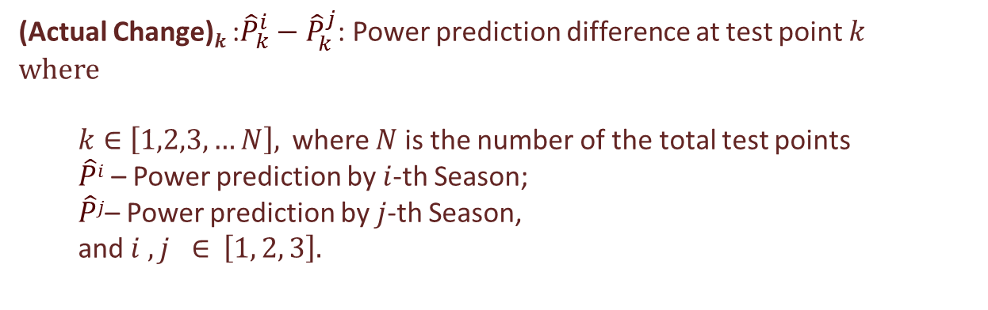

GP Model - Quantification
1)
(Actual Change)$k$ :${\hat{P}}_{k}^{i}−{\hat{P}}_{k}^{j}$: Power prediction difference at test point $k$
where
$k∈$ $\left[1,2,3,…N\right],$ where $N$ is the number of the total test points
$\hat{P}i$ – Power prediction by $i$-th Season;
$\hat{P}j$– Power prediction by $j$-th Season,
and $i , j ∈$ $\left[1, 2, 3\right].$
2)
(% Change)$k$ : Performance of one season over other under similar conditions at test point $k$
positive percentage change(%) – $i$-th season predicting more
negative percentage change(%) – $j$-th season predicting more
$$\frac{{\hat{P}}_{k}^{i}−{\hat{P}}_{k}^{j}}{{\hat{P}}_{k}^{j}}∗100$$

Slide 9
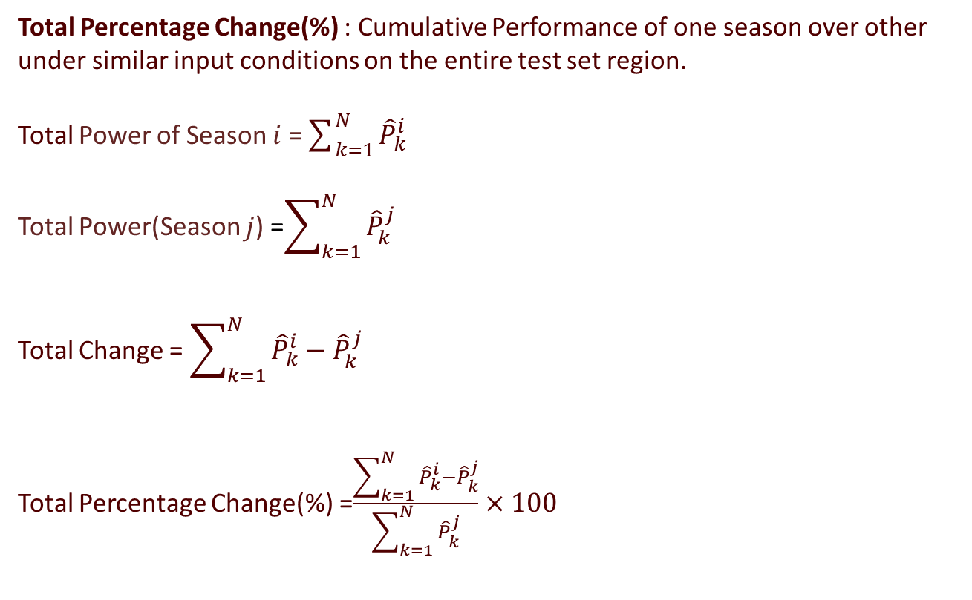
3)
Total Percentage Change(%) : Cumulative Performance of one season over other under similar input conditions on the entire test set region.
Total Power of Season $i$ =$\sum_{k=1}^{N}{{\hat{P}}_{k}^{i}}$
Total Power(Season $j$) =$\sum_{k=1}^{N}{{\hat{P}}_{k}^{j}}$
Total Change = $\sum_{k=1}^{N}{{\hat{P}}_{k}^{i}−{\hat{P}}_{k}^{j}}$
Total Percentage Change(%) =$\frac{\sum_{k=1}^{N}{{\hat{P}}_{k}^{i}−{\hat{P}}_{k}^{j}}}{\sum_{k=1}^{N}{{\hat{P}}_{k}^{j}}}×100$

Slide 10
Definitions and Methodologies
Test Set : They play a key role in comparing two seasons given a fixed domain.
The steps of creating test points :
Selecting the same covariates as used in training the model.
Selecting the domain of each covariates( for example wind speed – 3 to 13 m/s)
Dividing the domain of each covariates in N equally spaced points
Finally taking every combination of these divided points for all the covariates (for example, with two covariates: N*N total combination)
Every test point = (Cov1 , Cov2)
where Cov1 – Covariate 1 and Cov2- Covariate2
Demonstration of test points given the covariates, wind speed and ambient temperature, with 50 equally spaced points for both the covariates.
Domain of wind speed : 3 to 13 (m/s); so grid -> (3,3.2,3.4,3.6……..13)
Domain of ambient temperature : 0 to 30 (C); so grid -> (0,0.6,0.12,0.18…..30)
Test Point 1 – (3,0) ……………………………………………Test Point 2500 – (13,30)

Slide 11
Bound : The maximum difference in power prediction possible, between two seasons, at a given confidence level (95%), if the underlying power curves are same.
Performance Metrics :
Metric 1 - The performance of one season over other. This accounts for the gain-
- ( % change and Total change %) of one season over other in the prediction of target ( Power) given the same input parameters.
Metric 2 – Is there a statistical difference in two seasons? This accounts for hypothesis testing at every test input. The methodology involves defining a 95% confidence bound. The seasons are said to statistically differ if the power prediction difference (absolute ( Actual Change )) at any test point exceeds the given Bound.

Slide 12
Gaussian Process - Seasonality Comparison
Data Set : 2016
Turbine - 34
Train Set
Data-Set | Time-Period | Number of Observations | Seasons
1 | Jan - March | 7310 | Season 1
2 | April - June | 8809 | Season 2
3 | July - September | 9989 | Season 3
Models
Comparison :Test Set
Model | Covariates
1 | W + T
2 | G + T
3 | W + G
Model | Test Set
1 | 2500 test points
2 | 2500 test points
3 | 2500 test points

Slide 13
Summary
Quantification of the changes
 | Season 1 over Season 2 | Season 2 over Season 3 | Season 1 over Season 3
Total Change (%) under model 1 (W+T) | 4.33 % | 2.99 % | 7.84%
Total Change (%) under model 2 (G+T) | (-1.34 %)* | 1.85 % | 0.5 %
Total Change (%) under model 3 (W+G) | 4.74% | 2.96 % | 7.84 %
Total Change (%) under Binning method | 4.73 % | 2.96 % | 7.84 %
*Note :- Model 2 predicts more for season 2 over season 1 so (-1.34 %) means positive change predicted by season 2 over season 1 by 1.34 %

Slide 14
Statistical Test at 95% level
 | Season 1 and Season 2 | Season 2 and Season 3 | Season 1 and Season 3
Significant Difference(W+T), (G+T), (W+G)? | Yes | Yes | Yes

Slide 15
Covariates Matching + Hypothesis Testing

Slide 16
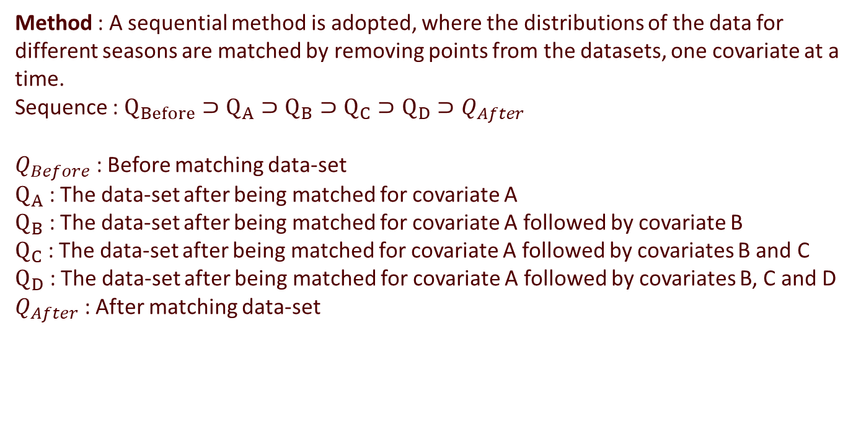
Covariates Matching
Covariates Matching :The difficulty in quantifying the actual effect of environmental conditions paves way for a controlled experiment where the environmental features are screened to almost give a similar distribution for all the time periods in comparison.
Method : A sequential method is adopted, where the distributions of the data for different seasons are matched by removing points from the datasets, one covariate at a time.
Sequence : $Q_{Before}⊃Q_{A}⊃Q_{B}⊃Q_{C}⊃Q_{D}⊃Q_{After}$
$Q_{Before}$ : Before matching data-set
$Q_{A}$ : The data-set after being matched for covariate A
$Q_{B}$ : The data-set after being matched for covariate A followed by covariate B
$Q_{C}$ : The data-set after being matched for covariate A followed by covariates B and C
$Q_{D}$ : The data-set after being matched for covariate A followed by covariates B, C and D
$Q_{After}$ : After matching data-set

Slide 17
Covariates used for matching :
Wind speed
Wind Direction
Ambient Temperature
Turbulence Intensity
Before covariates matching:
Data Set 1 : 23275 observations
Data Set 2 : 28421 observations
Data Set 3 : 32511 observations
After covariates matching:
Data Set 1 : 1158 observations
Data Set 2 : 1158 observations
Data Set 3 : 1158 observations
Model used after covariates matching : Gaussian Process

Slide 18
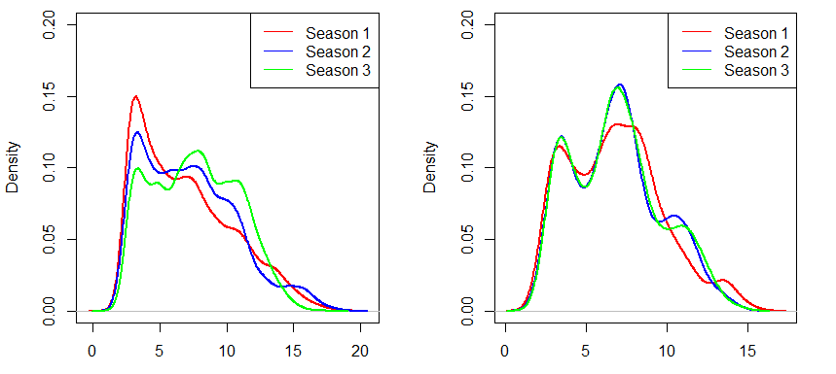
Before matching
After matching
Wind Speed (m/s)
Wind Speed (m/s)

Slide 19
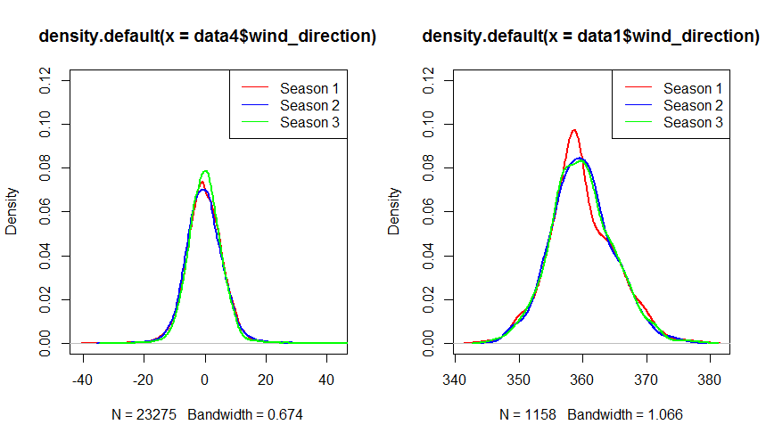


Before matching
After matching
Wind Direction$(degrees)$
Wind Direction$(degrees)$

Slide 20
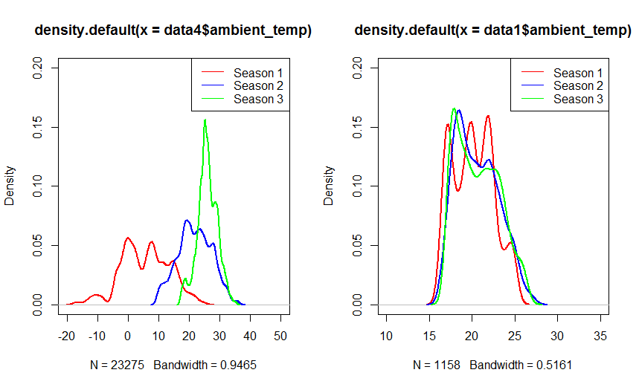


Before matching
After matching
Ambient Temperature$(°C)$
Ambient Temperature$(°C)$

Slide 21
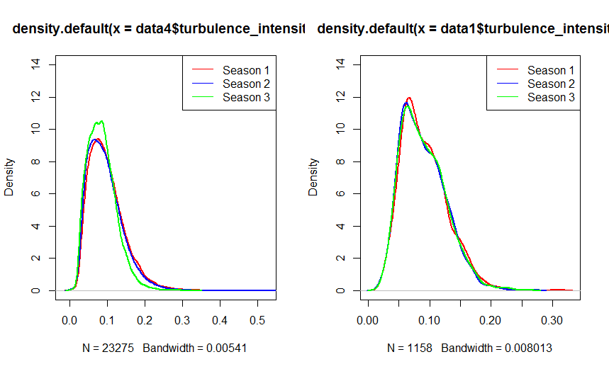
Before matching
After matching
Turbulence Intensity
Turbulence Intensity

Slide 22
Gaussian Process - Seasonality Comparison
Data Set : 2016
Turbine - 34
Train Set
Data-set | Time-Period | Number of Observations | Seasons
1 | Jan - March | 1158 | Season 1
2 | April - June | 1158 | Season 2
3 | July - September | 1158 | Season 3
Models
Comparison – Test Set
Model | Covariates
1 | W + T
2 | G + T
Model | Test Set
1 | 2500 test points
2 | 2500 test points

Slide 23
Summary
Quantification of the changes
 | Season 1 over Season 2 | Season 2 over Season 3 | Season 1 over Season 3
Total Change (%) under model 1 (W+T) | 3.28 % | 1.90 % | 5.24%
Total Change (%) under model 2 (G+T) | 0.14 % | 0.82 % | 0.68 %
Total Change (%) under Binning method | 3.36 % | 1.93 % | 5.36 %

Slide 24
Statistical Test at the 95% level
 | Season 1 and Season 2 | Season 2 and Season 3 | Season 1 and Season 3
Significant Difference(W+T) ? | Yes | Yes | Yes
Significant Difference(G+T) ? | No | No | No

