Slide 1

EDA-Report Project-3: Wine Quality data
Submitted By: Nitesh Kumar Srivastava
Email: Nitesh.us@yahoo.com

Slide 2
Domain & Topic Of Project
This project is about analyzing Red wine quality which comes under food and Beverages domain.
ingredients’ data have been collected for different kind of wines. Which we need to analyze and find the factors which are very important for good quality wines.

Slide 3
Project Description
In this project we are going to analyze different attributes provided in data set to determine which attributes are impacting wine’s quality.
In This project we are going to perform following tasks:
Data extraction : from given dataset
Data pre-processing:
Cleaning data – removing invalid values/ duplicate records
Filling / removing missing data
Create new column
Modify existing columns
Visualization
Data Exploratory Analysis

Slide 4
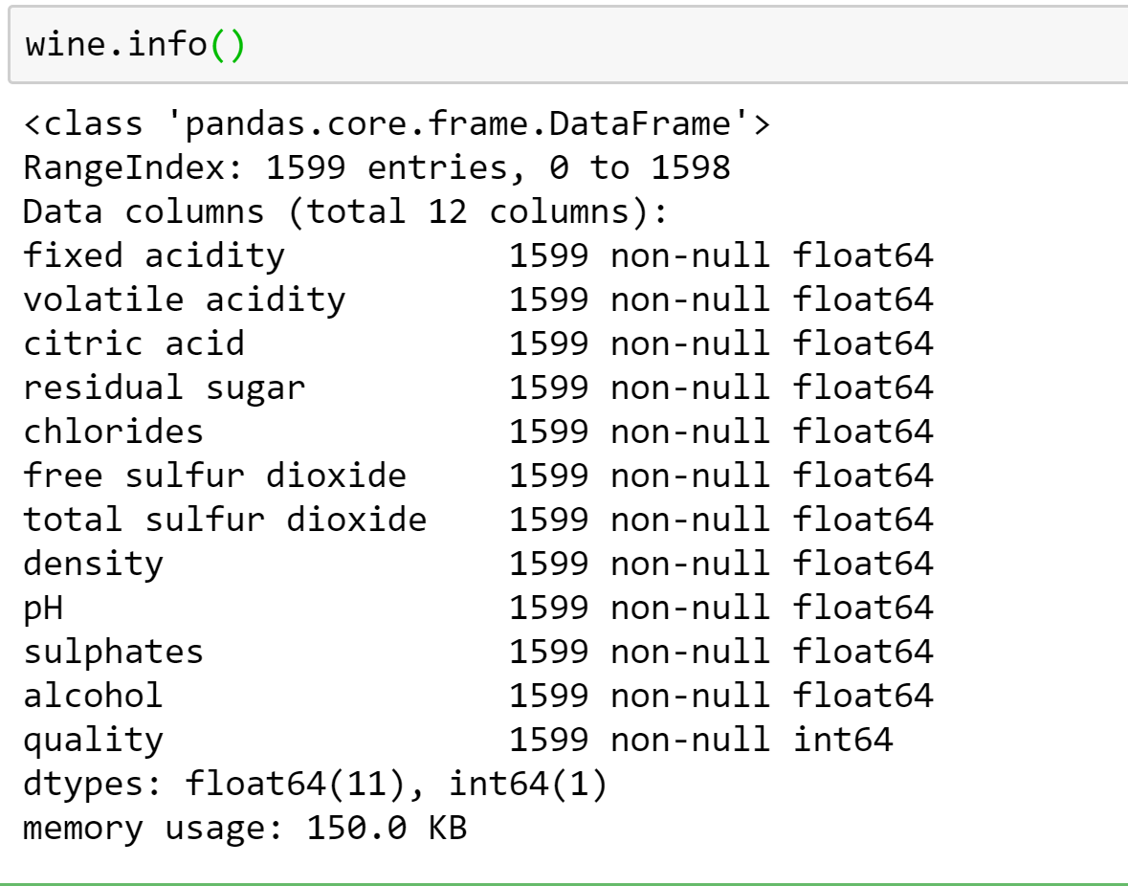
Dataset Description
Given Data set (in CSV format) is having 12 attributes of a red wine. The 12th column “Quality” can be considered as output of other 11 attributes of a wine.
In given Dataset:
No of records: (1599, 12) – After removing Duplicates (1359,12)
Records with Null value: 0
Data types : 11 float columns and 1 integer column

Slide 5
Business Question Identified
Question 1: If there are three types of wine (quality wise) how the data distributed
Question 2: Which attributes are increasing quality of wines
Question 3: Which attributes are impacting quality of wines negatively
Question 4: How increase in alcohol content impacts wine quality
Question 5: How “volatile acidity” is impacting wines quality
Question 6: How “citric Acid” is impacting wine quality
Question 7: How “Density” is impacting wine quality
Question 8: fixed acidity is having linear relation with density and ph. Are the impacting wine quality too?
Question 9: How alcohol and volatile acidity is impacting wine quality as both are having positive and negative correlation with quality respectively.

Slide 6
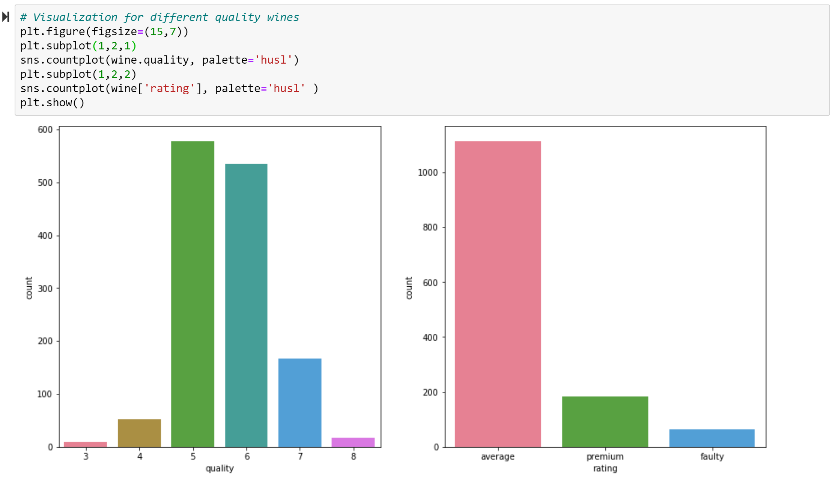
Question 1: If there are three types of wine (quality wise) how the data distributed
Approach: Assigning 3 different Quality Labels based on wine quality ratings
Faulty: for wines which are having quality rating 4 or below,
Average: For wine rating greater than 4 and less than 7 ie, 5 & 6
Premium: for wine rating 7 or above
Findings & Visualizations:
Most of collected data are having average quality wines

Slide 7
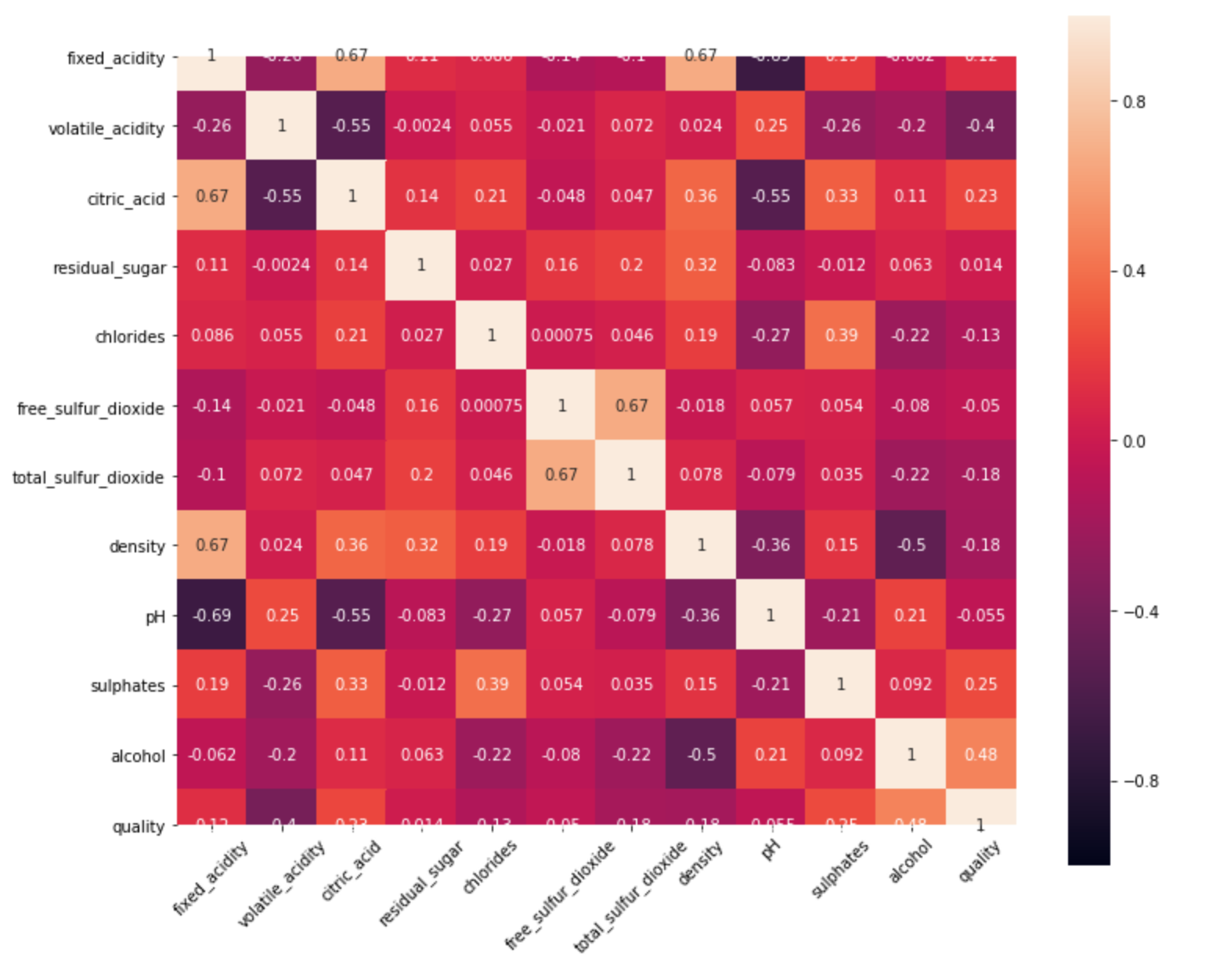
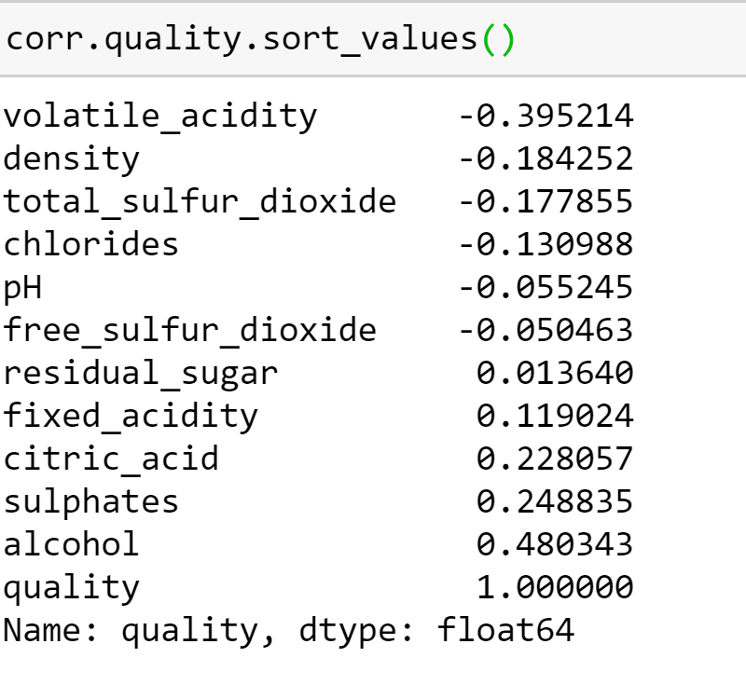
Question 2:Which attributes are increasing quality of wines
Approach: Find the correlation between quality and other attributes
Findings & Visualizations: after calculating correlation between attributes we found that Alcohol, sulphates an citric acid are positively impacting wines quality

Slide 8
Question 3:Which attributes are impacting quality of wines negatively
Approach: Find the correlation between quality and other attributes
Findings & Visualizations: after calculating correlation between attributes we found that volatile acidity, density an total_sulphar dioxide and chlorides are impacting wines quality negatively

Slide 9
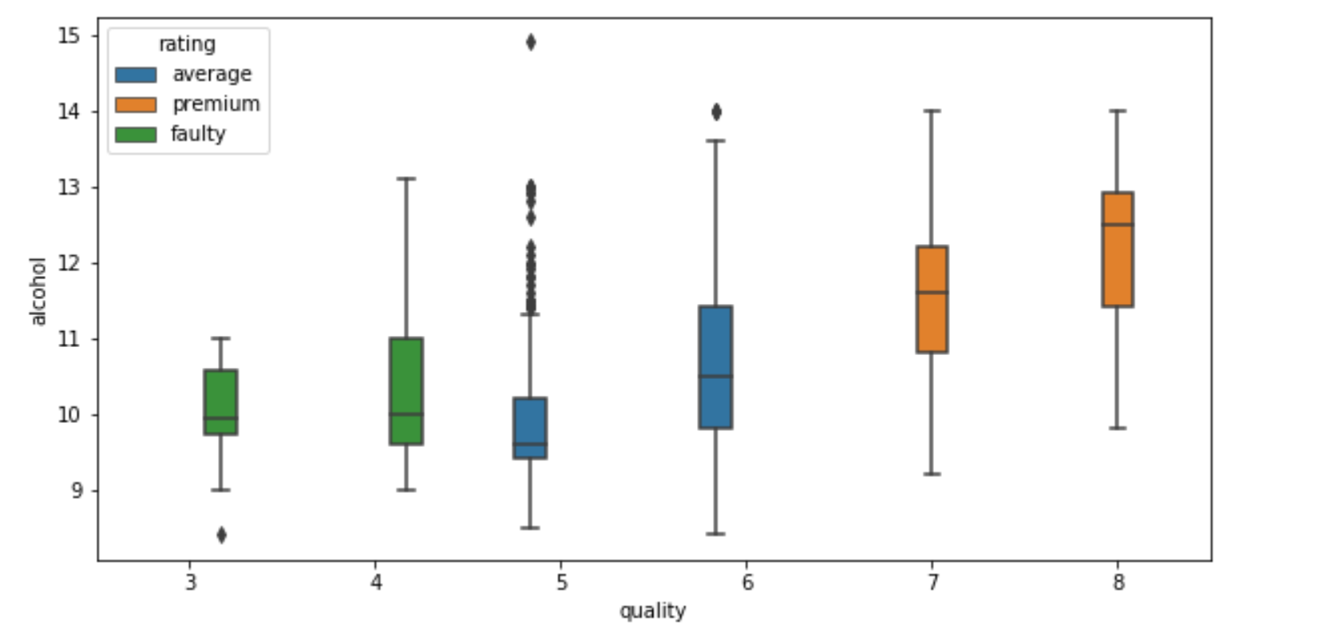
Question 4:How increase in alcohol content impacts wine quality.
Approach: find alcohol’s distribution pattern for different type of wines
Findings & Visualizations: from the box plot it is clearly visible that quality wines are having higher alcohol content and on average it is around 12

Slide 10
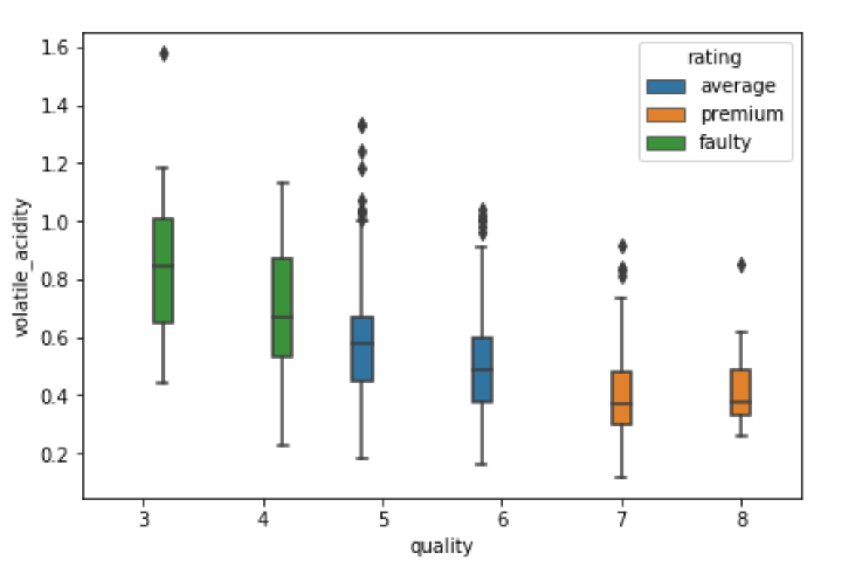
Question 5: How “volatile acidity” is impacting wines quality
Approach: find volatile acidity’s distribution pattern for different type of wines
Findings & Visualizations: box plot of “volatile acidity” vs quality is clearly showing that as quality increases volatile acidity’s content decreases ie, premium wines are having less volatile acidity and it is around 0.4.

Slide 11
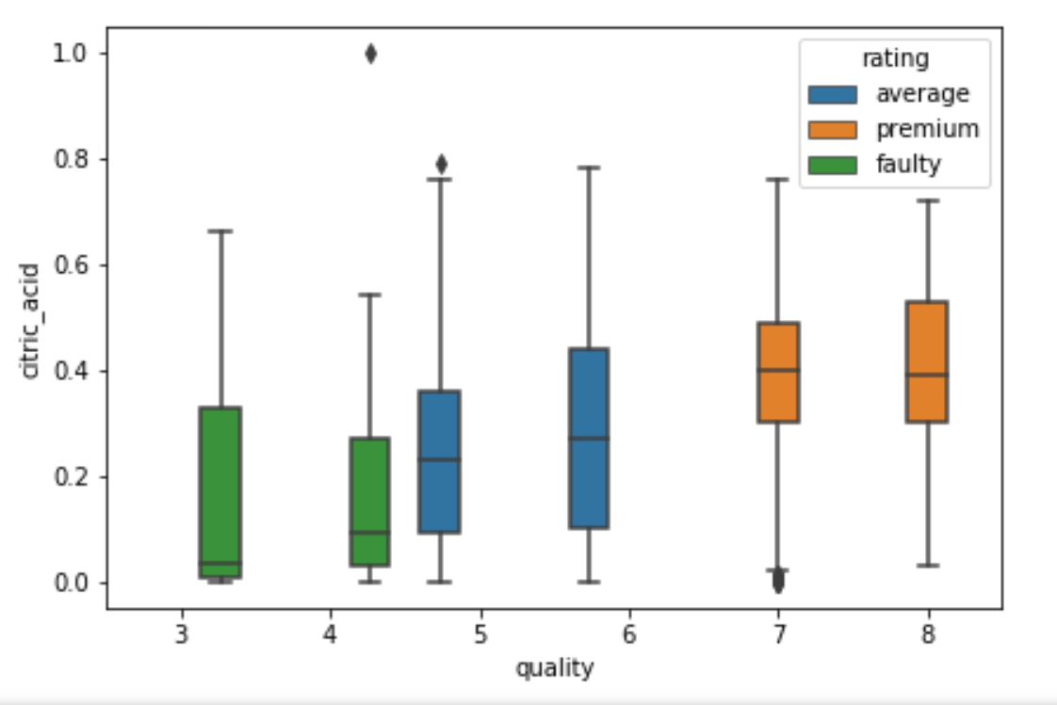
Question 6: How “citric Acid” is impacting wine quality
Approach: create a box plot for citric acid
Findings & Visualizations: from the box plot is clearly visible that Citric Acid content is higher in premium wines than average and faulty wines. The range of citric acid in premium wine are varying between 0.4 to 0.5

Slide 12
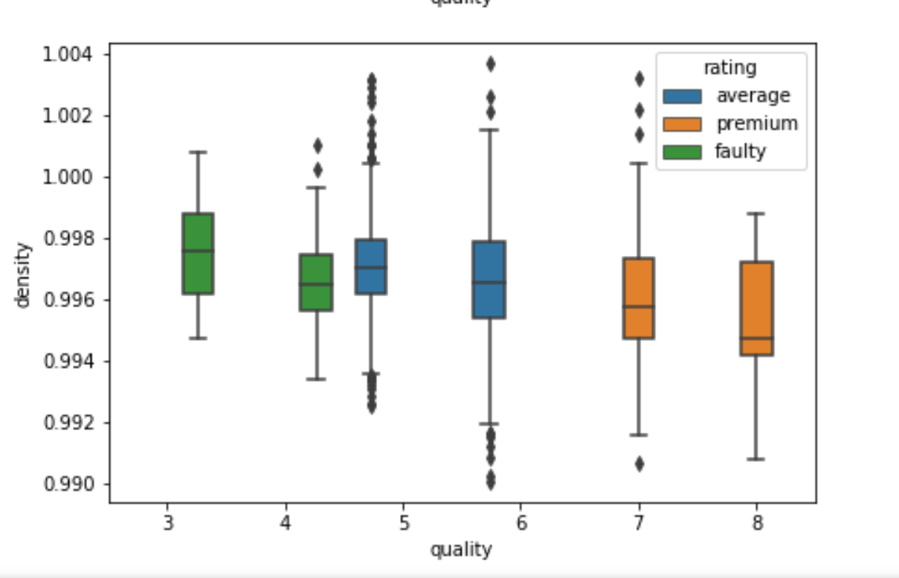
Question 7: How “Density” is impacting wine quality
Approach: create a box plot for “density”
Findings & Visualizations: from the box plot is clearly visible that density in premium wines are lower than other type o wines. The range of density in premium wine are varying between 0.997 to 0.994

Slide 13
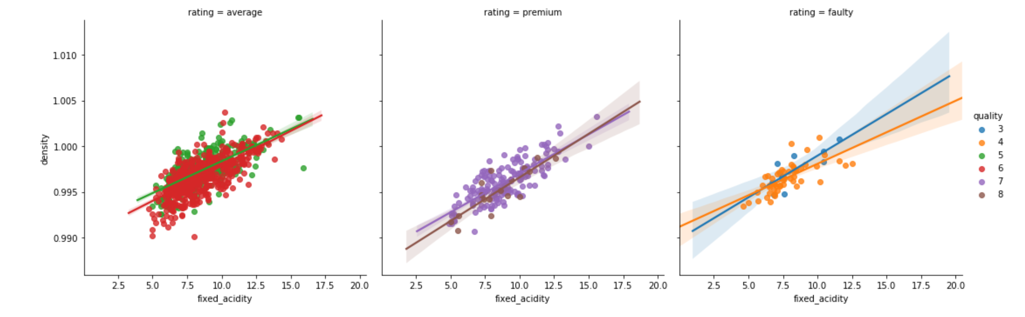
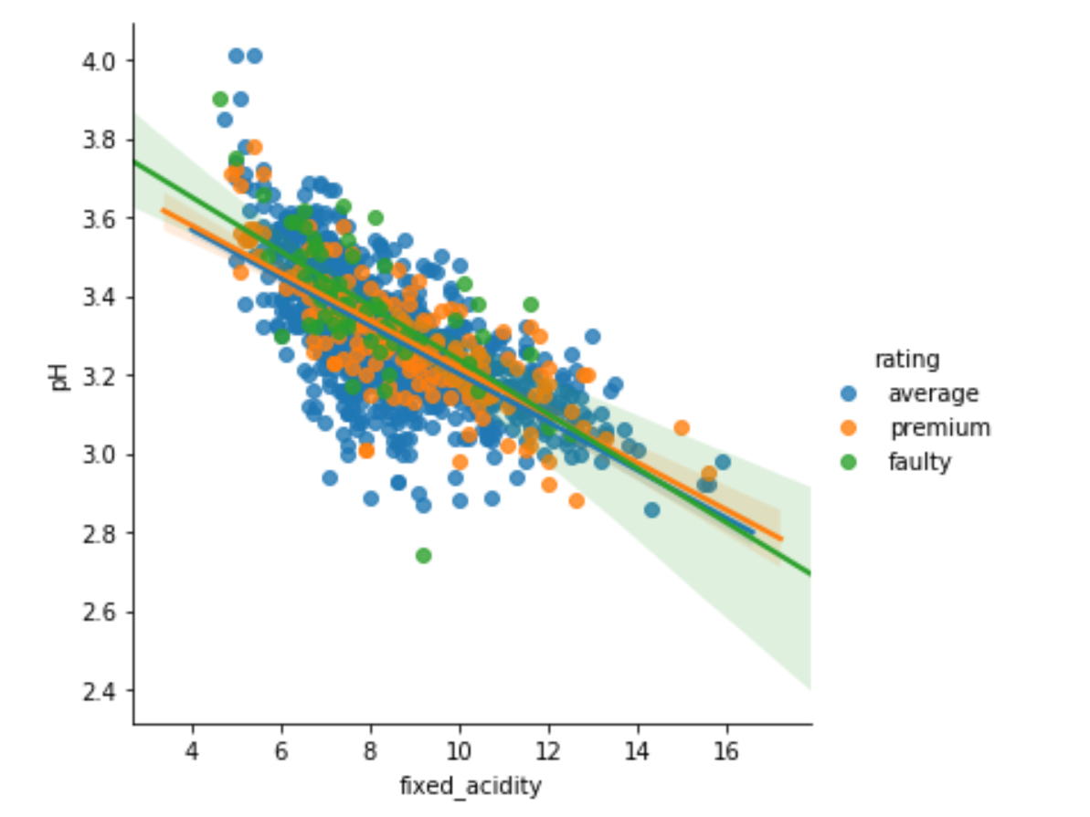
Question 8: fixed acidity is having linear relation with density and ph. Are the impacting wine quality too?
Approach: create a scattered plot between Fixed Acidity and Density and observe the trend.
Findings & Visualizations: From visualization it is clear that though ph and density are having linear dependencies but it is not same for all three types of wines.

Slide 14
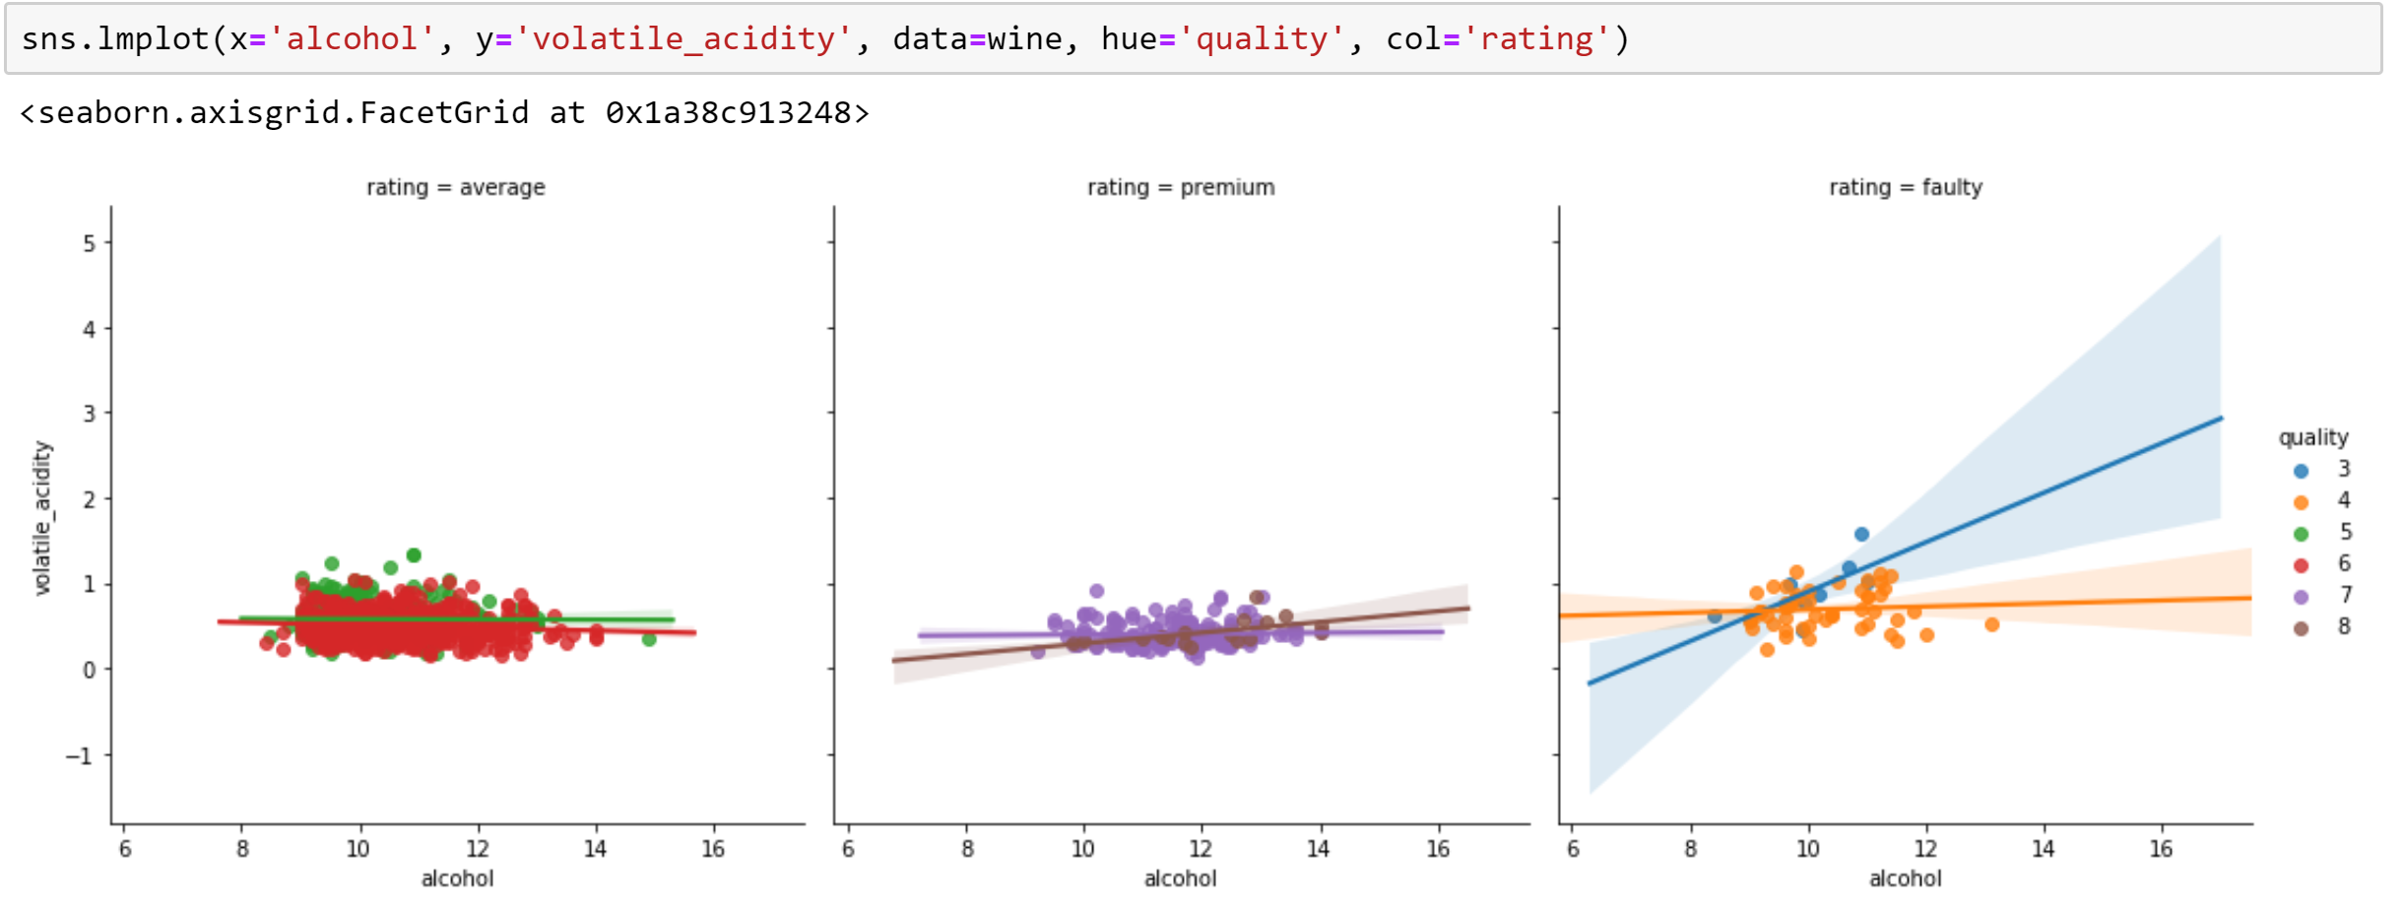
Question 9:How alcohol and volatile acidity is impacting wine quality as both are having positive and negative correlation with quality respectively.
Approach: Draw a scattered plot between alcohol and volatile acidity and observe their dependency for different quality types
Findings & Visualizations: from the graph it is clear that alcohol content are varying for average and premium wines but volatile acidity is almost constant for both.

