Slide 1
L
LIVEpro Software Solutions
Raghuji Nagar, Nagpur – 440024
MELA SEVA
Smart Event Management Platform
Geo-Tagged Asset Management • QR-Based Complaint System • GIS Smart Navigation
A comprehensive digital solution for large-scale public events & temporary infrastructure
📅 Project Pitch Presentation 🔒 Confidential 📍 Nagpur, Maharashtra
© 2026 LIVEpro Software Solutions. All Rights Reserved.

Slide 2

THE CHALLENGE
Why Mela Management Needs Digital Transformation
⚠️ Current Pain Points
• No digital record of temporary assets (poles, wires, substations)
• Complaints reported verbally — no tracking or accountability
• No real-time visibility into complaint resolution status
• Citizens struggle to locate nearest hospitals, police, toilets
• SLA breaches go unnoticed until major escalation
• No data for post-event analysis & improvement
Large-scale events manage thousands of temporary electrical assets, serve lakhs of visitors daily, and require 24×7 monitoring — yet most operations still rely on manual processes.
5000+
10L+
Temporary Poles per Mela
Daily Visitors
LIVEpro Software Solutions
Confidential | Mela Seva – Project Pitch

Slide 3
OUR SOLUTION
Mela Seva — Complete Digital Platform
A unified, scalable platform connecting citizens, field staff, control room, and administration through QR codes, GIS mapping, and real-time communication.
📱
🎯
👷
📊
Citizen App
Control Room
Field Staff App
Admin Portal
Scan QR → Report issues → Find facilities → Navigate — no login needed
Real-time dashboard → Assign complaints → Monitor SLA → GIS maps
Receive assignments → Navigate → Resolve → Upload proof → Close
Asset management → User control → Reports → Configuration
12
4
8
3
24×7
Core Modules
Platforms
User Roles
Languages
Monitoring
LIVEpro Software Solutions
Confidential | Mela Seva – Project Pitch

Slide 4
KEY FEATURES
Comprehensive Feature Suite
1
GIS-Based Asset Survey
2
QR Code on Every Asset
3
Public Complaint Registration
GPS-tagged mapping of every pole, wire, substation
Unique weatherproof QR stickers with pole#, road, sector
Scan QR → auto-fill location → submit in 30 seconds
4
Real-Time Control Room
5
Smart Navigation Map
6
SLA & Auto-Escalation
Live dashboard with complaint feed, GIS map, assignment
Find hospitals, police, toilets, parking, ghats — nearby
Timer-based SLA with automatic warning & escalation
7
SMS Notifications
8
Field Officer Mobile App
9
MIS & Reporting
Automatic SMS at each stage of complaint lifecycle
Offline-capable app for resolution with GPS & photo proof
Department-wise, officer-wise reports with Excel/PDF export
10
Multi-Event Scalable
11
Multilingual Support
12
Complete Audit Trail
Same platform for any event — configurable per event
English, Hindi, Marathi — all UI, SMS, and reports
Every action logged — who did what, when, from where
LIVEpro Software Solutions
Confidential | Mela Seva – Project Pitch

Slide 5
QR CODE SYSTEM
End-to-End QR Code Lifecycle
1
2
3
4
5
📋
🔢
🖨️
📌
📱
→
→
→
→
GIS Survey
Generate QR
Print Labels
Apply to Pole
Citizen Scans
Surveyor captures GPS + photo of each pole
System generates unique QR linked to asset & GPS
Weatherproof stickers with QR, pole#, road, sector
Sticker applied at 5-6 ft height — visible & scannable
Any phone camera opens complaint form with pre-filled data
📄 QR Label Format
📱 What Happens When Scanned
MELA SEVA 2026
✅ Asset identified — pole number, road, sector auto-loaded
✅ GPS location — captured automatically
QR CODE
✅ Complaint form — opens in browser (no app needed)
✅ Pre-filled data — citizen only enters name, mobile, issue
Pole No: P-00125
✅ Nearby facilities — shows hospitals, police, toilets
Road: Main Road | Sector: 05
✅ Navigation — get directions to any facility
SCAN FOR HELP
LIVEpro Software Solutions
Confidential | Mela Seva – Project Pitch

Slide 6
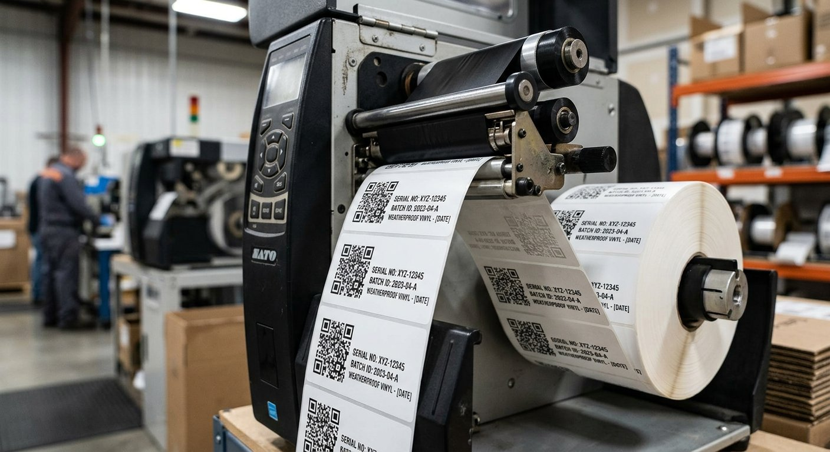
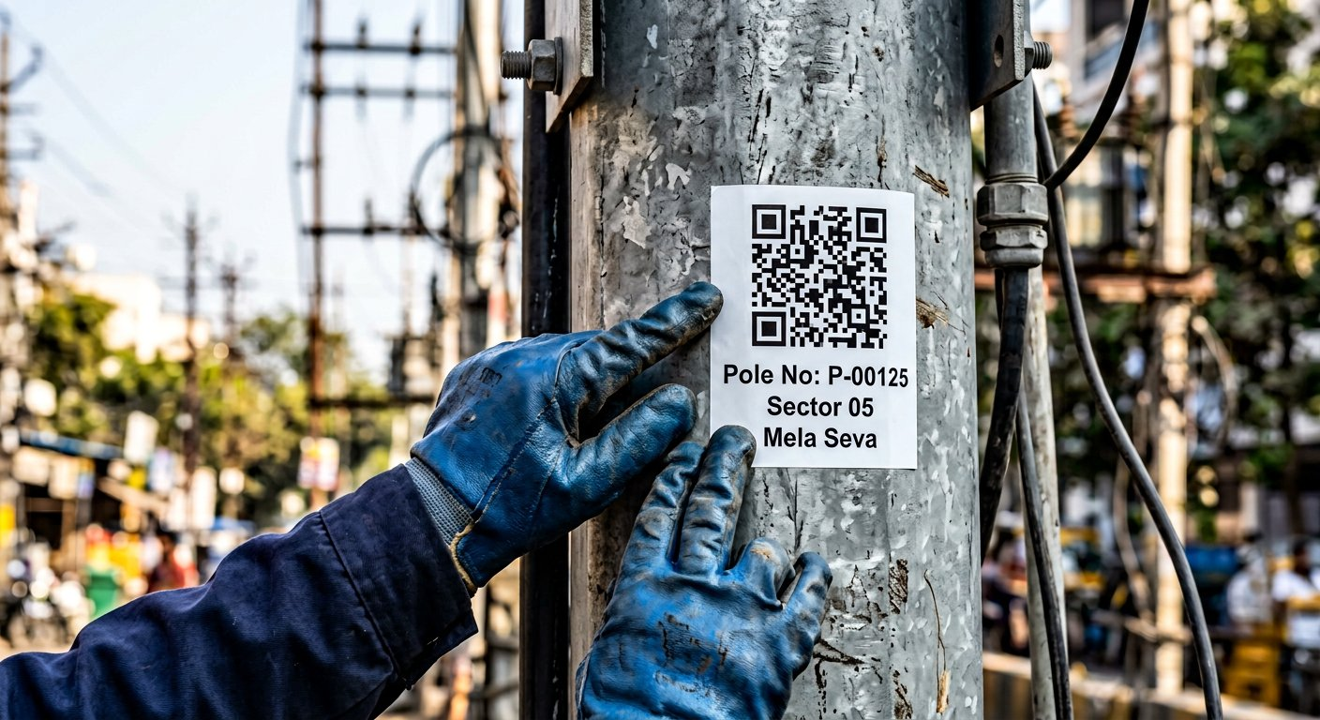
FIELD OPERATIONS
QR Printing, Application & Field Process
🖨️ Printing Specifications
📌 Application Process
Material
Weatherproof vinyl / PET sticker
1
Survey Team maps pole with GPS during initial field survey
Size
50mm × 50mm (standard) / Custom available
2
Admin generates & prints QR labels in bulk from portal
Print Format
A4 sheet (20 labels) / Roll printer
Durability
UV resistant, waterproof, 6+ months outdoor
3
Field team applies sticker at ~6 ft height on each pole
QR Error Correction
Level H (30% damage tolerant)
4
Verification — scan test to confirm QR works correctly
Content
Event logo, Pole#, Road, Sector, QR code
5
Status updated to "Verified" in system with photo proof
LIVEpro Software Solutions
Confidential | Mela Seva – Project Pitch

Slide 7
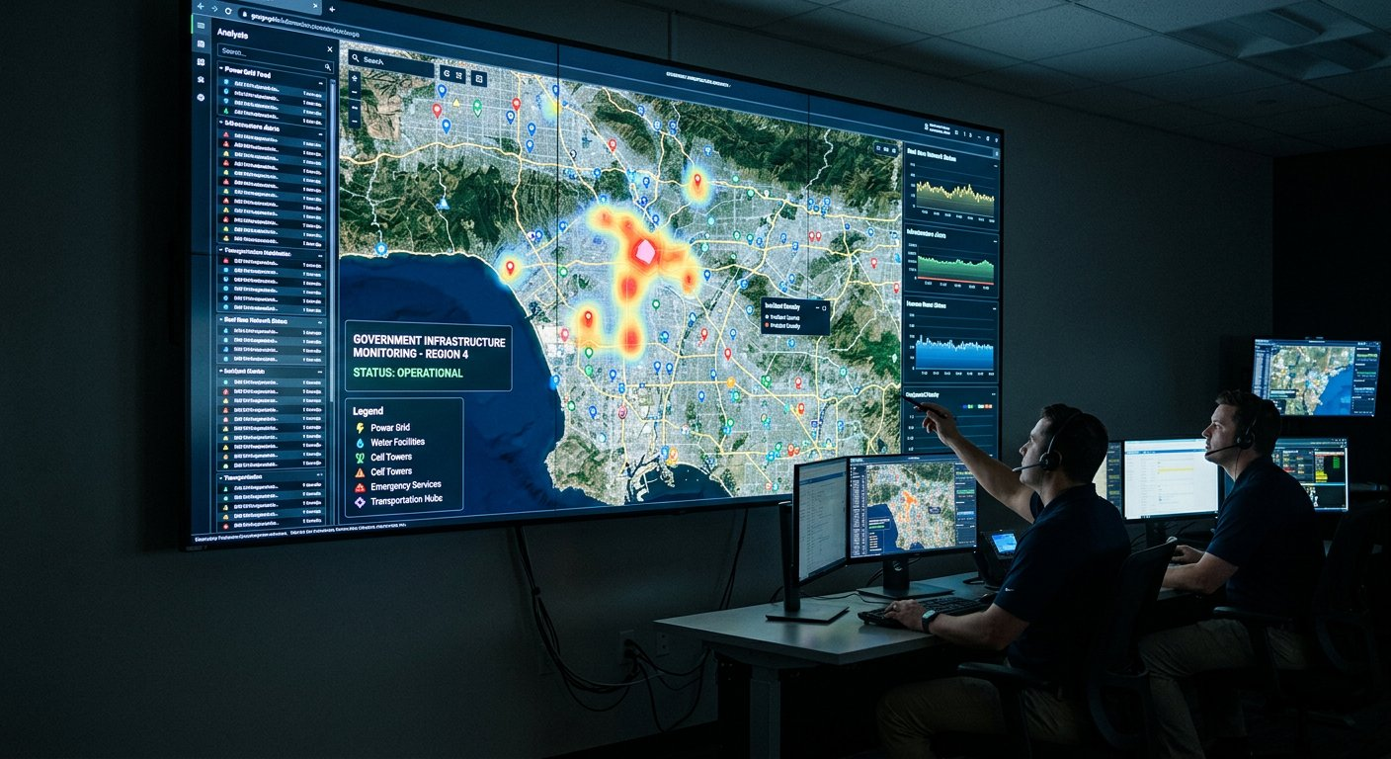
GIS & MAPPING
GIS Tagging — Complete Geographic Intelligence
What Gets Mapped
🔌 Electrical Poles — every temporary pole with GPS + photo
⚡ Electrical Lines — wire routes between poles mapped
🏭 Substations & Transformers — location + capacity
🏥 Public Facilities — hospitals, police, toilets, parking
🚨 Complaint Locations — every complaint geo-tagged
🗺️ Event Boundary — complete Mela area demarcation
GIS Capabilities
2dsphere
< 5m
Real-time
✅ Nearby asset search within configurable radius
✅ Assets inside event boundary polygon
MongoDB Geo Index
GPS Accuracy
Live Map Updates
✅ Heatmap visualization for complaint density
✅ Layer-based map (toggle assets/facilities/complaints)
✅ Route navigation integration with Google Maps
✅ Sector-wise and zone-wise spatial analysis
LIVEpro Software Solutions
Confidential | Mela Seva – Project Pitch

Slide 8
DATA FLOW
Complete Complaint Lifecycle — End to End
📱
📝
🔔
🖥️
👤
✅
→
→
→
→
→
Citizen Scans QR
Submits Complaint
SMS Confirmation
Control Room Alert
Assign to Officer
Resolve & Close
Asset + GPS auto-loaded
Name, mobile, description
Complaint # sent to citizen
Real-time dashboard update
Dept + officer selected
Photo proof + SMS to citizen
📊 Status Workflow
🔄 Real-Time Events (Socket.IO)
NEW
→
RECEIVED
→
ASSIGNED
→
IN PROGRESS
→
RESOLVED
→
CLOSED
⚡ New complaint → Control room instantly notified
⚡ Assignment → Officer gets push notification + SMS
+ Rejected, Duplicate, Invalid, Reopened, Escalated
⚡ SLA Warning → Dashboard highlights at 75% time
⚡ Resolution → Control room verifies & closes
⚡ Closure SMS → Citizen receives confirmation
🔑 Key Principle: Every complaint gets a unique number, never disappears, and every action is logged for complete accountability.
LIVEpro Software Solutions
Confidential | Mela Seva – Project Pitch

Slide 9
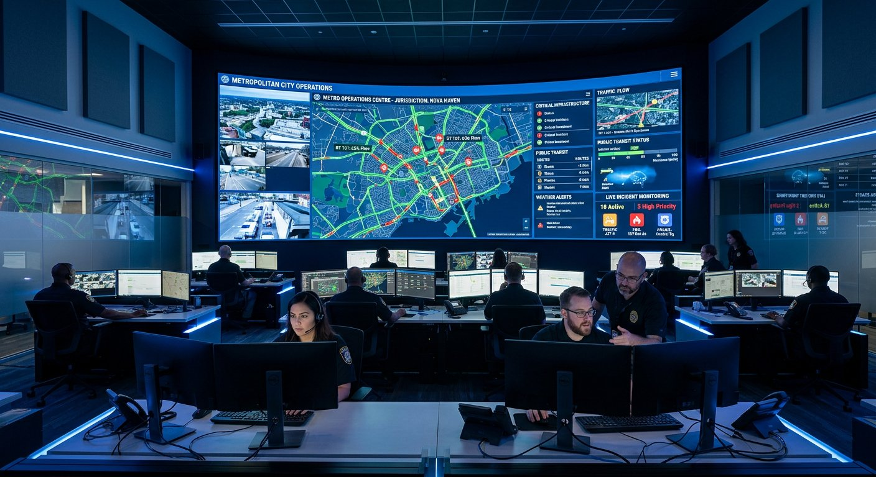
CONTROL ROOM
24×7 Command & Control Dashboard
Dashboard Components
!
Live Complaint Feed
Incoming complaints appear instantly
🗺
GIS Map
All complaints color-coded by status
📊
KPI Cards
Total, new, assigned, overdue, resolved
⏱
SLA Monitor
Overdue complaints highlighted prominently
📈
Trend Charts
Hourly/daily complaint visualization
👆
Quick Assign
One-click complaint assignment
Purpose-built control room interface optimized for large screens with real-time data feeds, GIS map, and instant complaint assignment capabilities.
Sample KPI Snapshot
4,250
127
18
89%
Total
New
Overdue
Resolved
LIVEpro Software Solutions
Confidential | Mela Seva – Project Pitch

Slide 10
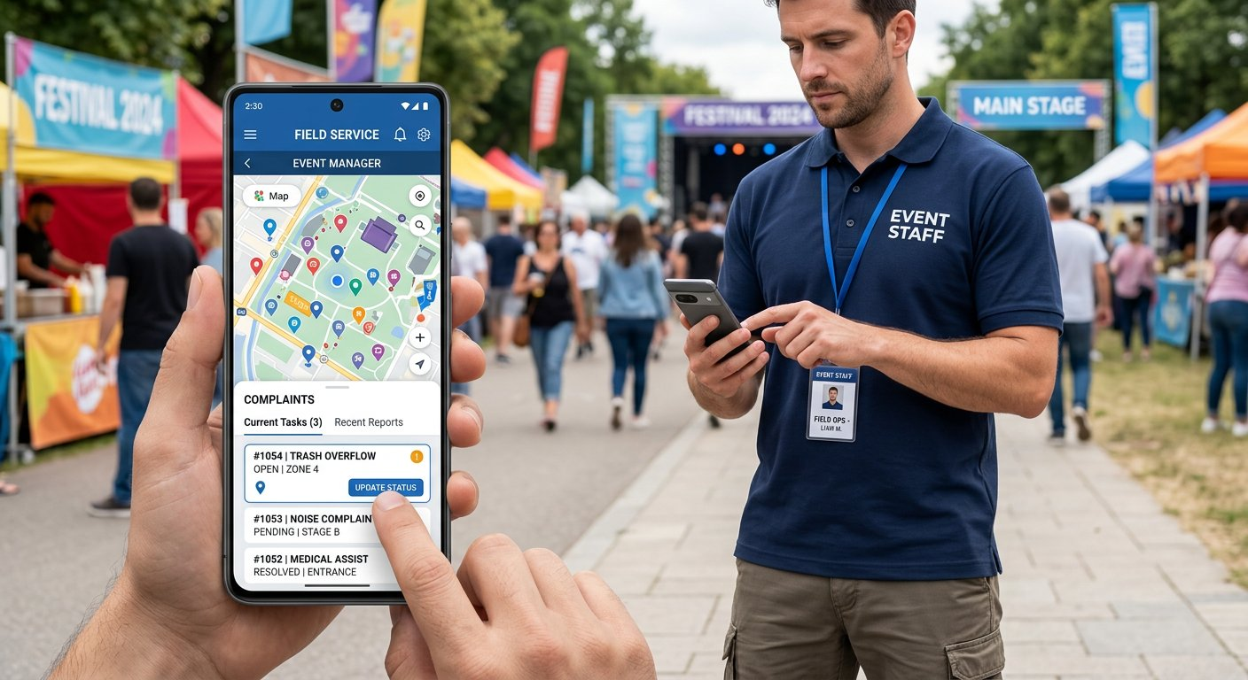
MOBILE APPLICATIONS
Field-Ready Mobile Apps for Every Role
👷 Field Officer App
📐 Surveyor App
• View assigned complaints
• Add new assets with GPS
• Navigate to location (GPS)
• Capture asset photographs
• Upload resolution photos
• Assign QR codes in field
• Call complainant directly
• Bulk survey mode
• Offline mode with auto-sync
• Work offline in low-network
🧑 Public (No App)
🖥️ Web Admin
📱
🍎
📶
🔔
• Scan QR → browser opens
• Complete admin dashboard
• Register complaint instantly
• User & role management
Android
iOS
Offline
Push Alerts
• Track complaint status
• Asset inventory & QR codes
• Find nearby facilities
• Reports & analytics
• Get navigation directions
• Works on any browser
LIVEpro Software Solutions
Confidential | Mela Seva – Project Pitch

Slide 11
PUBLIC SERVICE
Smart Navigation — Help Citizens Find Everything
Every citizen can instantly find essential facilities around them with real-time distance and navigation — no app installation required.
📍 Nearby Facilities (Example)
🗺️ Interactive Smart Map
🏥 Hospital
500m
→ Navigate
✅ Current location auto-detected via GPS
👮 Police Post
700m
→ Navigate
✅ Event boundary displayed on map
✅ Category filters — toggle facility types
🚻 Toilet
150m
→ Navigate
✅ Distance calculation — shows meters/km
🅿️ Parking
300m
→ Navigate
✅ Search — find specific facility by name
✅ Facility details — contact, timings, capacity
💧 Water Point
100m
→ Navigate
✅ One-tap navigation — opens Google/Apple Maps
🏠 Shelter
450m
→ Navigate
✅ Emergency shortcuts — hospital, police, fire
�� No App Installation Required — Works on any smartphone browser
LIVEpro Software Solutions
Confidential | Mela Seva – Project Pitch

Slide 12
ARCHITECTURE
Enterprise-Grade System Architecture
PUBLIC USERS
↓
QR Scan / Web Browser / Mobile App
↓
React Web App
React Native Mobile
↓
Node.js + Express API | Socket.IO Real-time
↓
MongoDB
Socket.IO
File Storage
External: Maps API | SMS Gateway | Push Notifications
Technology Stack
WEB
MOBILE
BACKEND
DATABASE
React.js • Vite • Tailwind CSS • Leaflet/OSM • Recharts
React Native • Expo • Expo Camera • GPS/Location • Offline Cache
Node.js • Express.js • JWT Auth • Socket.IO • Winston
MongoDB • Mongoose • 2dsphere Index • Aggregation
LIVEpro Software Solutions
Confidential | Mela Seva – Project Pitch

Slide 13
SECURITY & COMPLIANCE
Enterprise-Grade Security & Data Protection
🔐 Authentication
🛡️ Access Control
🔒 Data Protection
• JWT token-based auth
• 8 distinct user roles
• HTTPS encryption
• Refresh token rotation
• Permission-based API access
• Secure HTTP headers
• Password hashing (bcrypt)
• Event-level data isolation
• Input sanitization
• Session management
• Department-level filtering
• MongoDB injection prevention
• Auto-logout on inactivity
• Role-specific dashboards
• XSS/CSRF protection
📝 Audit Trail
🚫 Abuse Prevention
👤 Privacy
• Every action logged
• API rate limiting
• No public data exposure
• User + timestamp + IP
• CAPTCHA on public forms
• Complainant info protected
• Before/after values stored
• Duplicate complaint detection
• Role-specific visibility
• Searchable audit logs
• File upload validation
• Soft deletion (no data loss)
• Exportable reports
• Size limits enforced
• Mobile numbers masked
LIVEpro Software Solutions
Confidential | Mela Seva – Project Pitch

Slide 14
GUIDELINES
Operational Do's & Don'ts
✅ DO's
❌ DON'Ts
✅ Survey every pole before Mela begins — capture GPS + photo
❌ Don't skip GPS tagging — location is critical for navigation
✅ Use weatherproof QR stickers rated for 6+ months outdoor
❌ Don't use paper QR codes — they won't survive weather
✅ Apply QR at 5-6 ft height — visible & scannable by public
❌ Don't place QR below 3 ft — will be damaged/blocked
✅ Test-scan every QR after application — verify data accuracy
❌ Don't leave complaints unassigned for more than 30 min
✅ Assign complaints within 15 minutes of receipt
❌ Don't close complaints without verifying resolution photo
✅ Verify resolution photos before closing complaints
❌ Don't share complainant's personal info publicly
✅ Monitor SLA dashboard continuously — act on overdue items
❌ Don't allow officers to resolve without reaching location
✅ Keep backup power for control room — 24×7 uptime essential
❌ Don't hardcode business rules — use admin configuration
✅ Conduct daily review meeting using MIS reports
❌ Don't delete complaints — maintain complete history
✅ Maintain complete audit trail for accountability
❌ Don't ignore SLA breach warnings — escalate immediately
LIVEpro Software Solutions
Confidential | Mela Seva – Project Pitch

Slide 15
TIMELINE
Implementation Roadmap — 12 Weeks
Week 1-2
Phase 1: Foundation & Setup
⚡ Rapid Delivery Guarantee
Infrastructure, DB design, authentication, user management
• Agile methodology — 2-week sprint cycles with demos
Week 3-4
Phase 2: Asset & GIS Module
• Dedicated team — 6+ developers + 1 project manager
Asset master, GIS survey tools, GPS capture, QR generation
• Daily standups — progress visibility to stakeholders
• Bi-weekly demos — see working features every 2 weeks
Week 5-6
Phase 3: Complaint Management
• Nagpur-based team — on-site support when needed
Public complaint, status workflow, assignment, SLA tracking
📦 Deliverables
Week 7-8
Phase 4: Control Room & Dashboard
Real-time dashboard, GIS map, Socket.IO integration
✅ Web Application (Admin + Public Portal)
✅ Android App (Play Store ready)
Week 9-10
Phase 5: Mobile Apps
✅ iOS App (App Store ready)
Field officer app, surveyor app, QR scanning, offline support
✅ Backend API with documentation
✅ QR printing system + label templates
Week 11-12
Phase 6: Testing & Deployment
✅ User training + operation manual
UAT, performance testing, training, production deployment
✅ Source code + deployment scripts
✅ 3 months post-launch support
LIVEpro Software Solutions
Confidential | Mela Seva – Project Pitch

Slide 16
COMPARISON
Before vs After — Digital Transformation Impact
Aspect
❌ Current (Manual)
✅ With Mela Seva
Asset Tracking
Paper registers, no GPS, no photographs
GPS-tagged, photographed, searchable on map
Complaint Registration
Phone calls, verbal, no tracking
QR scan → 30 sec → instant complaint number
Assignment
Manual dispatch, phone calls, delays
Instant digital assignment with push notification
Resolution Tracking
No visibility, follow-ups needed
Real-time status, SLA timer, auto-escalation
Citizen Information
No way to find facilities
Smart map with all facilities + navigation
Reporting
Manual compilation, days to prepare
One-click reports, real-time dashboards
Accountability
No audit trail, blame games
Complete audit log, officer-wise performance
Reusability
Start from scratch every event
Same platform — create new event, go live
Avg Resolution Time
24-48 hours (often more)
1-2 hours with SLA enforcement
LIVEpro Software Solutions
Confidential | Mela Seva – Project Pitch

Slide 17
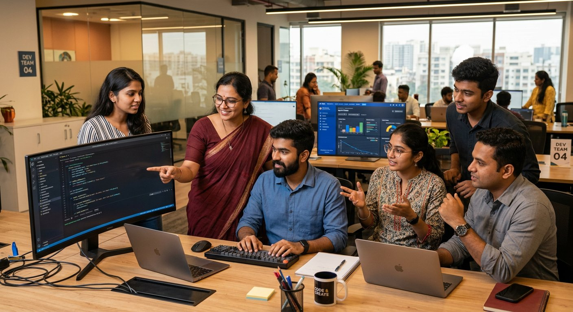
WHY US
Why LIVEpro Software Solutions?
Our Strengths
🏠
Nagpur-Based Company
Local team = on-site support, quick turnaround
💡
Domain Expertise
Government projects, smart city, GIS applications
🔧
Full-Stack Capability
Web, mobile, backend, GIS, real-time — all in-house
10+
50+
100%
24×7
📱
Mobile-First Approach
Designed for low-connectivity, rugged field conditions
Years Experience
Projects Delivered
On-Time Delivery
Support Available
🤝
End-to-End Ownership
Requirement → Development → Training → Support
📊
Proven Technology
Modern, scalable stack — future-proof investment
LIVEpro Software Solutions
Confidential | Mela Seva – Project Pitch

Slide 18
L
LIVEpro Software Solutions
Raghuji Nagar, Nagpur – 440024
Thank You
We look forward to partnering with you to build a smarter, safer, more connected Mela experience for lakhs of citizens.
📞 Let's Connect
🏢 LIVEpro Software Solutions
📍 Raghuji Nagar, Nagpur – 440024
📧 info@liveprosoft.com
🌐 www.liveprosoft.com
© 2026 LIVEpro Software Solutions. All Rights Reserved.

