Slide 1
Real Time Event Detection in Twitter
Presented By | Supervisor
Nitesh Rawal (18MCMC12) Shubham Singh (18MCMC52) | Dr. Rajendra Prasad Lal Assistant Professor SCIS, University Of Hyderabad

Slide 2
Outline of Presentation
Introduction
Related Work
Methodology
Experiment and Results
Conclusions
References

Slide 3
Introduction
The aim of this project is to detect the real world event from the twitter data stream.
Social platform like twitter are becoming primary medium for what is happening around the real world events.
Twitter data is huge and various kind of topics are going on in the real world.
So it is a important task to detect those events.

Slide 4
Twitter is a 'microblogging' system that allows you to send and receive short posts called tweets and these tweets has 280 character limit.
Twitter provide a lot of meta-data, which can help in providing information such as location, time-stamps, and popular trends, etc.
Twitter provides an application programming interface (API),which allows developers to programmatically access the public data streams as well as many features of the service.

Slide 5
Application of Event Detection
Health Monitoring and Management.
Environmental Monitoring and Prediction.
Safety and Security.
Business Process Optimization.

Slide 6
Related Work
Event detection techniques can be classified as
Feature-pivot(FP)
Document-pivot(DP)
Topic modelling

Slide 7
Entity-based Approach
In [1] paper authors have proposed an entity based event detection technique as follows :
Entity Extraction
Entity Filtering
Vectorization of Entity
Computing Similarity
Similarity Filtering
Entity Graph Generation
Entity Clustering
We have Studied and implement these steps.

Slide 8
Entity Extraction
Here are some example of entity type that are extracted from each tweet.
Named entities: bhuvneshwar
Hashtags: #indiavsengland
We recognise entities from tweet text data using NER.
NER, short for Named Entity Recognition, primary objective of NER is to locate and classify named entities such as names of persons, organization, location etc.
We recognise names entities NER using NLTK.
Example :
I hear Berlin is wonderful in the winter
Place
Time

Slide 9
Vectorization of Entity
First we obtain a vectorized representation of the texts
Let us take the following example tweets to illustrate further
Tweet ID | Text
1 | jason roy has depart bowled by bhuvneshwar england early wicket are Falling now
2 | #indiavsengland Jason roy shocked by inswing ball of bhuvneshwar
3 | Sanju samson awesome catch upfront Team india in a high pressure game # indiavsengland
4 | bhuvneshwar man of the match results India win the game by 20 runs #indiavsengland
5 | #indiavsengland looking forward to one more thrilling game as well from india

Slide 10
We can represent the co-occurrences for entities as seen below:
The vector list for #indiavsengland and bhuvneshwar are the corresponding rows:
#indiavsengland = [0,1,1,1,1]
bhuvneshwar = [1,1,0,1,0]
 | Tweet 1 | Tweet 2 | Tweet 3 | Tweet 4 | Tweet 5
#indiavsengland | 0 | 1 | 1 | 1 | 1
bhuvneshwar | 1 | 1 | 0 | 1 | 0

Slide 11
Compute Similarities
Cosine Similarity is a measurement that quantifies the similarity between vectors.
The cosine similarity is the cosine of the angle between vectors.

Slide 12
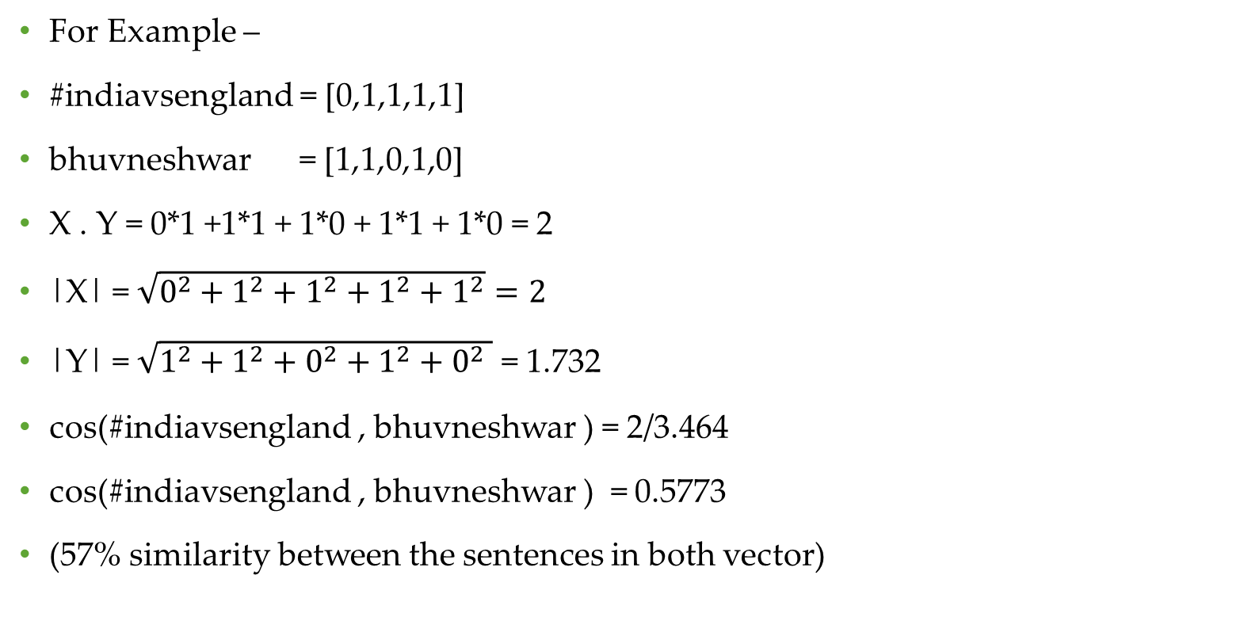
For Example –
#indiavsengland = [0,1,1,1,1]
bhuvneshwar = [1,1,0,1,0]
X . Y = 0*1 +1*1 + 1*0 + 1*1 + 1*0 = 2
|X| = $\sqrt{0^{2}+1^{2}+1^{2}+1^{2}+1^{2}}=2$
|Y| = $\sqrt{1^{2}+1^{2}+0^{2}+1^{2}+0^{2} }$ = 1.732
cos(#indiavsengland , bhuvneshwar ) = 2/3.464
cos(#indiavsengland , bhuvneshwar ) = 0.5773
(57% similarity between the sentences in both vector)

Slide 13
Similarity Filtering
After computing the entity similarities then, we can filter them based on the minimum threshold value S (in the range 0-1) to remove noisy connections between the entities.
Example:
Let Threshold value S = 0.2
if sim of e1 & e2 < S
then edge will be not added between them
else
edge between node and its weight Similarities value.

Slide 14
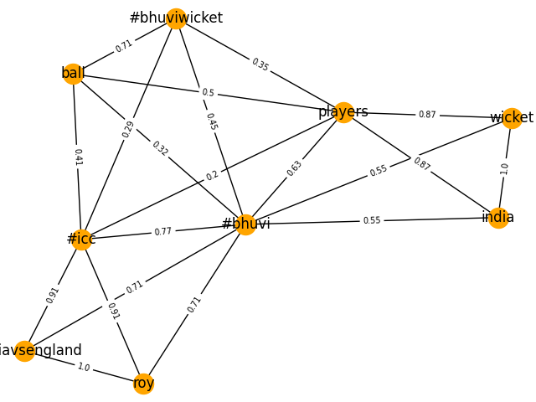
Entity Clustering
At this stage ,we are able to naturally construct a graph consisting of the entities as nodes and their similarity as edge weights.

Slide 15
Once we generate the graph between entity the advantage is that wide variety of clustering algorithm can be used.
One of the most popular algorithm is Louvain method it is based on optimising the modularity very effectively.
Louvain method is an algorithm to detect communities in large networks.it maximizes a modularity score for each community, where the modularity quantifies the quality of an assignment of nodes to communities.

Slide 16
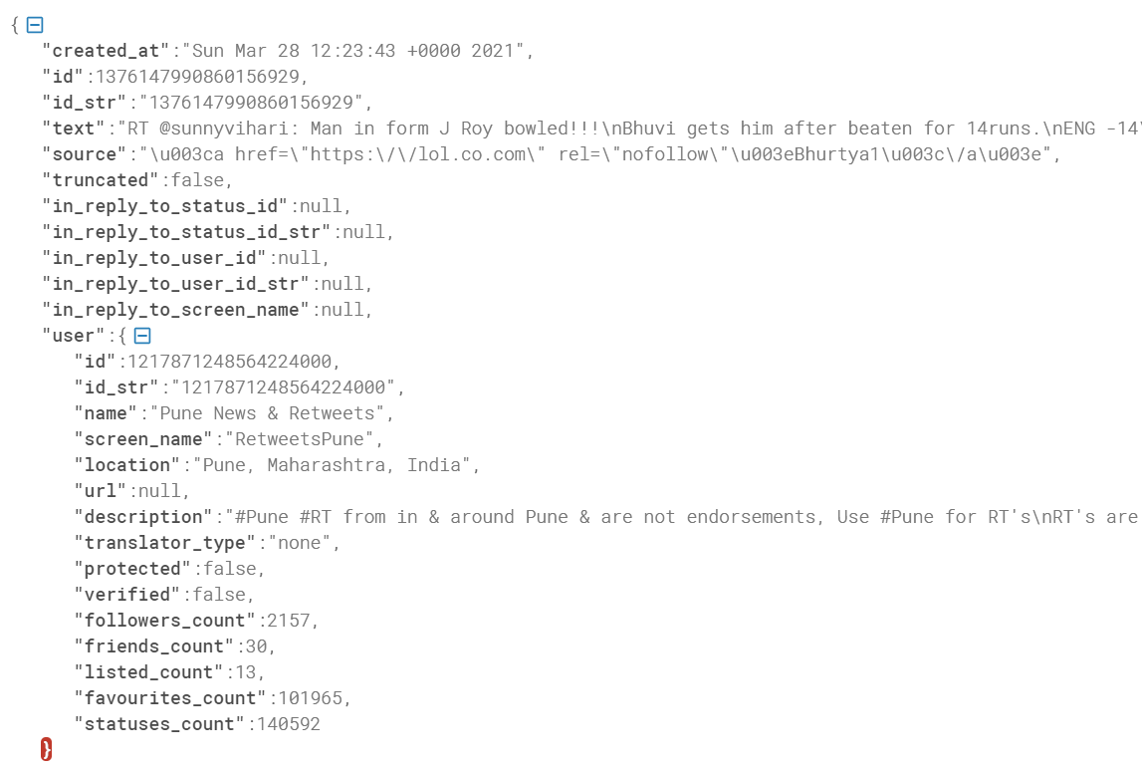
Experiment and Result
Extracting Data From twitter –
Twitter API using Tweepy library is a way to extract tweets based on certain topics.
Example extracted data in json format.

Slide 17
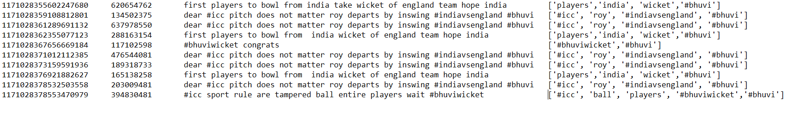
Preprocessing Tweet Data
We clean that unstructured data and extract Tweet_id, User_id, Tweet_text from that data.
We also add named entities and hashtags in the below given data by using NER.

Slide 18
Compute Similarity
To compute the cosine similarities among the entities
We have make the inverted index where if the entity is present it will add 1 to the vector else add 0 if it is absent.

Slide 19
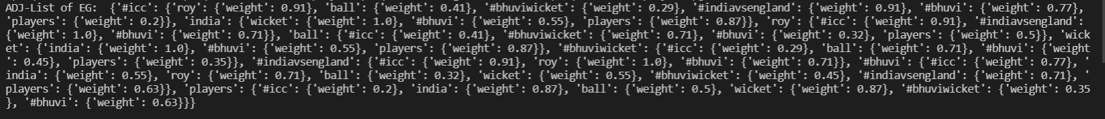
Cosine Similarity
After inverted index making we have computed the cosine similarity between entities and we compute the cosine similarity between each unique entity

Slide 20
Graph Generation
At this stage we are able to construct graph, here entities as node and it edge weight is based on its similarity value.
We filter connection between node using similarity filtering.

Slide 21
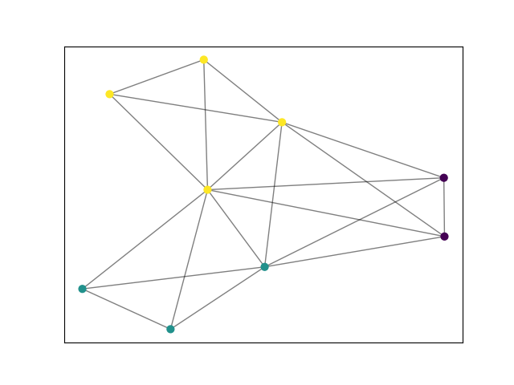
Community Detection
Once we generate the Graph we can perform community detection algorithm with respect to graphs and detect similar community in graph.
Louvain algorithm is based on optimizing the modularity very effectively.

Slide 22
Number of Event with Description
Number of Events | Event Description
1 | #bhuviwicket, ball
2 | India, players, wicket
3 | #bhuvi, #icc, #indiavsengland,

Slide 23
Conclusion
In this project we have studied and implement the author[1] proposed technique which is entity based event detection approach for detecting an event using Twitter data stream and we have evaluated our final output as total number of events related to each other.
In this approach we have followed a methodology which includes following steps such as entity extraction, entity filtering, vectorization of entity, computing similarity, similarity filtering, entity graph generation, entity clustering.

Slide 24
Future Work
Future work will include a wider evaluation, an additional labelling for the event entities, an optimization of the thresholds in order to improve the performances in terms of event detection speed and reduce the clustering complexity.

Slide 25
References
[1] Mateusz Fedoryszak, Brent Frederick, Vijay Rajaram, and Changtao Zhong.2019. Real-time Event Detection on Social Data Streams. In The 25th ACMSIGKDD Conference on Knowledge Discovery and Data Mining (KDD ’19),August 4–8, 2019,
[2] L. M. Aiello, G. Petkos, C. Martin, D. Corney, S. Papadopoulos, R. Skraba, A. Goker, I.Kompatsiaris, and A. Jaimes,``Sensing trending topics in Twitter,'' IEEE Trans. Multimedia, vol. 15, no. 6, pp. 12681282, Oct. 2013.
[3] Z. Saeed, R. A. Abbasi, O. Maqbool, A. Sadaf, I. Razzak, A. Daud, N. R. Aljohani, and G. Xu, ``What's happening around the world? A survey and framework on event detection techniques. 17, no. 2, pp. 279_312, 20
[4] Farzindar Atefeh and Wael Khreich. 2015. A survey of techniques for event detection in twitter. Computational Intelligence 31, 1 (2015), 132–164.

Slide 26
THANK YOU

