Slide 1
Ripple-View
RippleView
Framework
Deliver Faster. Test Smarter. Release with Confidence.
✓ Silent breaking changes caught before they ship
✓ 165 hrs lost across 3 real Jira tickets — catchable in 2 min
✓ No QA bottleneck, no blocked sprints
Notes:
NARRATION (0:00–0:45) Open strong. Don't introduce the tool yet — introduce the pain. "Every sprint, at least one shared UI component ships with a change that silently breaks something. The teams using that component don't find out until their users do — or until QA runs manual checks hours later. RippleView ends that. Automatically."

Slide 2
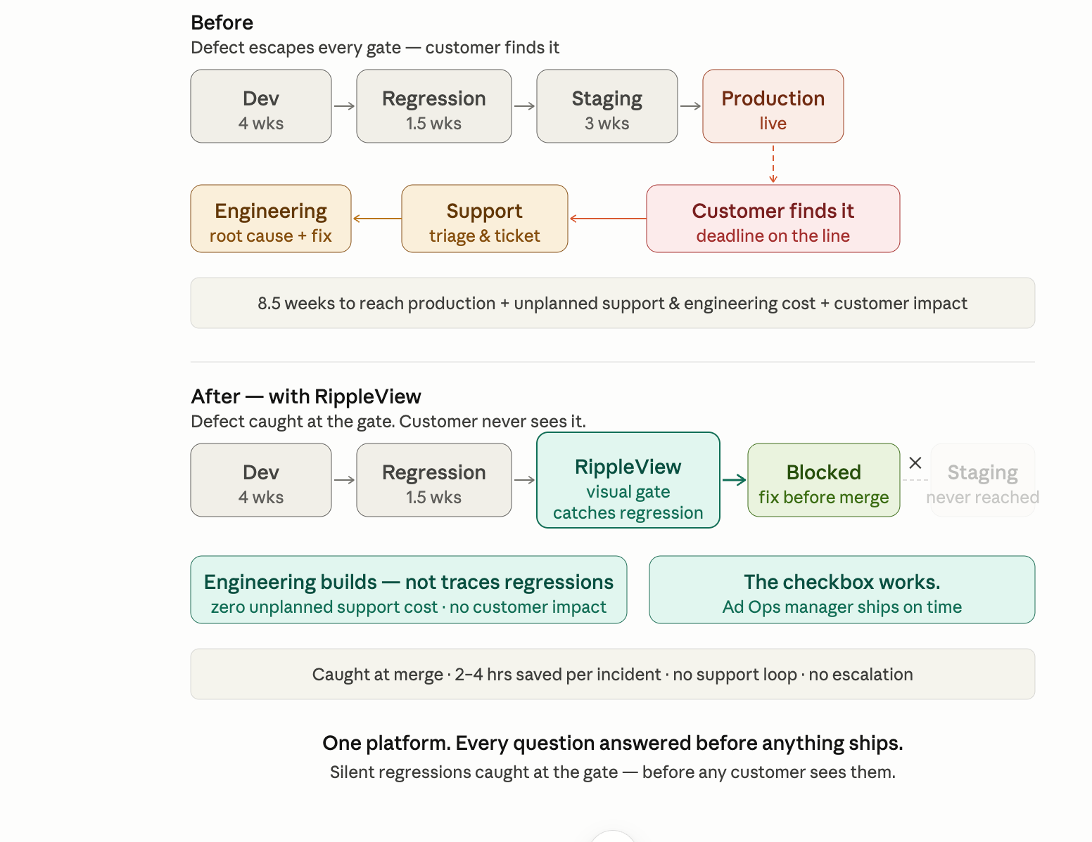

The Problem Costs Real Hours. Every Sprint.
165
hours lost
across 3 real tickets
Tracked in Jira — this quarter alone.
Silent lib upgrade regressions.
Notes:
NARRATION (continues 0:00–0:45) "These aren't hypotheticals — they're in our Jira backlog right now. Three tickets. One hundred and sixty-five engineering hours. All caused by silent regressions from library upgrades. PAOS-281163 is the most painful: a spacebar stops working in every dropdown — an accessibility regression in the shared controls library that users found before QA did. 22 hours to trace, reproduce, and fix something that should have been caught in 2 minutes." LOOK AT LINA when you say 'users found before QA did' — that one stings for a QA lead. PAUSE. Let 165 hours land before moving to the solution.

Slide 3



RippleView Catches It First.
Before the library ships. Before anyone is blocked.
1
Library team ships a component update
RippleView automatically validates every app that uses that component — not just the library itself
2
Claude AI reasons about the impact
Identifies which specific apps and features will be affected — with an explanation, not just a file list
3
2-minute report before the PR merges
"Safe to ship" or "These 2 apps will break — here's exactly why" — in plain English, not error logs
Notes:
NARRATION (0:45–1:15) "RippleView plugs directly into the library release process. When a component update is ready to ship, RippleView runs in the background — checks every app that depends on that component — and gives the library team a verdict in under 2 minutes. Not a wall of error logs. A plain-English impact report: safe to ship, or here's exactly what will break and where."

Slide 4
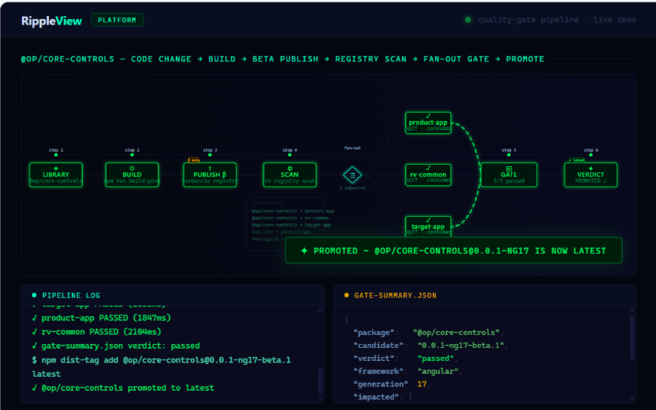
Live Demo — One Complete Flow
Component update ships → affected apps validated → impact report delivered
Notes:
NARRATION (1:15–2:30) — LIVE DEMO HAPPENS HERE "Let me show you the actual tool running." [Run: rv run against playground-ng15 live] Walk through each step as it executes: 1. "Here's the component update that just shipped." 2. "RippleView automatically finds every app using this component." 3. "It's now running targeted validations — watch the output." 4. "Under 2 minutes. Here's the verdict." Point at the results table. Read one line aloud. Keep it simple.

Slide 5



THE WOW MOMENT
This Is What No Static Tool Can Do.
Claude doesn't just run tests. It reasons about why something will break.
Static Analysis Says:
Claude Reasons:
FAIL: 3 test failures
"The onSelect interface was removed from
op-cc-dropdown. Two apps depend on it:
› Finance Module — date picker uses
onSelect to update the booking form.
It will silently stop working.
› Reporting App — filter panel uses
onSelect for multi-select state.
Recommend: hold release. Update
consumers before shipping."
File: dropdown.component.ts
File: date-picker.module.ts
File: filter-panel.spec.ts
"Which apps? Why? What to fix?" — still unknown.
Judgment call. Specific. Actionable. Human-readable.
Notes:
NARRATION (2:30–3:30) — THE WOW MOMENT This is the slide where judges lean forward. Slow down here. "Here's the thing. Every CI tool can tell you a test failed. That's not intelligence — that's a red light. What RippleView does differently is that Claude doesn't just report failures. It looks at the code change, understands the dependency chain, and tells you which specific apps will break, which feature inside that app, and why — because it traces the interface through to where it's actually used. No static analysis tool does this. No rule engine does this. This is Claude making a judgment call that an engineer would have spent an hour making." Point at the right side. Read the Claude output aloud slowly. Let it land.

Slide 6
The After.
WITHOUT RIPPLEVIEW
WITH RIPPLEVIEW
Time to detect a silent breaking change
2–4 hours
< 2 minutes
Teams blocked per incident
3–5 teams
0 — stopped before shipping
How teams find out
User reports / staging panic
Automated report, pre-merge
Root cause analysis
1–2 hours of debugging
Instant — Claude names the file and interface
QA effort per library release
Manual re-test every sprint
Automated — only affected apps re-run
Notes:
NARRATION (3:30–4:30) "So what actually changes when RippleView is in the pipeline? The 2-to-4 hours your teams spend debugging silent breakages — gone. The 3 to 5 teams that get blocked every time — never blocked again, because the problem is stopped upstream. The QA team that manually re-tests every library release — automated. This isn't a tool for engineers. It's infrastructure for releasing confidently. It's the difference between selling a library upgrade as a risk and selling it as a guarantee." LOOK AT YAEL when you say 'selling it as a guarantee.'

Slide 7
This Is Running Right Now.
Live results from the Angular 15 playground — run during this hackathon
8
5
< 2m
1
Scenarios Validated
Passed
Total Run Time
Command
Across imported + local tests
All consumer app scenarios
35 seconds wall-clock
rv run · no config needed
Scenario | Source | Result | Time
Dropdown opens the options panel | Library import | PASS | 1.7s
Selecting an option updates the display | Library import | PASS | 1.9s
All options visible in panel | Library import | PASS | 2.1s
Activating dropdown opens options panel | Consumer app | PASS | 1.7s
Selecting an option updates displayed value | Consumer app | PASS | 1.9s
All configured options shown in panel | Consumer app | PASS | 2.1s
Panel shows configured number of options | Consumer app | PASS | 1.8s
Dropdown renders collapsed by default | Consumer app | PASS | 1.8s
Notes:
NARRATION (2:00–2:30 — during live demo) "These are real results from a run that happened during this hackathon. Not a mock. Not a screenshot. The tool actually ran against a live Angular 15 app and validated 8 scenarios — including tests inherited from the shared component library — in under 2 minutes." Point at the 'Library import' rows. "These came from the shared library. The consuming app didn't write these tests — it just declared which component it uses, and the tests ran automatically."

Slide 8



What This Means for the Business
For Sales
For Operations
For Engineering & QA
Sell library upgrades with a regression guarantee — not a risk disclaimer
One command validates all downstream apps — no manual coordination
Write component tests once — every consuming app inherits them via YAML
Faster release cycles without manual QA blocking every sprint
JSON reports feed directly into dashboards and ticketing systems
Zero test rewrites when components change — coverage is automatic
Demonstrable SLA on UI stability per release
Hotfix costs drop — issues caught upstream, not in production
Works with Angular, React, Vue — no framework lock-in
Notes:
NARRATION (3:30–4:30 — The After) "The impact isn't technical. It's business. For sales — you can now guarantee a library upgrade won't break a client's app. That's a competitive differentiator. For operations — one command replaces a manual coordination process that currently blocks multiple teams every release. For QA — test coverage is inherited automatically. When a new app starts using a component, it gets the full test suite without writing a single line."

Slide 9
What's Next
The foundation is working. Here's where it goes.
Done ✓
Sprint 1
Sprint 2
Scale
Core validation engine
Real-time results dashboard
React & Vue support
Hosted SaaS offering
Playwright-powered execution
Firefox + WebKit matrix
API validation layer
Company-wide component registry
Tag-driven test selection
Per-app test overrides
Slack/Teams alerts on regression
Release trend analytics
5-line YAML app onboarding
Bundle diff + rollback view
Auto ticket on breaking change
Auto PR gates on upgrades
Local registry integration
Notes:
NARRATION (4:30–5:00) "We built the core in one hackathon sprint. It's running live today. Sprint 1 adds the dashboard — so ops teams can see release health at a glance without reading a terminal. The long-term vision: a SaaS layer where every team at Operative gets regression coverage for every library release, automatically. No setup. No manual QA. Just a green light that means: safe to ship." End with confidence. Don't trail off.

Slide 10
Ship with confidence.
Every component. Every app. Every release.
2–4 hours of debugging → 2-minute automated report
Write once, run in every consuming app
Claude doesn't just detect failures — it explains them
nitesh.ks@operative.com · Team #17 · Core Controls Platform
Notes:
CLOSING — say this looking at the camera, not the slides: "RippleView is running against a live app right now. Not a concept. Not a prototype. Working code that prevented a silent breaking change during this hackathon. Every library team at Operative ships with a question mark today. We're here to turn that into a green light." STOP. Don't add anything. Let the silence hold.

