Slide 1

Campus Marketplace
A college-only platform where students buy, sell, and discover second-hand items — built entirely on free-tier services. Cost: ₹0 / $0.
MVP IN PROGRESS
MIT LICENSE
RUNNING COST: ₹0

Slide 2
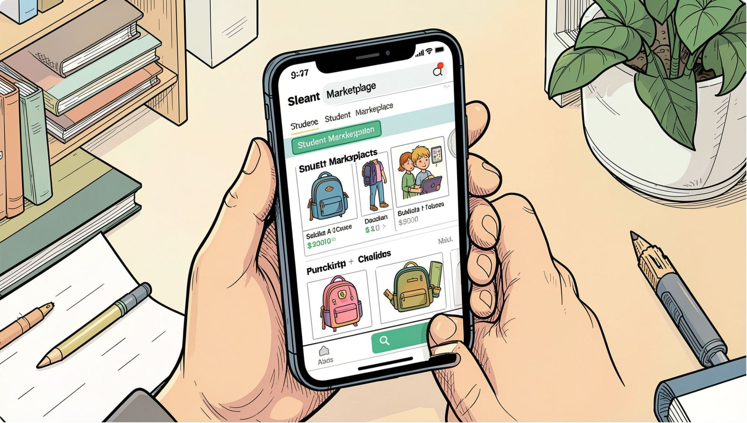

OVERVIEW
Project Overview
Campus Marketplace replaces chaotic WhatsApp and Telegram groups with one organised, searchable platform. Verified students can:
Post listings with photos
Browse, search, and filter products
Contact sellers directly via WhatsApp
Manage listings and mark items as sold
The first release is a focused MVP — no real-time chat, payments, or delivery. Built on free-tier services with no credit card required.

Slide 3
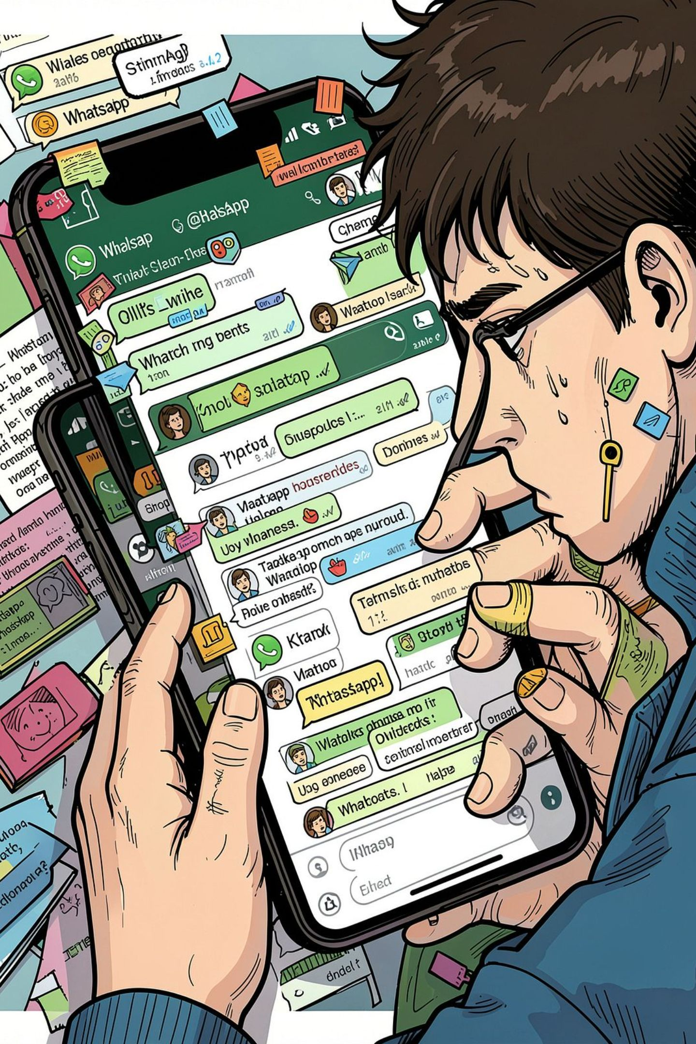
PROBLEM
The Problem with WhatsApp Groups
🔍 Hard to Search
📦 No Listing Management
No keyword search, categories, or price filters. Old listings disappear under new messages.
Sellers can't edit, delete, or mark items as sold. Posts are permanent and unmanageable.
🔒 No Campus Restriction
Groups are open and unverified. There's no way to confirm buyers or sellers are actual students.

Slide 4




GOALS
Objectives & Target Users
College-Restricted Access
Full Listing Management
Only students with @college-domain emails can register and log in.
Create, edit, and delete listings with 1–3 images, price, category, and condition.
Search & Filter
WhatsApp Contact
Browse by keyword, category, price range, and item condition.
One tap opens a WhatsApp chat with the seller via wa.me links.
Every student is both a buyer and a seller. An admin role (future) will handle moderation and user management.

Slide 5
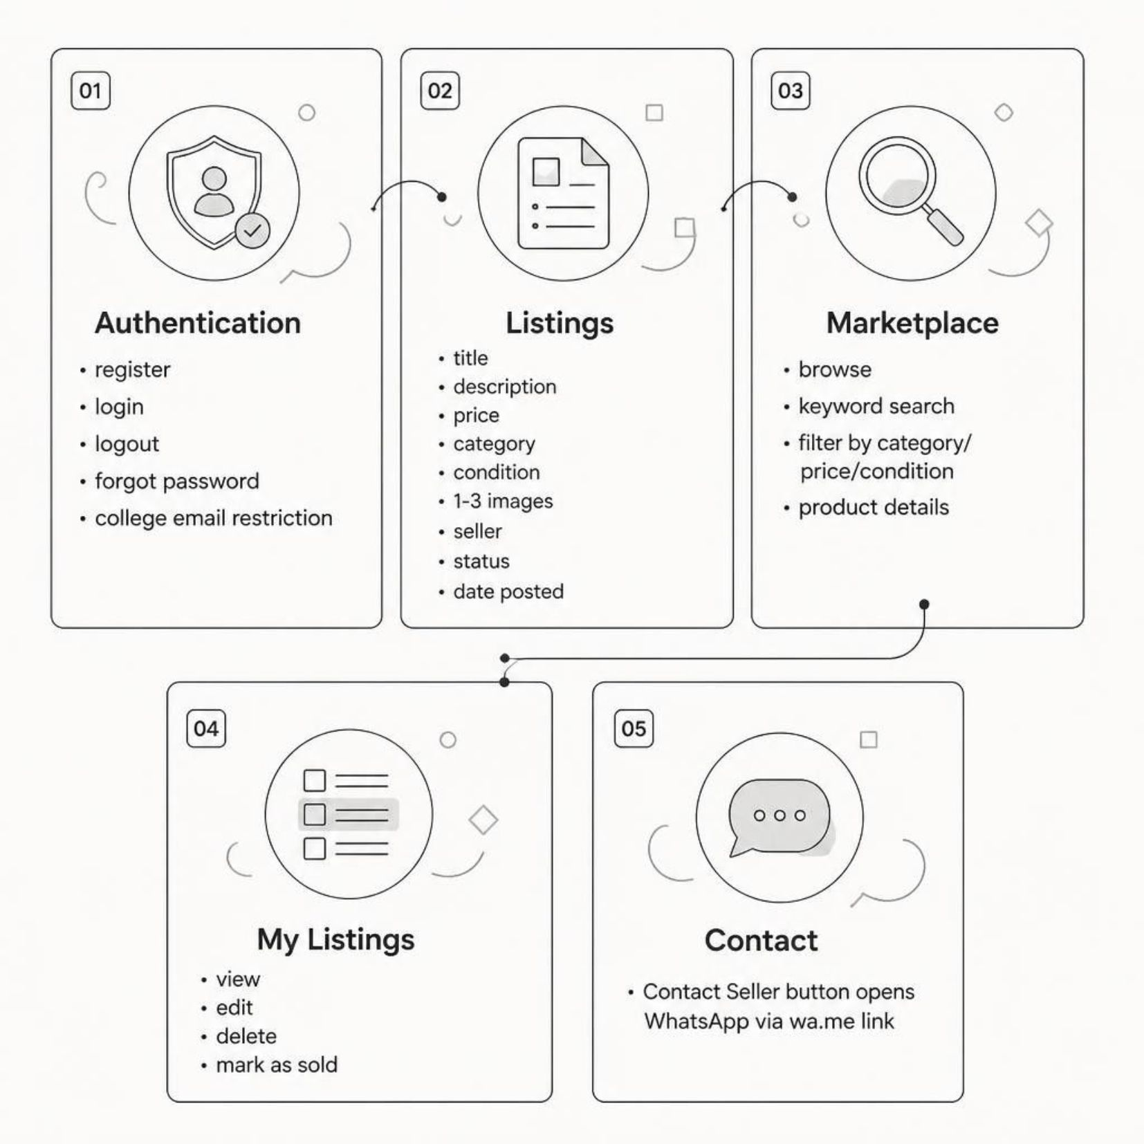

SCOPE
MVP Scope
Buyer Flow
Register → Browse → Search & Filter → View Details → Contact Seller → Meet on Campus
Seller Flow
Register → Create Listing → Upload Images → Publish → Receive Contact → Mark as Sold
Out of scope for MVP: real-time chat, in-app payments, delivery, and admin dashboard.

Slide 6
TECH STACK
Technology Stack — 100% Free
Layer | Technology | Free Tier | Card?
Frontend | HTML5, CSS3, Vanilla JS / React + Vite | Open source | No
Database | Supabase PostgreSQL | 500 MB | No
Auth | Supabase Auth | 50K MAU | No
Storage | Supabase Storage | 1 GB | No
Emails | Brevo SMTP | ~300/day | No
Hosting | Cloudflare Pages | Unlimited | No
Total monthly cost: ₹0. Connect Brevo SMTP in Supabase → Auth → SMTP Settings for real verification emails.

Slide 7
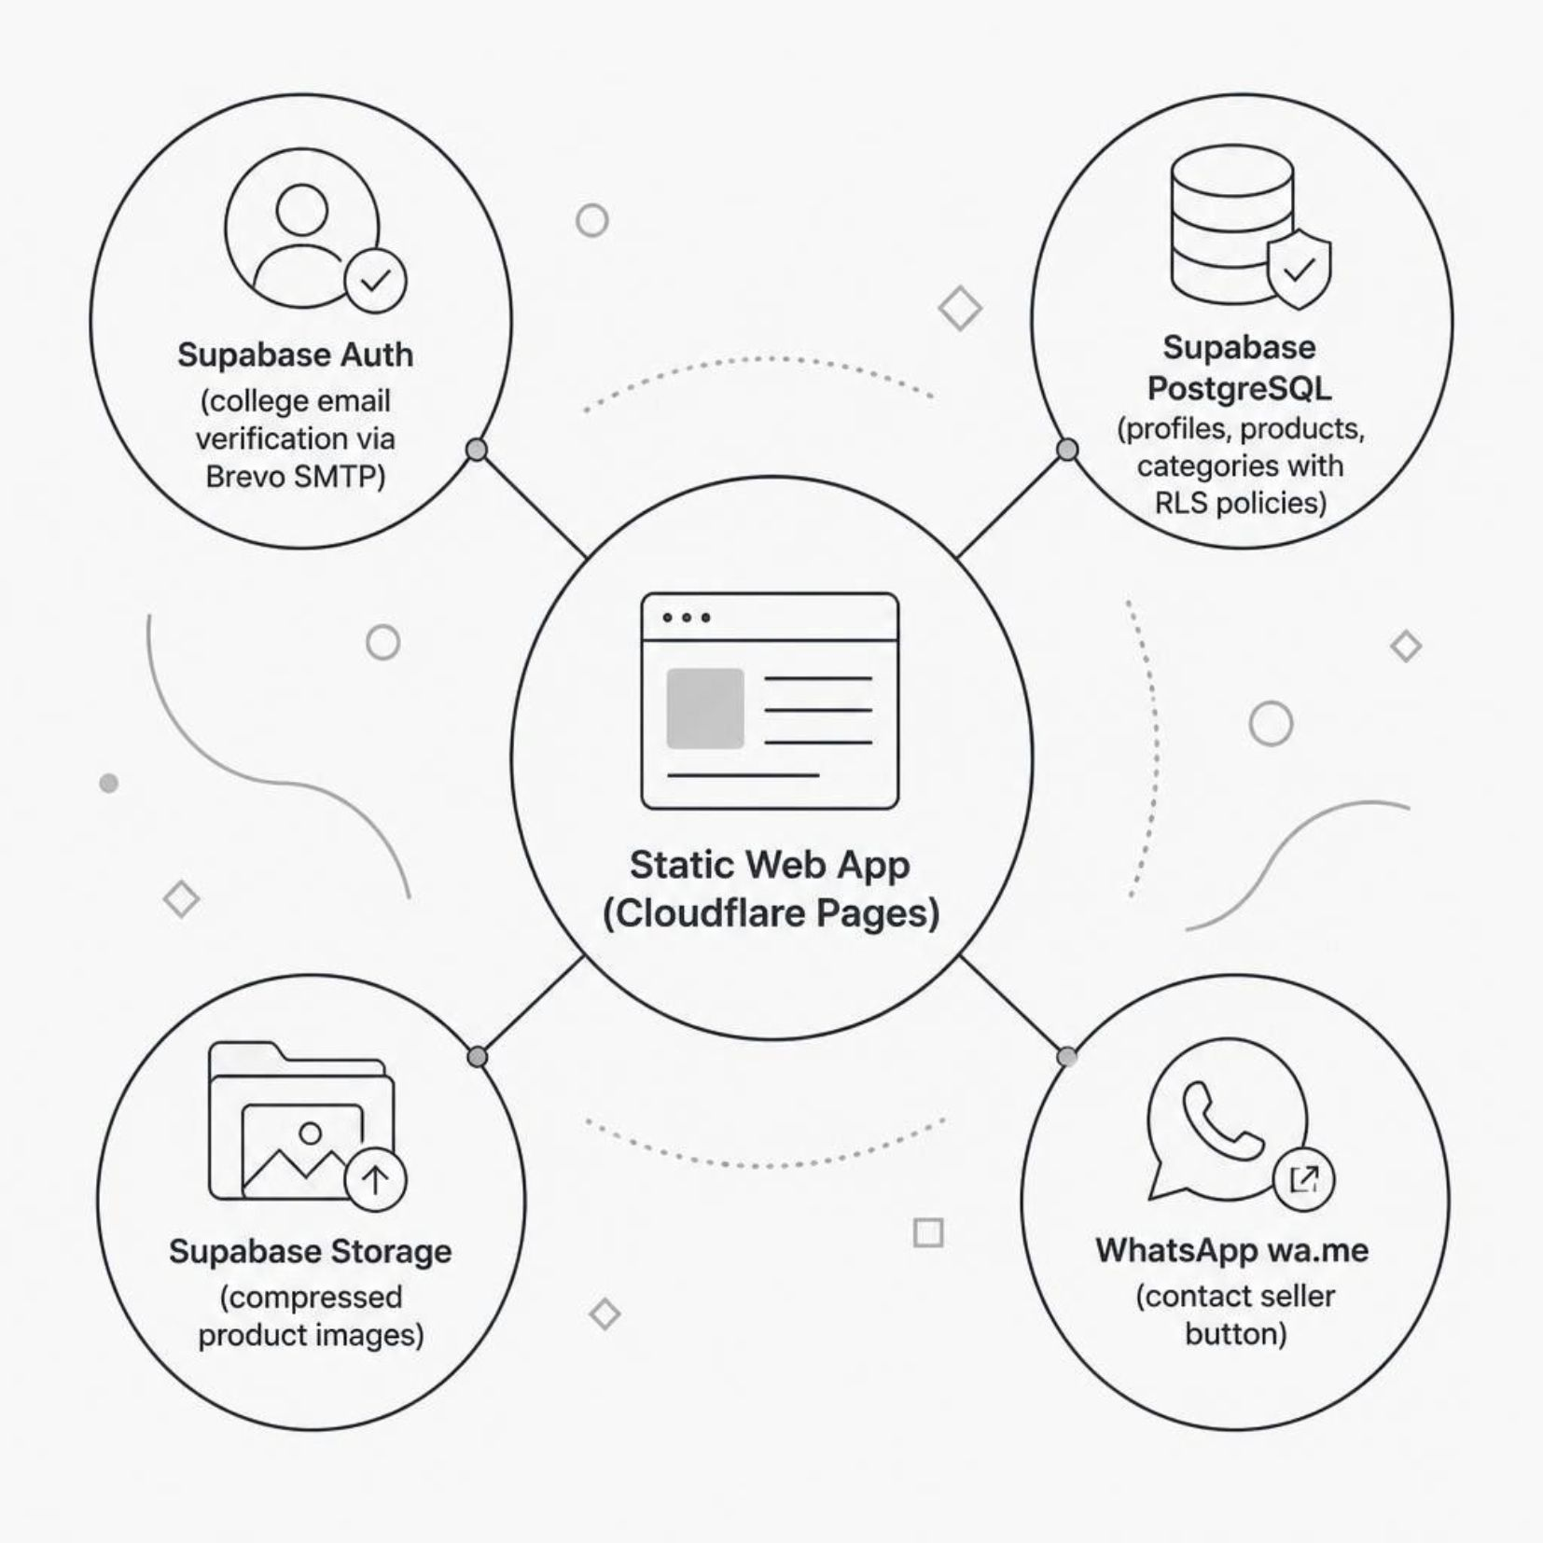
ARCHITECTURE
Database & System Architecture
Why Supabase?
PostgreSQL with full-text search and pg_trgm fuzzy search
Row Level Security (RLS) enforces all permissions
1 GB image storage, no credit card
Real SQL — ideal for DBMS coursework
Supabase pauses after 7 days of inactivity. A GitHub Actions workflow pings the DB twice weekly to keep it alive.
The app needs no custom backend server. The browser talks to Supabase directly, and Row Level Security enforces every permission at the database level.

Slide 8
DATA & SECURITY
Database Design & Security
Core Tables
Row Level Security (RLS)
profiles — id, full_name, college_email, phone, created_at
categories — id, name, slug, parent_id
products — id, seller_id, title, description, price, category_id, condition, status, created_at
product_images — id, product_id, image_url, sort_order
SELECT products: everyone can read
INSERT products: only authenticated users
UPDATE / DELETE products: only the owner (auth.uid() = seller_id)
profiles: users can only read and update their own row
All tables include created_at / updated_at timestamps. Foreign keys enforce referential integrity.
RLS is enforced at the database level — even a compromised client cannot bypass these rules.

Slide 9
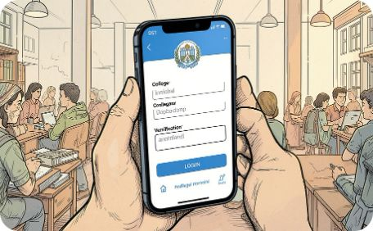
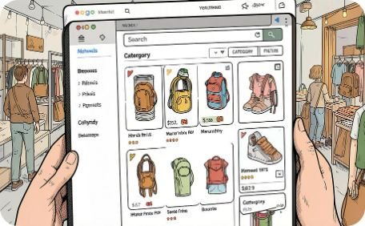
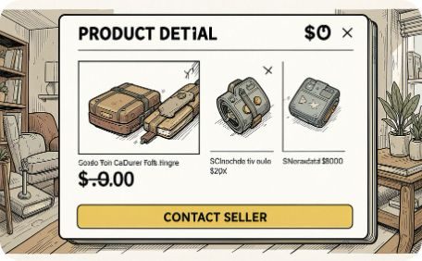
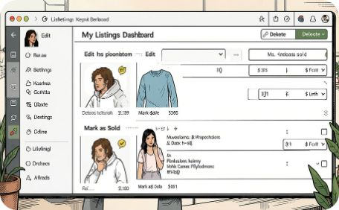
UX & OPERATIONS
App Screens & Staying Free
Auth Screens
Marketplace
Product Details
My Listings
Register, login, forgot password — restricted to college email domain.
Browse all listings with search, category, price, and condition filters.
Photos, description, price, seller info, and WhatsApp contact button.
Manage your posts — edit details, delete, or mark items as sold.
Free-tier guardrails: Compress images to WebP (~200 KB each), enforce 3-image limit, purge old listings quarterly, and use a GitHub Actions cron job to ping Supabase twice weekly (prevents auto-pause).

Slide 10

ROADMAP
Development Plan & Future Scope
Week 1
1
Project setup, Supabase config, Brevo SMTP, Auth screens
2
Week 2
Database schema, RLS policies, Create Listing with image upload
Week 3
3
Marketplace browse, search, filters, Product Details, My Listings
4
Week 4
Testing, deployment to Cloudflare Pages, demo preparation
Future (free-tier only): Admin dashboard, email notifications for new listings, bookmarking, and advanced search with PostgreSQL full-text ranking. No paid services planned.
Academic value: This project demonstrates RDBMS design, SQL joins, authentication, API integration, deployment, and security — all at zero cost.

