Slide 1
PRT661 · Data Science Practice Assessment 3
Australian NEM Price & Demand Analysis and
Forecasting System
End-to-end ETL · feature engineering · operational & strategic decisions
Danala Group 8 · Theme 2 · 2026
Dipesh Sedhai (S395457)
Dilliram Dhakal (S396633)
Roshan Kumar Shrestha (S395498)
Nitesh Raj Chaudhary (S394811) *
https://youtu.be/DIrxi1R78ys
https://github.com/niteshS394811/S226-PRT661-DATA-SCIENCE-PRACTICE.git

Slide 2
Agenda | Nitesh
1. Problem, planning value & objectives
2. Architecture & tools (Docker, Airflow, Postgres)
3. Raw data → cleaning → feature engineering
4. Operational & strategic dashboards (meaning + UI)
5. Models, challenges, future work
Danala Group 8 · PRT661 Assessment 3 · 2/24

Slide 3
WHAT & WHY — the problem | Nitesh
The NEM publishes rich five-minute, multi-region data — but without a structured path it stays hard to use. The issue is not missing data; it is missing AEMO → clean features → models → actions.
Too heavy & technical
One-off spreadsheets
Operational gap
Large AEMO tables; not analysis-ready
No maintained warehouse or daily refresh
Markets move every 5 min — stale CSVs fail
Strategic gap
Engineering gap
Decision gap
One week cannot show multi-year patterns
Full reloads do not scale; need incremental load
Charts without interpretation are not actionable
Danala Group 8 · PRT661 Assessment 3 · 3/24

Slide 4
WHO — affected users | Nitesh
Energy operators
Near-term price, demand, interchange — firm VRE, start peakers, watch regional stress.
Big industry
When flexible load is expensive today; multi-year peaks for shifts and hedges.
Customers
Evening peaks vs cheaper overnight windows for EVs and appliances.
Planners / analysts
Multi-year regional evidence for capacity, storage and tariffs.
Danala Group 8 · PRT661 Assessment 3 · 4/24

Slide 5
Project objectives | Nitesh
O1
End-to-end framework: ETL for operational daily and historical strategic analysis
O2
Ingest real AEMO data via NEMOSIS (price, demand, interchange, generation)
O3
Layered warehouse: staging → dwh → datamart on PostgreSQL
O4
Strategic full load + daily incremental; Airflow DAGs for scheduling
O5
Feature engineering + multi-step forecasts (Naive, Ridge, HistGB)
O6
Two decision-ready dashboards: Operational (:8501) and Strategic (:8502)
Danala Group 8 · PRT661 Assessment 3 · 5/24

Slide 6
End-to-end architecture & tools | Nitesh
AEMO
NEMOSIS
Clean
Staging
DWH
Mart+ML
2 UIs
Docker Compose
Apache Airflow
Reproducible stack: app images, Postgres, optional Airflow, Streamlit on fixed ports
DAG nem_strategic_history (manual full load)
DAG nem_operational_daily (scheduled incremental)
PostgreSQL
Python / Streamlit
Schemas staging → dwh → datamart → analytics
Persistent volume for history
ETL, sklearn models, Plotly dynamic dashboards
:8501 ops · :8502 strategic
Danala Group 8 · PRT661 Assessment 3 · 6/24

Slide 7
Two coordinated ETL paths | Nitesh
Strategic history
Operational / Daily
• Window e.g. 2024–2025
• max(settlementdate) + 1 day
• Full refresh staging/dwh/mart
• Upsert (delete day, insert)
• Build hourly analytics
• Keeps strategic history
• Train models + insight cards
• Refresh short-term forecasts
• Airflow: nem_strategic_history
• Airflow: nem_operational_daily
• CLI: run_strategic_history.py
• CLI: run_daily_pipeline.py
Danala Group 8 · PRT661 Assessment 3 · 7/24

Slide 8
What the raw data looked like |Dipesh
AEMO tables via NEMOSIS
Issues in the raw feed
• DISPATCHPRICE: SETTLEMENTDATE, REGIONID, RRP, INTERVENTION
• UPPERCASE column names
• DISPATCHREGIONSUM: TOTALDEMAND, NETINTERCHANGE, DEMANDFORECAST
• Intervention / non-physical rows
• Generation fields: AVAILABLEGENERATION, SEMISCHEDULE_CLEAREDMW, UIGF, …
• Possible duplicate keys
• Grain: 5-minute dispatch intervals
• Missing or non-numeric cells
• Regions: NSW1, QLD1, VIC1, SA1, TAS1
• Optional columns sometimes absent
• Example: 2025-01-08 00:05 NSW1 RRP=72.4 TOTALDEMAND=7480
• Very large files for multi-year pull
• ~288 intervals/day × 5 regions ≈ 1,440 rows/day
• Not model-ready without features
Danala Group 8 · PRT661 Assessment 3 · 8/24

Slide 9
Cleaning in detail (clean_data) |Dipesh
Steps
1. Rename → snake_case (rrp, totaldemand, …)
2. Filter INTERVENTION == 0 at extract
3. to_numeric on price, demand, gen fields
4. dropna on settlementdate, regionid, rrp, demand
5. drop_duplicates(time, region)
6. Sort by time then region
7. Defaults: netinterchange=0 if missing
8. Keep generation cols for strategic path
Danala Group 8 · PRT661 Assessment 3 · 9/24

Slide 10
Feature engineering |Dipesh
Feature
Example meaning
Why it helps models / users
demand_lag_1
Demand 5 min ago
Captures very short-run level
demand_lag_12
Demand 1 hour ago
Recent hourly shape
demand_lag_288
Demand ~1 day ago
Daily cycle (same clock time)
price_lag_1 / 12
Recent RRP
Price persistence & last hour
demand_roll_mean_12
1-hour rolling mean
Smoothed local level
demand_roll_std_12
1-hour rolling std
Volatility before spikes
netinterchange_lag_1
Prior interchange
Import/export pressure
hour, DOW, is_weekend
Calendar
Evening peaks, weekend behaviour
aemo_demand_error
demand − DEMANDFORECAST
Where prior AEMO 5-min miss occurred
Danala Group 8 · PRT661 Assessment 3 · 10/24

Slide 11
Feature engineering — numeric examples |Dipesh
Illustrative NSW1 timeline (concept)
Time 00:05 demand=7480 → demand_lag_1 = demand at 00:00
Time 01:05 demand=7600 → demand_lag_12 ≈ demand one hour earlier
Time 00:05 next day → demand_lag_288 ≈ same 00:05 yesterday (daily seasonality)
If last 12 intervals demand std is high → roll_std_12 flags volatility
If netinterchange was strongly negative → region was exporting; lag carries that signal
Models use these columns in dwh.features; early rows with NaN lags are dropped so Ridge/HistGB can train.
Danala Group 8 · PRT661 Assessment 3 · 11/24

Slide 12
Model Justification |Dipesh
Model | Why it fits this problem
Seasonal Naive | NEM price and demand repeat strongly day-to-day. “Same interval yesterday” is a fair real-world baseline for a 5-minute market.
Ridge | Our features are mostly linear effects (lags, hour-of-day, recent demand). Ridge uses them without overfitting when features are correlated.
HistGradientBoosting | Price spikes and region interactions are non-linear. Trees can split on high demand + tight interchange in ways a linear model cannot.
Why not ARIMA
Strong for one series; weaker when we need five regions and many exogenous features (lags, interchange, calendar) in one consistent pipeline.
Why not LSTM
Needs longer, denser sequences, more tuning, and heavier training. For short-horizon forecasts with clear engineered features, HistGB gives a better cost/benefit in our Docker retrain workflow.
Danala Group 8 · PRT661 Assessment 3 · 12/24

Slide 13
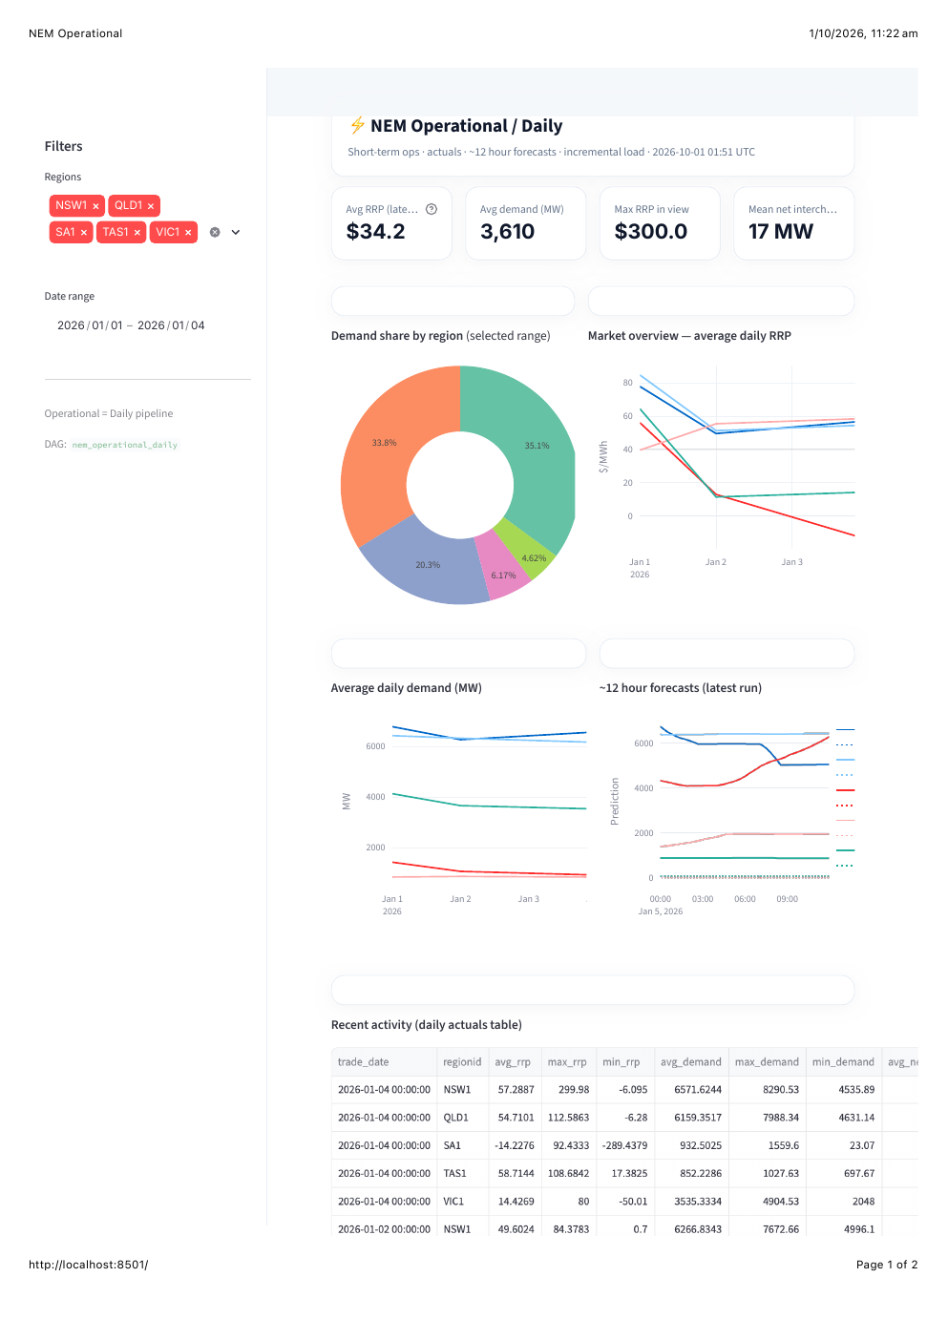
Operational dashboard — meaning & actions |Dipesh
• Rising RRP → start gas peakers / hold hydro
• High demand share → focus that region
• Forecast up → prepare flexible plant
• Industry: delay furnaces/EV fleets on spikes
• Customers: shift EV/appliances off peak
• Interchange stress → price coupling risk
• Daily upsert → decisions use fresh data
• Solar midday often softer prices
Danala Group 8 · PRT661 Assessment 3 · 13/24

Slide 14
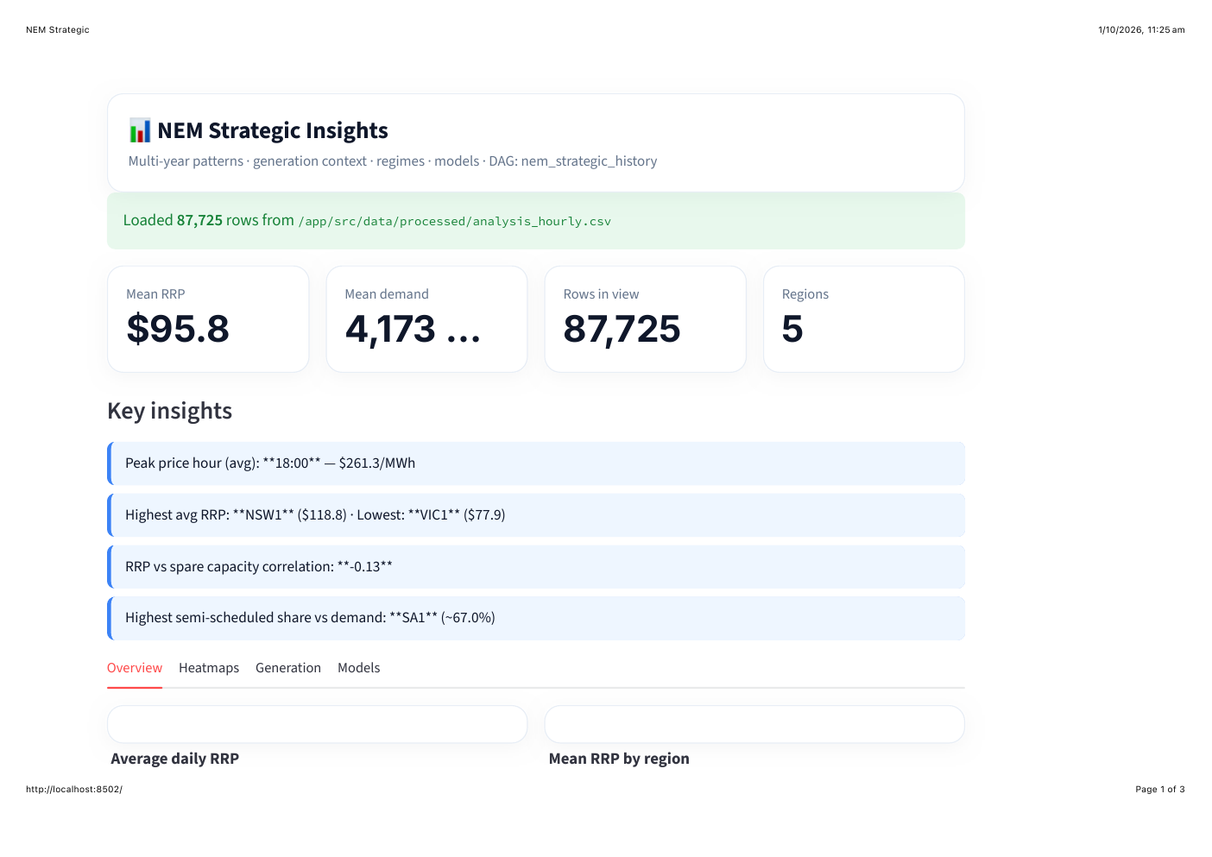
Strategic overview — meaning & actions | Dilli
• Mean RRP ~$96: budget wholesale level
• Peak ~18:00: evening is critical window
• NSW often dearer than VIC: regional planning
• Spare capacity ↔ higher prices when tight
• Operators: maintenance off structural peaks
• Industry: design shifts around peak hours
• Customers: TOU plans match evening peaks
• 87,725 hours: multi-year evidence base
Danala Group 8 · PRT661 Assessment 3 · 14/24

Slide 15
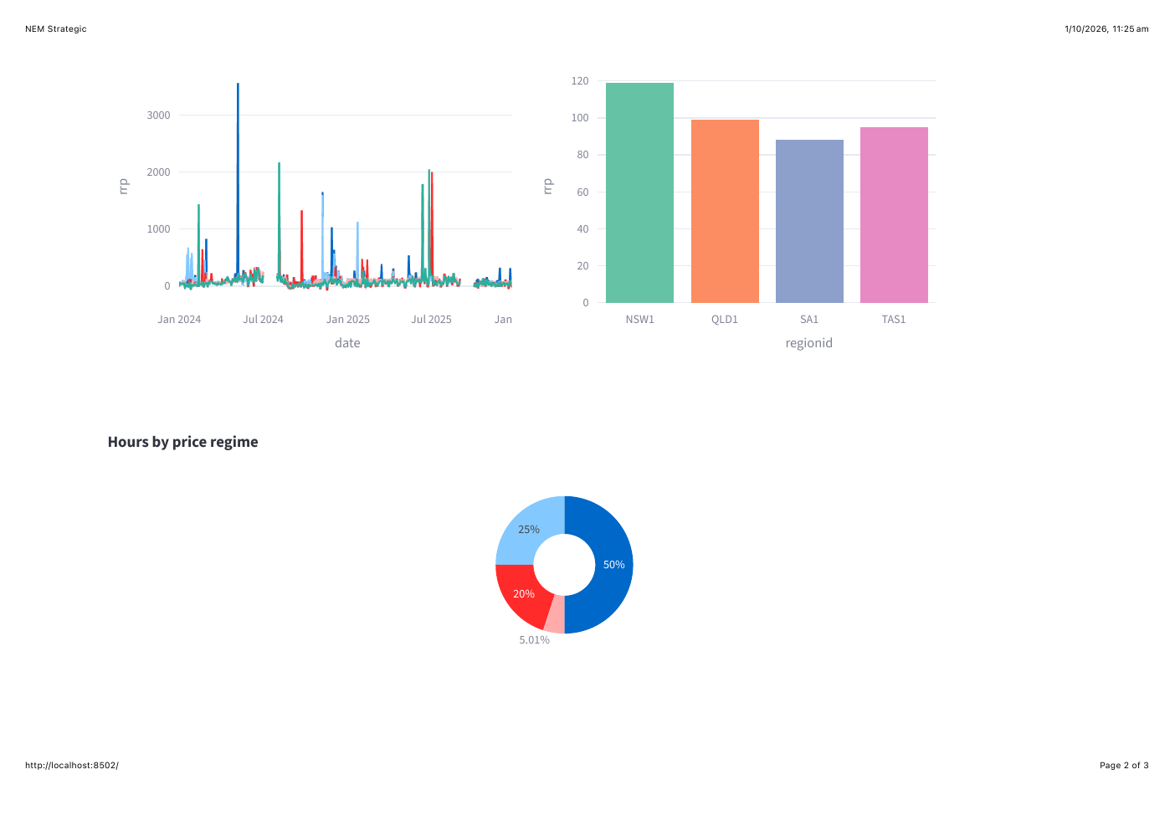
Regional RRP trends — planning use | Dilli
• Who is structurally expensive?
• Generators: where firming earns more
• Industry: site flexible load carefully
• Retailers: regional product risk
• Compare years for persistence
• Supports hedge & investment talks
Danala Group 8 · PRT661 Assessment 3 · 15/24

Slide 16
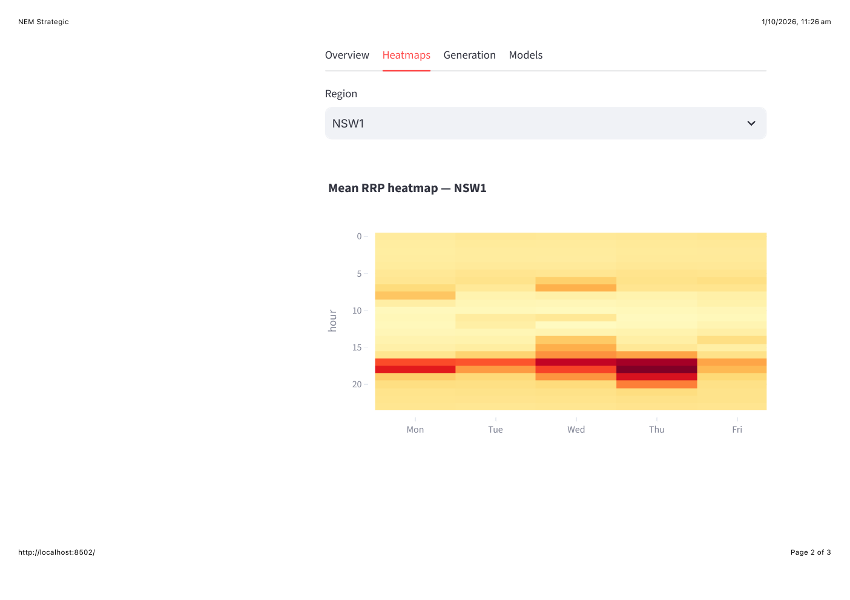
Heatmap — schedule plant & loads | Dilli
• Dark = typically expensive hours
• Gas peakers: value in evening blocks
• Solar: midday; may meet lower RRP
• Wind: avoid maintaining in peak blocks
• Industry: batch work in pale hours
• Households: charge EVs overnight
• Retail TOU windows from this shape
Danala Group 8 · PRT661 Assessment 3 · 16/24

Slide 17
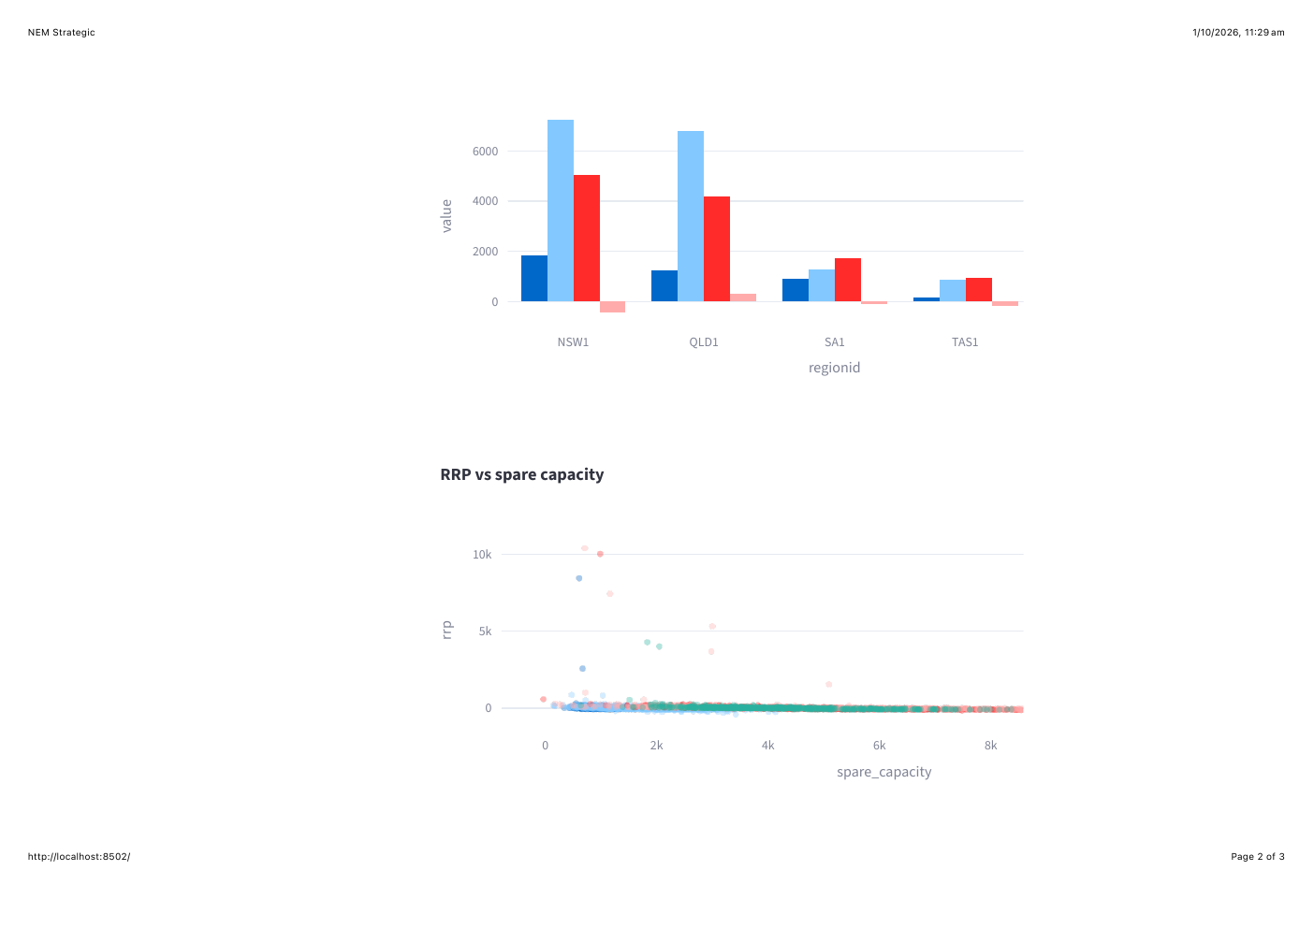
Generation & interchange — system meaning | Dilli
• High semi-scheduled → more VRE variability
• Need firming: gas, storage, interconnect
• Low spare + high RRP = scarcity
• Interchange shows import/export stress
• Import regions: higher price risk
• Case for storage & demand response
Danala Group 8 · PRT661 Assessment 3 · 17/24

Slide 18
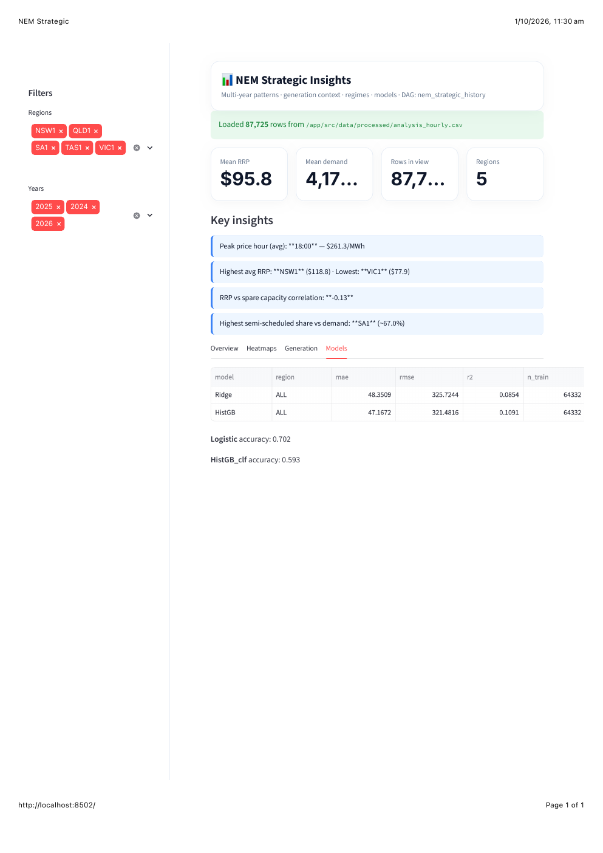
Model metrics | Roshan
• MAE ~$48 typical RRP error
• Low R²: spikes hard to nail
• HistGB slightly better than Ridge
• Regime acc ~0.70: high/spike alerts
• Ops: risk signal, not perfect schedule
• Industry: flexible load windows
• Retrain as daily data grows
Danala Group 8 · PRT661 Assessment 3 · 18/24

Slide 19
From chart → action by user type | Roshan
User
Operational
Strategic
Energy operators
Peakers, firm VRE, watch interchange
Maintenance & capacity at repeat peaks
Big industry
Shift MW off spike hours today
Redesign shifts / hedges multi-year
Customers
Delay EV/appliances when RRP high
TOU plans aligned with evening peaks
Danala Group 8 · PRT661 Assessment 3 · 19/24

Slide 20
Challenges & solutions | Roshan
Port / drivers
→ Host 5433 · postgresql+psycopg://
Large extract
→ NEMOSIS feather cache · skip-extract
Daily upsert
→ Delete full calendar day then insert
Price hard to fit
→ MAE/RMSE + regime labels for decisions
Feature NaNs
→ Drop early lag rows before Ridge/HistGB
Limitation
Concept: live dashboards + continous scheduled
Reality: local Docker only — not cloud-hosted
Airflow schedules run only when the local machine is powered on
Danala Group 8 · PRT661 Assessment 3 · 20/24

Slide 21
Future work before Assessment 4 | Roshan
1. Stabilise full multi-year load for markers
2. Walk-forward evaluation in final report
3. Document horizon config (1h vs 12h)
4. One-command clone-and-run README
Danala Group 8 · PRT661 Assessment 3 · 21/24

Slide 22
Repository | Roshan
https://github.com/niteshS394811/S226-PRT661-DATA-SCIENCE-PRACTICE
Docker · Airflow · PostgreSQL · Streamlit
nem_strategic_history · nem_operational_daily
Danala Group 8 · PRT661 Assessment 3 · 22/24

Slide 23
References
Australian Energy Market Operator. (n.d.). NEMWeb market data. https://www.aemo.com.au/energy-systems/electricity/national-electricity-market-nem/data-nem/market-data-nemweb
Australian Energy Market Operator. (n.d.). Market Management System (MMS) data. https://www.aemo.com.au/energy-systems/electricity/national-electricity-market-nem/data-nem/market-management-system-mms-data
Australian Energy Market Operator. (n.d.). Dispatch data. https://www.aemo.com.au/energy-systems/electricity/national-electricity-market-nem/data-nem/market-management-system-mms-data/dispatch
Apache Software Foundation. (n.d.). Apache Airflow documentation. https://airflow.apache.org/docs/
Google. (n.d.). TensorFlow documentation. https://www.tensorflow.org/
Pedregosa, F., Varoquaux, G., Gramfort, A., Michel, V., Thirion, B., Grisel, O., Blondel, M., Prettenhofer, P., Weiss, R.,Dubourg, V., Vanderplas, J., Passos, A., Cournapeau, D., Brucher, M., Perrot, M., & Duchesnay, É. (2011). Scikit-learn:Machine learning in Python. Journal of Machine Learning Research, 12, 2825–2830.
Group 8. (2026). PRT661 Data Science Practice project repository. GitHub. https://github.com/niteshS394811/S226-PRT661-DATA-SCIENCE-PRACTICE
Group 8. (2026). PRT661 project board. Jira. https://shrestharoshan931-1785816864381.atlassian.net/jira/software/projects/KAN/list
UNSW Collaboration on Energy and Environmental Markets. (n.d.). NEMOSIS: NEM open-source information service.GitHub. https://github.com/UNSW-CEEM/NEMOSIS

Slide 24
Thank you
Danala Group 8 · PRT661 Assessment 3

