Slide 1
DISASTERSENSEAI
DisasterSenseAI
AI-Powered Disaster Tweet Classification
Using NLP and Machine Learning
Presented by
Nitesh Ramdas Dahiwale
Notes:
Sources: Project source and saved evaluation.json
Project root: C:\Users\nites\Documents\Codex\2026-10-15\files-mentioned-by-the-user-project\outputs\DisasterSenseAI
Saved experiment: seed 42, 6,142 train rows, 1,471 holdout rows, 3-fold grouped training CV. Future work is explicitly marked.

Slide 2
DISASTERSENSEAI
Disaster language needs context
The same word can describe an emergency,
a metaphor or casual conversation.
Objective: classify historical tweets and make the evidence reviewable.
Explore
Compare
Review
Class balance, text patterns
and missing metadata
TF-IDF features and models
with grouped validation
Single and batch predictions
with explanations
A model label describes language. Human review must verify incident context.
Notes:
Sources: Project source and saved evaluation.json
Project root: C:\Users\nites\Documents\Codex\2026-10-15\files-mentioned-by-the-user-project\outputs\DisasterSenseAI
Saved experiment: seed 42, 6,142 train rows, 1,471 holdout rows, 3-fold grouped training CV. Future work is explicitly marked.

Slide 3
03 / EVIDENCE
The dataset at a glance
HISTORICAL TWEETS
4,342 non-disaster
57.0% of labeled tweets · target 0
7,613
5 fields
id, keyword, location,
text and target
3,271 disaster
43.0% of labeled tweets · target 1
Notes:
Sources: Source workbook and evaluation.json dataset metadata
Project root: C:\Users\nites\Documents\Codex\2026-10-15\files-mentioned-by-the-user-project\outputs\DisasterSenseAI
Saved experiment: seed 42, 6,142 train rows, 1,471 holdout rows, 3-fold grouped training CV. Future work is explicitly marked.

Slide 4
04 / EXPLORATORY ANALYSIS
EDA: missing metadata and tweet length
Missing metadata (rows)
Length (characters; % within class)
110 repeated raw texts. Text and target fields contain no missing values.
Disaster tweets average 108.8 characters, compared with 96.3 for non-disaster tweets.
Notes:
Sources: Workbook missing values and length_distribution.json
Project root: C:\Users\nites\Documents\Codex\2026-10-15\files-mentioned-by-the-user-project\outputs\DisasterSenseAI
Saved experiment: seed 42, 6,142 train rows, 1,471 holdout rows, 3-fold grouped training CV. Future work is explicitly marked.

Slide 5
05 / NLP PROCESSING
Preprocessing preserves useful language
Raw text
Cleaned text
@rescue I can't reach home! #Flood https://example.com
i cannot reach home flood
1
2
3
Normalize
Keep negation
Remove noise
Decode HTML and lowercase.
Expand “can’t” to “cannot”.
Remove URLs, mentions, symbols and extra spaces.
Illustrative input, actual cleaning rules. Raw text remains available to the structural feature branch.
Notes:
Sources: src/preprocessing.py::clean_text
Project root: C:\Users\nites\Documents\Codex\2026-10-15\files-mentioned-by-the-user-project\outputs\DisasterSenseAI
Saved experiment: seed 42, 6,142 train rows, 1,471 holdout rows, 3-fold grouped training CV. Future work is explicitly marked.

Slide 6
06 / TF-IDF AND STRUCTURAL FEATURES
Feature engineering adds character context
33,809 fitted features
Logistic variants: grouped CV F1
13,809 word features
Unigrams and bigrams
20,000 character features
Word-boundary 3–5 grams
Alternative structural inputs:
length, words, hashtags, mentions and exclamations; scaled and capped at 3.
Character features improve grouped CV F1 by 1.94 percentage points over word-only logistic.
Notes:
Sources: Fitted model.joblib; preprocessing.py; evaluation.json
Project root: C:\Users\nites\Documents\Codex\2026-10-15\files-mentioned-by-the-user-project\outputs\DisasterSenseAI
Saved experiment: seed 42, 6,142 train rows, 1,471 holdout rows, 3-fold grouped training CV. Future work is explicitly marked.

Slide 7
07 / ARCHITECTURE AND VALIDATION
A reproducible pipeline supports fair evaluation
Tweet text
TF-IDF
Logistic model
Prediction
Original message
Word + character
Selected C = 1
Label for review
6,142
1,471
3 folds
Training rows
Held-out rows
Grouped training CV
Seed 42. Normalized duplicate texts stay together. Select the highest training CV disaster F1.
The holdout is 19.32% of the data. It evaluates the selected model and does not drive selection.
Notes:
Sources: src/model_training.py; saved seed-42 evaluation
Project root: C:\Users\nites\Documents\Codex\2026-10-15\files-mentioned-by-the-user-project\outputs\DisasterSenseAI
Saved experiment: seed 42, 6,142 train rows, 1,471 holdout rows, 3-fold grouped training CV. Future work is explicitly marked.

Slide 8
08 / VERIFIED MODEL PERFORMANCE
Character TF-IDF leads the comparison
Disaster-class F1 by model
81.31%
Model | CV F1 | Holdout F1
Naive Bayes | 71.55% | 70.53%
Logistic regression | 73.36% | 73.85%
Linear SVC | 73.30% | 73.63%
Random forest | 57.12% | 58.66%
Logistic + structure | 73.47% | 74.33%
Logistic + character | 75.30% | 75.02%
Holdout accuracy
75.02%
Holdout disaster F1
ROC-AUC 0.8764
The saved model scores 75.30% CV F1. Holdout performance comes from 1,471 unseen partition rows.
Notes:
Sources: evaluation.json: six candidates, same saved experiment
Project root: C:\Users\nites\Documents\Codex\2026-10-15\files-mentioned-by-the-user-project\outputs\DisasterSenseAI
Saved experiment: seed 42, 6,142 train rows, 1,471 holdout rows, 3-fold grouped training CV. Future work is explicitly marked.

Slide 9
09 / CONFUSION MATRIX
Errors reveal the cost of missed signals
PREDICTED LABEL
275 incorrect predictions
Non-disaster
Disaster
783
80
83.77% disaster precision
67.93% disaster recall
Actual
non-disaster
Correct rejection
False positive
195
413
195 missed disaster tweets exceed the 80 false alarms. Human review remains necessary.
Actual
disaster
False negative
Correct detection
These are historical dataset labels. They do not establish whether a real incident occurred.
Notes:
Sources: evaluation.json selected model confusion matrix
Project root: C:\Users\nites\Documents\Codex\2026-10-15\files-mentioned-by-the-user-project\outputs\DisasterSenseAI
Saved experiment: seed 42, 6,142 train rows, 1,471 holdout rows, 3-fold grouped training CV. Future work is explicitly marked.

Slide 10
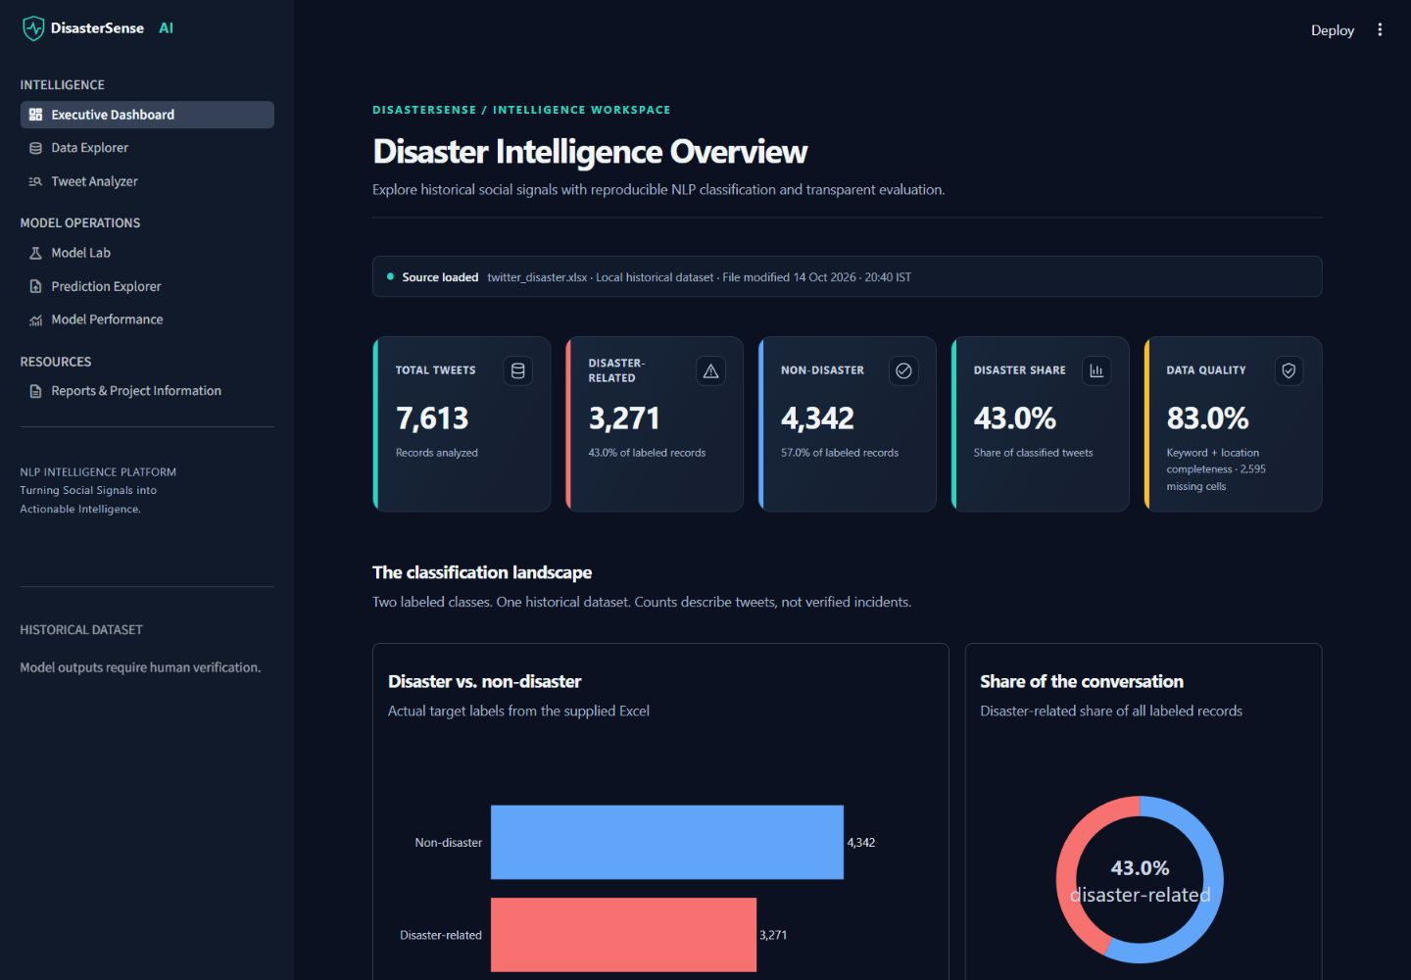
10 / APPLICATION AND PREDICTION
The application makes evidence reviewable
Seven connected pages
Dashboard and Data Explorer
Tweet Analyzer and Model Lab
Prediction Explorer
Performance and Reports
Prediction workflow
Paste text or upload CSV/XLSX.
Run the saved pipeline.
Inspect explanations and status.
Export filtered results.
Notes:
Sources: app.py; src/ui.py; actual unchanged dashboard capture
Project root: C:\Users\nites\Documents\Codex\2026-10-15\files-mentioned-by-the-user-project\outputs\DisasterSenseAI
Saved experiment: seed 42, 6,142 train rows, 1,471 holdout rows, 3-fold grouped training CV. Future work is explicitly marked.

Slide 11
11 / THE PROJECT STORY
Useful signals still need human judgment
Classification organizes the message stream.
ACTUAL HOLDOUT EXAMPLE
“13,000 people receive #wildfires evacuation orders in California”
The same model correctly labels “I love fruits” as non-disaster (ID 24). These examples show separation, not guaranteed reliability.
Limits: historical English tweets, missing context and uncalibrated estimates. Missed disaster messages require particular attention.
ID 6: predicted disaster
Correct against dataset label
Notes:
Sources: Verified saved-model holdout predictions: IDs 6 and 24; evaluation.json limitations
Project root: C:\Users\nites\Documents\Codex\2026-10-15\files-mentioned-by-the-user-project\outputs\DisasterSenseAI
Saved experiment: seed 42, 6,142 train rows, 1,471 holdout rows, 3-fold grouped training CV. Future work is explicitly marked.

Slide 12
DISASTERSENSEAI
The next step is stronger evidence
FUTURE DEVELOPMENT
External and temporal validation
Calibrated confidence and explanation testing
Multilingual evaluation and human feedback
Proposed next steps; these capabilities are not yet implemented.
DisasterSenseAI
Presented by Nitesh Ramdas Dahiwale
Notes:
Sources: Project source and saved evaluation.json
Project root: C:\Users\nites\Documents\Codex\2026-10-15\files-mentioned-by-the-user-project\outputs\DisasterSenseAI
Saved experiment: seed 42, 6,142 train rows, 1,471 holdout rows, 3-fold grouped training CV. Future work is explicitly marked.

