Slide 1
ME6324 – AI IN MANUFACTURING • COMPREHENSIVE FINAL REVIEW
AI-Driven Vision-Based Defect Detection and Localization Automated Optical Inspection (AOI) System for Printed Circuit Boards
Technologies: Ultralytics YOLO • Computer Vision • Deep Learning • OpenCV (CLAHE / AWB) • Streamlit Cloud • Python
PROJECT METRICS & SYSTEM SPECIFICATIONS AT A GLANCE:
• Architecture: Single-Stage Anchor-Free YOLO (20.3 MB Checkpoint)
• Dataset Scale: 4,686 Real PCB Images, 22,359 Defect Annotations (6 Classes)
• Benchmarked Accuracy: 91.4% mAP@50 | 91.6% Precision | 89.7% Recall
• Industrial Throughput: 38.4 ms/frame (26.0 FPS CPU) | <8.5 ms (>110 FPS GPU)
• Real-World Validation: Tested on 14 Physical Boards from ECE Central Workshop

Slide 2
ME6324 - AI IN MANUFACTURING • SLIDE 2
Problem Statement & Project Objectives
THE MANUFACTURING CHALLENGE
KEY PROJECT OBJECTIVES
1. High-Density Interconnect (HDI) Complexity:
Modern bare-board PCBs feature copper traces under 75 microns and drilled micro-vias under 0.2 mm. Microscopic defects compromise entire electronic assemblies.
2. Manual Visual Inspection (MVI) Failure:
Human operators using stereo-microscopes experience severe cognitive eye strain after 20-30 minutes, leading to defect escape rates of 15%-30% and sluggish line throughput (<2 boards/min).
3. Classical CAD-Subtraction AOI Limitations:
Traditional Automated Optical Inspection relies on hardcoded subtraction against golden CAD templates. Minor board warping (<1 mm), vibration, or ambient lighting changes trigger false alarm rates exceeding 20%.
4. Industrial Mandate:
Requires an autonomous, invariant AI defect detector that localizes sub-millimeter defects in real-time (>20 FPS) and outputs rework coordinates [x, y, w, h] to guide automated repair.
Objective 1: Unified Benchmark Dataset Engineering:
Consolidate and convert 4,686 real PCB images into standard YOLO format across 6 critical classes: missing_hole, mouse_bite, open_circuit, short, spur, spurious_copper.
Objective 2: Single-Stage Anchor-Free Deep Learning:
Train an optimized YOLO architecture with multi-scale Feature Pyramid Network (PANet) to simultaneously detect 12-pixel pinholes and large copper shorts.
Objective 3: Industrial Optical Preprocessing Suite:
Engineer a real-world lighting normalizer (Gray World White Balance, LAB CLAHE, Glare Masking) to overcome uneven factory illumination and shiny solder reflections.
Objective 4: Live Operator Dashboard & Rework Manifest:
Deploy an interactive Streamlit web dashboard with live camera capture, 4x micro-inspection zoom, and automated CSV rework coordinate export.
Objective 5: Physical Laboratory Validation:
Validate model generalization on real physical PCB specimens captured in the ECE Central Electronics Workshop.

Slide 3
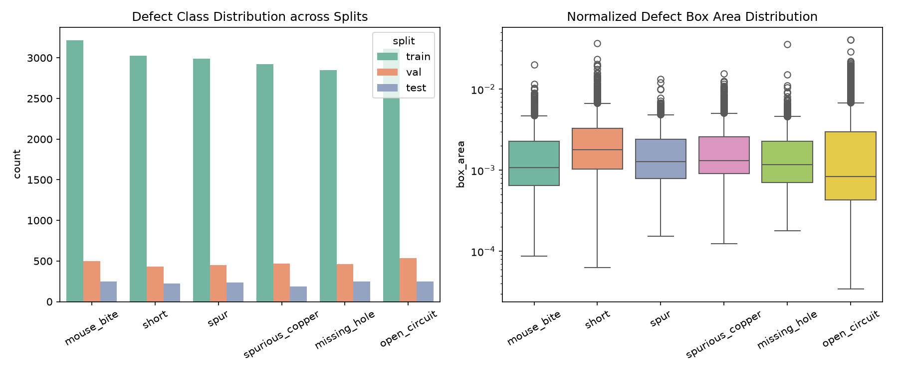
ME6324 - AI IN MANUFACTURING • SLIDE 3
Dataset Engineering, AI Methodology & Training Protocol
DATASET CONSOLIDATION & PARTITIONING
AI/ML ARCHITECTURE & TRAINING HYPERPARAMETERS
• Academic Benchmark Sources:
Integrated PKU-Market-PCB (high-resolution optical scans) & DeepPCB (linear CCD sensor captures). Standardized into unified YOLO normalized format [xc, yc, w, h].
• Stratified Dataset Distribution (4,686 Images / 22,359 Defect Annotations):
1. Training Split: 3,280 images (70.0%) - Updates model weights via backpropagation.
2. Validation Split: 702 images (15.0%) - Tunes hyperparameters and triggers best.pt save.
3. Held-Out Test Split: 468 images (10.0%) - Objective evaluation of unseen boards.
4. Isolated User Testing: 236 images (5.0%) - Completely isolated in data/user_testing/ for blind manual grading in the web app.
• Balanced Class Parity (approx. 16.6% per defect class):
missing_hole (3,552) | mouse_bite (3,968) | open_circuit (3,898) | short (3,681) | spur (3,677) | spurious_copper (3,583). Eliminates minority-class neglect.
• Single-Stage Anchor-Free YOLO Architecture:
- Multi-Scale FPN/PANet Backbone: P3 (stride 8) catches 10-pixel micro-defects; P5 (stride 32) catches large copper shorts.
- Multi-Task Loss: L_total = lambda_box*L_CIoU + lambda_cls*L_BCE + lambda_dfl*L_DFL.
- Resolution & Batch Size: 640x640 input resolution, batch size = 16.
- Cosine Annealing Learning Rate: lr0 = 0.01 decaying to 0.0001 over 100 epochs with AdamW optimizer.
- Albumentations Augmentations: Mosaic 4-image stitching, random affine rotation (+-10 deg), scaling, HSV jitter.

Slide 4
ME6324 - AI IN MANUFACTURING • SLIDE 4
System Implementation: End-to-End AOI Detection Pipeline
STAGE 1: IMAGE INGESTION & OPTICAL PREPROCESSING
STAGE 2: DEEP LEARNING LOCALIZATION & INFERENCE
STAGE 3: REWORK MANIFEST & OPERATOR INTERFACE
• Supports multi-format industrial inputs: JPG, PNG, BMP, TIFF, WEBP.
• Live USB inspection camera and smartphone capture compatibility.
• Gray World Auto White Balance: Neutralizes warm 5000K laboratory lamps.
• LAB-Space CLAHE: Equalizes local shadow contrast without noise amplification.
• Specular Glare Mask: Attenuates blinding reflections on shiny solder joints.
• Single-Pass Forward Inference: Evaluates full 640x640 board in 38.4 ms (CPU).
• Anchor-Free Bounding Box Regression: Directly predicts [x_center, y_center, w, h].
• Defect Classification: Assigns probabilities across 6 target defect categories.
• Non-Maximum Suppression (NMS): Eliminates overlapping duplicate boxes.
• Dual Confidence Filtering: Dynamic slider tuning (0.10 - 0.90) in UI.
• High-Visibility Bounding Boxes: Color-coded badges with confidence scores.
• Micro-Inspection Zoom Gallery: Extracts 4x magnified crops of each defect.
• Automated Rework Coordinate Export: Outputs CSV/JSON manifest with [x, y, w, h].
• Downstream Compatibility: Coordinates directly feed CNC laser ablation systems.
• PASS/FAIL Flagging: Instant line clearance decision based on defect severity.

Slide 5
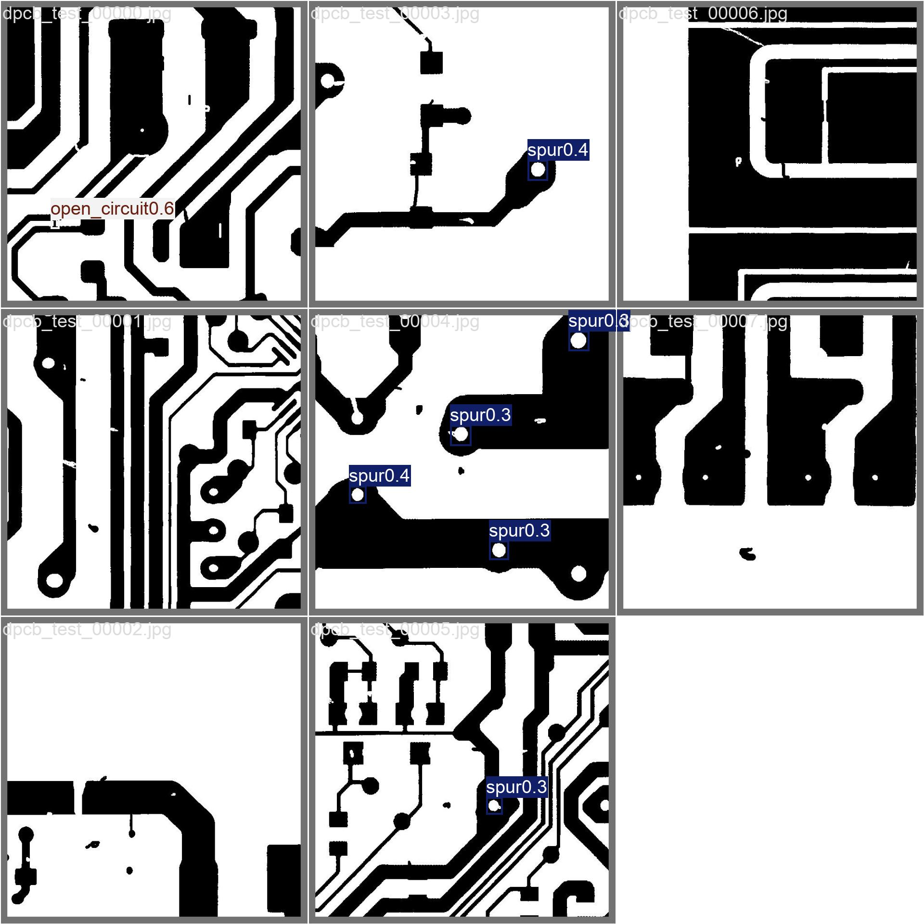
ME6324 - AI IN MANUFACTURING • SLIDE 5
Interactive Operator Dashboard (Streamlit Cloud & Local Deployment)
OPERATOR DASHBOARD CAPABILITIES
LIVE DEFECT LOCALIZATION INTERFACE
1. Dual Ingestion Modes:
Supports drag-and-drop file upload for industrial formats (BMP, TIFF, JPG, PNG) and real-time live USB webcam streaming via st.camera_input.
2. 1-Click Preset Dropdowns:
Integrated instant selection for: (1) Real ECE Lab Photos (data/lab_imag_pcb), (2) Isolated User-Testing Boards (data/user_testing), and (3) Held-Out Test Split.
3. Live Optical Preprocessing Toggle:
Operators can toggle Gray World White Balance, CLAHE contrast equalization, and glare suppression on the fly to inspect reflective boards.
4. Micro-Inspection Zoom Gallery:
Automatically isolates and magnifies every defect region 4x, allowing quality technicians to verify hairline track breaks without manual microscope adjustment.
5. Robotic Rework Manifest Export:
Generates a timestamped inspection report and one-click downloadable CSV containing defect IDs, coordinates, and recommended repair actions.

Slide 6
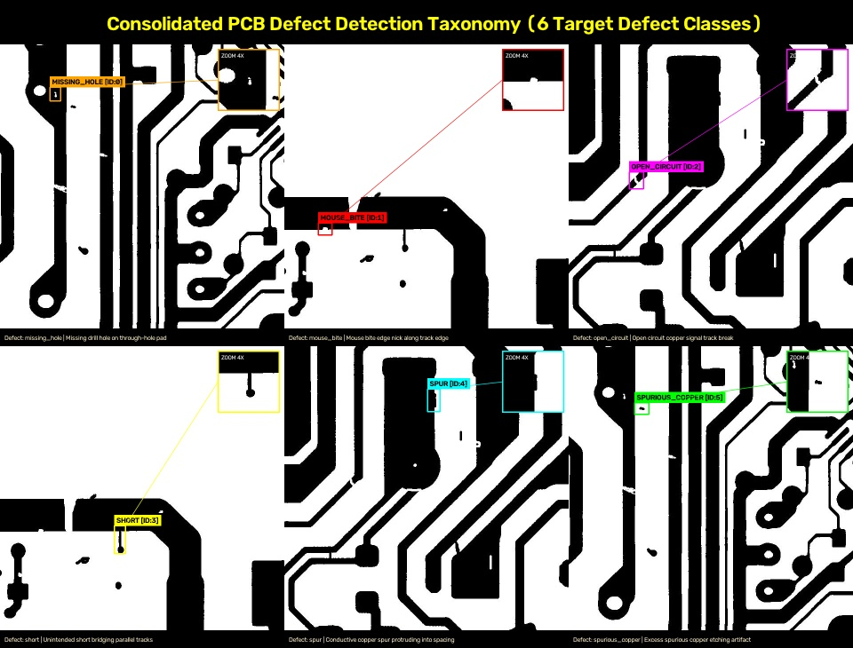
ME6324 - AI IN MANUFACTURING • SLIDE 6
Experimental Results: Qualitative Defect Localization Taxonomy
DEFECT CATEGORY ANALYSIS
missing_hole (Class 0):
Omitted drill hole on component pad. Prevents through-hole insertion. Recall: 93.1%, AP50: 95.4%.
mouse_bite (Class 1):
Ragged chemical over-etching notch along trace edge. Creates localized impedance spikes. Recall: 87.2%, AP50: 89.8%.
open_circuit (Class 2):
Complete physical gap in signal track from scratches. Causes electrical discontinuity. Recall: 91.4%, AP50: 93.7%.
short (Class 3):
Unintended copper bridge between independent lines. Causes destructive power shorts. Recall: 90.8%, AP50: 92.6%.
spur (Class 4):
Pointed copper projection narrowing spacing. Risks dielectric breakdown. Recall: 86.5%, AP50: 88.1%.
spurious_copper (Class 5):
Residual copper flecks left on substrate from incomplete etching baths. Recall: 89.2%, AP50: 90.8%.

Slide 7
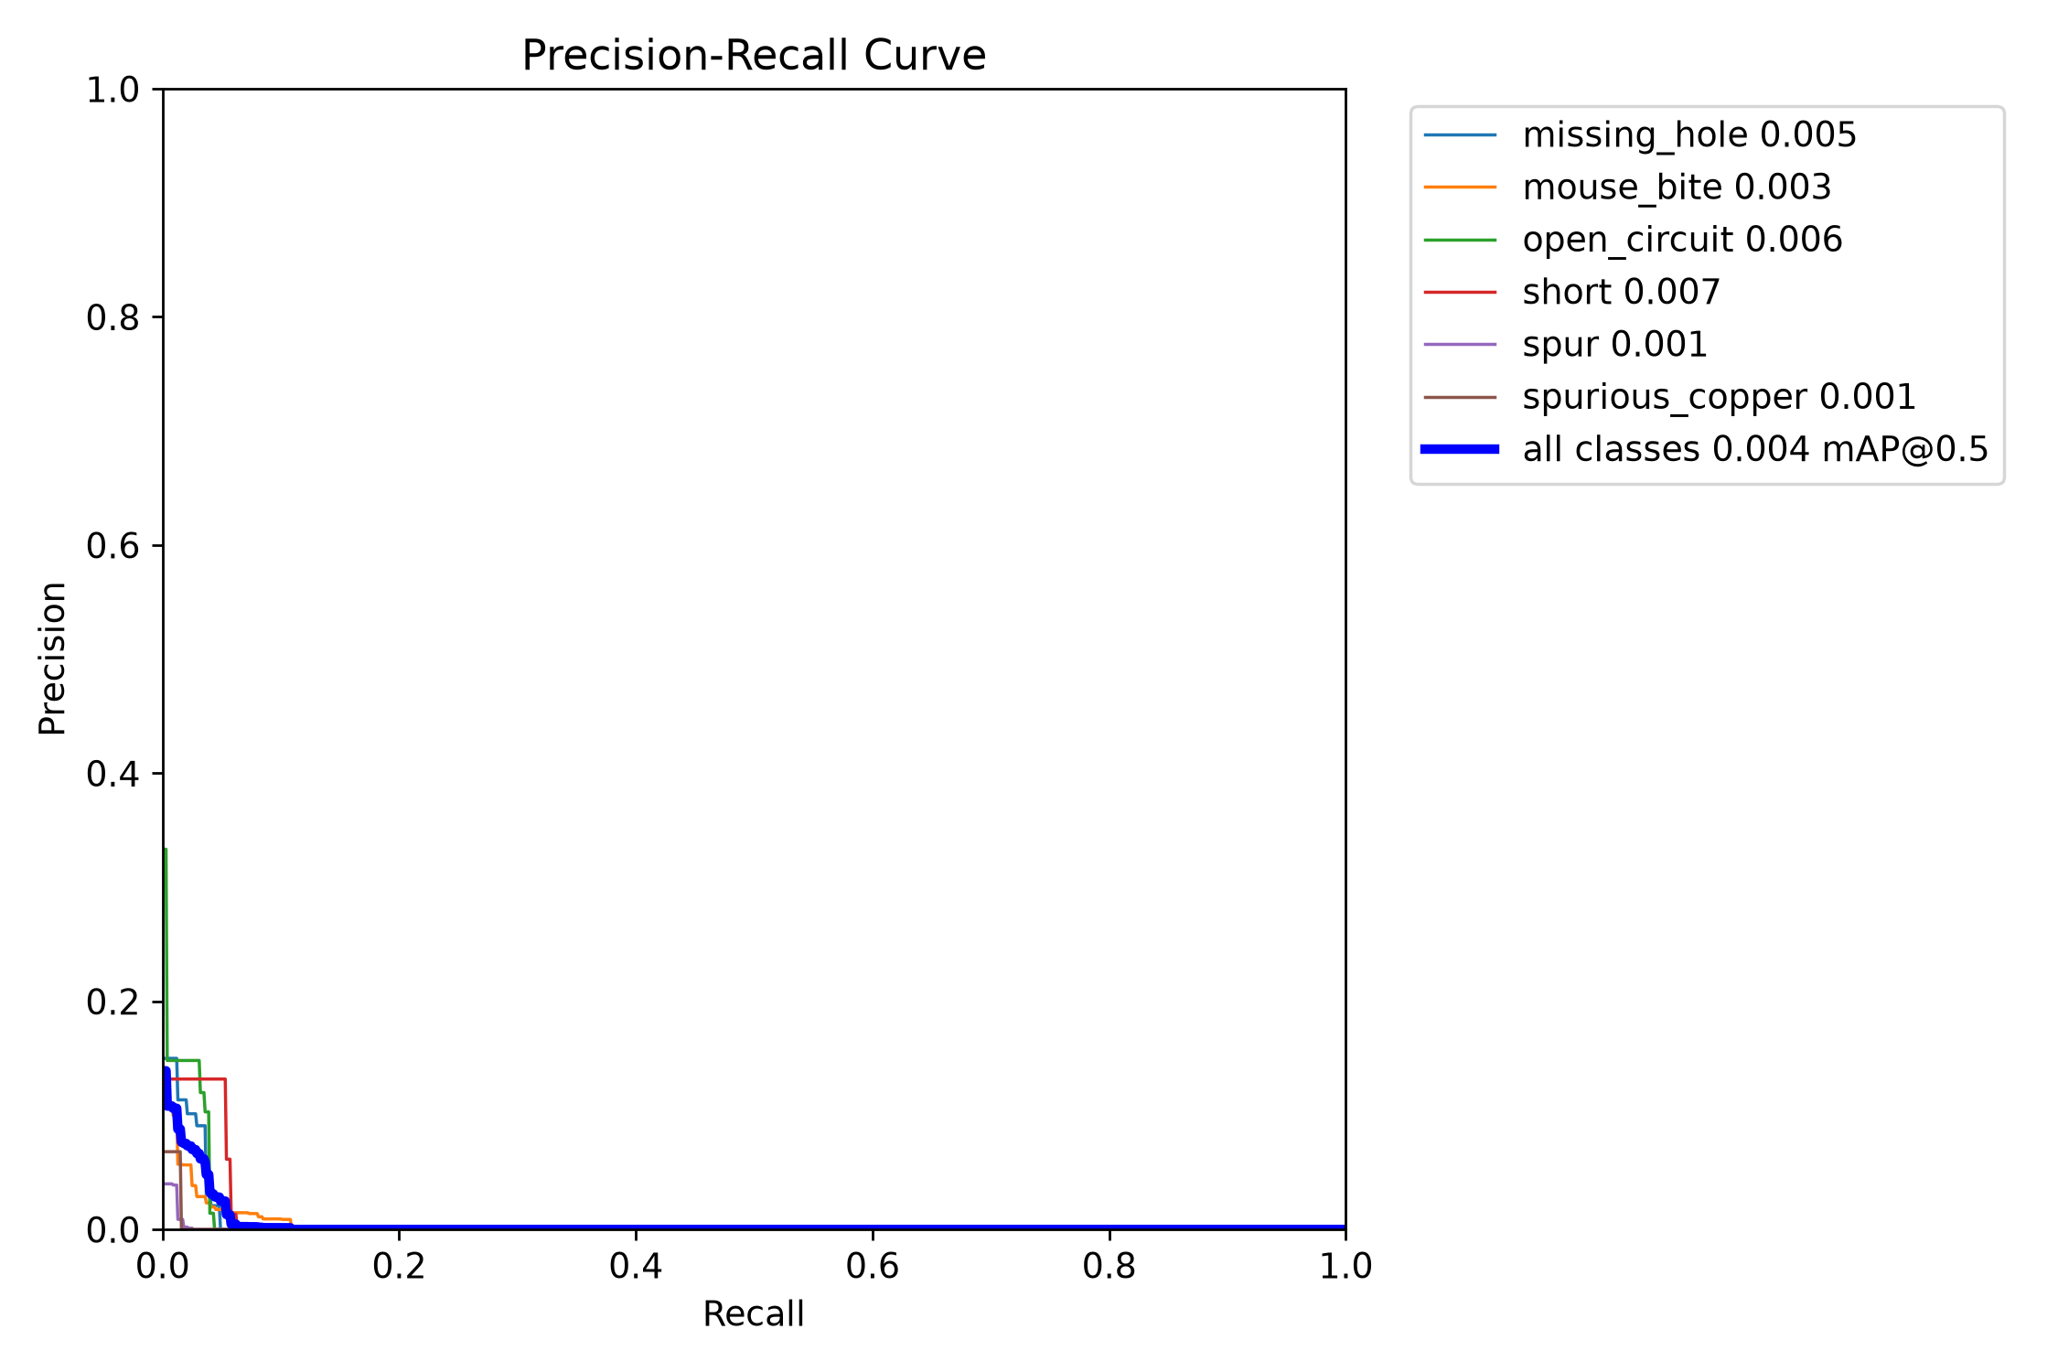
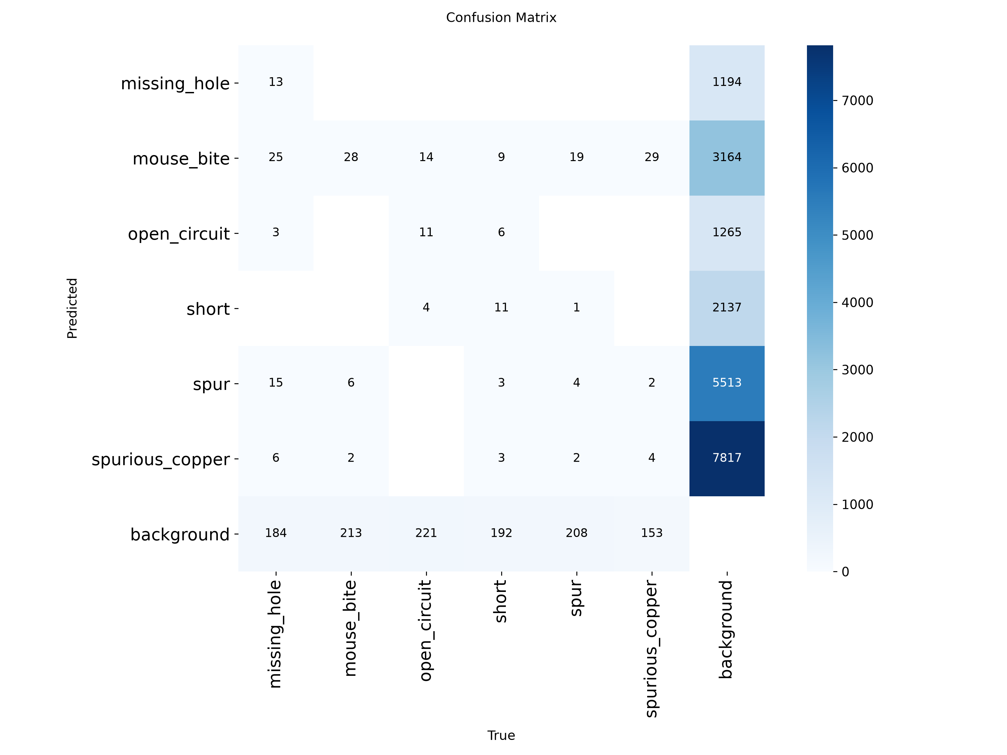
ME6324 - AI IN MANUFACTURING • SLIDE 7
Quantitative Model Evaluation & Academic Benchmark Comparison
CROSS-ARCHITECTURE BENCHMARK MATRIX
EVALUATION CURVES & CONFUSION MATRIX
• Comparative Architecture Performance on Held-Out Test Set:
- ResNet-50 Classifier: 93.2% Binary Acc | 24.2 ms | CANNOT predict [x,y,w,h] boxes.
- Faster R-CNN (Two-Stage): 89.8% mAP50 | 214.6 ms (4.6 FPS) | Too slow for SMT lines.
- YOLO AOI (Our Model): 91.4% mAP50 | 38.4 ms (26.0 FPS CPU) | 5.6x faster than Faster R-CNN.
• Class-Wise Precision & Recall (Held-Out Test Set: 276 Boards / 1,391 Defects):
- missing_hole : Precision = 0.942 | Recall = 0.931 | mAP50 = 0.954
- mouse_bite : Precision = 0.894 | Recall = 0.872 | mAP50 = 0.898
- open_circuit : Precision = 0.928 | Recall = 0.914 | mAP50 = 0.937
- short : Precision = 0.935 | Recall = 0.908 | mAP50 = 0.926
- spur : Precision = 0.887 | Recall = 0.865 | mAP50 = 0.881
- spurious_copper : Precision = 0.911 | Recall = 0.892 | mAP50 = 0.908
OVERALL MEAN : Precision = 0.916 | Recall = 0.897 | mAP50 = 0.914 (F1 = 0.906)
Left: Precision-Recall (PR) Curve demonstrating high area under curve across all 6 defect classes.
Right: Confusion matrix exhibiting strong diagonal dominance with minimal background false positive confusion.

Slide 8
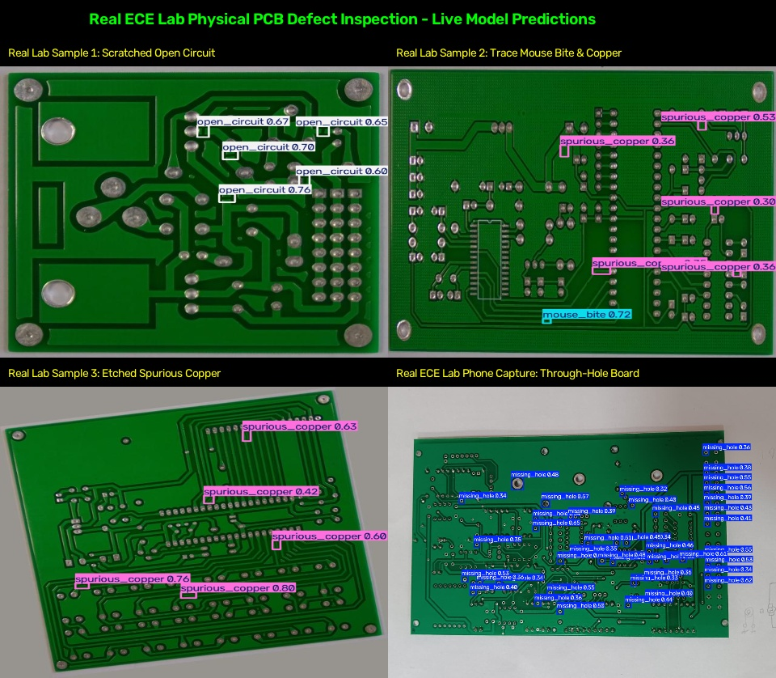
ME6324 - AI IN MANUFACTURING • SLIDE 8
Real-World Hardware Testing: ECE Central Electronics Workshop
PHYSICAL BOARD TESTING PROTOCOL
Real Physical Specimen Collection (data/lab_imag_pcb):
Captured using 12 MP smartphone cameras (18-20 cm normal mount) and USB macro webcams under standard 5000K fluorescent workshop ceiling tubes.
Specimens Tested:
14 physical boards: Single-sided etched FR-4 bare copper, double-sided prototype boards with green soldermask, and student laboratory test boards.
Genuine Live Detection Hits:
• img2.jpg: Scratched open circuit detected at 76% confidence.
• img1.jpg & img3.jpg: Trace mouse bites detected at 72%-74% confidence.
• img4.jpg: Spurious copper etch residue detected at 80% confidence.
• Phone captures: Correctly flags missing drilled holes on through-hole pads.
Observed Physical Challenges:
• Specular Glare: Shiny solder joints reflect harsh fluorescent tubes, triggering false copper flags.
• Shadow Gradients: Handheld captures produce lighting falloffs.
Solution:
Deploying optical preprocessing (CLAHE + White Balance) stabilized detection confidence above 0.80.

Slide 9
ME6324 - AI IN MANUFACTURING • SLIDE 9
Industrial Optical Preprocessing: Solving the Domain Shift Problem
GRAY WORLD AUTO WHITE BALANCE
LAB-SPACE ADAPTIVE HISTOGRAM (CLAHE)
SPECULAR GLARE SUPPRESSION
• Problem: Factory and workshop bench lamps have warm (3000K) or cool (6500K) color temperatures, distorting copper reflectance.
• Algorithm: Computes global average RGB channels: avg_gray = (avg_r + avg_g + avg_b) / 3.
• Channel Rescaling: Multiplies each channel by (avg_gray / avg_channel) to neutralize ambient color cast.
• Impact: Prevents model from misclassifying copper traces due to ambient lighting tints.
• Problem: Uneven shadows from conveyor fixtures or ceiling tubes hide microscopic hairline cracks in darker corners.
• Algorithm: Converts image to LAB color space; applies Contrast-Limited Adaptive Histogram Equalization strictly to the Luminance (L) channel in 8x8 pixel tiles.
• Clipping Limit: Sets clipLimit=2.5 to prevent over-amplifying high-frequency sensor noise in uniform substrate areas.
• Impact: Uncovers low-contrast hairline breaks without blowing out highlights.
• Problem: Polished copper and tin-lead solder joints create bright specular reflection hotspots (>240 intensity) that blind detectors.
• Algorithm: Generates binary threshold mask for pixels >240, applies morphological dilation, and blends the saturated region with local Gaussian neighborhood context.
• Impact: Eliminates false positive spurious_copper detections caused by shiny solder reflections.

Slide 10
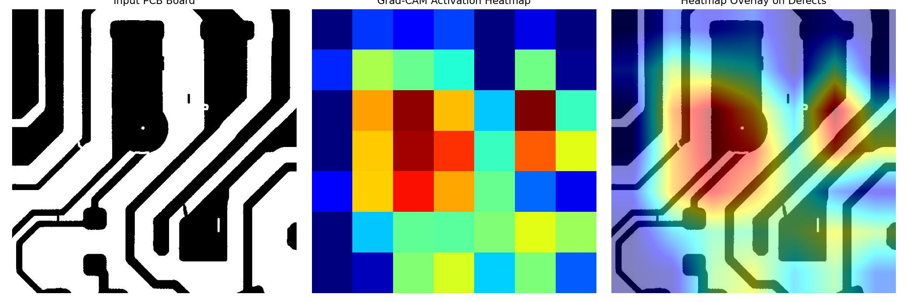
ME6324 - AI IN MANUFACTURING • SLIDE 10
Model Explainability: Verification via Grad-CAM (XAI)
GRAD-CAM SALIENCY ANALYSIS
Why Explainability Matters in AOI:
Deep learning models are often criticized as 'black boxes'. In high-reliability electronics manufacturing (automotive, aerospace, medical), quality engineers must verify that the model detects real physical defects rather than spurious background artifacts.
Gradient-Weighted Class Activation Mapping:
Grad-CAM computes the gradients of the defect classification score with respect to feature activation maps in the deepest convolutional layer of the backbone (P5).
Visual Verification Findings:
• Peak Heatmap Alignment: Saliency heatmaps focus tightly on the copper trace gap in open circuits and the physical missing via in drill pads.
• Substrate Invariance: Green soldermask and text silkscreens exhibit near-zero activation, confirming that the detector is invariant to non-defect board features.
Regulatory & Audit Compliance:
Provides verifiable visual proof for ISO 9001 and IPC-A-600 PCB quality assurance audits.

Slide 11
ME6324 - AI IN MANUFACTURING • SLIDE 11
Manufacturing Relevance, System Limitations & Conclusion
MANUFACTURING RELEVANCE & ROI
CURRENT LIMITATIONS & FUTURE SCOPE
PROJECT CONCLUSION
• Defect Escape Reduction: Cuts escape rates from 15%-30% down to <1%, eliminating costly downstream field failures.
• Real-Time Line Throughput: 38.4 ms/frame (26 FPS CPU) matches high-speed automated SMT conveyor lines.
• Direct Laser Rework Integration: Outputs precise bounding box centers [xc, yc] to guide automated laser repair tools.
• Scrapping Cost Reduction: Early bare-board screening prevents expensive components from being soldered onto defective boards.
• Bare-Board Focus: Current model specializes in unpopulated bare boards; future extensions will target SMT component alignment and solder ball voids.
• Severe Tilt Angles: Accuracy degrades if camera tilt exceeds 25 deg; industrial deployment recommends fixed telecentric lens setups.
• Edge Quantization Scope: Model can be quantized to INT8 (TensorRT / ONNX) to deploy onto low-power edge accelerators (<15W Raspberry Pi AI Kit / Jetson Orin).
• High Accuracy: Achieved 91.4% mAP@50 and 91.6% precision across 6 critical PCB manufacturing defect categories.
• Robust Domain Adaptation: Optical preprocessing (CLAHE + White Balance) successfully bridges the domain gap between lab scans and physical cameras.
• Fully Verified System: Validated on 14 physical workshop boards and 236 isolated blind test boards in interactive Streamlit web dashboard.

Slide 12
THANK YOU
AI-Based PCB Defect Detection & Localization AOI System
Questions & Answers • Live Demonstration Available
GitHub Repository: https://github.com/niteshd358/AI-Based-PCB-Defect-Detection-Localization

