Slide 1
Interpolation
and
Approximating polynomials

Slide 2
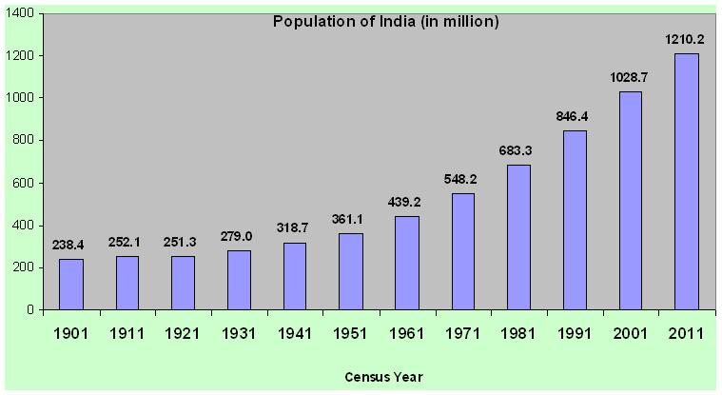

Slide 3
Can you find sin(1.2) approximately just by using the known value of sin(x) at x=0, Π/6, Π/4, Π/3, and Π/2 ?

Slide 4
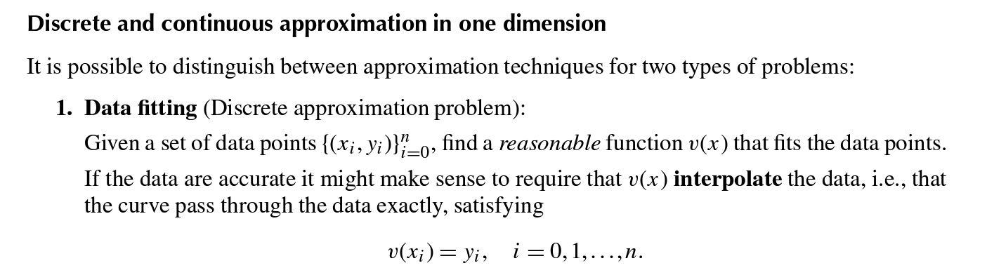
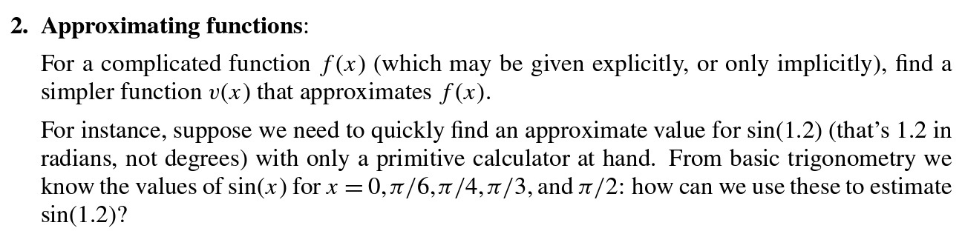

Slide 5
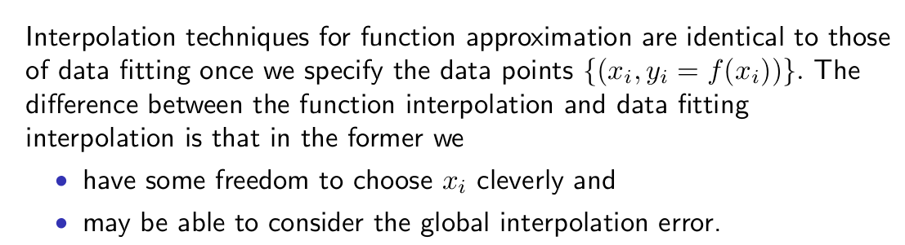

Slide 6
Why do we want to find and an approximating function v(x) in general?
* For prediction: we can use v(x) to find approximate vaues of the underlying function at locations x other than the data x_0,.........., x_n.
* For manipulation: an instance is finding approximation for derivatives and integrals of the underlying function.

Slide 7
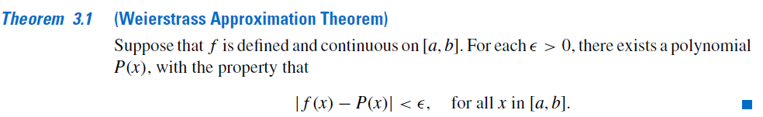
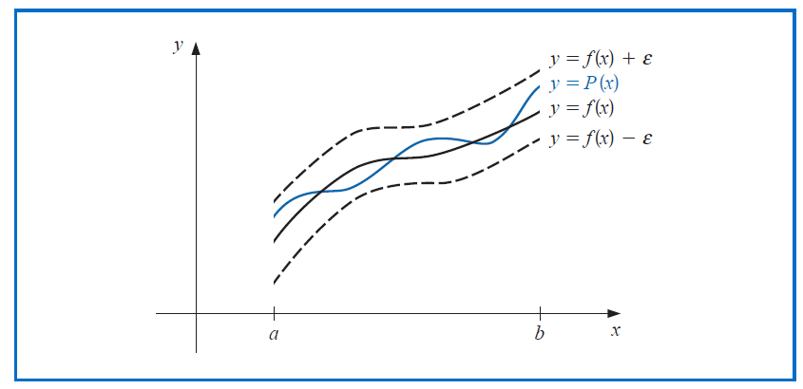

Slide 8
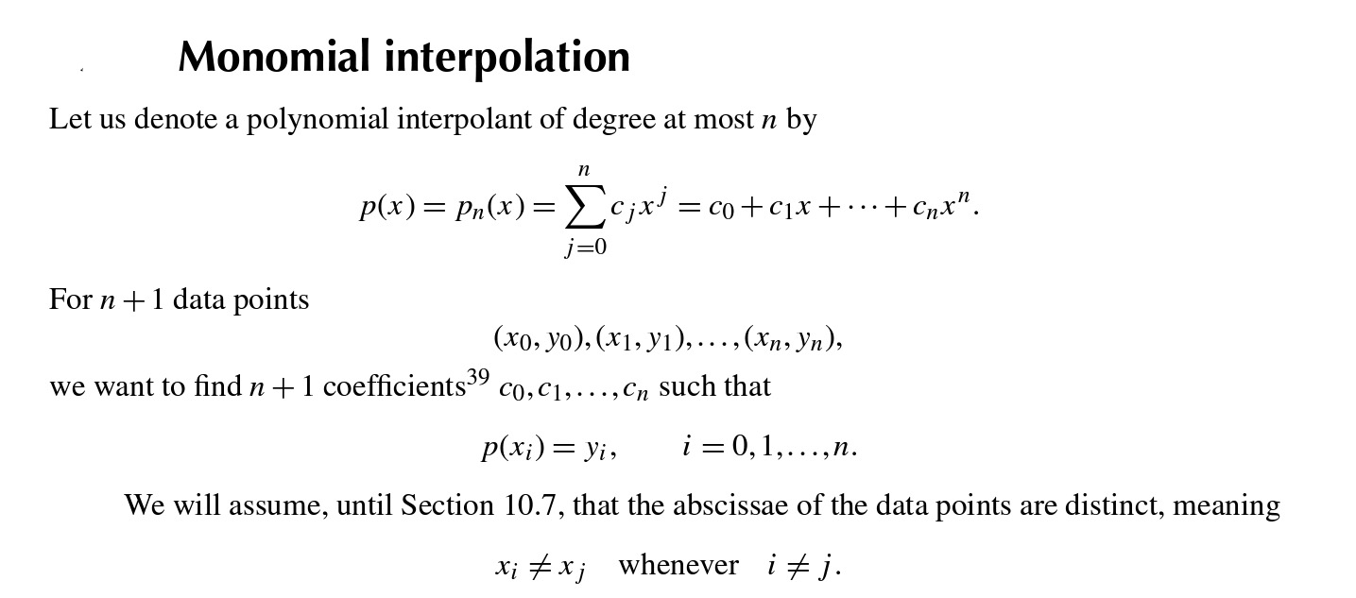

Slide 9
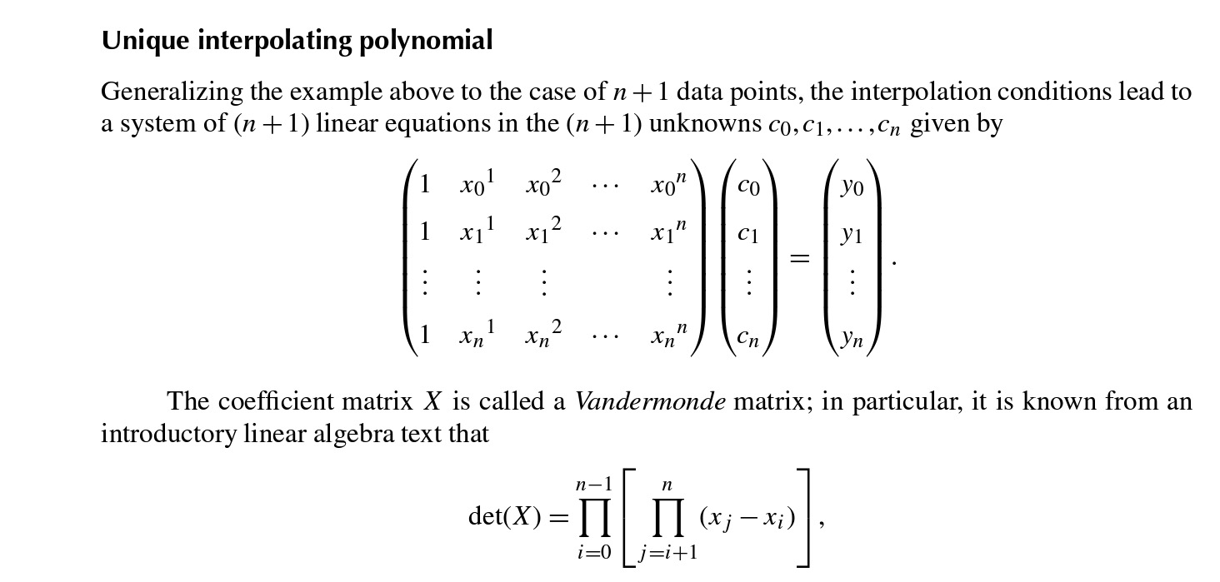

Slide 10
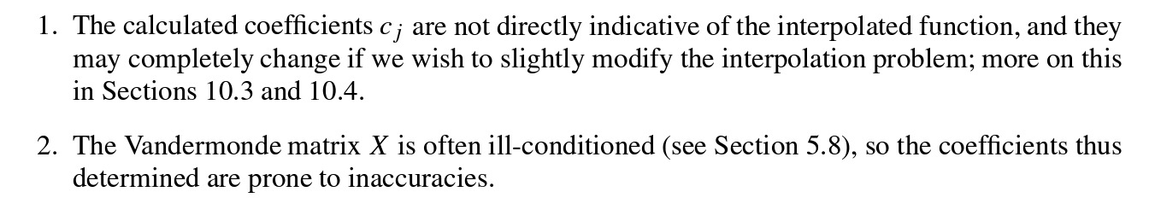

Slide 11
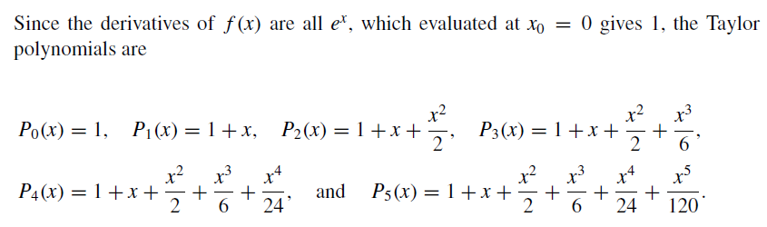
Should we go for Taylor polynomials
as
Interpolating polynomials?

Slide 12
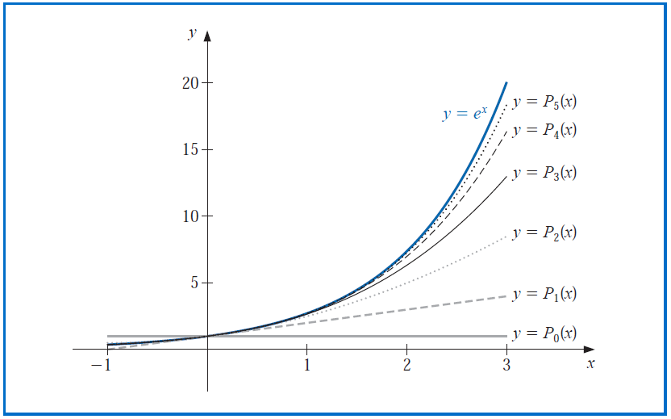
What does their graphs tell you?

Slide 13
The error becomes progressively worse as we move away from zero.
Better approximations are obtained if higher degree Taylor polynomials are used.

Slide 14
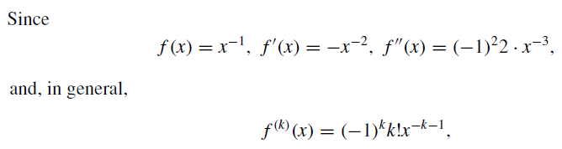
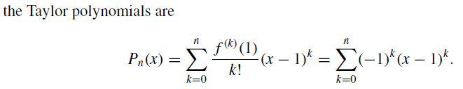

Consider this one:
But look at the table!!!

Slide 15
Consider this one:
But look at the table!!!

Slide 16

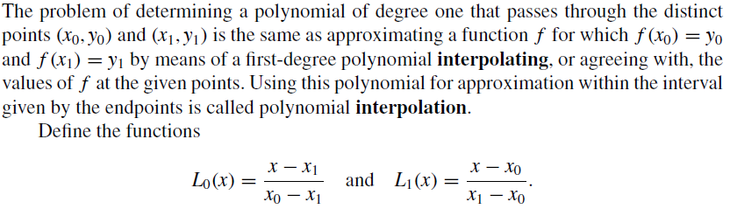
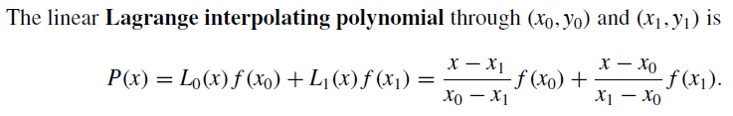
Interpolation and the Langrange Polynomial
Can you tell me one (or more) immediate property (ies) of L(x)’s and P(x)?

Slide 17
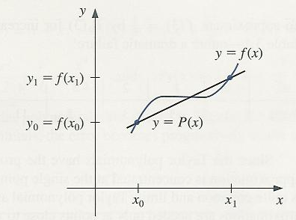

Slide 18
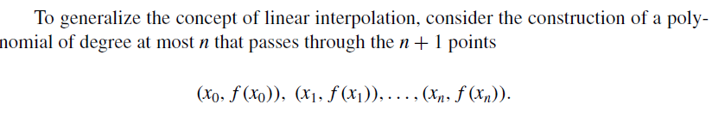
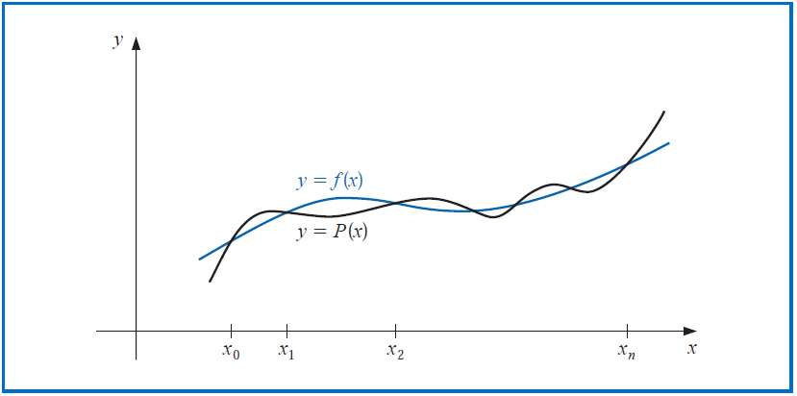

Slide 19
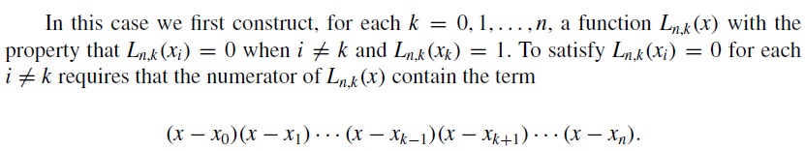
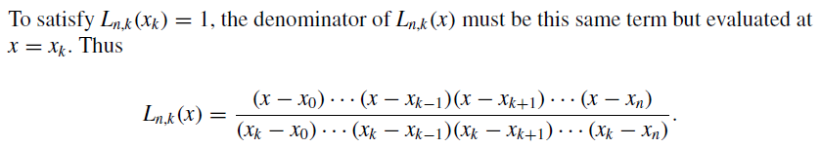
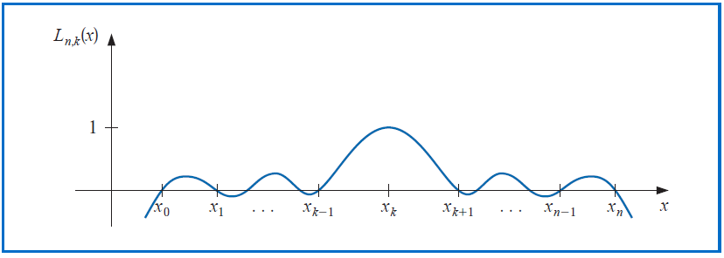

Slide 20

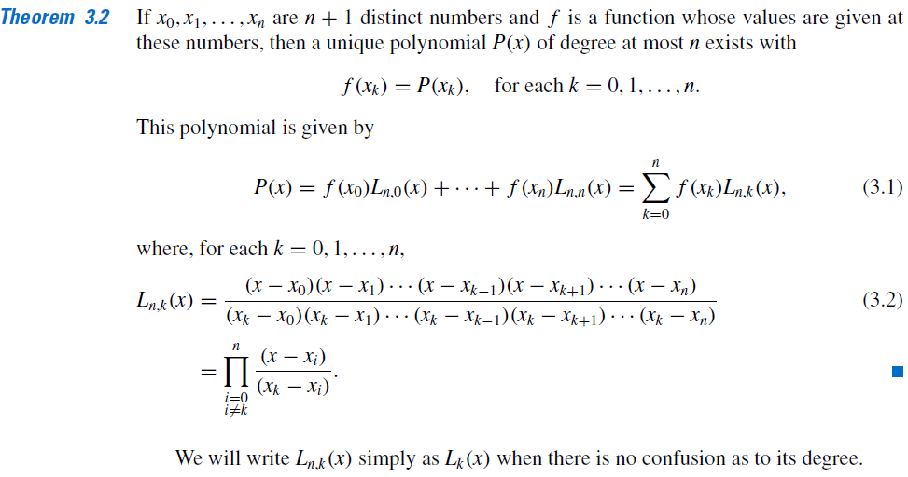
Lagrange Polynomial

Slide 21

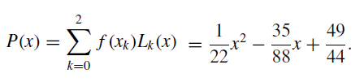

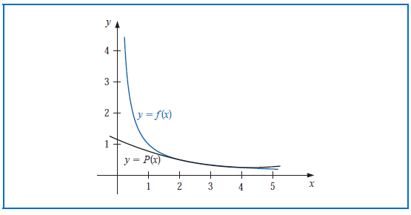

Slide 22
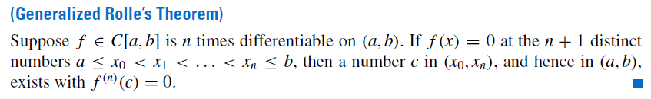
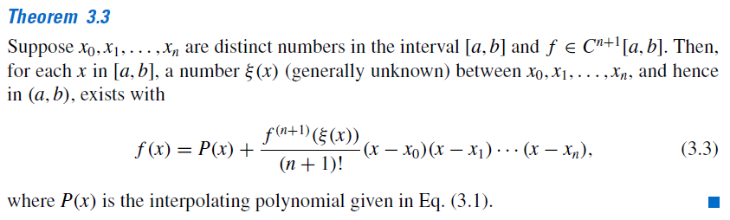
Back to some review of Calculus
What is the difference between the errors in Taylor’s and
Langrange polynomials?

Slide 23
