Slide 1


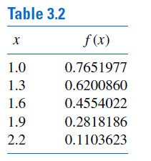


Slide 2



Slide 3
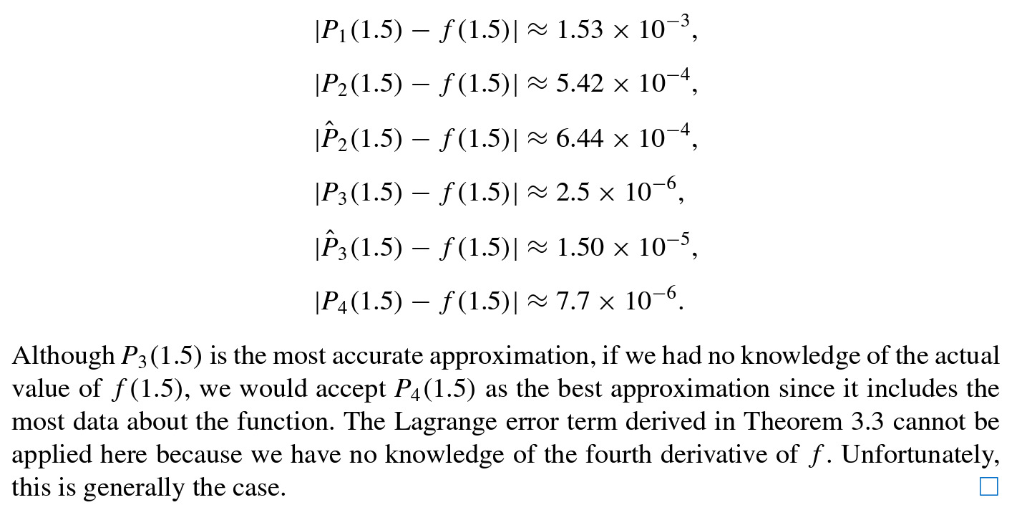
Does P4 give the best approximation?

Slide 4



Neville’s Method

Slide 5



Slide 6





Slide 7



Divided differences

Slide 8




Slide 9

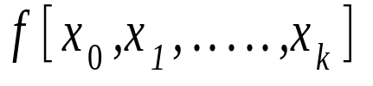
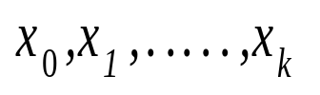
Invariance Theorem: The divided difference is invariant under all permutations of the arguments

Slide 10
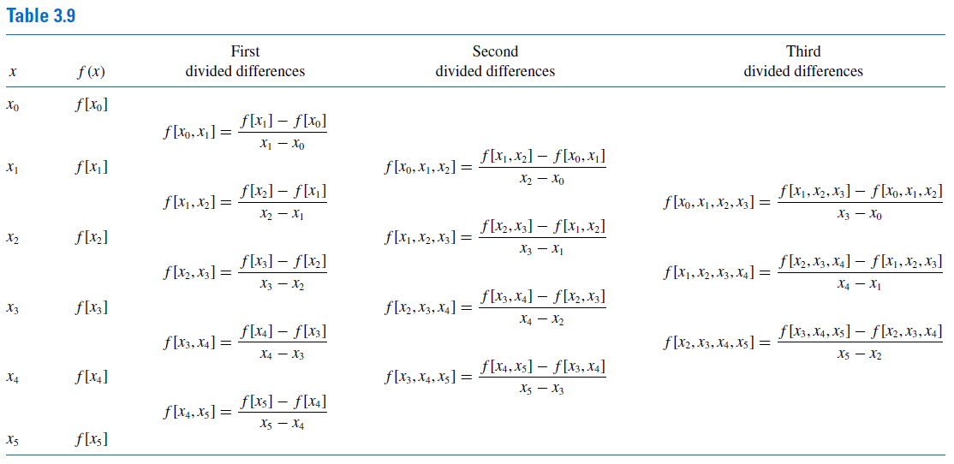

Slide 11
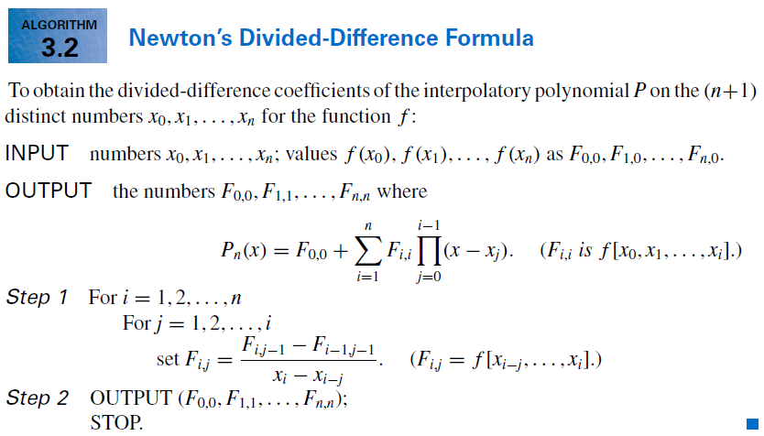

Slide 12
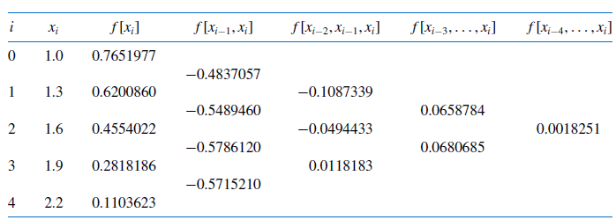
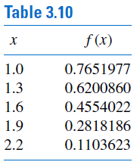


Slide 13


Theorem
Ref: David Kindcaid and Ward Cheney, (Indian third edition, pp-333)

Slide 14


Newton’s forward divided-difference formula

Slide 15


Forward difference operator:

Slide 16
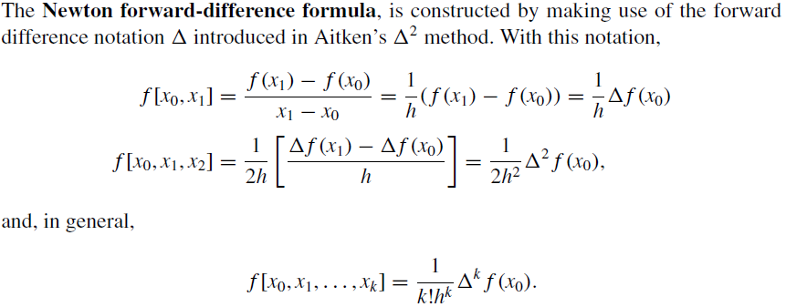


Slide 17


Backward difference operator:

Slide 18

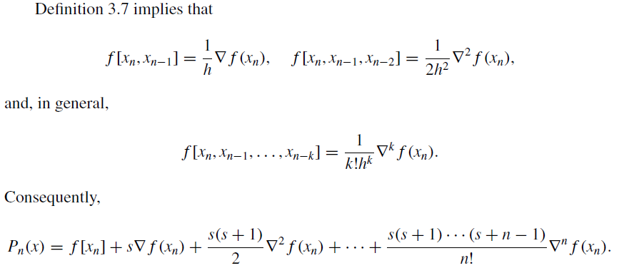

Slide 19
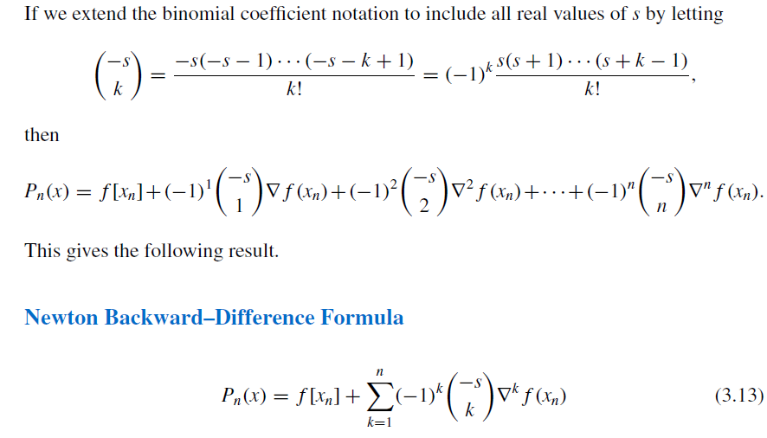

Slide 20
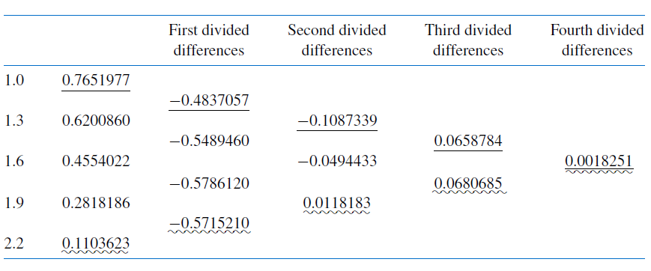
Let us recycle an earlier example

Slide 21
Let us recycle an earlier example

Slide 22
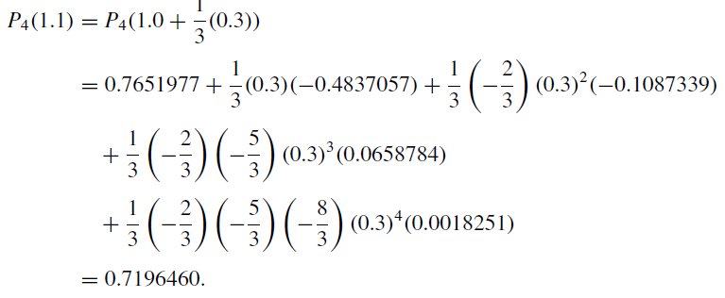


Slide 23

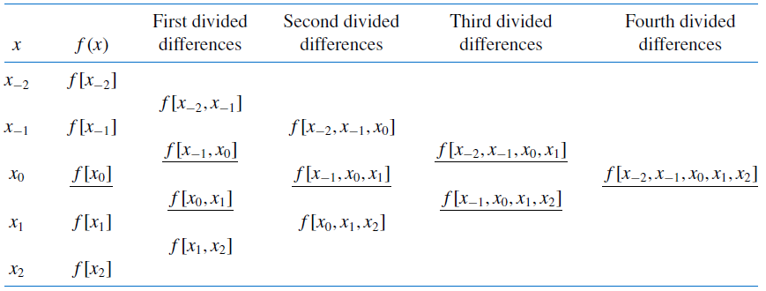
Central Differences: Stirling’s formula

Slide 24
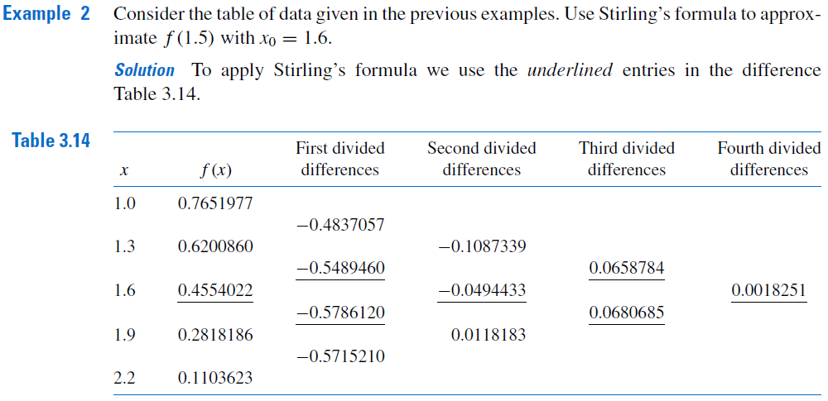

Slide 25
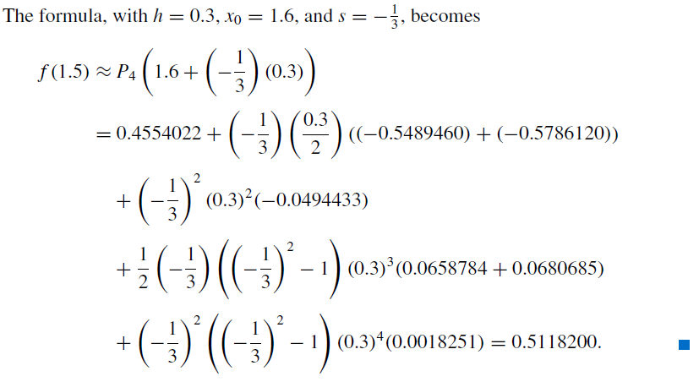

Slide 26






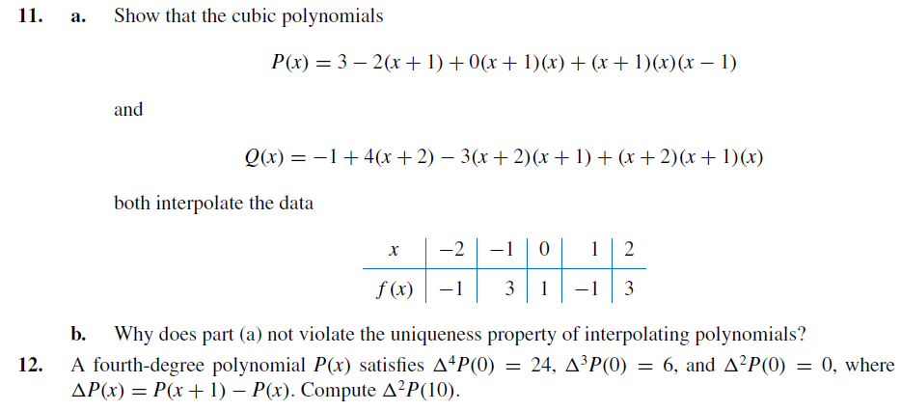
Inverse Interpolation:
..........
...........

