Slide 1
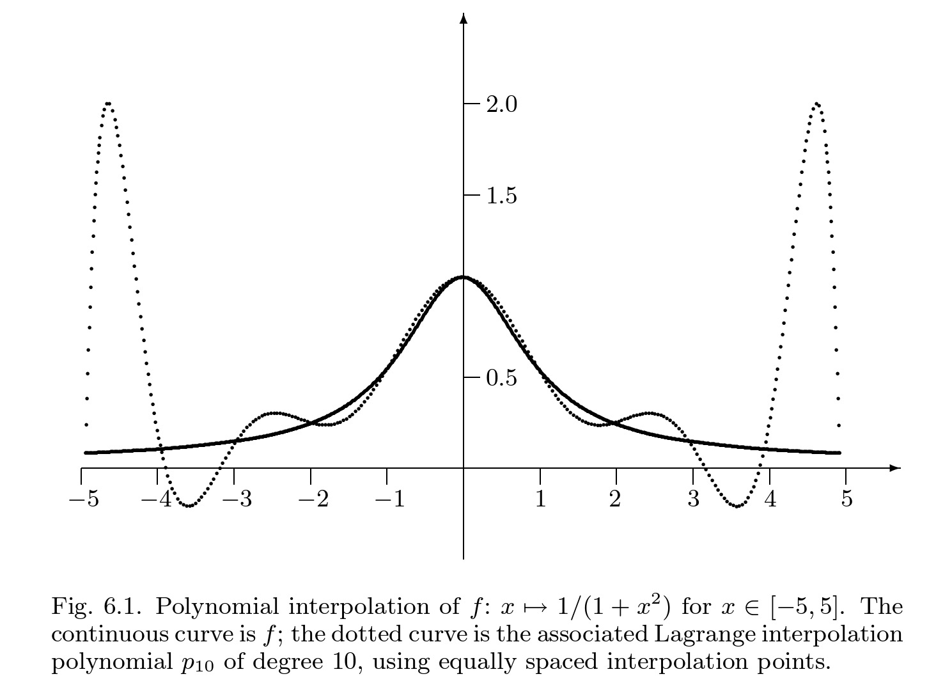
Shortcomings of polynomial interpolation of a function
It turns out that high order interpolation using a global polynomial often exhibit these oscillations hence it is “dangerous” to use (in particular on equidistant grids).

Slide 2
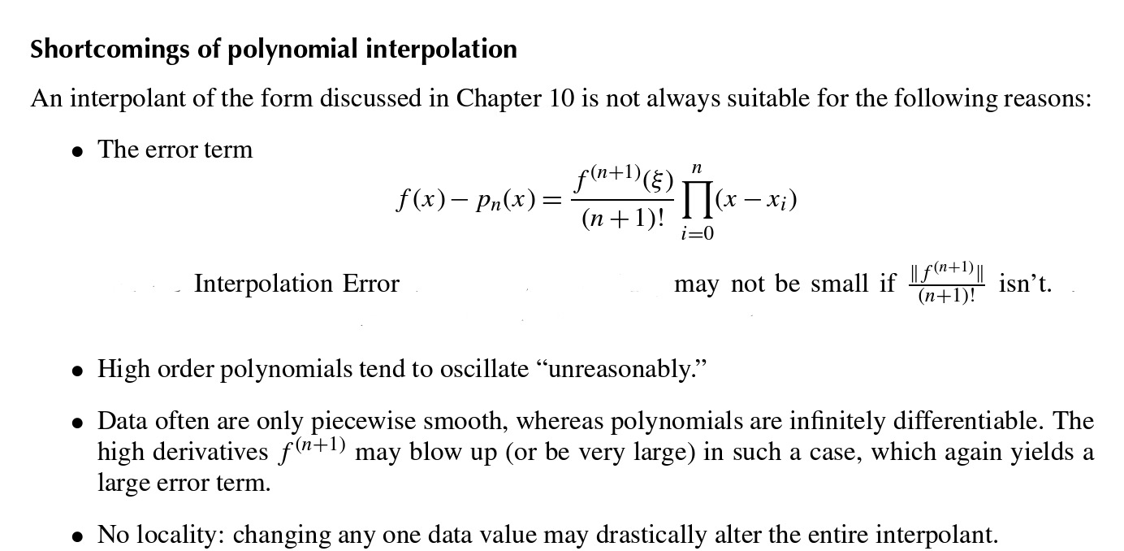

Slide 3

Ref: David and Cheney

Slide 4
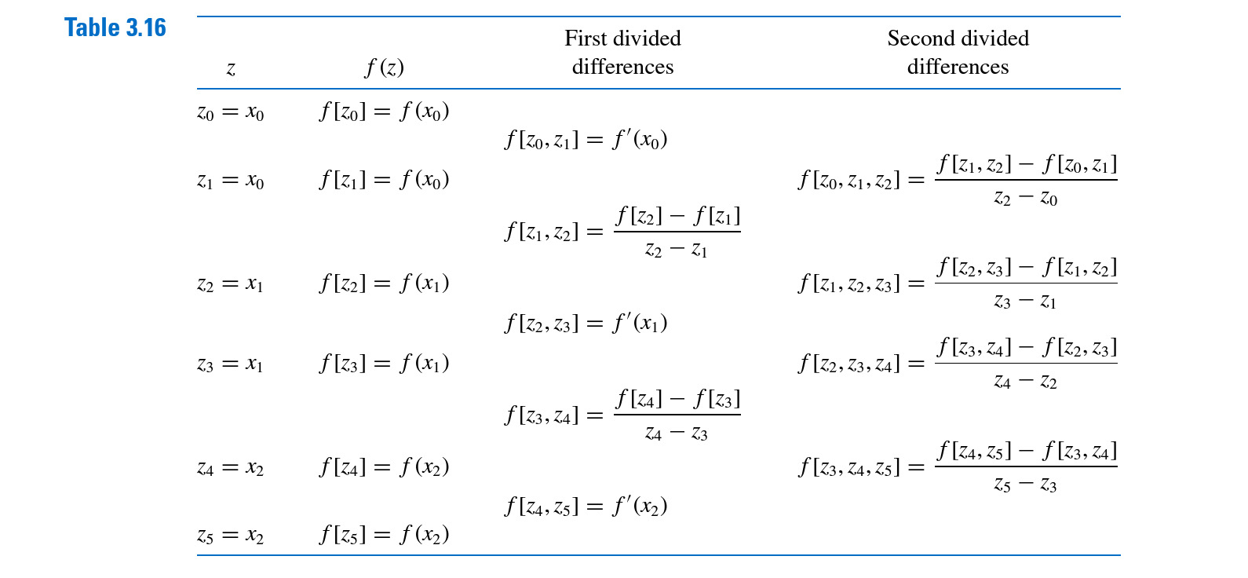
Hermite interpolation

Slide 5


Piecewise polynomial interpolation

Slide 6
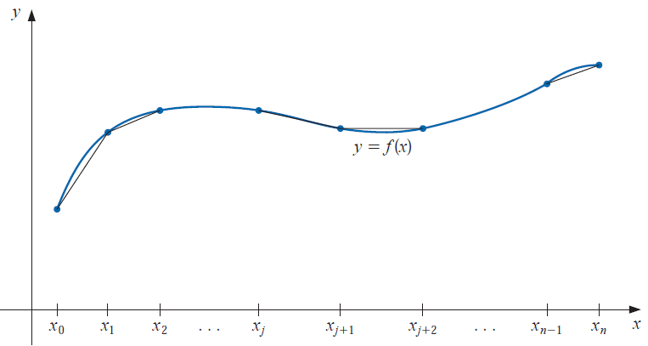
Not advisable. WHY?
Even quadratic polynomials may not be advisable.

Slide 7
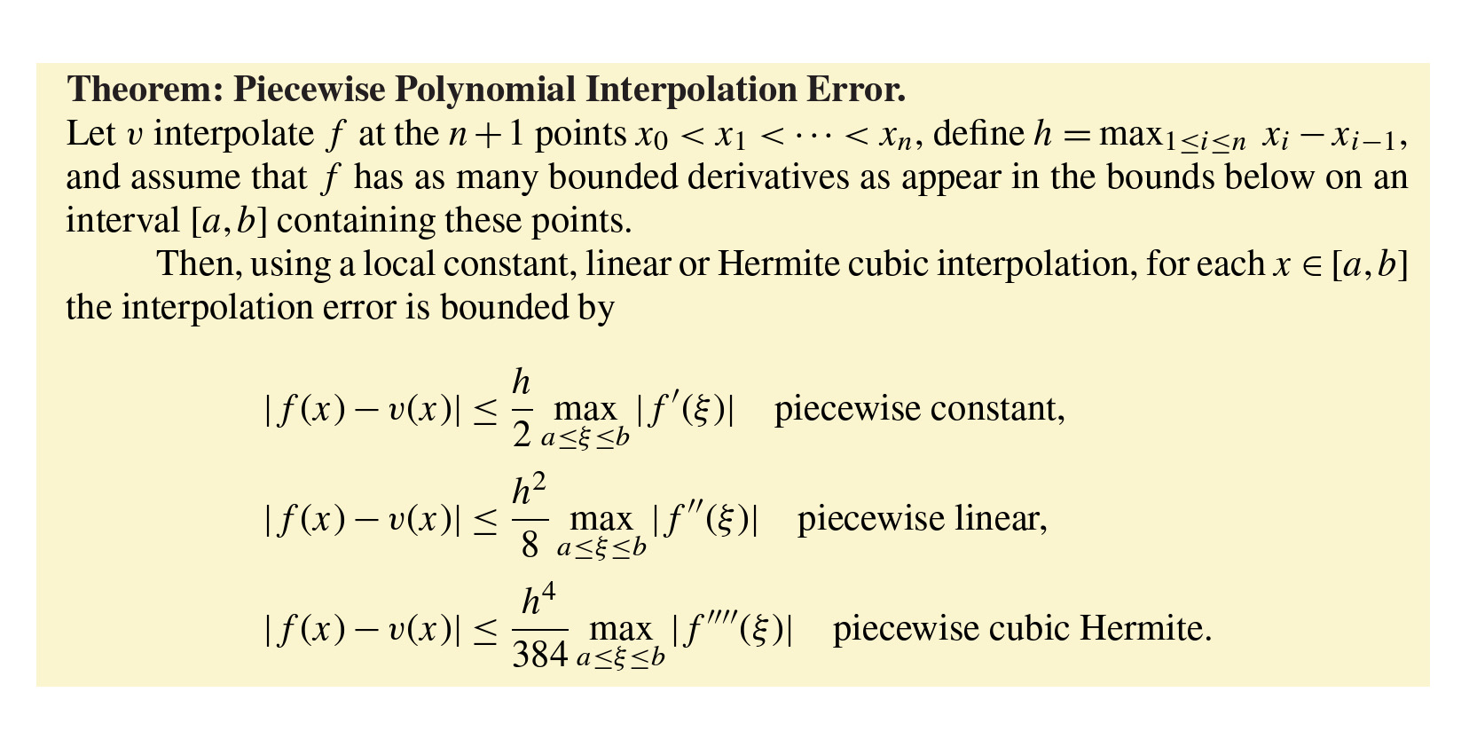


Slide 8

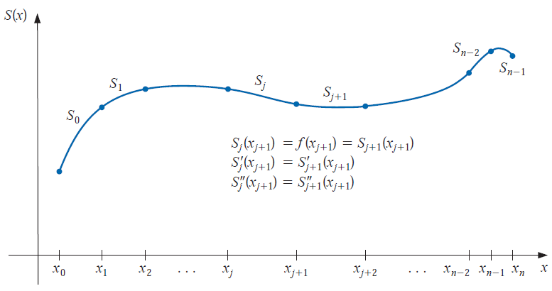
Cubic spline interpolation

Slide 9

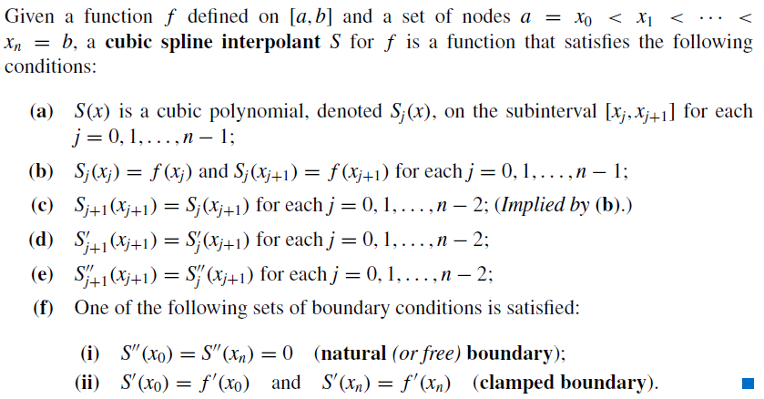

Slide 10
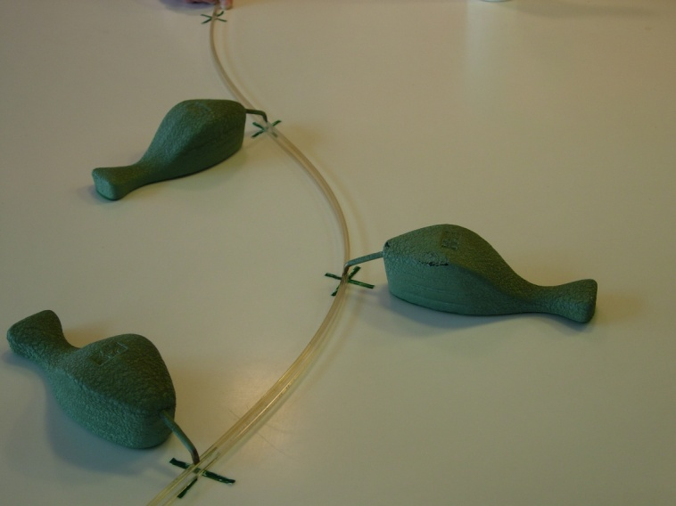

30 August/ 4 September, 2017

Slide 11

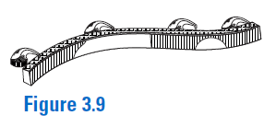

Why the word spline?
Construction of the spline:

Slide 12

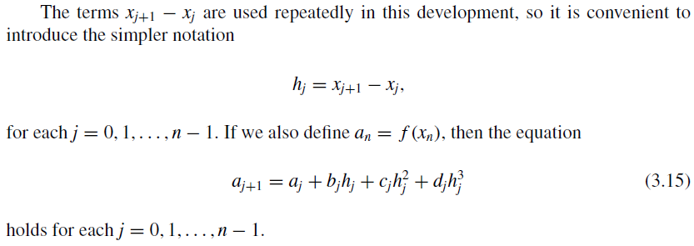


Slide 14
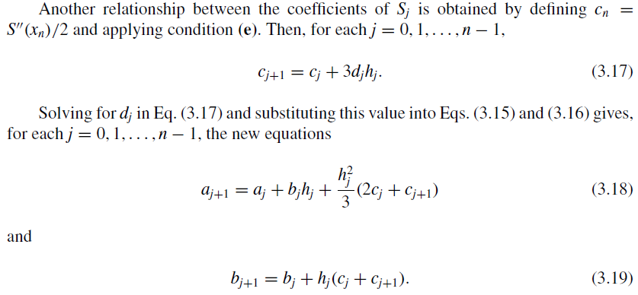


Slide 15
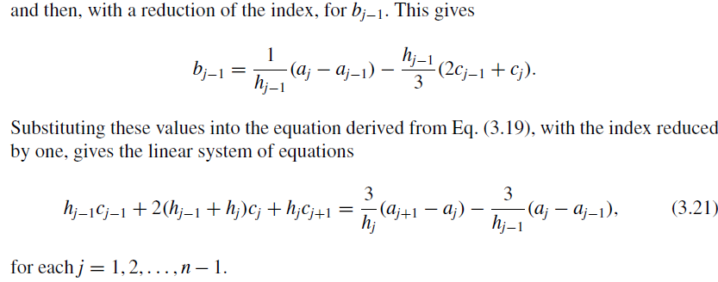

Slide 16





Slide 17


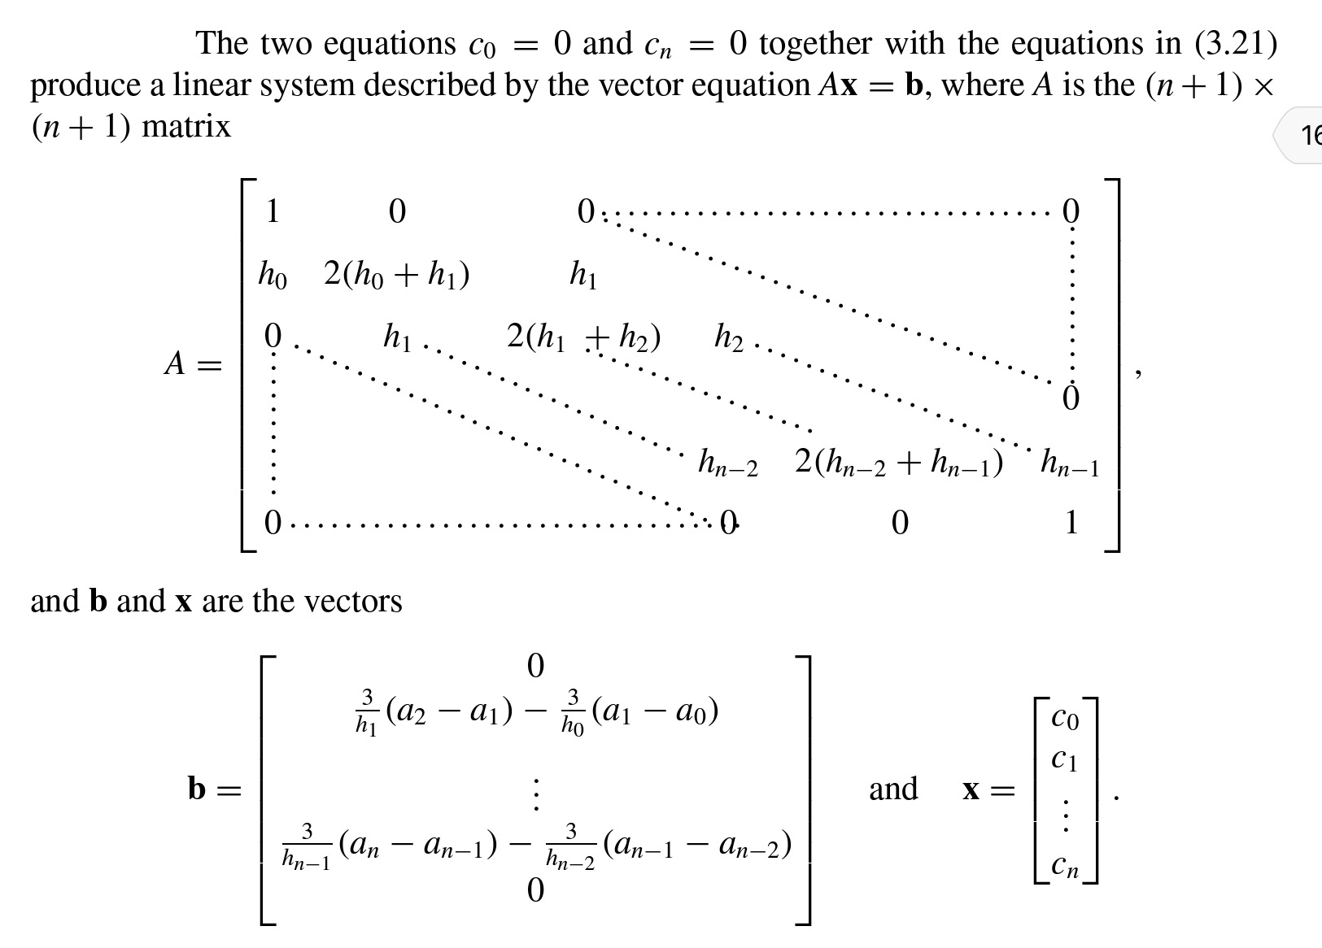

Slide 18
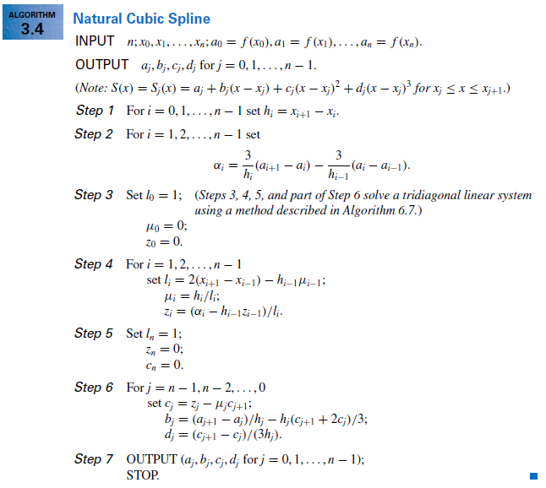
30 August/ 4 September, 2017

Slide 19



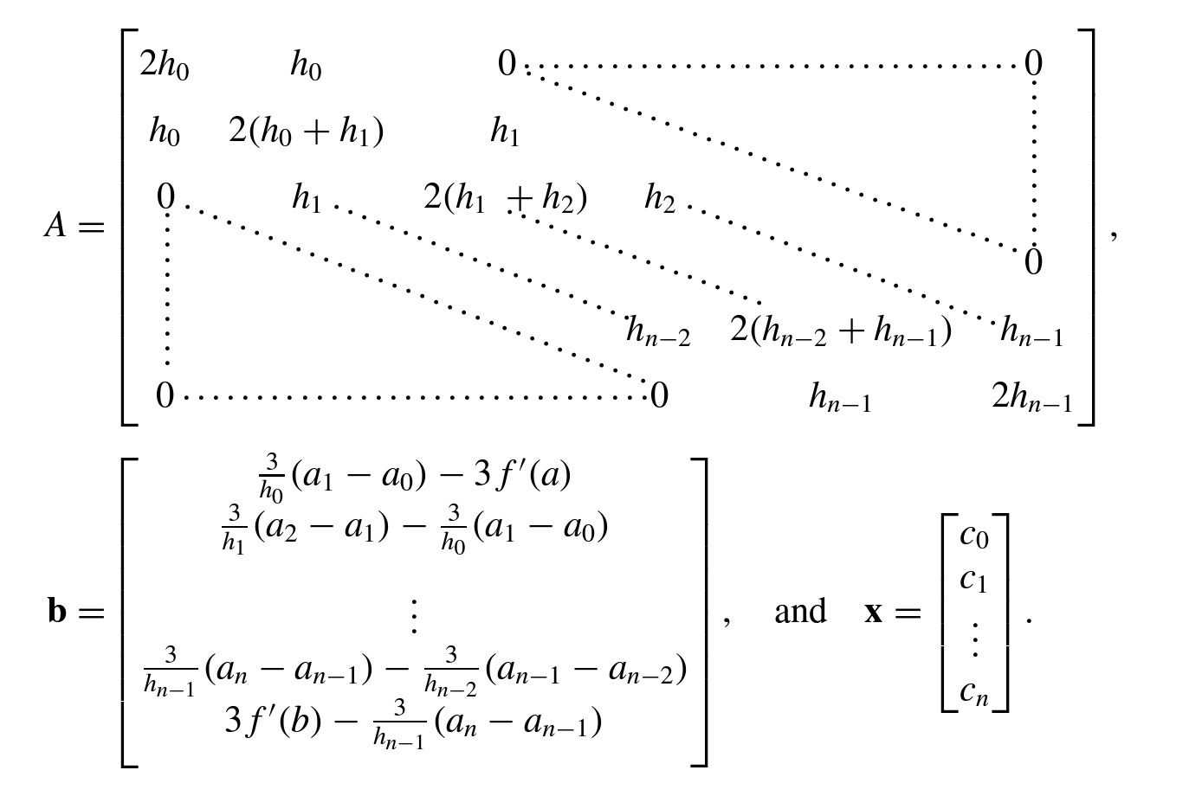

Slide 20


Slide 21




Slide 22
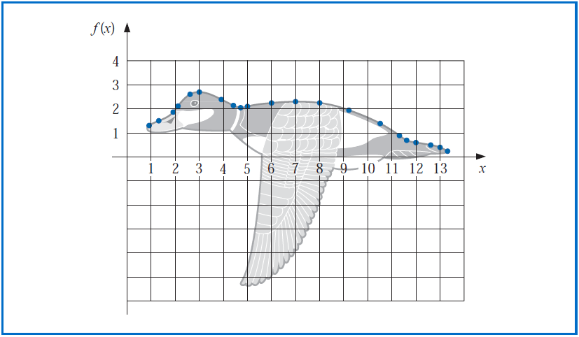

Slide 23
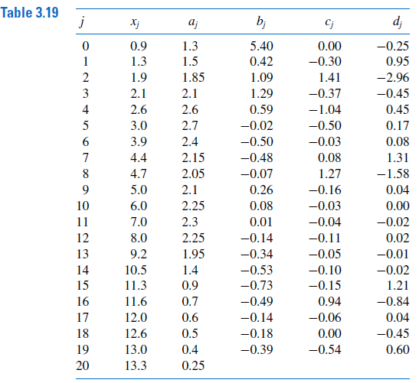


Slide 25
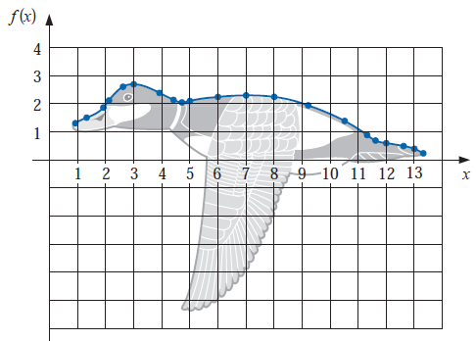
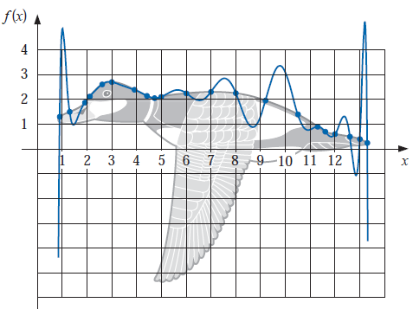
Cubic spline
20th degree polynomial

Slide 26


