Slide 1
Numerical method for PDEs
Some basics

Slide 2
PARTIAL DIFFERENTIAL EQUATIONS
General Features
Classification
Classification of Physical Problems
Describing the type in terms of characteristics
The Convection-Diffusion Equation
Initial and Boundary Values
Well Posed-ness

Slide 3
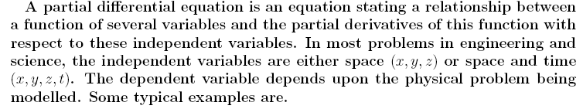


General Features
Diffusion coefficient
Wave propagation speed

Slide 4
Solution is satisfied in a domain D(x, y) or D(x, t) and
satisfies conditions on the boundaries of the domain
of interest
ORDER: Determined by highest order derivatives appearing in the PDE
Large number of problems are determined by second order PDEs.

Slide 5
SO FAR WE HAVE TALKED ONLY ABOUT
LINEAR PDEs
WHAT IS LINEAR AND
NON-LINEAR?

Slide 6



A linear PDE is one in which all the partial derivaties appear in linear form and none of the coefficients depends upon the dependent variable.
If the coefficients depends upon the dependent variable or the derivatives appear in a non-linear form, then the PDE is non-linear.

Slide 7

Homogeneous, non-homogeneous,
semilinear, quasilinear
If there appears a forcing function like g(x,y), g(x,y,t) or g(x,y,z) etc, the
PDE will be called non-homogeneous. Otherwise it is homogeneous.
If the coefficients of highest order derivatives depends only on the independent variable then the PDE is semilinear.

Slide 8

If all the coefficients of highest order derivatives depends on the independent variables, the dependent variable and its lower order derivatives then the PDE is quasilinear.

Slide 9
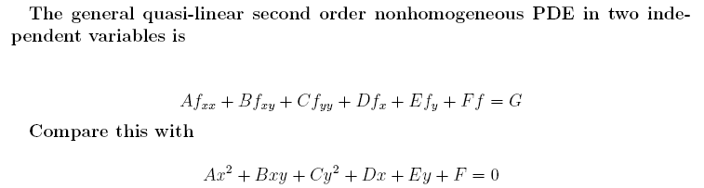
Classification

Slide 10
------------------------------------------------------------------------------------
Classification Type of Curves
------------------------------------------------------------------------------------
Negative Elliptic
Zero Parabolic
Positive Hyperbolic
What is the significance of the above classification?
Does it have any impact on the allowable or required initial and BC?
Does it have any effect on the choice of numerical method?

Slide 11


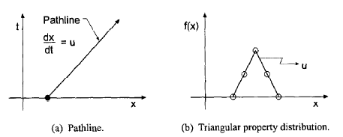
Example of characteristic curves: The 1D convection equation
Along the characteristic curves, f is constant.

Slide 12



Are there any point in the solution domain D(x, y) passing through a general point p along which the second derivatives of the dependent variable are multivalued or discontinuous?
Finding characteristics of the general second order PDE in two variable:

Slide 13
------------------------------------------------------------------------------------
Characteristic Curves Classification
------------------------------------------------------------------------------------
Negative Complex Elliptic
Zero Real and Repeated Parabolic
Positive Real and distinct Hyperbolic
Show that a first order partial differential equation is always hyperbolic.

Slide 14
