Slide 1
BASIC CONCEPTS OF DISCRETIZATION
Recalling finite difference again

Slide 2
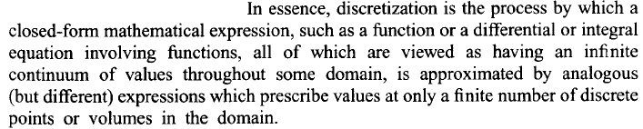
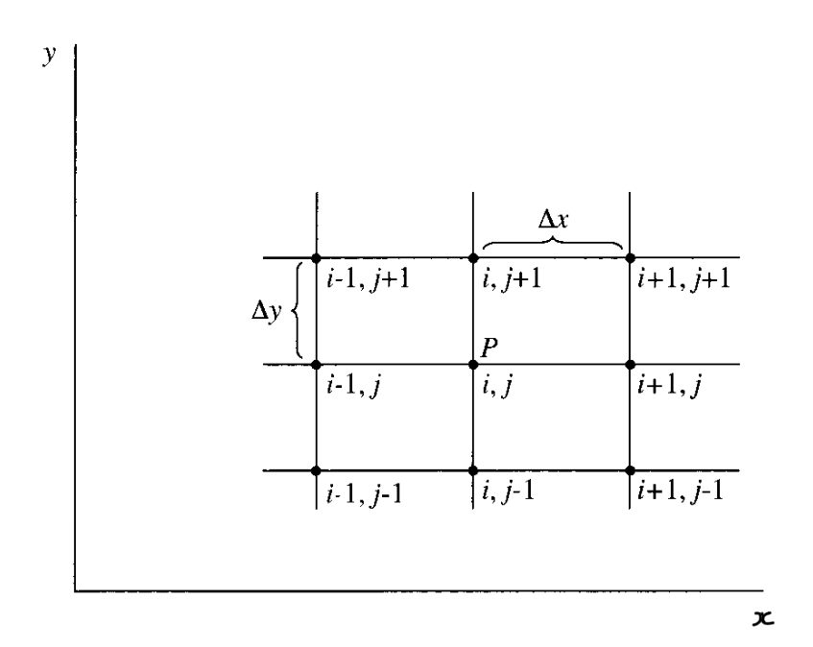
DISCRETIZATION………
A finite difference stencil in 2D

Slide 3
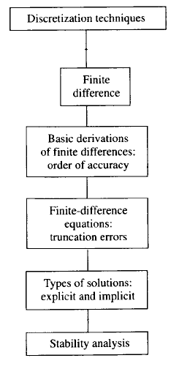
Road map for this section

Slide 4
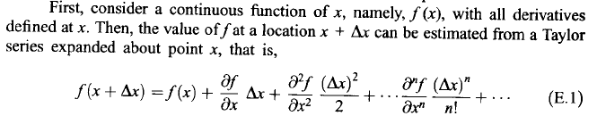

Back to Taylor Series…..
Let us see the effect….

Slide 5
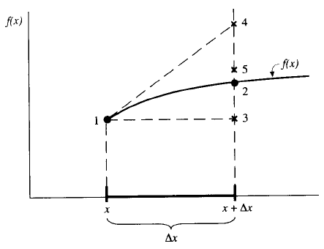




Slide 6
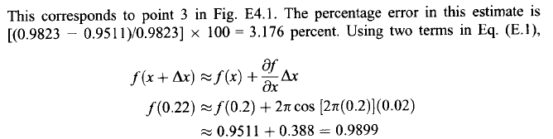
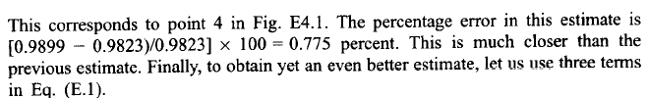
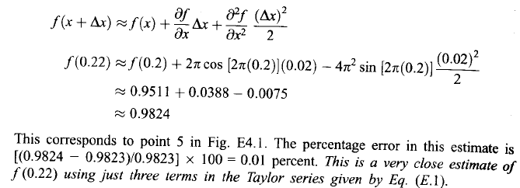

Slide 7
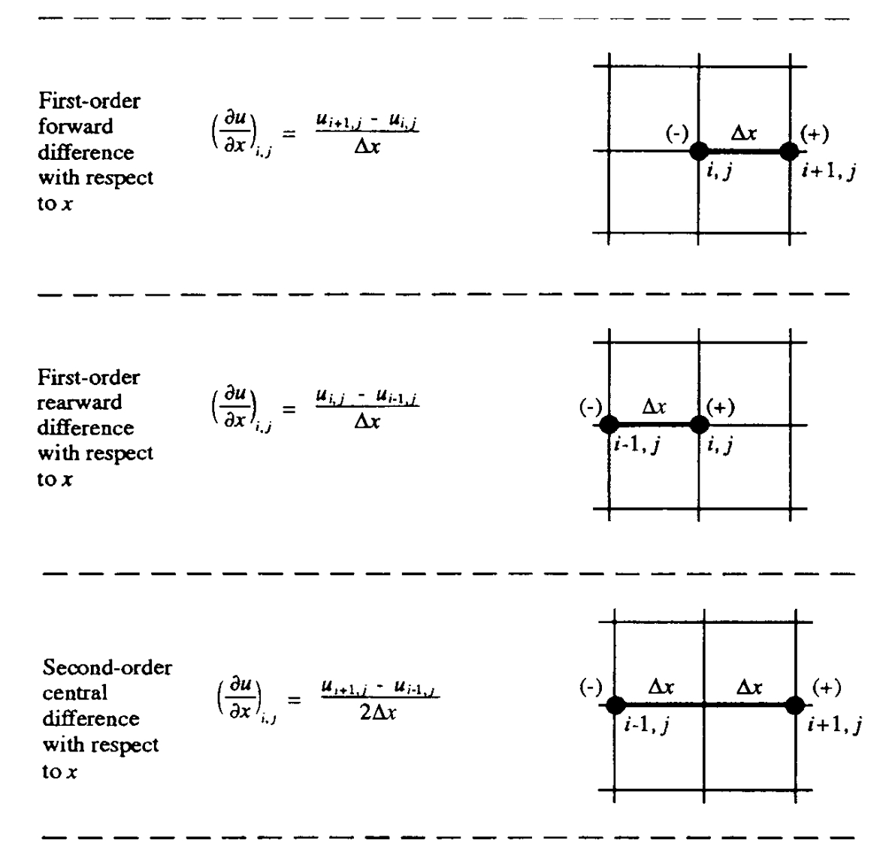
Higher order accuracy is desired. We shall come back to that shortly. Before that, let us have a quick recap of the finite difference formulas that we have learn t already…..

Slide 8
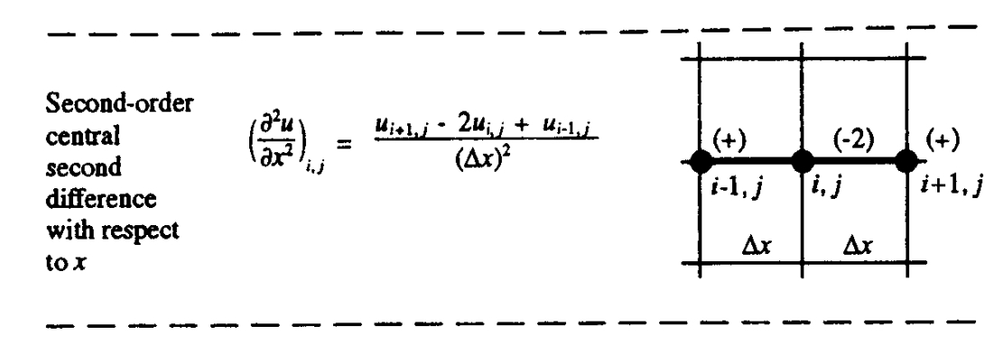
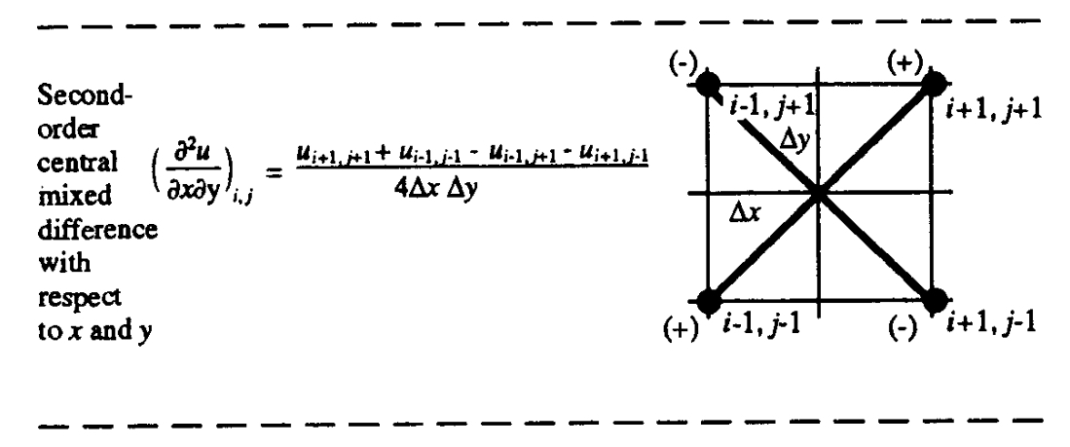

Slide 9

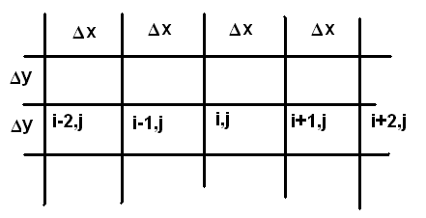
As stated earlier, higher order accuracy is desired. Let us look at following formula…
Stencil
Would you still like to use higher order formulas?????

Slide 10



Pros and Cons of using HOF

