Slide 1
Finite difference approximation of diffusion equation

Slide 2
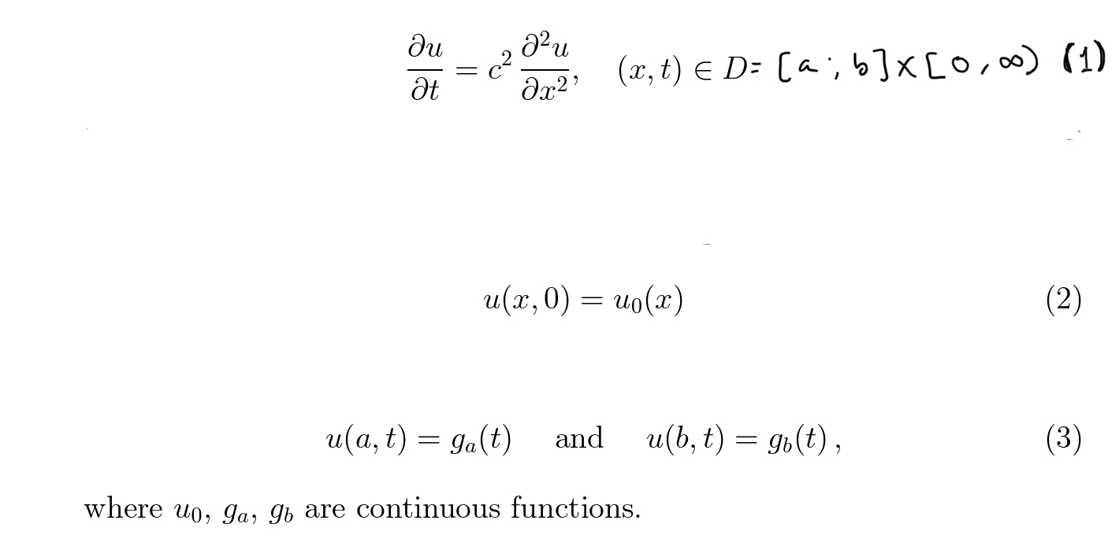
Diffusion equation: in one space dimension

Slide 3
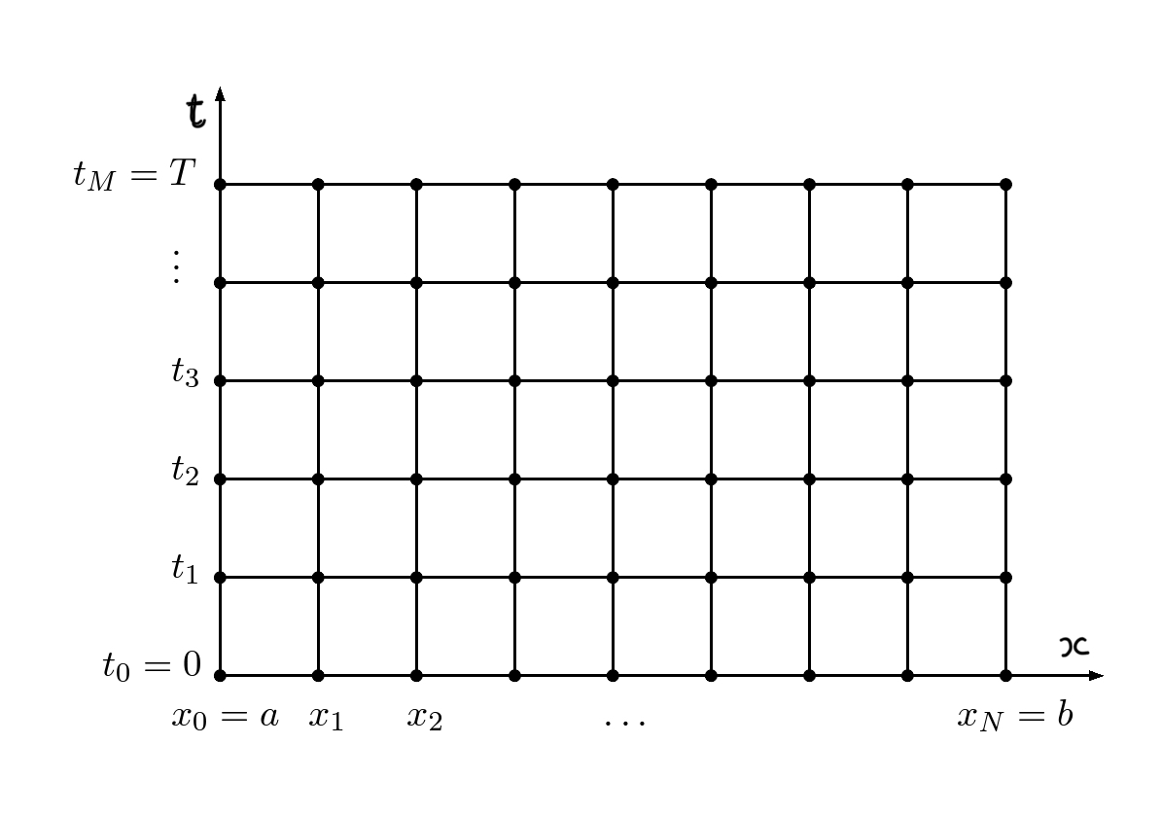

Slide 4
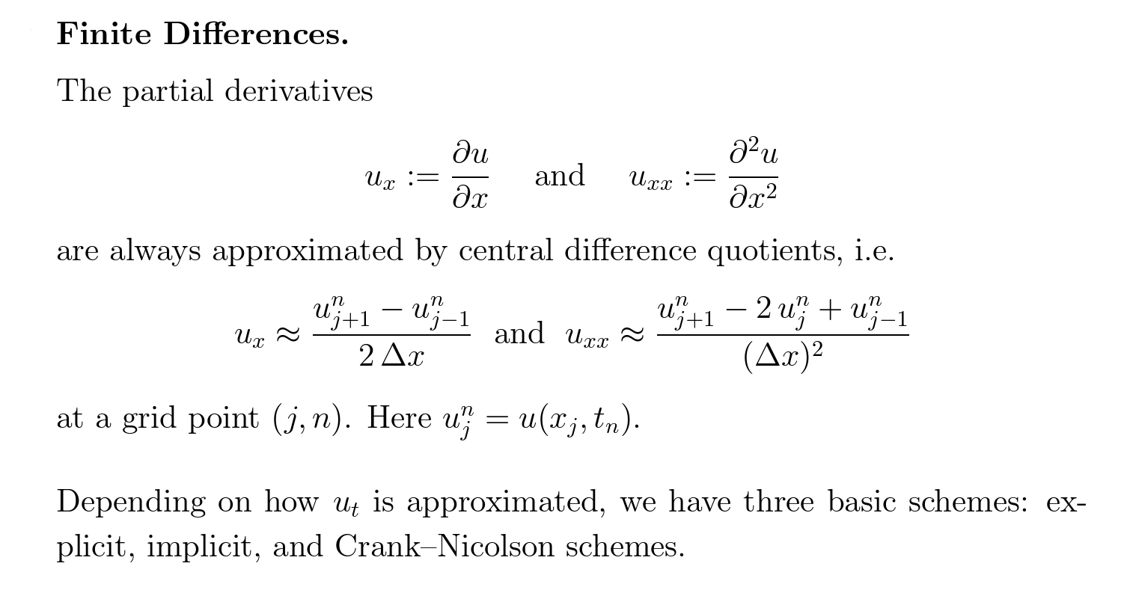

Slide 5
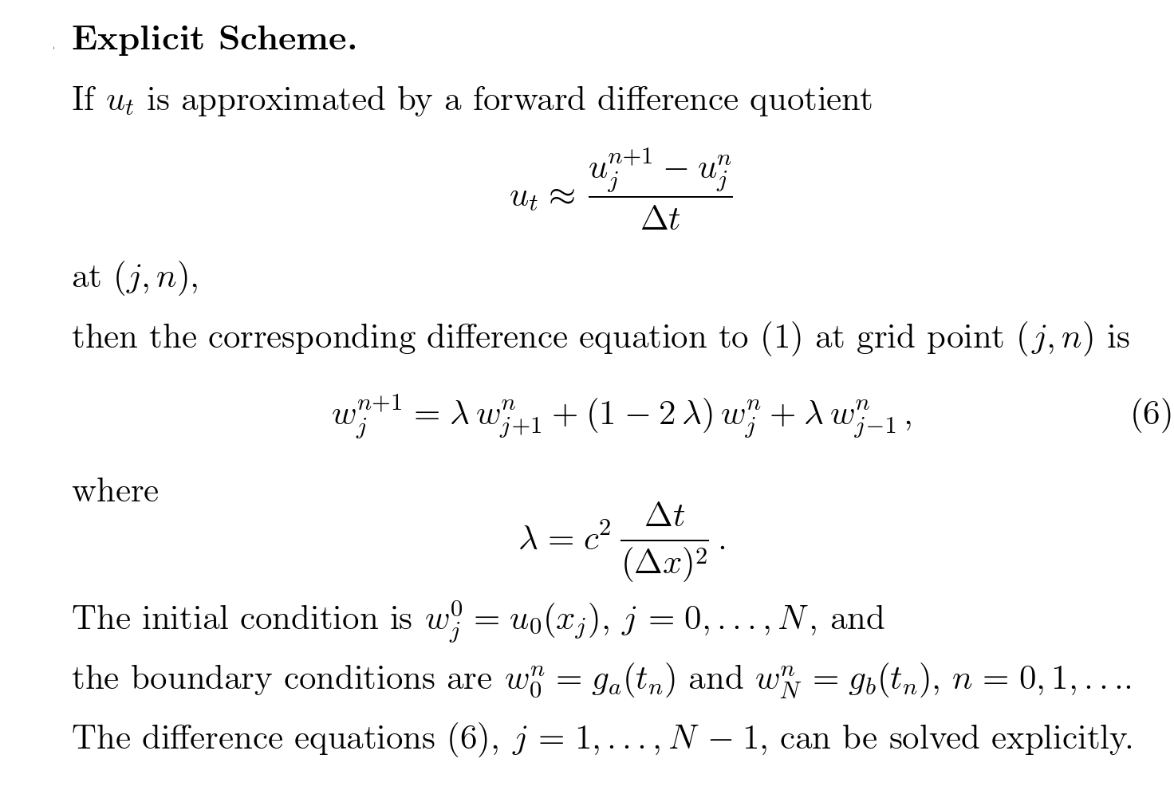
Forward time central space (FTCS)

Slide 6
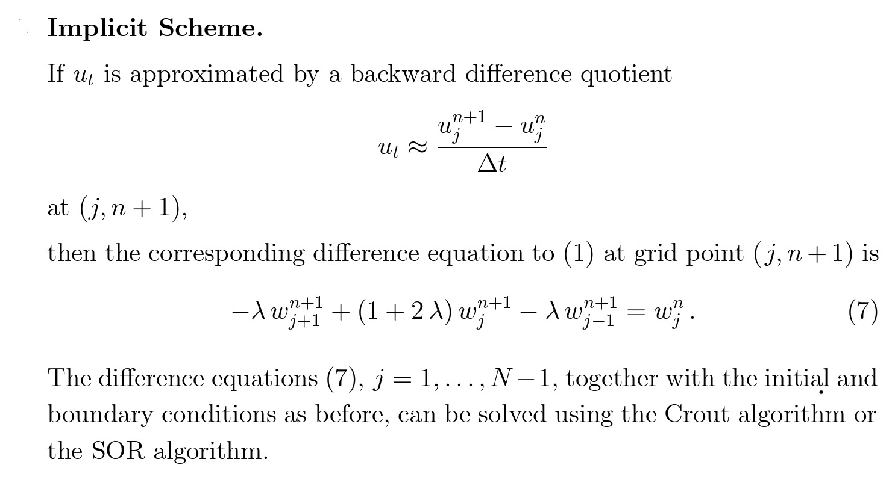
Backward time central space (BTCS)

Slide 7
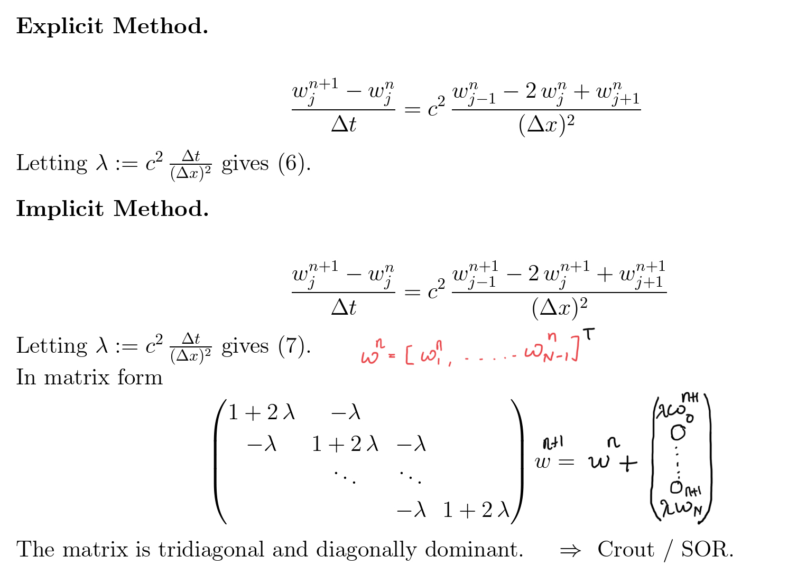
The matrix on the L.H.S. of above equation is invertible as it is strictly diagonally dominant.

Slide 8
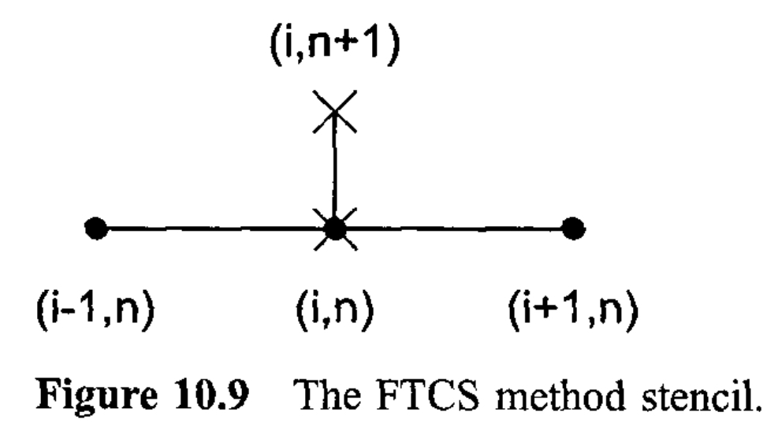
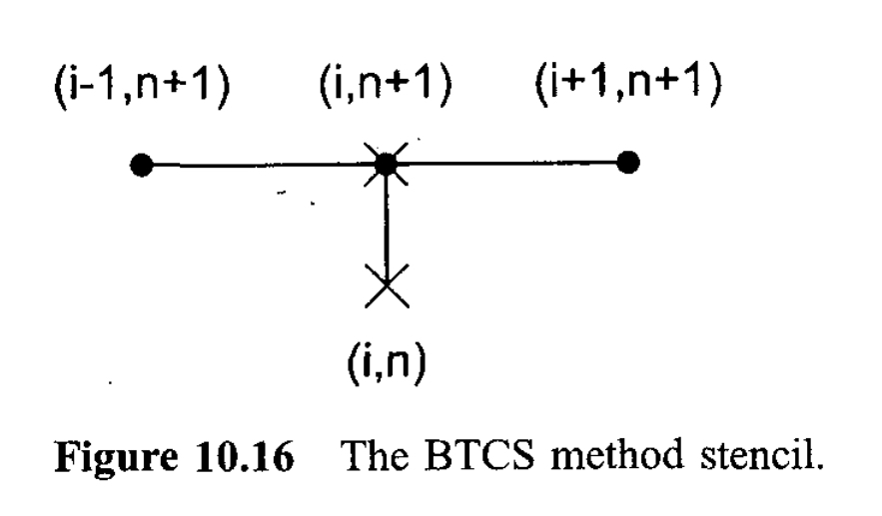

Slide 9
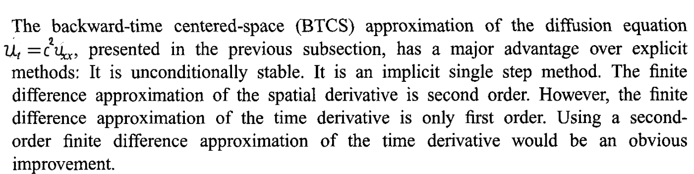
Crank-Nicolson method

Slide 10
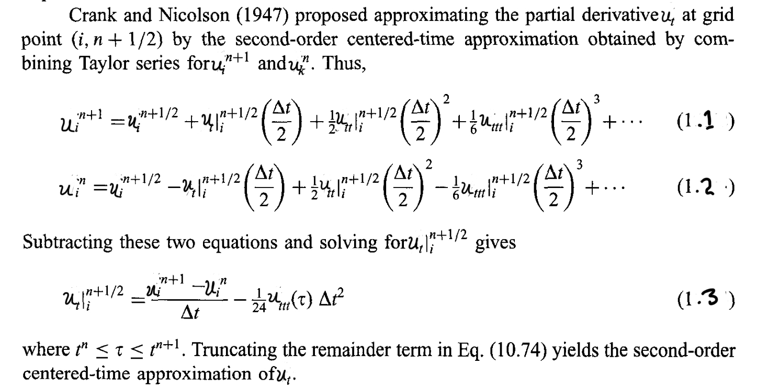

Slide 11
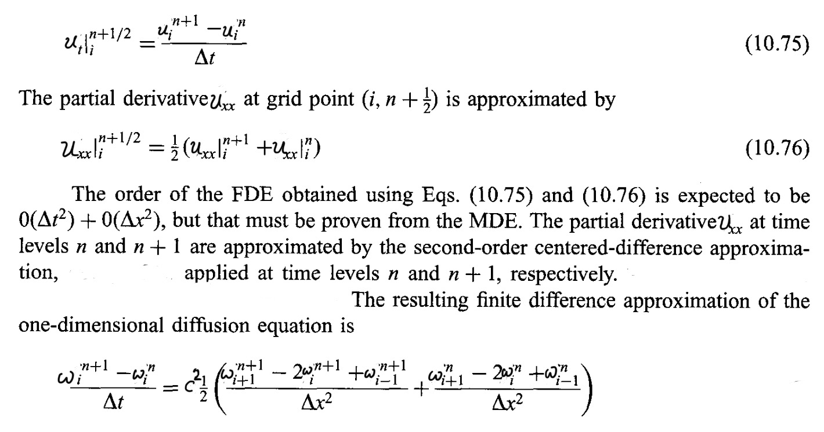

Slide 12
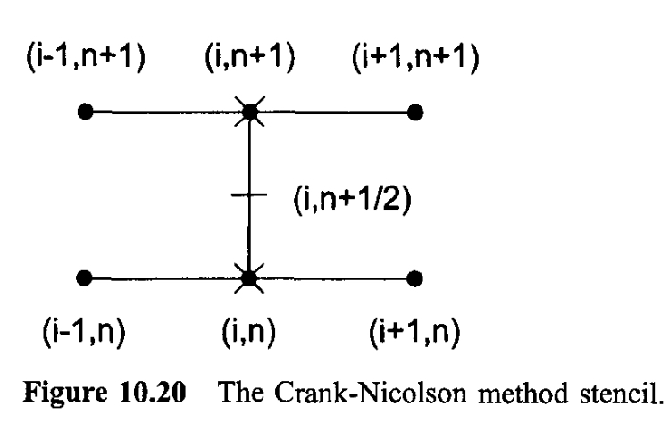

Slide 13
A finite difference equation is consistent with a PDE if the difference between the PDE and FDE (ie., the T. E.) vanishes as the sizes of the grid spacing go to zero independently.
When applied to a PDE that has a bounded solution, a FDE is stable if it produces a bounded solution and is unstable if it produces an unbounded one.
A fd method is convergent if the solution of the FDE approaches the exact solution of the PDE as the sizes of the grid spacing approach zero.

Slide 14
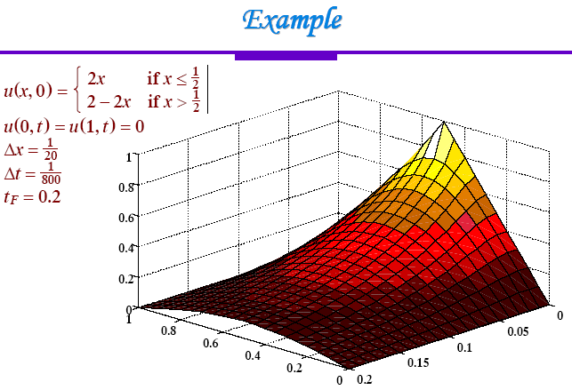
Consider the equation u_t=u_xx

Slide 15
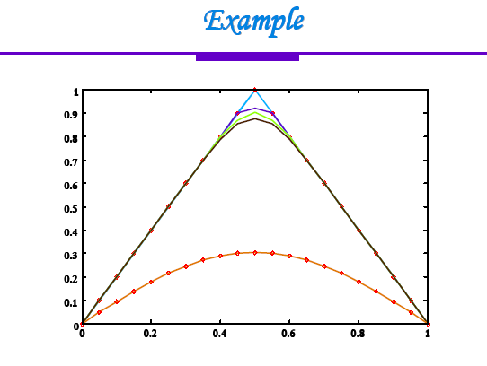

Slide 16
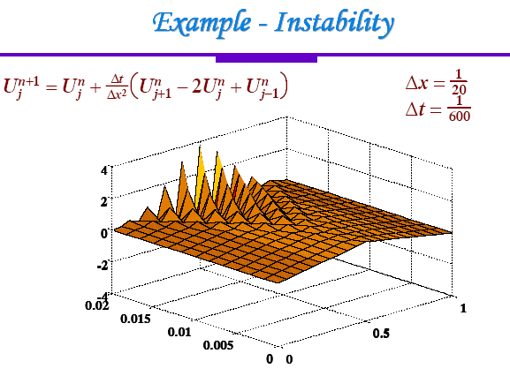

Slide 17
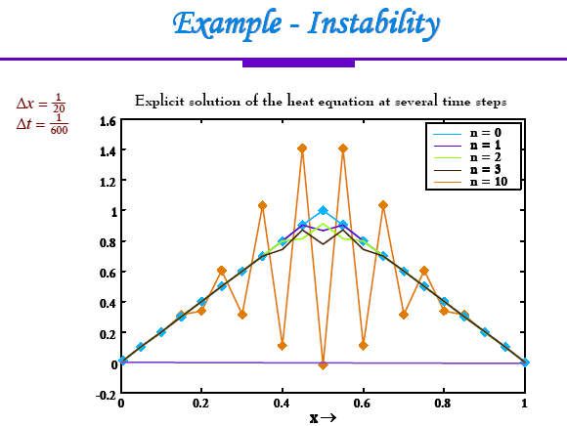
Apparently, we cannot choose the time step/mesh width arbitrary!
So the instability must be due to choices in the numerical scheme.

Slide 18
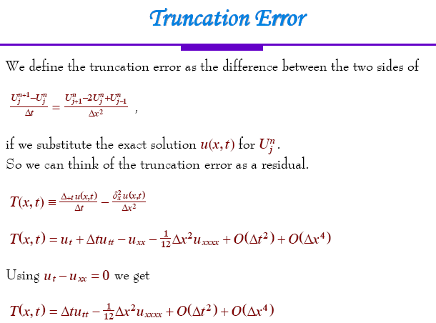

Slide 19
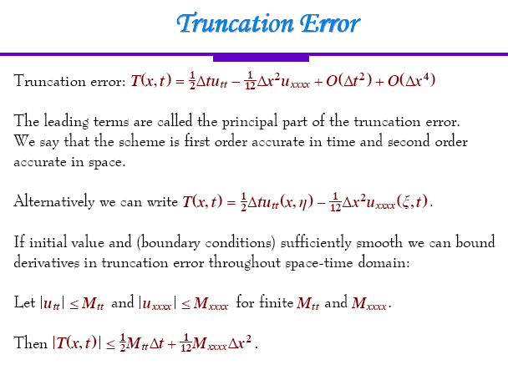

Slide 20
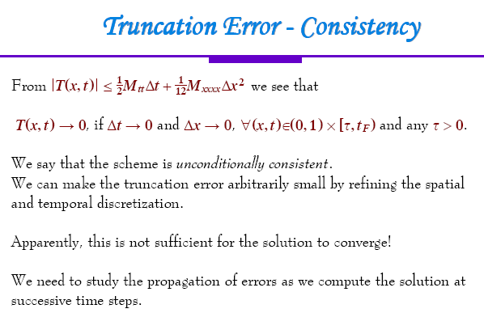

Slide 21
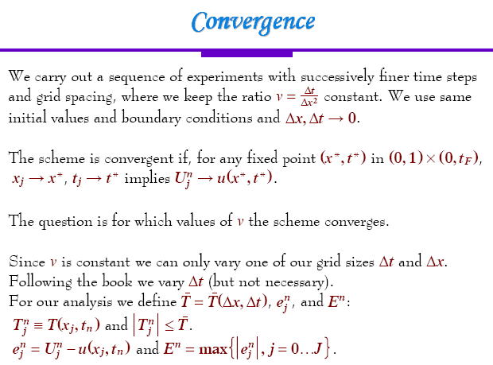

Slide 22
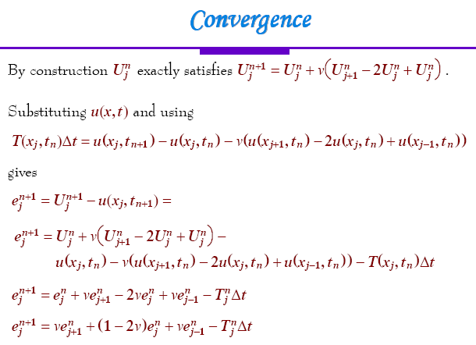

j-1

Slide 23
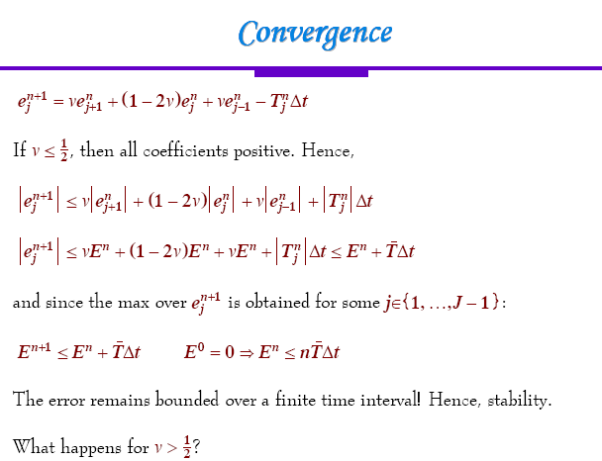

Slide 24
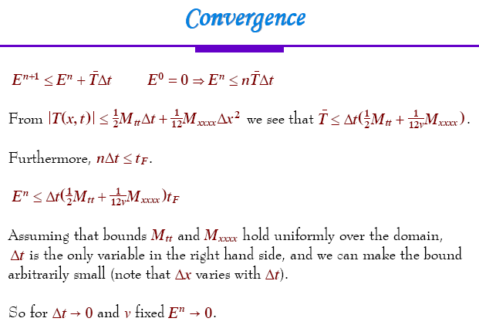

Slide 25
Home work:
(1) Derive the truncation error of both BTCS and Crank-Nicolson scheme and find the order of accuracy of the scheme.

Slide 26
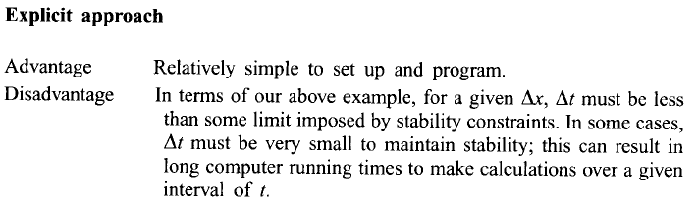
Relative advantages and disadvantages of the two approaches

Slide 27
