Slide 1
Round-off error stability....

Slide 2
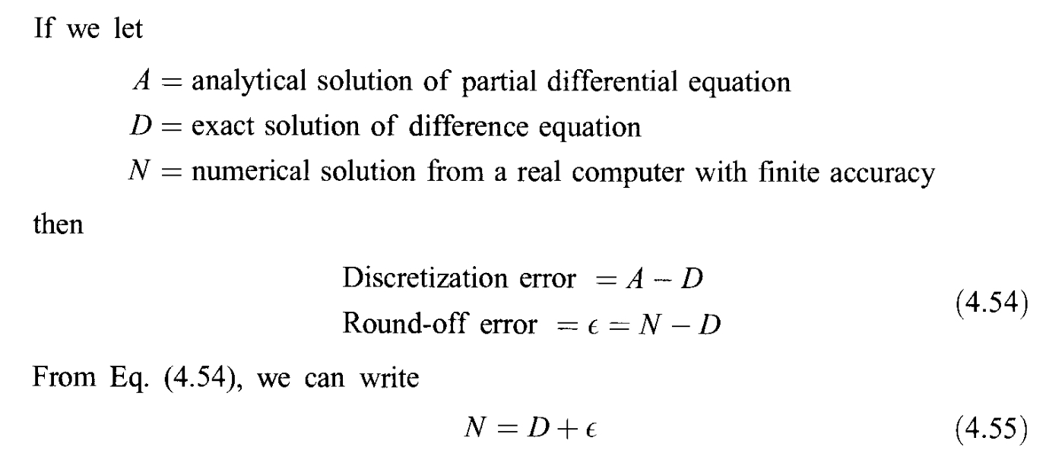

Slide 3

Consider the FTCS discretization of T_t=\alpha T_xx

Slide 4
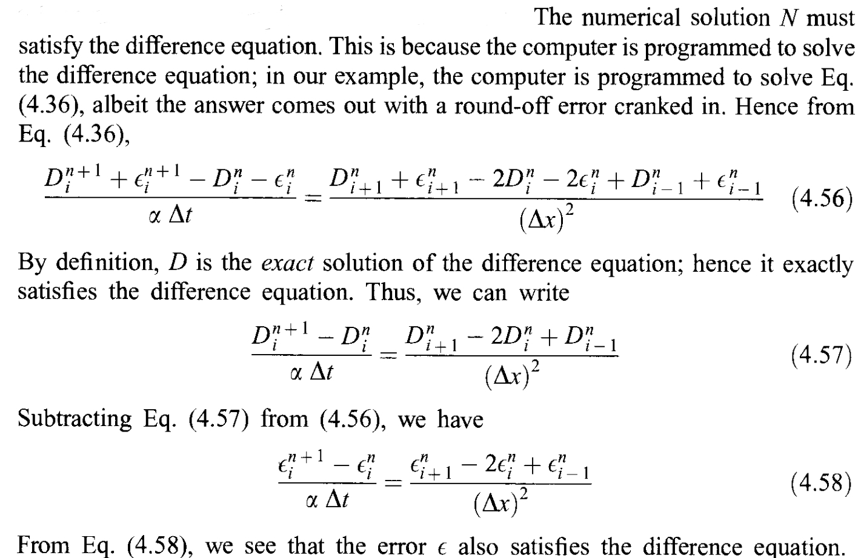

Slide 5
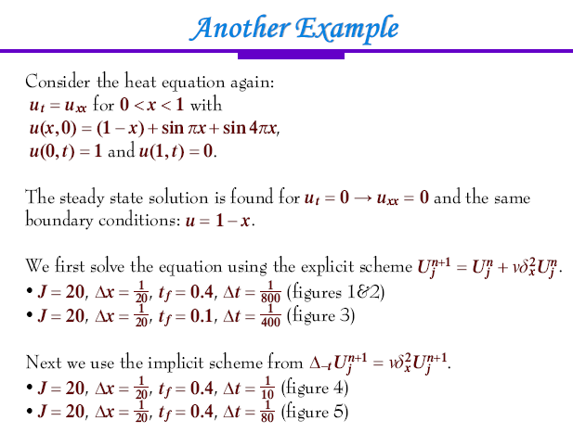

Slide 6
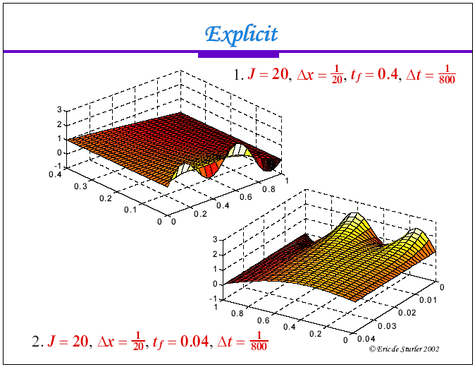

Slide 7
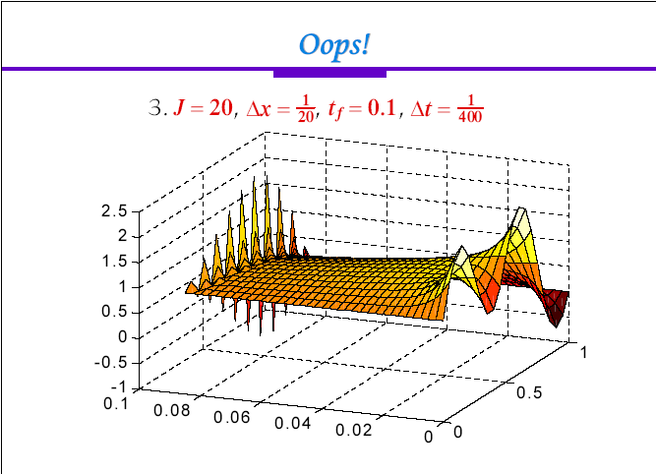

Slide 8
