Slide 1
Stability analysis through Matrix Method

Slide 2
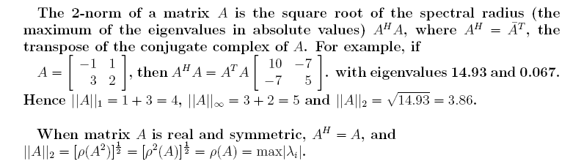

The 2-norm of a Matrix:
Remember, for any matrix norm ||.||,

Slide 3

Necessary and sufficient condition for stability
Let the following be the algebraic system of equations
Resulting from the discretization of a marching problem.
This will result in….

Slide 4
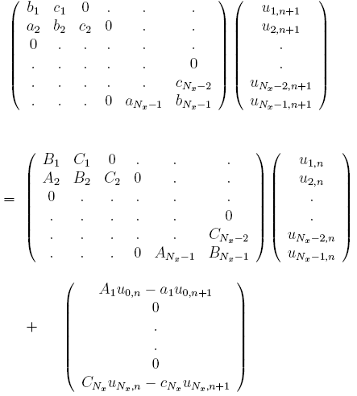
Boundary conditions

Slide 5

The necessary and sufficient condition for the
difference equations to be stable is that
Lax equivalence theorem: Given a properly posed
Initial value problem and a linear finite-difference
Approximation to it that satisfies the consistency
Condition, stability is the necessary and sufficient
Condition for convergence.

Slide 6
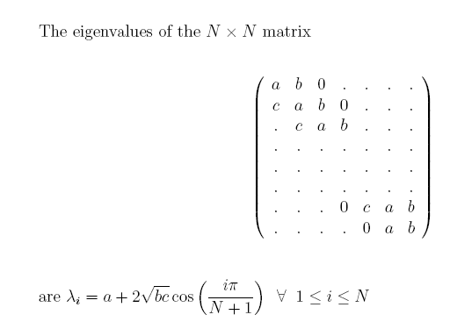
The eigenvalues of a common tridiagonal matrix:

Slide 7

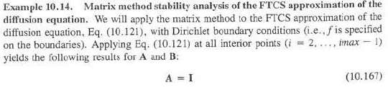
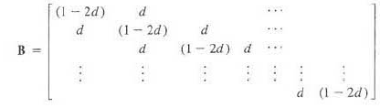

Slide 8
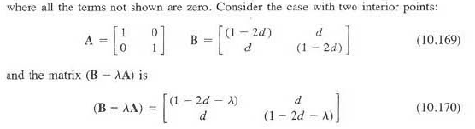
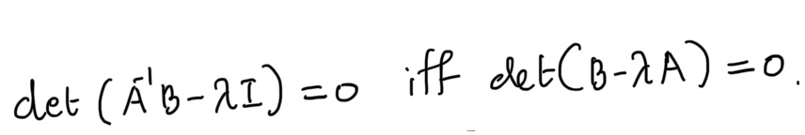
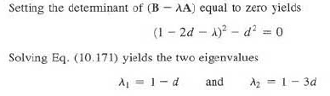

Slide 9
