Slide 1

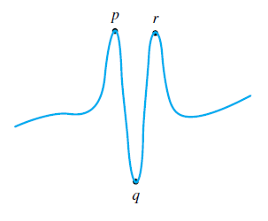
How does cubic spline overcome the oscillation?

Slide 2


Ref: David and Cheney

Slide 3


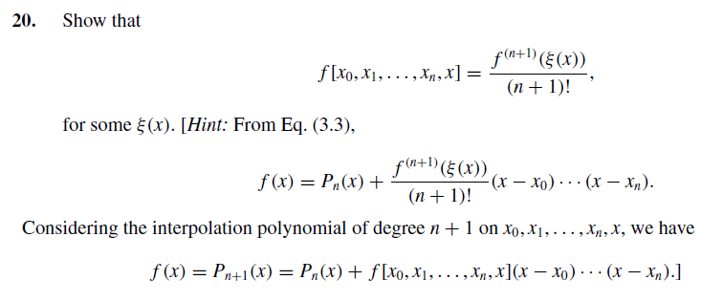
HOMEWORK

Slide 4


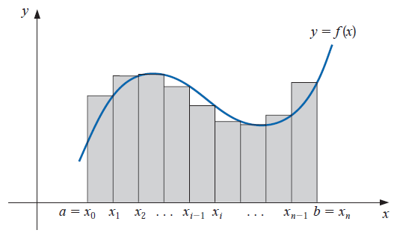
Numerical Integration
Some review of Calculus again

Slide 5
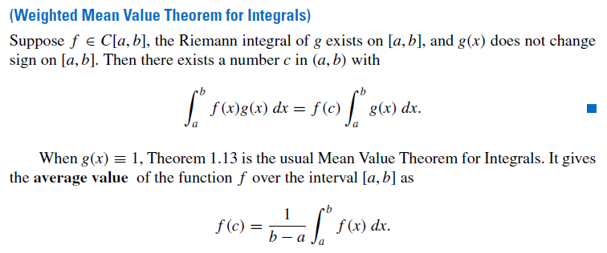
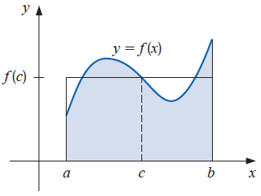

Slide 6


Numerical Quadrature

Slide 7
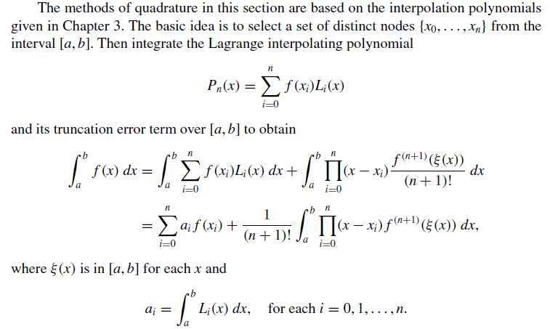

Slide 8
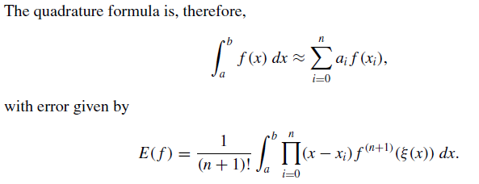

Slide 9
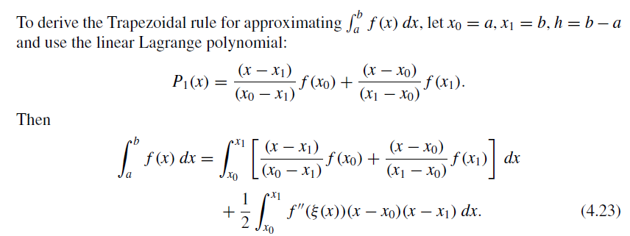

Trapezoidal Rule

Slide 10

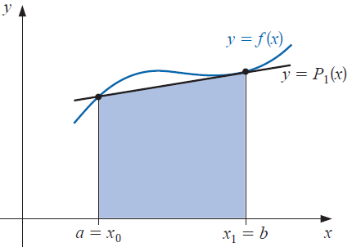


Slide 11

Simpson rule

Slide 12

Midpoint rule

Slide 13
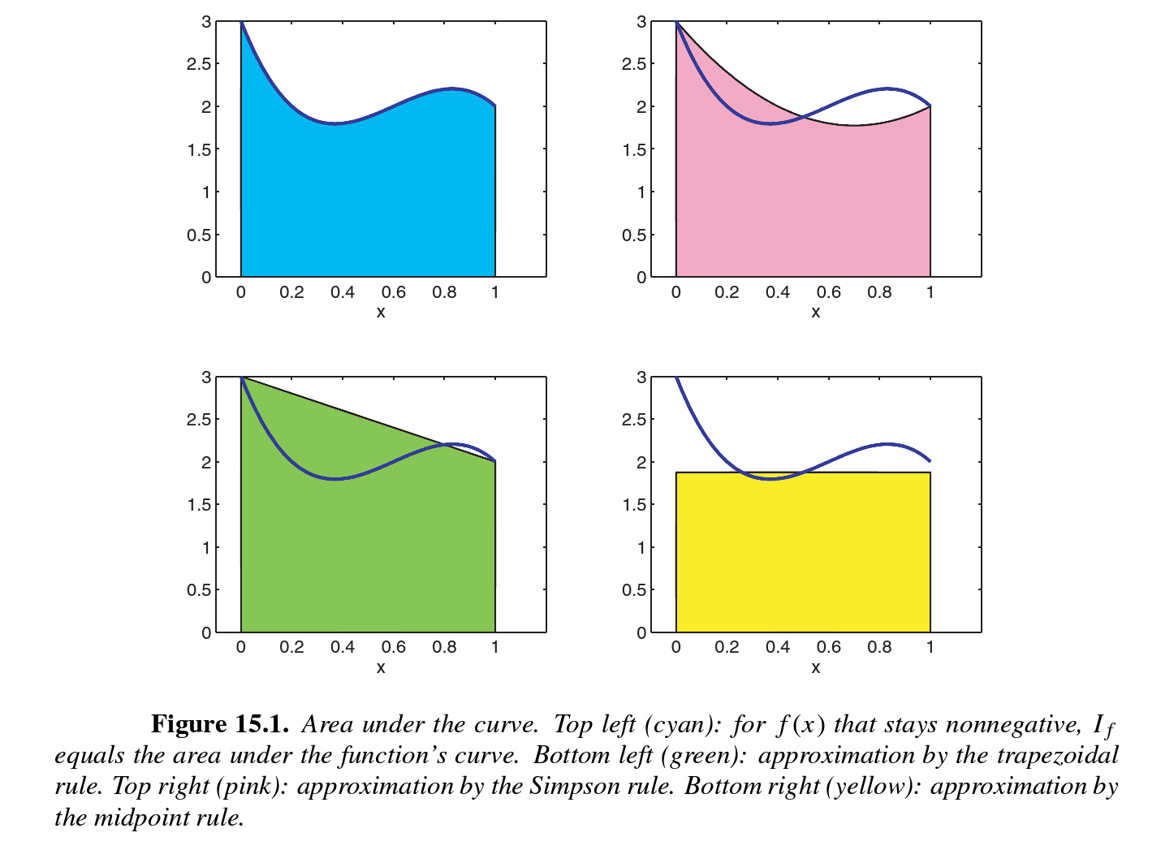

Slide 14
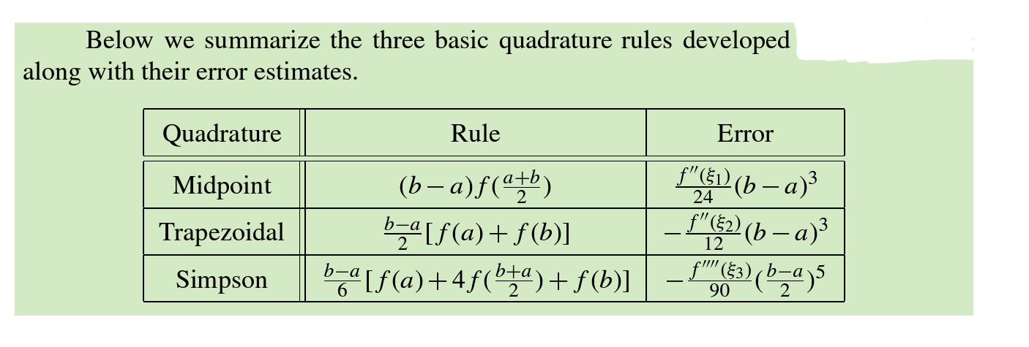
What if f is a polynomial of degree 3?
Error estimate for Simpson rule is an exercise for you.

Slide 15
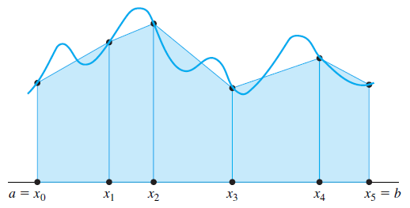
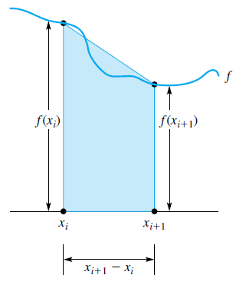
Composite Numerical Integration

Slide 16
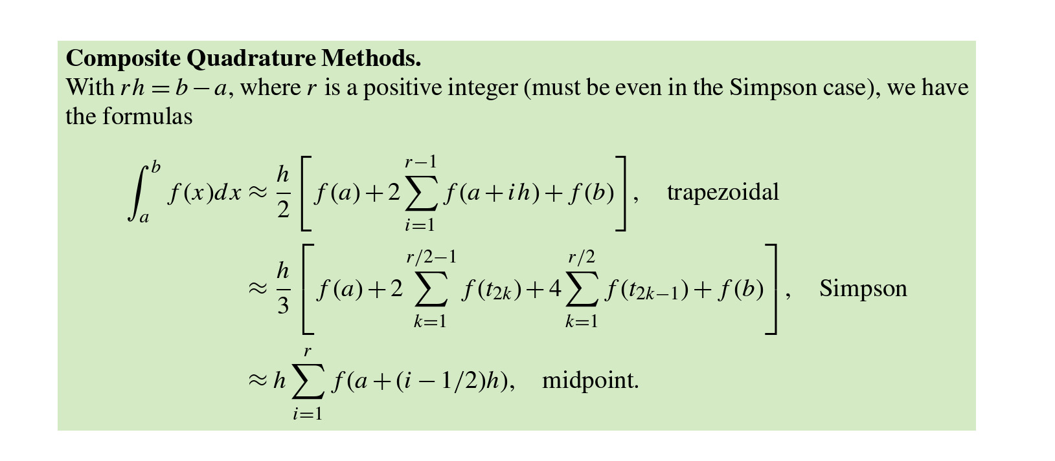

Slide 17


Slide 18


Slide 19
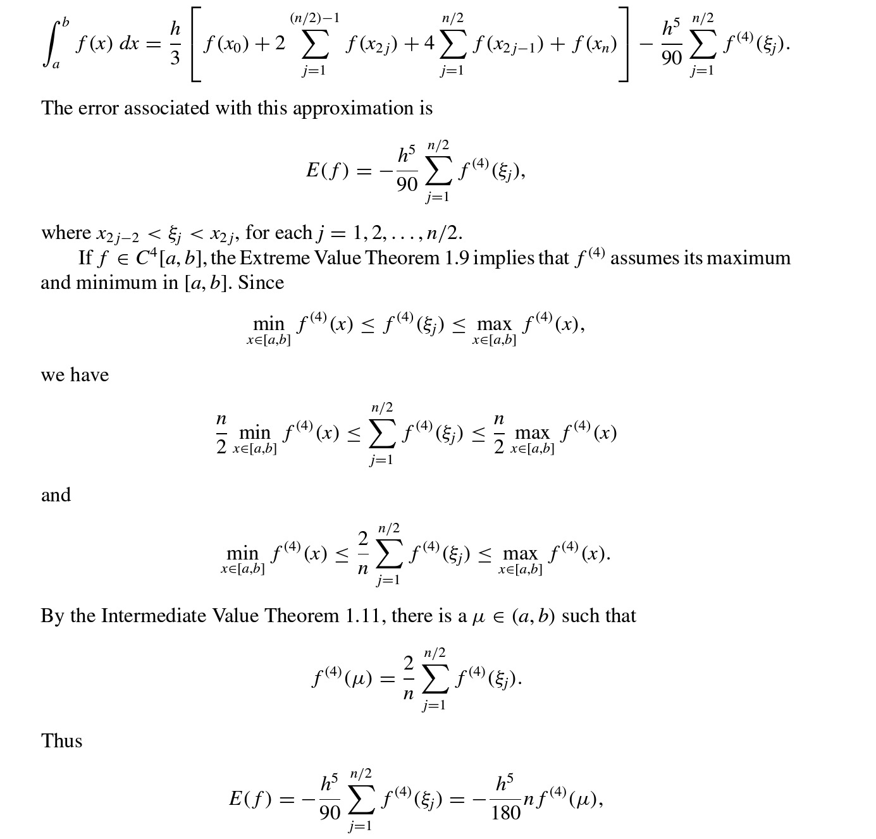
Proof:

Slide 20


Slide 21

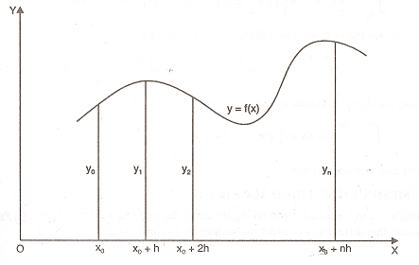

Slide 22
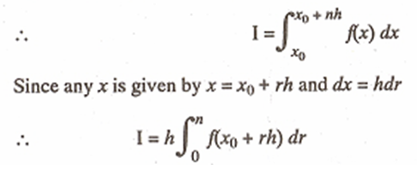



Slide 23


This is a general quadrature formula and is known as Newton-Cotes’s quadrature formula. A number of importand deductions viz. Trapezoidal rule, Simpson’s one-third and three-eighth rules, weddle’s rule can be immediately deduced by putting n=1,2,3 and 6 respectively in formula (1).
Ref: Kendall E. Atkinson pp-264, Isaacson and Keller (1966, pp-308-314)

Slide 24



Also called Composite rules

Slide 25



IMPORTANT

Slide 26
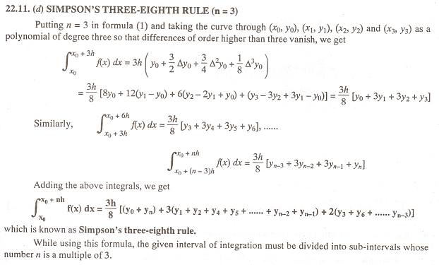

Slide 27


Slide 28
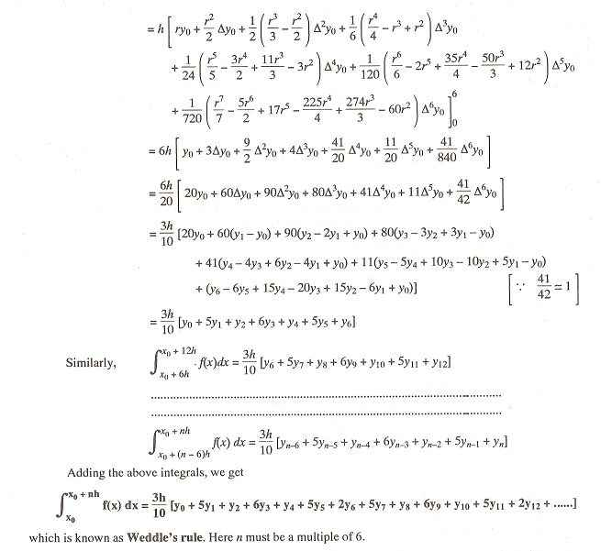

Slide 29
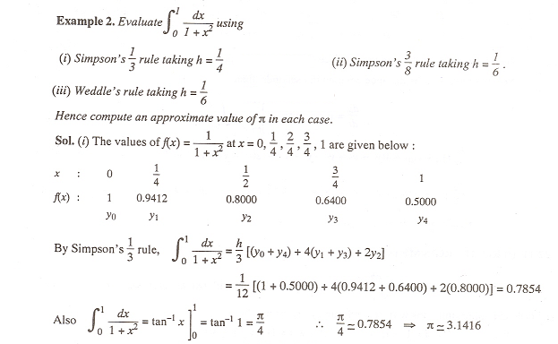

Slide 30
