Slide 1
What is degree of precision??
Why do you need composite rule? (Runge Phen..)
OR why don’t you take a large degree polynomial in Newton-Cote?
When n is odd, precision of Newton-Cote is n, when n is even, precsion is n+1, check the Simpson rule.
Verify this from theorem on error estimates for Newton-Cotes.

Slide 2
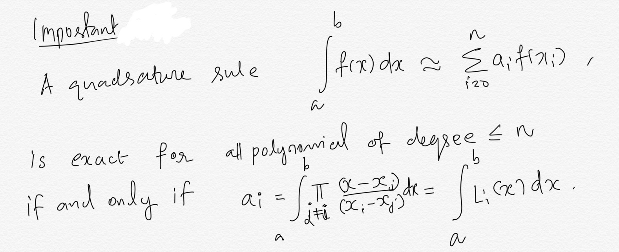

Slide 3
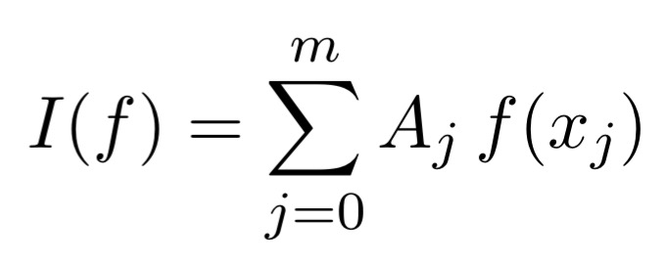
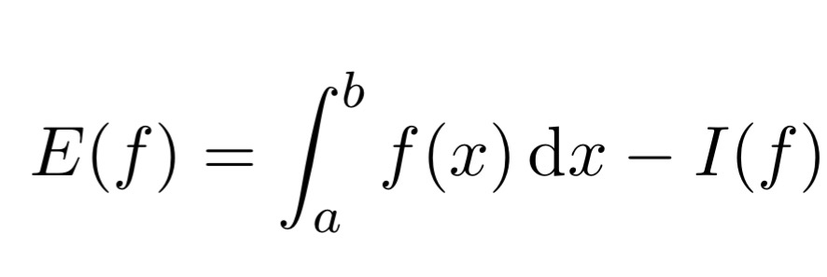
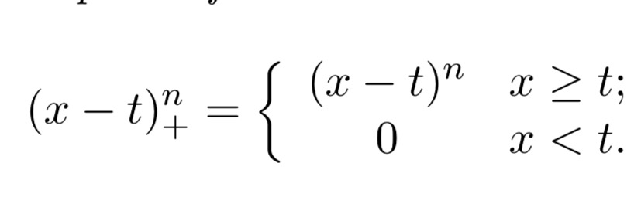


Slide 4
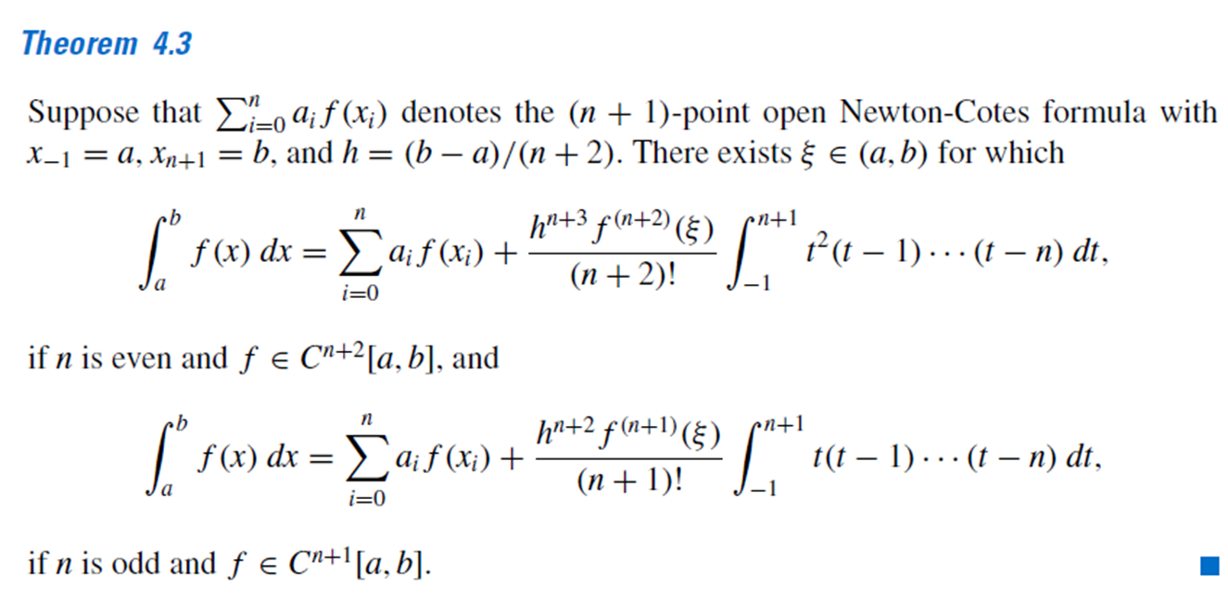

Slide 5

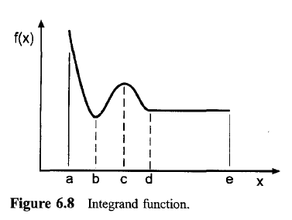
ADAPTIVE QUADRATURE
LOOK AT THIS

Slide 6

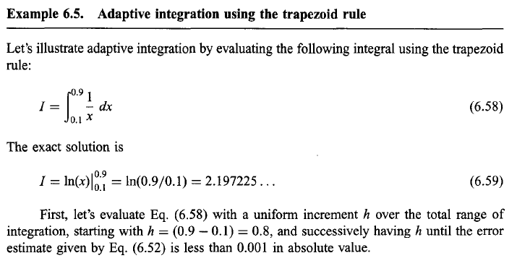

Slide 7
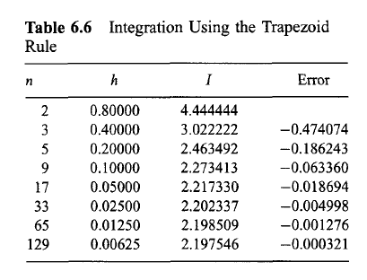


Slide 8

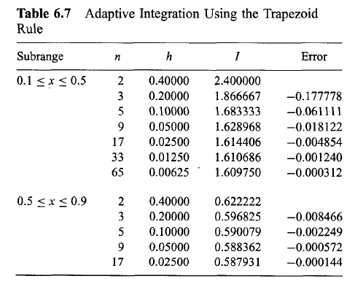
Let’s try it in a different way.

Slide 9
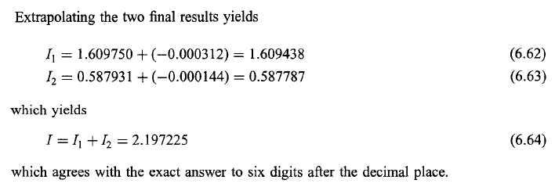
THIS IS ADAPTIVE INTEGRATION.

Slide 10
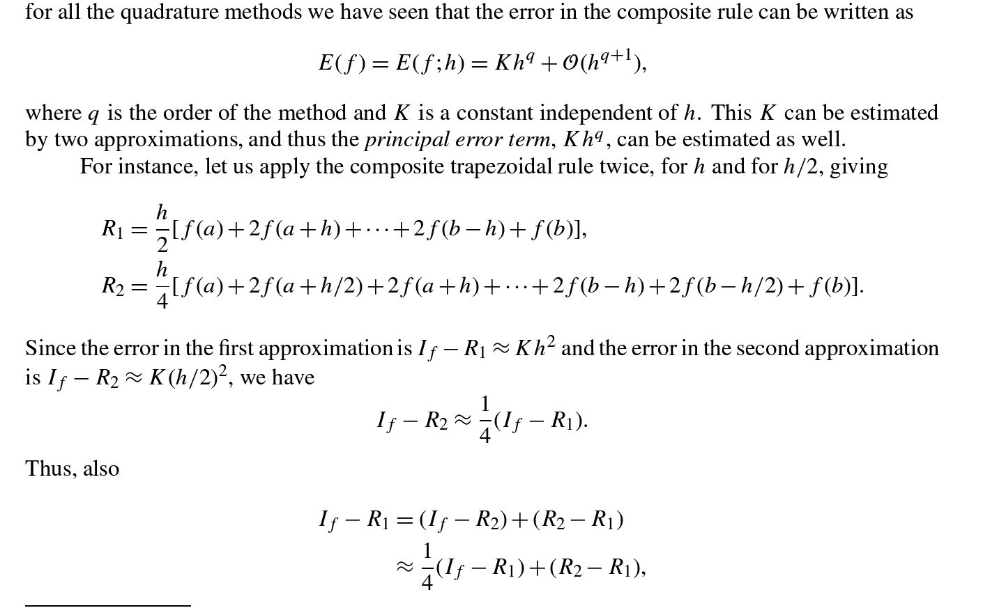
Algorithm for adaptive quadrature

Slide 11



Slide 12
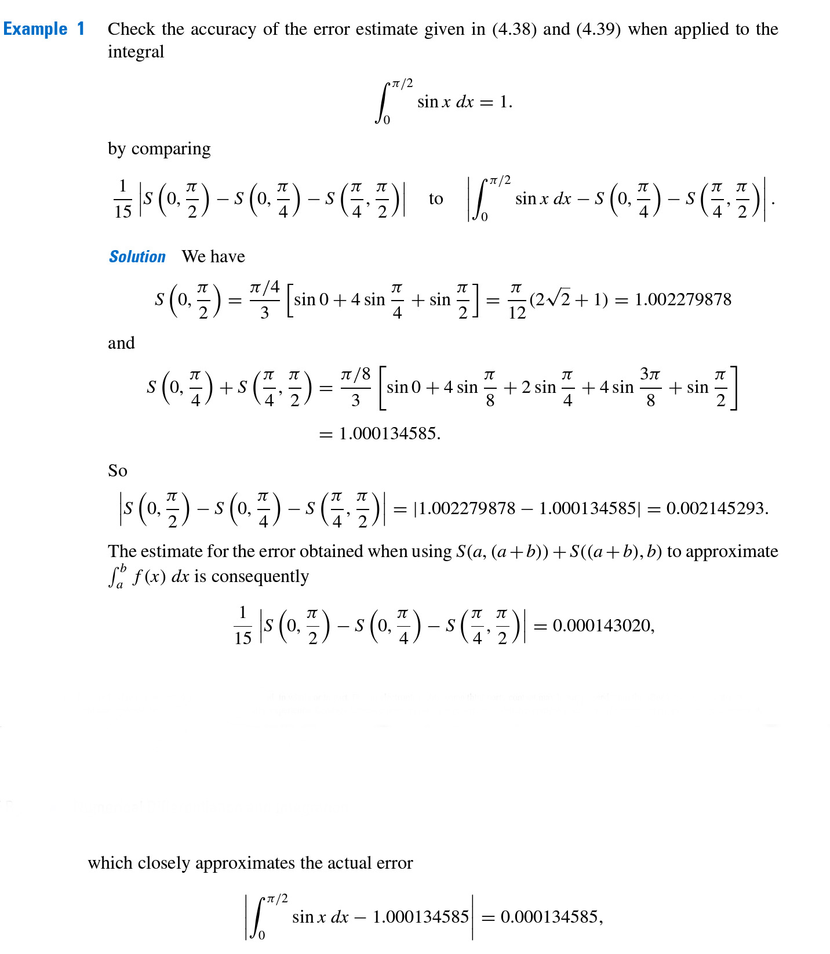

Slide 13
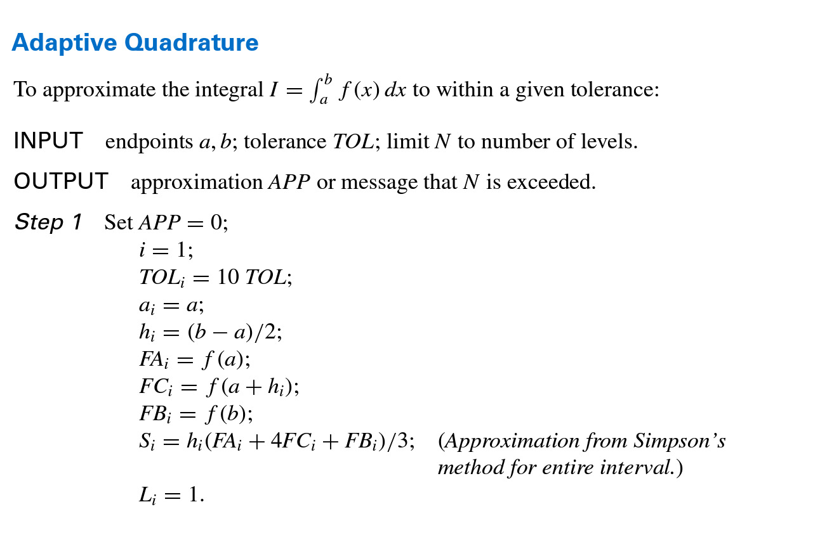
Ref: Burden and Faires

Slide 14
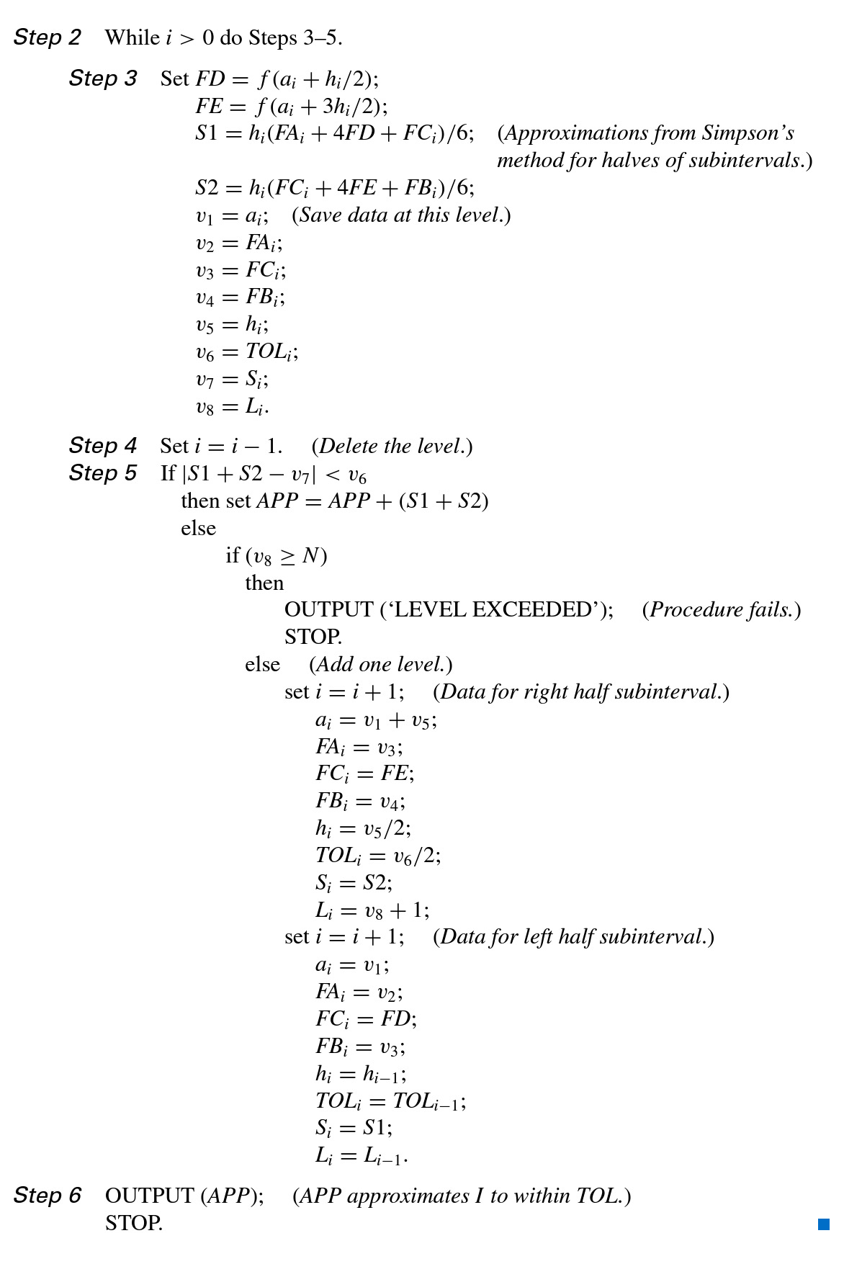

Slide 15


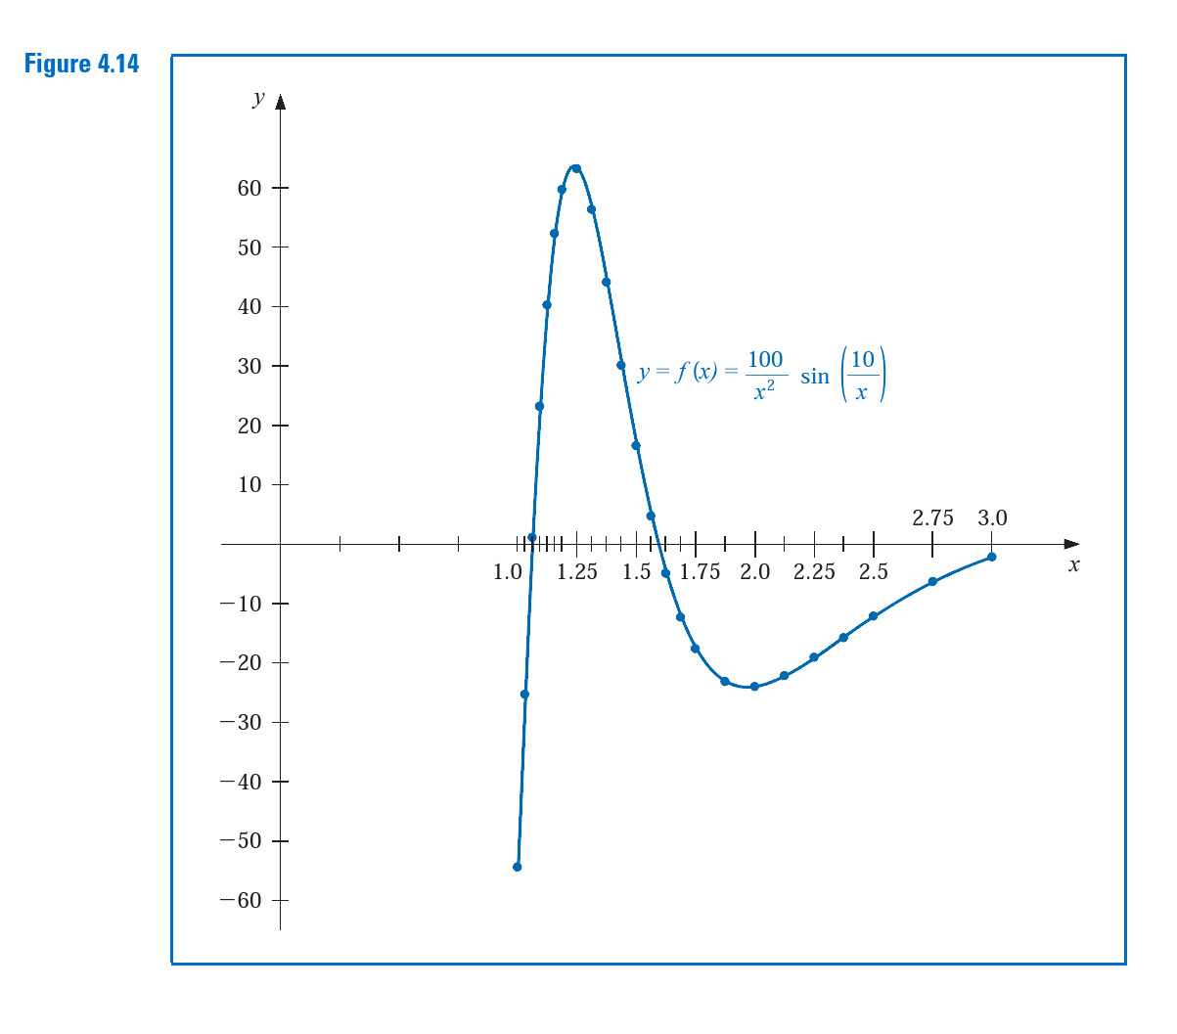

Slide 16


