Slide 1
Gaussian quadrature
For (n+1) absissae the least expected precision is n of course!
What if we get a high precision say 2n+1, from x_0, x_1,....x_n, (n+1) absissae?
Trust me!! Gaussian quadrature rule makes it possible!!!
The whole idea is to chose the points x_0,x_1,......x_n wisely

Slide 2
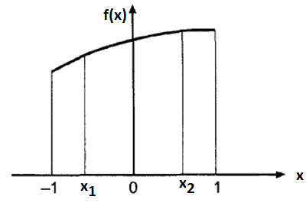
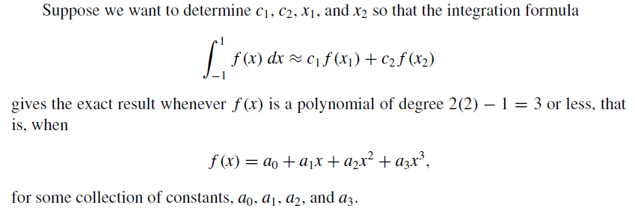

Slide 3
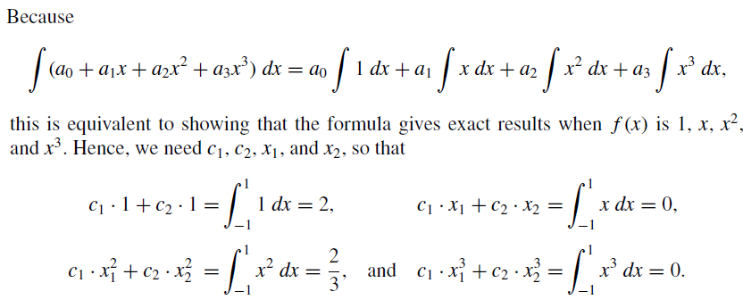
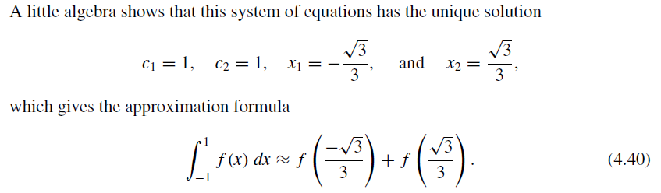

Slide 4
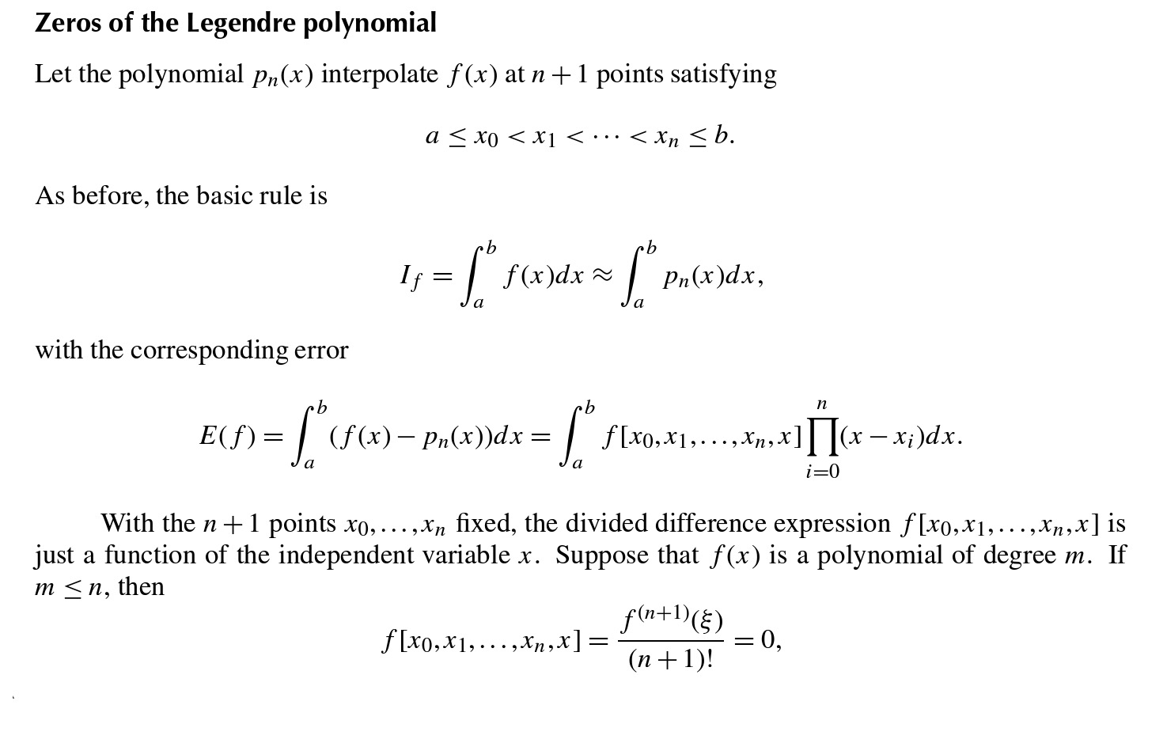
In general, how to determine the abscissae and weights?

Slide 5
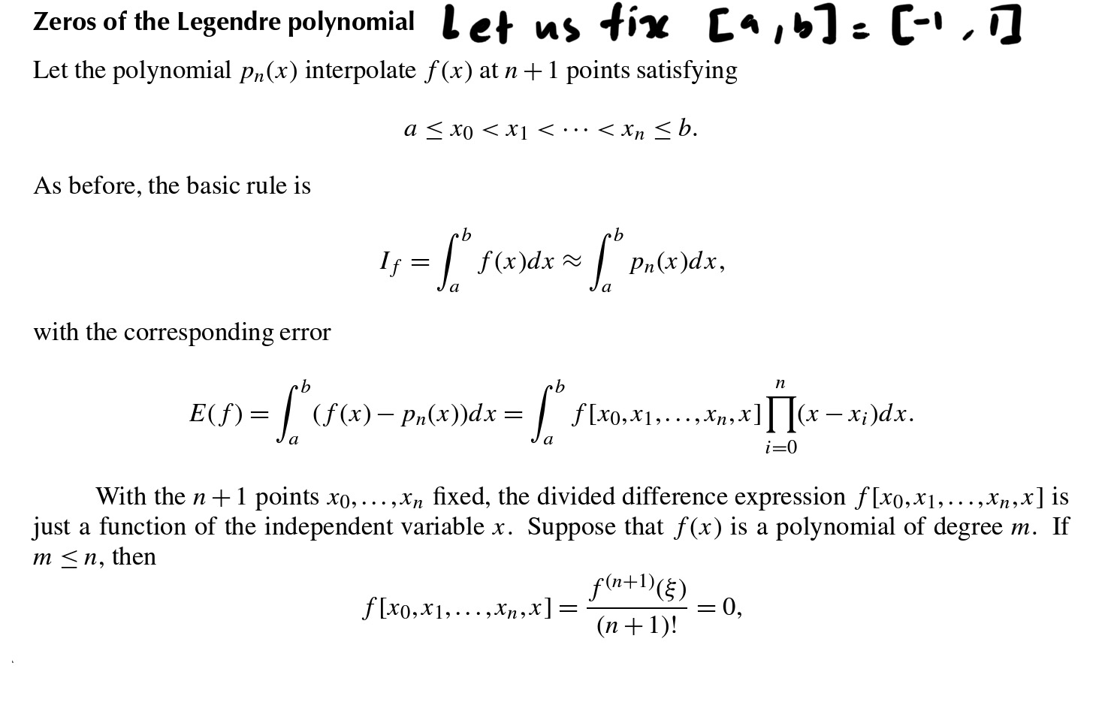
In general, how to determine the abscissae and weights?

Slide 6
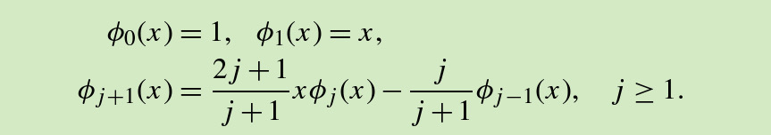
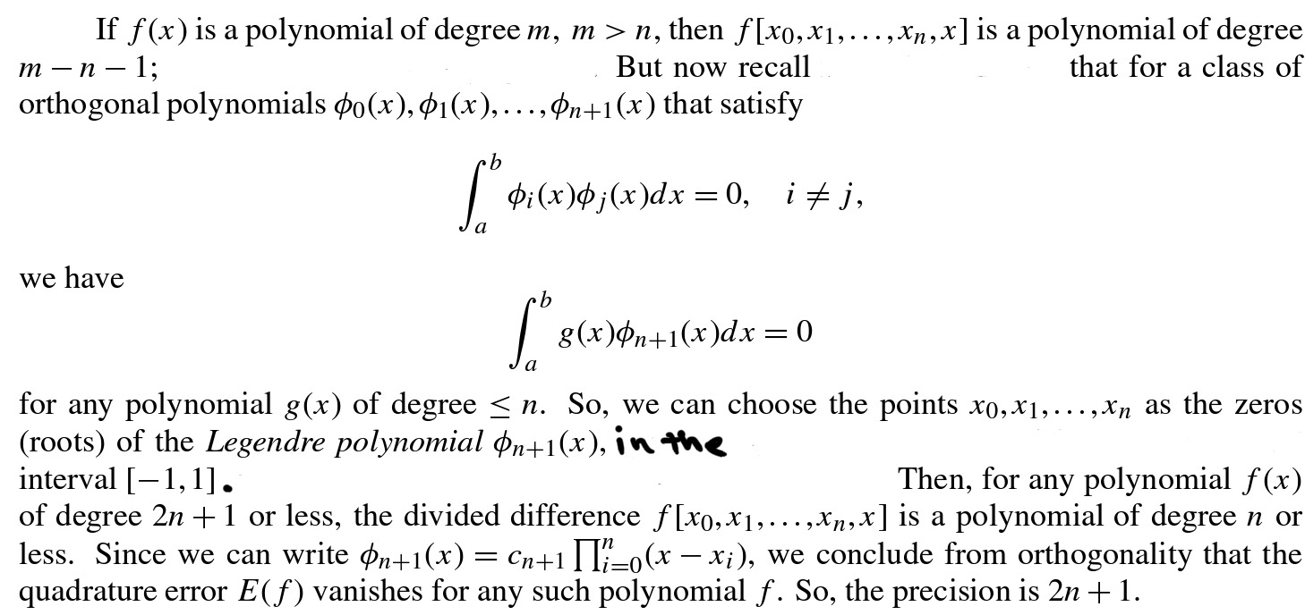
Legendre polynomials
Legendre polynomial of degree n has n distinct real roots in [-1,1], Its wonderful, isn’t it??

Slide 7
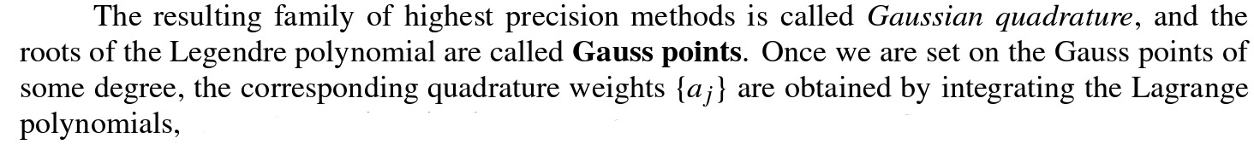
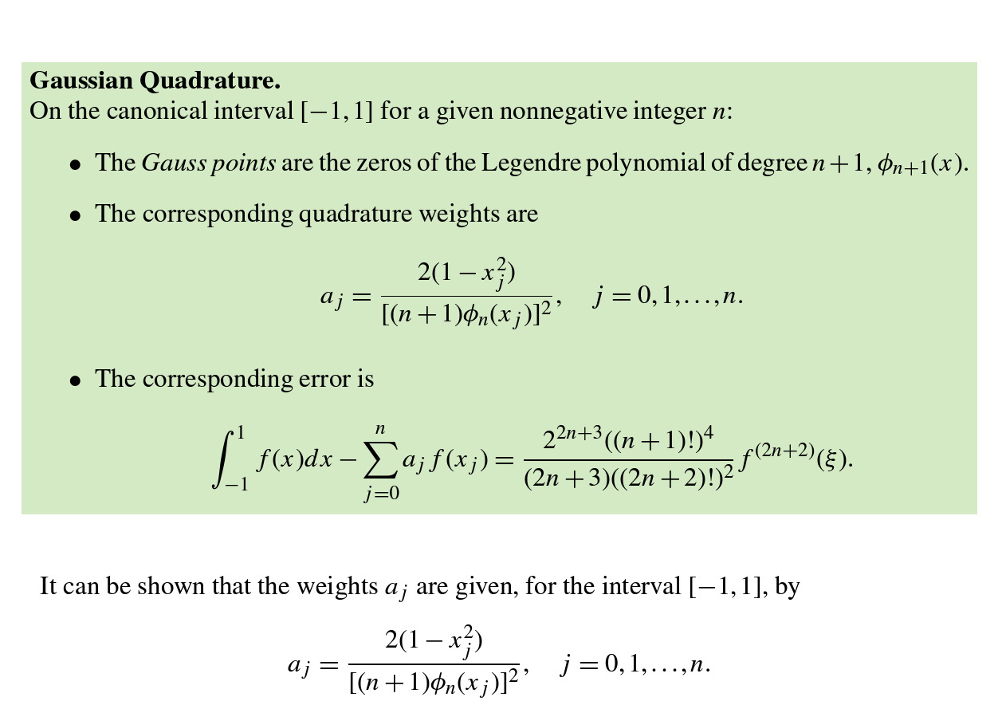

Slide 8
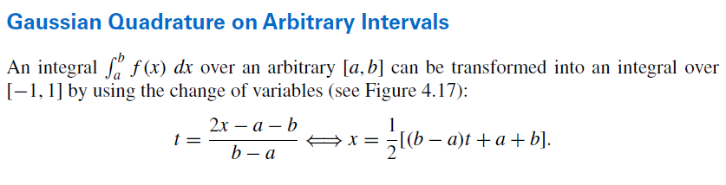
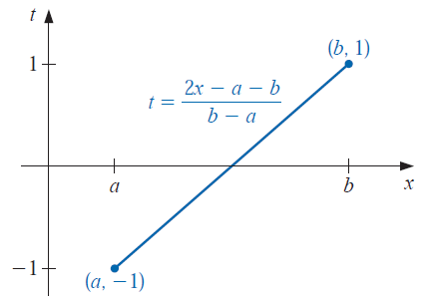
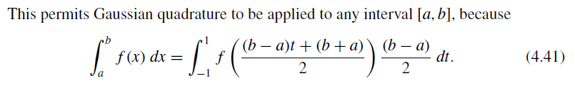

Slide 9
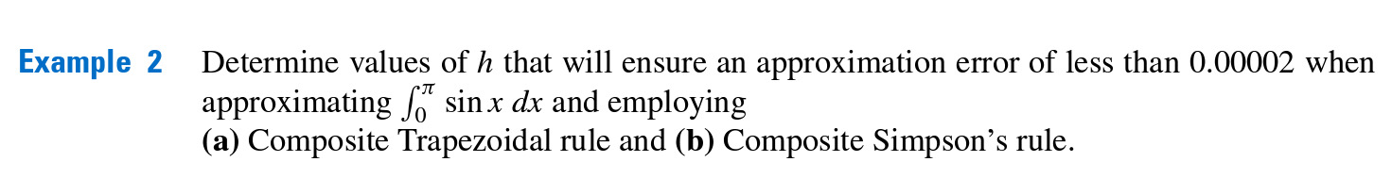
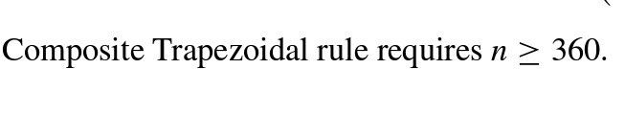
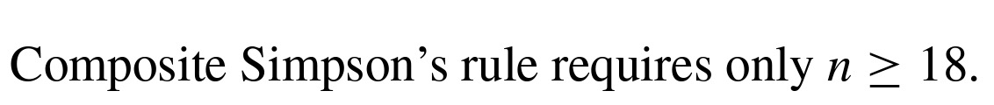
Round-Off error stability
You might suspect that because of fewer computations Simpson method involve less round-off error.
In fact round-off error does not depend o nthe number of caluclations performed.

Slide 10
