Slide 1

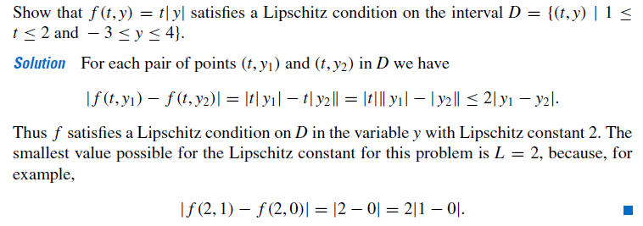
EXAMPLE:

Slide 2
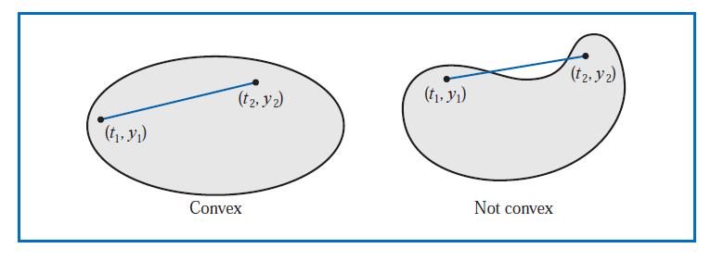
What does this definition mean GEOMETRICALLY?

Slide 3



Example:

Slide 4

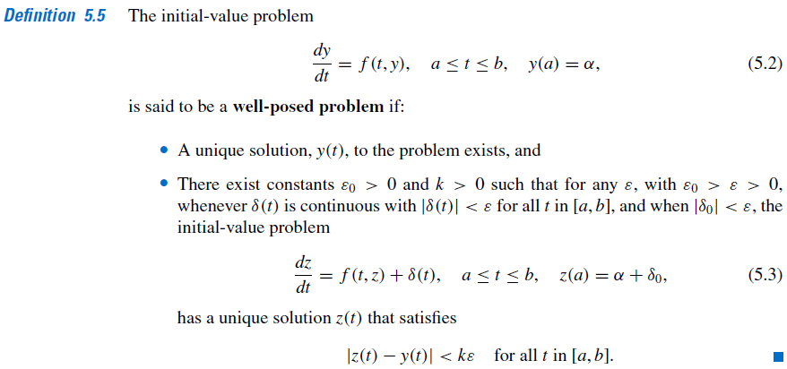
DEFINITION: Well-Posed problem
Perturbed Problem

Slide 5


Example:
Ref: Earl A. Coddington, An introducntin to ordinary differential equations

Slide 6
