Slide 1

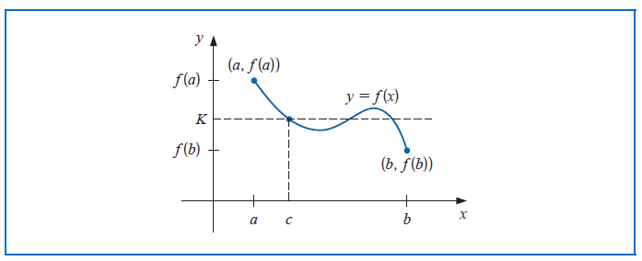
Review of Calculus

Slide 2

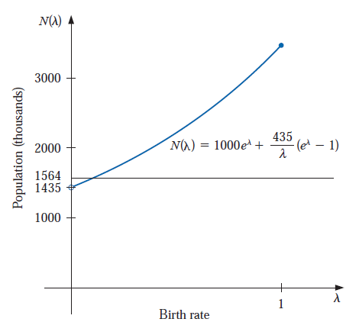




Slide 3


Bisection Method

Slide 4

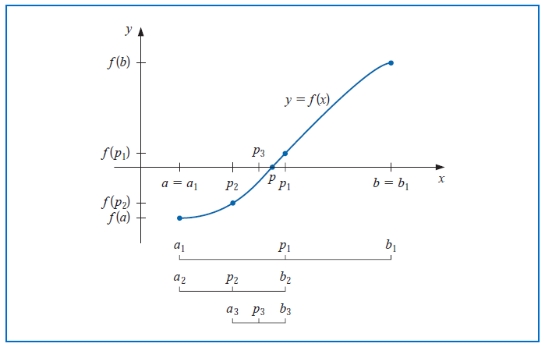

Slide 5


Slide 6


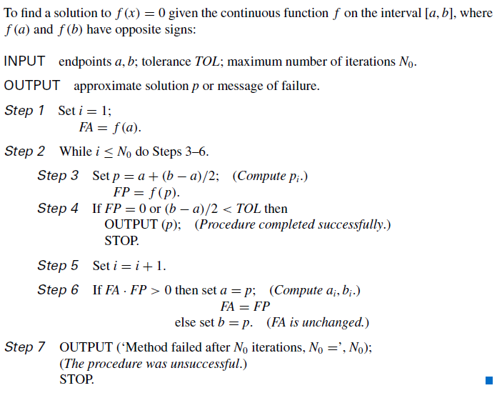

Slide 7
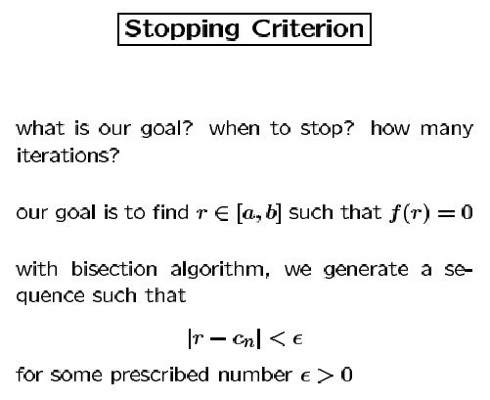
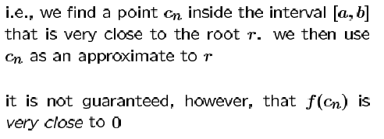

Slide 8


Stopping Criteria (contd.)

Slide 9



What initial interval?
We have both [-4, 4] and [0, 1]
Upper bound for no. of iterations

Slide 10
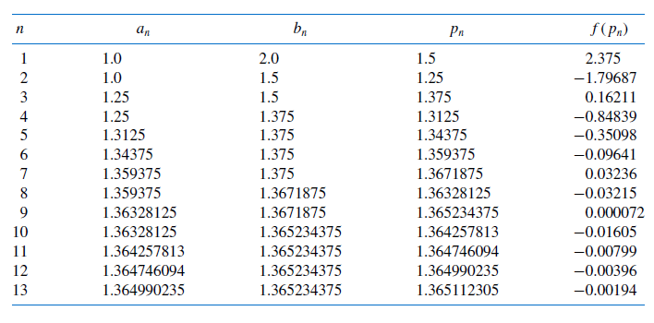
Example

Slide 11


How many iterations?
NOTE:

