Slide 1

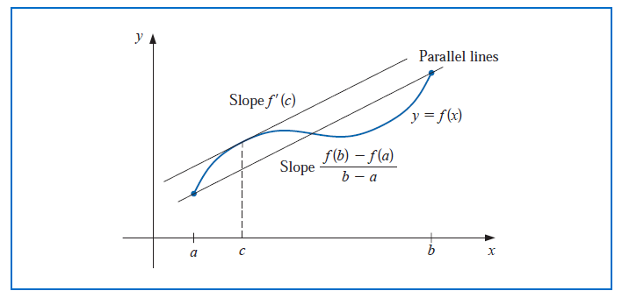

Slide 2


Equivalence between root finding and fixed point

Slide 3
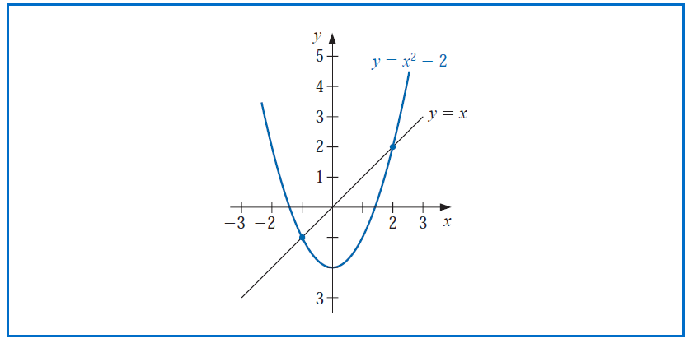
Example

Slide 4


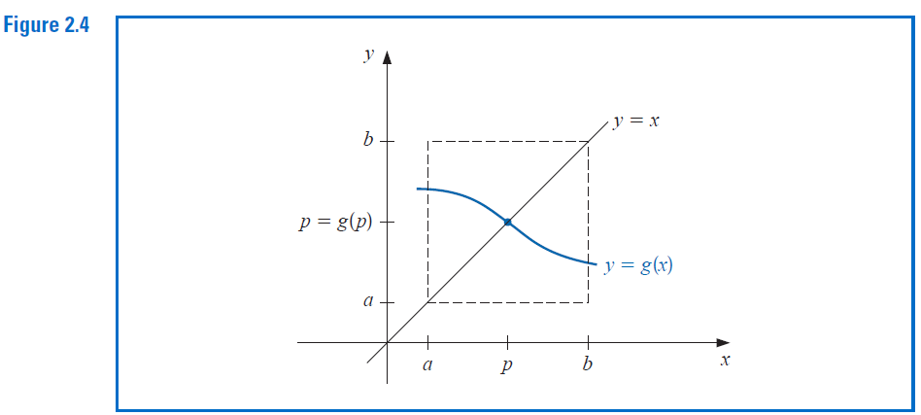

Slide 5
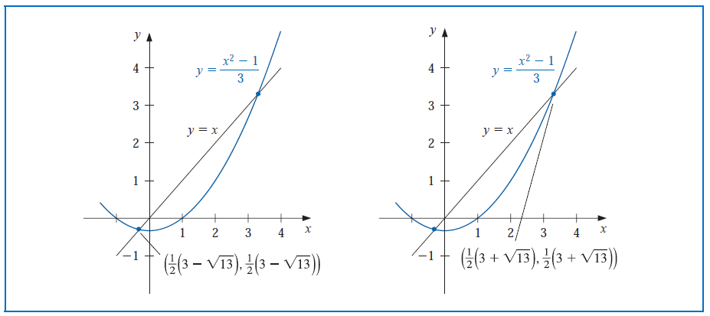

Example

Slide 6
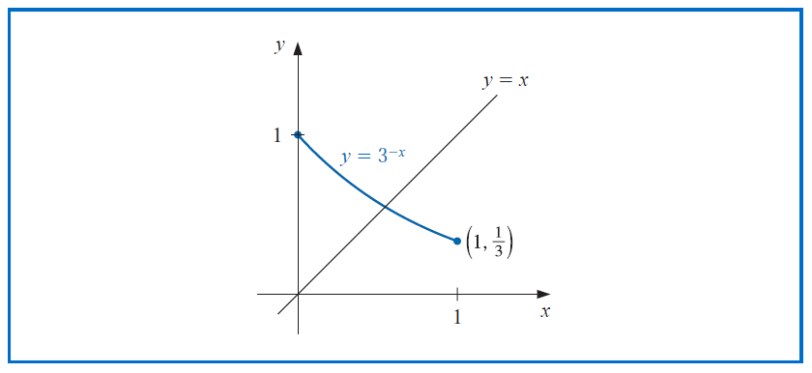


Slide 7


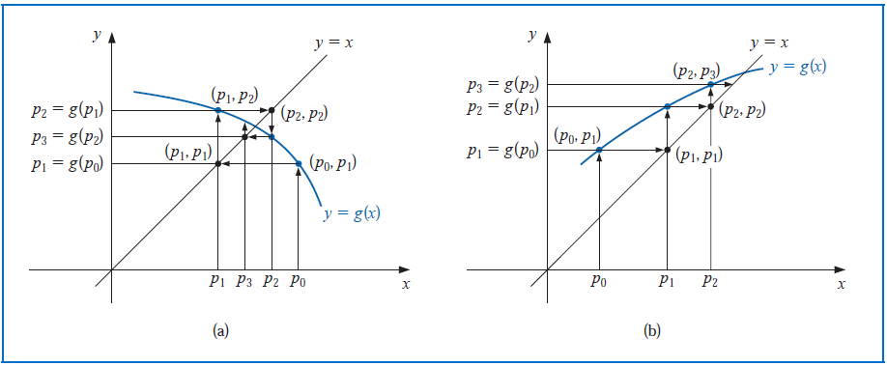

Slide 8
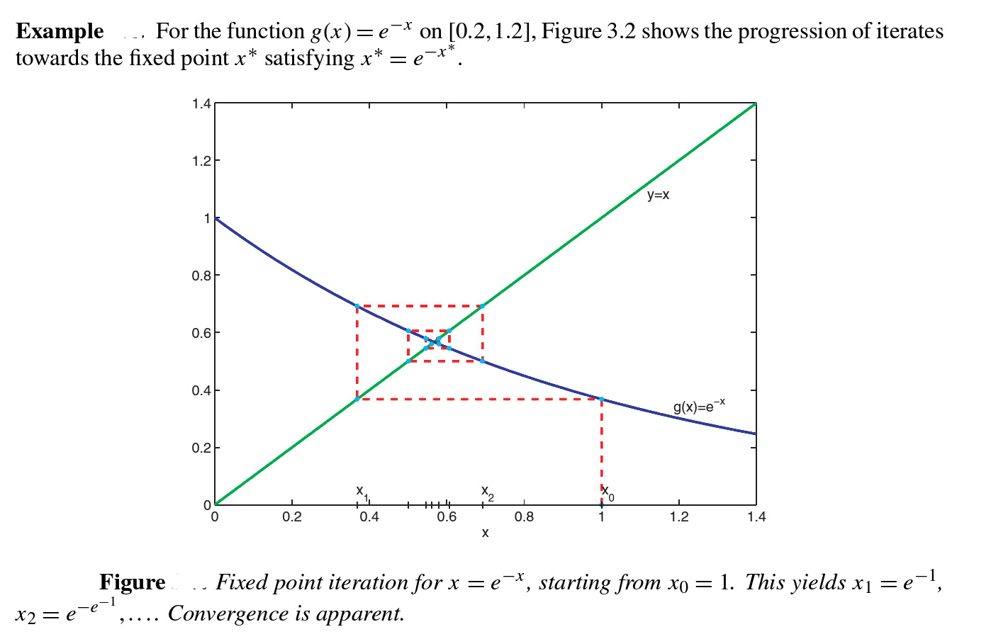

Slide 9
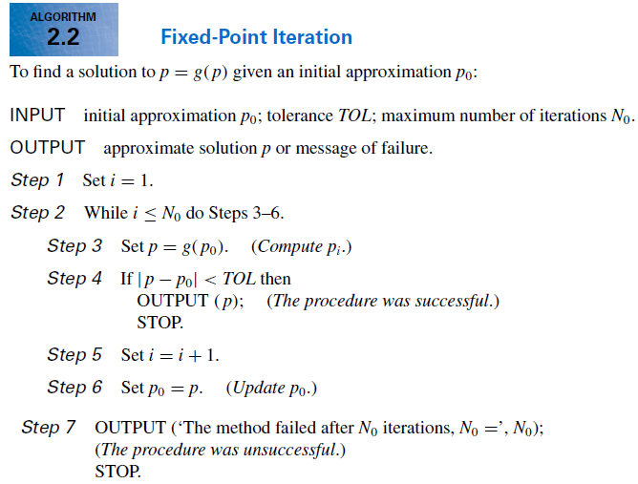

Slide 10

EXAMPLE

Slide 11



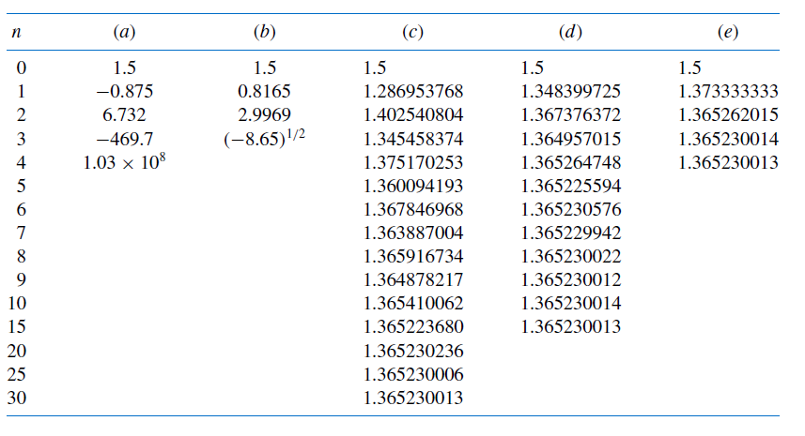



Slide 12
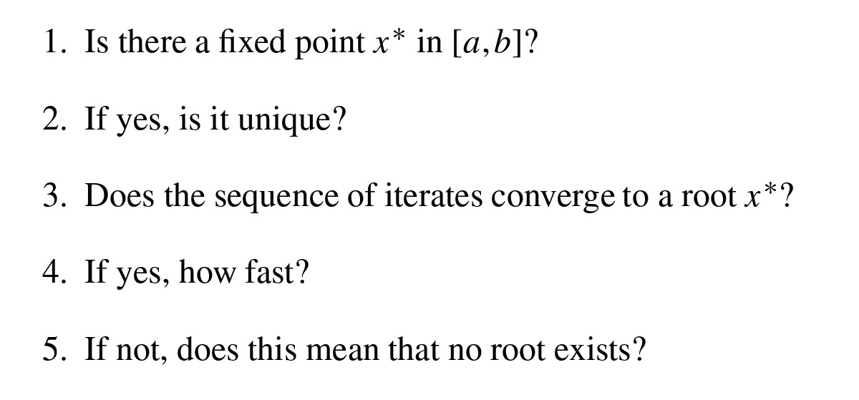

Slide 13

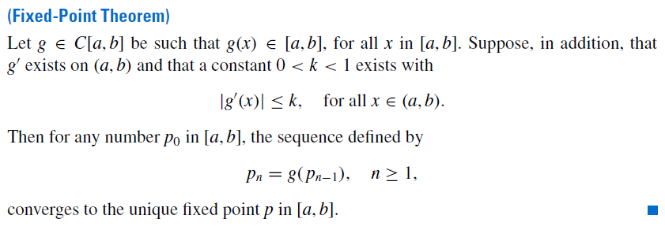
How can we find a fixed point problem that produces a sequence that reliably and rapidly converges to a solution to a given root finding problem?

Slide 14


What is the difference between theorem 2.4 and 2.3 (ii) ?

Slide 15



Slide 16



Slide 17
