Slide 1
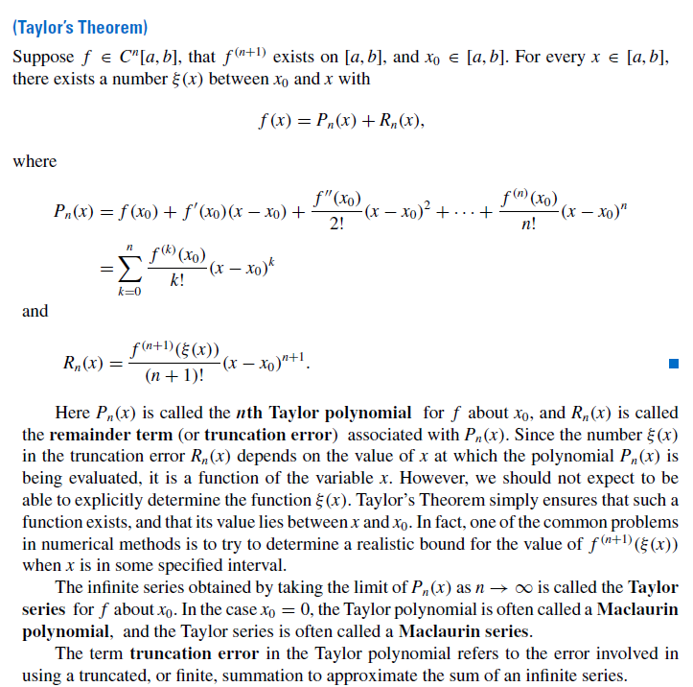
Back to review
of Calculus
9 August 2017

Slide 2






Slide 3
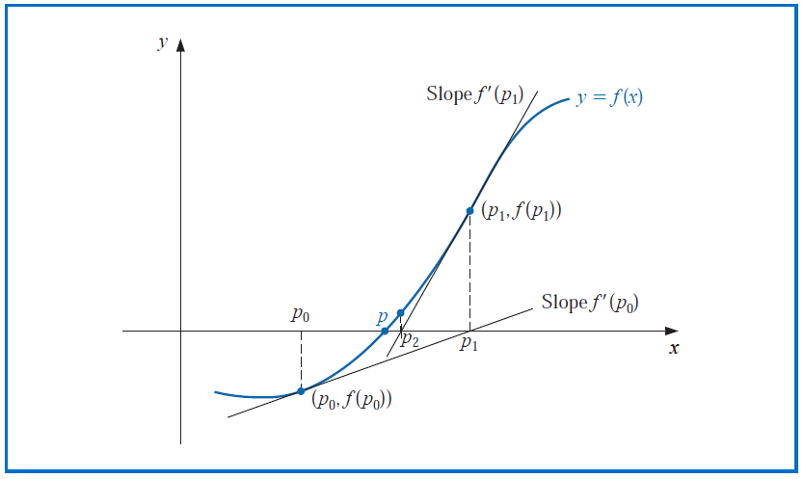
Graphical representation of Newton’s method

Slide 4


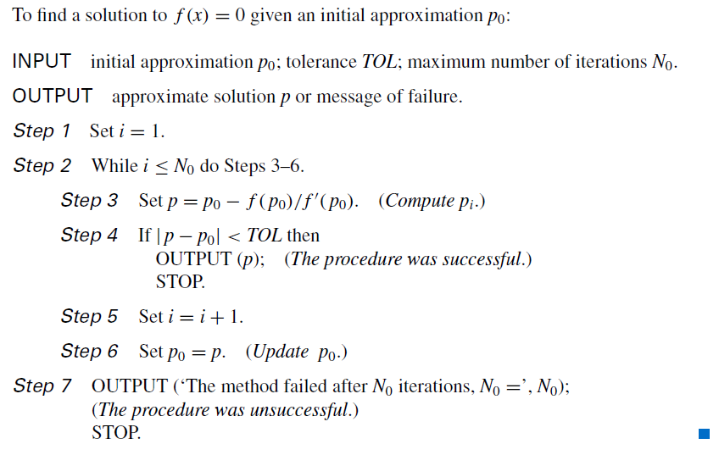

Slide 5

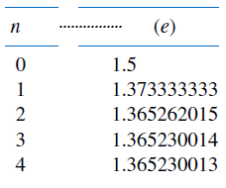

Recall the following problem?

Slide 6
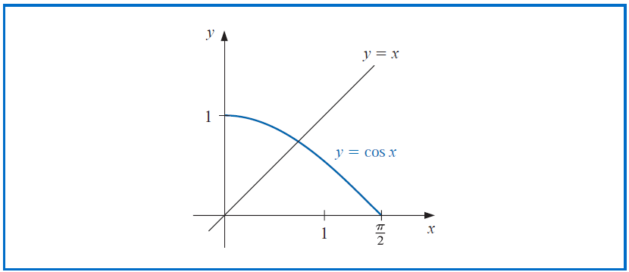

Slide 7
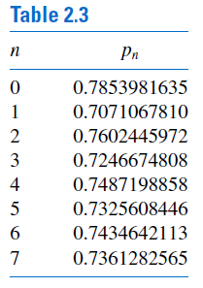

Slide 8

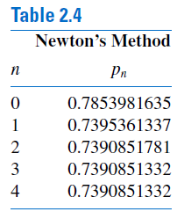

Slide 9

Back to graphical representation of Newton’s method

Slide 10

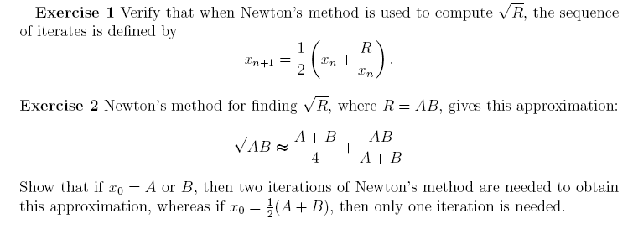

Slide 11




Slide 12
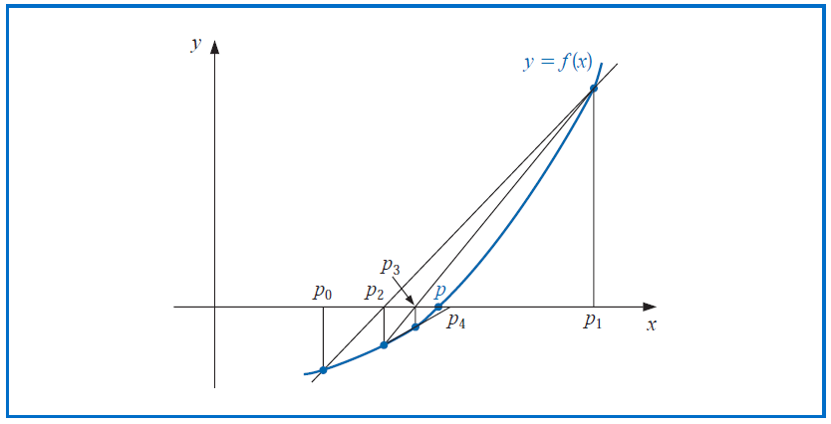
Graphical representation of Secant method

Slide 13

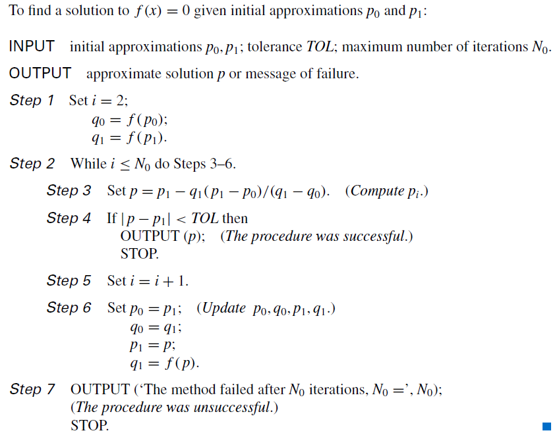

9 August 2017

Slide 14
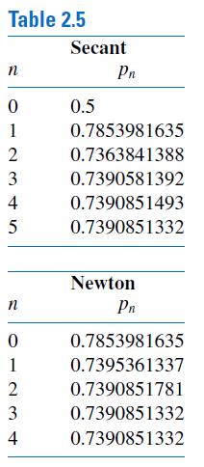

E
X
A
M
P
L
E
Correct up to ten decimal places

