Slide 1
SOFTWARE PROJECT MANAGEMENT
15XW83

Slide 2


Slide 3

Introduction To SPM
AAKASH HEMADRI (17PW01)

Slide 4
Contents
What is a “Project”?
Project life-cycle
The project as a System
What is “Management”?
Problems with Software Projects
Project Control life Cycle
Who are “Stakeholders”?
Information and Control in Organizations
Case-Study

Slide 5
What is a Project ?
A specific plan or design
A Planned undertaking
A large undertaking Eg. A Public works scheme

Slide 6
What is a “Project” ?
The following key characteristics that distinguish projects are:
Planning is required
Non-routine tasks are involved
Specific objectives have to be met
Project has a predetermined time span
Work is carried out for someone other than yourself
Work is carried out in several phases
The resources needs to be constrained
The work involves several specialisms

Slide 7
Prioritize the following projects
Producing an edition of newspaper
Putting a robot vehicle on Mars to search for signs of life
Getting Married
Amending a financial system to deal with a common European currency;
A research project into what makes a good HCI
An investigation into the reason why a user has a problem with a computer system
A second year programming lab assignment for a computer science student
Writing an operating system for a new computer
Installing MS-WORD in an organization
LOGIN 2019

Slide 8

ADITHYA SIVASANKAR (17PW02)

Slide 9
Project Life-Cycle
Requirements
Analysis
Finding out in detail what the users require of the system
Specification
Detailed Documentation of what the proposed system is to do
Design
A design that meets the specification has to be drawn up either external or user design
Coding
This refers to the language that is used
Verification &
Validation
Testing needs to be done to check the proposed system meets the requirements
Implementation
Installation of the system after the software has been developed
Maintenance &
Support

Slide 10
Software Projects VS Other Projects
Many of the techniques followed in general project management is also applicable to software projects management.
Invisibility:
Unlike projects related to roads and bridges software projects are not immediately visible.
Complexity:
Per dollar ,pound spent ,software products contains more complexity.
Flexibility:
The ease at which the software's can be changed is usually seen as one of its strength. The software will change based on the environment it is put into.
Conformity : Developers have to conform user requirements.
Physical materials like Iron, steel, cement, governed by physical laws

Slide 11
The Project as a System
A project is concerned with creating a new system and/or transforming an old one and is a system
System:
The simple definition of the term system is a ‘ set of interrelated parts’.
Subsystems:
The system will itself comprise of subsystems. The are smaller parts of the larger system.
Environment:
Outside the system there will the system’s environment
Open systems:
Open Systems are those that interact with the environment completely.

Slide 12

AISHWARYA A (17PW03)

Slide 13
What is “Management”?
The open University suggest that management involves the following activities:
Planning - Deciding what is to be done
Organizing - Making arrangements
Staffing - Selecting right people for the job
Directing - Giving instructions
Monitoring - Checking on progress
Controlling - Taking actions to remedy hold-ups
Innovating - Coming up with new solutions
Representing - Liaising with users.

Slide 14
Paul Duggan is the project manager of a software development company. On Tuesday at 10am he and his fellow section heads have a meeting with their senior manager about the staffing requirements for the coming year. This is based on the work planned for his project for the next year. At 2pm, Paul has a meeting with a senior staff about an important project his section is undertaking. One of the programming staff has just had a road accident and will be hospitalised for some time. It is decided that the project can be kept on schedule by transferring another team member to his project. But this temporary arrangement, may take a week for transferring the staff. Paul has to phone to the Personnel manager about getting a replacement and the user for whom the project work is being done. Identify which of the 8 management responsibilities, Paul was responding to at different points during his day.

Slide 15

AKHILESH R (17PW04)

Slide 16
Problems with Software Projects
Problems as per Project Managers
The most commonly experienced problems
Poor estimates and plans
Lack of quality standards and measures
Lack of guidance about making organizational decisions
Lack of techniques to make progress visible
Poor role definition - who does what?
Incorrect success criteria
Problems of a Team member
Inadequate specification of work
Management ignorance of IT
Lack of knowledge of application area
Lack of standards
Lack of up-to-date documentation

Slide 17
Problems with Software Projects
Lack of training
Deadline pressure
Lack of quality control
Narrow scope technical expertise
Lack communication leading to duplicate of work
Lack of communication between users and technicians
Changing software environments
Preceding activities not completed in time – including the late delivery of products

Slide 18
PROBLEMS FACED BY CUSTOMERS
SUPPLIER NOT DELIVERING PACKAGE IN TIME
OVER BUDGET
DELAYED BY A YEAR
LACK OF CONFIDENCE
POOR MANAGEMENT
FAILED PROJECT

Slide 19

APSARA G (17PW05)

Slide 20
Project Control life cycle
Real World
Actions
Data
Collection
Data
Define
Objectives
Data
Processing
Information
Making decisions/
plans
Modelling
Decisions
Implementation

Slide 21
STAKE HOLDERS
These are who have stake or interest in the project. They might be internal to the project team ,external but within the same organization ,or totally external to the organization
Internal to the project Team:
They will under the direct managerial control of the project leader.
External to the project but within the same organization:
The project leader might need assistance to carry out system testing etc.

Slide 22
STAKE HOLDER ...
External to both the project team and organization:
External stakeholders might be customers who will benefit from the system that the project implements or contractors who will carry out the work.
‘Theory W’:
Proposed by Boehm and Ross suggests that the manager needs to concentrate on creating situations where all parties involved in the project benefit from it and therefore have an interest in its success.

Slide 23
Information and Control in Organizations
Hierarchical information and control systems:
With small projects , the project leaders work very closely with the team members and might be carrying out non managerial activities.
Larger projects are likely to have hierarchical management as shown in the fig below
Control
Information

Slide 24
Levels of decision making and information
Decisions can be grouped into three levels
Strategic decision:
This is essential about deciding objectives. These decisions need to be taken whenever the objectives for the projects are been decided. (Top Management)
Eg. Here afterwards Testing group will be an independent and not a part of the project team
Tactical decision:
This is needed to ensure that the objectives will be fulfilled. The need to formulate a plan of action to meet those objectives. (PM or PL). Eg. Peer review will be done once in 2 days--→ Decided by a Project Manager

Slide 25
Levels of decision making and information…
Operational decision:
This relates to day-to-day work of implementing the project. For e.g. deciding the content of the acceptance tests might come under this. (Team Leader / Team Member)

Slide 26
Measurement
Software measurements can be divided as,
Performance measures:
These measures the characteristics of the system that been delivered. Eg. Reliability, Efficiency, Usability
Predictive measures:
Predictive measures are taken during development and indicate the performance of the final system likely to be.
Ex. 1. Errors found per KLOC may help to predict the reliability and correctness of a final system.
2. Keystrokes required to carry out a particular transaction may help to predict the time taken by an operator to complete a transaction

Slide 27

Overview of Project Management ARAVIND R M (17PW06)

Slide 28
Introduction
AIM – To provide a framework of basic steps in Project Planning and control.
Outline of various activities involved in each step of Project Planning.

Slide 29
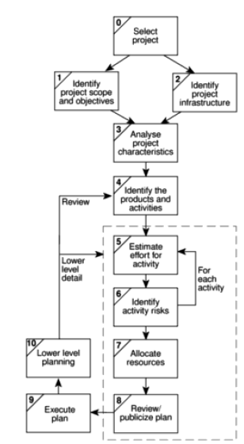
An overview of Step Wise

Slide 30
Steps in Project Planning
Step 0: Select project
Step 1: Identify project scope and objectives
Step 2: Identify project infrastructure
Step 3: Analyze project characteristics
Step 4: Identify project product and activities
Step 5: Estimate effort for each activity

Slide 31
Steps in Project Planning
Step 6: Identify activity risks
Step 7: Allocate resources
Step 8: Review/publicize plan
Step 9: Execute plan
Step 10: Lower levels of planning

Slide 32

ASHFAAQ IQBAL IRSHAD MOHAMMED (17PW07)

Slide 33
Step 0: Select project
Step outside the main project planning process
Projects are not initiated out of thin air!!
Some activity has to take place before deciding that the project is worth undertaking.

Slide 34
Step 1: Identify project scope and objectives
1.1 Identify objectives and measures of effectiveness in meeting them
Need for agreed objectives of a project
Success lies in achieving the objectives
1.2 Establish a project authority
Single overall project authority
Unity of purpose among those concerned

Slide 35
Cont..
1.3 Identify all stakeholders in the project and their interests
Who are the stakeholders?
All parties who have an interest in the project
1.4 Modify objectives in the light of stakeholder analysis
Aim is to gain full cooperation of stakeholders
Modify objectives to achieve cooperation
Danger of increase in system size..Original objectives may be obscured.
1.5 Establish methods of communications with all parties
Internal staff – straightforward
External parties – email etc. can be used

Slide 36
Step 2: Identify project infrastructure
2.1 Identify relationship between the project and strategic planning
Identify projects and order of carrying them out
Establish framework to fit the new system
Ex: Hardware and Software standards
Strategic decisions should be documented
2.2 Identify installation standards and procedures
Change control & configuration management standards
Quality standards & procedure manual
A measurement programme to find project status
P.M should control project activities
Eg. Time sheets for work done by team members

Slide 37
Cont..
2.3 Identify Project team organization
By the Project leader
High level managerial decisions are taken
Project Manager should have control over project team
Example of High level Managerial decision
Testing group should be independent
Programmers and system analysts will be in different
groups

Slide 38

DHARANEEDHARAN S (17PW08)

Slide 39
Step 3: Analyze project characteristics
3.1 Distinguish project as Objective or Product driven
3.2 Analyze other Project characteristics
Quality based ones
Ex: Safety critical systems are identified
Whether it is an IS or process control system ?
Is it a safety critical system ? Could human life be threatened by a malfunction ?
3.3 Identify high level project risks which will affect the successful outcome of the project

Slide 40
Cont..
3.4 Take into account User requirements concerning implementation
Clients will have procedural requirements
Ex: Govt. departments use SSADM
3.5 Select general lifecycle approach
3.6 Review overall resource estimates
Once the major risks are identified, we have to re-estimate the effort and other resources required to implement the project

Slide 41
Step 4: Identify project product and activities
More detailed planning of individual activities that will be needed currently is done at this stage
4.1 Identify or describe project products
(deliverables)
Technical, quality, management products
Training materials, operating instructions
Products form a hierarchy
Relationships should be documented – Product Breakdown Structure (PBS)
4.2 Document generic product flows
Some products will need some other product to exist first before they can be created. Eg. A program design must be created before the program can be written and program specification must exist before the design can be commences

Slide 42
PBS-Product Breakdown Structure
Selection Products
Volume Figures
Office Layouts
User Requirements
List of suppliers
Invitation to tenders
Existing system description
User’s modified requirements
Test examples

Slide 43
Cont..
4.3 Recognize product instances
Same generic PFD (Product Flow Diagram) relates to more than one instance of a particular type of product
Each instance to be identified
4.4 Produce ideal Activity network
Tasks to be carried out are shown
Order in which they are to be carried out

Slide 44
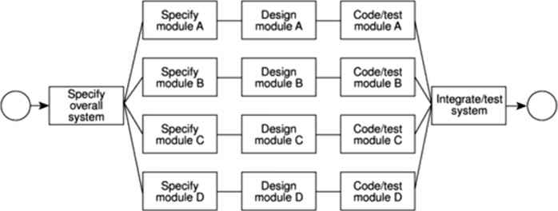
An activity network for Accounts-maintenance project

Slide 45
Cont..
4.5 Modify the ideal to take into account need for stages and checkpoints
Divide project into stages
Introduce checkpoint activities
Sequencing activities will minimize the elapsed time for the project (overall duration)
It assumes that activity will start soon as, preceding activity is completed

Slide 46

GANGA B (17PW10)

Slide 47
Step 5: Estimate effort for each activity
5.1 Carry bottom-up estimates
Staff effort and other resources required
Individual activity estimates are calculated
Summed up to get overall bottom-up estimate
5.2 Revise plan to create controllable activities
Long activities make a project difficult to control
Break down into a series of smaller sub-tasks

Slide 48
Step 6: Identify activity risks
6.1 Identify & quantify activity-based risks
Seriousness of a risk and likelihood of it occurring
6.2 Plan risk reduction & contingency measures where appropriate
Avoid or at least reduce some of the identified risks
Contingency plans – action to be taken if risk materializes
6.3 Adjust overall plans & estimates to take account of risks
By adding new activities, we may reduce risks
For example, training should be given in case of a new technology or language is to be incorporated in the project

Slide 49
Step 7: Allocate resources
7.1 Identify & allocate resources
Type of staff needed for each activity
7.2 Revise plans & estimates to take into account resource constraints
Priority of tasks is established
Resources are allocated to the tasks based on availability & task priority
Some team members may be needed for more than one task at a time and in this case an order of priority is established.
Some tasks may be delayed, while waiting for a team member to become free, which will affect overall project duration

Slide 50
Step 8: Review/Publicize Plan
8.1 Review quality aspects of the project plan
Before every activity is completed, quality checks have to be passed, so that next activity will be successful if they are dependant on each other.
8.2 Document plans and obtain agreement
Plans should be carefully documented
All parties should agree to commitments required of them in the plan

Slide 51
Step 9 & 10: Execute Plan & Lower levels of planning
Plans will be drawn up in greater detail for each activity
More information will be available near the start of a stage – delaying the detailed planning of later stages

Slide 52

Software Project Management Chapter 3 : Project Evaluation
GRANDHI VENKATANITEESH (17PW11)

Slide 53
3.1 Introduction
Project evaluation is normally carried out in step 0 of step wise planning of the project.
A Project evaluation will be normally undertaken as part of the feasibility study for any software development.
It will be based on strategic, technical and economic criteria.
3.2 Strategic assessment
Consists of Programme management and Portfolio management.

Slide 54
3.2.1 Programme management
Individual projects are seen as a component of programme and should be evaluated and managed as such.
A programme, here, is a collection of projects that all contribute to the same overall organizational goals.
Effective programme management requires that there is a well defined programme goal.
An organization’s projects are selected and tuned to contribute to this goal.
A project must be evaluated according to how it contributes to this programme goal and its viability timing, resourcing and final worth can be affected by the programme as a whole.

Slide 55
3.2.2 Portfolio management
An organization needs a strategic and operational assessment of a project before taking up it.
These assessment are done by the customer or by the software organization on behalf of the customer.
The project will form part of a portfolio of ongoing and planned projects
The selection of projects must take account of the possible effects on other projects in the portfolio (eg, competition for resources) and the overall portfolio profile (eg, specialization vs diversification).

Slide 56
3.3 Technical assessment
Consists of evaluating the required functionality of a project against the hardware and software available.
All the technical parameters of a project are assessed before taking up it.

Slide 57

HARI RAHUL R (17PW12)

Slide 58
3.4 Cost-benefit analysis
Done by comparing the expected costs of development and operation
of the system with the benefits of having it in place.
The main condition is that the estimated income and benefits should exceed the estimated costs.
A best suitable project has to be chosen from available options.
Consists of two steps :
Identifying and estimating all the costs and the benefits of a project –includes estimated development, operational costs and expected benefits.
Expressing the costs and benefits in common units – net profit has to be calculated by deducting the costs from the total benefit. For this the costs and the benefits have to be expressed in some common monetary units.

Slide 59
3.4 Cost
Costs are easy to identify and quantify in terms of monetary units.
Development costs – costs involved in the development phase of a project (eg, salaries to the employees
purchase of s/w & h/w)
Setup costs – costs of putting the system into place (eg, costs of any new hardware needed to setup the software
It will also include costs of file conversion, recruitment &
staff training, purchase of stationery, disks, furniture for
computers).
Operational costs – costs of operating the system once it has been installed. (power consumption, etc)

Slide 60
Benefits
Benefits are difficult to quantify in monetary terms.
Direct benefits – these accrue directly from the operation of the proposed system.
(eg. Salary to clerical staff is reduced due to reduction
of man power bcos of computerisation)
Assessable indirect benefits – secondary, indirect benefits.(eg. decrease in number of customer complaints)
Intangible benefits – long term benefits. Difficult to quantify these. (eg. public approval of the organization in the location where it is based)

Slide 61
3.5 Cash flow forecasting
Expenditures like staff wages occur during the development stages of a project.
Such expenditures cannot be deferred until income is received.
Generally in a project expenditures come first, and then the income comes at a later stage.
So we can make a cash flow forecasts.
Its impossible to make cash flow forecasts accurate as it is done at the very initial stage.
Generally in cash flow forecasts inflation are ignored as it increases the uncertainty of the forecasts.
A graph is drawn for the cash flow forecasts which depicts the duration for which the income and expenditure are occuring.

Slide 62

HARISAIPRAVIN S V (17PW13)

Slide 63
3.6 Cost-benefit evaluation techniques
A Project is considered only if its benefits outweigh the costs.
The timing of the costs and benefits, benefits relative to the size of the investment are main factors in choosing a project.
Common cost based project evaluation methods:
Net profit
Payback period
Return on investment
Net present value
Internal rate of return
they are explained with the help of a table.

Slide 64
Cash Flow Projections
Year | Project1 | Project2 | Project3 | Project4
0 | -100,000 | -1,000,000 | -100,000 | -120,000
1 | 10,000 | 200,000 | 30,000 | 30,000
2 | 10,000 | 200,000 | 30,000 | 30,000
3 | 10,000 | 200,000 | 30,000 | 30,000
4 | 20,000 | 200,000 | 30,000 | 30,000
5 | 100,000 | 300,000 | 30,000 | 75,000
Net profit | 50,000 | 100,000 | 50,000 | 75,000
Table 3.1 Four Cash Flow Projections – figures are end of year totals

Slide 65
3.6.1 Net profit
Formula : Net Profit = total costs – total income over the life of the project
Advantage : Simple method
Disadvantage : Takes no account of timing of the cash flows
Evaluation (with respect to the Table 3.1): Going by this method, “Project 2“ is chosen. (Highest Net profit ) BUT,
(i) return is relatively low but huge investment (Rs.10Lakhs)
(ii) Project 1 and 3 yield same net profit, but 3 is preferable, as it yields a steady cash inflow, where in 1 much of the income comes at a later stage. In
(iii) If we invest 3,20,000 (for other 3 projects) we get a profit
of Rs.1,75,000.

Slide 66
3.6.1 Payback period
Definition : The Payback period is the time taken to break even or pay back the initial investment. Normally, the project with shortest payback period will be chosen as the organization will wish to avoid loan repayments, etc.
Payback periods for each project will occur during the year indicated.
Project 1 - Year 5
Project 2 - Year 5
Project 3 - Year 4
Project 4 = Year 4 (end)
So, we prefer project 3 or 4 than other two projects. But project 3 has shorter payback period than project 4.

Slide 67
3.6.1 Payback period
Advantage : Simple, insensitive to small forecasting errors.
Disadvantage : Ignores the overall profitability of the project – doesn’t take into consideration any income/expenditure once the project has broken even.
Evaluation: Project 3 is chosen as it has got the least payback period. BUT, Project 4 has a greater overall profitability and its return is relatively higher than project 3.

Slide 68
3.6.3 Return On Investment (ROI)
Also known as the accounting rate of return (ARR).
Formula: ROI = (Average annual profit / Total investment) * 100
where Average annual profit = Total profit / no. of years
Advantage: simple, helps to compare the net profitability to the investment required.
Disadvantage:
Takes no account of the timing of the cash flows.
It tempts to compare the ROI with the current interest rates offered by the bank, but there’s no relation between them (hence misleading).
Evaluation: By this method project 4 (ROI = 12.5%) is chosen. Project 1 and 3 have the same ROIs (10.%), but in project 3, there’s a regular cash inflow, hence it scores over the other.

Slide 69
3.6.4 Net Present Value (NPV)
It gives an idea of the estimated worth of a project in terms of current monetary value.
This is done so by discounting future cash flows by a percentage known as the “discount rate”.
Discount Rate - The annual rate by which we discount future earnings.

Slide 70
NPV PROBLEM
Eg: $100 today is worth more than $100 after a year. $100 today may be worth $91 only after a year, or $91 today is worth $100 after a year. There’s an approx discount of 10% in the value of $100 after a year. This percentage is known as the discount rate.
Formula : Present Value (PV)= value in year t / (1 + r)^t, where ‘r’ is the discount rate, or,
PV = Cash flow of a year * chosen discount factor.
NPV = Sum of all PVs.
Advantage : Takes into account the profitability of a project and the timing of the cash flows.
Disadvantage : Difficulty in deciding the appropriate discount rate.

Slide 71
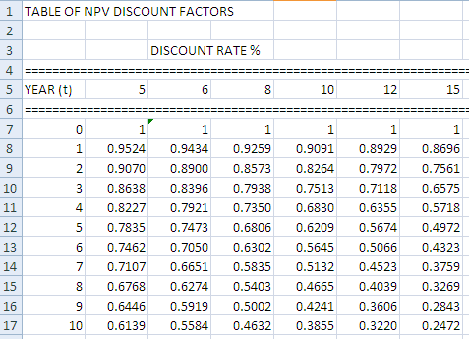

Slide 72
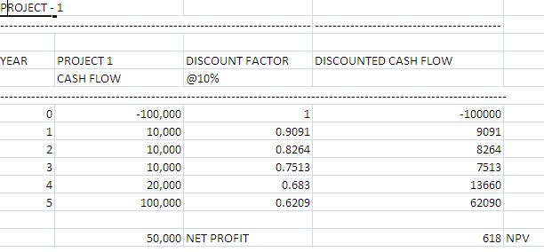

Slide 73
NPV contd…
Evaluation 1:
NPV for project 2 is -179,770 (Not worth)
NPV for project 3 is 13,721
NPV for project 4 is 21,662 (Worth)
Project 4 provides greatest NPV and Project 2 is not worth
Evaluation 2: (comparing project 1 and 3) project 3 is chosen, even though both 1 and 3 have the same net profit ($50000), in 1 much of the income comes only at the later stage and its NPV is just $618 as opposed to $13721 of project 3, which is attributed to regular cash inflow and comparatively more income at the initial years itself. Income at the later years gives a little NPV (worth less) than income at the initial years as the value of money tends to decrease with time.

Slide 74
3.6.5 Internal Rate of Return (IRR)
The IRR attempts to provide a profitability measure as a percentage return that is directly comparable with interest rates.
Calculated as a “discount rate” that gives “zero NPV”
Project with a greater IRR is chosen.
Advantage: One single method that gives an IRR value which can be directly compared to bank interest rates.
Disadvantage: Does not indicate the absolute size of the return of the project.

Slide 75
IRR Contd..
Evaluation: (comparing project 1 and 3) project 1 has 10.17% (10% approx) as IRR, and 3 has a little above 15%. Thus investing $100,000 in project 1 having 10% IRR is like earning an interest every year for 10% rate when the amount is invested in bank. For project 3 the interest rate is 3%. Obviously project 3 is chosen because it has got a greater IRR over 1.
(NOTE: IRR can be compared with bank interest rates).

Slide 76
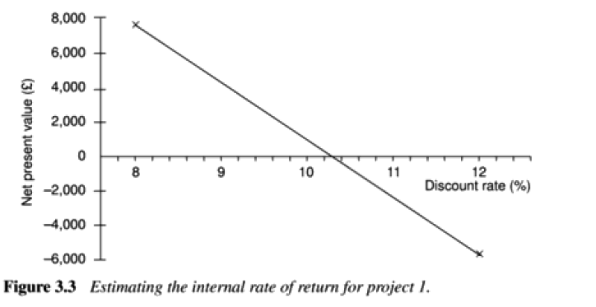

Slide 77
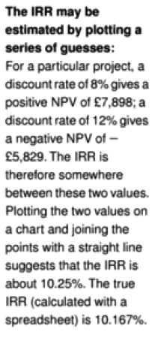

Slide 78
TUTORIAL
Year | Project A | Project B | Project C
0 | -8,000 | -8,000 | -10,000
1 | 4,000 | 1,000 | 2,000
2 | 4,000 | 2,000 | 2,000
3 | 2,000 | 4,000 | 6,000
4 | 1,000 | 3,000 | 2,000
5 | 500 | 9,000 | 2,000
6 | 500 | -6,000 | 2,000
Net profit | 4,000 | 5,000 | 6,000

Slide 79

HARISH KUMAR V (17PW14)

Slide 80
3.7 Risk evaluation
Every project has got an element of risk of some form.
When assessing about a project, the risk involved in it has to be importantly analyzed.
The various risk evaluation techniques are :
Risk identification and ranking
Risk and net present value
Cost-benefit analysis
Risk profile analysis
Using decision trees

Slide 81
3.7.1 Risk identification and ranking
Identifies risks involved and quantifies it.
Done by constructing a “project risk matrix” using all the possible risks involved in the projects, their importance and their likelihood.
Risks are classified and their importance and likelihood need to be assessed separately.
The list of risks in the project risk matrix should be the same for each project.
Risk | Importance | Likelihood
Software never completed or delivered | High | Unlikely
Response time targets not met | Low | High
Table 3.2 Project Risk Matrix

Slide 82
Risk | Importance | Likelihood
Software never completed or delivered
Response time targets not met
Project cancelled after design stage
Software Delivered late
Development budget exceeded <= 20%
Development budget exceeded > 20%
Maintenance cost higher than estimated

Slide 83
Risk Matrix for a typical software project
Risk | Importance | Likelihood
Software never completed or delivered | High | Unlikely to happen
Response time targets not met | Low | High
Project cancelled after design stage | High | Unlikely to happen
Software Delivered late | Low | Medium
Development budget exceeded <= 20% | Low | Medium
Development budget exceeded > 20% | Medium | Low
Maintenance cost higher than estimated | Low | Low

Slide 84
3.7.2 Risk and NPV
When a project is relatively more risky, use a high discount rate to calculate NPV, (even then the NPV is still higher, the project can be considered).
The high discount rate accounts for the “Risk Premium” also.
By a scoring method, we assess a project to be risky of different grade.
For a relatively low risk the risk premium is a less value, and for a high risk one, the risk premium may be more (say 2% for low risk, and 5% for high risk).

Slide 85
3.7.3 Cost-benefit analysis
An approach, in which each possible outcome of the risk, its probability, and the corresponding value of the outcome are calculated.
Rather than a single cash flow forecast for a project, a set of cash flow forecasts and their probability of occurrence is considered.
Advantage: helps to evaluate the large projects, where every parameters are uncertain.
Disadvantage: Probability of each outcome has to be correctly decided.

Slide 86
ABC Corp., a software house is considering developing a payroll application for use in academic institutions and is currently engaged in a cost-benefit analysis. Study of the market has shown that, if they can target it efficiently and no competing products become available, they obtain a high level of sales generating an annual income of $8,00,000. They estimate that there is a 1 in 10 chance of this happening. However, a competitor might launch a competing application before their own launch date and then sales might generate only $1,00,000 per year. They estimate that there is a 30% chance of this happening. The most likely outcome, they believe, is somewhere in between these two extremes – they will gain a market lead by launching before any competing product becomes available and achieve an annual income of $6,50,000. Calculate their expected sales income .

Slide 87
Cost-benefit analysis contd…
Example:
ABC Corp’s income forecasts
Sales | Annual Sales Income ($) i | Probability p | Expected Value ($) (i x p)
High | 800, 000 | 0.1 | 80,000
Medium | 650,000 | 0.6 | 390,000
Low | 100,000 | 0.3 | 30,000
Expected Income |  |  | 500,000
The above table shows the ABC Corp’s various income forecasts and the expected net income. Decision can be made whether to take upon the project depending upon the expected net income.

Slide 88
3.7.4 Risk Profile Analysis
This methods involves varying each of the parameters that affect the project’s cost or benefits to ascertain how sensitive the project’s profitability is to each factor.
A “Risk analysis profile (standard deviation curve)” is constructed using the sensitiveness of the project to a factor.
The original estimates of a project can be varied + or – 5% or so and the benefits can be recalculated to know how critical is that parameter’s estimate that by varying it, to what extent the project’s prospects are affected.
Advantage : Helps to identify the critical parameters for a project.
Disadvantage : More than one parameter cannot be assessed simultaneously.

Slide 89

HARSHA K (17PW15)

Slide 90
3.7.5 Using decision trees
Used to evaluate whether a risk is important, and if it is, to indicate a suitable course of action.
Used to analyze how a risk will affect future profitability of the project.
This method accounts for the “lost revenue”.
Lost revenue – revenue that was lost because of not releasing a product meeting the consumer requirements.
This method involves constructing a decision tree, which shows the organization to take the correct path of action.

Slide 91
Eg (Scenario):
ABC Corp wants to extend their software for invoice system.
The consumer for such a software tool is the equipment maintenance business.
They can either extend (CASE 1) the functionalities (features) of the tool or replace (CASE 2) the entire tool.
CASE 1: By this, the tool will generate an NPV of $75000, BUT, if the market expands (many such kind of business comes up), there would be a lost revenue of $100,000 (because the extended tool may not be suitable to latest market scenario, which the replaced system could have met).
CASE 2: By this, the tool generates an NPV of $250000 if the market expands, BUT, if the market doesn’t expand there will be a loss of NPV $50000.

Slide 92
Using decision trees contd…
The company estimate the likelihood of the market increasing significantly at 20%. Therefore the probability that it will not increase as 80%.
The expected value of extending the system is therefore $40,000 (75,000 * 0.8 – 100,000 * 0.2) and that of
replacing the system is $10,000 (2,50,000 * 0.2 – 50,000 * 0.8).
Hence the ABC Corp decides to go with the option of extending the existing system.
This can be illustrated using a decision tree given below.

Slide 93
DECISION TREES
Expansion 0.2
-100,000
Extend
D – Decision point (root of the decision tree)
No Expansion 0.8
75,000
D
Expansion 0.2
250,000
Replace
-ve value for loss
No Expansion 0.8
-50,000

Slide 94
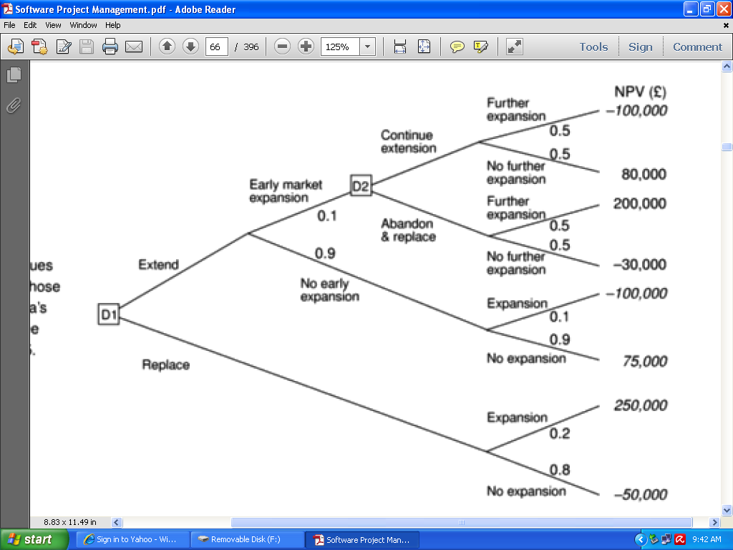

Slide 95
3.8 Summary
Projects must be evaluated on the strategic, technical and economic grounds.
Economic assessment involves the identification of all costs and income over the lifetime of the system, including its development and operation and checking that the total value of benefits exceeds total expenditure.
Money received in the future is worth less than the same amount of money in hand now, which may be invested to earn interest.

Slide 96
Summary Contd..
The uncertainty surrounding estimates of future returns lowers their real value measured now.
Discounted cash flow techniques may be used to evaluate the present value of future cash flows taking account of interest rates and uncertainty.
Cost-benefit analysis techniques and decision trees provide tools for evaluating expected outcomes and choosing between alternative strategies.

Slide 97

[Chapter 4] Selection of an appropriate project approach IHJASS THASBEKHA I (17PW16)

Slide 98
Objectives
Take account of the characteristics of the system
to be developed when planning a project
Select an appropriate process model
Make best use of the “waterfall” process model
Reduce risks by the creation of appropriate prototypes
Reduce other risks by implementing the project in increments

Slide 99
Agenda
Project Characteristics
Choosing Technologies
Technical Plan Contents List
Choice of Process Model
Software Prototyping
Categorizing Prototypes
Incremental delivery
Selecting the Most Appropriate Process Model
Conclusion

Slide 100
Project Characteristics
Technical planning or Project analysis
All project have certain characteristics
Methodologies and technologies to be used will be decided for each individual project
Characteristics for an in-house project
Project team and users belong to the same organization
The projects being considered slot into a portfolio of existing computer based systems
The methodologies and technologies to be used are dictated by local standards

Slide 101
Project Characteristics …
Reference to step wise approach
Project characteristics are analyzed at step 3 of stepwise project
The output of this activity is used by step 4 : Identify the products and activities of the project

Slide 102
Choosing Technologies
An outcome of project analysis will be the selection of the most appropriate methodologies and technologies
Some of the methodologies
Object Oriented (OO) development
SSADM
JSP (Jackson Structured Programming)

Slide 103
Choosing Technologies …
The chosen technology will influence the following aspects of the system
The training requirements for the development staff
The types of staff to be recruited
The development environment – both hardware and software
System maintenance arrangements

Slide 104
Choosing Technologies …
Analyse other project characteristics
Is a data oriented or a control oriented system to be implemented?
‘Data oriented’ system – will have a considerable database
‘Control oriented’ system – embedded control systems
Uncommon to have systems with components of both types
Will the software be a general or application specific?
General package – spreadsheet package
Application specific – airline seat reservation system

Slide 105
Choosing Technologies …
Is the system to be implemented of a particular type for which specific tools have been developed?
Does it involve concurrent processing?
Will the system to be created be knowledge –based?
Will the system to be produced make heavy use of computer graphics?
Is the system to be created safety – critical?
what is the nature of the hardware/software environment in which the system will operate?
The environment in which the final software will operate is different from which it is being developed

Slide 106
Choosing Technologies …
Identify high level project risks
Uncertainty can be associated with the products, processes or resources
Product uncertainty
Users are uncertain about what the system is to do
We ask how well the requirements are understood
Process uncertainty
Project uses a method (SSAD or OMT) for the first time
Any change in the way systems are being developed bring uncertainty
Resource uncertainty
Uncertainty over the availability of staff
Depends on the sheer size of the project

Slide 107
Choosing Technologies …
Select general life cycle approach
Control systems
A real-time system will have to be implemented using an appropriate methodology
Mascot can be used
Information systems
SSADM or Information Engineering, that matches the environment
General applications
Methodology should be thought of very carefully
SSADM can be used

Slide 108
Choosing Technologies …
Specialized techniques
Invented to expedite the development of specialized systems
number of specialized tools and logic based programming languages can be used
knowledge based system & graphics based system
Hardware environment
The environment in which the system is to operate can put constraints on the way it is to be implemented
Low programming languages can be used

Slide 109
Choosing Technologies …
Safety – critical systems
Safety and reliability are of the essence
Formal specification using a notation such as Z or VDM
Calls for expensive measures
Imprecise requirements
Uncertainties or a novel hardware/software platform
Prototyping approach should be considered

Slide 110

JEIVARDAN V (17PW17)

Slide 111
Technical Plan Contents List
The technical plan is likely to have the following contents
Introduction and summary of constraints:
Character of the system to be developed
Risks and uncertainties of the project
User requirements concerning implementation
Recommended approach
Selected methodology or process model
Development methods
Required software tools
Target hardware/software environment

Slide 112
Technical Plan Contents List …
Implementation
Required development environment
Required maintenance environment
Required training
Implications
Project products and activities – these will have effect on the schedule duration and overall project effort
Financial – this report will be used to produce costings

Slide 113

KARANRAJ M (17PW18)

Slide 114
Choice of Process Models
“Process” – used to emphasize the idea of a system in action
Executing one or more activities – Process
Activities can be organized in different ways
Can be categorized into different process models
Major part of the planning will be the choosing of the development methods to be used and slotting of these into an overall process model

Slide 115
Choice of Process Models …
Structured methods
They are made up of sets of steps and rules
When rules are applied, they produce system products such as data flow diagrams
Each of these products is carefully documented
Usually time consuming compared to others
Pay-off – less error prone and more maintainable system
Mostly used in large projects

Slide 116
Choice of Process Models …
Rapid application development
Gets working business applications delivered quickly and at less cost
Adopts tactics such as joint application development (JAD)
Workshops are conducted where developers and users work together
Workshops are conducted at clean rooms – free from interruption
Speeds up communication between users and developers
Time-boxing – scope of the project is set to meet the deadline

Slide 117
Choice of Process Models …
The Waterfall Model
Feasibility study
User requirements
Analysis
System design
Program design
Coding
Testing
Operation

Slide 118
Choice of Process Models …
The Waterfall Model (continued…)
“Classical” model of system development
It is an one-shot approach
There is a sequence of activities working top to down
The project is expected to progress down the path through each of the phases of development
Each stage has a deliverable

Slide 119
Choice of Process Models …
The Waterfall Model (continued…)
Advantages
The use of reviews at end of each phase permits acquirer and user involvement
The model permits early imposition of baselines and configuration control
Each preceding step serves an approved, documented baseline for the succeeding step

Slide 120
Choice of Process Models …
The Waterfall Model (continued…)
Disadvantages
Customers must be able to express their requirements completely, correctly and with clarity
Delays can occur in design, coding and testing
Difficult to access the true stage of progress during the first two to three stages
No demonstration of system capabilities can occur until the end of the project

Slide 121
Choice of Process Models …
The V – process model
Feasibility study
Corrections
Review
Corrections
User requirements
User acceptance
System design
Corrections
System testing
Program design
Corrections
Program testing
code

Slide 122
Choice of Process Models …
The V – process model (continued…)
Elaboration of the waterfall model
Stresses the necessity for validation activities
Each step has matching validation process
Defects cause a loop back to the corresponding development stage and a reworking of the succeeding steps
May slip into an ‘evolutionary prototype’

Slide 123
SPIRAL MODEL
Another way of looking at waterfall model.
Greater level of detail are considered at each stage of the project
Hence greater degree of confidence about the success of the project
More details are analyzed in each sweep and an evolution process is undertaken for next iteration.

Slide 124
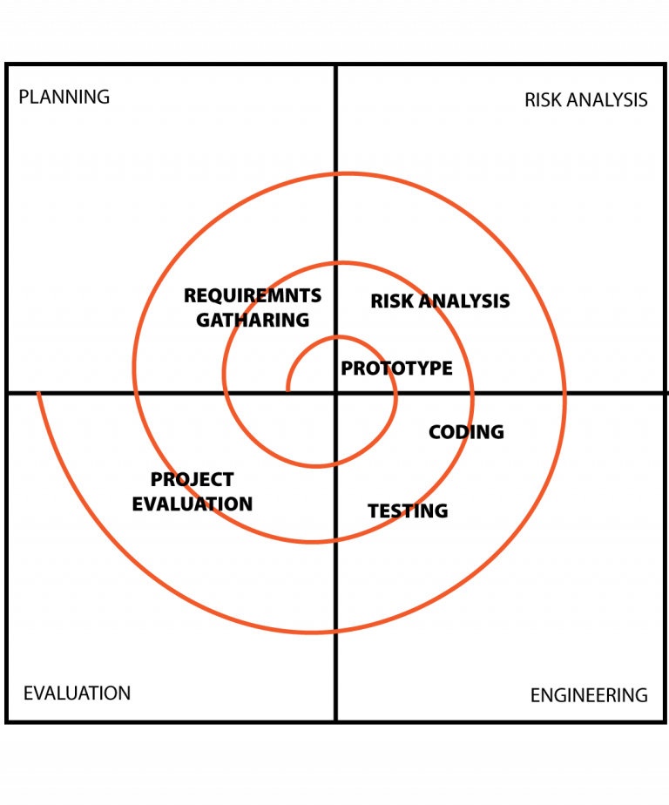
SPIRAL MODEL

Slide 125

KAVITHA J (17PW19)

Slide 126
Software Prototyping
A prototype is a working model of one or more aspects of the projected system.
In order to test assumptions it is constructed and tested quickly and inexpensively.
Classification
Throw-away prototypes
Used only to test out ideas and is then discarded.
Evolutionary prototypes
It is developed and modified until it is in a state where it can
become the operational system.
Incremental prototypes
The operational system is developed and implemented in small stages so that the feedback from earlier stages can influence later stages of project

Slide 127
Software Prototyping
Advantages
Learning by doing.
Improved communication and user involvement.
Reduced need for documentation.
Reduced maintenance costs.
Production of expected Results.
Disadvantages
Lack of control and projects standards.
Additional expense.
Close proximity of developers.

Slide 128
Software Prototyping
Other ways of categorizing prototypes
What is being learnt?
To what extent is the prototyping to be done?
What is being prototyped?

Slide 129
Software Prototyping
What is being learnt?
Helps to learn about an area of uncertainty in the project.
Specify what they hope to learn from the prototype
Plan how the prototype is to be evaluated.
Report on what has actually been learnt.
To what extent is the prototyping to be done?
Mock-ups.
Simulated interaction.
Partial working model.
Vertical: some features are prototyped fully.
Horizontal: All features are prototyped but not fully.
What is being prototyped?
Human - Computer Interface.
The Functionality of the system.

Slide 130
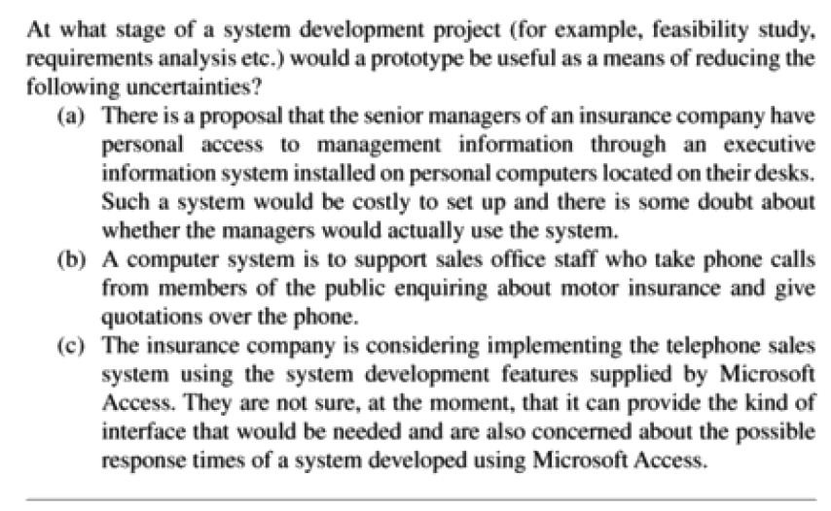

Slide 131
Software Prototyping
Incremental approach
Incremental Delivery Plan
Identify system objectives
Plan increments
Create open technology
plan
Design Increment
Build the increment
Feedback
Repeat for each increment
Implement the increment
Evaluate the results

Slide 132
Software Prototyping
Incremental approach
Advantages
Feedback from early stages can influence later stages.
Earlier delivery improves cash flow, because you get some return on investment early on.
Smaller sub-projects are easier to control and manage.
‘Gold Plating’, the requesting of features that are unnecessary should be less as users will know that they get more than one opportunity to make their requirements known.
Disadvantages
Software Breakage.
Developers might be more productive working on one large system than on a series of smaller one.

Slide 133

Exercise – Incremental Delivery

Slide 134

Software Effort Estimation
KOWSHIKA RANI A (17PW20)

Slide 135
CONTENTS
Introduction
When estimates are done?
Problem with over and under estimates
The basis for software estimating
Software effort estimation techniques
Estimating by analogy
Function points
Object points
COCOMO

Slide 136
Introduction
Definition of the successful project : The system is delivered ‘on time within budget and with the required quality’.
Realistic estimates are crucial to the project leader.
Difficulties in Effort estimation
Novel Application of software
Changing Technology
Lack of homogeneity of Project Experience
Subjective nature of Estimating
Political Implications

Slide 137
Where are Estimates Done?
Strategic Planning:
Cost of computerizing potential applications and to decide what priority to give to each project.
These estimates influence the number of development staff to be recruited by the organization.
Feasibility Study:
This ascertains the benefits of potential system will justify the costs.
System Specification:
The effort needed to implement different design proposals will need to be estimated.

Slide 138
Where are Estimates Done? (...)
System Specification
Evaluation of Supplier’s Proposals:
Staff in software houses would need to scrutinize the system specification and produce estimates on which to base proposals.
Project Planning
More detailed estimates of smaller work components will be made as the knowledge about the nature of the project increases.
Estimator will have to speculate about the physical implementation.

Slide 139
Problems with Under and Over Estimates?
Over estimate will cause the project to take longer time than it would otherwise.
Parkinson’s Law:
‘Work expands to fill the time available’ .which implies that given an easy target staff will work less hard.
Brook’s Law:
The effort required to implement a project will go up disproportionately with the number of staff assigned to the project.
Under Estimate will affect the quality of the Project.
Weinberg’s zeroth law of reliability:
If a system does not have to be reliable , it can meet any other objective.

Slide 140
Basis for software Estimating
Need For Historical Data:
All estimating methods needs information about how projects have been implemented in the past.
Measure of Work:
To express the work content of the system is to be implemented independently of the effort, using a measure such as source lines of code(SLOC).
Complexity:
Two programs with the same kloc will not necessarily take same time to write, even if it is done by the same developer in the same environment. SLOC estimates have to be modified to take complexity into account.

Slide 141
Software Effort Estimation Techniques
Algorithmic models
Which uses ‘effort driver’ representing characteristics of the target system and the implementation environment to predict effort
Expert judgment
Where the advice of the knowledgeable staff is solicited.
Analogy
where a similar, completed project is identified and its actual effort is used as a basis for the new project.
Parkinson
Identifies the staff effort available to do a project and uses that as an ‘estimate’

Slide 142
Software Effort Estimation Techniques (…)
Price to Win
Where the ‘estimate’ is a figure that appears to be sufficiently low to win a contract.
Top-Down
The effort needed to implement a project will be related to variables associated with the characteristics of the final system
effort=(system size)*(productivity rate)
Bottom-Up
Estimator breaks the project into its component tasks and then estimates how much effort will be required to carry out each task. This is done at the later stage of the project.

Slide 143
Expert Management
Asking someone who is knowledgeable about either the application area or the development environment to give an estimate of the effort required to carry out a task.
Estimator would have to carry out some kind of impact analysis in order to judge the proportion of code that would be affected and from that derive an estimate.

Slide 144
Analogy
Also called “case based reasoning”
Identify source cases [project that have been completed
Identify target cases [project that has similar characteristics
ANGEL package calculates effort using “Euclidean distance”
Distance=square-root of((target_parameter1-source_parameter1)2+…..+(target_parameter n –source_parameter n)2)

Slide 145

MADHUPPRASAD S (17PW21)

Slide 146
Albrecht Function Point Analysis
Top Down Design Method Devised by Allan Albrecht
Albrecht Functional Points – way to Quantify the functional size of programs independent of the programming languages used.
Basis of Function Points – External User Types
External Input Types
External Output Types
Logical Internal File Types
External Interface File Types
External Inquiry Types

Slide 147
Albrecht ..
Each Component is classified as having either high, average or low complexity.
The count of each external user type in each complexity are multiplied by specified weights given in the table to get FP scores.
Identify each instance of each external user type .

Slide 148
Albrecht Complexity Multipliers
External User Type | Multipliers
 | Low | Average | High
External Input Type | 3 | 4 | 6
External Output Type | 4 | 5 | 7
Logical Internal File Type | 7 | 10 | 15
External Interface File Type | 5 | 7 | 10
External Inquiry Type | 3 | 4 | 6

Slide 149
Function points Mark II
The ‘Mark II’ label implies an improvement and replacement of the Albrecht method.
The information processing size is initially measured in unadjusted function points (UFP) to which a technical complexity adjustment can then be applied.
Data Store
input
Process
output
Return to user
From user
Model of a Transaction

Slide 150
Function points Mark II …
For each transaction the UFP’s are calculated :
Wi * (number of input data element types) +
We* (number of entity types referenced) +
Wo* (number of output data element types) +
Wi , We and Wo are the weightings derived using effort values of previous projects.
From this the average hours of work generated by instances of each type of element is calculated.
The averages are then normalized into weightings which add up to 2.5.
This way of calculating the weightings is time consuming and hence industry averages are available:
Wi=0.58 ; We=1.66 ; Wo=0.26

Slide 151
Example 1
A cash receipt transaction in the IOE maintenance accounts system accesses two entity types – INVOICE and CASH RECEIPT.
The data elements that are input are
Date Received
Invoice Number
Cash Received
If an Invoice record is not found for the invoice number, then an error message is issued.If the invoice number is found, then a CASH RECEIPT record is created.
The error message constitutes the only output data element that the transaction has to cater for.
The unadjusted function points, using the industry average weightings, for this transaction would therefore be
0.58*3 + 1.66*2 +0.26*1=5.32

Slide 152
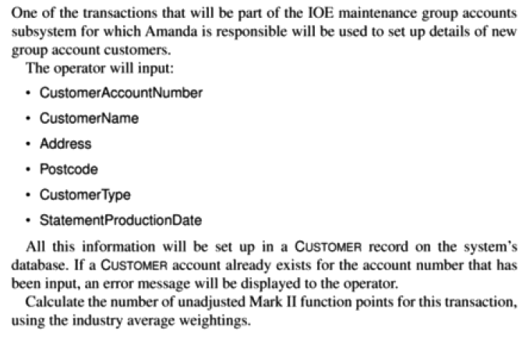

Slide 153
Object Points
Devised at Leonard N.Stern School of Business, New York University.
Similar to FP approach but takes account of readily identifiable features.
This approach uses the counts of screens, reports and 3GL components
that an application might posses. These components are referred to as objects.
Each object has to be classified as one of the following:
Simple
Medium
Difficult
Based on the classification, complexity weightings are allotted to various object types. [Object Points Complexity Weightings]
The number of objects at each level are multiplied by the approximate complexity weighting shown in the table.
The weighted Sub-totals are then summed tobacco get an overall score for the application.

Slide 154
Object Points Complexity Weightings
Complexity Weighting
Object Type | Simple | Medium | Difficult
Screen | 1 | 2 | 3
Report | 2 | 5 | 8
3GL Component | - | - | 10

Slide 155
Object Points …
Some of these objects need not be developed if there are existing components that can be reused.
To take this into account, OP score must be adjusted.
For Example, In an application containing 840 object points, If 20% can be supplied by using existing components, then the adjusted new object points (NOP) score would be:
NOP=840*(100-20)/100=672
Finally, a productivity rate has tobacco be identified using the details of previous projects. [Productivity Rate]

Slide 156
Productivity Rate
Developer’s experience and capability | Very low | Low | Nominal | High | Very High
PROD | 4 | 7 | 13 | 25 | 50
Person Months needed to carry out the project NOP/PROD = 672/13
= 52 months.

Slide 157
A Procedural Code-Oriented Approach
Steps to estimate the effort to develop an individual software module
Envisage the number and type of programs in the final system
Estimate the SLOC of each identified program
Estimate the work content, taking into account complexity and technical difficulty
Calculate the work days effort

Slide 158
COCOMO
Constructive Cost Model.
COCOMO refers to a group of modules.
Projects are classified to Organic, Semidetached and Embedded.
Based on the type of the project the constant values will vary. [COCOMO Constants]

Slide 159
COCOMO CONSTANTS
System Type | Values of a | Values of b
Organic | 3.2 | 1.05
Semidetached | 3.0 | 1.12
Embedded | 2.8 | 1.20

Slide 160
COCOMO CONSTANTS
System Type | Values of c | Values of d
Organic | 2.5 | 0.38
Semidetached | 2.5 | 0.35
Embedded | 2.4 | 0.32

Slide 161
Steps in COCOMO
STEP 1
Nominal Effort = a * (size )^b
Where size is the number of lines of code in KLOC.
STEP 2
True Effort = Nominal Effort * Product of Cost Drivers
STEP 3
Duration = c*(True Effort) ^d
STEP 4
Effort Distribution for each phase = True Effort * Effort percentage for that phase
STEP 5
Schedule Distribution for each phase = Duration * Duration percentage for that phase.
STEP 6
Manpower = Effort / Distribution

Slide 162
COCOMO II
Enhanced version of COCOMO.
This approach uses various multipliers and exponents.
In COCOMO II the effort multipliers are similar in nature to the development effort multipliers used in COCOMO.
COCOMO II has models for 3 different stages
Application Composition
Early Design
Post Architecture

Slide 163

Activity Planning
MEDEHAL PAVAN ACHYUT (17PW22)

Slide 164
Introduction
A detailed project must include a schedule indicating the start and completion times for each activity.
This chiefly enables us to
Ensure that the appropriate resources are available.
Avoid activities competing for the same resource.
Produce a chart for each activity.
Produce a detailed plan against which the achievements are measured.
Produce a cash flow forecast.
Re-plan the project during its life to correct drift from target.
A plan must have a set of targets.
The achievements are to be measured against these targets.
The starts and completion of the activities must be clearly visible.

Slide 165
Objectives of Activity Planning
Feasibility assessment: To check for the possibilities that the project will be completed within the estimated time with parameters.
Resource allocation: The most effective ways of allocating resources to the project and when they should be available.
Detailed costing: The cost of the project and a forecast of the likely expenditure.
Motivation: Providing targets and being seen to monitor achievement against targets is a way of motivating staff.
Co-ordination: Synchronize the various activities as and when the project demands.
Activity Planning and scheduling techniques place an emphasis on the timescale and the allocation of the resources.

Slide 166
When to Plan
Planning is an on-going process of refinement where each iteration becomes more detailed than the previous.
The main purpose of planning will be to estimate the timescales and the risks of not achieving target.
As the project progresses, the emphasis will be placed uopn the production of activity plans.
Monitoring and replanning must continue to correct any drift until the project proceeds to completion.

Slide 167
Project schedules
The first step in planning is to construct a ideal activity plan.
Ideal Activity plan is a plan of when each activity would ideally be undertaken and where resources are not a constraint.
The ideal activity plan will be a subject of an activity risk analysis, aimed at identifying potential problems.
Next is resource allocation, the expected availability of resources may place constraints on when certain activities may be carried out and our ideal plan may need to be adapted to take account of this.
The final step is schedule production, once resources are allocated to each activity we will be in a position to draw up and publish a project schedule.

Slide 168
Projects and Activities
Defining activities
Some assumptions that are relevant when we start an activity plan are
A project is composed of a number of inter-related activities.
A project may start when atleast one of the activities are ready.
a project is completed when all the activities are completed.
An activity must have a clearly defined start and end.
An activity requires resources that are available to the activity during the project cycle.
Some activities may require that others are completed before thay can begin (precedence requirements).

Slide 169
Identifying activities
two ways of identifying activities, activity-based and product-based approach.
Activity based approach consists of writing down a list of all the activities. When listing the activities, particularly for a large project, it may be helpful to subdivide the project into the main life-cycle stages and consider each of these separately.
Product based approach consists of producing a Product Breakdown Structure and a Product Flow diagram and then deriving an ordered list of activities by identifying the transformations that turn some products into others.

Slide 170
Sequencing and scheduling
We will require a schedule that clearly indicates when each of the project’s activities are planned to occur.
This can be represented with the use of a Bar chart.
 | 1 | 2 | 3 | 4 | 5 | 6 | 7 | 8 | 9 | 10 | 11 | 12 | 13
A: Andy
B: Andy
C: Andy
D: Andy
E: Bill
F: Bill
G: Charlie
H: Charlie
I: Dave
A: Overall Design
B: Specify module 1
C: Specify module 2
D: specify module 3
E: Code module 1
F: Code module 3
G: Code module 2
H: Integration Testing
I : System testing
Approaches to scheduling that achieve this separation between the logical and physical use networks to model the project.

Slide 171
Network planning models
As mentioned project scheduling activities model the project and their relationships as a network.
In the network time flows from left to right.
The two best known techniques are CPM (Critical Path Method) and PERT (Program Evaluation Review Technique).
Most recently a variation on these techniques called Precedence networks has become popular
All the three methods are popular and have been admitted along by people especially the CPM.

Slide 172


Critical Path Method
NARAYANAA S R (17PW23)
NITESHKUMAR S (17PW24)

Slide 173
Critical Path Method (CPM)
Designed to provide intense micro-control
The system is dynamic; it continues to provide periodic reports as the project progresses

Slide 174
Manager’s View of CPM
List of project activities
Precedence relationship among activities
Estimate of each activity’s duration
CPM processing procedures
Estimated duration of project
Identification of critical activities
Amount of slack for each activity

Slide 175
CPM Terminology
Activity
A task or a certain amount of work required in the project
Requires time to complete
Represented by an arrow
Dummy Activity
Indicates only precedence relationships
Does not require any time of effort

Slide 176
CPM Terminology
Event
Signals the beginning or ending of an activity
Designates a point in time
Represented by a circle (node)
Network
Shows the sequential relationships among activities using nodes and arrows

Slide 177
CPM Terminology
Path
A connected sequence of activities leading from the starting event to the ending event
Critical Path
The longest path (time); determines the project duration
Critical Activities
All of the activities that make up the critical path

Slide 178
CPM Terminology
Earliest Start (ES)
The earliest that an activity can begin; assumes all preceding activities have been completed
Earliest Finish (EF)
ES + activity time
Latest Finish (LF)
The latest that an activity can finish and not change the project completion time
Latest Start (LS)
LF - activity time

Slide 179
Steps in CPM Analysis
Draw the CPM network
A graphic view of the relationships among the required activities
Analyze the paths through the network
Determine the length of each path (time required to complete each path)
Starting at the beginning of the network and working toward the end (from left to right), determine the ES and EF for each activity
. . . more

Slide 180
Steps in CPM Analysis
Path analysis (continued)
Identify the critical path(s) (the longest path[s] through the network)
The critical path(s) determines how long the project will take
. . . more

Slide 181
Steps in CPM Analysis
Determine the slack for each activity
Working from the end of the project network (from right to left), find the LF and the LS for each activity
Compute the activity’s slack
slack = LS - ES = LF - EF
Slack is the maximum amount of time that this activity can be delay in its completion before it becomes a critical activity, i.e., delays completion of the project

Slide 182
CPM Example:
CPM Network
f, 15
g, 17
h, 9
a, 6
i, 6
b, 8
d, 13
j, 12
c, 5
e, 9

Slide 183
CPM Example
ES and EF Times
f, 15
g, 17
h, 9
a, 6
0
6
i, 6
b, 8
0
8
d, 13
j, 12
c, 5
0
5
e, 9

Slide 184
CPM Example
ES and EF Times
f, 15
6
21
g, 17
h, 9
a, 6
0
6
6
23
i, 6
b, 8
0
8
d, 13
j, 12
8
21
c, 5
0
5
e, 9
5
14

Slide 185
CPM Example
ES and EF Times
f, 15
6
21
g, 17
h, 9
a, 6
21
30
0
6
6
23
i, 6
23
29
b, 8
0
8
d, 13
j, 12
8
21
21
33
c, 5
0
5
e, 9
Project’s EF = 33
5
14

Slide 186
Node convention
ES | EF ES+activity time
LS LF-ACTIVITY TIME | LF

Slide 187
CPM Example
f, 15
LS and LF Times
6
21
h, 9
21
30
a, 6
g, 17
24
33
0
6
6
23
i, 6
23
29
b, 8
27
33
0
8
d, 13
j, 12
8
21
21
33
c, 5
21
33
ES | EF= ES+activity time
LS= LF-activity time | LF
0
5
e, 9
5
14

Slide 188
CPM Example
f, 15
LS and LF Times
6
21
h, 9
18
24
21
30
a, 6
g, 17
24
33
0
6
6
23
i, 6
4
10
10
27
23
29
b, 8
27
33
0
8
d, 13
j, 12
0
8
8
21
21
33
c, 5
8
21
21
33
0
5
e, 9
7
12
5
14
12
21

Slide 189
CPM Example
f, 15
Slack
6
21
3
h, 9
9
24
21
30
a, 6
g, 17
3
24
33
0
6
6
23
i, 6
3
4
3
9
10
27
23
29
4
b, 8
27
33
0
8
d, 13
j, 12
0
0
8
8
21
21
33
0
0
c, 5
8
21
21
33
0
5
e, 9
7
7
12
5
14
slack = LS - ES = LF - EF
7
12
21

Slide 190
CPM Example
Critical Path
f, 15
g, 17
h, 9
a, 6
i, 6
b, 8
d, 13
j, 12
c, 5
e, 9

Slide 191
Critical Path
There will be atleast one critical path in any network
Any delay to any activity on this critical path will delay the completion of the project
In Project Management, pay attention to critical path activities, so that it is not delayed
If we plan to shorten the overall duration of the project, we have to shorten the critical path activities

Slide 192
Find the critical path for given project schedule

Slide 193
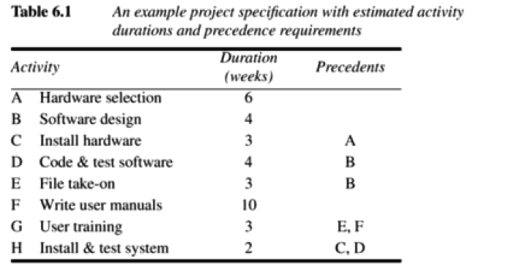

Slide 194
Conclusion
We can complete the project in 12 weeks by reducing the duration of activity F by one week i.e. 9 weeks
Suppose activity F is reduced to 8 weeks, calculate the end date of the project
What would be the end date for the project if activity F is shortened to 7 weeks. Why?

Slide 195
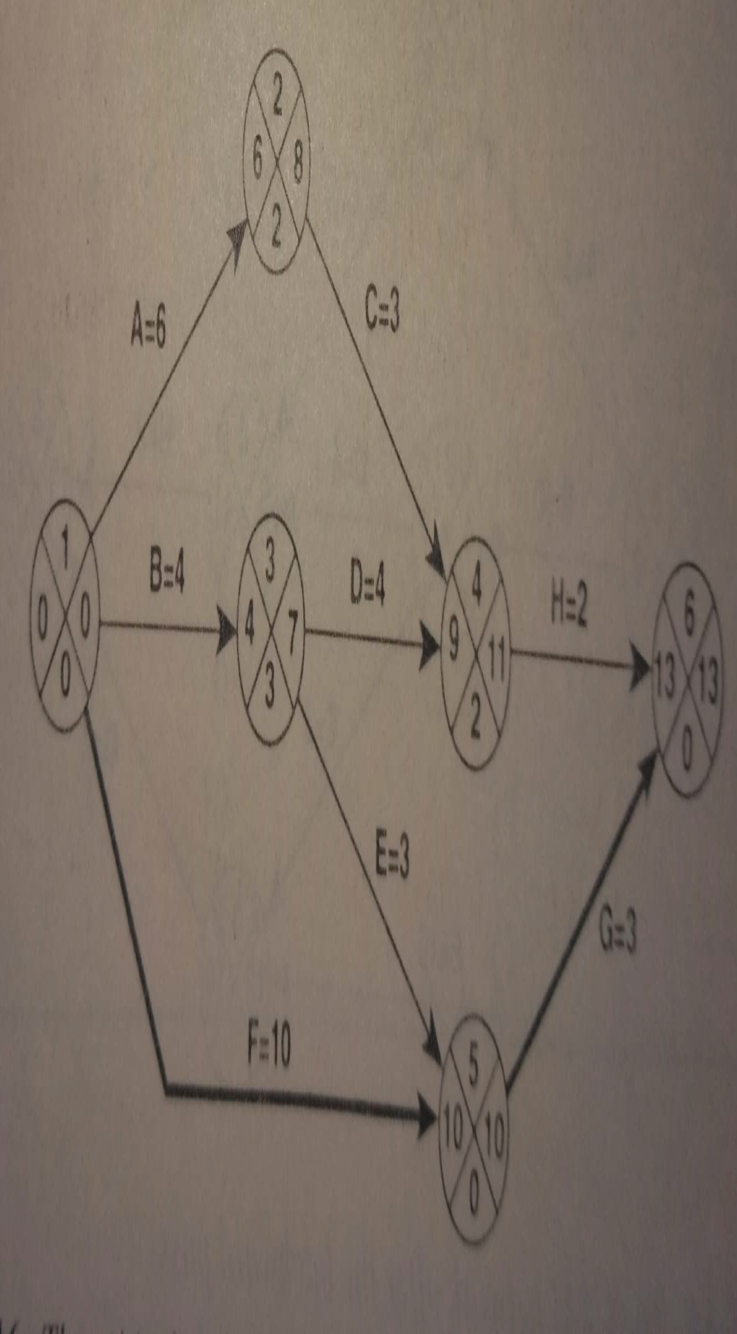

Slide 196


PERT NETWORK
NIVEYDHITHAA R (17PW25)
PADMANABAN M (17PW27)

Slide 197
Evaluating risks to the schedule
The likely effects of risks on planned activities can be identified and categorized – impacts can be assessed
Using PERT to evaluate the effects of uncertainty
PERT was developed to take account of the uncertainty surrounding estimates of task durations
Similar to CPM technique
PERT requires three estimates
Most Likely Time - The time we would expect the task to take under normal circumstances. Denoted by m
Optimistic Time - The shortest time in which we would expect the task to complete. Denoted by a
Pessimistic Time – The worst possible time in which we would expect the task to complete. Denoted by b

Slide 198
Evaluating risks to the schedule- PERT (Contd…)
Using expected durations
Used to carry out forward pass similar to CPM technique
Activity Standard Deviation
This SD formula is based on the rationale that there are approximately six SDs between the extreme tails of many statistical distributions
A quantitive measure of the degree of uncertainty of an activity duration estimate is obtained by using
s=(b-a)/6
The activity SD is proportional to the difference between the optimistic and pessimistic estimates and can be used as a ranking measure of the degree of uncertainty

Slide 199
Evaluating risks to the schedule- PERT (Contd…)
The likelihood of meeting targets
PERT provides a method for estimating probability of meeting or missing the target dates
The method used for calculating involves the fillowing steps:
Calculate the SD o each project event
Calculate the z values for each event that has a target date
Convert z values to probabilities

Slide 200
Evaluating risks to the schedule- PERT (Contd…)
Calculating the SD of each project event
SDs can be calculated by carrying out a forward pass
The only difference is that- to add to SDs their squares must be added and then find out the square root of the sum
Calculating the z values
The z value is calculated for each node that has a target date
It is equivalent to the number of SDs between the node’s expected and target dates by using the formula
z=(T-te)/s
T - Target Date
te - expected date

Slide 201
Evaluating risks to the schedule- PERT (Contd…)
Converting z values to probabilities
A z value may be converted to probability of not meeting the target date by using a graph
Advantages of PERT
It focuses attention on the uncertainty of forecasting
We can use this technique to find the SD for each task and use this to rank them according to their degree of risk.
By setting target date along the critical path, we can focus on those activities posing the greatest risk to the project’s schedule

Slide 202
Using PERT to evaluate the effects of uncertainty
Three estimates are produced for each activity
Most likely time (m)
Optimistic time (a)
Pessimistic (b)
‘expected time’ t_{e} = (a + 4m +b) / 6
‘activity standard deviation’ S = (b-a)/6
Notes:
Most likely time (m) the time we would expect the task to take normally
Optimistic time (a) the shortest time could be realistically be expected
Pessimistic (b) worst possible time (only 1% chance of being worse, say)
Some straightforward activities (data input of standing data might perhaps be an example) might have little uncertainty and therefore have a low standard deviation, while others (software design, for instance?) have more uncertainty and would have a bigger standard deviation.
Exercise 7.6 in the textbook will give some practice in calculating these values.

Slide 203
PERT Example
PERT activity time estimates, expected times and SDs
Activity duration (Weeks)
Activity Optimistic (a) Most likely (m) Pessimistic (b) Expected (te) SD (s)
A
B
C
D
E
F
G
H
5
3
2
3.
1
8
2
2
6
4
3
4
3
10
3
2
8
5
3
5
4
15
4
2.5
6.17
4.00
2.83
4.08
2.83
10.50
3.00
2.08
0.50
0.33
0.17
0.25
0.50
1.17
0.33
0.08

Slide 204
PERT Example
PERT network after forward pass
Event No.
Target date
2
Expected Date
SD
6.17
C t=2.83
A t=6.17
1
B t=4.00
3
D t=4.08
4
H t=2.08
6
0
4
9
13.5
E t=2.83
F t=10.5
G t=3.00
5
10.5

Slide 205
PERT Example
PERT network with 3 target dates and calculated event SDs
2
6.17
0.50
C t=2.83
A t=6.17
s= 0.17
s= 0.50
1
B t=4.00
3
D t=4.08
4
H t=2.08
10
6
15
0
0
s= 0.33
0.33
s= 0.25
0.53
s= 0.08
4
9
13.5
1.22
E t=2.83
F t=10.5
s= 0.50
G t=3.00
s= 1.17
s= 0.33
5
10
10.5
1.17

Slide 206
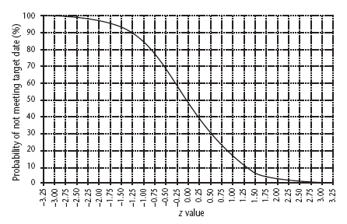
Graph of z values
Notes:
There is about a 15% chance of not meeting the target of 52 days.

Slide 207

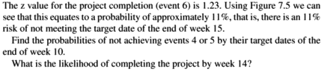

Slide 208

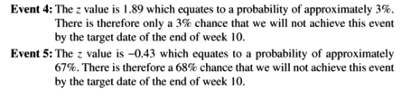

Slide 209
Monte Carlo Simulation
It is an alternative technique to PERT which provides a greater degree of flexibility in specifying likely activity durations
This technique can be used to evaluate the risks of not achieving deadlines
The basis of this technique is the calculation of event times for a project network a large number of times, each time selecting activity times randomly
Activity durations can be specified in a number of forms, depending upon the information available

Slide 210
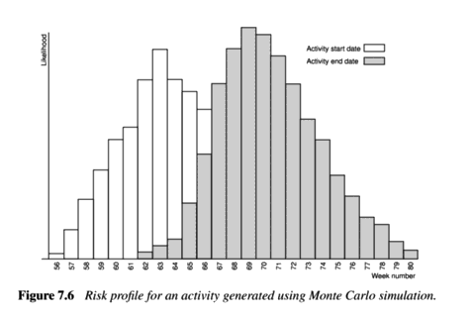
Monte Carlo Simulation for one activity

Slide 211

Risk Management
PRACHI DHINGRA (17PW28)

Slide 212
Contents
Introduction
Nature of Risk
Managing Risk
Risk Identification
Risk Analysis
Prioritizing Risks
Reducing Risks

Slide 213
Introduction
Purpose of Risk Management is to,
decide whether a particular risk is important during completion of project.
evaluate high risk activities on a project’s critical path that are a cause for concern.
Minimize risk, i.e. Minimized over the project and removed from critical path activities.
Common risks in a project include project running late, allocation of staff or the process of identifying risks.

Slide 214
Nature of Risk
Classified under three broad types,
Estimation Errors: The lack of accuracy in estimation is a common type of risk though predicting with a degree of accuracy might be difficult. Estimation errors can be corrected using historic data for similar projects and activities.
Planning Assumptions: Invalid assumptions may put the plan at risk. At each stage in the planning process, it is important to list explicitly all of the assumptions that have been made and identify the effects that might have on the project.
Eventualities: Some eventualities might never be foreseen and we can only resign the fact that unimaginable things do. Such events do happen from time to time and, although the likelihood of any one of them happening during a particular project may be relatively low, they must be considered and planned for.

Slide 215
Managing Risk
The objective of risk management is avoid or minimize the effect of the risks.
Barry Boehm suggested Risk Engineering as a model for risk management.
Risk identification: List of all the risks that can adversely affect the successful completion of project.
Risk estimation: Analyzing the likelihood and impact of each hazard.
Risk evaluation: Ranking risks and determining risk aversion.
Risk planning: Drawing contingency plans and adding these to the project's task structure.
Risk control: Functions of the risk manager in minimizing and reacting to problems throughout the project.
Risk monitoring: Ongoing activity to determine risk status.

Slide 216
Risk Identification
The first stage in risk management is to identify hazards.
An hazard is an event that might occur and will, if it does occur, create a problem for the successful completion of project.
We have to usefully distinguish between the cause (or hazard), its immediate effect of the cause.
A common way of identifying hazards is to use a checklist listing all the possible hazards and factors that influence them.
Risks are of two types, generic risks, relevant to all software projects and standard checklists can be used and augmented from an analysis of past projects. Specific risks are relevant to an individual project and more difficult to identify without the involvement of the team members.

Slide 217
Factors that will be considered include,
Application Factors: the nature of the application is a critical factor. The expected size is also important with greater being the likelihood for errors when the system is big.
Staff factors: The experience and skills of the staff involved are clearly important to determine the success of the project.
Project factors: Important that the project and its objectives are well defined and that they are absolutely clear to all the members of the team.
Project methods: Usage of well specified and structured methods for project management will decrease the risks in the system.
H/W-S/W Factors: A system developed on one type of h/w and s/w platform to be used on another might be an additional risk to the project.
Changeover factors: Incremental or gradual changeover minimizes the risk involved. Parallel running can provide safety but is too costly.
Supplier factors: The extent to which a project relies on external organizations that cannot be directly controlled influences the project.

Slide 218
Environment factors: Changes in the environment can affect a project’s success.
Health and safety projects: The effect of the health and safety projects should also be considered though not a major issue for the software projects.

Slide 219
Risk Analysis
Assessing the importance of the risks once identified.
risk likelihood: The probability of a hazard’s occurrence.
risk impact: The effect of the resulting problem on the project.
risk exposure/value: The importance of the risk.
risk exposure = risk likelihood * risk impact
Risk impact is identified in monetary terms and risk likelihood is assessed as a probability. The estimation of these costs and probabilities is likely to be difficult, subjective, time-consuming and costly.
Easy way is to categorize the likelihoods and impacts as high, medium or low does not need the calculation of risk exposure.

Slide 220
Prioritizing Risks
Managing risks involves the use of two strategies;
reducing the risk exposure by reducing likelihood or impact.
drawing up a contingency plans to deal with the risk should it occur.
Factors to be taken into account while prioritizing risks are,
confidence of risk assessment: making good judgment.
compound risks: risks dependent on other risks.
number of risks: limit to the number of risks considered.
cost of action: risks can be avoided or reduced with little cost and effort.
Risk Reduction Leverage (RRL),
RRL = Original risk exposure – expected risk exposure
risk reduction cost

Slide 221
Reducing the Risks
There are five strategies for risk prevention,
Hazard prevention: Some hazards can be prevented or their likelihood reduced to insignificant levels.
Likelihood reduction: Though some risks cannot be prevented their can be likelihood reduced to insignificant levels.
Risk Avoidance: Detailing certain methods to avoid methods and standards to avoid risks.
Risk transfer: The impact of some of the risks can be transferred from the project.
Contingency planning: Some risks are not preventable and contingency plans will need to be drawn to reduce their impact.

Slide 222


Precedence Network
RAHUL LEONARD ARUN KUMAR (17PW29)
SAI CHARAN PRASAD T (17PW30)

Slide 223
Precedence Network
Precedence Network use boxes to represent activities also known as work items) and links to present dependencies.
The boxes may carry task description and duration estimates and the links may contain a duration denoting a lag between the completion of 1 task and the start of another.
The difference between CPM and Precedence Network is that CPM networks use links to represent activities and nodes to represent events.
Advantages of Precedence Network
They are easier to draw, dummy activities are virtually redundant and also easier to interpret them.
They can also be used to represent parallel lagged activities

Slide 224
Precedence Network (continued…)
Activity Label
Duration
The items indicated in the boxes are the same as those shown in the CPM network and the activity table with the addition of Activity span.
Activity Span is the difference between the earliest start date and the latest start date and is a measure of the maximum time allowable for the activity
Precedence Network will be further discussed in the next chapter
1
3
Activity
Description
2
4
Activity Span
Float
1 → Earliest Start Date
2 → Latest Start Date
3 → Earliest Finish Date
4 → Latest Finish Date

Slide 225
Specify Overall System
Specify Modules
Check Spec
Design Modules
Coding/Testing Modules
System Integration
IoE/P/2
20
IoE/P/7
7
IoE/P/11
30
34
39
54
59
61
61
68
58
68
68
98
98
A
A
A
25
5
7
0
30
0
IoE/P/3
15
IoE/P/8
6
IoE/P/12
28
34
44
B
49
59
61
61
B
67
70
67
76
B
95
98
IoE/P/1
20
IoE/P/6
2
IoE/P/15
6
0
0
34
34
59
59
61
61
98
98
104
104
25
10
9
3
31
3
34
0
2
0
6
0
IoE/P/4
25
IoE/P/9
4
IoE/P/13
20
34
34
C
59
59
61
79
C
65
83
20
30
C
20
30
25
0
22
18
33
20
Blue lines indicate critical activities
IoE/P/5
20
IoE/P/10
4
IoE/P/14
25
34
44
D
49
59
61
69
D
65
73
65
73
D
90
98
25
10
12
8
33
8

Slide 226
Specify Overall System
Specify Modules
Check Spec
Design Modules
Coding/Testing Modules
System Integration
IoE/P/2
20
IoE/P/7
7
IoE/P/11
30
34
54
54
54
56
56
63
63
63
63
93
93
A
A
A
20
0
7
0
30
0
IoE/P/3
15
IoE/P/8
6
IoE/P/12
28
34
44
B
49
54
56
59
B
62
65
62
65
B
90
93
IoE/P/1
34
IoE/P/6a
2
IoE/P/14
6
0
0
34
34
54
54
56
56
93
93
99
99
20
5
9
3
31
3
34
0
2
0
6
0
IoE/P/5
15
IoE/P/10
4
IoE/P/14
25
Here we decide on a compromise i.e.,A,B and D will be specified together but will then go ahead with their design without waiting for the completion of Module C
34
44
D
49
54
56
64
D
60
68
60
68
D
85
93
20
5
12
8
33
20
Blue lines indicate critical activities
IoE/P/4
25
IoE/P/6a
2
IoE/P/9
4
IoE/P/13
15
34
48
C
59
73
59
73
60
74
60
74
C
64
78
64
78
C
79
93
39
14
15
14
18
14
29
14

Slide 227
Specify Overall System
Specify Modules
Check Spec
Design Modules
Coding/Testing Modules
System Integration
IoE/P/2
20
IoE/P/7
7
IoE/P/11
30
34
35
54
55
56
57
63
64
63
64
93
94
A
A
A
21
1
8
1
30
0
IoE/P/3
15
IoE/P/8
6
IoE/P/12
28
34
34
B
49
49
60
60
B
66
66
66
66
B
94
94
IoE/P/1
34
IoE/P/6
2
IoE/P/15
6
0
0
34
34
54
55
56
57
94
94
100
100
15
0
6
0
28
0
34
0
3
1
6
0
IoE/P/4
15
IoE/P/10
4
IoE/P/14
25
34
45
D
49
55
56
65
D
60
69
60
69
D
85
94
Here we delay the specification of module C for a further day to ensure that only 3-analyst designers are required
21
6
12
8
34
9
IoE/P/5
25
IoE/P/6a
1
IoE/P/9
4
IoE/P/13
15
Blue lines indicate critical activities
49
49
C
74
74
74
74
75
75
75
75
C
79
79
79
79
C
94
94
25
0
1
0
4
0
15
0

Slide 228
Cost Schedules
After converting the activity schedule to work plan, we have to produce a detailed and accurate cost schedule.
The cost schedule can project the weekly or monthly cost and serve as a plan against which project progress can be monitored.
Calculating cost can be straightforward when the organization has standard cost figures for staff and other resources.
In the absence of standard figures, it is the responsibility of the project manager to come up with the cost figures.

Slide 229
Types of Cost
Cost are categorized as follows:
Staff Costs – These will include staff salaries as well as other direct costs of employment. These are commonly charges to at hourly rates based on weekly work records completed by staff. Contract staff are usually charged by the week or month even when they are idle.
Overheads – Overheads represent expenditure that an organization incurs, which cannot be directly related to individual projects or jobs. These costs can be recovered by making a fixed charge on development departments or by an additional percentage charge on direct staff employment costs.

Slide 230
Types of Cost (continued…)
Usage Charges – In some organizations, projects are charged directly for use of resources such as computer time. This will normally be on an ‘as used basis’.

Slide 231
A typical Cost Profile
9000
This is a typical cost profile – building up slowly to a peak and then tailing off quite rapidly towards the end of the project
8000
Cumulative cost (in Pounds)
7000
6000
5000
4000
3000
2000
1000
0 1 2 3 4 5 6 7 8 9 10 11 12 13 14 15 16 17 18 19 20
Week Number

Slide 232
Cumulative Cost of a Project
9000
8000
Cumulative cost (in Pounds)
7000
6000
5000
4000
3000
This cost is generally considered for cost control purposes
2000
1000
0 1 2 3 4 5 6 7 8 9 10 11 12 13 14 15 16 17 18 19 20
Week Number

Slide 233
The scheduling sequence
Going from an ideal activity to a costed schedule can be represented as a sequence of steps, rather like the classic waterfall life cycle model.
In the ideal world, we would start with the activity plan and use this as the basis for our risk assessment.
The activity plan and the risk assessment would provide the basis for our resource allocation and schedule from which we produce the cost schedules.
The interplay between the plans and schedules is complex – any change to one will affect each of the others.

Slide 234
The scheduling sequence…
Some factors can be directly compared in terms of money where are others are difficult to express in terms of money terms and will include an element of subjectivity.
While good project planning software will assist greatly in demonstrating the consequences of change and keeping the planning synchronized, successful project scheduling is largely dependant upon the skill and the experience of the project manager in juggling the many factors involved.

Slide 235
Conclusion
This chapter discusses the problems of allocating resources to project activities and the conversion of the activity plan to a work schedule. The following point have to be kept in mind during this process:
Identifying all the resources needed
Arranging activity starts to minimize variations in resource levels during the duration of the project.
Allocating resources to competing activities in a rational order of priority.
Taking care in allocating the right staff to critical activities

Slide 236

Resource Leveling SAISWETHA R (17PW31)

Slide 237
Problem Description
The case that we are considering for the precedence network consists of three main phases i.e. analysis, check specifications and design.
The phases are staffed by four people for the activities A, B, C and D. The activities in the project can be constructed into a precedence network shown in the next slide.
The reason for accommodating resource leveling is that, there might be activities that have float to spare can be delayed corresponding to the float value.
By doing so the resources that had been allocated to the delayed activity can be effectively utilized for the other activities waiting for the resources.
This scenario has been portrayed in the forthcoming slides with precedence networks, bar charts and histograms.

Slide 238
Based on Precedent Network
STAGE 1
STAGE 2
STAGE 3
STAGE 4
STAGE 5
STAGE 6
IoE/P/2
20 days
IoE/P/7
7 days
IoE/P/11
30 days
34
Specify
Module
A
54
61
Design
Module
A
68
68
Code/Test
Module A
98
35
59
61
68
68
98
25 days
5 days
7 days
0 days
30 days
0 days
IoE/P/3
15 days
IoE/P/8
6 days
IoE/P/12
28 days
34
Specify
Module
B
49
61
Design
Module
B
67
67
95
Code/Test
Module B
IoE/P/1
34 days
44
59
64
76
IoE/P/15
6 days
34 days
IoE/P/6
2 days
70
98
0
34
25 days
10 days
59
98
104
Specify Overall system
Check specs
61
9 days
3 days
31 days
3 days
System integration
0
34
59
61
98
104
34 days
0 days
IoE/P/4
25 days
2 days
0 days
IoE/P/9
4 days
IoE/P/13
15 days
6 days
0 days
34
Specify
Module
C
59
61
Design
Module
C
65
65
Code/Test
Module C
80
34
59
79
83
79
98
25 days
0 days
22 days
18 days
33 days
18 days
IoE/P/5
15 days
IoE/P/10
4 days
IoE/P/14
25 days
34
Specify
Module
D
49
61
Design
Module
D
65
65
90
Code/Test
Module D
44
59
69
73
73
98
25 days
10 days
12 days
8 days
33 days
8 days

Slide 239
Table 8.1 Part of Amanda’s resource requirement list
Stage Activity Resource Days Quantity Notes
ALL Project Manager 104/FT
1 All Workstation 34 Check software availability
IoE/P/1 Senior Analyst 34/FT
2 All Workstation - 3 1 per person would be ideal
IoE/P/2 Analyst-Designer 20/FT
IoE/P/3 Analyst-Designer 15/FT
IoE/P/4 Analyst-Designer 25/FT
IoE/P/5 Analyst-Designer 15/FT Could use analyst-programmer
3 All Workstation 2/FT
IoE/P/6 Senior Analyst 2/FT
4 All Workstation - 3 As stage 2
IoE/P/7 Analyst-Designer 7/FT
IoE/P/8 Analyst-Designer 6/FT
IoE/P/9 Analyst-Designer 4/FT
IoE/P/10 Analyst-Designer 4/FT
5 All Workstation - 4 1 per programmer
All Office space - if contract programmers used
IoE/P/11 Programmer 30/FT
IoE/P/12 Programmer 28/FT
IoE/P/13 Programmer 15/FT
IoE/P/14 Programmer 25/FT
6 All Full machine access - Approx. 16 hours for full system test
IoE/P/15 Analyst-Designer 6/FT

Slide 240
Revised Network after delaying module C
STAGE 1
STAGE 2
STAGE 3
STAGE 4
STAGE 5
STAGE 6
IoE/P/2
20 days
IoE/P/7
7 days
IoE/P/11
30 days
34
Specify
Module
A
54
56
Design
Module
A
63
63
93
Code/Test
Module A
35
55
57
64
64
94
21 days
1 day
8 days
1 day
31 days
1 day
IoE/P/3
15 days
IoE/P/8
6 days
IoE/P/12
28 days
34
Specify
Module
B
49
56
Design
Module
B
62
62
90
Code/Test
Module B
6 days
IoE/P/1
34 days
40
55
60
66
IoE/P/15
34 days
IoE/P/6
2 days
66
94
0
34
21 days
6 days
54
94
104
Specify Overall system
Check specs
56
10 days
4 days
32 days
4 days
System integration
0
34
55
57
94
104
34 days
0 days
IoE/P/5
15 days
3 days
1 day
IoE/P/10
4 days
IoE/P/14
15 days
6 days
0 days
34
Specify
Module
D
49
56
Design
Module
D
60
60
Code/Test
Module D
85
40
55
65
69
69
94
21 days
6 days
13 days
9 days
34 days
9 days
IoE/P/4
25 days
IoE/P/6a
1 day
IoE/P/9
4 days
IoE/P/13
25 days
49
Specify
Module
C
74
74
Check specs
75
75
Design
Module
C
79
79
94
Code/Test
Module C
49
74
74
75
75
79
79
94
25 days
0 days
1 day
0 days
4 days
0 days
15 days
0 days

Slide 241
Bar chart and resource histogram After Delaying module C
Week number
1
2
3
4
5
6
7
8
9
10
11
12
13
14
15
16
17
18
19
Specify overall system
Specify module A
Specify module B
Specify module C
Specify module D
Check Specification
Design module A
Design module B
Design module C
Design module D
No. of Analysts / designers
1
2
3
4
5
6
7
8
9
10
11
12
13
14
15
16
17
18
19
Week number

Slide 242
Revised Network not waiting for module C
STAGE 1
STAGE 2
STAGE 3
STAGE 4
STAGE 5
STAGE 6
IoE/P/2
20 days
IoE/P/7
7 days
IoE/P/11
30 days
34
Specify
Module
A
54
56
Design
Module
A
63
63
93
Code/Test
Module A
34
54
56
63
63
93
20 days
0 days
7 days
0 days
30 days
0 days
IoE/P/3
15 days
IoE/P/8
6 days
IoE/P/12
28 days
34
Specify
Module
B
49
56
Design
Module
B
62
62
90
Code/Test
Module B
6 days
IoE/P/1
34 days
39
54
59
IoE/P/15
34 days
IoE/P/6
2 days
65
65
93
0
34
20 days
5 days
54
93
99
Specify Overall system
Check specs
56
9 days
3 days
31 days
3 days
System integration
0
34
55
56
93
99
34 days
0 days
IoE/P/5
15 days
2 days
0 days
IoE/P/10
4 days
IoE/P/14
25 days
6 days
0 days
34
Specify
Module
D
49
56
Design
Module
D
60
60
Code/Test
Module D
85
39
54
64
68
68
93
20 days
5 days
12 days
8 days
33 days
8 days
IoE/P/4
25 days
IoE/P/6a
1 day
IoE/P/9
4 days
IoE/P/13
25 days
34
Specify
Module
C
59
59
Check specs
60
60
Design
Module
C
64
64
79
Code/Test
Module C
48
73
73
74
74
78
78
93
39 days
14 days
15 days
14 days
18 days
14 days
29 days
14 days

Slide 243
Not waiting for module C
Week number
1
2
3
4
5
6
7
8
9
10
11
12
13
14
15
16
17
18
19
Specify overall system
Specify module A
Specify module B
Specify module C
Specify module D
Check Specifications
Check Specification C
Design module A
Design module B
Design module C
Design module D
No. of Analysts / designers
1
2
3
4
5
6
7
8
9
10
11
12
13
14
15
16
17
18
19
Week number

Slide 244
Revised for allowing the delay of specifying module C
Week number
1
2
3
4
5
6
7
8
9
10
11
12
13
14
15
16
17
18
19
Specify overall system
Specify module A
Specify module B
Specify module C
Specify module D
Check Specifications
Check Specification C
Design module A
Design module B
Design module D
Design module C
No. of Analysts / designers
1
2
3
4
5
6
7
8
9
10
11
12
13
14
15
16
17
18
19
Week number

Slide 245
Bar chart and resource histogram (After Smoothing)
Week number
1
2
3
4
5
6
7
8
9
10
11
12
13
14
15
16
17
18
19
Specify overall system
Specify module A
Specify module B
Specify module C
Specify module D
Check Specifications
Design module A
Design module B
Design module C
Design module D
No. of Analysts / designers
1
2
3
4
5
6
7
8
9
10
11
12
13
14
15
16
17
18
19
Week number

Slide 246

Monitoring And Control
SATHWIK CHEPYALA (17PW32)

Slide 247
Objectives
Monitor the progress of projects
Access the risk of slippage
Visualize and access the state of a project
Revise targets to correct or counteract drift
Control changes to a project’s requirement

Slide 248
Introduction
Once work schedules have been published and the project is under way, attention must be focused on ensuring progress.
This requires monitoring of what is happening, comparison of actual achievment against the schedule and, where necessary, rivision of plans and schedules to bring the project as far as possible on target.

Slide 249
Creating the framework
Exercising control over a project and ensuring that targets are met is a matter of regular monitoring.
finding out what is happening, and comparing it with current targets.

Slide 250
Responsibility – key factor
The overall responsibility for ensuring satisfactory progress on a project is often the role of the project steering committee or Project Board.
Day-to-day responsibility will rest with the project manager and, in all but the smallest of projects, aspects of this can be delegated to team leaders.
With small projects (employing around half a dozen or fewer staff) individual team members usually report directly to the project manager, but in most cases team leaders will collate reports on their section’s progress and forward summaries to the project manager.
Reporting many be oral or written, formal or informal, or regular or ad hoc.

Slide 251
Project Reporting Structures
Steering Committee
Client
Project Manager
Team leader
Team leader
Team leader
Team leader
Programming section
Quality Control
section
User documentation section
Analysis/design section

Slide 252
Setting checkpoints
It is essential to set a series of checkpoints in the initial activity plan. Checkpoints many be:
Regular (monthly, for example);
Tied to specific events such as the production of a report or other deliverable.

Slide 253
Taking snap-shots
The frequency with which the manager needs to receive information about progress will depend upon the size and degree of risk of the project or that part of the project under their control.
In general, the higher the level, the less frequent and less detailed the reporting needs to be.

Slide 254
Collecting the data
It will still be necessary to gather information about partially completed activities and, in particular.
forecasts of how much work is left to be completed.

Slide 255
Partial completion reporting
Many organizations use standard accounting systems with weekly time sheets to charge staff time to individual jobs.
The staff time booked to a project indicated the work carried out it charges to the project.
It does not, however, tell the project manager what has been produced or whether tasks are on schedule.
Asking for estimated completion times can be criticized on the grounds that frequent invitations to reconsider completion dates deflects attention away from the importance of the originally scheduled targets.

Slide 256
Weekly time sheets are used for getting information about
work done in addition to time spent
Estimated and scheduled completion dates are also obtained

Slide 257
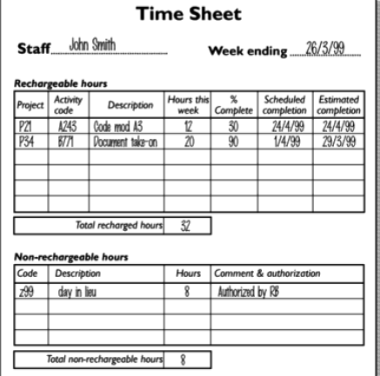

Slide 258
Risk reporting
One popular way of overcoming the objections to partial completion reporting is to avoid asking for estimated completion date, but to ask instead for the team members estimate of the likelihood of meeting the planned target date.
One way of doing this is the profit light method. This consists of the following steps:
Identify the key (first level) elements for assessment in a piece of work.
Break these key elements into constituent elements(second level)
Access each of the second level elements on the scale green ‘On Target’ , amber for ‘Not on target but recoverable’, and red for ‘Not on target and recoverable only with difficulty’.

Slide 259
Risk reporting…
Review all the second level assessments to arrive at first level assessments.
Review first and second level assessments to produce overall assessment.

Slide 260

SIVARANJAN M (17PW33)

Slide 261
Visualizing progress
Having collected data about project progress, a manager need some way of presenting data to greatest effect
Gantt chart
One of the simplest and oldest techniques for tracking project progress is the gantt’s chart.
This is essentially an activity bar chart indicating scheduled activity dates and durations frequently augmented with activity floats.

Slide 262
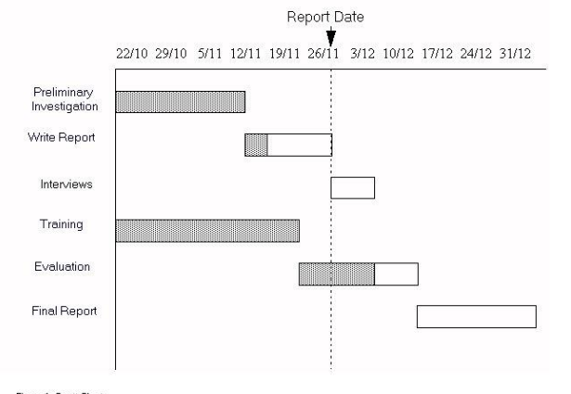

Slide 263
THE GANTT CHART
“Today Cursor” provides immediate visual indication
of which activities are ahead or behind schedule
Figure shows the Gantt chart at the end of Tuesday
of week 17.
“Code and test module D” has been completed ahead
of schedule and “Code and test module A” als appears
to be ahead of schedule.
“Coding and testing “ of other 2 modules are behind
Schedule

Slide 264
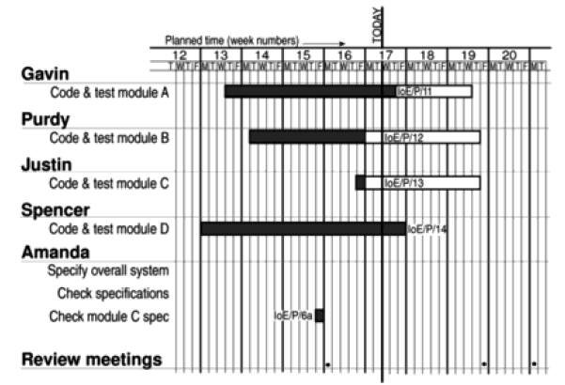

Slide 265
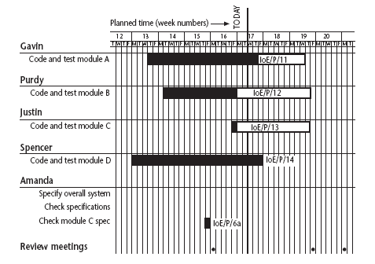
Gantt charts
Notes:
Note that the Gantt chart is named after Henry Gantt (1861-1919) and so should not be written in capitals! You could ask students what they think GANTT stands for before you tell them this to impress this on them. I really find Gantt written as GANTT very, very annoying and threaten students with instant failure of the module if they do this!
The format of the Gantt chart here differs from the format used in Microsoft project as the activities for each team member are grouped together. You could input the details so that they came out in this format, but it would not occur automatically.

Slide 266
Visualizing progress…
Slip Chart
The slip chart is a very similar alternative favoured by some project managers who believe it, provides a more striking visual indication of those activites that are ot progressing to schedule – the more the slip line bends the greater the variation from the plan.
Additional slip lines are added at the intervals and as they build up, the projectmanager will gain an idea as to whether the project is improving( subsequent slip lines bend less) or not.

Slide 267
More the slip line bends, the greater the variation from
the plan.
A very jagged slip line indicates a need for rescheduling

Slide 268
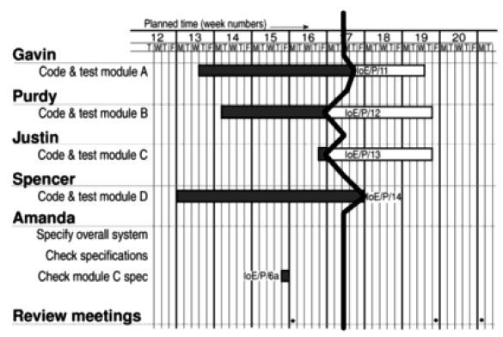
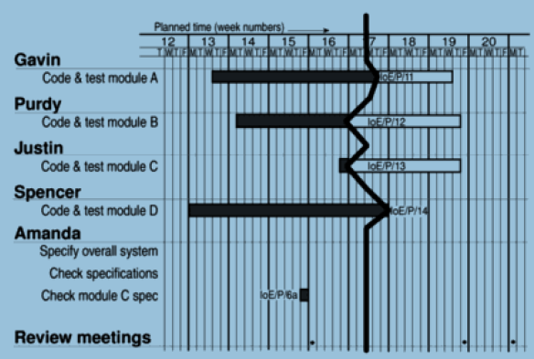

Slide 269
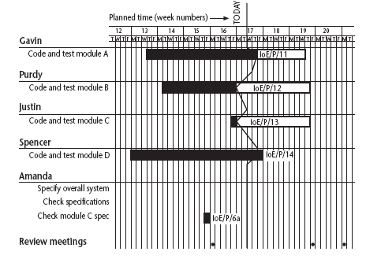
Slip charts
Notes:
A slip chart is a version of the Gantt chart where a line is drawn from top to bottom. To the left of the line are all the completed activities and to the right those activities ( or parts of activities) that have not been completed.
The more jagged the line, the more it means that that there are some activities that are lagging to various degrees and some that are ahead of themselves. A very jagged line means that there is scope for re-planning to move resources from those activities that are ahead to those that are behind.

Slide 270
Visualizing progress …
Ball chart
A somewhat more striking way of showing whether or not targets have been met is to use a ball chart.
In this version of ball chart, the circles indicate start and completion points for activities. The circles initially contain the original scheduled dates. Whenever revisions are produced these are added as second dates in appropriate circles until an activity is actually started or completed when the relevant dates replaces the revised estimate.

Slide 271
Ball charts
Code and test module A
10/10/05
21/10/05
23/10/05
10/10/05
Code and test module B
14/10/05
17/10/05
27/10/05
31/10/05
Code and test module C
17/10/05
17/10/05
27/10/05
7/11/05
Notes:
Circles, which represent the start or finish of activities, start with the initial target dates. If these are modified then the second dates are changed. When the event actually takes place, the colour of the circle is changed to green if it is on target and to red if it has missed the target.
The idea is that this chart is put on a wall in a prominent position as a constant reminder to the project team of the current situation – hence it is often referred to as ‘balls on the wall’.

Slide 272
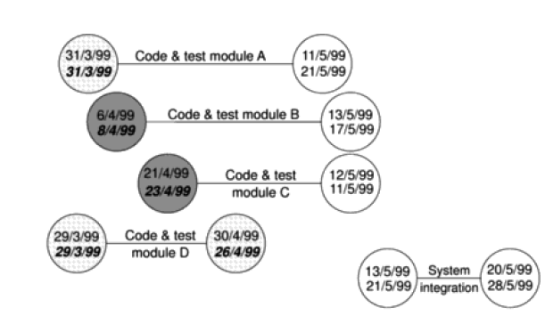

Slide 273
The timeline
One disadvantage of the charts described so far is that they do not show clearly the slippage of the project completion dates through the life of the project.
The timeline chart is a method of recording and displaying the way in which the targets have been changed throughout the duration of the project.
Planned time is plotted along the horizontal axis and elapsed time down the vertical axis.
The lines meandering down the chart represents scheduled activity completion date.

Slide 274
At the start of the project ‘analyse existing system’ is scheduled
to be completed by the Tuesday of week 3, ‘obtain user
Requirements’ by Thursday of week 5, ‘issue tender’ the final
Activity by Tuesday of week 9 and so on.
At the end of week 2, ‘obtain user requirements’ will not be
completed until Tuesday of week 6 – therefore extends the
activity line to reflect this.
By the Tuesday of week 3, ‘analyse existing system’ is
Completed and a blob is marked on the timeline to indicate
that it is finished.

Slide 275
At the end of week 4 another three days are
added to the activities ‘draft tender’ and
‘issue tender’
At the end of week 6, two activities have been
completed and three are not completed.
The project as a whole is running 7 days late

Slide 276
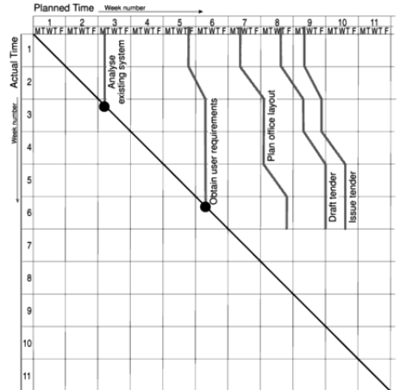

Slide 277
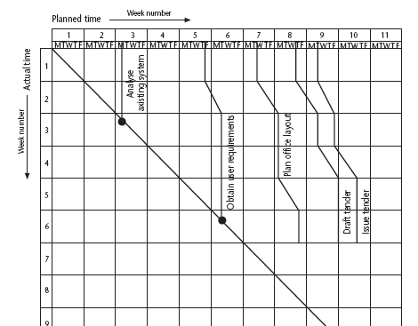
The timeline
Notes:
This records the way that targets have changed throughout the project.
Planned time is plotted on the horizontal axis, and actual time on the vertical axis. The bendy lines going from top to bottom represent the scheduled completion date for each activity e.g.
‘analyse existing system’ – at start this was due finish on the Monday of week 3 and it did finish then
‘obtain user requirements’ was originally planned to finish on the Thursday of week 5, but at the end of the first week it was rescheduled to finish on the Tuesday of week 6.

Slide 278
Cost monitoring
Expenditure monitoring is an important component of project control. Not only in itself but also because it provides an indication of the effort that has gone into a project.
A project might be on time but only because more money has been spent on activities than originally budgeted.

Slide 279
Monitoring earned value
Having created the baseline budget, the next task is to monitor earned value as the project progresses.This is done by monitoring the completion of task.
Cost charts become much more useful if we add projected future costs calculated by adding the estimated cost of uncompleted work to the cost already incurred.
Where a computer based planning tool is used division of cost schedules is generally provided automatically once actual expenditure has been recorded.

Slide 280
Earned value
Earned value analysis has gained in popularity in recent years and may be seen as a refinement of cost monitoring.
Earned value analysis is based on assigning a value to each task or work package (as identified in WBS) based on the original expenditure forecast.
The assigned value is the original budgeted cost for the item and is known as the baseline budget or budgeted cost of work scheduled(BCWS).

Slide 281
Earned value…
Tasks have been started but are not yet complete some consistent method of assigning an earned value must be applied. Common methods in software projects are:
0-100 technique – where a task is assigned a value of zero until such time it is completed when it is given a value 100 of the budgeted value.
50 –50 technique – where a task is assigned a value of 50 percent of its value as soon as it is started and then given a value of 100 percent once it is completed.
Milestone technique – where a task is given a value based on the achievement of milestones that have been assigned values as part of the original budget plan.

Slide 282
Prioritizing monitoring
In this section we list the priorities we might apply in deciding levels of monitoring.
Critical path activities – any delay in an activity on the critical path will cause the delay in the completion date for the project. Critical path activities are therefore likely to have a very high priority for close monitoring.
Activities with no free float – A delay in any activity with no free float will delay atleast subsequent activities even though the delay is less than the total float it might not delay the project completion date.

Slide 283
Prioritizing monitoring…
Activities with less than specified float – If any activity has very less float it might use up this float before the regular activity monitoring brings the problem to the project manager attention.
High risk activities – A set of high risk activities should have been identified as part of the initial risk profiling exercise.
Activities using critical resources – activities can be critical because they are very expensive.

Slide 284
Getting the project back to target
Shorten the Critical path
The overall duration of the project is determined by the current critical path, so speeding up non critical path activities will not being forward a project completion date.
Reconsider the precedence requirements
Consider the constraints by which some activities have to be differed pending completion to others. The original project network could most probably have been drawn up assuming ideal conditions and normal working practices.

Slide 285

SOUNDARYA S (17PW34)

Slide 286
Change control
Configuration librarian’s role
Control changes and documentations ought to be responsibility of someone who may variously be named the configuration librarian, the configuration manager or protect librarian. Among the persons duties would be:
The identification of all items that are subjected to change control.
The establishment and maintenance of the central repository of the master copies of all project documentations and software products.
Settling up and running of formal set of procedures to deal with changes.
The maintenance of records of who has access to which library item and the status of each librarian item.

Slide 287
Change control procedures
A simple change control procedure for operational systems might have following steps:
One or more users might perceive a need for a modification to a system and ask for a change request to be passed to the development staff.
The user management consider the change request and if they approve it to the development manager.
The development management delegate a member of staff to look at the request and to report on the particular practicality and cost of carrying out the changes.
The development management report back to the user management on the findings and the user management decide whether in view to the cost quoted, they wish to go ahead.

Slide 288
Change control procedures (contd)
One or more developers are authorized to .take copies of the master products that are to be modified
The copies are modified. In case of software components this would involve modifying the code and recompiling and testing
When the development of new versions of the product has been completed , the user management will be notified and copies of the software will be released for the user acceptance testing.
When the user is satisfied that the products are adequate, they will authorize their operational release. The master copies of the configuration items will be replaced.

Slide 289
Changes in scope of a system
A common occurrence with IS development projects is for the size of system gradually to increase.
One cause for this is changes to requirements that are requested by users.
The scope of the project needs to be carefully monitored and controlled. One way is to re estimate the system size in terms of SLOC or function points at key mile stones.

Slide 290

Managing Contracts
SREHARINE D (17PW35)

Slide 291
Types of Contract
Supply of completed software:
A bespoke system, that is, a system developed from scratch for one customer.
Off-the-shelf, which you buy ‘as is’ – this is sometimes referred to as shrink-wrapped s/w.
Customized off-the-shelf (COTS) s/w – this is a basic core system, which is modified to meet the needs of a particular customer.
Payment based:
Fixed price contracts
Time and material contracts
Fixed price per delivered unit contracts.

Slide 292
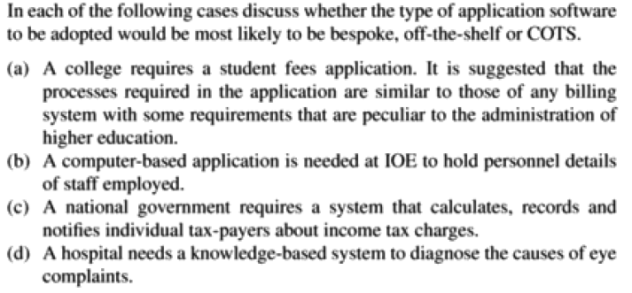

Slide 293
Fixed Price Contracts
Price is fixed when the contract is signed. If there are no changes in the contract terms, this is the price to be paid on completion of work.
Advantages:
Known Customer Expenditure.
Supplier motivation.
Higher prices to allow for contingency.
Difficulties in modifying requirements.
Upward pressure on the cost of changes.
Threat to system quality.

Slide 294
Time and Material Contract
The contractor is charged at a fixed rate per unit of effort.
E.g.: salary per hour
Advantages:
Ease of changing requirements.
Lack of price pressure.
Customer liability.
Lack of incentives for supplier.

Slide 295
Fixed price per unit delivered contract
Often associated with functional point (FP) counting.
The size of the system to be delivered is calculated and estimated at the outset of the project.
Size is based on lines of code.
Advantages:
Customer understanding
Comparability
Emerging functionality
Supplier Efficiency
Life cycle range
Difficulties with s/w size measurements
Changing requirements

Slide 296
More Classification
Based on the approach in selection of contractors:
Open tendering process
Any supplier can bid to the supply the goods and services. Furthermore all bids that are compliant with the original condition laid down in the invitation to the tender must be considered and evaluated in the same way as all others.
Restricted tendering process
Very similar to open tendering, except that its open only to restricted number of vendors, to submit.

Slide 297
More Classification…
Negotiated process
Restricted tendering is not suitable for certain cases.
E.g. s/w system developed by third party. Customer wants to make certain extensions to it. But the usual tender process in tedious and time consuming.
So will have to be negotiated with Vendors and resolved.

Slide 298
Stages In Contract Placement
Requirement Analysis
Clear set of requirements from the customers
External Consultant can also be brought to draw up requirements, but the resulting requirements should again be reviewed
Requirement document (or operational requirement) must include the following
Functions needed to be carried out
Input/Output of the functions
Standards with which there should be compliance
Quality requirements like response times, reliability, usability and maintainability

Slide 299
Requirement Analysis…
Each requirement needed to be identified as
Mandatory: If a proposal does not meet this requirement then the proposal is to be immediately rejected. No further evaluation.
Desirable : A proposal might be deficient in this respect, but other features of the proposal could compensate for it.

Slide 300
Evaluation Plan
Draw up plan of how the proposals are to be evaluated
Specially written systems are evaluated by proposals, for off-the-shelf applications the system itself is evaluated.
A means of checking the mandatory requirements have to be identified

Slide 301
Evaluation Plan…
Desirable requirements can be evaluated by weighing the quality of one against the other using standards like ISO 9126
‘Value for money’ (price) is also a key criterion for evaluation
The costs for the whole life time of the system is taken into account

Slide 302

SRI NANDITA S (17PW36)

Slide 303
Invitation to tender
Issuing the invitation to tender includes requirement document with a supporting letter involving additional info like deadline etc.
The invitation to tender is not an offer but an invitation for suppliers to make an offer.
Customer needs to know the price as well as the way in which the requirements are intended to satisfy (esp. for system developed from scratch)
In some cases post tender clarifications and negotiations are enough

Slide 304
Invitation to tender
Two stage tendering process
First stage
Technical proposals from the suppliers without quotation of price
Filtering the proposals based on meeting the mandatory requirements
Discussions with the representative of the selected suppliers with demos and the result of which is Memorandum Of Agreement with each prospective supplier.

Slide 305
Invitation To tender…
Memorandum Of Agreement is an acceptance by the customer that the proposed solution offered by the supplier meets the requirements.
Second Stage
Tenders are invited from the suppliers who have signed (MoA) and would be concerned with financial terms of the contract.
In some cases design should also be proposed and the suppliers would be paid for it.
Final contract is awarded to the most attractive proposal

Slide 306
Evaluation of Proposals
Done in a methodical and planned manner
Different type of evaluation patterns for different applications
System itself is evaluated for off-the-shelf systems, proposals evaluated for bespoke systems, both system and proposal for COTS

Slide 307
Evaluation of Proposals…
The process of evaluation may include
Scrutiny of the proposal documents: It involves reviewing the proposal documents whether they meet the requirements, clarification on certain points, legal issues.Written, agreed record can be sought.The terms of the contract has to be scrutinized to check the supplier has not excluded pre contract negotiations.
Interviewing suppliers representatives

Slide 308
Evaluation of Proposals…
Demonstrations: Demos on the mandatory features can be given by suppliers
Site visits: Features like platform dependency could be checked by visits to operational sites.
Practical tests
There can be contract department in the organization to check for the correct procedures and legal format of the contract could be checked by a legal expertise.

Slide 309
Typical terms of Contract
Definitions:
Terminology used in the contract document may be defined, example the words ‘client’ and ‘supplier’
Form of agreement
Is it a contact of sale, a lease, or a license.
Goods and service to be supplied
All hardware and equipments needed are delivered.
Services like, training, documentation, installation, maintenance agreement.
Ownership of the S / W
Decision on who owns the software. Certain contracts for a particular user, the users owns the license. Else the contractor takes care of the ownership.

Slide 310
Terms of contract cont…
Environment
Where physical equipments are to be installed. They include accommodation, electrical supply and h/w and operating system for the s/w.
Customer commitment
Basic and general facilities had to be provided by the customer.
Acceptance procedure
Accept a delivered system only after it has under gone the user acceptance testing.
Standards
Standards with which the goods and services should comply.
E.g. ISO 12207 talks about standards regarding the s/w life cycle and documentation.

Slide 311
Terms of contract cont…
Project and quality management
Arrangements for the management of the project must be agreed.
Contract should require the appropriate ISO 9000 series standards
Timetable
Provides a schedule of when the key parts of the project should be completed.
Price and payment method
Supplier’s desire to be able to meet the costs as they are incurred needs to be balanced by the customers requirement to ensure that goods and services are satisfactory before parting with money.

Slide 312

Managing People and Organizing teams
SUBASREE N (17PW37)

Slide 313
Introduction
Project leader can encourage effective group working and decision making while balancing this,where needed,by purposeful leadership.
Although perhaps having little control over organizational structure, the project leader needs to be aware of its implications.
The scope and nature of activities can be set in a way that will enhance staff motivation.
Many risks to project success relate to staffing.
The qualities of individual members of staff should be taken into account when allocating staff to activities.

Slide 314
Understanding behaviour
Handling of people is one of most important aspects of project management.
OB(Organizational Behaviour) has evolved theories that try to explain people’s behaviour and that tend to be structured ‘If A is the situation then B is likely to result’.
Attempt are then made to observe behaviour where variables for A and B are measured and a statistical relationship between the two variables is sought.
In real world, it is difficult to decide which set of research findings is relevant.

Slide 315
Organizational behaviour:a background
Taylor has three basic objectives:
To select the best person for the job;
To instruct such people in the best methods;
To give incentives in the form of higher wages to the best workers.
‘Taylorism’ is often represented as crude and mechanistic these days.

Slide 316
Organizational behaviour:a background…
State of mind of workers influence their productivity.
Theory X
The cash-oriented view of work of some managers.This attitude is labelled as Theory X,which holds that:
The average human has an innate dislike of work;
There is a need therefore for coercion,direction and control;
People tend to avoid responsibility.

Slide 317
Organizational behaviour:a background…
Theory Y
People in their place of work.This attitude is labelled as Theory Y,which holds that:
Work is as natural as rest or play;
External control and coercion are not the only ways of bringing about effort directed towards the company’s ends;
Commitment to objectives is a function of the rewards associated with their achievement;
The average human can learn to accept and further seek responsibility;
The capacity to exercise imagination and other creative qualities is widely distributed.

Slide 318
Selecting the right person for the job
One of the biggest differences in software development performance is between individuals.
What sort of characteristics should the company look for? Should they go for experienced programmer or new graduate?
It is dangerous to generalize but American researcher Cheney found that the most important influence on programmer productivity seemed to be experience.

Slide 319
The recruitment process
A general approach:
Create a job specification
Formally or informally the requirements of the job need to be documented.
Create a job holder profile
Using the job specification, a profile of the sort of person who would be needed to carry out the job is constructed.

Slide 320
The recruitment process…
Obtain applicants
Advertisements with enough information would be placed to allow an element of self-elimination and to obtain realistic candidates.
Examine Curricula vitae
CV should be read carefully and compared with the job holder profile.
Interviews
A number of selection techniques can be adopted. Formal scoring system for the qualities being judged should be devised. Interviews can be either technical or general.

Slide 321

VELKUMARAN A P (17PW38)

Slide 322
Instruction in the best methods
When a new member of the team is recruited, the team leader need to plan his induction very carefully.
Team leader should assess the training needs of his team members.
Training needs profile is drawn up for each staff before considering specific courses.
The methods learnt during the training need to be actually applied. Reviews and inspections should help to ensure this.

Slide 323
Motivation
There are several models of motivation.
The Taylorist model
Taylor’s viewpoint is reflected in the use of piece-rates in manufacturing industries and sales bonuses amongst sales force.
Radical changes in work practices have to be preceded by a move from piece-rates to day-rates.
In a company, a reward system that makes excessive distinctions between co-workers can be damaging to morale and eventually to productivity.

Slide 324
Motivation…
Maslow’s hierarchy of needs
Abraham Maslow, a an American psychologist, suggested that there is a hierarchy of needs.
As lower level of needs are satisfied then gradually higher level needs will emerge.
Project Leader must realize that people are likely to be motivated by different things at different stages of their life.

Slide 325
Motivation…
Herzberg’s two-factor theory
Certain things about a job might make the employee dissatisfied. If the causes of this dissatisfaction are removed, this does not necessarily make the job more exciting.
Hygiene or maintenance factors
The level of pay or the working conditions;
Motivators
These make the employee feel that the job is worthwhile, like a sense of achievement or the nature of work itself.

Slide 326
Motivation…
The expectancy theory of motivation
A model developed by vroom and his colleagues identifies three influences on motivation:
Expectancy
the belief that working together will lead to a better performance;
Instrumentality
The belief that better performance will be rewarded;
Perceived value
perceived value of the resulting reward.
Motivation will be high when all three factors are high. A zero level for any one of the factors can lead to a lack of motivation.

Slide 327
Motivation…
The Oldham-Hackman job characteristics model
Satisfaction of a job is based on five factors.
Skill variety
The number of different skills that the job holder has the opportunity to exercise;
Task identity
The degree to which your work and its results are identifiable as belonging to you;
Task significance
The degree to which your work and its results are identifiable as belonging to you.

Slide 328
Motivation…
Autonomy
The discretion you have about the way that you do the job;
Feedback
The information you get back about the results of your work.
In practical terms, activities should be designed so that, where possible, staff follow the progress of a particular product and feel personally associated with it.

Slide 329
Methods of improving motivation
Setting specific goals
Involving staff in the setting of goals helps to gain acceptance for them.
Providing feedback
Not only do the goals have to be set but staff have to have regular feedback about how they are progressing.
Job design
Jobs can be altered to make them more interesting and give staff more feeling of responsibility.

Slide 330
Methods of improving motivation…
Two measures are often used to enhance job-design.
Job enlargement
The scope of the job is increased so that the member of staff carries out a wider range of activities.
Job enrichment
Job is changed so that the holder carries out tasks that are normally done at a higher, managerial level.

Slide 331
Working in groups
Any software project involves working in groups which many people find it difficult.
Formal groups can be subdivided into command groups.
Command groups are departmental groupings which reflect the formal management structure
Task groups set up to deal with specific tasks. they call on people from different command groups and would typically be disbanded once the task has been completed.

Slide 332
Becoming a team
Teams go through five basic stages of development:
Forming-the members of the group get to know each other and try to set up some ground rules about behaviour.
Storming- conflicts arise as various members of the group try to exert leadership and the group’s methods of operation are being established.
Norming-conflicts are largely settled and a feeling of group identity emerges.
Performing-the emphasis is now on the tasks at hand.
Adjourning-the group disbands.
According to belbin,a team needs a balance of different types of people

Slide 333
Becoming a team…
The chair -leader good at running meetings,calm,strong but tolerant
The plant -very good at generating ideas and potential solutions for problems
The monitor-evaluator good at evaluating ideas and helping to select the best one
The shaper-helps to direct the team’s attention to the important issues
The team worker-skilled at creating a good working environment
The resource investigator-finding resources in terms of both physical resources and information
The completer-finisher-Good at completing tasks
The company worker-A good team player who is willing to undertake less attractive tasks if hey are needed for team success

Slide 334
Becoming a team…
To be a good team member :
time your interventions
be flexible
be restrained
keep the common goals of the team in mind all the time
Group Performance
A manager of IBM was quoted as saying:' Some work yields better results if carried out as a team while some things are slowed down if the work is compartmentalized on an individual basis’.

Slide 335
Becoming a team…
Group tasks can be categorized into
Additive tasks-are where the efforts of each participant are added together to get the final result.
Compensatory tasks-the judgements of individual group members are pooled so that errors by some group members are compensated for by the inputs from others.
Disjunctive tasks-the effectiveness of the group depends on:
someone coming up with the right answer.
the others recognizing it as being correct.
Conjunctive tasks-are where progress is governed by the rate of the slowest performer. The overall task is not completed until every participant's work is complete.

Slide 336

VIGNESHWARAN S (17PW39)

Slide 337
Decision making
Decisions can be categorized as being
Structured-simple, routine decisions where rules can be applied in a straightforward way
Unstructured-more complex and often requiring a degree of creativity
Some mental obstacles to good decision making
Faulty heuristics-Heuristics means rules of thumb. There are dangers in it.
They are based only on information that is to hand and this can be misleading.
They are based on stereotypes.

Slide 338
Decision making…
Escalation of commitment-once a decision is made it is increasingly difficult to alter it even in the face of evidence that it is wrong.
Information overload-presenting with too much data is also a mental obstacle for good decision making.
Group Decision Making
With a project team, different specialists and points of view can be brought together.
Research show that groups are better at solving complex problems where the members of the group have complementary skills and expertise.

Slide 339
Decision making …
Groups are less effective when dealing with poorly structured problems, which needs creative solutions.
Prototyping and participatory approaches such as JAD(Joint Application Development) might be adopted to get the involvement of the end users
Obstacles to good group decision making
Some drawbacks are,
It is time consuming.
It can stir up conflicts within the group.
Decisions can be unduly influenced by dominant members of the group.
People will modify the personal judgements to conform to group norms.
People in a group often make decisions that carry more risk than when they have to make the decisions on their own. This is called as risky shift.

Slide 340
Decision making …
Measures to reduce the drawbacks of group decision making
The Delphi technique makes this more efficient by training members to follow a set of procedure. The following is the procedure:
The cooperation of a number of experts is enlisted
The problem is presented to the experts
The experts record their recommendations
These recommendations are collated and reproduced
The collected responses are recirculated
The experts comment on the ideas of others.
If the leader detects a consensus then the process is stopped, otherwise comments are recirculated to the experts

Slide 341
Leadership
Leadership is based on some kind of authority or power, although leaders do not necessarily have much formal authority.
This power comes from either the person’s position(position power) or from the person’s individual qualities(personal power)
Position Power is further analysed as
coercive power-the ability to force someone to do something by threatening punishment
connection power-which is based on having access to those who have power
legitimate power-which is based on a person’s title conferring a special status
reward power-where the holder can confer rewards on those who carry out tasks to their satisfaction

Slide 342
Leadership…
Personal power can be analysed into
Expert power-which comes from being the person who is able to do a specialized task
Information power-where the holder has access to information that others do not
Referent power-which is based on the personal attractiveness of the leader
Leadership styles
It is measured on two axes: directive vs. permissive and autocratic vs. democratic.
Directive autocrat-makes decision alone with close supervision on their implementation
Permissive autocrat-makes decision alone but gives subordinates latitude in implementation.

Slide 343
Leadership…
Directive democrat-makes decisions participatively but closely supervises their implementation.
Permissive democrat-makes decisions participatively and gives subordinates latitude in implementation.
A manger will either be task oriented or people oriented.
task oriented-extent to which the execution of the task at hand is paramount. where there is a high degree of uncertainity ,subordinates will seek guidance from above and welcome a task oriented management style.
people oriented-degree to which the manager is concerned about the people involved. People oriented managers are better where staff can control the work they do and know what to do without referring matters to their line managers.

Slide 344

VISRUTHA B S (17PW40)

Slide 345
Organizational structures
Formal versus informal structures
The formal structure is the one that is expressed in the staff hierarchy chart, concerned with authority.
Informal structure of contacts and communication that grows up spontaneously among members of staff during the course of work.
Hierarchical structure
Based on the concept of hierarchy. Authority flows from top down through the structure.
Span of control-the number of people that a manager can effectively control

Slide 346
Organizational structures…
Staff versus line
Staff can be subdivided into line workers who actually produce the end product and support staff who carry out supporting roles.
In a software company, software specialists might be seen as a part of the line.
In a financial organization, the information systems department can be seen a part of the support staff.
Controlled decentralized groups
A project team is made of groups under the leadership of senior programmers.
Within the group there is free communication and a practice of reviewing each others work.

Slide 347
Organizational structures…
Egoless programming
Gerald Weinberg made the revolutionary suggestion that programmers and programming team leaders should read other people’s programs.
Programs would become in effect the common property of the programming group and programming would become egoless.
Peer code reviews are based on this idea
Chief programmers team
The chief programmer is the person who defines the specialisation,and designs,codes,tests and documents the software.
Copilot-with whom the chief programmer can discuss problems and who writes some code.
They are supported by an Editor who writes up the documentation drafted by the chief programmer and Program clerk who maintains the actual code ,and a Tester
Problem is getting hold of really outstanding programmers to carry out the chief programmer role.

Slide 348
Organizational structures…
Centralized versus decentralized group structures
In a decentralized organization group members would tend to make major decisions collectively and there would be a larger degree of free communication among group members
Decentralized group tend to work slowly. They are affected by the establishment of group norms and the influence of risky shift. But they are better at dealing with complex problems
With centralized approach, the group would be broken down into sections. each of which would be directed by a leader.
It deals more effectively with simple problems.

Slide 349
Organizational structures…
Departmentalization
Functional departmentalization
System analysts might be put in a group separate from the programmers. Programmers would act as a pool from which resources may be drawn for particular tasks.
It can lead to a more effective use of staff.
It also makes it easier for programmers to have careers that are technically oriented
Drawback is that two separate departments can lead to communication problem and also problems with software maintenance
Task oriented approach
Programmers and system analysts are grouped together in one project team.
The project team might be gathered to implement a specific long term project or to service the needs of a particular set of users

Slide 350
Organizational structures…
Life cycle phase
A departmentalization where there are separate teams for development and maintenance.
Some staff concentrate on developing new applications while other teams more oriented towards service and support, deal with maintenance.
Matrix Structure
The programmer would have two managers-a project leader who would give day-to-day direction about the work in hand.
A programming manager who would be concerned about such things as career development.

Slide 351
SMALL PROJECTS
NIVEYDHITHAA R (17PW25)

Slide 352
Introduction
One of the problem faced by the students when
planning projects is lack of knowledge in applying
techniques learned in software project.
This chapter present an outline of how the students
should set out their Project plan.

Slide 353
Some problems with student projects
Some problems or risks that seem particularly to affect student projects as follows
Use of unfamiliar tools.
Uncertain design requirements
Incomplete systems.
Lack of commitment from clients.

Slide 354
Use of unfamiliar Tools
Use of unfamiliar tools during project development will halt or delay the project progress
To avoid this either familiar tools have to be used or proper time have to be allocated on studying the tool.
The risk of technical problems will be reduced if proper software tools are used.

Slide 355
Uncertain design requirements
Project assignments require students to carefully perform analysis and design of the project.
Example: If 10 weeks is allocated for the project then it should follow the following schedule
Weeks 1-2:Analysis
Weeks 3:Design
Weeks 1-2:System building
Weeks 1-2:Testing and evaluation
Actual breakdown will vary depending on the circumstances of a particular project.

Slide 356
Uncertain design requirements…
Have to prepare to delay planning a particular phase of a project until more information become available in detail.
The scope of the application has to be cut down to fit the available time.

Slide 357
Incomplete Systems
Sometimes students simply run out of time and so
do not have a working system to demonstrate.
To avoid that the following schedule can be used which break down the work into increments
Weeks 1-2:Analysis
Weeks 3:Design increment 1
Weeks 4:Build/Test increment 1
Weeks 5:Design increment 2
Weeks 6:Build/Test increment 2
Weeks 7:Design increment 3
Weeks 8:Build/Test increment 3
Weeks 9:Evaluate complete system
Weeks 10:Writing up/contingency

Slide 358
ADITHYA SIVASANKAR (17PW02)

Slide 359
Content of the project plan
In this section we shall discuss what should be there in the project planning document .It is suggested that the plan for small projects being done for outside clients should follow
the following formats.
Introduction
Background
Objectives of the projects
Constraints
Methods/technology to be used
Project products
Activities
Resources
Risk analysis

Slide 360
Content of the project plan
INTRODUCTION
The introduction to the project plan should include the following
Identity of clients
Short description of project
Objectives of the projects
Identity of the project authority

Slide 361
Content of the project plan
BACKGROUND
This includes
Relevant information about the client’s business
Description of the existing software/hardware environment
Circumstances or problems leading to the current project
Work already carried out in the area of the project
Stakeholders in the projects

Slide 362
Content of the project plan
OBJECTIVES OF THE PROJECT
It might be already have been defined in terms of reference document.
The objectives must define what is to be achieved and the method of measuring the extent of that achievement.
This document is the part of benefit of the client, the objectives from the client’s viewpoint should have the emphasis here. Circumstances or problems leading to the current project
Students should recognize the distinction between the project objectives and their personal objective
In case of several objectives an order of priority should be given to them.

Slide 363
Content of the project plan
CONSTRAINTS
This is convenient to merge this into the project objective .Constraints includes
Externally imposed time scales
Legal requirements
Specific standards
Limitations on the people who can be approached for information

Slide 364
Content of the project plan
METHODS/TECHNOLOGY TO BE USED
The part of the projects will involve the selection of most appropriate technologies and methods
some cases it is needed to specify the general approach
for instance the use of SSADM or SSM approach.
The training and other resource requirements that result from the decisions should be noted.

Slide 365
Content of the project plan
PROJECT PRODUCT
This is a list of all the products or deliverables that the project will produce, such as software modules, documentation, user guides and reports
Intermediate products, such as design documents , should be included

Slide 366
Content of the project plan
ACTIVITIES
This is a list of the main activities that the project will involve.
For each activity, define
Pre-requisites
Dependent activities
Estimated time/effort
Quality checks
PERT or Gantt charts may be used but are often not needed

Slide 367
Content of the project plan
RESOURCES
This includes staff time, accommodation and hardware/software requirements .
RISK ANALYSIS
Identify the main things that can be seen as possible going wrong. This includes
Unavailability of resources
Unavailability of key client personnel
Technical problems
A priority can be given to each risk by allocating a probability rating(1-10) .Multiplying the two together gives an overall
Score for priority purpose

Slide 368
Conclusion
Take care when using techniques or tools that are completely new to the project
Students should have to adjust the scope of the project to fit the time available
Take steps to maintain the commitment of the client to the students ‘free’ project
Recognize the distinction between the project objectives and the students personal objective
Avoid planning activities for which there is no tangible result – like ‘familiarization’

Slide 369
Case Study Exercise

Slide 370
Case Study – 1
Title: THE PROJECT WAS THREE YEARS LATE: BUT AN INCREDIBLE SUCCESS!!
It started like any other project. We had a scope statement, a diverse team, a list of interested contractors, and the enthusiastic support of management. We even had binders with an indexed list of the plans deemed essential for successful projects: communication, change management, risk management, and all the others. And although we had challenging cost and schedule requirements, we knew we had an excellent plan. Nothing could prevent us from delivering this project on time and under budget. At least, that is what we thought!

Slide 371
Case Study – 1...
We had hardly started when trouble struck. The first hint of a problem came in the form of questions about our spending curve. The company was concerned about its overall capital spending and it was looking for opportunities to delay major expenditures into the next fiscal year. We were able to oblige initially. We reassessed our schedule and proudly offered a new plan with the most expensive scope deferred to late in the project. The best news was that we would still meet our original cost and schedule commitments.
Our excitement was short lived. No sooner had we submitted our new plan than we were asked to reduce our early spending even more. In fact, each new plan drew the same request. Eventually, we had to admit we could no

Slide 372
Case Study – 1...
longer complete the project on time. That is when the second
blow struck. We were informed the project was no longer a
top priority. In fact, some members of management were
advocating our project be canceled. Morale within the
project team plummeted to a new low. Just a few short
weeks earlier, our project had been priority #1. Success was
guaranteed. Now we were on the verge of being shut down.
Our project was intended to increase production by
modifying each of our 21 paper machines at four
manufacturing plants located throughout the USA. Generally,
we were to install control devices designed to reduce defects
and allow us to speed up the machines. Some of the
technology was new, even unproven, but our technical
experts assured us it would work as intended.

Slide 373
Case Study – 1...
“A no brainer” they called it. And so we had developed a
comprehensive list of which devices were to be installed on
which machines, and how much additional production we
could expect from each.
However, our sales volume was not developing as
anticipated. And as disappointing monthly sales reports
continued to accumulate, management became increasingly
reluctant to spend any money on increasing production.
Eventually we were ordered to put the project on hold, but to
be ready to restart at any moment.
It was time for a new strategy. And since we were no
longer under a time constraint we decided to reduce our risk
by prototyping each of the technologies included in the original
scope. We installed and tested each device on a different

Slide 374
Case Study – 1...
paper machine. To our surprise, some did not work as
intended. They were not the key to increasing the production
rate we expected. Some even had the opposite effect. They
produced unintended side effects that caused a decrease in
production. But fortunately, not all were failures. Some
worked much better than we expected, enabling us to
increase the production rate by two or three times the amount
we had initially estimated.
The obvious solution at this point was to modify our
scope. Clearly, we could achieve the same overall production
increase by just installing the devices that worked better than
expected and abandoning the others. But an even better
strategy began to emerge. As the technical experts analyzed
the results of our prototypes, new ideas arose. The experts

Slide 375
Case Study – 1...
identified modifications that could work even better than the
devices that had proven successful. And so we prototyped
these ideas too. And as we now expected, some worked and
some did not. And the results prompted even more ideas.
Eventually, the company’s sales began to recover and
management started asking for increased production. By this
time, we had a menu of proven technologies ready for
installation. And we were therefore able to quickly reapply the
modifications that provided the best return on investment.
But we now had a proven strategy and we resisted the
temptation to deviate. We continued to encourage new ideas,
but then insisted on testing them on a single paper machine
before declaring them ready for reapplication.

Slide 376
Case Study – 1...
We eventually ran out of money five years after the
project was initially authorized, and more than three years
after our original completion date. But by this time, we had
added three times the production increase we had initially
promised. We still had to complete all the paper work to
changed the scope and missed our completion date, of
course, but nobody really cared. The real project objective
was to increase production at an affordable cost, and we had
succeeded beyond our wildest dreams.
Real evidence of success came when the company
asked us to submit the paper work to initiate another project.
This time, we admitted our scope was a guess and sure to be
wrong. But management did not care. They just told us to
continue with the same approach, and gave us the amount we

Slide 377
Case Study – 1...
requested. It was the easiest project approval I ever
experienced.
Clearly, if we had treated this as a traditional project we
would have failed. We would have achieved our initial cost
and schedule commitments, but produced only a fraction of
the production increase we promised. Fortunately, unexpected
problems arose and we were forced to develop a strategy
much more appropriate for the situation. And we delivered
what the company really wanted: additional production at an
affordable cost.

Slide 379
Case Study – 2
Title: Learning from Experience
Dr. Alex Laufer
I was confused and didn't know how to react when Jim
Carroll, proudly presented me with his "Nine Elements for
Project Success," the product of two years arduous labor.
These nine elements were presented as a well-accepted
model, as if they were based on solid findings, and were
meant to serve as guidelines for the successful management
of capital projects. To my mind, however, the nine elements
were based on weak hypotheses and were clearly deficient.
Jim, President of Flour Daniel/Morrison Knudsen, LLC,
was at the time, February 1988, serving on the Construction
Industry Institute (CII) Project Organization task force. When I
was first invited to join this task force, it was just after it had

Slide 380
Case Study – 2...
experienced a breakthrough. In one of its most productive
meetings, the task force was able to identify the "Nine
Elements for Project Success." The task force then appointed
a small team of five members, headed by Jim, to produce a
handbook for practitioners that would thoroughly explain each
of these nine elements.
I just could not accept the "Nine Elements for Project
Success." First, they did not cover very important areas of
capital projects. Second, they were stated as the "one-best-
way" principles, completely ignoring the rich variety of project
contexts stemming from the different environments,
organizations, technologies, projects, and people.
There was another issue complicating the matter for me.
I came to the CII with the understanding that I was expected

Slide 381
Case Study – 2...
to conduct research for them. I did not feel that my
accumulated theoretical research findings allowed me to
prepare a chapter useful for practitioners.
I spent a full three hours talking with Jim. To be more
accurate, I should say arguing and debating with him, often
quite heatedly. At first he stonewalled me. I could not produce
the tiniest dent in his rock-hard opinion. Jim stubbornly
maintained that applying these nine elements was the way,
and the only way, to achieve project success. After all, it took
the task force two years to agree on these elements, and Jim
was clearly in no mood to retreat and re-examine them. He
wanted to make further progress and bring back to the task
force tangible products, that is, finalized chapters of the
handbook.

Slide 382
Case Study – 2...
It was close to midnight when I realized that I would
never be able to convince Jim of the weakness of the nine
elements, and was almost about to give up. As a last resort, I
asked him whether he would be ready to put the nine
elements to a personal test. That is, I asked him to see
whether the application of the nine elements could explain the
success or failure of the projects with which he was involved
during his career. Jim confidently agreed to put the elements
to the test.
The next day, the entire five-member team received a
fax from Jim in which he shared a simple analysis of the
seven projects with which he was involved during his career.
He rated the projects according to their success -- four
projects were rated successes and three were rated failures.

Slide 383
Case Study – 2...
He also examined whether the nine elements applied to those
projects. Now it was Jim's turn to be confused.
There was very little, if any, apparent correlation
between project success and the nine elements. For example,
some elements were applied to all seven projects, and some
almost to none. Two factors exhibited a most bizarre behavior.
They applied to all the failed projects, but they did not apply to
all the successful ones.
Jim is an unusually courageous man. He was willing to
reflect on his experience and to learn from it, or more
accurately in our case, to unlearn from it, and to share his
unlearning with us. He was willing to admit that the nine
elements could not provide the complete answer. I was very
satisfied; especially in light of the fact that now I felt I was able

Slide 384
Case Study – 2...
to conduct a study within the CII organizations before
attempting to write my chapter.
Denying Uncertainty
But my problems with the task force were not over yet. A
year later, I submitted my research report to the task force.
The results, based on an elaborate study in 11 CII member
companies, were quite shocking to most members of the task
force. Among other things, my findings showed that in most
capital projects, uncertainty is not resolved early in the life of
the project, for example, at the end of project design. Even
more troubling was my finding that in most capital projects, not
only are the "means uncertainty" (how to do it) resolved late in
the project life, but so are the "end uncertainty" (what to do).

Slide 385
Case Study – 2...
Since most members of the task force could not accept
that capital projects suffer from uncertainty, and definitely not
from "end uncertainty," they adjusted the presentation of my
findings. Instead of portraying project planning as a gradual
process of lessening uncertainty, they portrayed it as a
gradual process of increasing certainty.
The task force's behavior at the conclusion of my study
was very much in line with, and may even explain, their
behavior from the outset of the study. The task force members
felt comfortable in a certain world, and so they denied
uncertainty, even in the face of empirical data from within their
own organizations. Most of the members were not really
interested in learning, even when they lead a research activity.
They did not formulate research questions, only research

Slide 386
Case Study – 2...
answers. It could be that the mix of contractors and clients put
everyone in a marketing mode. Marketing always starts with
an answer; research with a question. They hired "researchers"
not to find out or understand reality, but to confirm their own
beliefs.

