Slide 1
Missing Data and Data Imputation

Slide 2
Missing data, or missing values, occur when no data is stored for a certain observation in a variable.
Missing data are a common occurrence in most datasets
Missing data can have a significant effect on the conclusions that can be drawn from the data.

Slide 3
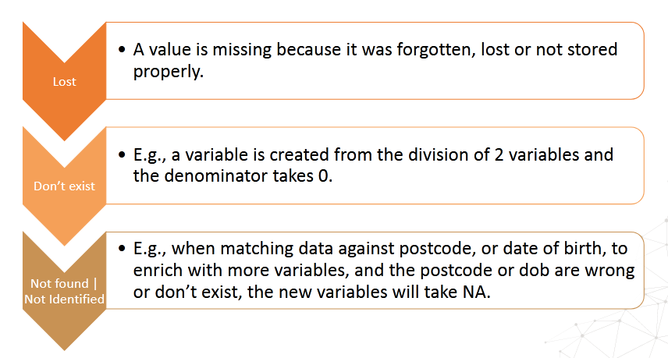

Slide 4
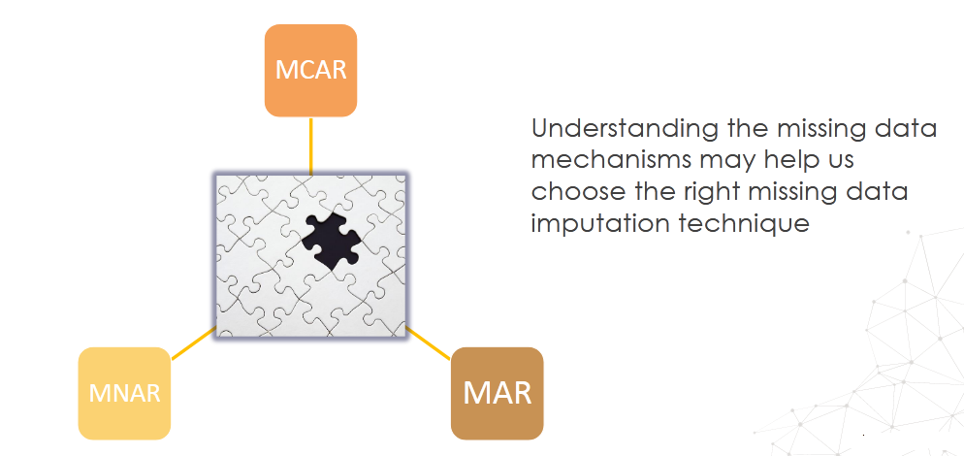

Slide 5
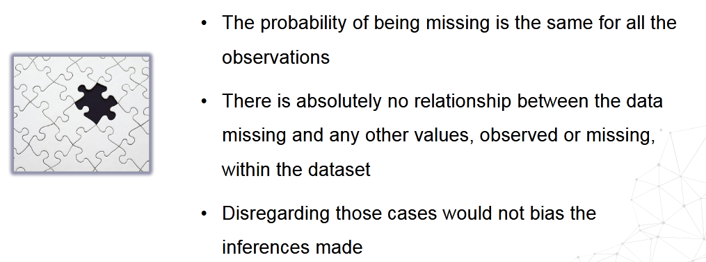
Missing Data Completely at Random(MCAR)

Slide 6
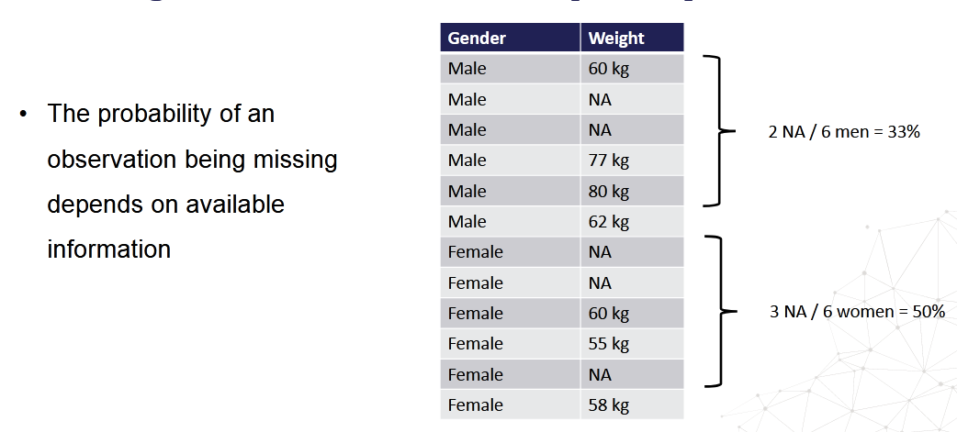
Missing Data at Random (MAR)

Slide 7
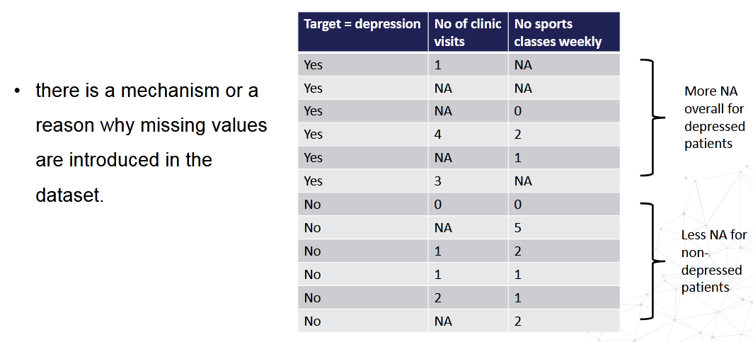
Missing Data not at Random(MNAR)
Notes:
If the data are Missing Not At Random, then the missingness depends on the values of the missing data.

Slide 8
To understand the mechanisms by which missing data is introduced, we need to become familiar with the methods used for data collection.
This is not always possible. However, it is a good idea to understand the methods of data collection as much as possible, to decide how best to engineer the features.

Slide 9
Data Imputation
Imputation is the act of replacing missing data with statistical estimates of the missing values.
The goal of any imputation technique is to produce a complete dataset that can be used to train machine learning models.

Slide 10
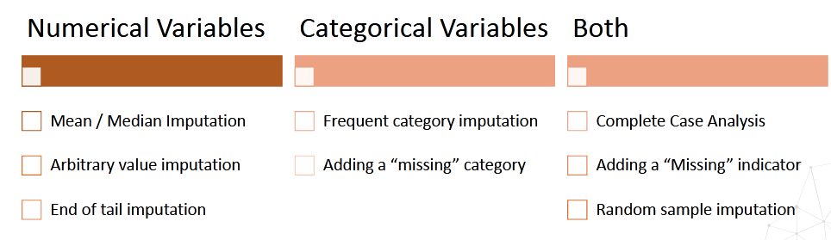

Slide 11
Complete-case analysis (CCA)
Complete-case analysis (CCA), also called "list-wise deletion" of cases, consists in discarding observations where values in any of the variables are missing.
In Complete Case Analysis, we analyse only those observations for which there is information in all of the variables in the dataset.
Suitable for categorical and numerical variables
Assumption – Data is missing at Random

Slide 12
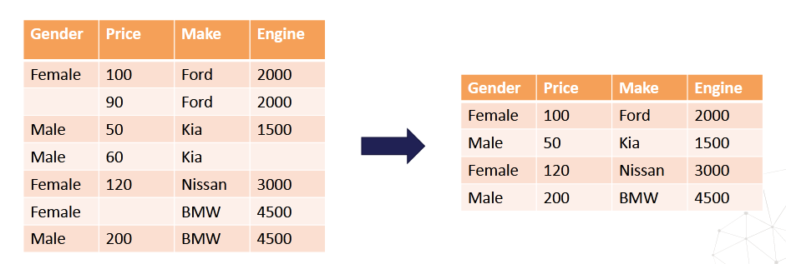

Slide 13
Limitations
It can exclude a large fraction of the original dataset (if missing data is abundant)
Excluded observations could be informative for the analysis (if data is not missing at random)
CCA will create a biased dataset if the complete cases differ from the original data (e.g., when missing information is in fact not missing at random).
When using our models in production, the model will not know how to handle missing data

Slide 14
When to use CCA?
Data is missing completely at random
No more than 5% of the total dataset contains missing data

Slide 15
Mean/Median Imputation
Mean / median imputation consists of replacing all occurrences of missing values (NA) within a variable by the mean or median
Suitable numerical variables

Slide 16
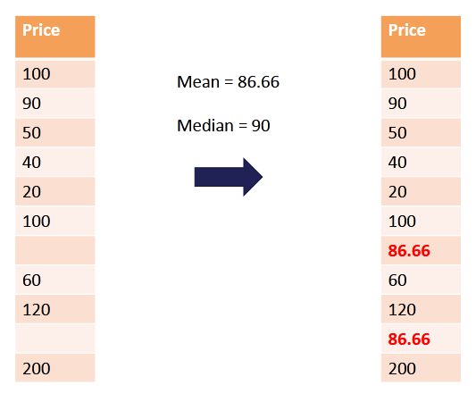

Slide 17
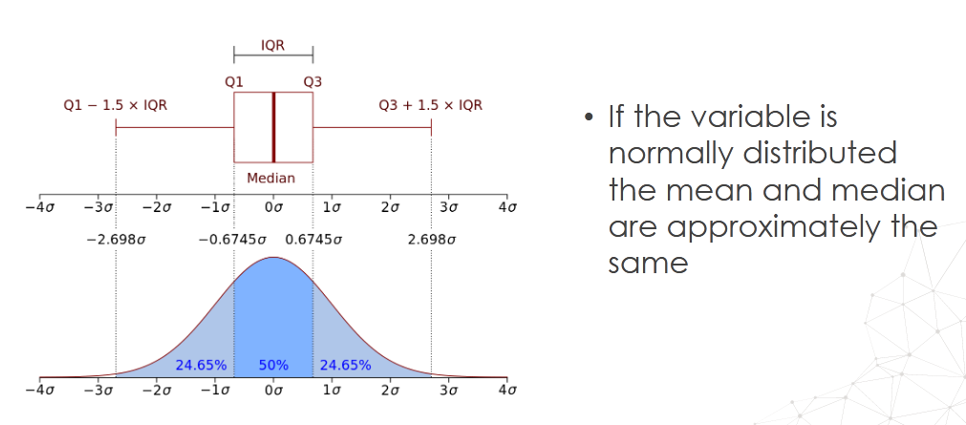
Mean or Median

Slide 18
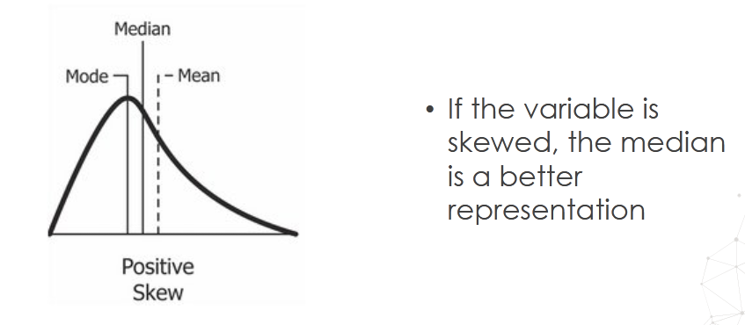

Slide 19
When to use?
Data is missing at random
The missing observations, most likely look like the majority of the observations in the variable (aka, the mean / median)

Slide 20
Advantages
Easy to implement
Fast way of obtaining complete datasets
Can be integrated in production (during model deployment)

Slide 21
Limitations
Distortion of the original variable distribution
Distortion of the original variance
Distortion of the covariance with the remaining variables of the dataset
The higher the percentage of NA, the higher the distortions

Slide 22
When to use mean/median imputation
Data is missing completely at random
No more than 5% of the variable contains missing data

Slide 23
Arbritrary Value Imputation
Arbitrary value imputation consists of replacing all occurrences of missing values (NA) within a variable by an arbitrary value.
Typically used arbitrary values are 0, 999, -999 (or other combinations of 9s) or -1 (if the distribution is positive).
Suitable numerical and categorical variables
Categorical :“Missing”

Slide 24
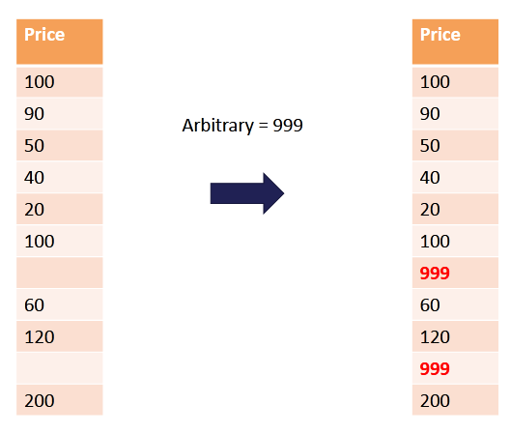

Slide 25
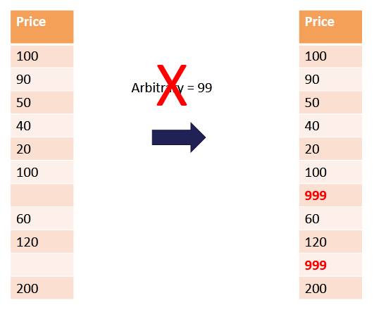

Slide 26
Data is not missing at random.
If this is the case, we want to flag the missing values with a different (arbitrary) value, instead of replacing those occurrences with the mean or the median, which represent the most common value.

Slide 27
Easy to implement
Fast way of obtaining complete datasets
Can be integrated in production (during model deployment)
Captures the importance of being "missing" if there is one

Slide 28
End of tail imputation
End of tail imputation is equivalent to arbitrary value imputation, but automatically selecting arbitrary values at the end of the variable distributions.
If the variable is normally distributed, we can use the mean plus or minus 3 times the standard deviation
If the variable is skewed, we can use the IQR proximity rule
Suitable for numerical variables

Slide 29
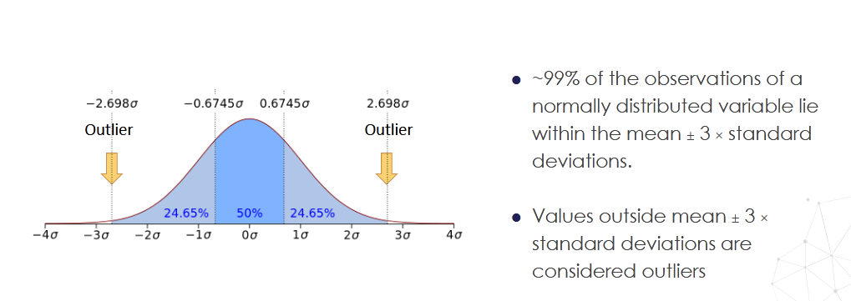
Normal distribution

Slide 30
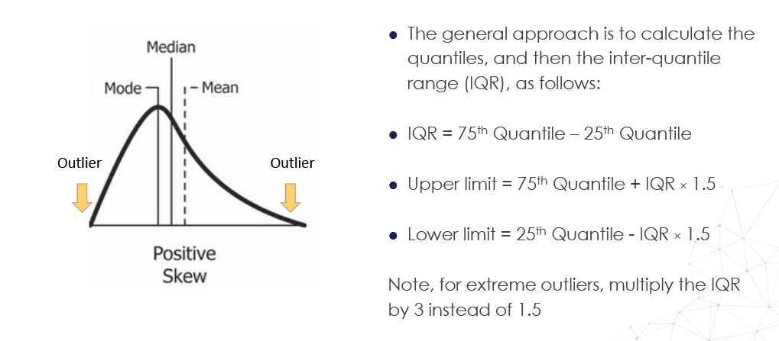
Skewed distributions

Slide 31
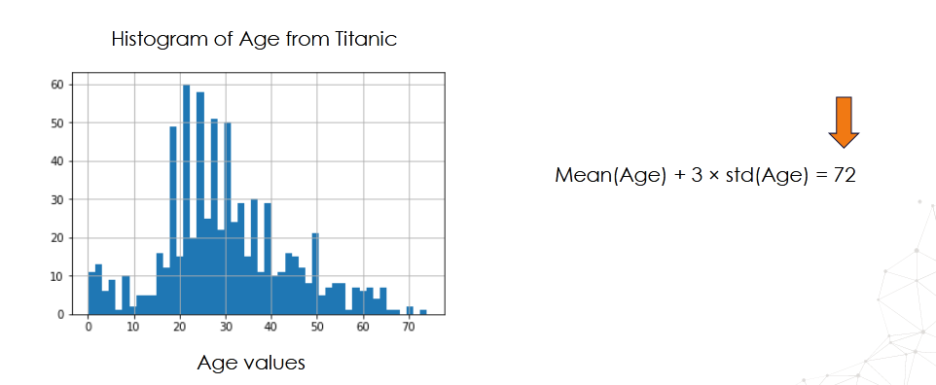

Slide 32
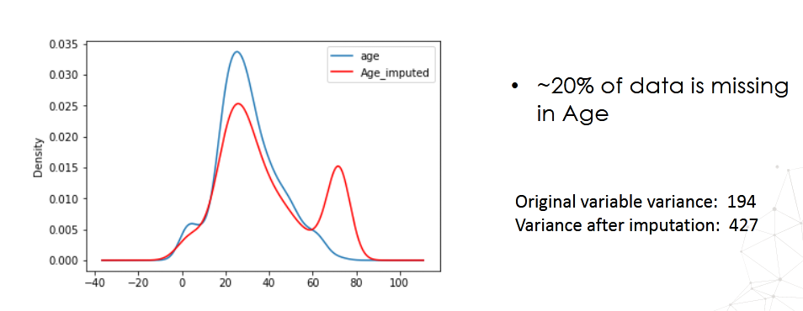

Slide 33
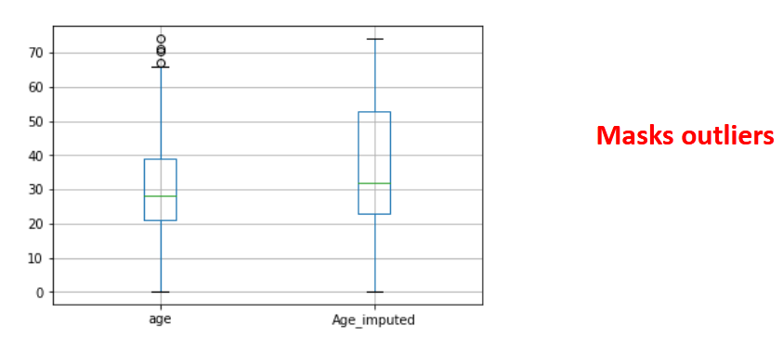
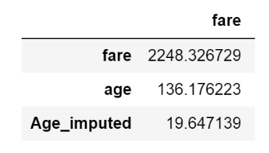

Slide 34
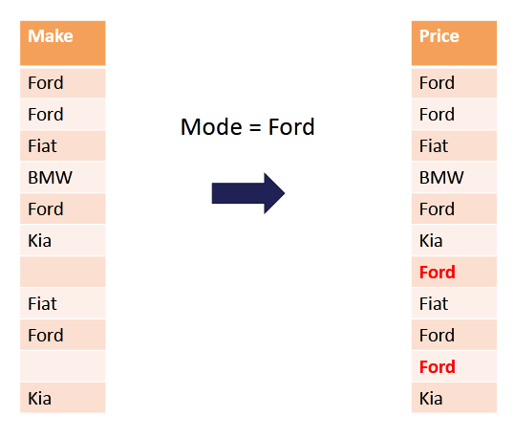
Frequent Category Imputation

Slide 35
When to use?
Data is missing completely at random
No more than 5% of the variable contains missing data
Suitable numerical and categorical variables.
In practice, we use this technique with categorical variables

Slide 36
Missing category Imputation
This method consists in treating missing data as an additional label or category of the variable.
Missing observations are grouped in the newly created label 'Missing'.
This is the most widely used method of missing data imputation for categorical variables.
Suitable for categorical variables

Slide 37
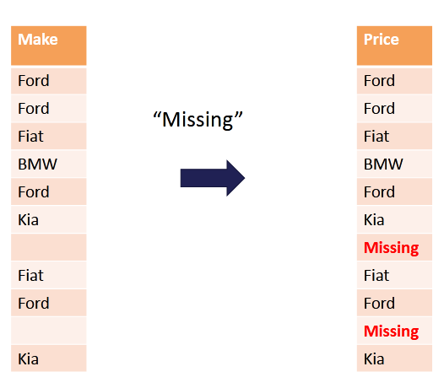

Slide 38
Random Sample Imputation
Random sampling consist in taking a random observation from the pool of available observations of the variable, and using that randomly extracted value to fill the NA.
Suitable for both numerical and categorical variables

Slide 39
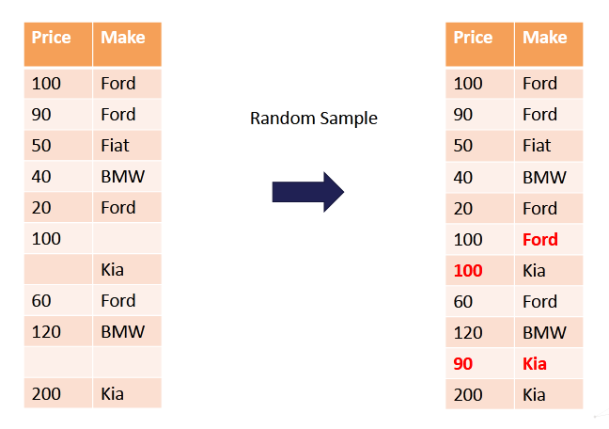

Slide 40
Assumption
Data is missing at random
The idea is to replace the population of missing values with a population of values with the same distribution of the original variable.
Easy to implement
Fast way of obtaining complete datasets
Can be integrated in production (during model deployment)
Preserves the variance of the variable

Slide 41
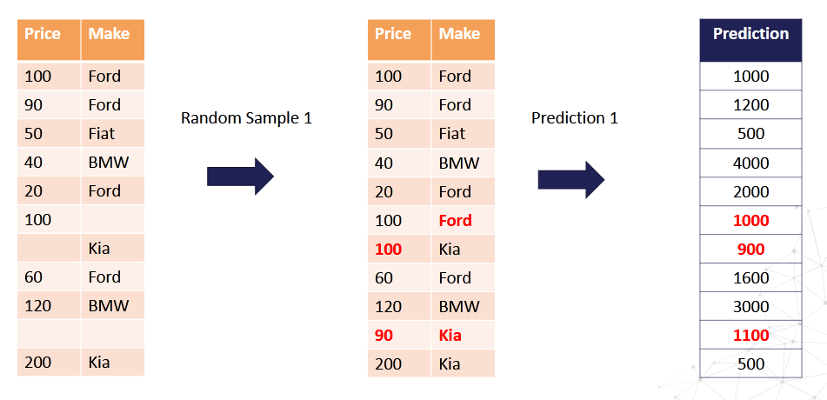

Slide 42
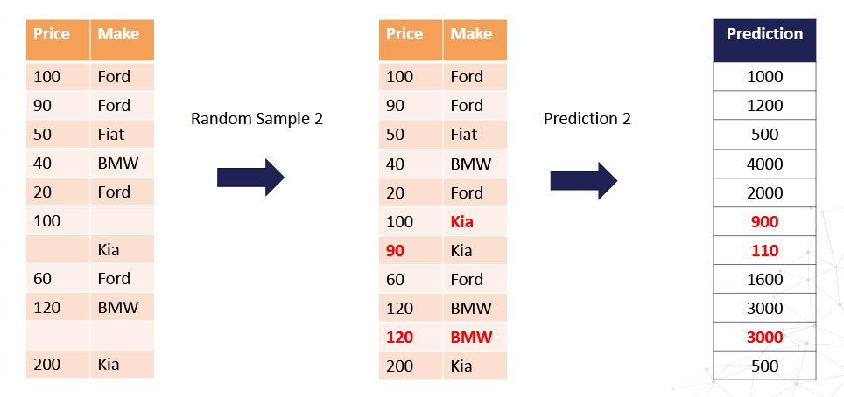

Slide 43
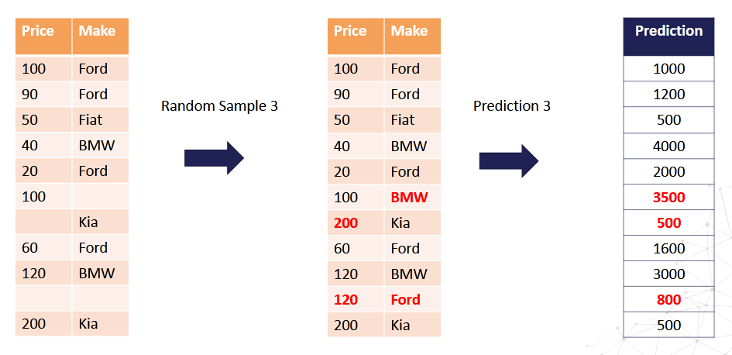

Slide 44
Every time we score the same observation, we may obtain a different prediction
Unwanted side-effect

