Slide 1
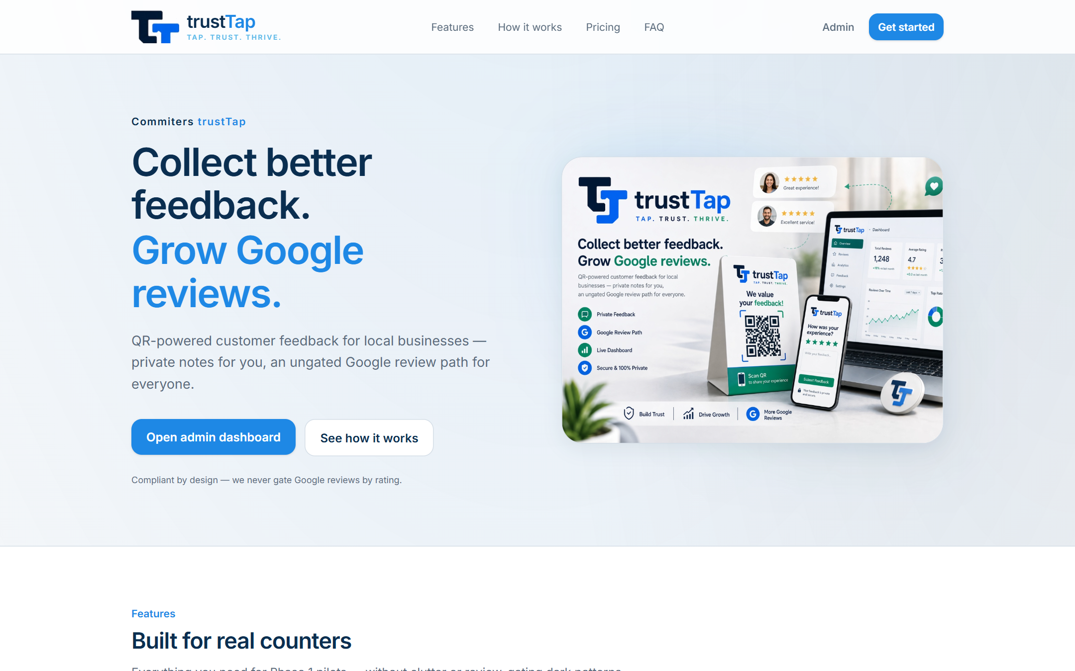
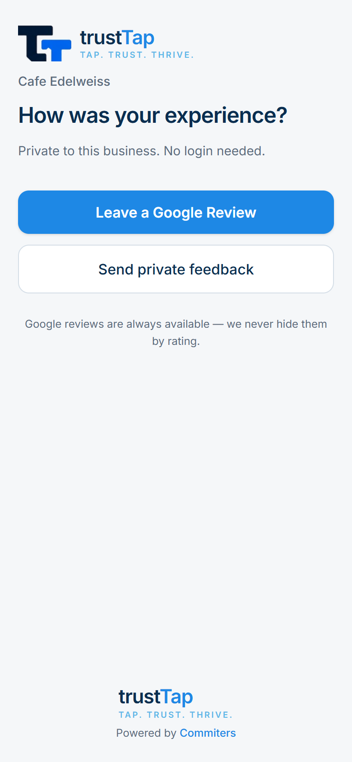
SLIDE 1 — PROJECT OVERVIEW
trustTap: QR feedback & reputation for local businesses
PRODUCT
• Commiters trustTap + new restaurant plan trustTap DinePro
ONE LINE
• QR-based customer feedback and Google review tool for local businesses
PROBLEM
• Owners learn about unhappy customers only after a public Google review
• Static QR boards only print a link: no private recovery, no alerts
TARGET USERS
• Cafés, restaurants, barbers, local shops (pilot in Udaipur)
• Restaurants wanting table-level feedback (DinePro)
PURPOSE
• Easy Google reviews for every customer (never filtered by rating)
• Private feedback + instant owner alerts on low ratings
• Micro-SaaS + lead engine for Commiters services
Homepage — brand, headline and product visual (/)
Customer QR page on phone (/r/cafe-edelweiss)
Commiters trustTap · Product walkthrough
1 / 6

Slide 2
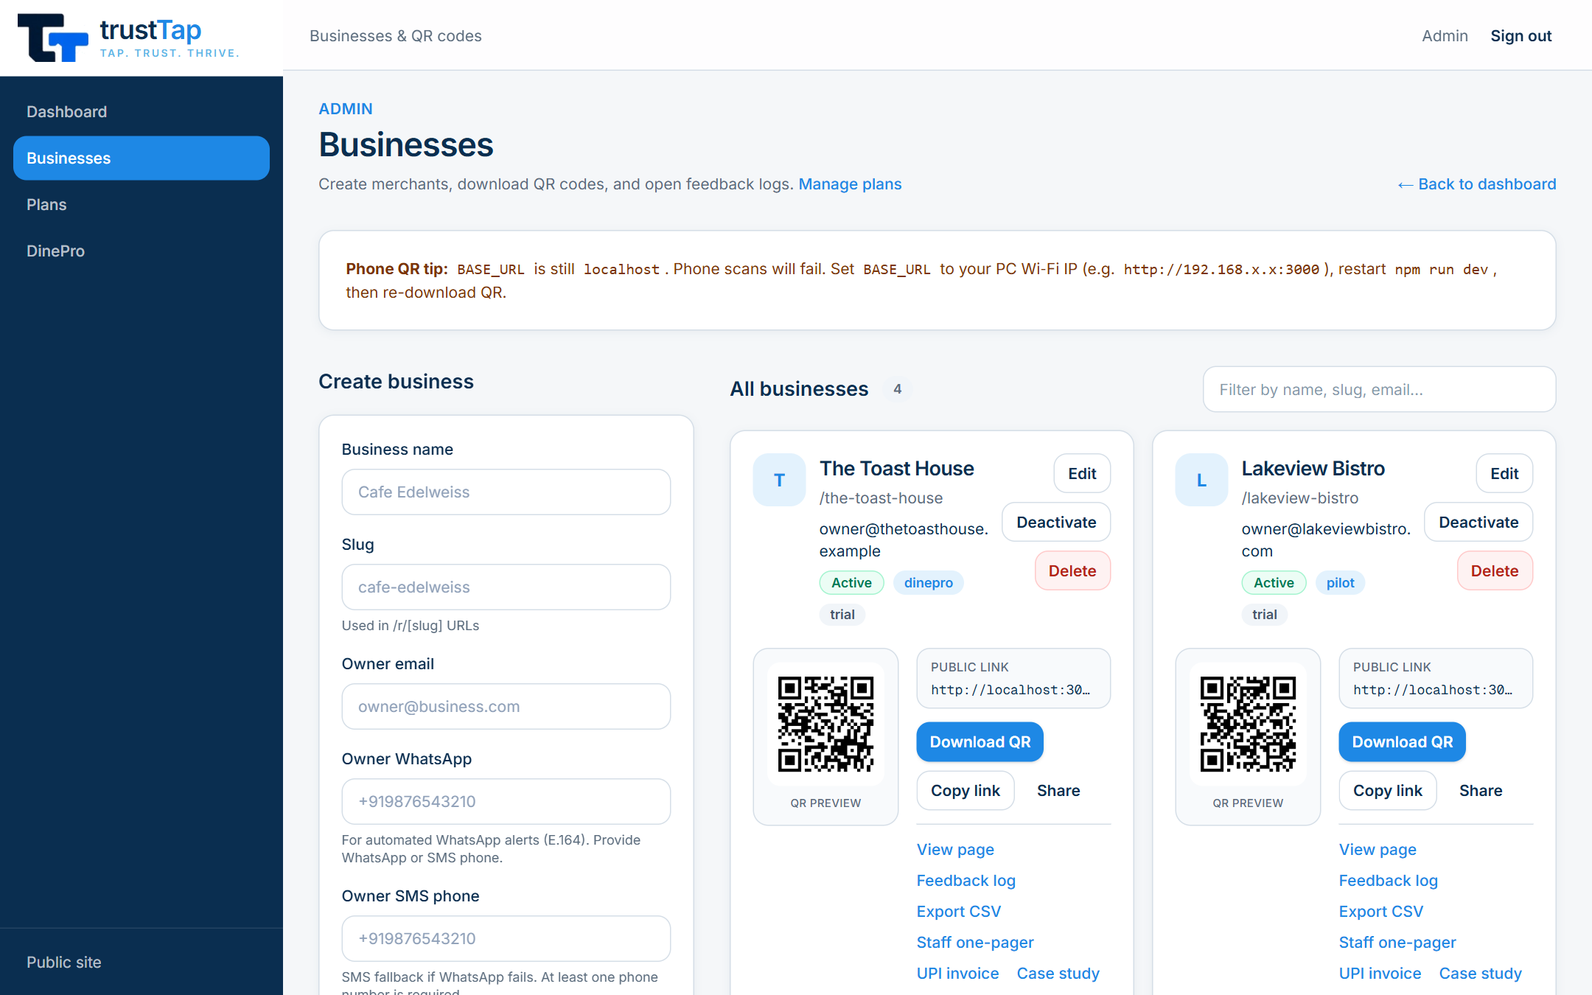
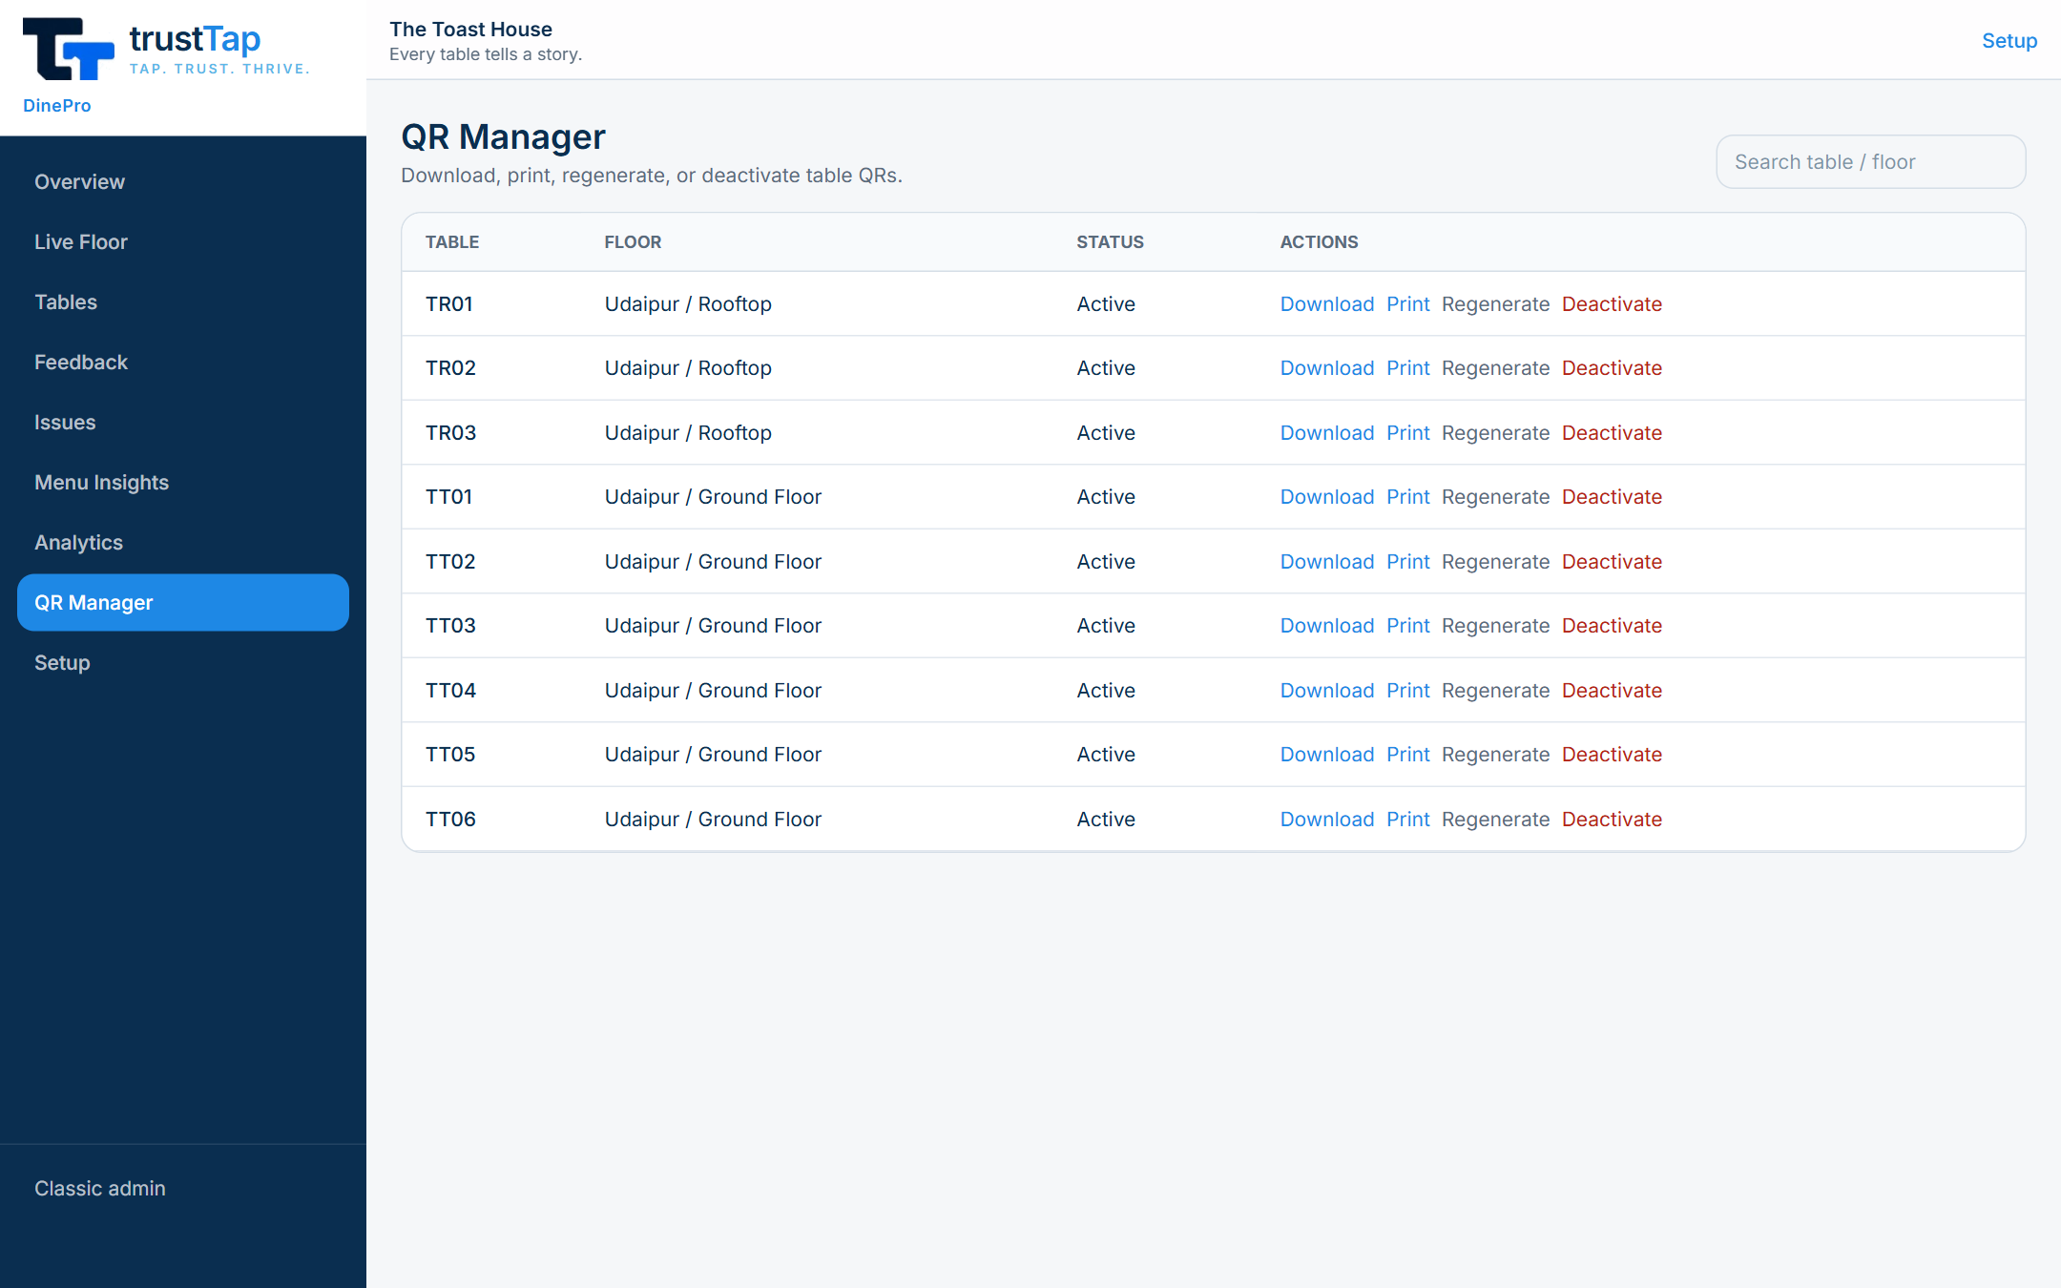
SLIDE 2 — KEY FEATURES
What the product does
CUSTOMER SIDE
• QR landing page per business (/r/{slug}), mobile-first
• Google review button shown to everyone — no gating
• Private feedback: stars, comment, optional name/phone
OWNER & ADMIN
• Alerts on ≤3★: WhatsApp/SMS (Twilio) + email backup
• Admin: businesses, feedback log, CSV export, QR PNG download
• Weekly owner report (Monday cron + “Send report now”)
• Plans & billing: Pilot / Core ₹499 / Premium ₹999 + ₹2,999 setup
• Online signup wizard with Razorpay or cash/UPI
• Printables: staff one-pager, UPI invoice, case study
DINEPRO (RESTAURANTS)
• Unique QR per table · food/service/ambience/wait ratings
• Live Floor, issues, Table Health, menu ratings, analytics
Admin → Businesses: QR, plan/billing badges, actions (/admin/businesses)
DinePro QR Manager: per-table download / print / regenerate (/admin/dinepro/qr)
Commiters trustTap · Product walkthrough
2 / 6

Slide 3
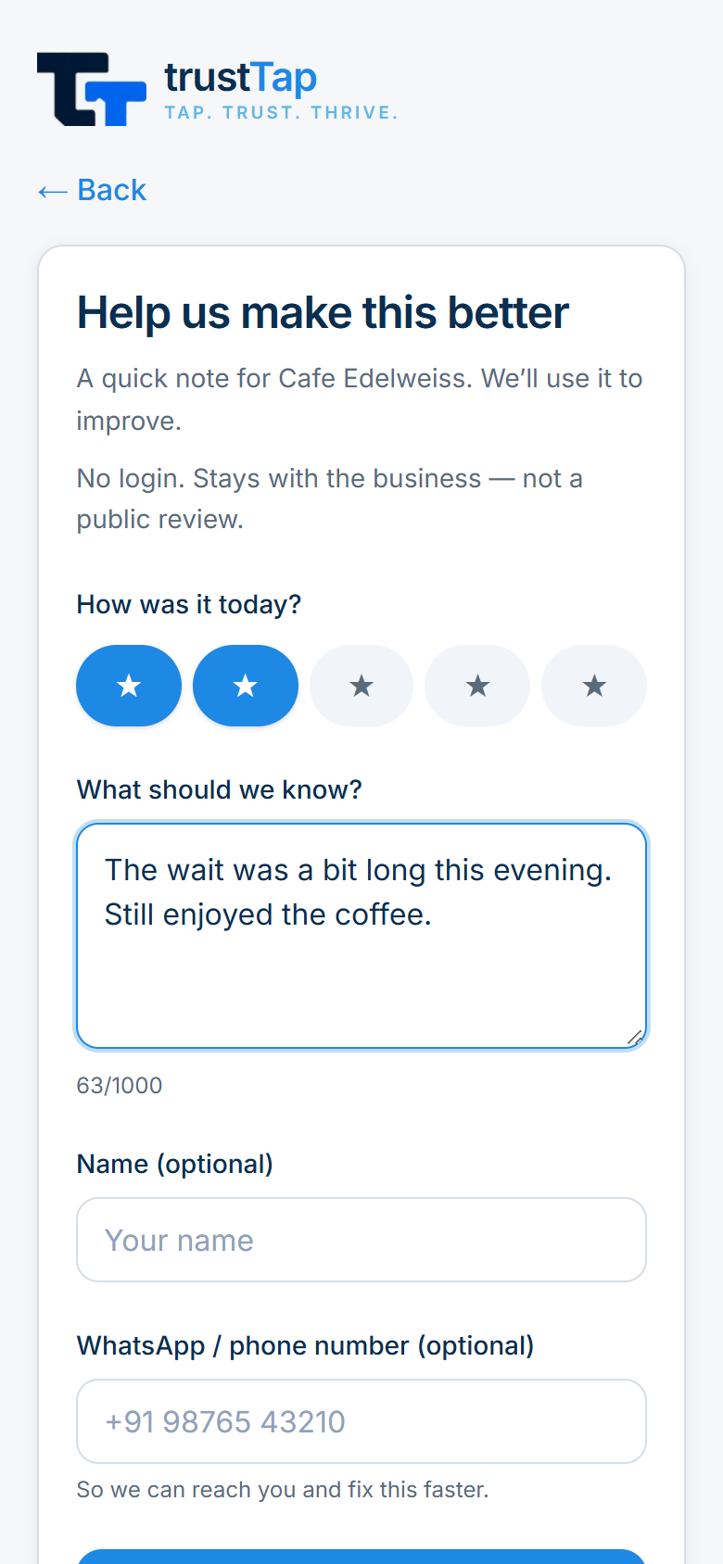
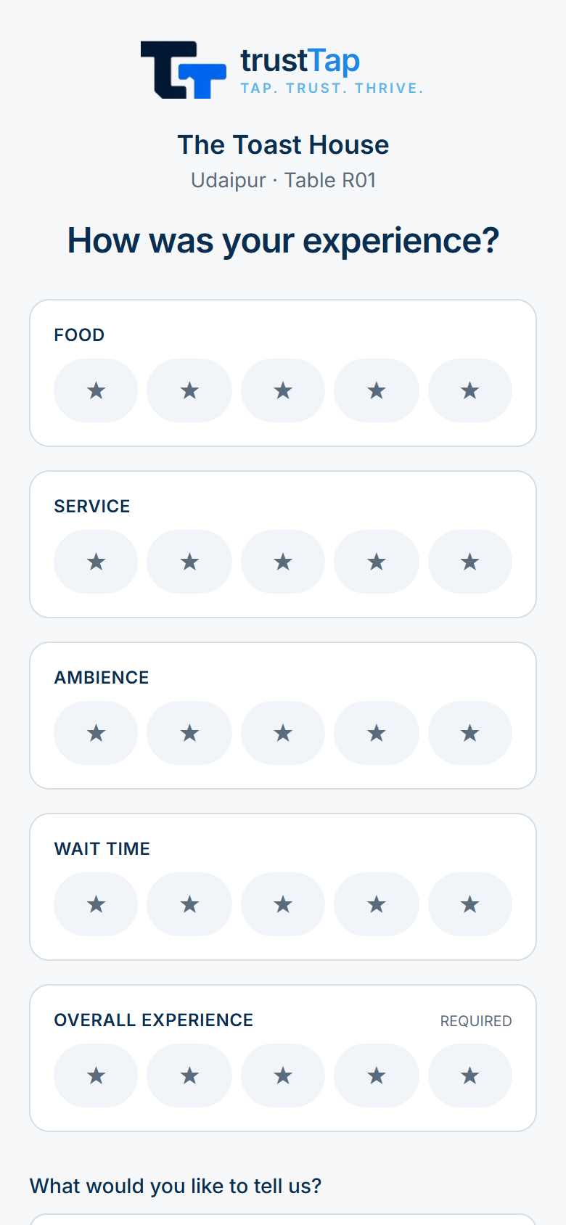
SLIDE 3 — HOW IT WORKS
From QR scan to owner action
CUSTOMER JOURNEY
• 1. Scan QR at the counter → page shows business name
• 2. Tap “Leave a Google Review” (tap logged) or “Send private feedback”
• 3. Private rating ≤3★ → automatic alert to owner
• 4. Entry appears in admin log and weekly report
ADMIN / OWNER WORKFLOW
• Create business (or owner self-signup at /get-started)
• Print QR + staff one-pager → monitor feedback, Google taps, billing
• Send invoice, mark paid, send weekly reports
DINEPRO WORKFLOW
• Setup wizard: branch → floor → tables → QR codes
• Guest scans table QR → rates food, service, ambience, wait time
• Issue opened + manager alerted → resolved from Live Floor / Issues
MODULES
• QR · feedback · alerts · reports · billing & payments · admin · DinePro
Private feedback form (/r/cafe-edelweiss/feedback)
DinePro table guest form (/dine/the-toast-house/udaipur/r01)
Commiters trustTap · Product walkthrough
3 / 6

Slide 4
SLIDE 4 — TECHNOLOGY & ARCHITECTURE
Built on a simple, modern stack
FRONTEND
• Next.js 15 (App Router), React 19, TypeScript, Tailwind CSS 4, Framer Motion
BACKEND
• Next.js API routes → backend/ services, Zod validation
DATABASE
• PostgreSQL with Prisma ORM + migrations
INTEGRATIONS
• Razorpay (payments) · Twilio (WhatsApp/SMS) · SMTP via Nodemailer
• qrcode library for PNGs · Google review links (no Google API)
AUTHENTICATION
• Secure session cookie; platform admin secret; owner password from signup
HOSTING
• Vercel (Mumbai region) + Monday cron · Postgres on Neon/Supabase
• Target domain: trusttap.commiters.com
QUALITY
• Vitest unit tests (127 passing) · Playwright E2E smoke · GitHub Actions CI
Simple architecture
Customer phone / Admin browser
QR scan · dashboard
Vercel cron
Mon weekly
Next.js app on Vercel
pages + API routes
Twilio
WhatsApp/SMS
Service layer (backend/)
feedback · alerts · reports · billing
SMTP
email
Razorpay
payments
PostgreSQL (Prisma)
businesses · feedback · plans · DinePro
Commiters trustTap · Product walkthrough
4 / 6

Slide 5
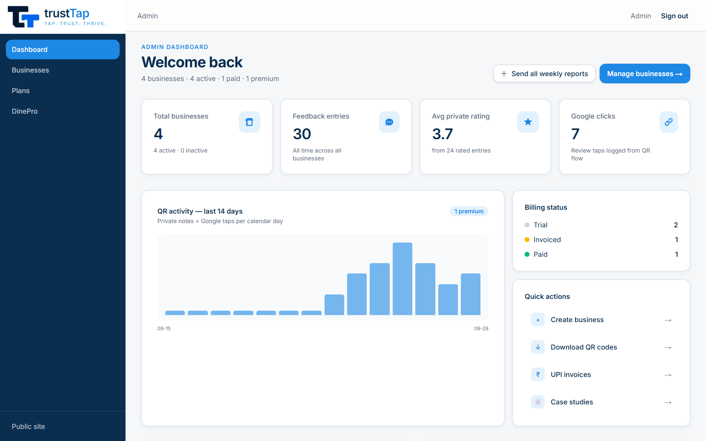
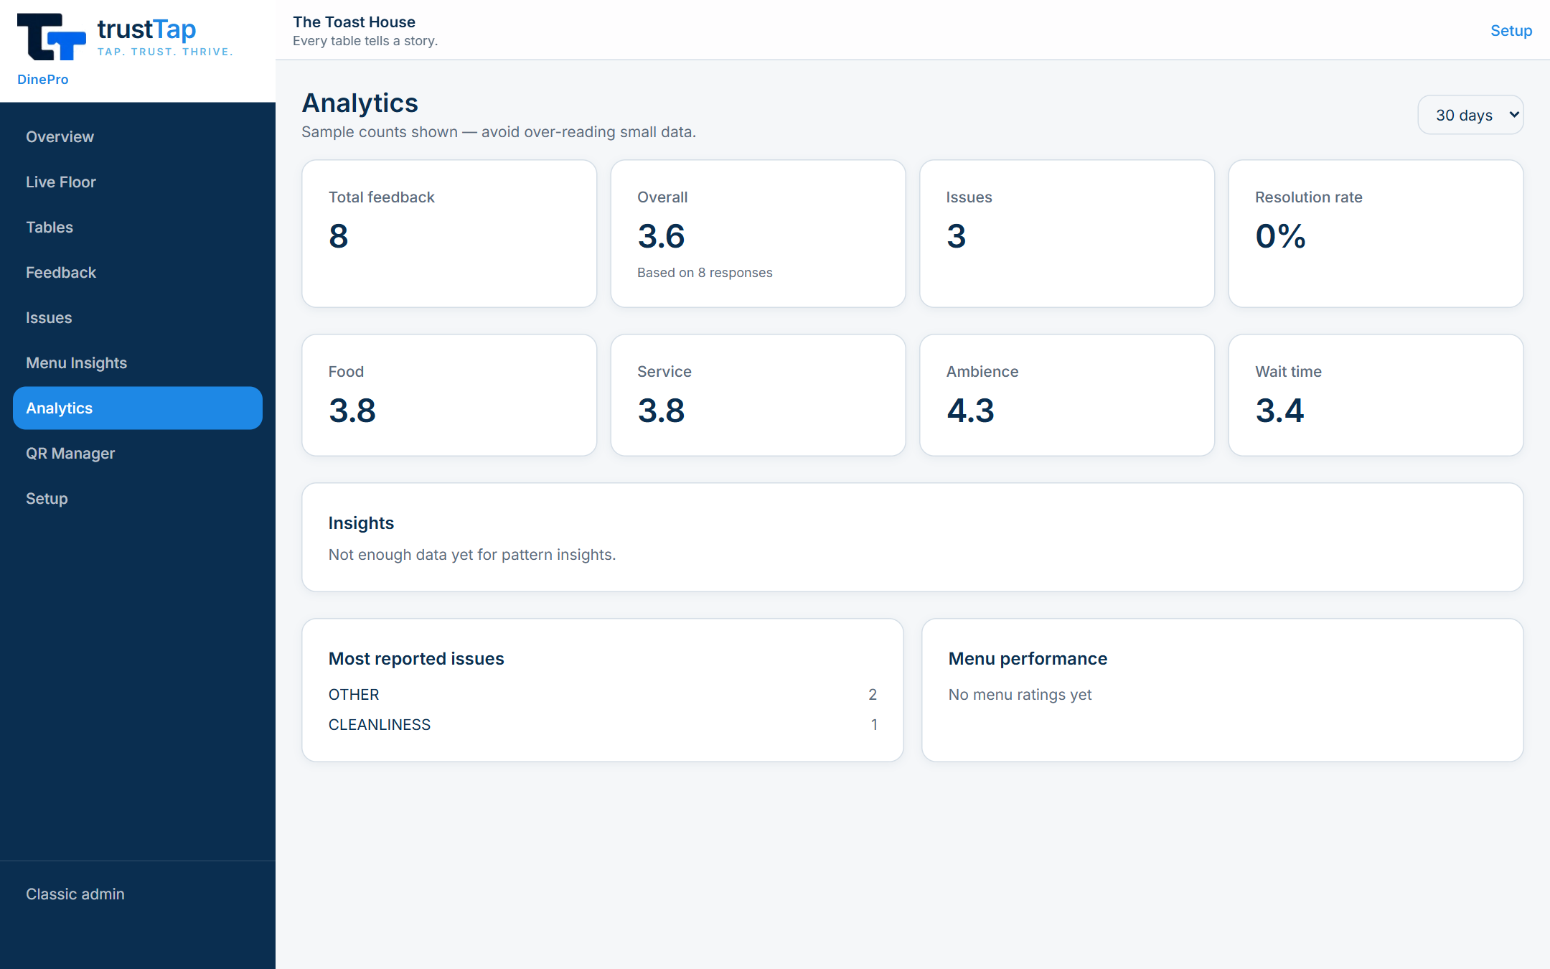
SLIDE 5 — BUSINESS VALUE & CURRENT STATUS
Why it matters and where it stands
BUSINESS VALUE
• Owners hear about unhappy customers privately, before a public review
• Google-compliant: no review gating
• Recurring revenue (setup + monthly) and upsell path for Commiters
• A live system with alerts, log and reports — not a static poster
CURRENT STATUS
• Phase 1 pilot product: complete · Phase 2 monetisation: delivered
• Early Phase 3: online signup, Razorpay, plan catalog
• DinePro first version built (data model, APIs, dashboard)
PENDING WORK
• Owner data isolation in the classic admin console
• Email verification and password reset
• Multi-location QR for the classic product
• DinePro: admin restaurant picker, real-time floor, bulk QR ZIP/PDF
• DinePro: real-data testing, commit and deploy
Admin dashboard: KPIs, 14-day activity, billing status (/admin)
DinePro analytics with sample counts (/admin/dinepro/analytics)
Commiters trustTap · Product walkthrough
5 / 6

Slide 6
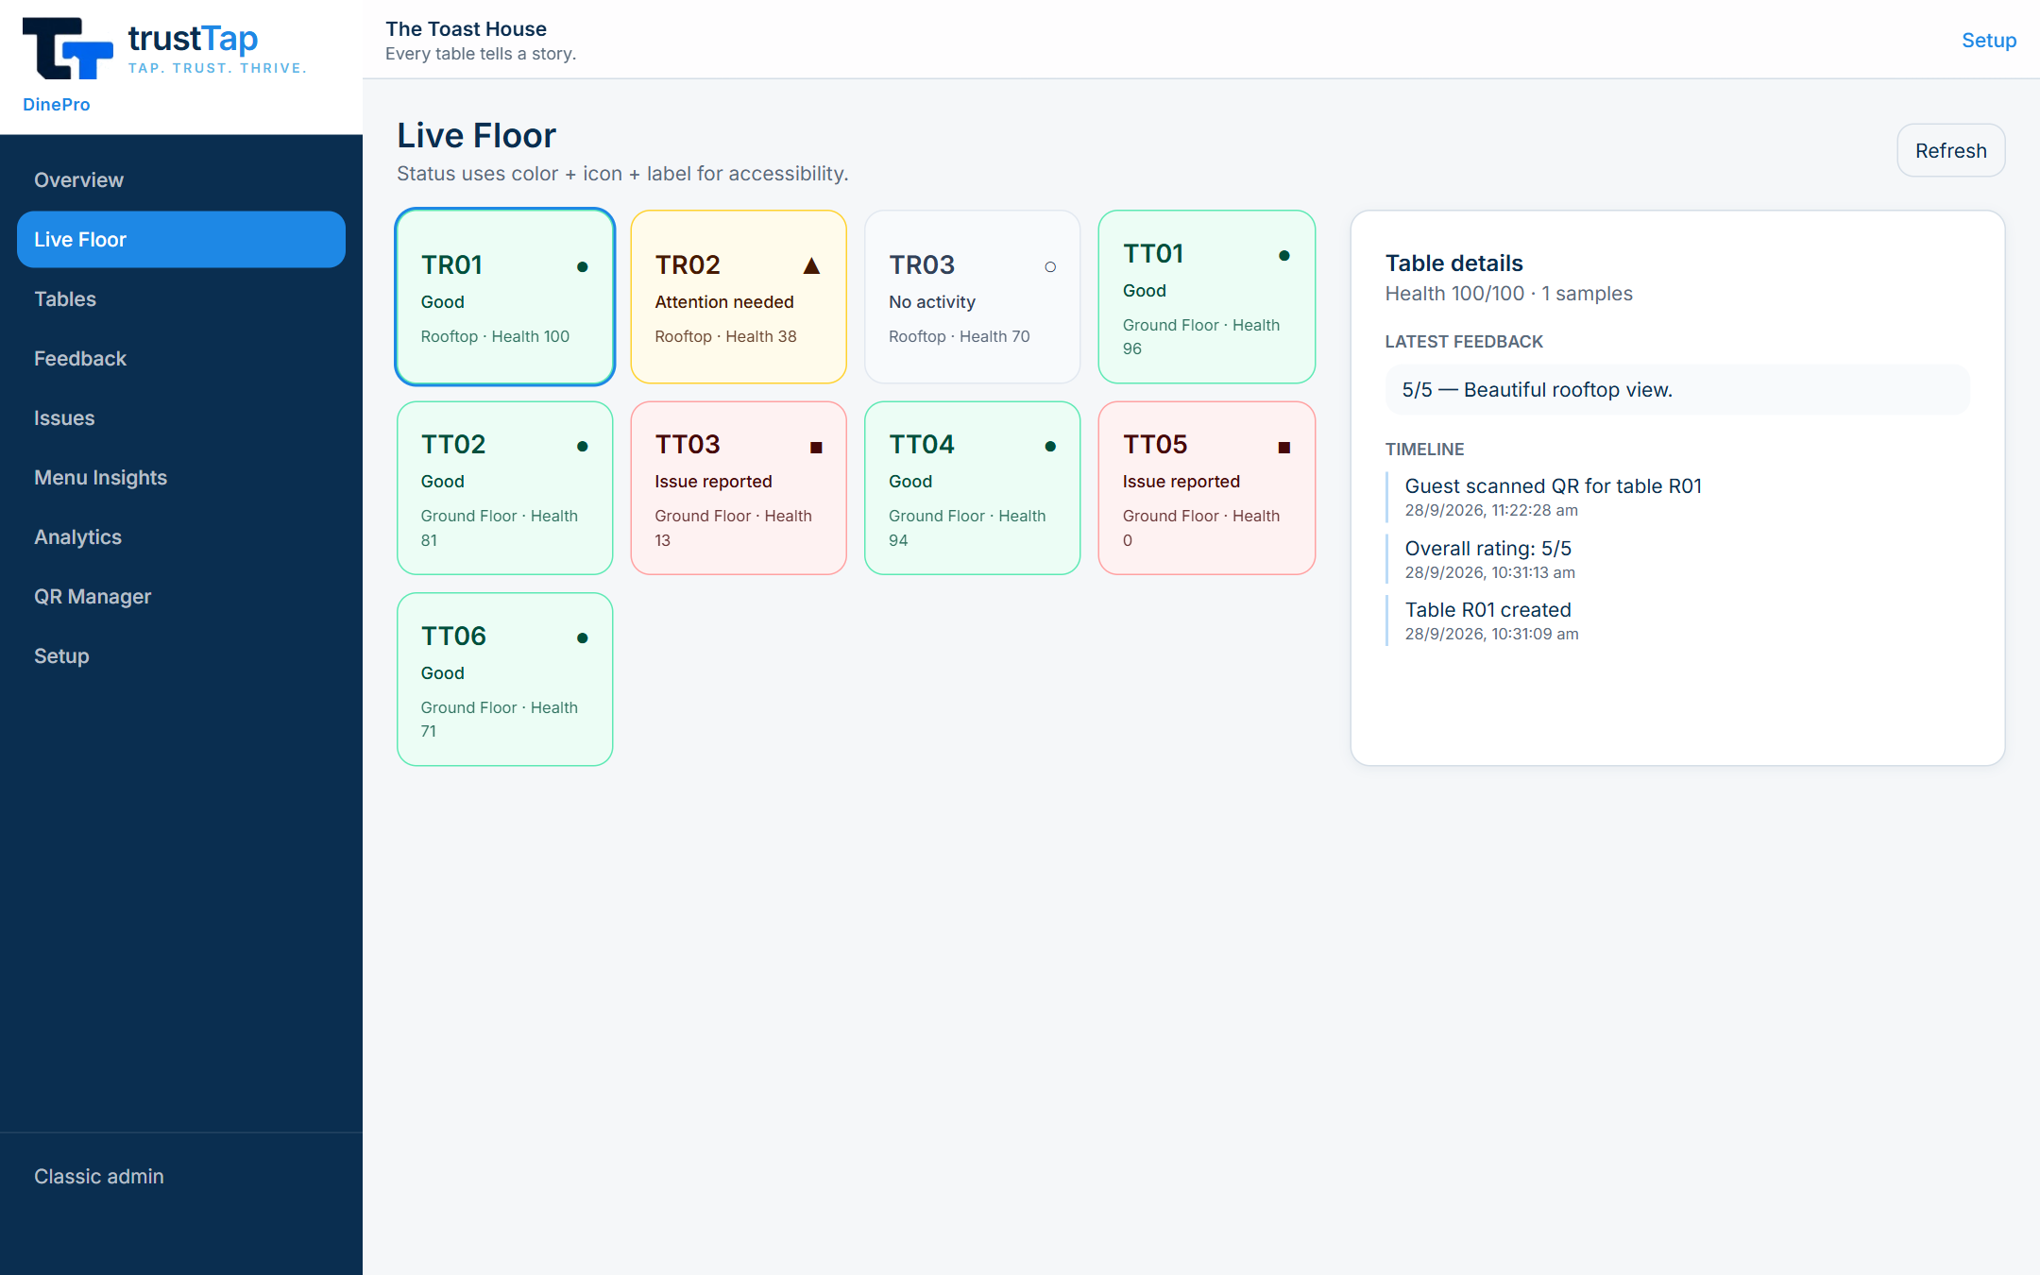
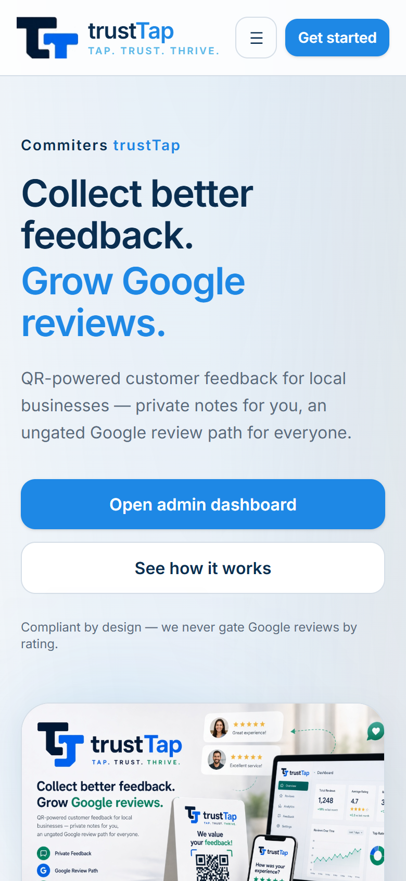
SLIDE 6 — DEMO & FUTURE SCOPE
Live demo plan and what comes next
3–5 MINUTE DEMO
• Homepage → pricing (30s)
• QR page on phone → Google button (30s)
• Submit 2★ private feedback → show alert log/email (1 min)
• Admin dashboard → Businesses → QR / CSV / invoice (1 min)
• DinePro: setup → QR Manager → guest form → Live Floor & issues (1–1.5 min)
ROADMAP
• Phase 3: merchant accounts, self-serve dashboard, multi-location QR
• Phase 4: WhatsApp weekly digest, AI sentiment (Gemini), Google profile health
• Phase 4: analytics dashboard, competitor snapshot, white-label & webhooks
Q&A POINTS
• Doesn’t stop bad Google reviews — gives early private warning
• WhatsApp/SMS needs Twilio configured; demo mode only logs
• Name/phone optional · rate limit is in-memory (Redis at scale)
DinePro Live Floor with table details (/admin/dinepro/floor)
Responsive homepage on mobile
Commiters trustTap · Product walkthrough
6 / 6

