Slide 1



SMART INDIA HACKATHON 2024
TITLE PAGE
Problem Statement ID – SIH1680
Problem Statement Title - Few Shot Language Agnostic Key Word Spotting system (FSLAKWS) for audio files.
Theme- Smart Automation
PS Category- Software
Team ID-
Team Name - CodeWrapper’s

Slide 2

Few Shot Language Agnostic Key Word
Spotting system (FSLAKWS) for audio files.
Code
Wrapper’s
Problem Statement
What Specific Problem Are we Addressing in Your Proposal ?
Development of a Few Shot Language Agnostic Keyword Spotting (FSLAKWS) system.
The system must detect, localize, and classify keywords in audio files of variable duration.
It must function with few examples per keyword for training (Few Shot learning).
The system should support multiple audio sample rates (8k-48k).
It must be language-agnostic and adaptable to additional keywords.
Needs to maintain high performance with low latency and throughput.
The model should be small in size for real-time usage.
Few Shot Language Agnostic Key Word Spotting system (FSLAKWS) for audio files.

Slide 3
Few Shot Language Agnostic Key Word
Spotting system (FSLAKWS) for audio files.
Code
Wrapper’s
Problem as Per our Understanding
Undersatnding
Efficiently training a keyword spotting system with limited data (few-shot learning).
Ensuring the system is robust across different languages and audio formats.
Generalizing from few examples to accurately detect keywords in various scenarios.
Supporting diverse audio sample rates (8k-48k Hz).
Minimizing model size, latency, and computational resources for real-time performance.
The system must be scalable and adaptable to add new keywords.

Slide 4

Few Shot Language Agnostic Key Word
Spotting system (FSLAKWS) for audio files.
Code
Wrapper’s
Language Agnostic
The system leverages pre-trained models on a large multilingual dataset (such as the Multilingual Spoken Words Corpus (MSWC)) to ensure that it can spot keywords across diverse languages
Few-Shot Learning
Proposed Solution
We incorporate few-shot learning to enable the system to effectively detect keywords with just a few training examples. This is done by fine-tuning a pre-trained model using only the limited keyword examples provided during the hackathon.
We propose a Few Shot Language Agnostic Keyword Spotting (FSLAKWS) system designed to detect keywords across multiple languages in audio files of variable lengths, even with very few training examples per keyword. The system will be capable of adapting to new keywords and handling different audio sample rates
Handling Variable Sample Rates (8kHz to 48kHz)
The system will preprocess audio files with varying sample rates, ensuring that all data is normalized and transformed into suitable formats (e.g., spectrograms) for model input.
Upgradability for Additional Keywords
The system is designed with modularity, allowing new keywords to be easily added and trained in real-time. This is achieved through a scalable architecture that supports fine-tuning the model with additional keywords as they become available.
Latency & Throughput
The system is optimized for real-time performance, using lightweight models (like DSCNN or Wav2Vec 2.0) and advanced techniques like model pruning and quantization to reduce model size and improve response time.

Slide 5
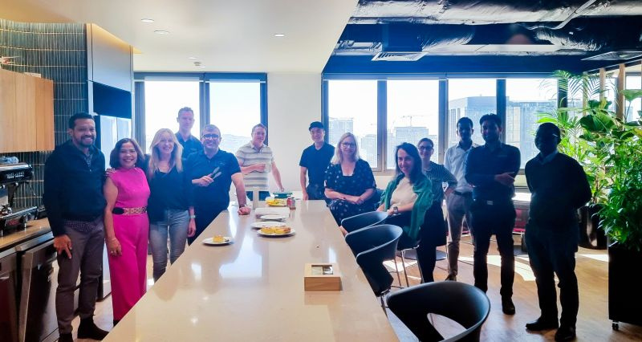
Few Shot Language Agnostic Key Word
Spotting system (FSLAKWS) for audio files.
Code
Wrapper’s
About the Industry/Ministry
National Technical Research Organisation (NTRO)
NTRO is a specialized technical intelligence agency in India. It is responsible for gathering and analyzing technical intelligence to support national security operations. The Few Shot Language Agnostic Keyword Spotting (FSLAKWS) system can assist NTRO by improving automated keyword spotting in audio files, which is crucial for processing large volumes of multilingual audio data in intelligence gathering and surveillance. This system enhances NTRO's ability to analyze communications across various languages, with minimal data and faster processing.

Slide 6
Few Shot Language Agnostic Key Word
Spotting system (FSLAKWS) for audio files.
Code
Wrapper’s
Current State-of-the-Art Solutions Available
Multilingual Spoken Words Corpus (MSWC)
Few-Shot Keyword Spotting
Wav2Vec 2.0
DSCNN (Depthwise Separable Convolutional Neural Networks)
MLCommons Multilingual Spoken Words Dataset

Slide 7
Few Shot Language Agnostic Key Word
Spotting system (FSLAKWS) for audio files.
Code
Wrapper’s
How we Addressing ?
Current solutions struggle with language support, variable sample rates, and keyword scalability. Our approach ensures language agnosticism, handles multiple sample rates, optimizes few-shot learning, and allows easy keyword upgrades.
01
02
03
04
Limited Language Support
Handling Variable Sample Rates
Few-Shot Learning Optimization
Scalability

Slide 8
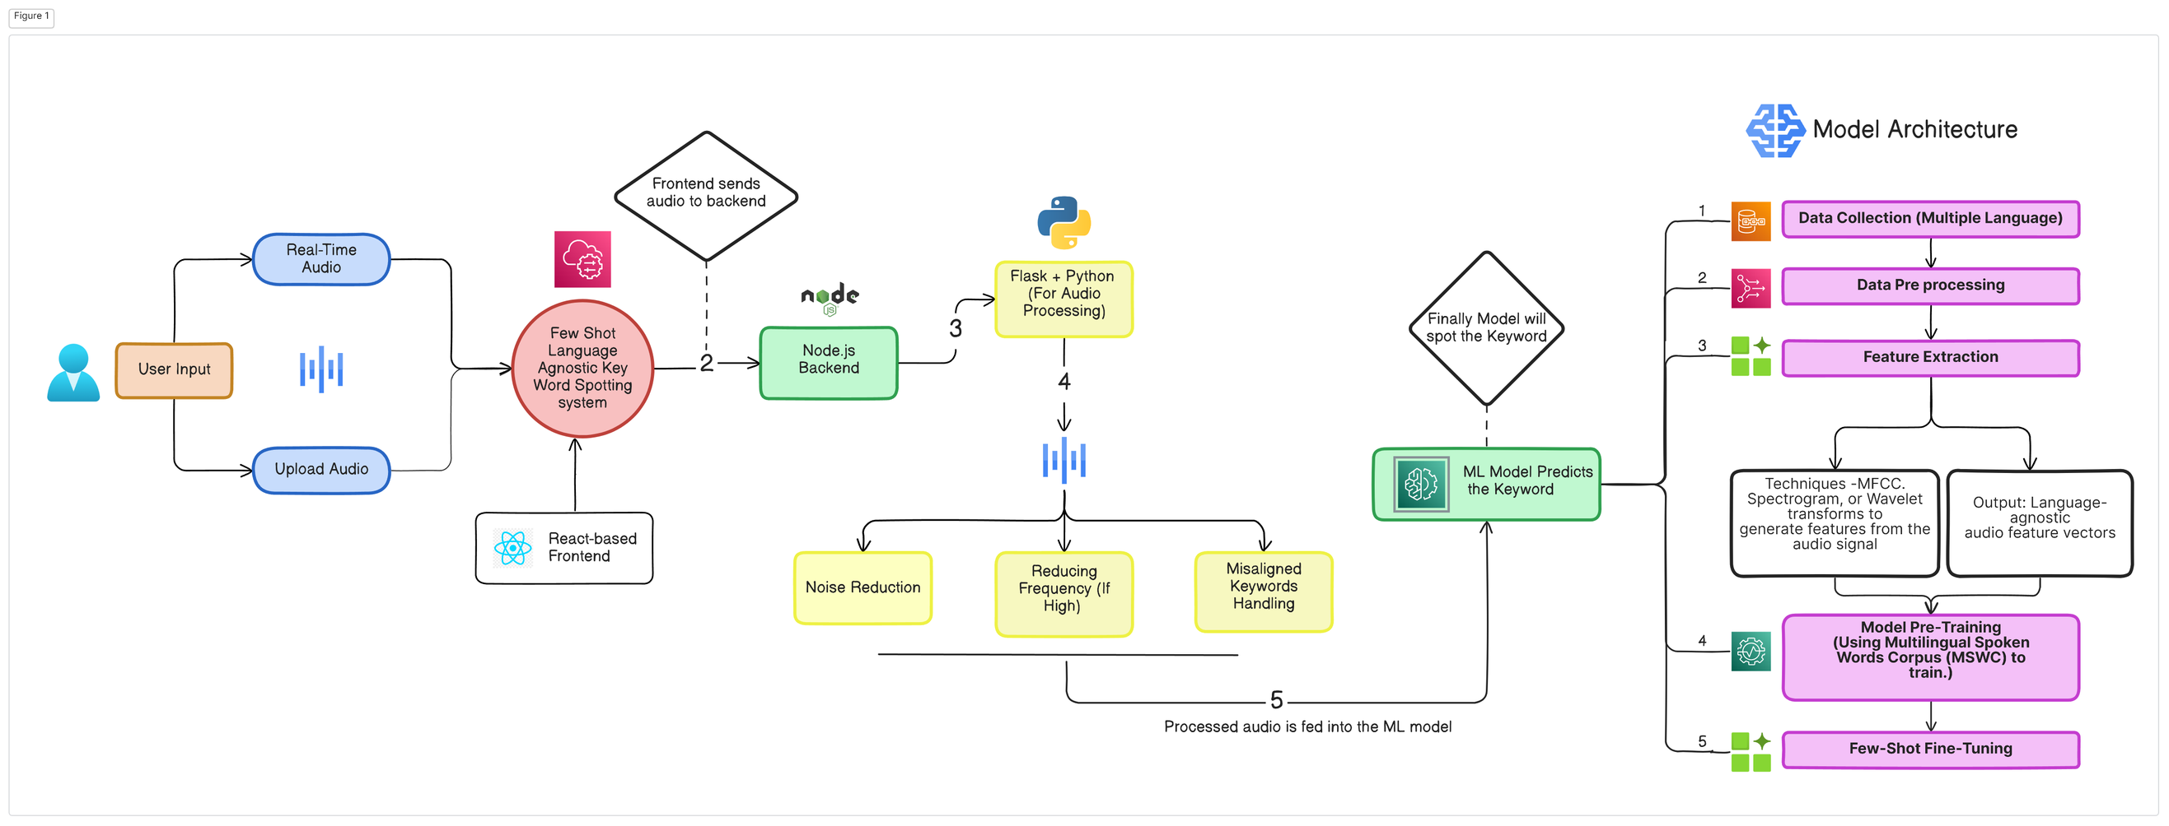
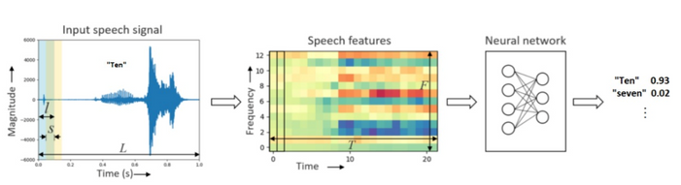












Code
Wrapper’s
Technical Approach

Slide 9
Few Shot Language Agnostic Key Word
Spotting system (FSLAKWS) for audio files.
Code
Wrapper’s
Solution Model Description
Our solution utilizes a pre-trained multilingual model fine-tuned for few-shot learning, enabling it to detect keywords with minimal data. Audio files with varying sample rates are normalized into spectrograms for consistent input. The system incorporates few-shot learning techniques to ensure high accuracy with limited examples.
1 | Pre-trained Multilingual Model: Utilize a pre-trained model (e.g., Wav2Vec 2.0) fine-tuned for few-shot learning on a large multilingual dataset like MSWC.
2 | Audio Preprocessing: Normalize and convert audio files of varying sample rates (8kHz to 48kHz) into spectrograms for consistent model input.
3 | Few-Shot Learning: Implement few-shot learning techniques to detect keywords with minimal training examples using Prototypical Networks or similar methods.
4 | Scalable Architecture: Design the system to allow easy addition of new keywords with minimal re-training by using a modular and upgradable structure.
5 | Optimized for Real-Time Performance: Use model compression techniques like pruning and quantization to reduce model size, ensuring low latency and high throughput.
6 | Scalable architecture that supports easy addition of new keywords and uses model compression techniques to optimize for real-time performance, ensuring low latency and throughput.

Slide 10







Few Shot Language Agnostic Key Word
Spotting system (FSLAKWS) for audio files.
Code
Wrapper’s
Dynamic Model Adaptation
This would enable the system to learn and adapt in real-time, improving its performance with ongoing use.
Differentiation Strategies
User-Centric Customization
Allow users to customize the system by defining their own keywords or phrases, which could be particularly useful in specialized domains (e.g., medical or technical fields).
Sentimental Analysis
User can predict the emotion associated to word.

Slide 11




Code
Wrapper’s
FEASIBILITY AND VIABILITY
Technical Feasibility
Operational Viability
Assessing the ability to develop the FSLAKWS system using current AI and speech processing technologies.
Evaluating the system’s performance in real-world applications, including latency and response time.
Data Feasibility
Market Viability
Utilizing large-scale multilingual datasets like MSWC for pre-training and handling diverse audio samples.
Potential to commercialize the system across industries like call centers, voice assistants, and healthcare monitoring.
Algorithm Feasibility
Financial Viability
Implementing clustering, anomaly detection, and forced alignment techniques for accurate keyword extraction.
Cost-effectiveness of the solution, leveraging open-source data and frameworks to reduce development expenses.
Scalability Feasibility
Maintenance and Upgradability
Ensuring the system can adapt to additional keywords and various languages with minimal modifications.
Ease of maintaining and upgrading the system with new keywords and languages, ensuring long-term relevance and utility.

Slide 12
Few Shot Language Agnostic Key Word
Spotting system (FSLAKWS) for audio files.
Code
Wrapper’s
Future Plans for Prototype Development
Find the magic and fun in presenting with Canva Presentations.
Press the following keys while on Present mode!
Phase 1 | Research and Initial Setup | Phase 5 | Finalization and Documentation
Phase 2 | Data Collection and Preprocessing | Phase 6 | Shifting to MERN based interactive website.
Phase 3 | Model Development and Training
Phase 4 | Prototype Testing and Iteration

Slide 13
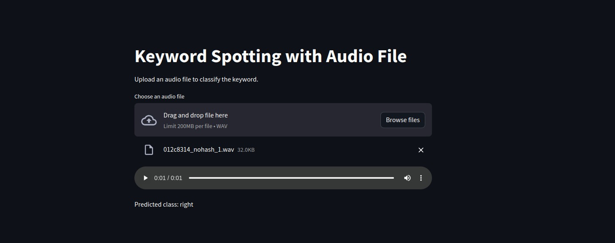
As for now We trained our model on 10 keywords and it has accuracy over 90%.
our prototype is currently support only english but in future we are planning for more than 50 languages.
In future we will try to add some extra feature like beeping certain keyword from audio along with Keyword spotting.

Slide 14












THANK YOU

