Slide 1



SMART INDIA HACKATHON 2024
TITLE PAGE
Problem Statement ID – SIH1680
Problem Statement Title - Few Shot Language Agnostic Key Word Spotting system (FSLAKWS) for audio files.
Theme- Smart Automation
PS Category- Software
Team ID-
Team Name - CodeWrapper’s

Slide 2


Few Shot Language Agnostic Key Word
Spotting system (FSLAKWS) for audio files.
Language Agnostic
The system leverages pre-trained models on a large multilingual dataset (such as the Multilingual Spoken Words Corpus (MSWC)) to ensure that it can spot keywords across diverse languages
Few-Shot Learning
Proposed Solution
We incorporate few-shot learning to enable the system to effectively detect keywords with just a few training examples. This is done by fine-tuning a pre-trained model using only the limited keyword examples provided during the hackathon.
We propose a Few Shot Language Agnostic Keyword Spotting (FSLAKWS) system designed to detect keywords across multiple languages in audio files of variable lengths, even with very few training examples per keyword. The system will be capable of adapting to new keywords and handling different audio sample rates
Handling Variable Sample Rates (8kHz to 48kHz)
The system will preprocess audio files with varying sample rates, ensuring that all data is normalized and transformed into suitable formats (e.g., spectrograms) for model input.
Upgradability for Additional Keywords
The system is designed with modularity, allowing new keywords to be easily added and trained in real-time. This is achieved through a scalable architecture that supports fine-tuning the model with additional keywords as they become available.
Latency & Throughput
The system is optimized for real-time performance, using lightweight models (like DSCNN or Wav2Vec 2.0) and advanced techniques like model pruning and quantization to reduce model size and improve response time.

Slide 3
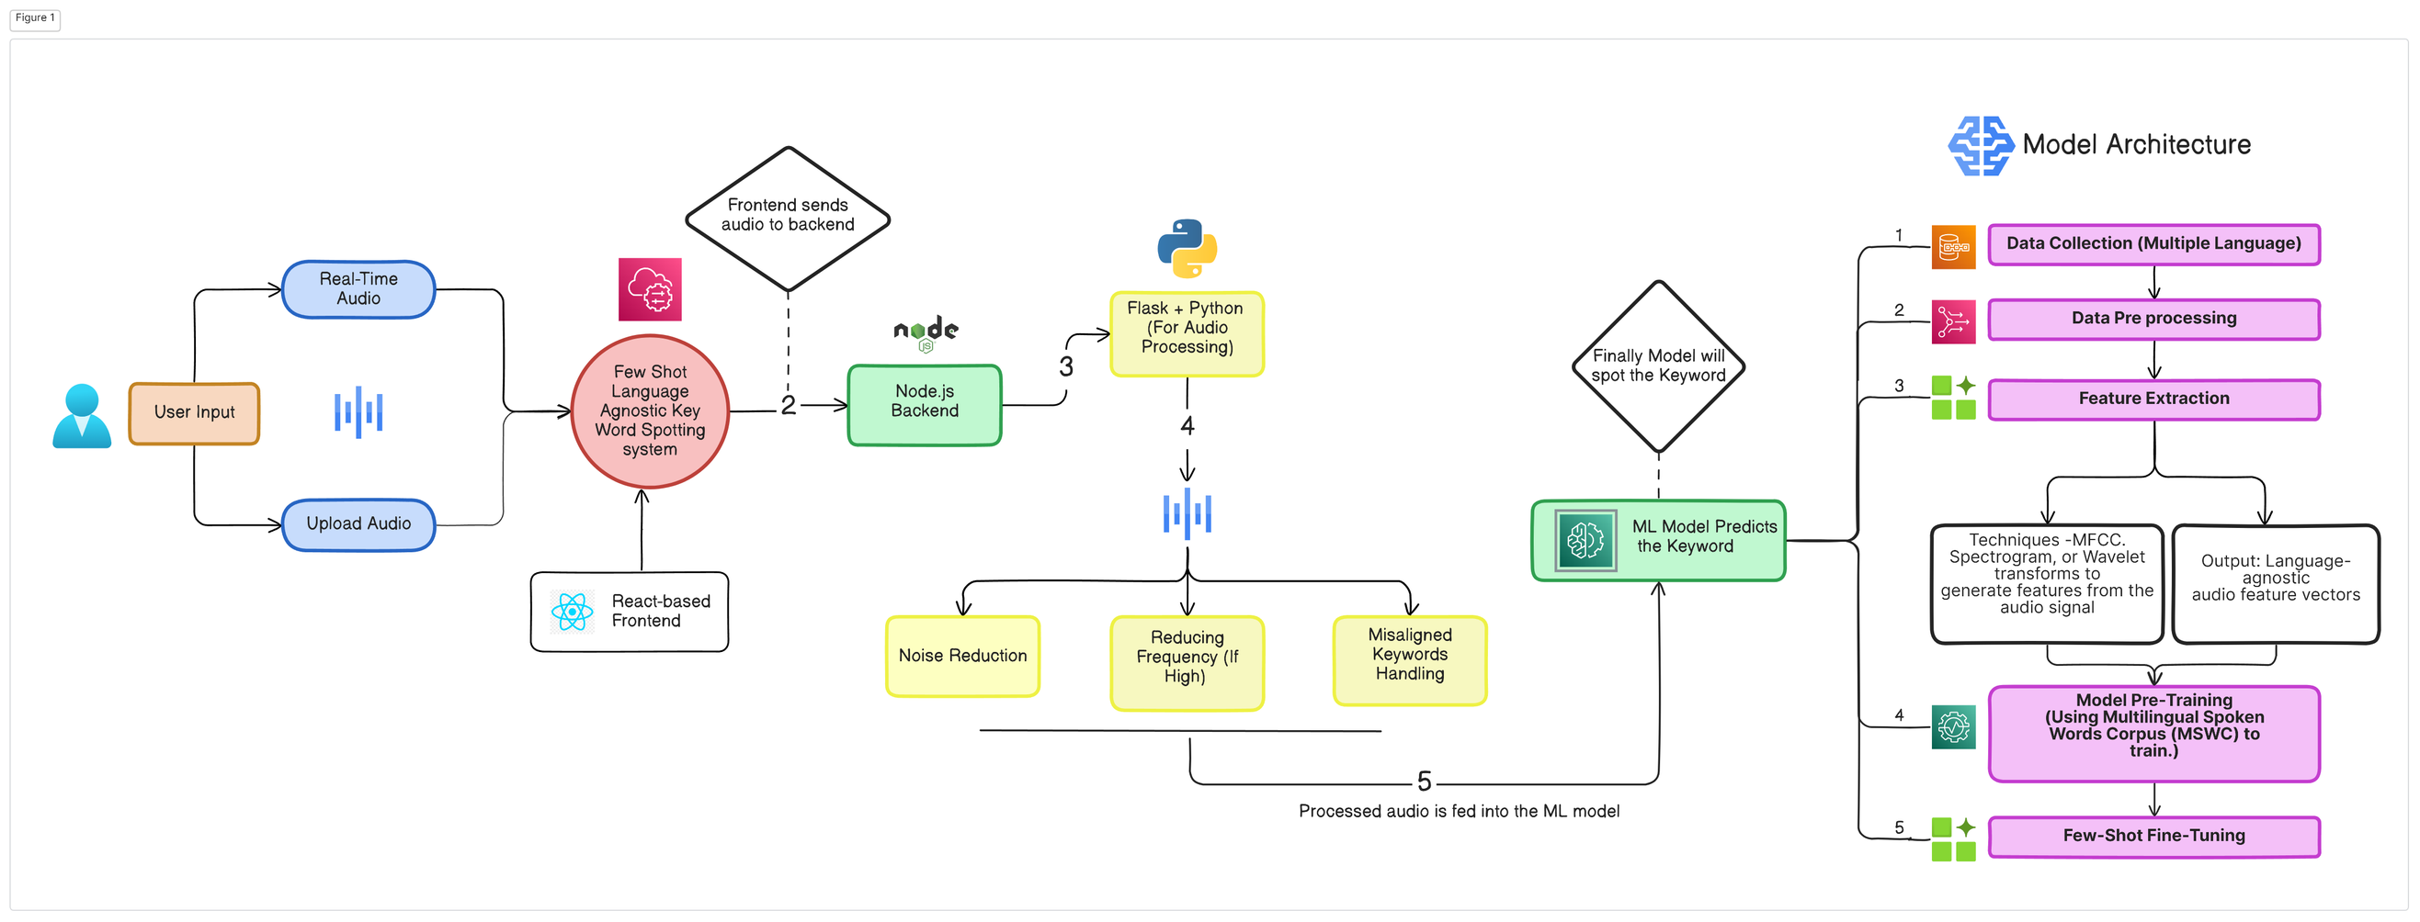
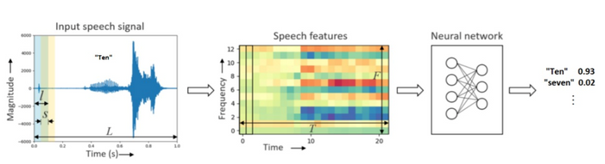












Technical Approach

Slide 4









FEASIBILITY AND VIABILITY
Technical Feasibility
Operational Viability
Assessing the ability to develop the FSLAKWS system using current AI and speech processing technologies.
Handles both pre-recorded and real-time audio for comprehensive keyword/hotword detection and immediate response.
Data Feasibility
Market Viability
Utilizing large-scale multilingual datasets like MSWC for pre-training and handling diverse audio samples.
Potential to commercialize the system across industries like call centers, voice assistants, and healthcare monitoring.
Algorithm Feasibility
Financial Viability
Implementing clustering, anomaly detection, and forced alignment techniques for accurate keyword extraction.
Cost-effectiveness of the solution, leveraging open-source data and frameworks to reduce development expenses.
Sustainability Feasibility
Maintenance and Upgradability
Energy-efficient algorithms cut carbon footprint, while pruned models minimize resource waste.
Ease of maintaining and upgrading the system with new keywords and languages, ensuring long-term relevance and utility.

Slide 5






IMPACT AND BENEFITS
Cross-Industry Applicability
Robust in Noisy Environments
Enhanced Crisis Management
Versatile use across various industries such as security, customer service, and healthcare, providing a broad range of applications.
Maintains high detection accuracy in noisy or challenging environments, ensuring reliable performance in diverse conditions.
Improves emergency management by delivering rapid and precise alerts for critical keywords, enabling faster and effective responses.
Benefits
Enhanced Emergency Preparednes
Improved Operational Efficiency
Strengthened Compliance and Monitoring
Impacts
Improves readiness for emergencies with real-time keyword detection, enabling quicker and more effective responses.
Streamlines workflows by automating keyword detection, reducing the need for manual oversight.
Assists in meeting regulatory requirements with accurate keyword detection, ensuring adherence to industry standards and protocols

Slide 6



RESEARCH AND REFERENCES
RESEARCH
GITHUB
Multilingual Spoken words Corpus
Few-Shot Keyword Spotting in Any Language
Few-Shot Keyword Spotting from Mixed Speech
Harvard-Edge-Multilingual-KWS
Plug-and-Play Multilingual Few-shot Spoken Words Recognition
Few-Shot Keyword Spotting with Prototypical Networks.
DATASETS
OTHERS
Speech Commands: A Dataset for Limited-Vocabulary Speech
Recognition
Hugging-face-audio-keyword-spotting
MLCommons Multilingual Spoken Words Dataset
Keyword Spotting in Noise Using MFCC and LSTM Networks
Simple audio recognition: Recognizing keywords
Training an audio keyword spotter with PyTorch

