Slide 1
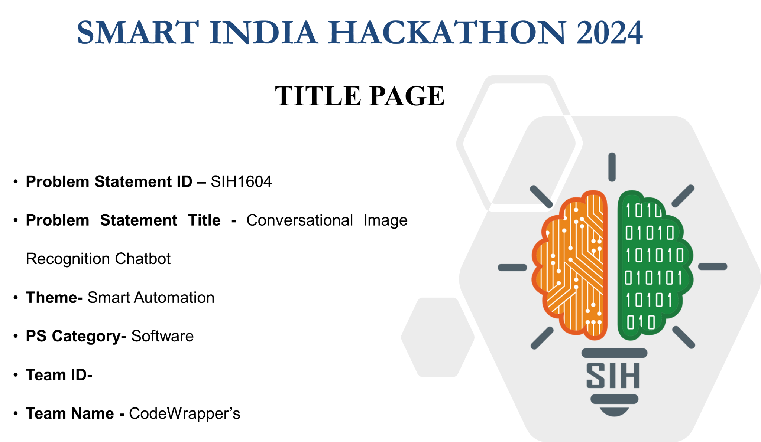

Slide 2
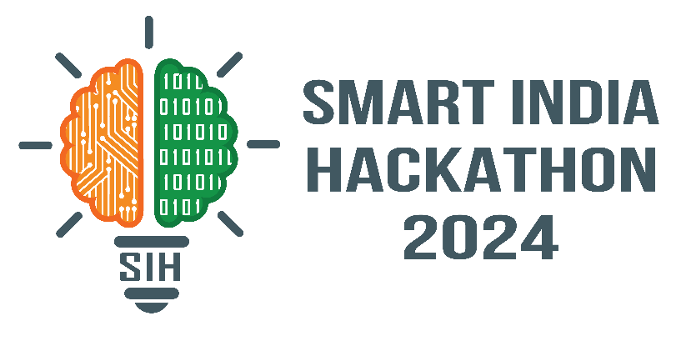

SMART INDIA HACKATHON 2024
Code
Wrapper’s
Specific Problem:
Develop an AI chatbot that can recognize objects in images.
Enable the chatbot to respond accurately to user queries about the images.
Combine natural language processing (NLP) with image recognition.

Slide 3
SMART INDIA HACKATHON 2024
Code
Wrapper’s
Underlying Problem:
Integrating image recognition with conversational AI.
Generating meaningful and grammatically correct responses based on image context.
Ensuring accurate object detection and understanding of user queries.

Slide 4
SMART INDIA HACKATHON 2024
Code
Wrapper’s
Industry/Ministry Associated:
Industry: Bharat Electronics Limited (BEL).
Connection: BEL, a government-owned electronics company, is focused on the development of advanced software solutions for automation and smart technologies. The chatbot solution aligns with BEL’s goal of leveraging AI and automation for smarter, more efficient platforms.

Slide 5
SMART INDIA HACKATHON 2024
Code
Wrapper’s
Current State-of-the-Art Solutions:
Google Cloud Vision API: Provides image recognition and object detection with some basic integration of NLP.
Microsoft Azure Computer Vision: Offers image analysis with NLP capabilities for building conversational bots.
IBM Watson Visual Recognition: Allows users to integrate object detection with natural language understanding for conversational AI.
OpenAI's CLIP (Contrastive Language–Image Pre-training): Combines image recognition with text understanding, useful for image-captioning and question-answering tasks.

Slide 6
SMART INDIA HACKATHON 2024
Code
Wrapper’s
Identified Problems/Shortcomings:
Limited Contextual Understanding: Current solutions may struggle to provide in-depth, conversational responses based on image context.
Integration of NLP and Image Recognition: Existing systems may not fully integrate the two technologies seamlessly, leading to mismatched or vague responses.
Lexical and Grammatical Accuracy: Some chatbots fail to generate responses that are grammatically accurate or contextually relevant during real-time interactions.

Slide 7
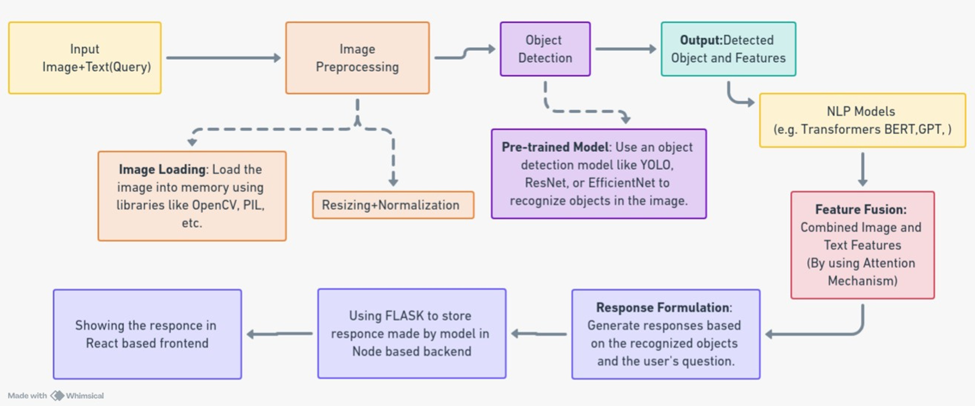
SMART INDIA HACKATHON 2024
Code
Wrapper’s
Technical Approach

Slide 8
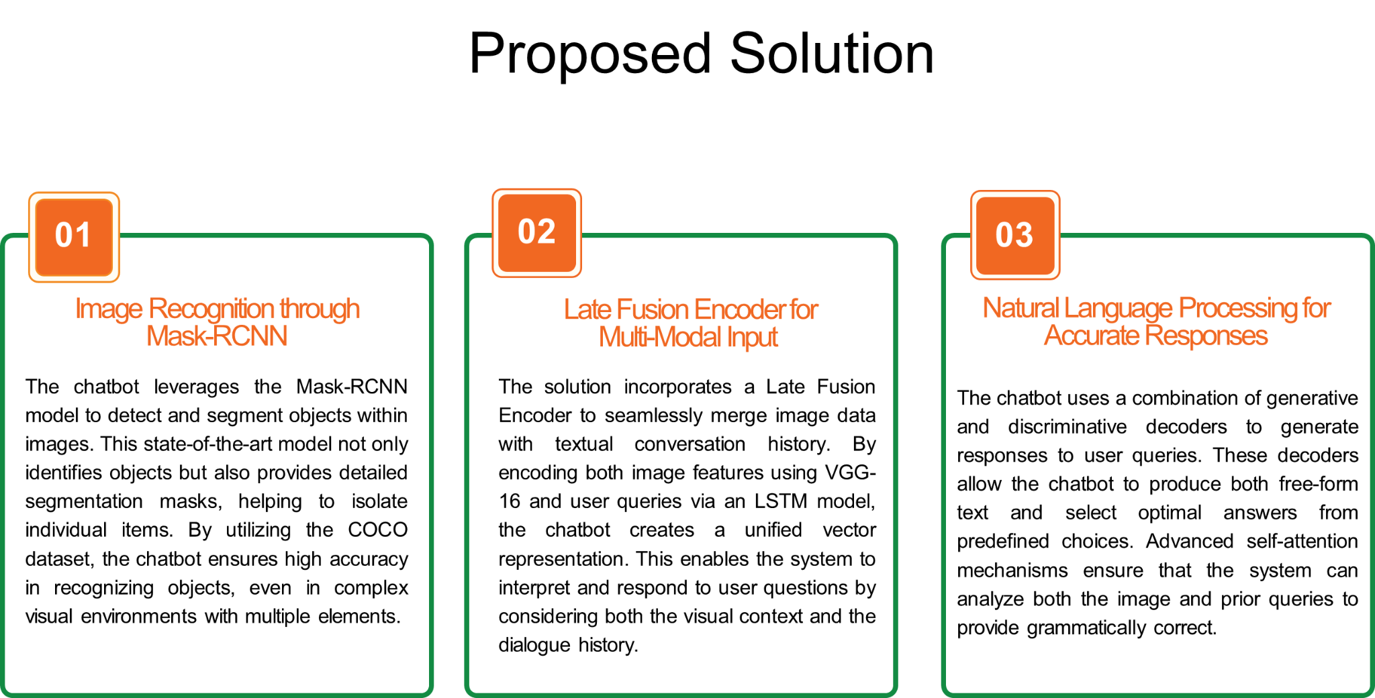
SMART INDIA HACKATHON 2024
Code
Wrapper’s

Slide 9
SMART INDIA HACKATHON 2024
Code
Wrapper’s
Novelty of the Solution :
Mask-RCNN for Image Segmentation: Utilizing the Mask-RCNN model allows the chatbot to not only recognize objects but also segment them, enhancing accuracy in complex visual environments.
Advanced NLP Integration: Combining generative and discriminative decoders ensures precise, context-aware responses to user queries, both free-form and predefined.
Late Fusion Encoder for Multi-Modal Input: The fusion of image features and conversation history through VGG-16 and LSTM models ensures the chatbot delivers coherent responses based on both visual and textual context.
Competitive Edge: Few solutions in the market seamlessly integrate conversational AI with image recognition, giving this chatbot a significant advantage

Slide 10
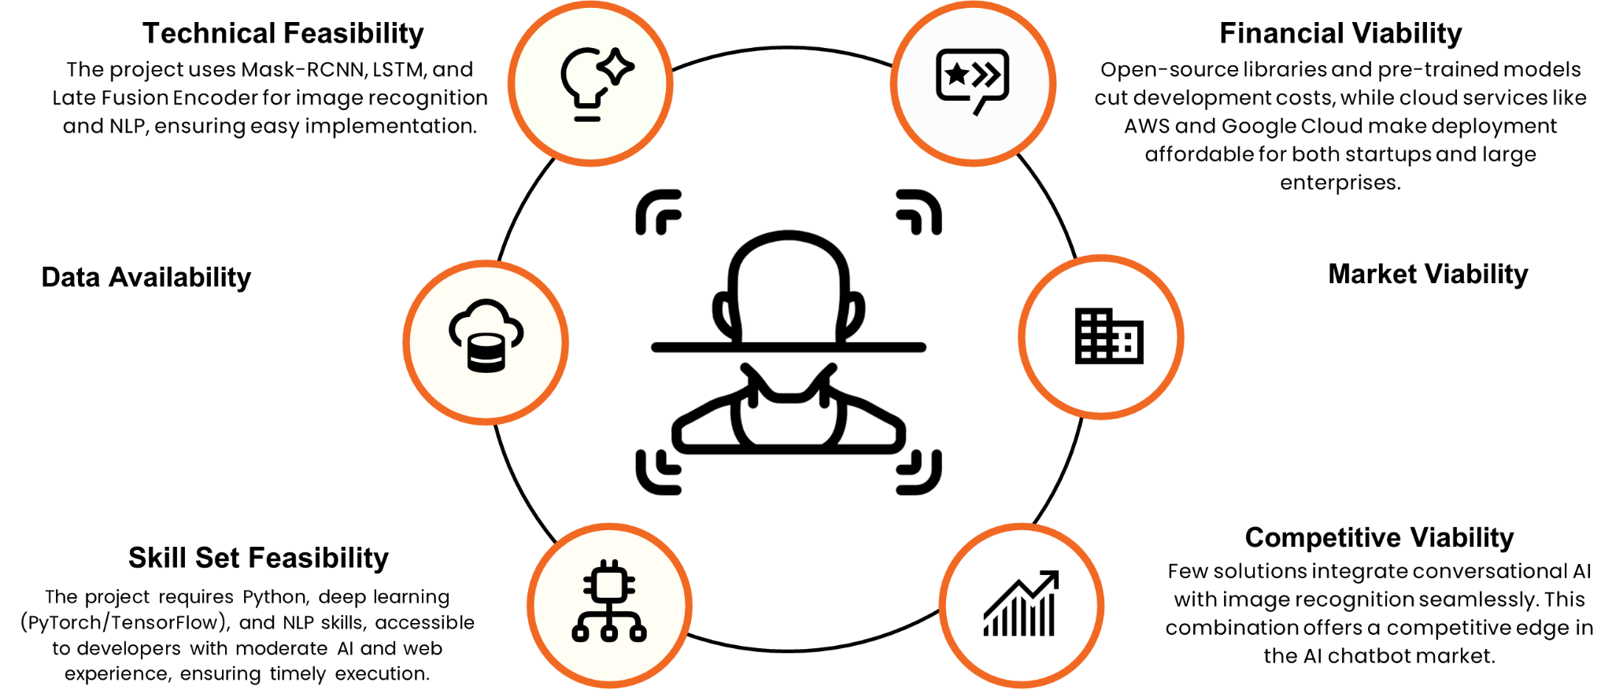
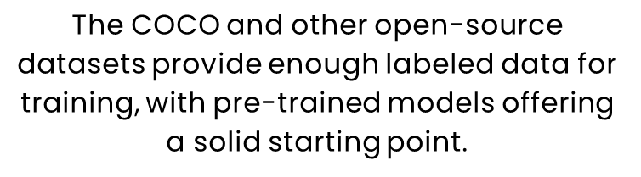
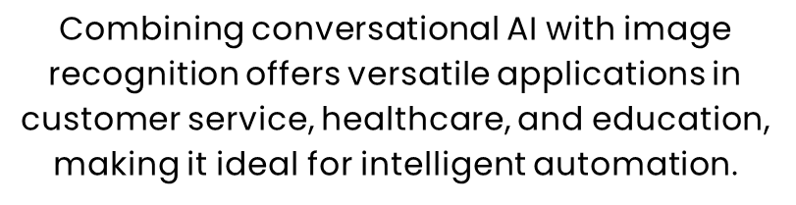
SMART INDIA HACKATHON 2024
Code
Wrapper’s
FEASIBILITY AND VIABILITY

Slide 11
SMART INDIA HACKATHON 2024
Code
Wrapper’s
Current Status of the Prototype:
Rating: 3 out of 5
Progress: Pre-trained models for object detection have been implemented. The integration of the chatbot is in progress, but further work is needed to optimize and refine the solution for seamless interaction between image recognition and conversational AI​

Slide 12
SMART INDIA HACKATHON 2024
Code
Wrapper’s
Resources Involved:
Image Recognition: The use of the Mask-RCNN model for object detection and segmentation is computationally expensive due to the complexity of deep learning networks, especially when processing high-resolution images or multiple objects. However, Mask-RCNN is efficient for applications requiring accurate object detection with segmentation.
NLP: The combination of generative and discriminative decoders along with self-attention mechanisms can be computationally intensive depending on the model size. The use of LSTM for handling dialogue history adds an additional computational layer, but it is effective for maintaining context.
Model Training: The use of open-source libraries (TensorFlow, PyTorch) and pre-trained models reduces training time and computational resources since it avoids training from scratch.
Deployment: With cloud-based deployment options, the project can leverage GPU/TPU instances for inference, reducing the strain on computational resources during deployment while maintaining efficiency for real-time responses.

