Slide 1
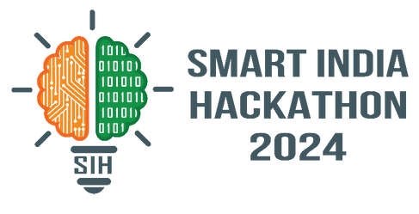

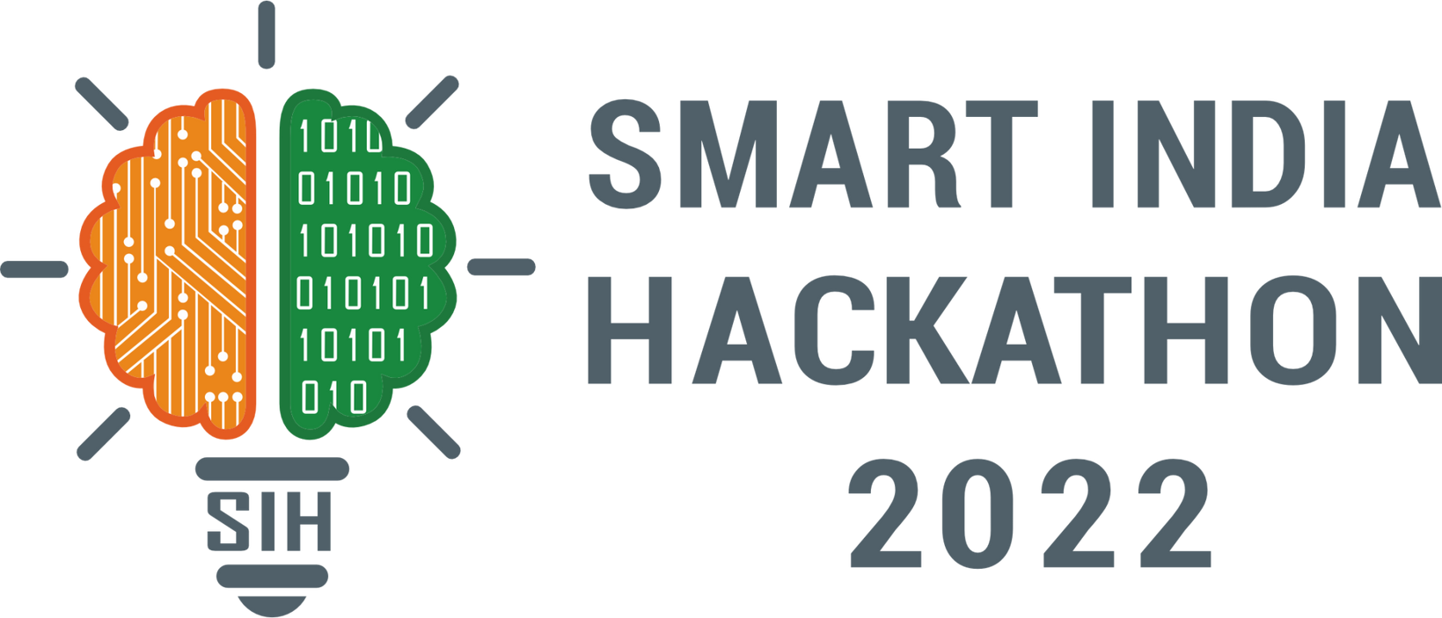
SMART INDIA HACKATHON 2024
TITLE PAGE
Problem Statement ID – SIH1604
Problem Statement Title - Conversational Image Recognition Chatbot
Theme- Smart Automation
PS Category- Software
Team ID-
Team Name - CodeWrapper’s

Slide 2





Conversational Image Recognition Chatbot
Proposed Solution
Develop a chatbot capable of recognizing objects in images and answering relevant user questions. The chatbot integrates advanced deep learning models for both image recognition and natural language processing to deliver accurate and context-aware responses.
01
02
03
Image Recognition through Mask-RCNN
Late Fusion Encoder for Multi-Modal Input
Natural Language Processing for Accurate Responses
The chatbot leverages the Mask-RCNN model to detect and segment objects within images. This state-of-the-art model not only identifies objects but also provides detailed segmentation masks, helping to isolate individual items. By utilizing the COCO dataset, the chatbot ensures high accuracy in recognizing objects, even in complex visual environments with multiple elements.
The solution incorporates a Late Fusion Encoder to seamlessly merge image data with textual conversation history. By encoding both image features using VGG-16 and user queries via an LSTM model, the chatbot creates a unified vector representation. This enables the system to interpret and respond to user questions by considering both the visual context and the dialogue history.
The chatbot uses a combination of generative and discriminative decoders to generate responses to user queries. These decoders allow the chatbot to produce both free-form text and select optimal answers from predefined choices. Advanced self-attention mechanisms ensure that the system can analyze both the image and prior queries to provide grammatically correct.

Slide 3
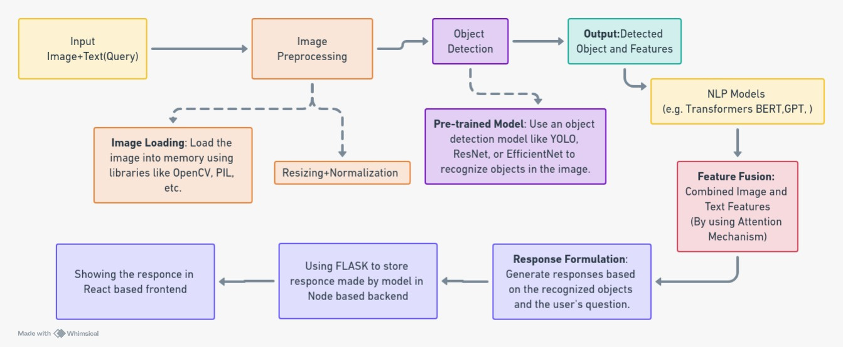






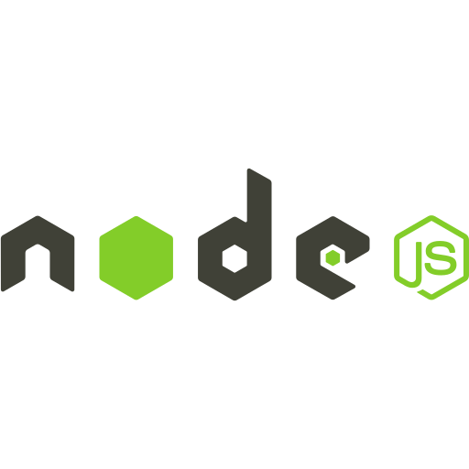





Technical Approach

Slide 4



FEASIBILITY AND VIABILITY
Technical Feasibility
Financial Viability
The project uses Mask-RCNN, LSTM, and Late Fusion Encoder for image recognition and NLP, ensuring easy implementation.
Open-source libraries and pre-trained models cut development costs, while cloud services like AWS and Google Cloud make deployment affordable for both startups and large enterprises.
Data Availability
Market Viability
The COCO and other open-source datasets provide enough labeled data for training, with pre-trained models offering a solid starting point.
Combining conversational AI with image recognition offers versatile applications in customer service, healthcare, and education, making it ideal for intelligent automation.
Competitive Viability
Skill Set Feasibility
Few solutions integrate conversational AI with image recognition seamlessly. This combination offers a competitive edge in the AI chatbot market.
The project requires Python, deep learning (PyTorch/TensorFlow), and NLP skills, accessible to developers with moderate AI and web experience, ensuring timely execution.

Slide 5






IMPACT AND BENEFITS
Enhanced User Interaction
Accessibility of Information
Personalized Experience
The chatbot improves user engagement by providing interactive and informative responses based on visual content, making conversations more dynamic and informative.
Users can easily obtain information about images, facilitating learning and understanding across various domains, including education and healthcare.
By understanding user queries and context, the chatbot can deliver tailored responses, enhancing user satisfaction and overall experience.
Benefits
Advancement in AI Technologies
Application in Diverse Fields:
Improved Accessibility
Impacts
This project contributes to the evolution of AI by integrating natural language processing with image recognition, pushing the boundaries of conversational agents.
The technology can be applied in sectors like education, healthcare, and customer service, improving efficiency and effectiveness in information dissemination.
By enabling image recognition and conversational capabilities, the chatbot can assist users with visual impairments, promoting inclusivity and accessibility.

Slide 6



RESEARCH AND REFERENCES
GITHUB
RESEARCH
Conversational and Image Recognition Chatbot
Mask R-CNN
A Neural Probabilistic Language Model
Mask R-CNN Benchmark
NLTK
Django
ImageAI
Transformers
DATASETS
OTHERS
COCO Dataset: A Dataset for Limited-Vocabulary Speech Recognition
MSWC Dataset
MLCommons Multilingual Spoken Words Dataset
Open Images Dataset
Kaggle Datasets
TensorFlow Object Detection API
Dialogflow

