Slide 1
Asset Tracking with WiFi and Magnetometry
Nitesh Kumar Salvi

Slide 2
Objective
Use of radio signal strength and the earth’s magnetic field to find the location and direction of an asset.
Ability to use bi-lateration of signals in order to approximate the location of the object.
Magnetometry is utilized for finding the facing direction, which adds more useful insight on the current orientation of the asset.
Tracked information is stored and visualized on the web platform.

Slide 3
Hardware configuration
Each room consists of 2 central units.
One gateway device hosting a server with static port and IP.
Multiple beacons as WiFi client.
Multiple beacons with magnetometer.
Software configuration
Centrals running own access point with authentication.
Beacons running own client script with RESt interface.
Server running Django with routes, views and controllers.
NoSQL elastic search database interface for server to store events.

Slide 4
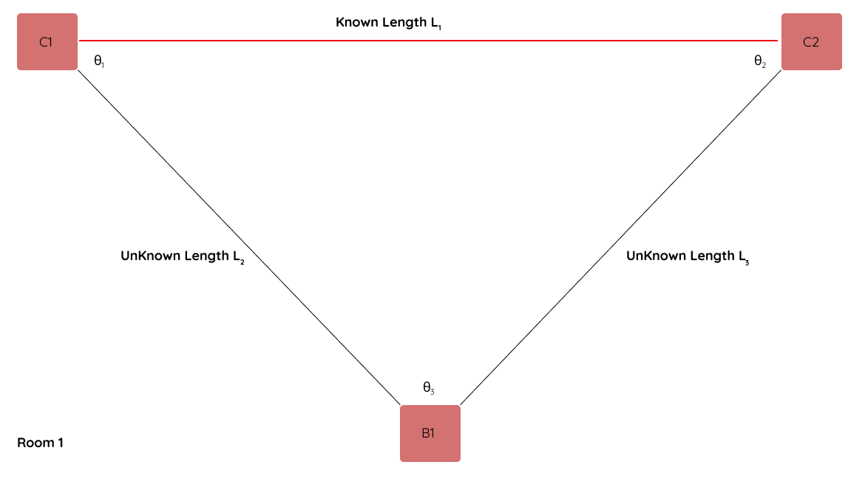
Working scenario
Central 1 and central 2 initializes by finding its distance.
Central 1 and beacon 1 will finds its distance.
Central 2 and beacon 1 will find its distance.
Within 30s both the beacons will transmit the information to the gateway.
Gateway will check for correctness of information.
Gateway stores the information in database.

Slide 5
Connection Algorithm
Central Algorithm
Emit own access point with authentication.
Wait for beacons to connect.
If beacon connects:
Retrieve magnetometry data and signal strength data of the client with respect to the server.
Check for correctness of information.
Disconnect from client.
Connect to WiFi Server.
Post data to server and disconnect.
Repeat cycle for Central 2 with same beacon.

Slide 6
Connection Algorithm
Beacon Algorithm
Every 30s look out for new access points.
Find two access points in same room.
Connect to one of the access points and transmit locale data.
Remember connection and connect to second central in the room.
Connect to second central and transmit locale data.
Disconnect from second beacon.
Repeat cycle for every 30s.

Slide 7
Central Server Algorithm
Listen on assigned port for incoming POST requests on certain route.
Accept incoming request.
Check for RoomID from central, always receive pair connections.
Check for received request if within 30s width.
If within 30s
Save information to database.
Else
Throw information and wait for new request.

Slide 8
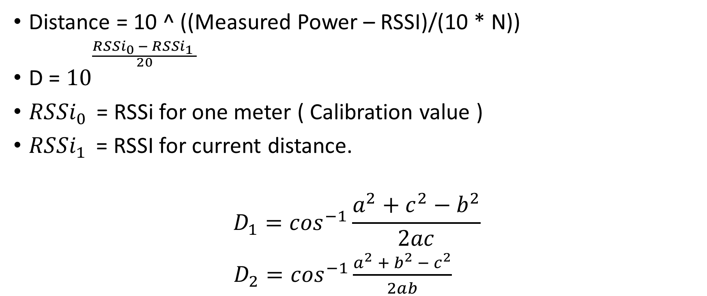
Handling Position Data.
Distance = 10 ^ ((Measured Power – RSSI)/(10 * N))
D = ${10}^{\frac{{RSSi}_{0} − RSSi_{1 }}{\begin{aligned}20 \\ \end{aligned}}}$
${RSSi}_{0 }$ = RSSi for one meter ( Calibration value )
${RSSi}_{1 }$ = RSSI for current distance.
$$D_{1}=\cos^{−1}\frac{a^{2}+c^{2}−b^{2}}{2ac}$$
$D_{2}=\cos^{−1}\frac{a^{2} +{ b}^{2 }−{ c}^{2}}{2ab}$
a
b
c

Slide 9
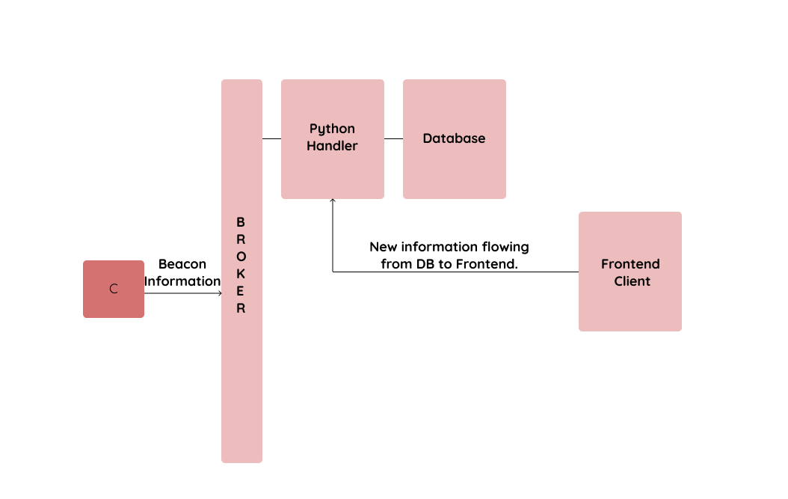
Aggregating Information
Frontend retrieves information from backend database and fills tables.
Frontend visualizes them in the form of tables and 2D representation.

Slide 10
Use Cases
Find your buddy in a building.
Track employees in large warehouses.
Analytics and big data applications, employees can check how long a person is idle in a certain room, how often a person takes a break, how far a person must travel to accomplish a task.
Optimization of workforce.
Security applications.

Slide 11
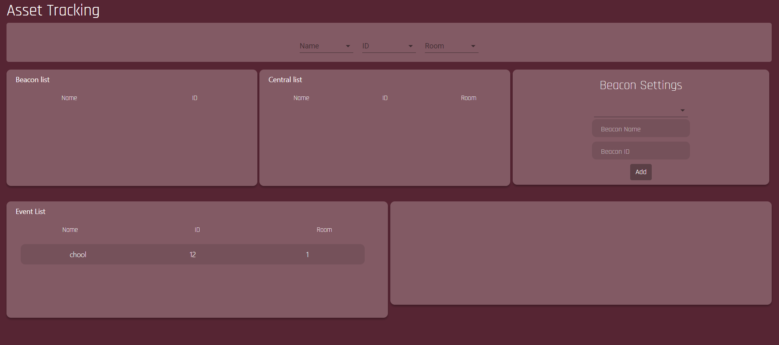
Current Features
Filterable events in different rooms.
Beacon settings.
Central device list.
Beacon device list.
Event list.

Slide 12
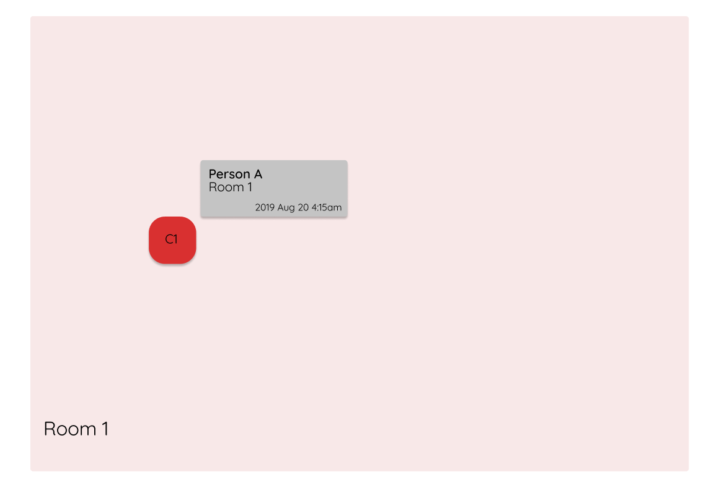
Position detection with assimilated data
Representation of the position of a person in a room.
Absolute position of the person in the room.
Time stamp of the person in the current position.
Multiple people can be tagged in the room.
Aggregatable results.

Slide 13
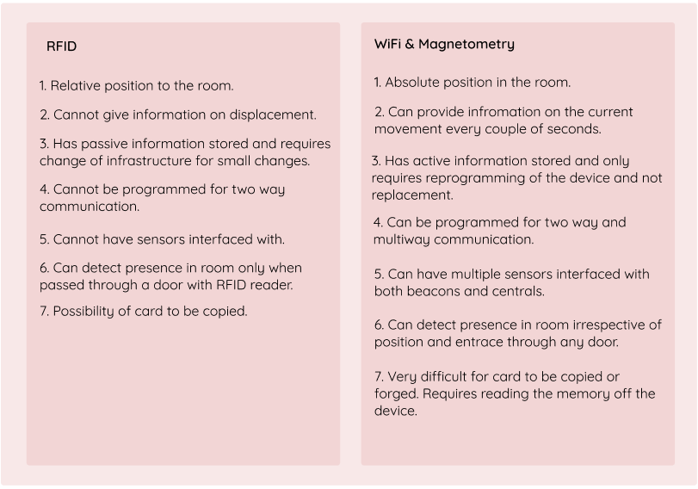
Current market trends

