Slide 1
Brand AI-Readiness Audit
An Agent Skill Marketplace that audits any website for AI discoverability and on-site engagement — and proves it works on sites it has never seen.
Recommend-only · read-only · deterministic · < 5 min · generalizes by construction

Slide 2
ROUND 3 — AGENT SKILL MARKETPLACE
The challenge
• Point an agent at ANY website; audit it and emit one findings-plus-fixes report.
• Cover both halves of the problem:
– AI discoverability — why AI assistants don't find or cite the brand
– On-site engagement — why visitors who arrive don't stay
• Recommend-only, read-only, deterministic, < 5 min, no site changes.
• Graded on the skill's LOGIC and on GENERALIZATION — no example sites are given.

Slide 3
THE MECHANISM
Why it's really two problems
• An AI assistant only cites a page it can:
– reach (crawler let in) → read (no JS wall) → pick a clean fact → trust it (entity + corroboration)
• A visitor only stays on a page that loads fast and orients them quickly.
• Two distinct failure surfaces → the marketplace is split along the real mechanism chain.
• Every finding is tagged discoverability / engagement / both.

Slide 4
ARCHITECTURE
What we built
• One entrypoint skill orchestrating five focused sub-skills over a single shared, read-only crawl.
• Hybrid: deterministic scripts do the mechanical signals; the AI agent does the judgment + fixes.
• Shared common/ spine: fetch + optional render, robots, finding contract, report assembly.
• 31 checks across the two halves, each with explicit false-positive guards.
• Each sub-skill is a valid agentskills.io skill (SKILL.md + scripts/ + references/) and runs on its own.
• marketplace.json names exactly one entrypoint; self-contained (1.8 MB, no model weights).

Slide 5
SEPARATION OF CONCERNS
The five sub-skills (+ one entrypoint)
Skill | The question it answers
website-ai-audit | Entrypoint: shared crawl → runs the 5 sub-skills → merges one schema-valid report
crawler-access | Can an AI citation crawler get in? robots per-bot, WAF/UA, indexability, sitemap
machine-readability | Once in, can a non-rendering crawler read it? JS render gap, latency
fact-extractability | Can a machine pick out the fact? JSON-LD, semantic HTML, facts-in-images
entity-trust | Is the fact trusted + attributed right? Organization anchor, sameAs, freshness
onsite-engagement | Why don't visitors stay? speed, a11y, interstitials, mixed content, readability

Slide 6
EXECUTION MODEL
Hybrid: deterministic signals + agent judgment
• Agent Skills are run BY an AI agent — so we split the work by what each side is best at.
• Scripts own the mechanical, measurable signals (robots, render gap, JSON-LD, headers, contrast).
– Reproducible, no LLM — this is the layer whose precision we measure.
• The agent owns judgment: answer-readiness, entity clarity, value-prop — and site-specific fixes.
– It reasons over an evidence pack the scripts emit; compose.py merges both into one report.
• Runs headless too (scripts alone = full report, no LLM/gateway); the agent layer is additive.

Slide 7
HOW IT RUNS
One polite, read-only pass
• Deterministic scope: homepage + a sorted, capped sample of internal/sitemap URLs.
• One shared fetch (and optional render) per page; sub-skills read the cache — never re-fetch.
• robots.txt honored; GET/HEAD only; no auth; nothing written to the site.
• Playwright render when available; otherwise a static SPA heuristic — it never crashes.
• Byte-identical output across runs (timestamp injectable); ~0.03 s per fixture audit.

Slide 8
OUTPUT DESIGN
What a finding looks like
• id · title · severity (critical/high/medium/low)
• evidence — concrete, with numbers + prevalence: "0/12 product pages carry schema.org markup"
• category · half · the mechanism it addresses
• suggested_action — fix summary, a fix-first priority (distinct from severity), effort, confidence
• Report adds counts-by-severity, a discoverability/engagement split, and an honest limitations block.
• Validated against a bundled JSON Schema before emit; counts computed, never hand-kept.

Slide 9
SAFETY & HYGIENE
Built-in guarantees
• Read-only & recommend-only — never modifies the audited site.
• Deterministic — fixed sampling, sorted output, bucketed thresholds.
• Fast & bounded — one shared pass, page cap, per-check timeouts, well under 5 min.
• Portable & small — pure-Python core, 1.8 MB, no model weights; browser/OCR optional.
• Conservative — every check has FP guards; blocked/unreadable pages never yield 'content missing'.

Slide 10
THE JOURNEY — WHY
Testing honestly: the bias problem
• If the same author writes the detector, the tests, AND the grader, the tests prove nothing.
• Our first fixtures — whose authors had seen the checks — reported a flawless 0% false-positive rate.
• That number was meaningless. So we rebuilt testing around a strict information barrier.
• Principle: no single model both creates the ground truth and judges against it.

Slide 11
THE JOURNEY — DESIGN
The information barrier
Role | Who | Sees the detector? | Model
System under test | the auditor (deterministic Python) | it IS the detector | code
Test-set author | blind red-team generators | no — walled off | Sonnet
Grader | blind adjudicators | no — judge on merits | Opus
Tie-breakers | prosecutor / defender / referee | no | Sonnet / Opus

Slide 12
THE JOURNEY — DATASET
Step 1 — a ground-truth dataset, kept blind
• An independent red team authored realistic sites: SaaS SPA, restaurant, e-commerce, news,
– corporate brand, personal blog, government page, and deliberately-clean controls.
• For each site it sealed its OWN ground truth: every real problem (severity + mechanism),
– plus what's FINE and the legitimate TRAPS that must NOT be flagged.
• The authors never saw how the auditor detects anything → trustworthy, unbiased labels.

Slide 13
THE JOURNEY — MEASURE
Step 2 — the first honest measurement
• Ran the deterministic auditor over the blind sites.
• Independent judges inspected each site themselves and scored every finding TP vs FP.
• A prosecutor/defender/referee debate settled every contested finding.
• Verdict: precision 0.576 — 49 true positives against 36 false positives.
• The biased fixtures had hidden all 36.

Slide 14
THE JOURNEY — ROOT CAUSES
Step 3 — what the judges + debate found
• Flagging 'plain HTTP' when the site's own canonical/sitemap declare HTTPS
• Over-claiming 'render-blocking/heavy' on tiny pages (only real factor: no gzip)
• Penalizing a legitimate off-domain canonical (staging/CDN)
• Treating ClaudeBot / Meta-ExternalAgent (training crawlers) as citation bots
• Rejecting a valid ProfilePage/Person author page; missing nested publisher Organization
• Auditing robots.txt as a page; emitting noise for a missing llms.txt

Slide 15
THE JOURNEY — FIX
Step 4 — fix generalizably
• Two fix cycles corrected the LOGIC, not the symptoms.
• Each fixer was told the general bug + mechanism — and forbidden from special-casing any site.
• Result on the round-1 set: 28 false positives removed, zero real regressions.
• White-box regression stayed perfect (26/26, 0 FP); harnesses green.

Slide 16
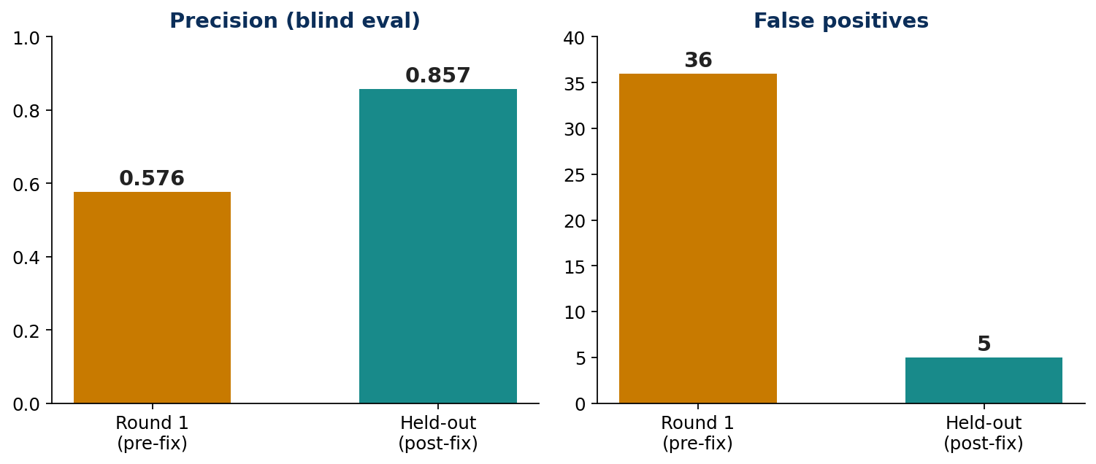
THE JOURNEY — HELD-OUT
Step 5 — proof it generalizes
Held-out sites were generated AFTER and blind to every fix → generalization, not overfitting.

Slide 17
SCORECARD
Results against the rubric
Rubric criterion | How we meet it
Detection accuracy / few FPs / both halves | 0.86 precision on UNSEEN sites (blind eval), per-half coverage
Suggested-action quality | mechanism + fix-first priority + effort + confidence per finding
Output design | one schema-validated JSON report + readable Markdown view
Skill / marketplace hygiene | 6 valid skills, exactly 1 entrypoint, deterministic, safe
Generalization | headline number comes from held-out sites made after the fixes

Slide 18
HONEST GAPS
Limitations & next steps
• Recall is the open axis — 28 lower-severity misses on the held-out set (meta descriptions,
– dark-bg contrast, dead CTAs, per-page social cards). Same blind loop applies next.
• Live network is out of scope in the sandbox → field suite runs via offline snapshots (reproducible).
• A few checks are network-dependent (sameAs, broken links) and are labeled as such.
• Next: recall pass, real-site snapshot capture, and a live demo run.

Slide 19
Precision 0.58 → 0.86 on unseen sites,
measured by a test harness that never grades itself.
6 agentskills.io-valid skills · 31 checks · one schema-valid report
Blind red-team dataset + independent adjudication + debate → generalizable fixes

