Slide 1

Sponsor By –
Dharmesh Rajodiya
Nikunj Bhuva
Ankit Kakdiya
Gaurang Devmurari

Slide 2


Presents a seminar on JavaScript and TypeScript..
Presenting By –
Riyal Savaj (Sr. Web Developer)
Yusuf Pathan (Sr. Web Developer)
Content By –
Jay Kakdiya (Jr. Web Developer)
Nitesh Singh (Trainee)

Slide 3
Contents
What is JavaScript
What is TypeScript
ECMAScript
ES5 vs ES6
Key difference between JS and TS
TypeScript Code Example
Why TypeScript
Features of TypeScript

Slide 4
What is JavaScript?

Slide 5
JavaScript is a scripting language which helps you create interactive web pages.
So, what is scripting language.
It follows rules of client-side programming, so it runs in the user’s web browser without the need of any resources forms the web server.
We have two side of programing. First server side scripting and second client side scripting. So, what is client side scripting and server side scripting?
You can also use JavaScript with other technologies like REST APIs, XML, and more.
However, JavaScript is not designed for large complex applications. It was developed for applications with a few hundred lines of code!

Slide 6
What is scripting language
A scripting language is a programming language that is interpreted. It is translated into machine code when the code is run, rather than beforehand.
Scripting languages are often used for short scripts over full computer programs. JavaScript, Python, and Ruby are all examples of scripting languages
What is server side - client side
The main difference between server-side scripting and client-side scripting is that the server side scripting involves server for its processing.
The client-side script executes the code to the client side which is visible to the users while a server-side script is executed in the server end which users cannot see.

Slide 7
What is TypeScript?

Slide 8
TypeScript is a modern age JavaScript development language.
TypeScript is a superset of JavaScript that provides features such as optional static typing, classes, interfaces, and generics
TypeScript is a programming language developed and maintained by Microsoft. It is a strict syntactical superset of JavaScript and adds optional static typing to the language.
TypeScript is designed for the development of large applications and it compiles to JavaScript.
It is a statically compiled language to write clear and simple JavaScript code.
It can be run on Node.js or any browser which supports ECMAScript3 or newer versions.
For a large JavaScript project adopting Typescript can bring you more robust software and easily deployable with a regular JavaScript application.

Slide 9
What are interfaces in TypeScript?
Interface is a structure that defines the contract in your application. It defines the syntax for classes to follow. Classes that are derived from an interface must follow the structure provided by their interface.
The TypeScript compiler does not convert interface to JavaScript.
TypeScript supports object-oriented programming features like classes, interfaces, etc.
A class in terms of OOP is a blueprint for creating objects. A class encapsulates data for the object. Typescript gives built in support for this concept called class. TypeScript uses generics with the type variable which denotes types.

Slide 10
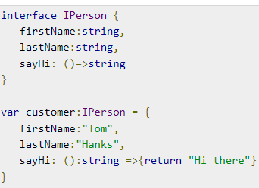
Interface Code Example..

Slide 11
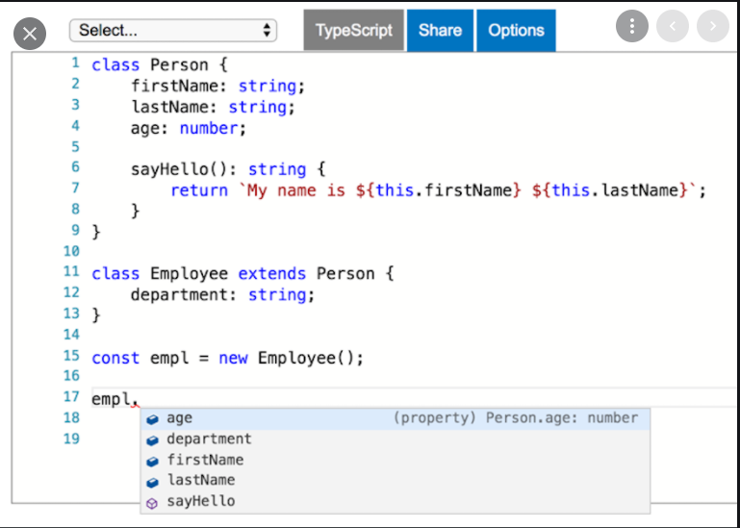
Interface Code Example..

Slide 12
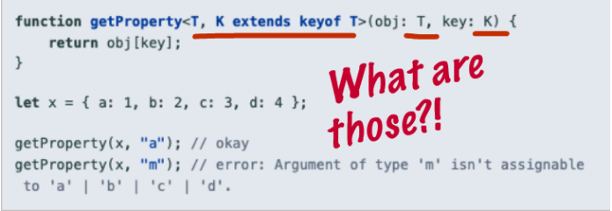
Interface Code Example..

Slide 13
What is ECMAScript?

Slide 14
ECMAScript
ECMAScript (European Computer Manufacturers Association Script) is a scripting language based on JavaScript.
It was created to standardize JavaScript. ECMAScript is used for client-side scripting of the World Wide Web.
ES5 is an abbreviation of ECMAScript 5 and also known as ECMAScript 2009. The sixth edition of the ECMAScript standard is ES6 or ECMAScript 6.

Slide 15
Difference Between ES5 and ES6.
VS
ES5
ES6

Slide 16
ES5 VS ES6
ES5 | ES6
ES5 supports primitive data types that are string, number, boolean, null, and undefined. | In ES6, there are some additions to JavaScript data types. It introduced a new primitive data type 'symbol' for supporting unique values.
In ES5, we could only define the variables by using the var keyword. | In ES6, there are two new ways to define variables that are let and const.
As ES5 is prior to ES6, there is a non-presence of some features, so it has a lower performance than ES6. | Because of new features and the shorthand storage implementation ES6 has a higher performance than ES5.
ES5 is time-consuming than ES6. | Due to destructuring and speed operators, object manipulation can be processed more smoothly in ES6.
In ES5, both function and return keywords are used to define a function. | An arrow function is a new feature introduced in ES6 by which we don't require the function keyword to define the function.

Slide 17
Var, Let, and Const – What's the Difference?
Var:
Before the advent of ES6, var declarations ruled. There are issues associated with variables declared with var, though.
That is why it was necessary for new ways to declare variables to emerge. First, let's get to understand var more before we discuss those issues.
The scope is global when a var variable is declared outside a function. This means that any variable that is declared with var outside a function block is available for use in the whole window. var variables can be re-declared and updated.
let:
let is now preferred for variable declaration.
It's no surprise as it comes as an improvement to var declarations.
It also solves the problem with var that we just covered. Let's consider why this is so. let can be updated but not re-declared.
const:
Variables declared with the const maintain constant values. const declarations share some similarities with let declarations.
const cannot be updated or re-declared.

Slide 18
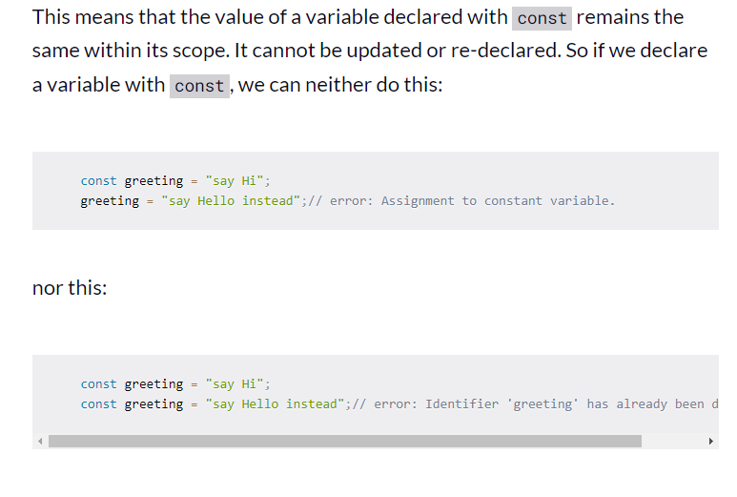
Code example…

Slide 19
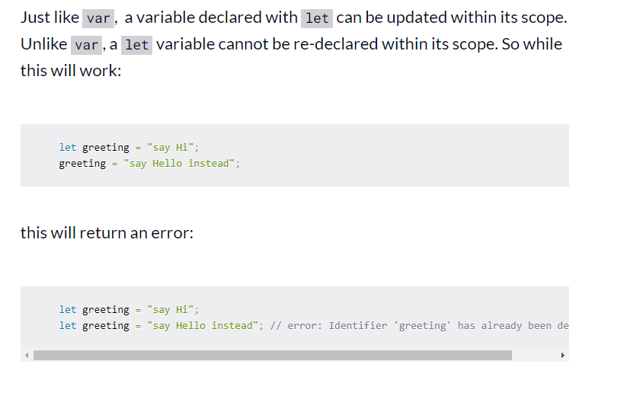
Code example…

Slide 20
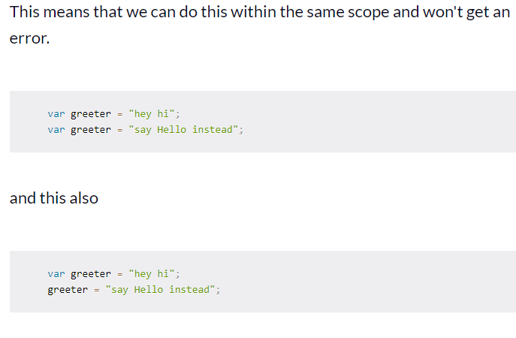
Code example…

Slide 21
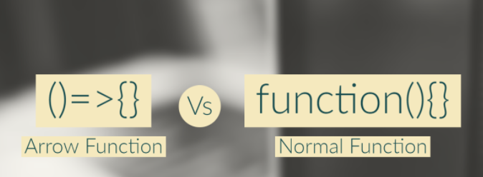
arrow function and function - What's the Difference?
arrow function:
Arrow functions are a new way to write anonymous function expressions, and are similar to lambda functions in some other programming languages, such as Python.
Arrow functions differ from traditional functions in a number of ways, including the way their scope is determined and how their syntax is expressed.
normal function:
Regular functions created using function declarations or expressions are constructible and callable.

Slide 22
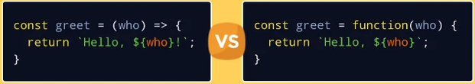
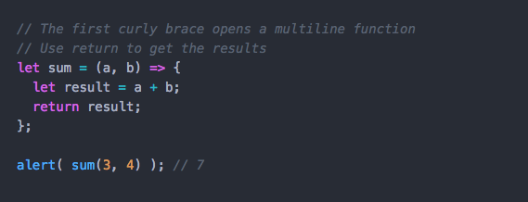
Code Example..
Code Example..

Slide 23
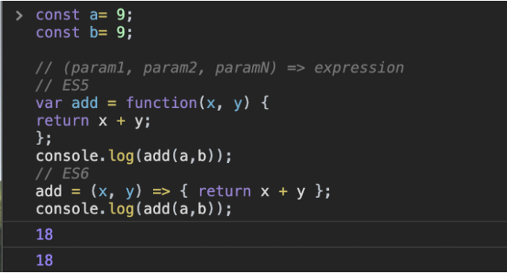
Code Example..

Slide 24
Difference Between TypeScript and JavaScript.
VS
TypeScript
JavaScript

Slide 25
Parameter | Typescript | JavaScript
Data Binding | TypeScript uses concepts like types and interfaces to describe data being used. | No such concept is available with JavaScript.
Prototyping | Typescript has a feature of prototyping. | JavaScript doesn’t have this feature.
Compilation | TypeScript code needs to be compiled | No need to compile JavaScript.
Community | Typescript does not have a large community of developers. | The JavaScript has a huge community of developers

Slide 26
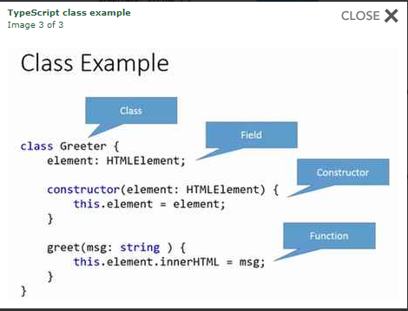

Slide 27
Why TypeScript ?

Slide 28
TypeScript supports JS libraries & API Documentation
Better code structuring and object-oriented programming techniques
Allows better development time tool support

Slide 29
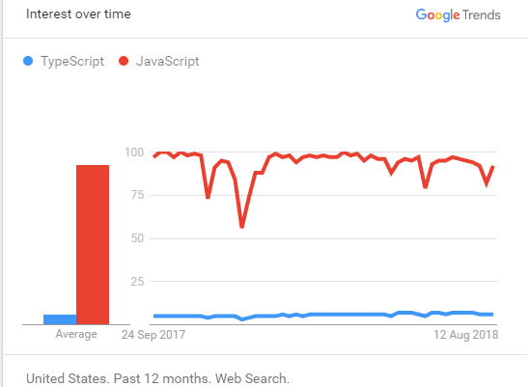
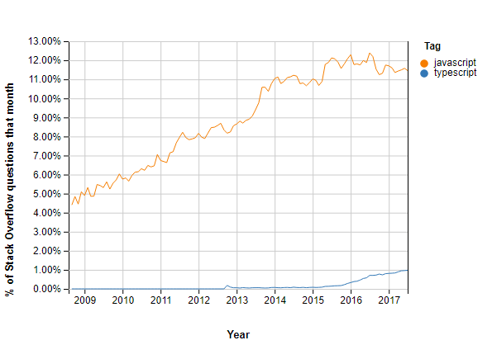

Slide 30
Thank You..

