Slide 1
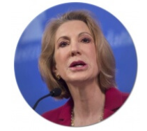
Term Project
Submitted by:
Nitesh Srivastava
Cohort : 6 –July – 2019
Studied Dataset:
Car Dekho Price Prediction
“The goal is to turn data into information, and information into insight.”
Carly Fiorina, American businessperson and political candidate, known primarily for her tenure as CEO of Hewlett-Packard

Slide 2

CarDekho.com is India's leading car search venture that helps users buy cars that are right
for them. Its website and app carry rich automotive content such as expert reviews,
detailed specs and prices, comparisons as well as videos and pictures of all car brands and
models available in India. The company has tie-ups with many auto manufacturers, more
than 4000 car dealers and numerous financial institutions to facilitate the purchase of
vehicles.
This study is done based on the data taken from Car Dekho company and the objective of
this study is to create a predictive model to predict Selling price of a car based on various
features like Make, Model, Distance driven, Manual or Automatic like many other features.

Slide 3
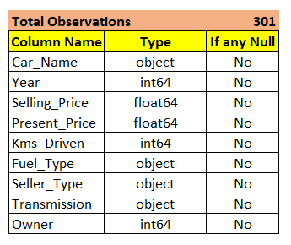
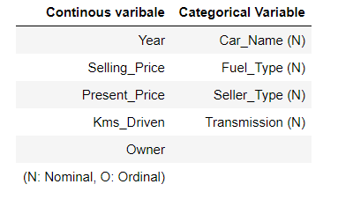
About the data
There are total 301 observations. Not good enough for modeling.
There are total 9 columns as shown left.
There are no null values, so filling missing value process will be skipped.
Selling price is Target Variable (TV)
There are two kind of variables
The data has been taken from Kaggle Repository.
Data Set extracted from: https://www.kaggle.com/shindenikhil/car-dekho-data

Slide 4
Observations
Correlation between Selling price and present price is high so will remove it.
The depreciation varies increases with Kilometer driven.
Depreciation is more for Automatic cars.
As the # of owners of the cars increases, depreciation also increases.
The data for KMs Driven and Selling price is full of outliers so need to manage the
outliers.
As there are less observation so outliers data will not be removed but be replaced by
3rd Quartile value for that column

Slide 5
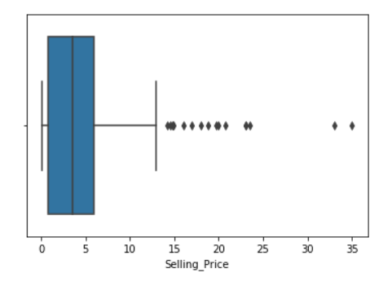
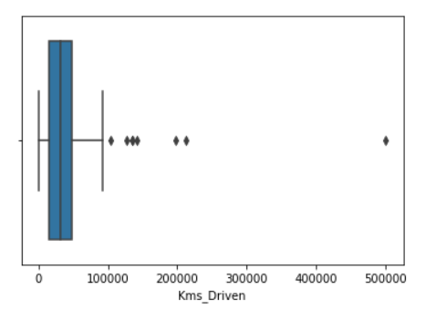
Outliers Detection:
Outliers in Selling Price
Outliers in Kms Driven

Slide 6

Let’s ask few questions to Data Set:
“Torture the data, and it will confess to anything.”
Ronald Coase, British economist and author

Slide 7
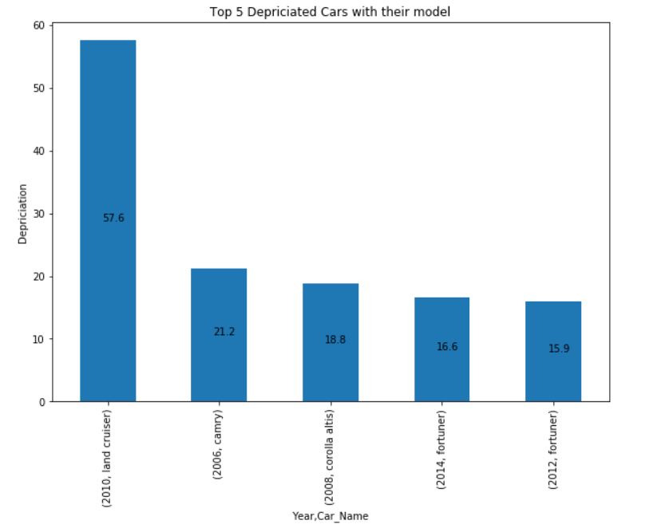
Get the top 5 depreciating cars with their make and model

Slide 8
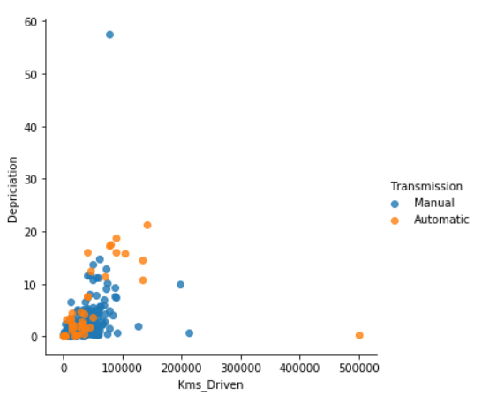
How the depreciation varying based on KMs driven and Transmission
(Manual or Automatic)

Slide 9
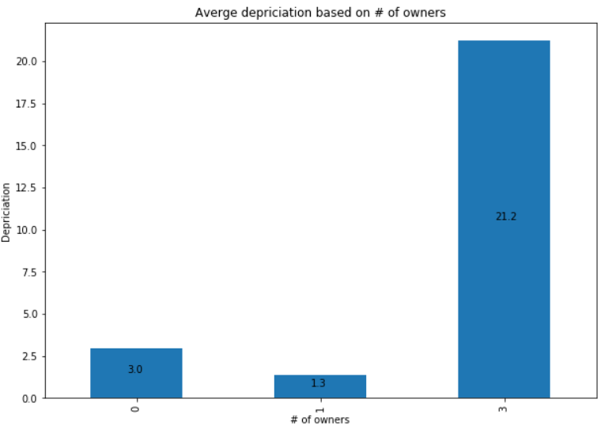
How depreciation depends on # of Owners changed (like first hand, second hand or more)

Slide 10
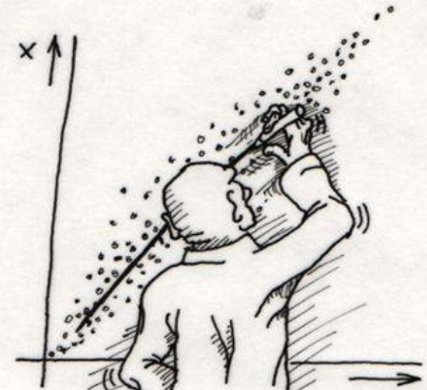
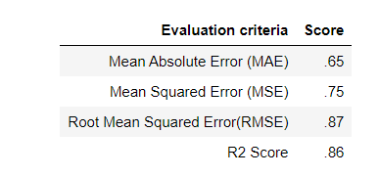
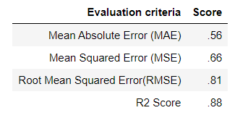
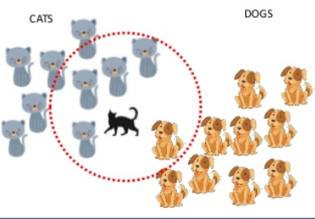

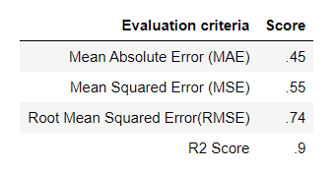
Predictive Modeling

Slide 11
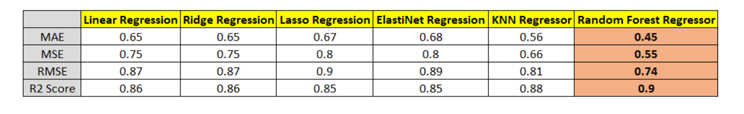
Comparative analysis

Slide 12
Conclusion
The data set is full of outliers so actions to be taken to make data correct.
Tried with various Regression techniques and found Random Forest Regressor has given best R2 and RMSE score for the given dataset.
Tried with various K values from KNN Regressor and maximum R2 score is achieved as 87%.
The best R2 score from Random Forest Regressor ~90% which is final model that I am suggesting for this data set.

