Slide 1
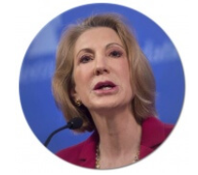
ML Intermediate Project
Submitted by:
Nitesh Srivastava
Cohort : 6 –July – 2019
Studied Dataset:
Telecom Churn Prediction
“The goal is to turn data into information, and information into insight.”
Carly Fiorina, American businessperson and political candidate, known primarily for her tenure as CEO of Hewlett-Packard

Slide 2
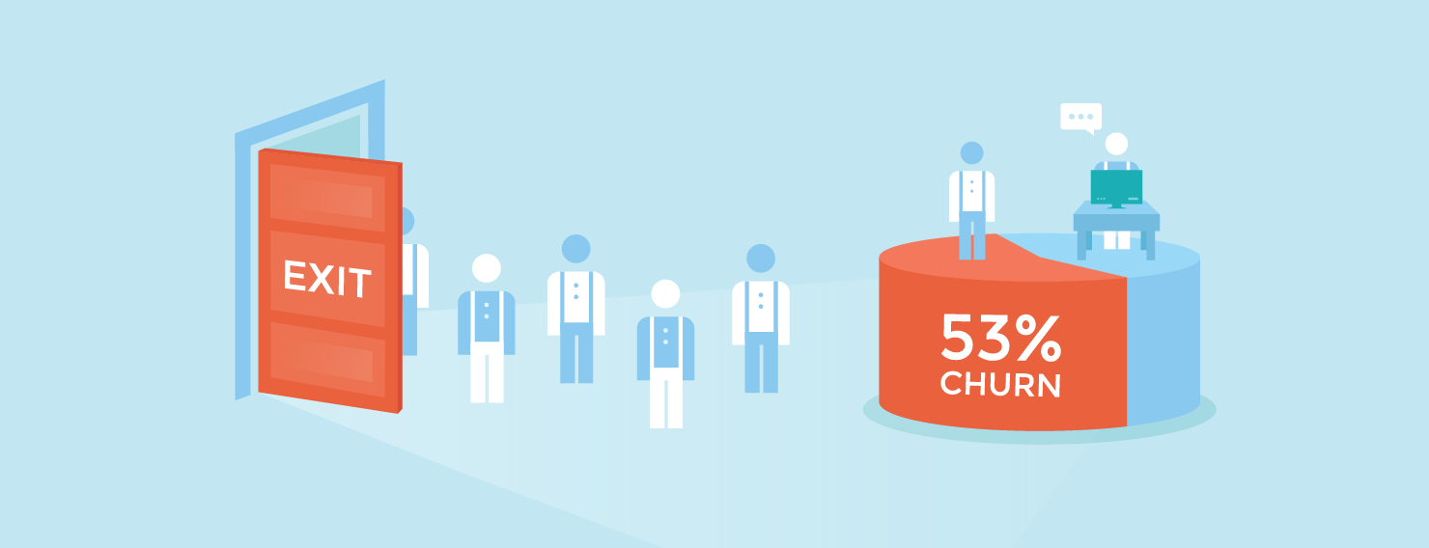
Customer churn is one of the most important metrics for a growing business to evaluate.
While it's not the happiest measure, it's a number that can give your company the hard
truth about its customer retention.
It's hard to measure success if you don't measure the inevitable failures, too.
While you strive for 100% of customers to stick with your company, that's simply unrealistic.
That's where customer churn comes in. Customer churn is the percentage of customers that
stopped using your company's product or service during a certain time frame. You can
calculate churn rate by dividing the number of customers you lost during that time
period -- say a quarter -- by the number of customers you had at the beginning of that
time period.
For example, if you start your quarter with 400 customers and end with 380,
your churn rate is 5% because you lost 5% of your customers.
The objective of the study is to analyze if the customer will take exit from services given
from a telecom company based on certain parameters given.

Slide 3
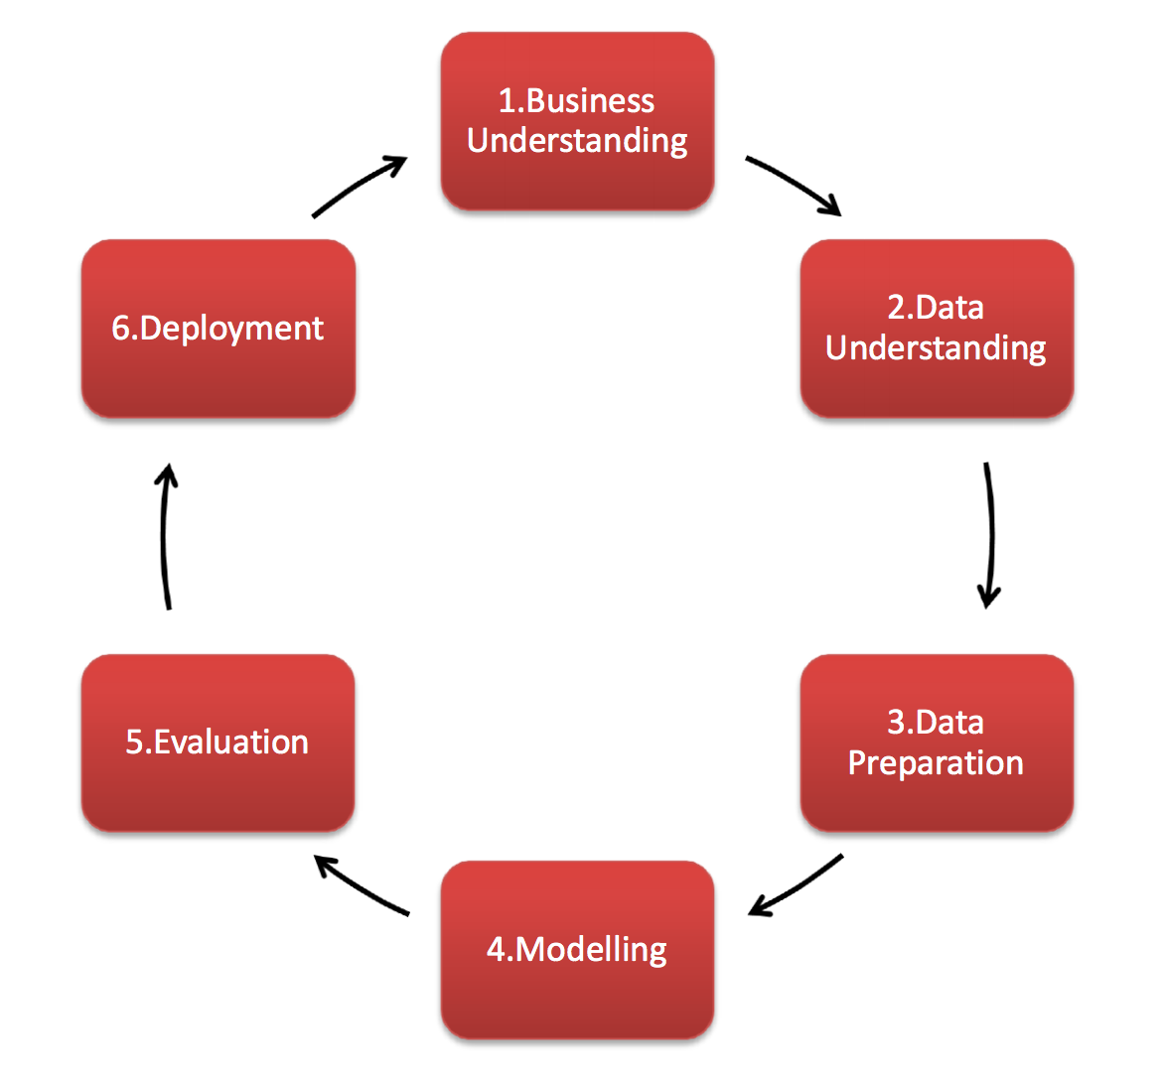
Project Methodology
CRISP DM

Slide 4
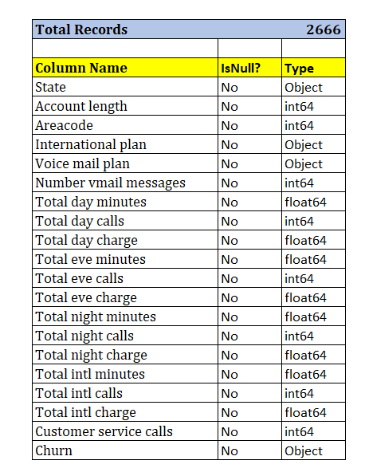
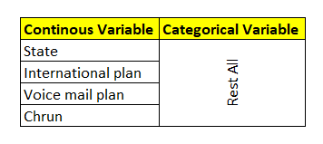
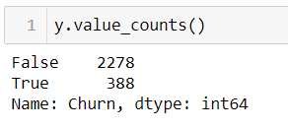
About the data
There are total 2666 observations in training set. Fairly enough data
There are 667 observation as test data set.
There are total 20 columns as shown left.
There are no null values, so filling missing value process will be skipped.
Churn is Target Variable (TV)
There are two kind of variables
Imbalanced Dataset

Slide 5
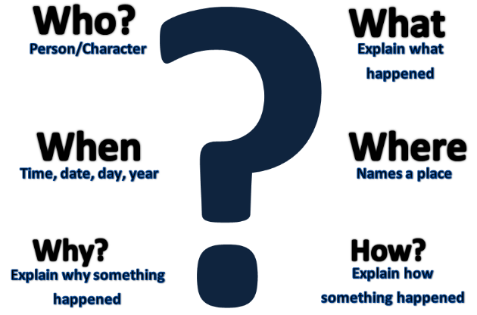
Let’s ask few questions to Data Set:
“Torture the data, and it will confess to anything.”
Ronald Coase, British economist and author

Slide 6
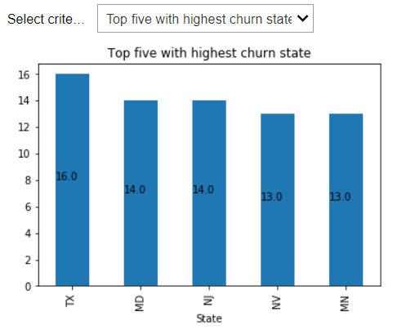
Get the top 5 States with highest churn

Slide 7
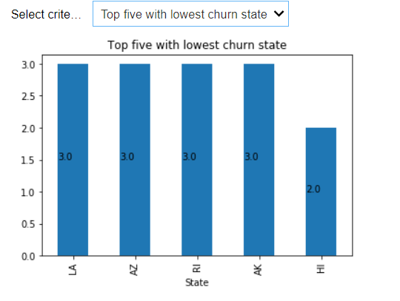
Get the Downmost 5 States with lowest churn

Slide 8
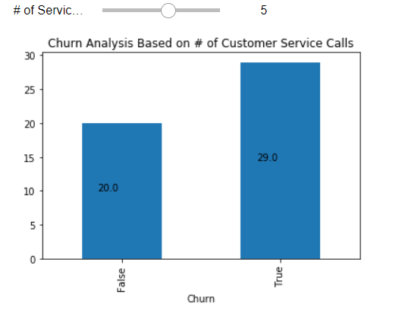
How the Churn is affected by # of service calls customer made
The increased # of calls from customer increase the customer dissatisfaction and causing churn.
There are customers who has made 8-9 calls also and exited. The court of these customer is less.

Slide 9
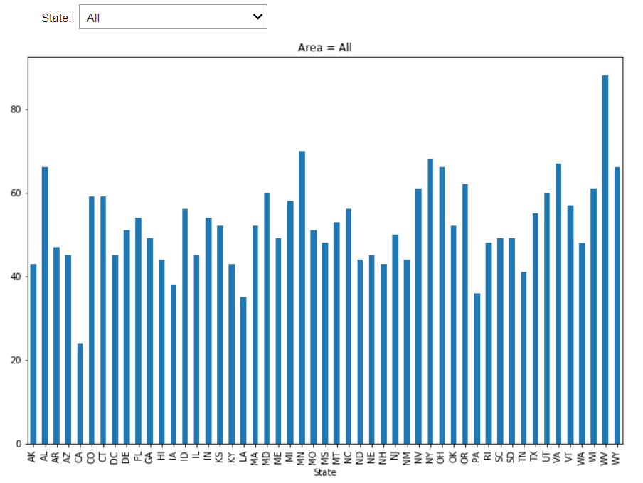
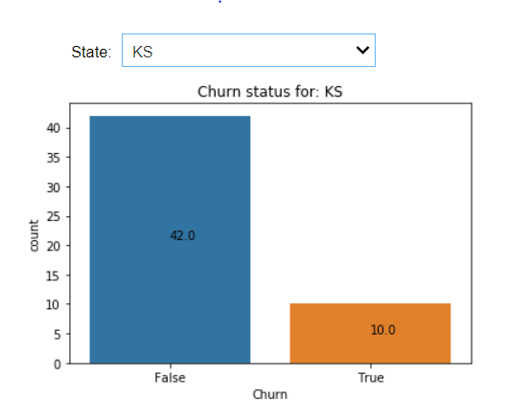
Get the churn state wise
Select All to see overview
Select state to see Churn status

Slide 10
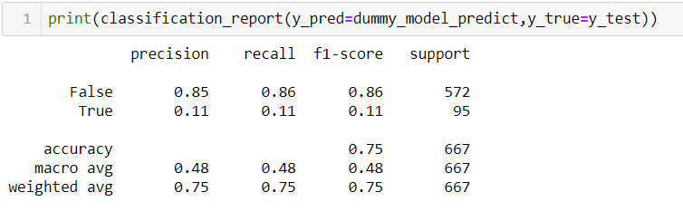
Predictive Modeling
Dummy Classifier with “Stratified” strategy:

Slide 11
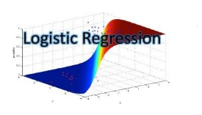
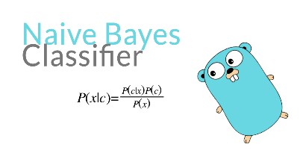
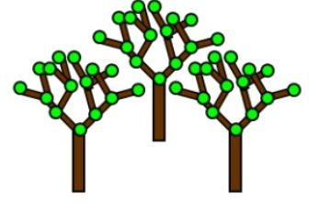
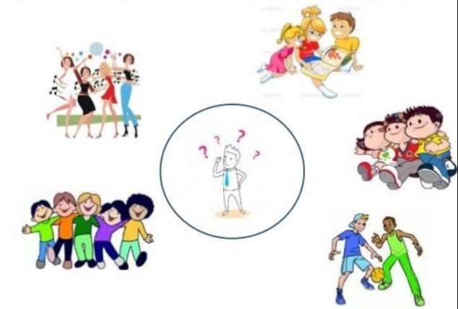
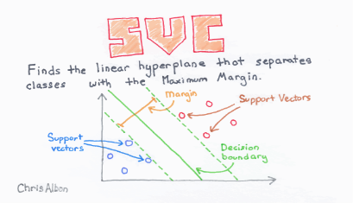
Comparative analysis
83.44%
86.01%
94.94%
84.82%
89.49%
Random forest giving best score after cross validation with average score of 94%

Slide 12
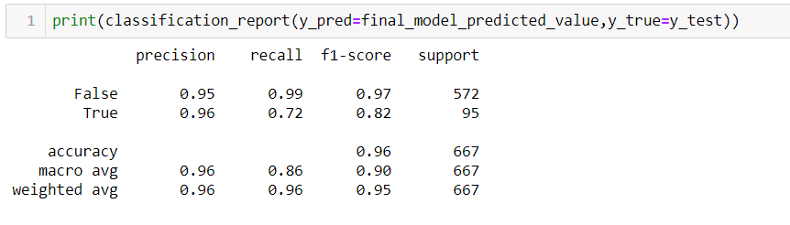

Model evaluation
High Precision
High Recall
High F1 Score

Slide 13
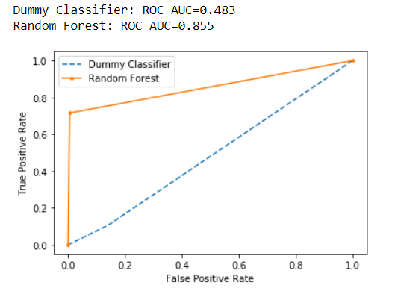
Model evaluation

Slide 14
Conclusion
The customer churn rate increases with # of customer service calls. A self-service option can be thought about like portal, SMS and WhatsApp mode to raise grievances.
Few states like Texas and Maryland has highest number of churn so plans and services can be improved in this area.
Few states like Hawaii, Rhodes Island where churn is very low. Company can study about the customer behavior and try to generalize it across.
Customers having International Plan churn more. So Company can seriously look into their International Plan’s relevancy and improve that.

Slide 15
Thank you

