Slide 1

Term Project
Submitted by:
Nitesh Srivastava
Cohort : 6 –July – 2019 (11-1 PM)
Studied Dataset:
Air Quality Index
“The goal is to turn data into information, and information into insight.”
Carly Fiorina, American businessperson and political candidate, known primarily for her tenure as CEO of Hewlett-Packard

Slide 2
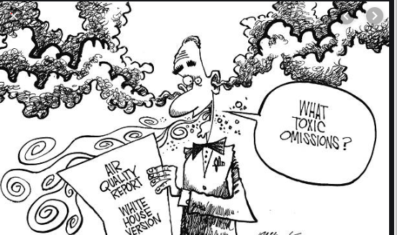
Air pollution has been a global problem now a days. Many countries are suffering from
polluted air and global warming due to bad air quality.
The Air Quality in atmosphere determines various human and environmental factors which
Directly or indirectly effects livings on earth.
The air quality effects Temperature and Humidity (Absolute and Relative) both causing
Problem to surroundings.
This study we will find the relation between various air quality factors, their effect and
mitigation aspects.

Slide 3
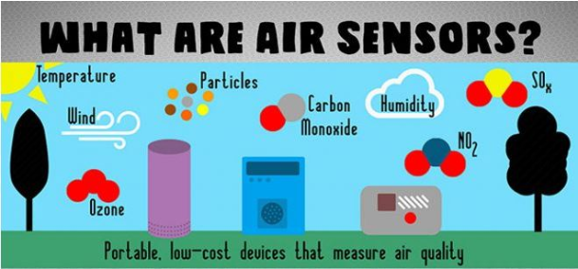
About the data
The data set chosen for study is recorded from March 2004 to February 2005 in an
Italian City. Various air particle's density along with temperature and humidity
has been captured
Image taken from here
The data has been taken from UCI Machine Learning Repository.
Data Set extracted from: https://archive.ics.uci.edu/ml/datasets/Air+quality

Slide 4
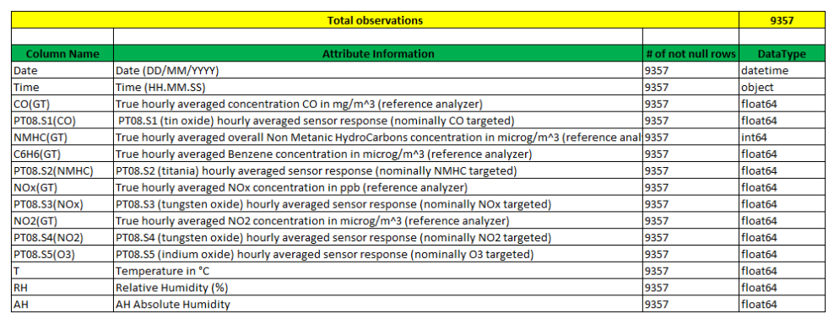
Data Structure from data source:

Slide 5
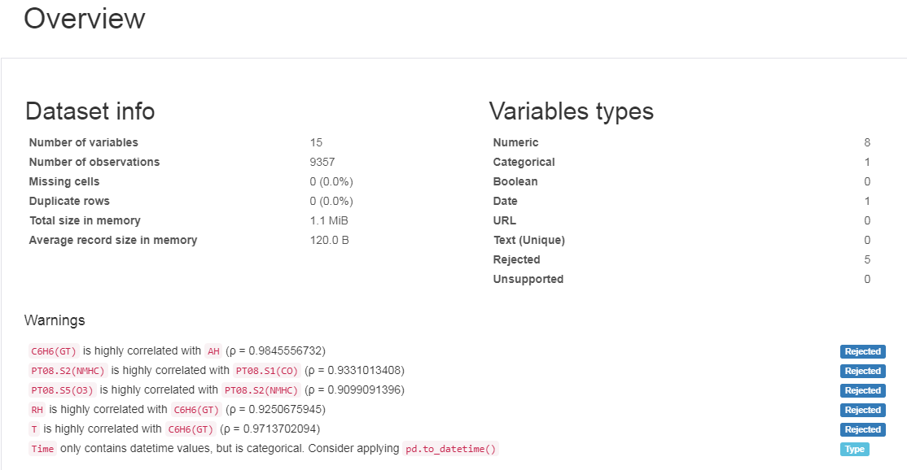
Data structure before profiling and feature engineering

Slide 6
Observations
There are total 9357 records.
There are total 15 features has been collected.
Out of which 8 are numerical, 1 is categorical and 5 columns are rejected because of
highly correlated as below:
C6H6(GT) is highly correlated with AH (ρ = 0.9845556732)
PT08.S2(NMHC) is highly correlated with PT08.S1(CO) (ρ = 0.9331013408)
PT08.S5(O3) is highly correlated with PT08.S2(NMHC) (ρ = 0.9099091396)
RH is highly correlated with C6H6(GT) (ρ = 0.9250675945)
T is highly correlated with C6H6(GT) (ρ = 0.9713702094)
5. All the columns has "-200" as minimum value which looks an anomaly as this value
is -200 for those columns which cannot be negative.
We will replace all "-200" with Nan because it is suspected that all non available value from devices cannot be recovered and has been replaced by "-200"

Slide 7
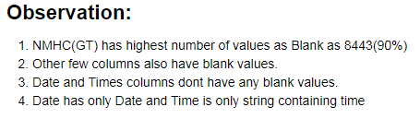
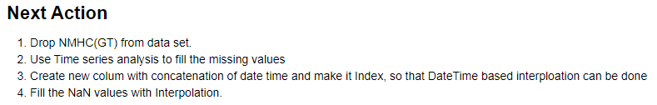
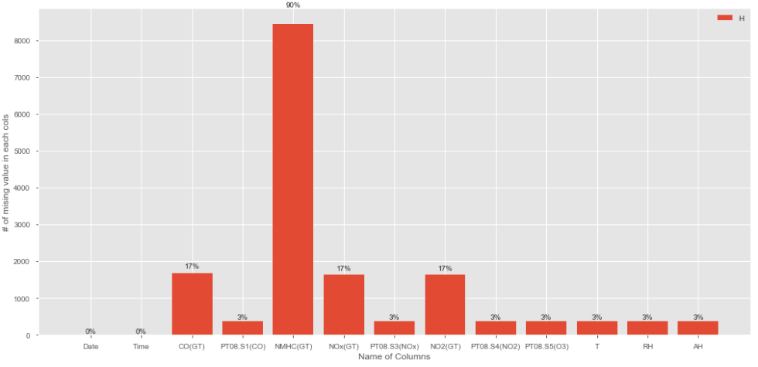
Finding missing values

Slide 8

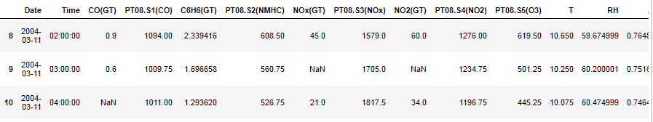
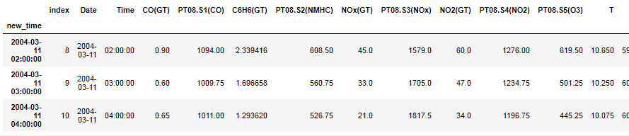
Fill the missing data
Before Interpolation
After Interpolation

Slide 9
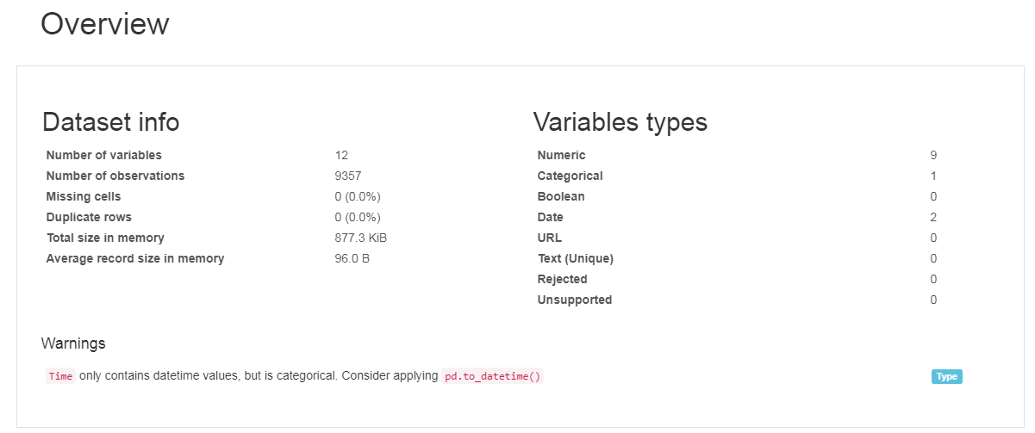
Data structure after profiling and feature engineering

Slide 10

Let’s ask few questions to Data Set:
“Torture the data, and it will confess to anything.”
Ronald Coase, British economist and author

Slide 11
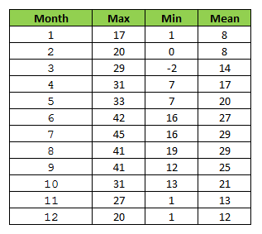
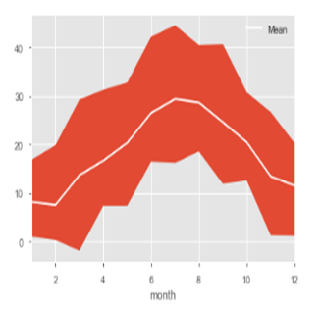
What is the Temperature variation monthly?

Slide 12
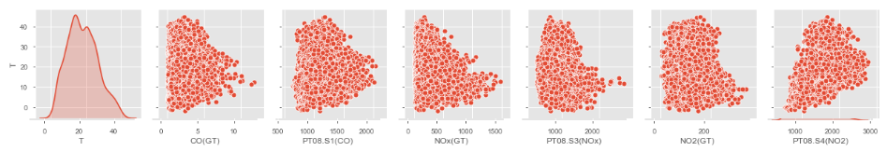

Factor for high Temperature in month of June?
Pair plot for Temperature and particles in month of JUNE
Observation: Main reason for High Temperature in JUNE month may be “PT08.S4(NO2)”
particle.
Reason: This particle is caused by high rate of Tungsten oxidation.

Slide 13
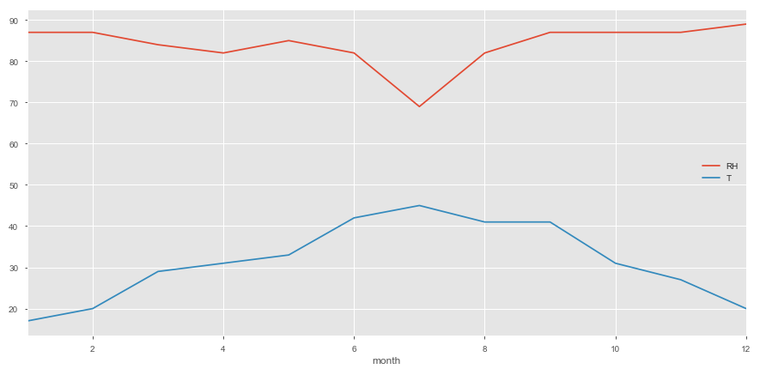
What is the Relative Humidity variation monthly?

Slide 14
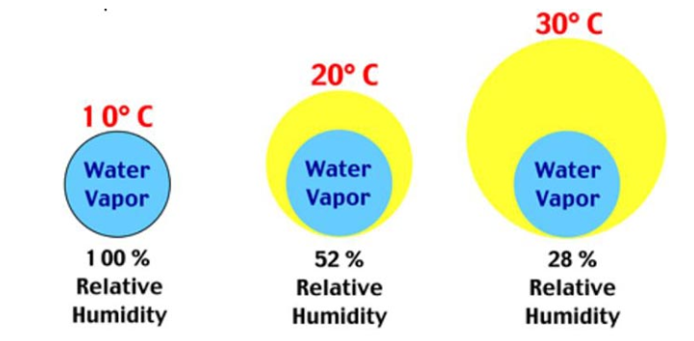
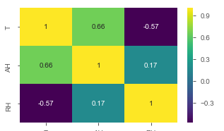
Relative Humidity Vs Temperature ?
Relative humidity is the ratio (expressed as a percentage) of the amount of moisture actually in the air to the maximum amount that can be present at that temperature
Because warm air can hold more water vapor than cool air, relative humidity falls when the temperature rises if no moisture is added to the air

Slide 15
Actionable items
The sensor which records “NMHC(GT) ” is not working properly because almost 90% data recorded as blank or default value -200
May need to fine tune sensors for “CO(GT)”, “NOX(GT)”, “NO2(GT)” as around 17% data recorded as blank or default value -200.
During June and July, the Relative humidity was very low, which will cause various health problems. Campaign to start awareness about these situations and its consequences.
Measures to be taken to prevent Tungsten quantity in atmosphere to avoid temperature rise.

Slide 16
References
https://archive.ics.uci.edu/ml/datasets/Air+quality
https://buythermopro.com/guides/low-humidity-effects-solutions/
https://share.upmc.com/2014/06/effects-humidity-body/
https://www.sciencedirect.com/science/article/abs/pii/S0263436896000273

