Slide 1

Central University of Rajasthan Dept. of Computer Science
AUTOMATIC NOISE DETECTION AND
REMOVAL USING HYBRID FILTER
Project guide: submitted By:
Mr. Raviraj Choudhary Nitesh Sukhwani
Asst. professor 2015imscs010
Dept. of computer science Int. M.sc Vi semester
curaj

Slide 2
Content :
Introduction
Objective
Significance
Type of Noise
Proposed Method
Work Remaining
References

Slide 3
Introduction :
Image denoising is the manipulation of the image data to produce a visually high quality image. At present there are a variety of methods to remove noise from digital images. There are different types of filters like mean filter, median filter, bilateral filter, wiener filter etc. available to remove a single type of noise such as salt and pepper noise, speckle noise, Gaussian noise etc.

Slide 4
Objective :
Identify the type of noise.
Comparative study of various filtering algorithm to find best suitable filter for each type of noise.
We try to make a hybrid filter for S&P noise which first detect the noisy pixels in image then processed only those noisy pixel.

Slide 5
Significances:
As in real life we do not know the type of the noise with which image is corrupted so this method is detect the noise type .
If we know the type of the noise we can apply an hybrid filter or best suitable filter on the image to get denoised image
If image is corrupted with salt and pepper noise it will detect the percentage of image corrupted with that noise and apply processing on only corrupted pixel

Slide 6
Type of Noise A. Additive noise
The additive noise is primarily caused by thermal noise. Thermal noise is a random fluctuations present in all electronic systems.
The mathematical model given for additive noise type is:
f(i, j) = y(i, j) + w(i, j) (1)
where 1 ≤ i ≤ M, 1 ≤ j ≤ N.
Let M and N be the size of the original image y(i, j), w(i, j) be the
noisy image and f(i , j) is the noisy image.

Slide 7
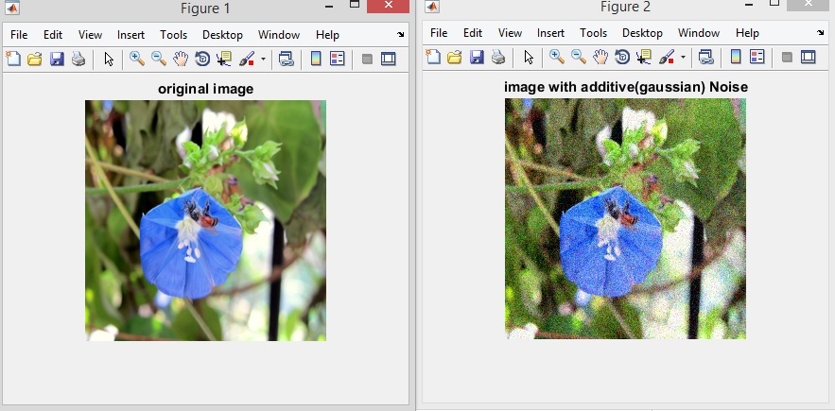

Slide 8
B. Multiplicative noise :
This kind of noise is also called as the speckle noise this type of noise is signal dependent and distorts the image in a large way. The mathematical model for
multiplicative noise type is:
f(i, j) = y(i, j) * w(i, j) (2)
where 1 ≤ i ≤ M, 1 ≤ j ≤ N
Let M and N be the size of the original image y(i, j), w(i, j) be the
noisy image and f(i , j) is the noisy image.

Slide 9
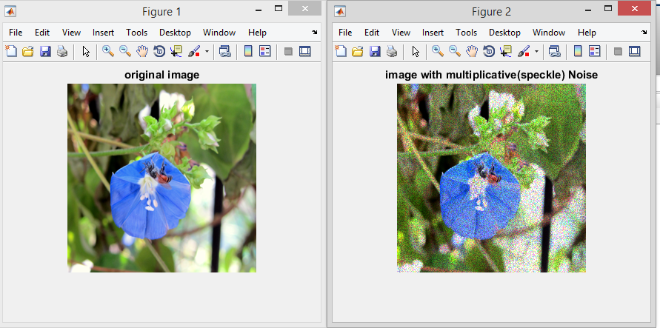

Slide 10
C. Impulsive noise :
Impulsive noise is sometimes called as salt-and-pepper noise or spike noise. This kind of noise is typically seen on digital images. It represents itself as randomly occurring white and black pixels.
0 with probability r
F ( I , J ) =
255 with probability 1 - r

Slide 11
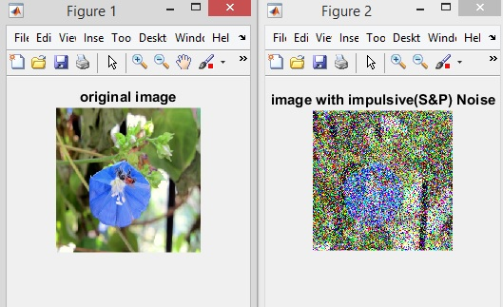

Slide 12
Proposed method :
The basic principle consists of three main steps to identify the
noise type.
Noisy image
Estimate Statistical feature
Pattern classifier to identify noise type

Slide 13
Cont. :
Noisy image ( I )
Median filter ( M )
Weiner filter ( W )
Homomorphic filter ( H )
M1 = I – M
W1 = I - W
H1 = I / H

Slide 14
Cont. :
M1
H1
Estimate statistical feature
W1
Estimate statistical feature
Estimate statistical feature
Apply pattern classifier
Apply pattern classifier
Apply pattern classifier

Slide 15
Cont. :
Pattern classifier
Gaussian noise
Speckle noise
Impulsive noise

Slide 16
Pattern classifier :
Suppose ω (i, j) is Salt-and-Pepper noise, then Median filter, should give the best estimate of y(i, j) and therefore ω = f (I,j) - y (i j) should be close to Salt-and-Pepper noise. A simple minimum distance pattern classifier based on measuring the similarity of Kurtosis and Skewness values is used to evaluate how close Wiener ω is to Gaussian white noise, Median ω is to salt-and pepper noise and Homo ω is to speckle noise. To measure the similarities:
First generate training sequences of Salt-and-Pepper noise.
Then, filter each noise sequence through the Median filter.
Then estimate the Kurtosis and Skewness of each filtered noise sequence and compute their average to yield the reference values of Kurtosis and Skewness for the Salt-and-Pepper noise.

Slide 17
Cont. :
the final measure of similarity between Median ω and actual Salt-and-Pepper noise. The same procedure is carried out to obtain the expected Kurtosis and Skewness values for Speckle noise and Gaussian white noise and based on these data we can identify the type of noise.

Slide 18
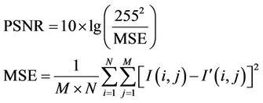
Comparative study:
We select the some predefine filtering algorithm apply every algorithm and do the analysis of the PSNR value.
The more the PSNR value the more is noise reduced. PSNR is calculated using the formula

Slide 19
Result :
noise | S&P | S&P | speckle | Speckle | gaussian | gaussian | gaussian
Filter | PSNR | PSNR | PSNR | PSNR | PSNR | PSNR | PSNR
Median | 17.84 | 15.18 | 15.32 | 18.11 | 17.66 | 13.04 | 19.77
Adpmedian | 18.09 | 15.35 | 15.39 | 18.15 | 17.61 | 13.36 | 18.80
Wiener | 13.54 | 13.98 | 15.40 | 18.17 | 17.80 | 13.45 | 19.93
Gaussian | 15.15 | 14.34 | 14.49 | 17.59 | 17.25 | 13.37 | 18.02
Homomorphic | 10.86 | 4.96 | 8.67 | 14.56 | 16.56 | 13.01 | 18.65
gaussian | 15.06 | 14.66 | 14.68 | 18.04 | 17.67 | 13.24 | 19.42

Slide 20
Impulsive noise :
If image is found to be contaminated by S&P noise to detect the percentage till which image is affected is proposed in this algorithm
I = Noisy image
A = a matrix of same size of image with all zero values.
S= maximum allowed window size
R= starting window size
Count0 = no. of black pixel
Count1 = no. of white pixel

Slide 21
Proposed Algorithm
for identify the noisy pixel:
1. Take matrix of size R*R
2. If ( A (i , j) != 1)
3. If (count0 + count1 != R^2) && ( I(i,j) == 0 || I (i , j) == 255)
A(i,j) = 1;
4. Repeat step 1,2 & 3 for entire image.
5. Increase window size while R<=S
6. Repeat step 1 to 5
7. Count = (no of 1’s in A matrix) / (resolution of image)
8. Return count and A;

Slide 22
Proposed Algorithm
for filter the noisy pixel
1. Take matrix of size R*R
2. If ( A (i , j) != 1)
3. Find median of R if (median != 0 && median != 255)
I ( i, j ) = median and A( i, j )=0;
4. Repeat step 1,2 & 3 for entire image.
5. Increase window size while R<=S
6. Repeat step 1 to 5
7. Return I;

Slide 23
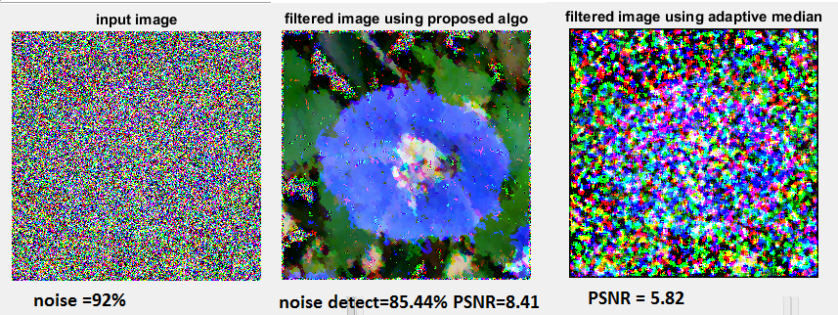
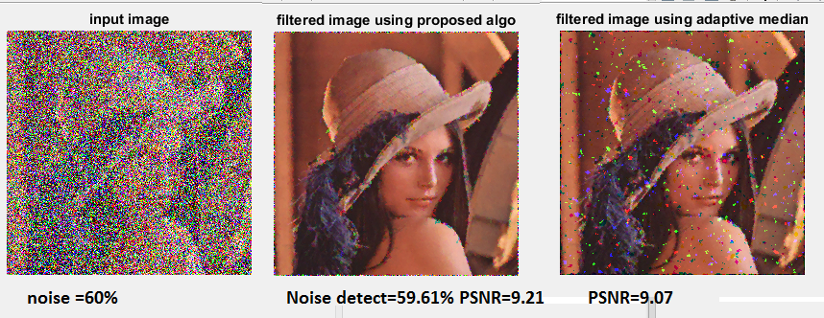
Output of proposed algorithm

Slide 24
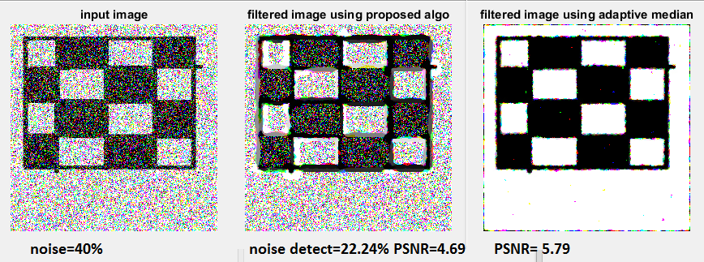
Limitation with proposed algorithm :
It does not give efficient output with binary image(image with intensity 0 & 255).

Slide 25
Future work
Extend noise identification for all parameter.
Detection of impulsive noise in binary image
Extend comparative method to more filtering techniques.

Slide 26
References :
Yixin Chen, Manohar Das, “ An Automated Technique for Image Noise Identification Using a Simple Pattern Classification Approach”, IEEE Trans, 2007
Dr. P. Subashini , Bharathi.P. T “Automatic Noise Identification inImages using Statistical Features “
M. C. Motwani, M. C. Gadiya, R. C. Motwani, F. C. Harris, Jr.,” Survey of image denoising techniques”, Proceedings of GSPx 2004, Santa Clara, CA, September 27-30, 2004.
Suman Shrestha “ Image denoising using adaptive based median filter”.
Y. Zhao, D. Li, Z. Li, “Performance enhancement and analysis of an adaptive median filter

Slide 27
Thank
You

