Slide 1
Air-Fuel Interaction of CRDI Engine using CFD Analysis
D.Sree Varsha,
GUIDE: Dr.Harshavardhan 18311D2114,
M.Tech(TE)

Slide 2
Introduction
CRDI stands for Common Rail Direct Injection. This is a fuel injection mechanism used for multi-cylinder engines. The main function of the CRDI system is to supply requisite amount of fuel at a constant pressure and also to maintain a certain amount of pressurized reserve fuel during starting of engine.
A further advantage of the CRDI system is that it injects the fuel directly into the combustion chamber. The indirect injection (IDI) system in older engines injected fuel into a pre-combustion chamber which then fed the main combustion chamber.

Slide 3
Literature Review
“Effect of piston shape on air-fuel interaction in a direct injection spark ignition engine.” – Ballapu Harshavardhan et al.,(2015)
In this study, a CFD analysis has been carried on air-fuel interactions in a four-valve four stroke engine. It has been done with different piston shapes viz., flat, flat-with-center-bowl, inclined and inclined-with-center-bowl pistons at an engine speed of 1500 rev/min., using a multi-hole injector with a fuel injection pressure of 500 bar.

Slide 4
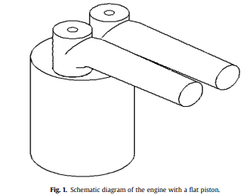

Slide 5
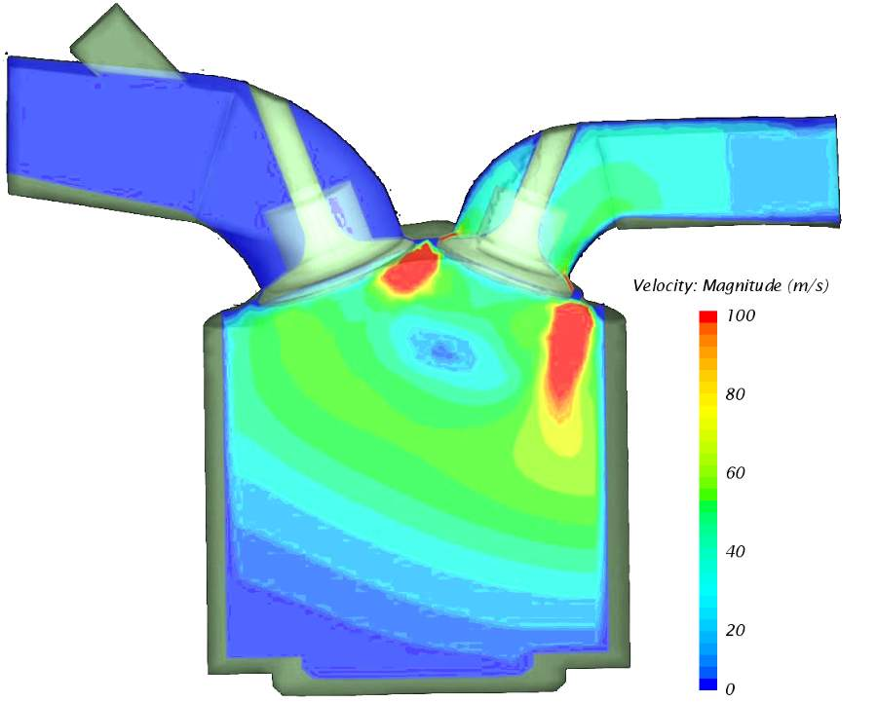

Slide 6
Thank You

