Slide 1

SMART INDIA HACKATHON 2026
Problem Statement ID – SIH26025
Problem Statement Title – Development of an AI-enabled Low Cost Real Time Mine Subsidence Monitoring, Prediction and Early Warning System for Underground Coal Mines in India
Theme - Smart Automation
PS Category- Hardware
Team ID- SIH26-A0H-T285
Team Name - The Invictus

Slide 2

The Invictus
Multi-Modal Intelligent Mine Safety & Early Warning System
PROBLEM :
OUR IDEA :
• Underground coal mines face sudden roof instability, ground movement, and strata failures, while single-sensor monitoring can cause false alarms, blind spots, and missed dangers, putting workers and infrastructure at serious risk.
• A Multi-Modal Mine Safety System that combines sensor, sound, camera, and historical data to detect risks in real time and provide reliable alerts by using AI and monitoring sensor health.
PROPOSED SOLUTION:
INNOVATION:
• Edge Sensing Nodes:
Deploy sensors to monitor displacement, tilt, strain, and abnormal sounds, with cameras for periodic structural monitoring.
• Reliable Telemetry:
Send sensor data through LoRa/mesh communication to a surface gateway for monitoring even with limited connectivity.
• Intelligent Risk & Response:
Use AI to combine sensor data, assess risk and confidence, detect faults, and provide real-time alerts and safety recommendations.
• Multi-Modal Evidence Fusion
Combines structural, sound, and camera data to improve accuracy and reduce false alarms.
• Confidence-Aware Assessment
Shows the risk level, confidence, and system health instead of treating every abnormal reading as a real danger.
• Intelligent Sensor Placement
Places sensors in the best locations based on risk, coverage, and communication.
• Fault-Tolerant Monitoring
Detects sensor or communication failures and continues monitoring with the available sensors instead of showing the area as safe.

Slide 3
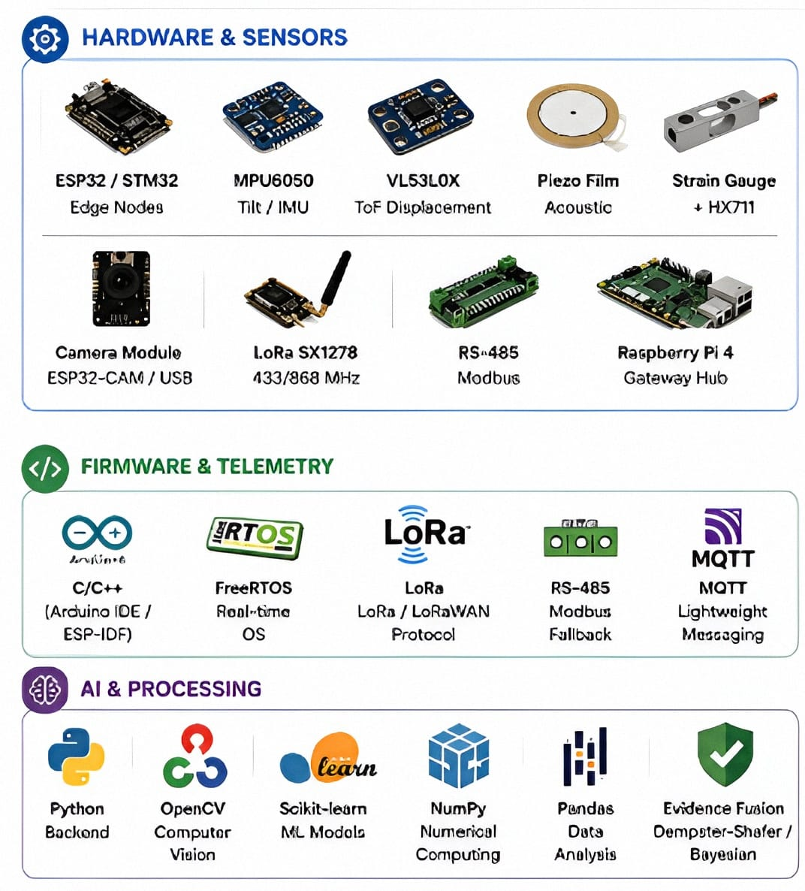
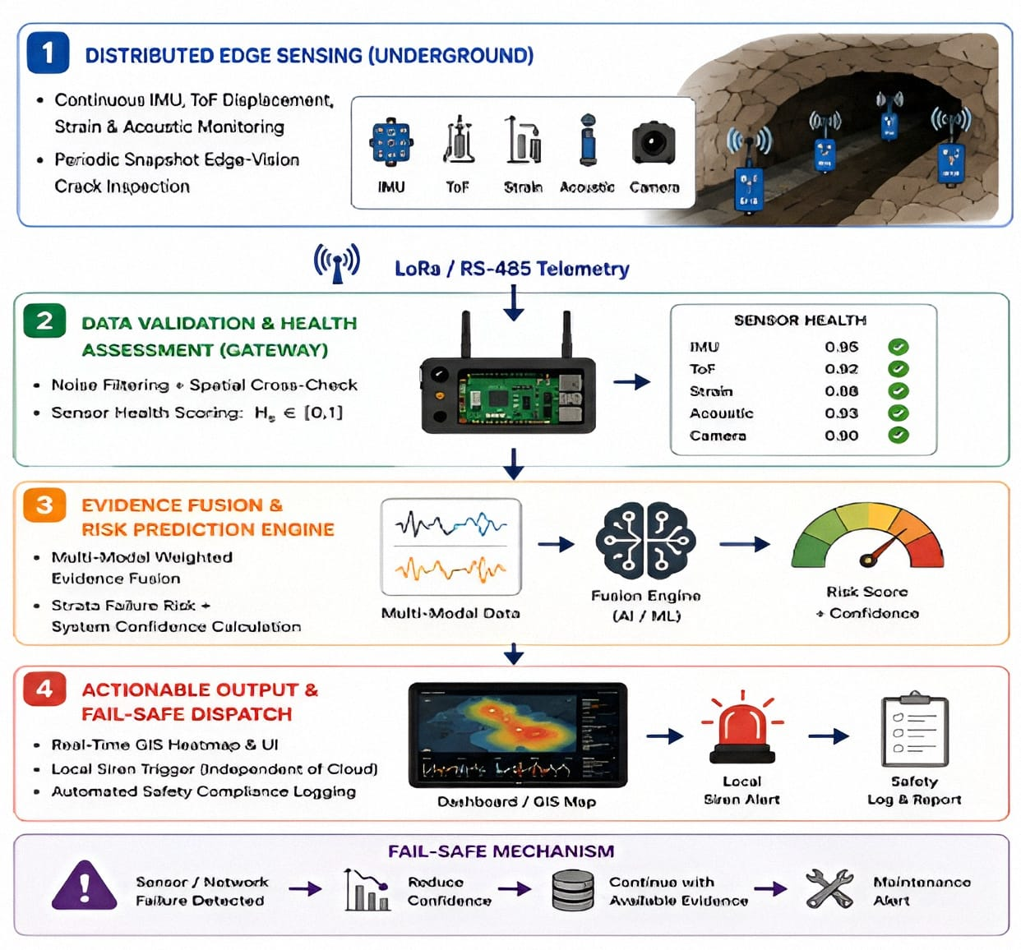
TECHNICAL APPROACH
The Invictus
TECHNOLOGIES & TOOLS STACK:
SYSTEM ARCHITECTURE & WORKFLOW:

Slide 4
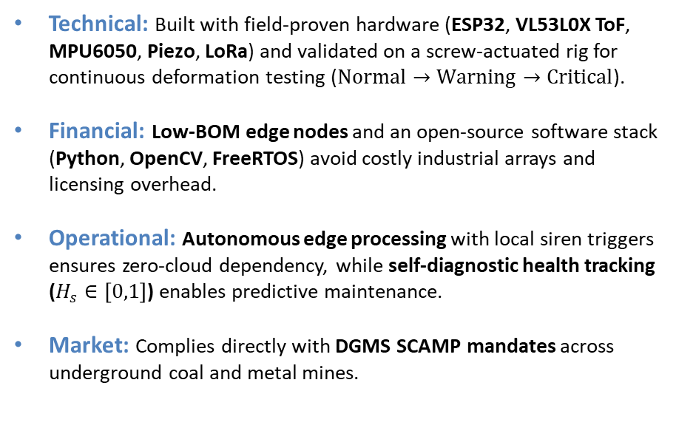
FEASIBILITY AND VIABILITY
The Invictus
Feasibility
Potential Challenges and Risks:
Technical: Built with field-proven hardware (ESP32, VL53L0X ToF, MPU6050, Piezo, LoRa) and validated on a screw-actuated rig for continuous deformation testing ($Normal→Warning→Critical$).
Financial: Low-BOM edge nodes and an open-source software stack (Python, OpenCV, FreeRTOS) avoid costly industrial arrays and licensing overhead.
Operational: Autonomous edge processing with local siren triggers ensures zero-cloud dependency, while self-diagnostic health tracking ($H_{s}∈\left[0,1\right]$) enables predictive maintenance.
Market: Complies directly with DGMS SCAMP mandates across underground coal and metal mines.
Technical Risks:
Underground RF signal attenuation and multipath fading through rock walls and tunnel bends.
Sensor drift, high humidity, dust accumulation, and false-positive vibration spikes from routine mining operations (blasting/machinery).
Operational & Environmental Risks:
Variable underground lighting impacting camera-based crack detection.
Battery drainage and power supply constraints across deep active faces.
Market & Adoption Risks:
Miner distrust caused by repeated false alarms from threshold-only conventional systems.
Strategies for Overcoming These Challenges:
Hybrid Telemetry (RF + Wired Fallback):
Deploy Sub-GHz LoRa (433/868 MHz) mesh relays with an industrial RS-485 Modbus wired bus fallback for uninterrupted subterranean transmission.
Multi-Modal Evidence Fusion:
Implement Dempster-Shafer / Bayesian Fusion to cross-check independent sensor streams (tilt, sag, acoustic, vision), eliminating false alarms.
Dynamic Sensor-Health Awareness:
Dynamically down-weight failing nodes and shift to a degraded monitoring state rather than falsely reporting an unsafe zone as green.
Triggered Edge-Vision with Active Illumination:
Use sensor-triggered snapshot capture with dedicated high-output LEDs and lightweight edge-segmentation (OpenCV/YOLOv8-nano) to isolate crack growth from airborne dust.
Optimal Placement (OSP): Heuristic/PSO placement maximizes gallery coverage within strict hardware budgets.

Slide 5
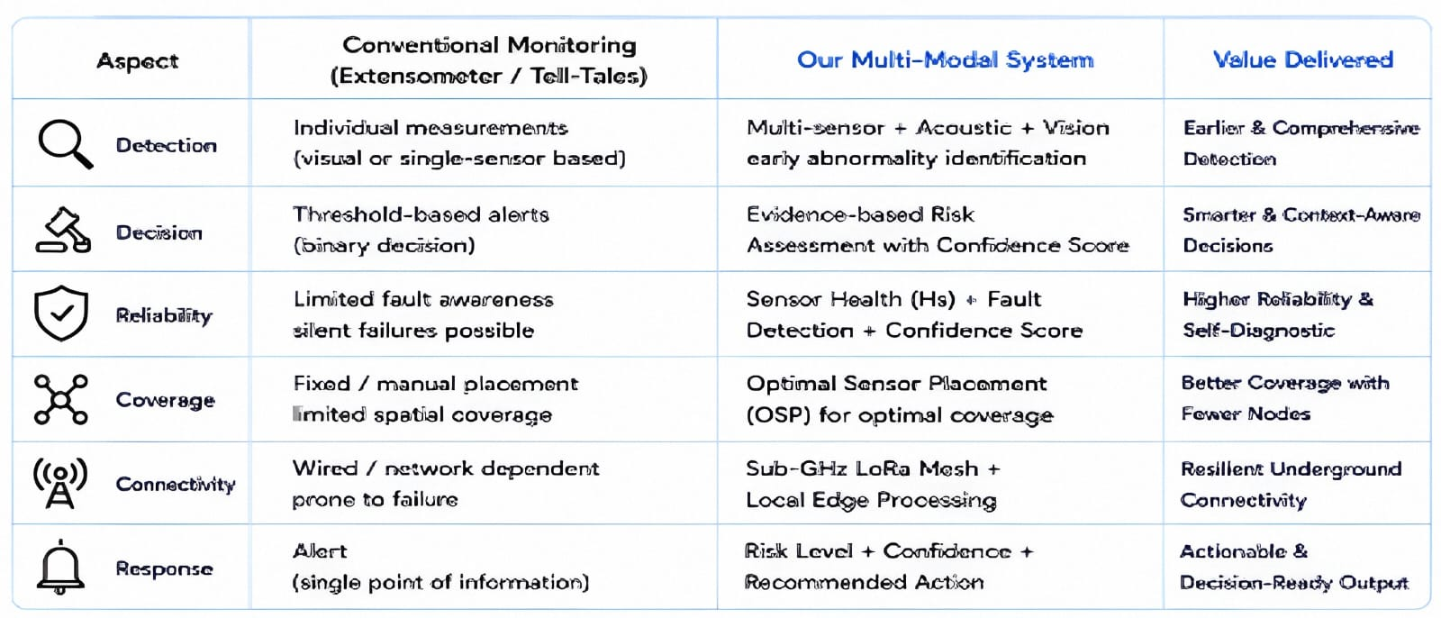
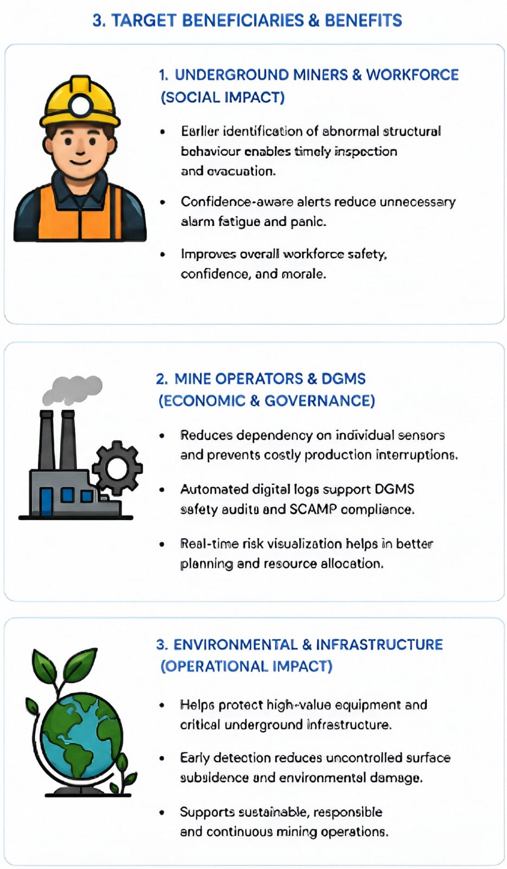
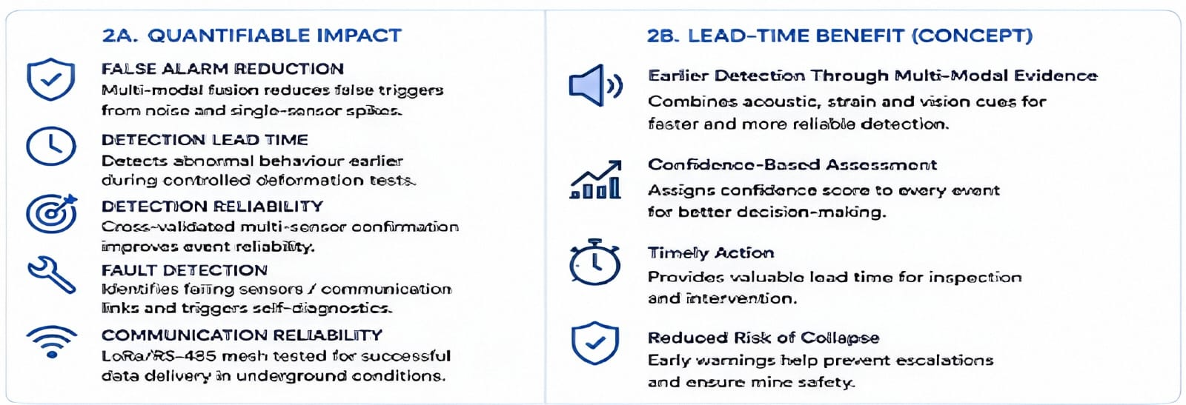
IMPACT AND BENEFITS
The Invictus

Slide 6
RESEARCH AND REFERENCES
The Invictus
1. Structural Monitoring & Early Damage Detection
Journal of Sensors (2018) — FBG-based condition monitoring and early damage detection for underground coal mines using IoT.
Reference : View ↗
2. Underground Coal Mine LoRa Communication
Processes (2023) LoRa-based communication for data transmission from underground coal mines
Reference :View ↗
3. Underground IoT & LoRaWAN Monitoring
Sensors (2024) — Review Article IoT/LoRaWAN-based wireless sensor networks for underground mine monitoring
Reference: View ↗
4. Statutory & Mine Safety Standards
Directorate General of Mines Safety (DGMS), India Official regulations, safety guidelines and mine-monitoring standards
Reference: View ↗

