Slide 1
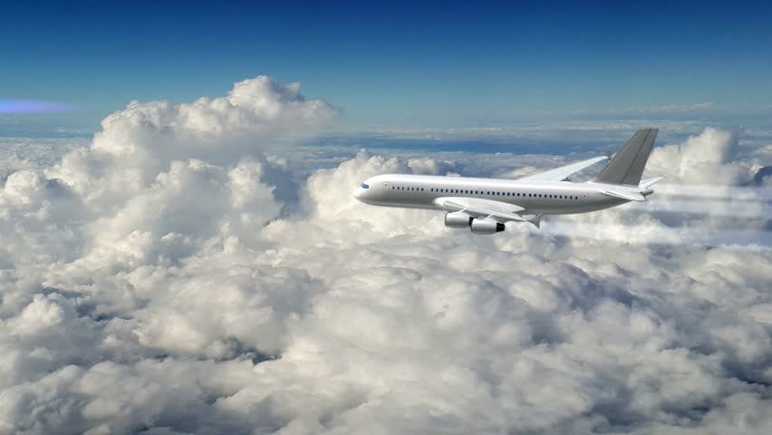
U.S.A Flight Predictions
By:
Natalie St
Loba Q
Nitha B

Slide 2
Contents
Data Mining
Cleaning
Analyzing Data
Creating Machine Learning Models
Specifications
Implementing our Models
Predictions

Slide 3
Data Mining
Main Resource : Bureau of Transportation
Extracting CSV files
Going back and forth to resources to update our parameters
12 months of 2018 data
Since the source was only available in months
Weather delay, National delay
During building the model, big data issues., i.e. memory error
Filtered the data by variables that affect flight delays
US Domestic flights only
Memory error and shrinking
Ended up with 7 million rows

Slide 4
Cleaning
12 months Data
7 million rows
Subset for the categorical model
Spinning wheels for data extraction
Fraction of Data used
15% of 7 million

Slide 5
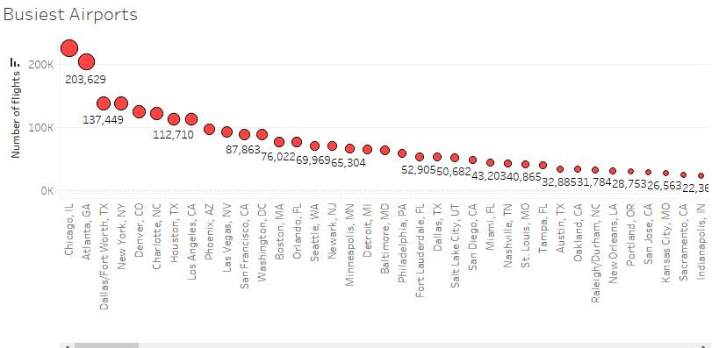
Analyzing data
Cities with the busiest airports by number of flights.
The marks are labelled by how many records of flights departing from that airport
Results for top 3:
Chicago
Atlanta
Dallas

Slide 6
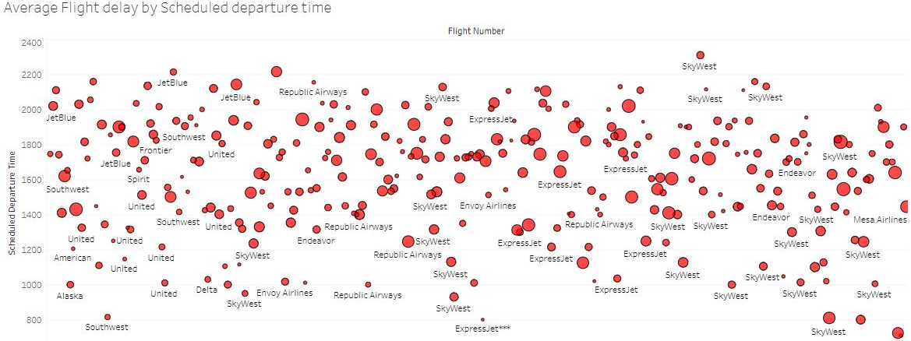
Average Flight Delay
Scheduled Time
Airlines

Slide 7
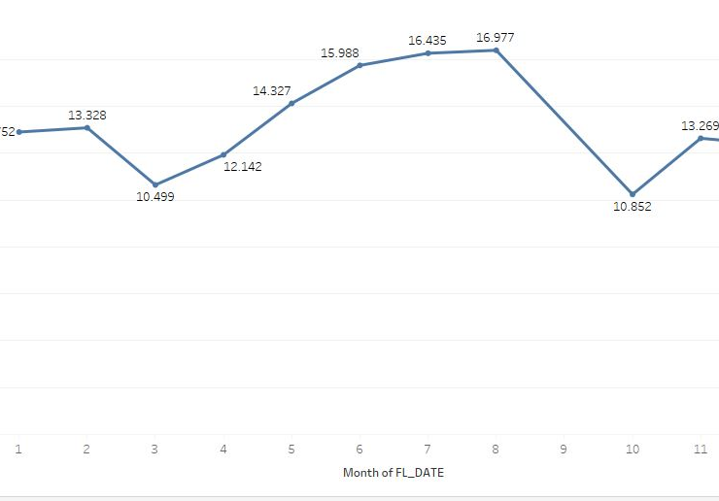
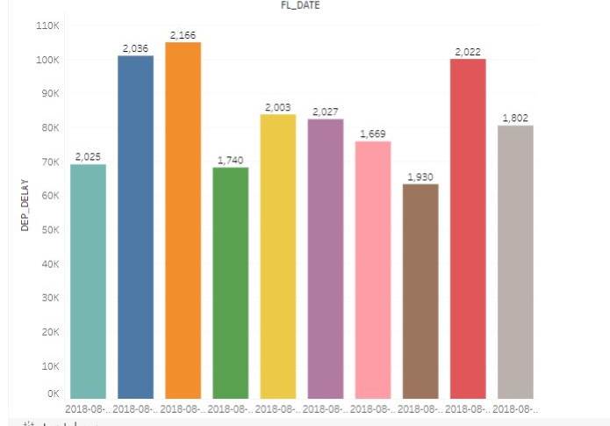
Route Delays by Month
Average number of delay in minutes

Slide 8
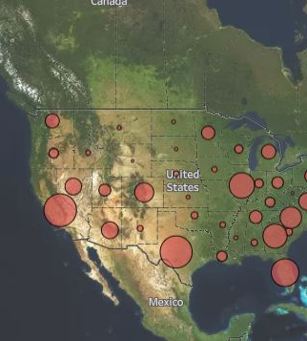
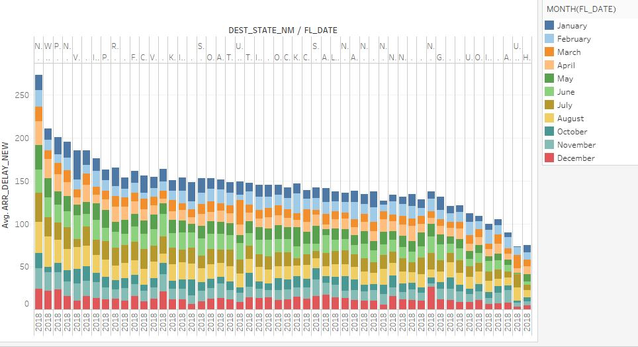
Delays by State(Avg)
Delays in each month by state (Totals)

Slide 9
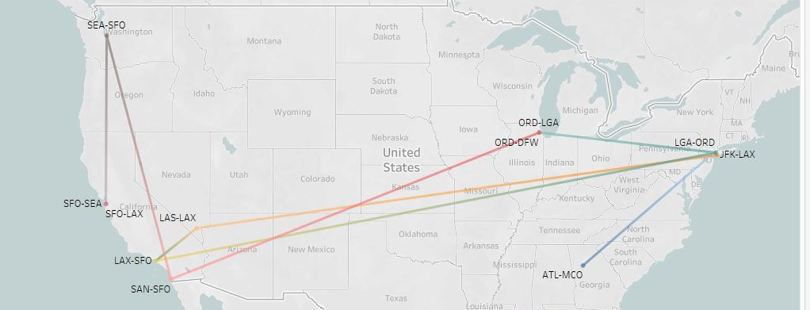
Top delayed Routes

Slide 10
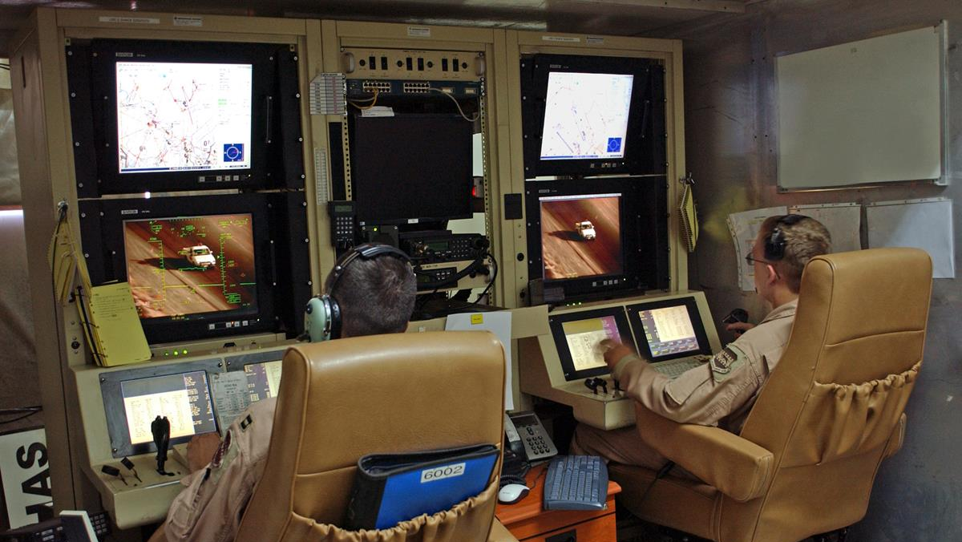
Machine Learning Developmental Models
Linear
Ridge
Classification
Notes:
Consider talking about:
Command and sensor systems
Deployment methodology
Armed versions
Later development and future

Slide 11
Building a model (or two)!
Flight predictor models
All prediction first we built mini model to get a better sense of what our dataset is capable of or its limits.
Random forest classifier
80/20 data set for training and testing respectively
Since its classifier just predicting delay or no delay
Parameters ‘day of month’, ‘departure airport’ ‘destination airport’
R2 = 78
Linear & ridge
50/50 split
Predicting how many minutes will be delayed
R2 = 94

Slide 12
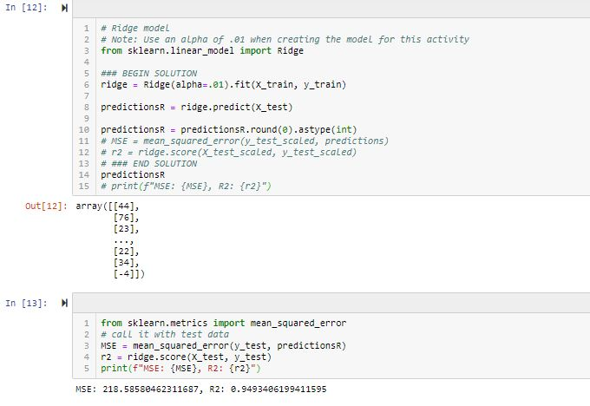
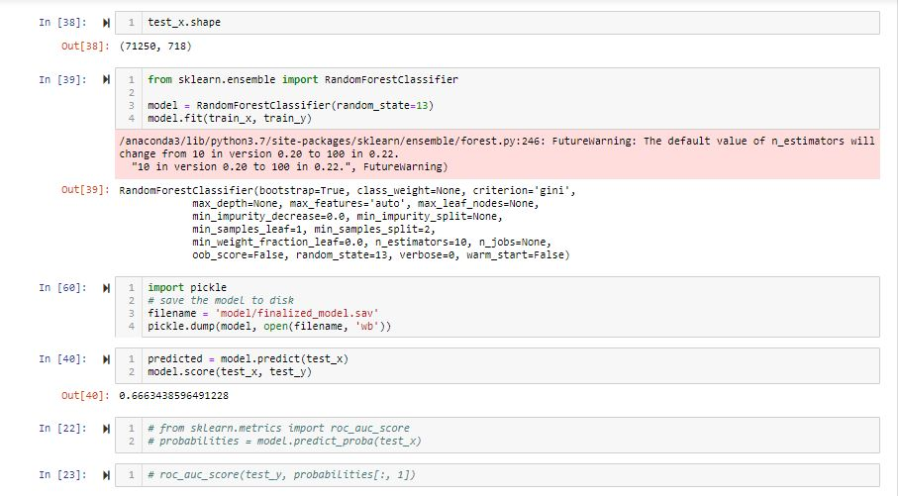
2 models
Random forest
Ridge Regression
Prediction parameters & R2
Prediction parameters & R2

Slide 13
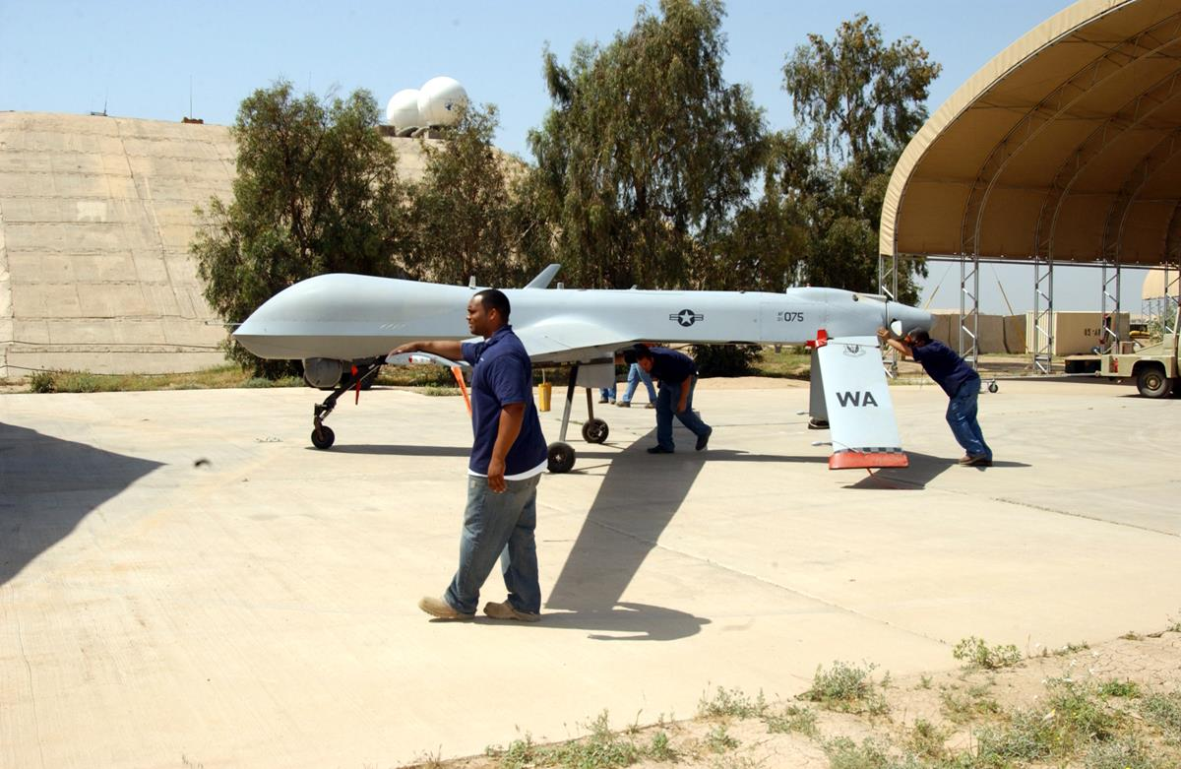
Operators for our Coding..
Jupyter notebook (heavy lifting)
Tableau
Flask
Python
Javscript

Slide 14

Our Takeaway:
Big data needs more RAM
More time
Be open to using different models depending on your data size
Have a clear picture of what you are looking to predict to make results more efficient
Know what you want

Slide 15

What we need to improve on:
If we did this over again
I would learn more about adding layers to my model
Neural networks framework
Play with more models for better accuracy
Use Zepl & AWS

Slide 16
Works cited
Bureau of transportation
https://www.bts.gov/
Airports csv for coordinates
https://openflights.org/data.html

