Slide 1
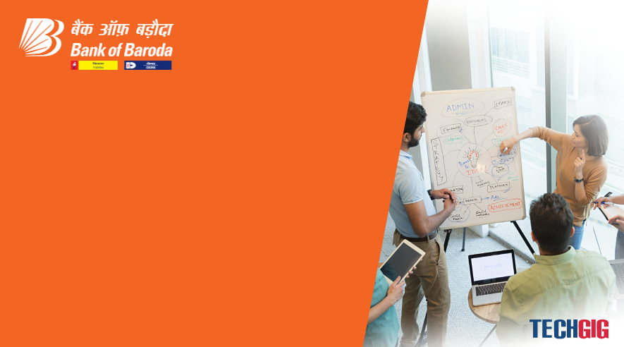
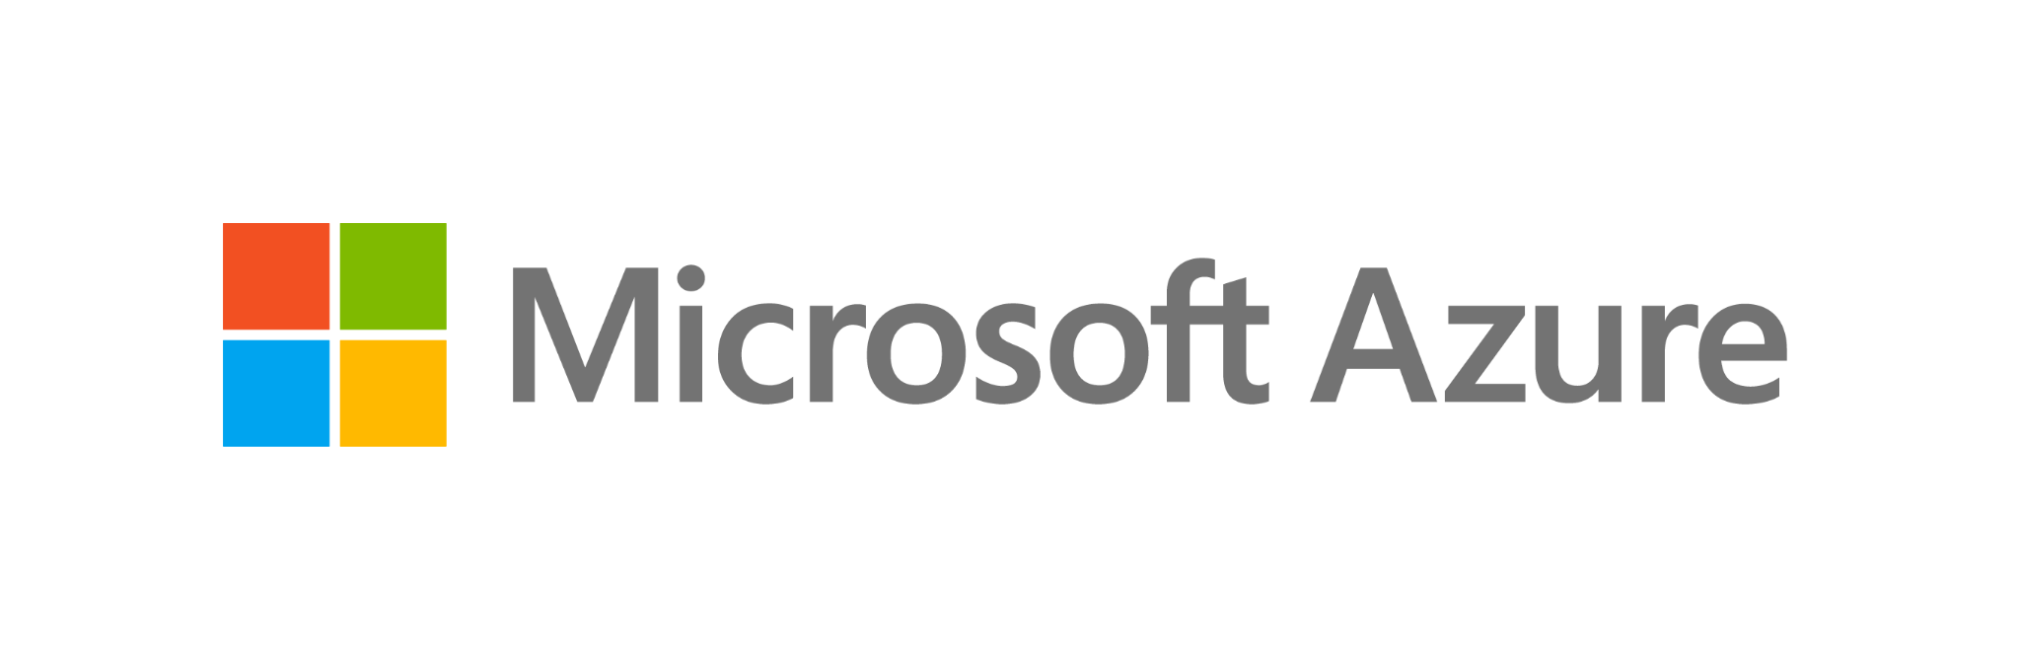
Bank of Baroda Hackathon - 2022
Technology Partner
Your Team Name : Kick the butbucket
YOURTEAM BIO:
Nitha.P
Rajarajeswari.M
Preethi.S
Srimathi.V
DATE:13.09.2022

Slide 2
Problem Statement?
Why did you decide to solve this Problem statement ?
Real world entities to graphical entities.
We can visualize that which cannot be realized.
It increases our imagination level in real world entity.
Through avatars, creators can portray themselves however they want, so they can explore different.

Slide 3
User Segment & Pain Points
Which user/advertiser segment would be early adopter of your product & why?
As we have an idea to overcome the diffficulty in virtual avatar , we hope that it will be an useful choice.
Using this they can range over many looks, genders, and different identities and play around with new ways to express themselves.
Fear of losing business to competitors.
There is also a fear of his/her agency falling behind in the digital business scene.

Slide 4
Pre-Requisite
What are the alternatives / competitive products for the problem you are solving ?
Here,we aim to permit customers to use their own personalized avatars on digital banking section, laptops, mobiles and mixed reality environments.
This platform will bring banking assistance from the real world to the virtual world.
Also have AI based digital customer interaction, like interacting with the relationship manager’s avatar creation and customization.
Analysis of portofolio, automated form filling so that it will easily co-operate with banking.

Slide 5
Azure tools or resources
The Microsoft Rocketbox Avatar library consists of 115 characters and avatars fully rigged and with high defenition that was developed over the course of 10 years.
The diversity of the characters and the quality of the rigging together with a relatively low-poly meshes, makes this library the go-to asset among research laboratories worldwide from crowd simulation to real-time avatar embodiment and social virtual reality .
Ever since their launch, laboratories around the globe have been using the library
Many of the lead authors in the VR community have extensively used these avatars during their research.

Slide 6
Any Supporting Functional Documents
start
Augmented reality is an interactive experience where the objects that reside the real world are enhanced by computer-generated perceptual information, also in multiple sensory modalities, ect… Example: Avatar
Immersion into virtual reality (VR) is a perception of being physically present in a non-physical world. Example: Digital projections
Metaverse is a hybrid of augmented reality, virtual reality (VR), and video technologies. Example: Nintendo’s Pokémon go
Input the voice
Process the input into a sentence
Process the sentence and make appropriate response
Process the response to an output voice
Render the Avatar
Output the avatar with voice
Any new input from user ?
Yes
No
End

Slide 7
Key Differentiators & Adoption Plan
How is your solution better than alternatives and how do you plan to build adoption ?
Virtual Avatar is a great way to entertain your team during a corporate event
In games and other some of the sectors it create communication between new-hires and within teams.
In case of our problem statement, it will very useful for the banks to interact with employees and customers from different countries.
It have a chance to take decision for the customers in digital way.
So that they can also efficiently interact with relationship manager’s and co-operate with banking.

Slide 8
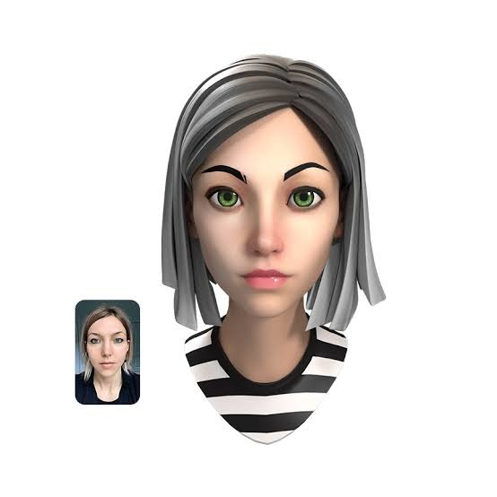
GitHub Repository Link & supporting diagrams, screenshots, if any
How far it can go?
Git hub link-
Diagram:

Slide 9
Thank You
TEAM MEMBERS NAME : NITHA P
RAJARAJESWARI M
PREETHI S
SRIMATHI V

