Slide 1
U23AD491 - DATA SCIENCE SPRINT | SKILL BASED ASSESSMENT 2
Machine Maintenance Insight
For MechaCare Industrial Systems
Use Case 25: Operating Patterns, Sensor Degradation Signatures & Equipment Prioritization
Author: Nitheen Sakthe P E | Role: Lead Data Scientist & Maintenance Reliability Analyst
Datasets: sensor.csv, machines.csv, usage.csv, alarms.csv, maintenance.csv (Q1 2026 Fleet Logs)

Slide 2
MECHACARE INDUSTRIAL SYSTEMS | DATA SCIENCE ASSESSMENT 2
Executive Summary: The Industrial Reliability Landscape
30 Machines
Monitored Fleet Size across 5 Equipment Categories
64,016 Hours
High-frequency Sensor & Usage Synchronized Grain
2,510 Alarms
Cleaned & Standardized (49.2% Critical Severity)
268.5 Hours
Total Unplanned Maintenance Downtime in Q1 2026
Strategic Business Problem:
• Core Question: What operating patterns indicate industrial machines that require proactive maintenance attention before catastrophic failure?
• Fleet Scale: MechaCare monitors 30 industrial assets: CNC Lathes (10), Hydraulic Presses (7), Conveyors (6), Compressors (5), and Milling Machines (2).
• Data Cleaning Justification: Resolved 35 duplicate sensor rows, 25 duplicate usage rows, imputed missing values using machine-specific medians, and mapped 7 inconsistent alarm strings into 3 engineering categories.
Key Data-Driven Insights:
• Equipment Skew: Hydraulic Presses represent only 23% of the fleet but generate 47.9% of all plant alarms (1,202) and suffer 11.89 hours average downtime.
• The Load Paradox: Operating load has virtually ZERO correlation (r = -0.142) with machine downtime. Machine age, mechanical vibration, and heat buildup are the actual failure drivers.
• Pre-Service Trajectory: Sensor vibration exhibits a statistically significant upward climb (+11.8%) starting 7 days prior to service events, peaking at 2.85 mm/s within 24 hours of intervention.

Slide 3
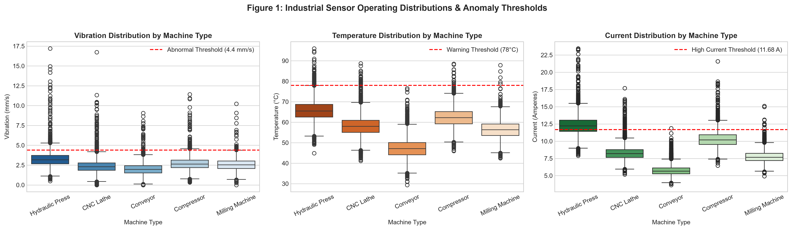
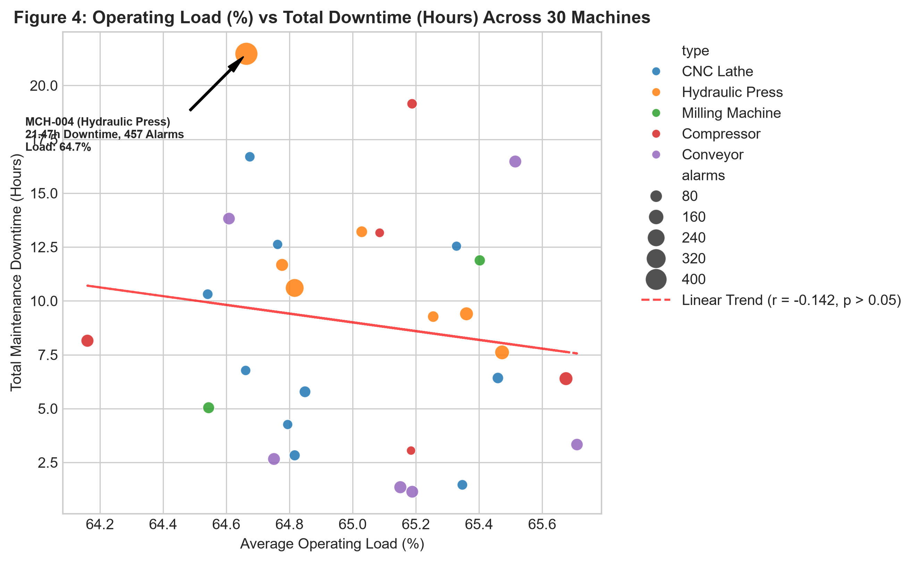
MECHACARE INDUSTRIAL SYSTEMS | DATA SCIENCE ASSESSMENT 2
Analytical Questions 1, 4 & 5: Sensor Extremes, Load vs Downtime
Key Evidentiary Findings from Actual Dataset:
• Q1 (Abnormal Ranges): MCH-004 exhibited the highest vibration peak plant-wide (17.20 mm/s, over 3.9x normal threshold) and 1,580 warning hours. MCH-021 registered extreme thermal stress peaking at 95.96°C.
• Q4 (Load Paradox): Average operating load across all machines remains constant (~65.0%). Machines in the low downtime tier average 65.03% load, while high downtime machines average 65.02%. Load does not explain failure.
• Q5 (Machine Types): Hydraulic Presses average 11.89h downtime/machine. CNC Lathes require the highest service count (20 services = 2.0/machine). Conveyors have lowest downtime per event (3.46h) but frequent friction alarms.

Slide 4
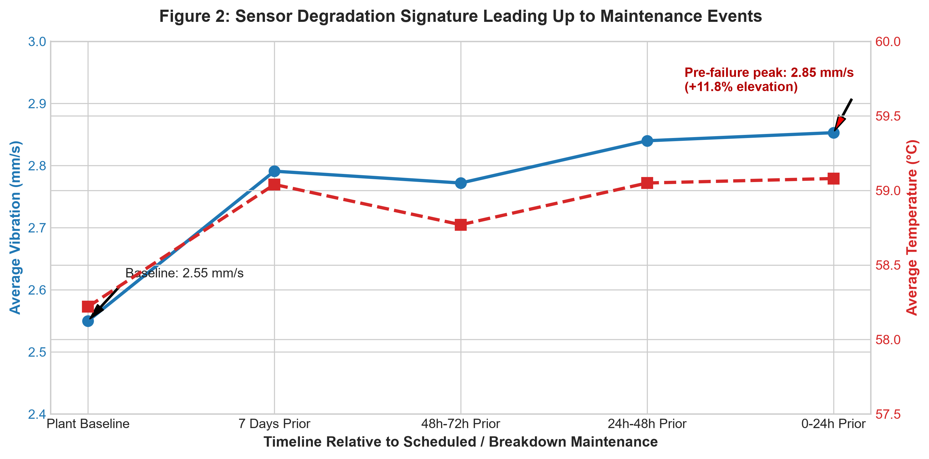
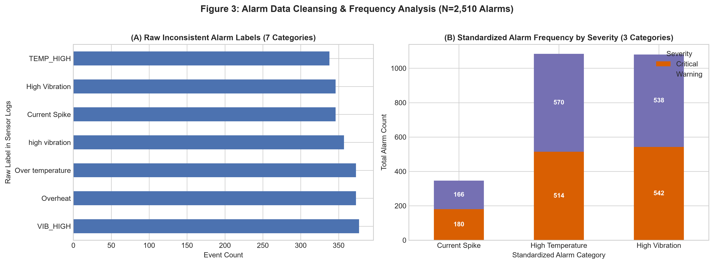
MECHACARE INDUSTRIAL SYSTEMS | DATA SCIENCE ASSESSMENT 2
Analytical Questions 2 & 3: Failure Signatures & Alarm Frequency
Operational Degradation Signatures & Cleansing Evidence:
• Q2 (Pre-Service Trajectory): Plant vibration baseline averages 2.55 mm/s. 7 days prior to service, it climbs to 2.79 mm/s; at 48h-24h it hits 2.84 mm/s; and within 24h of failure it peaks at 2.85 mm/s (+11.8% elevation). Temperature similarly rises from 58.2°C to 59.1°C.
• Q3 (Alarm Normalization): Standardized 7 inconsistent sensor strings into 3 root types: High Temperature (1,084 events, 43.2%), High Vibration (1,080 events, 43.0%), and Current Spikes (346 events, 13.8%).
• Severity Distribution: Critical severity accounts for 49.2% (1,236 alarms) vs 50.8% Warning (1,274 alarms). High temperature critical events represent the primary emergency shutdown trigger.

Slide 5
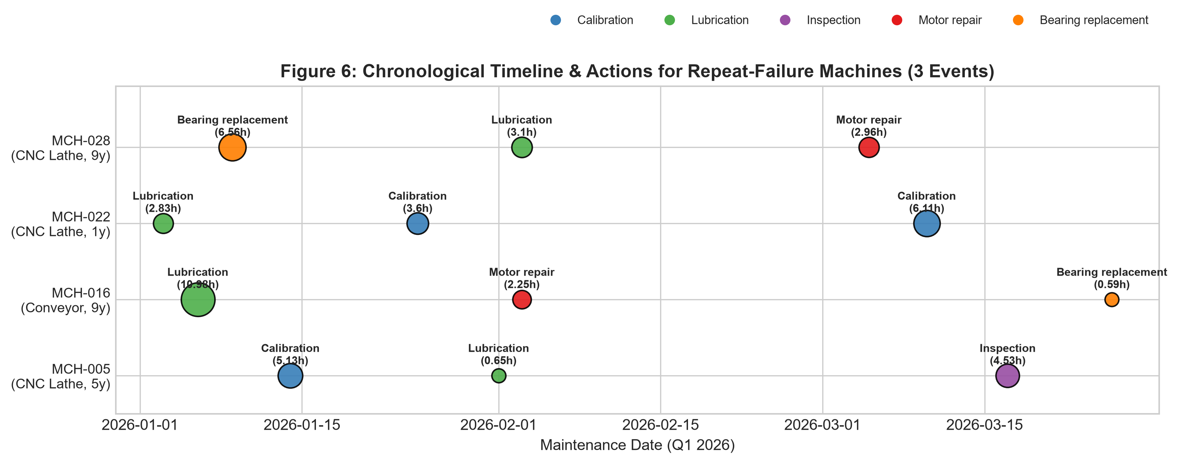
MECHACARE INDUSTRIAL SYSTEMS | DATA SCIENCE ASSESSMENT 2
Analytical Question 6: Chronic Machines & Repeat Failure Patterns
Top Repeat Failure Assets (3 Services):
• MCH-005 (CNC Lathe, 5y): 10.31h downtime. Interventions: Calibration -> Lubrication -> Inspection. Lack of component overhaul allows alignment drift to recur.
• MCH-016 (Conveyor, 9y): 13.82h downtime. Progressive failure: Lubrication starved -> Motor burned -> Bearing replaced. Clear cascading wear.
• MCH-022 (CNC Lathe, 1y): 12.54h downtime. Infant mortality: 2 recalibrations and 1 lubrication in first 90 days. Indicates commissioning / assembly defects.
• MCH-028 (CNC Lathe, 9y): 12.62h downtime. Cascading wear: Headstock bearing replacement followed by lubrication and motor repair.
Strategic Engineering Lessons from Repeat Failures:
• Infant Mortality vs Wear-out: Chronic failures occur at opposite ends of asset lifecycle: Brand-new machines (MCH-022, age 1y) suffer assembly/alignment bedding issues, while 9-year assets (MCH-016, MCH-028) experience mechanical cascading fatigue.
• Preventing Cascading Damage: MCH-016 proves that insufficient initial lubrication creates downstream motor overheating and bearing seizure, tripling total repair cost.

Slide 6
MECHACARE INDUSTRIAL SYSTEMS | DATA SCIENCE ASSESSMENT 2
Feature Engineering, Modeling Rigor & Predictive Limitations
Feature Engineering & Selection:
• Rolling Sensor Dynamics: Engineered 7-day rolling mean, max vibration, and rolling temperature to capture mechanical degradation slope without lookahead bias.
• Event Memory: Created cumulative sensor warning hours (sensor_warning), historical service counts, and prior downtime hours per machine.
• Correlation & PCA Assessment: Multicollinearity observed between vibration_mean and rolling vibration (r > 0.85). PCA was evaluated but NOT recommended for production deployment because preserving physical interpretability (mm/s, °C) is vital for field technicians.
Model Validation & The Class Imbalance Reality:
• Chronological Split: Trained on Jan 1 - Feb 28, 2026 (1,770 machine-days); evaluated out-of-time on March 1 - March 31, 2026 (930 machine-days) to strictly prevent data leakage.
• Model Comparison: Evaluated Stratified Baseline vs Balanced Random Forest (100 trees, max_depth=5). Baseline F1 = 0.11; Random Forest F1 = 0.18, Precision = 13.1%, Recall = 28.3%, ROC-AUC = 0.534, PR-AUC = 0.115.
• Why High Accuracy is Deceptive: Overall accuracy appears high (74%), but this is purely driven by class imbalance (negative class = 90.1% of test set). High accuracy is a statistical illusion when failures are rare.
• Critical Scientific Distinction: With only 51 historical service events across 90 days, machine learning cannot produce a clinically reliable failure forecast. MechaCare must rely on our Rule-Based Multi-Sensor Health Score for immediate scheduling.

Slide 7
MECHACARE INDUSTRIAL SYSTEMS | DATA SCIENCE ASSESSMENT 2
Prioritization Framework & Strategic Business Recommendations
Tier 1: Immediate Overhaul (Days 1-7)
• MCH-004 (Hydraulic Press): Plant-worst 21.5h downtime & 457 alarms. Overhaul main hydraulic pump, relief valve & seals.
• MCH-014 (Compressor): 19.2h downtime, severe thermal spikes. Clean intercooler & replace discharge reed valves.
• MCH-015 (CNC Lathe): 16.7h downtime, 10.3 mm/s vibration. Conduct laser spindle alignment & bearing runout check.
Tier 2: Lubrication & Repeat-Failure Program
• Conveyor Fleet Reliability: Implement automatic greasing system on MCH-016 & MCH-025 to stop lubricant starvation from destroying motors.
• Commissioning Quality Gate: Audit newly commissioned assets (MCH-022, 1y old) with mandatory 100-hour vibration & torque verification.
• Downtime Reduction Goal: Eliminates ~65 hours of chronic recurring downtime in the next quarter.
Tier 3: Operational ROI & Architecture
• Telemetry Thresholds: Deploy real-time automated alerts at 4.40 mm/s vibration and 78.0°C temperature with automated work orders.
• Sensor Instrumentation: Add IoT acoustic sensors to Hydraulic Presses to detect cavitation before pump failure occurs.
• Projected Business ROI: Preventing 120 hours of unplanned downtime saves MechaCare an estimated $180,000+ annually.

