Slide 1
Bluestock Mutual Fund Analytics
Capstone Project Presentation: Ingestion, ETL, Performance & Quantitative Risk
Author: Nitheesh Thondapu | Date: August 2026

Slide 2
Problem Statement & Project Objectives
Problem Statement:
Mutual fund data is stored across disparate formats, presenting gaps, weekends, and holidays in NAV values, as well as unstandardized transaction types and KYC statuses. Portfolio managers require structured risk models and interactive dashboards to evaluate performance.
Project Objectives:
1. Clean, reindex, and forward-fill NAV records; standardize transaction details. 2. Design SQLite Star Schema to store facts and dimensions. 3. Evaluate CAGR, Sharpe, Sortino, Alpha, Beta, Max Drawdown, VaR/CVaR, and Sector HHI concentration. 4. Deploy Custom Flask & HTML/JS/CSS interactive web application and schedule weekday ETL fetches.

Slide 3
Structured Data Sources
Blending 10 CSV datasets and live API feeds:
01_fund_master: Scheme info, expense ratios, exit loads.
02_nav_history: 64,320 rows of daily NAV records.
03_aum_by_fund_house: Total AMC assets and scheme counts.
04_monthly_sip_inflows / 05_category_inflows: Systematic inflow records.
06_industry_folio_count: Total, equity, debt, and hybrid accounts.
07_scheme_performance: Metrics including ratings and risk grades.
08_investor_transactions: 32,778 rows of investor transaction records.
09_portfolio_holdings: Weighted stock symbols and sectors.
10_benchmark_indices: Nifty 50 and Nifty 100 historical closes.
mfapi.in API: Live NAV history fetch for key schemes.

Slide 4
ETL Design & Relational Star Schema
Relational SQLite Star Schema (bluestock_mf.db) loaded via SQLAlchemy:
Dimension Tables: dim_fund (scheme manager/metadata) and dim_date (time-series indicators).
Fact Tables: fact_nav (daily net asset values), fact_transactions (investor actions), fact_performance (risk ratios), fact_aum (AMC total assets).
Orchestrator: scripts/etl_pipeline.py cleans datasets, establishes foreign key constraints, populates tables, and prints row count match reports.
B1 Scheduler: scripts/schedule_etl.py creates Windows Task Scheduler / Cron job to fetch live NAVs weekdays at 8 PM.

Slide 5
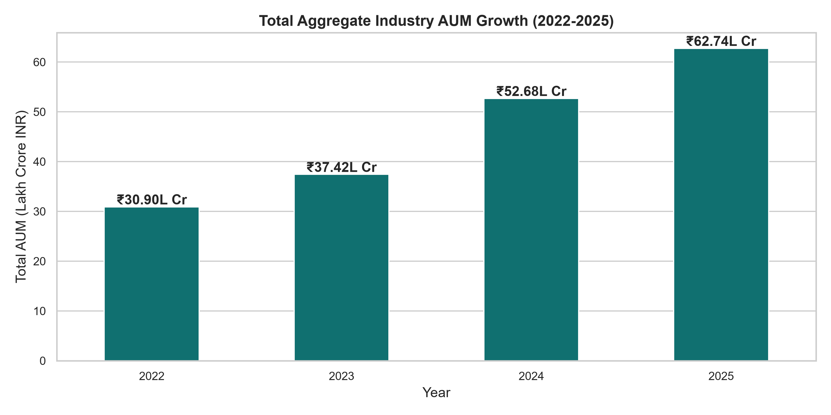
EDA Highlight: Industry AUM Growth

Slide 6
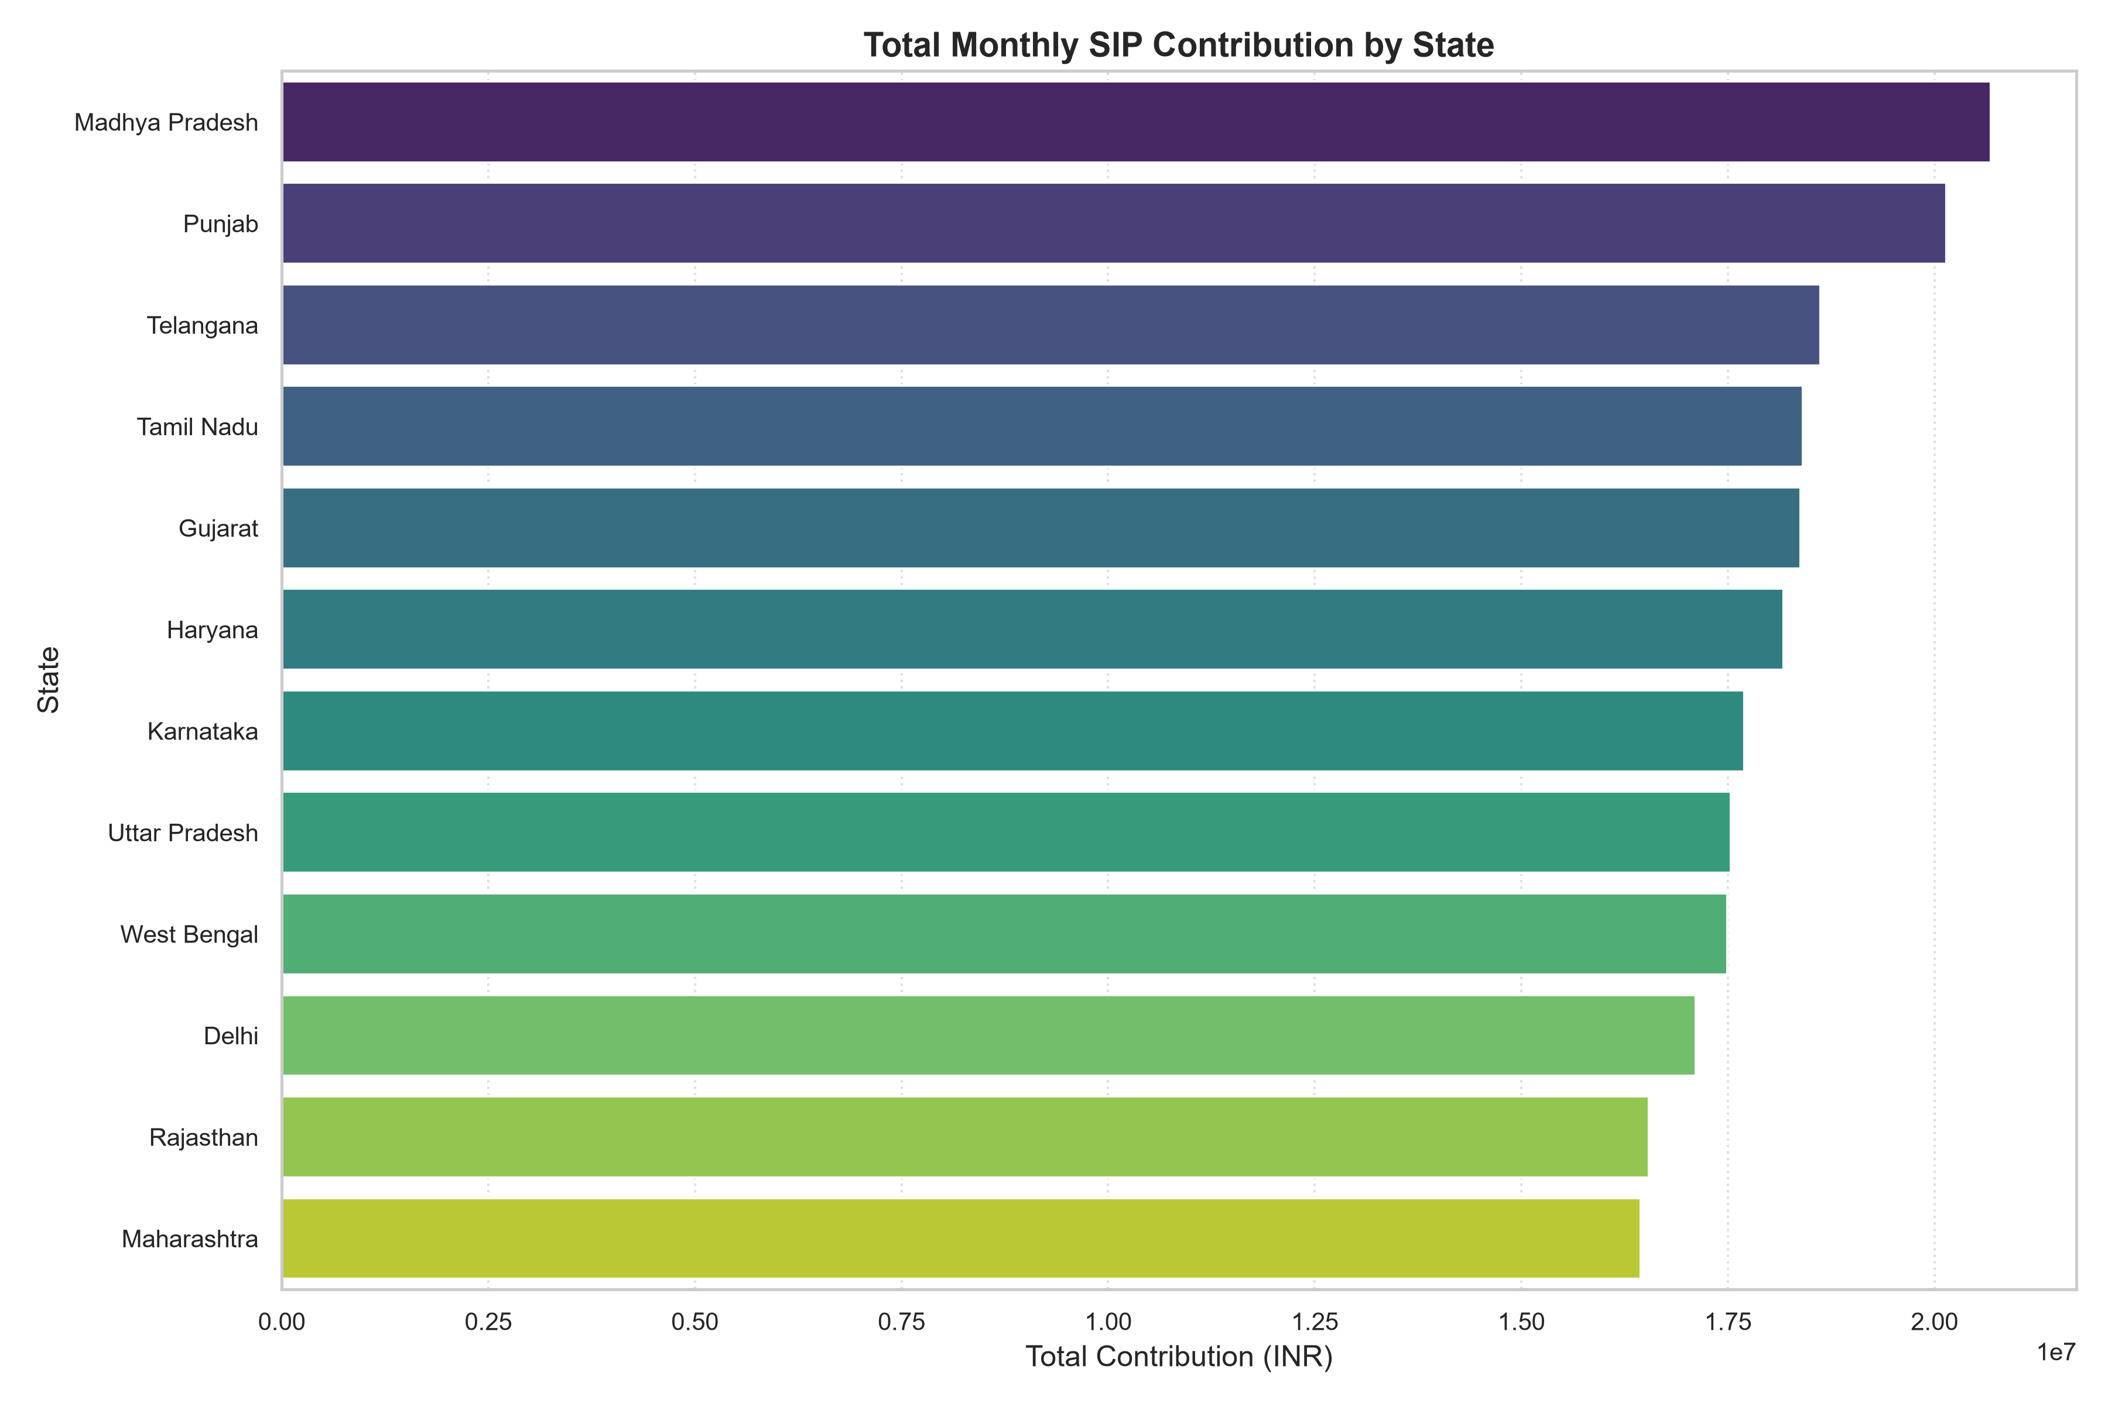
EDA Highlight: Investor Inflow by State

Slide 7
Mutual Fund Performance Analytics
Comprehensive performance ranking across 40 schemes:
CAGR: Annualized returns calculated for 1yr, 3yr, and 5yr using 252 trading days.
Sharpe Ratio: Annualized risk-adjusted excess return using Rf = 6.5% (RBI repo rate proxy).
Sortino Ratio: Downside deviation risk-adjusted return (excluding positive return days).
Alpha & Beta: Calculated via OLS regression against Nifty 100 benchmark index.
Maximum Drawdown: Tracks worst peak-to-trough drop and historical recovery duration.
Scorecard (0-100): Composite metric: 30% Return + 25% Sharpe + 20% Alpha + 15% Expense (inverse) + 10% Max Drawdown (inverse).

Slide 8
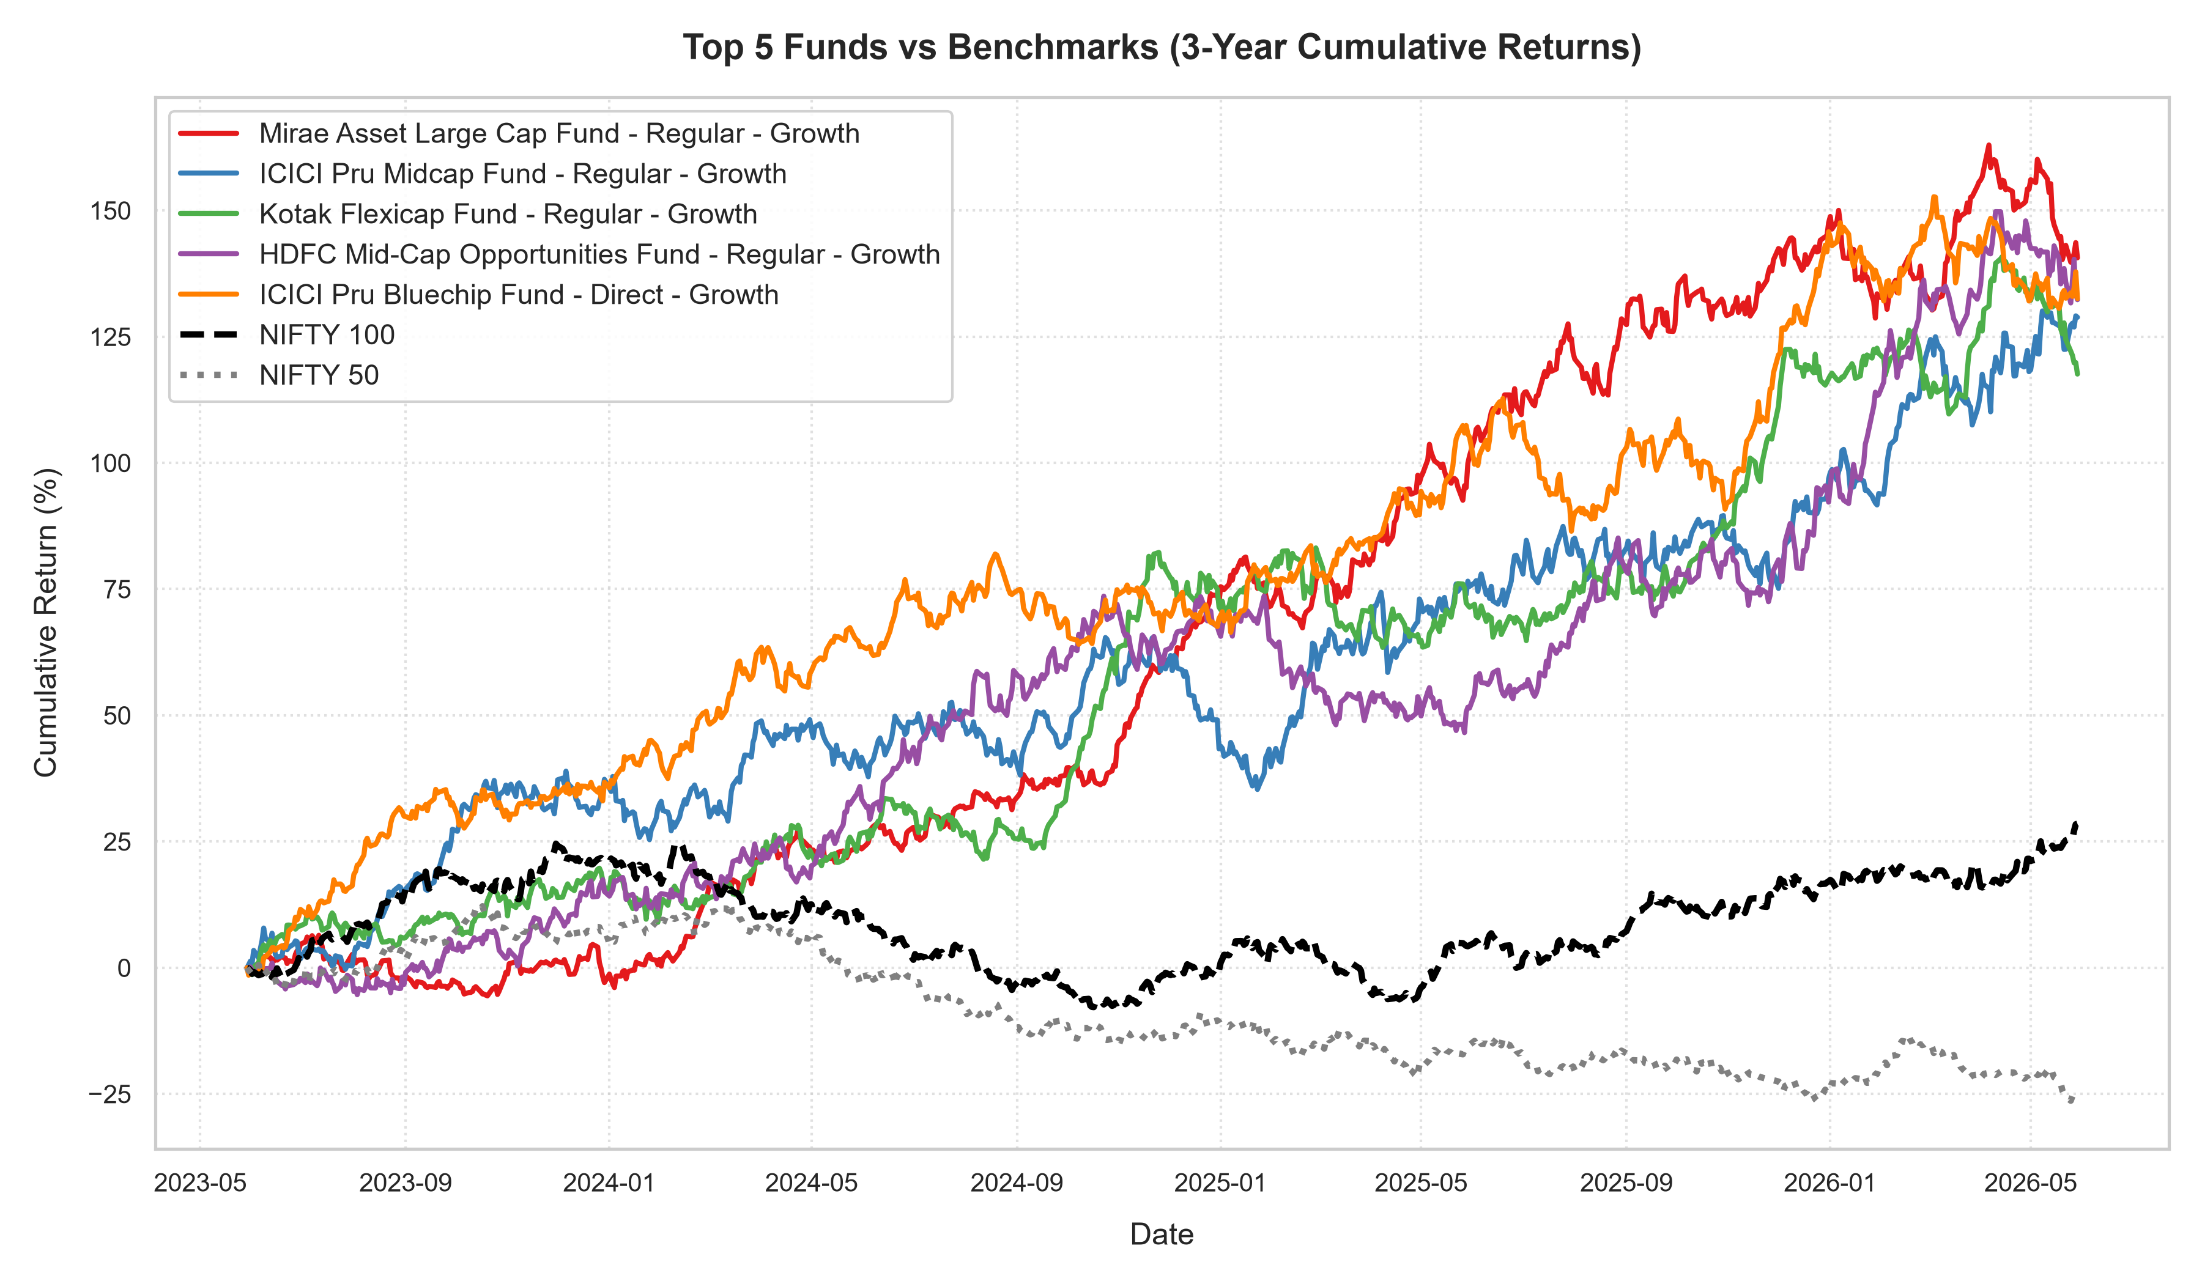
Performance: Top Funds vs Benchmark (3 Years)

Slide 9
Advanced Risk Modeling: VaR & CVaR
Assessing extreme tail risk via Historical Value at Risk (95%):
VaR (95%) represents the 5th percentile of daily returns for each mutual fund.
CVaR (Conditional VaR) is the average loss on days exceeding the VaR threshold.
SBI Small Cap Fund (VaR: -2.12%) and Quant Mid Cap Fund (VaR: -1.95%) have the highest daily tail risk.
HDFC Liquid Fund (VaR: -0.01%) represents minimal daily risk.
Sector HHI: herfindahl-hirschman index highlights high concentration in HDFC Money Market Fund (HHI: 3,124) vs. Nippon Large Cap (HHI: 1,142).

Slide 10
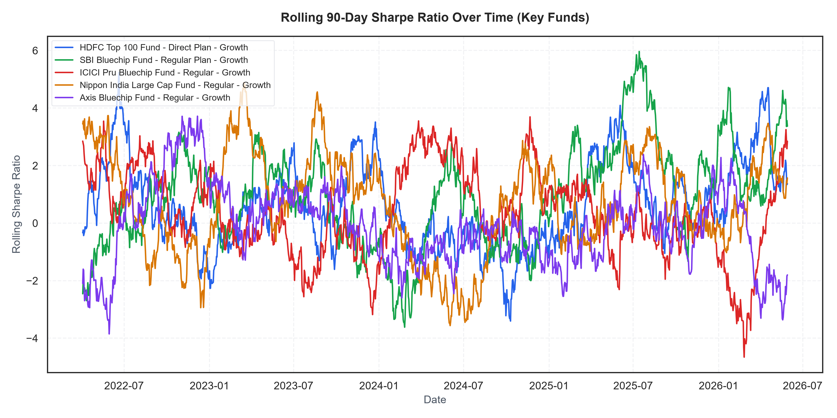
Advanced: Rolling 90-Day Sharpe Ratio

Slide 11
Premium Interactive Web Dashboard
A custom-engineered Single Page Web App (dashboard/server.py + index.html) with Chart.js visualization:
Industry Overview: KPI cards for total industry assets and line trends.
Fund Performance: Live Risk-Return scatter plot and sortable tables.
Investor Analytics: Split of transactions by state, age, and payment modes.
SIP & Market Trends: Dual-axis monthly SIP inflow vs. Nifty 50 close.
Intelligent Fund Recommender: Embedded engine recommending top 3 funds by Sharpe ratio matching risk appetites (Low / Moderate / High).

Slide 12
Key Takeaways & Recommendations
Key Recommendations:
1. Mitigate SIP Attrition: Deploy SMS alerts to resolve the 97.8% 'at-risk' transactions.
2. Diversify Concentration: Rebalance sector exposure for highly concentrated funds (HHI > 2800).
3. Automate Data Loads: Ensure the weekdays 8 PM scheduler remains active to pull live NAVs.
Thank You! Q&A Session.

