Slide 1
DISASTER MANAGEMENT & WOMEN SAFETY
SRUTI VERMA(18BCE1005)
NITHESH GURUDAS(18BCE1101)
RAM GUNASEKARAN(18BCE1234)
SURYA S(18BLC1124)
JACOB JEBARAJ(18BEC1107)

Slide 2
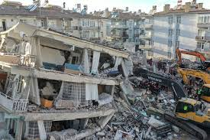
PROBLEM STATEMENT(A): DISASTER MANAGEMENT
1. EARTHQUAKES:
It is detected by accelerometer in black box
It will notify people not to enter into danger zone indicated on the map
It will send notification to government authorities to reach the place early

Slide 3
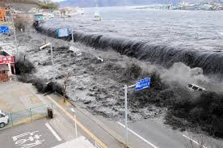
PROBLEM STATEMENT(A): DISASTER MANAGEMENT
Tsunamis:
Depending upon the magnitude of the earthquake ,probability of tsunami will be calculated based upon the location of earthquake,
like if that area is a coastal area and magnitude of earthquake is high then alert will be given as notification to government,police,NGOs,people etc.

Slide 4
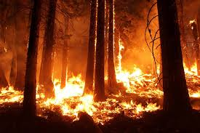
PROBLEM STATEMENT(A): DISASTER MANAGEMENT
2. FIRE:
Our project detects fire when it starts using the camera module(image classification) and alerts the people around and drive them to safety.

Slide 5
PROBLEM STATEMENT(A): DISASTER MANAGEMENT
3. FLOODS :
By calculating amount of rainfall
Using level sensor(ultra sonic)
If it is above the limit of normality, it will notify the civilians

Slide 6
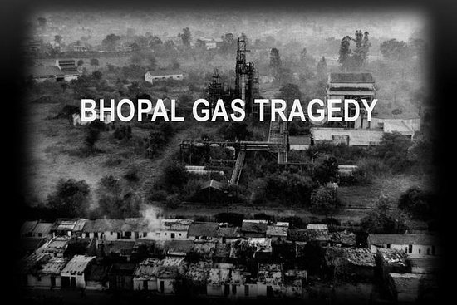
PROBLEM STATEMENT(A): DISASTER MANAGEMENT
4. GAS LEAK:
NH3, NOx, alcohol, Benzene, smoke, CO2, etc. are detected using sensors and notification is sent to people about the possible accidents that can happen and risk of going to a particular location.

Slide 7
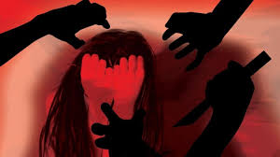
PROBLEM STATEMENT(B): WOMEN SAFETY
1. In our project we have implemented features to detect harrassment against women.
2. It consists
of a camera module which constantly surveils the location and tries to classify human-human
interactions as harrasament or not .
3. If it classifies as harrasment then it sends alert to the near
by police authorities and tries to identify the harraser's details using government database.

Slide 8
PROBLEM STATEMENT(C): HELPING THE DISABLED
We are helping the disabled(blind) by making his neighbours aware that he is blind so that in road traffic and in some other crowd, so that the people around the disabled may not intervene and cause unneccesary problems.

Slide 9


