Slide 1

MULTIMEDIA PROJECT
By NITHESH K R

Slide 2

MULTIMEDIA...

Slide 3
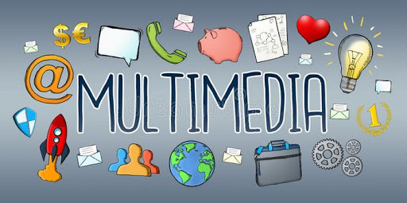
What is MULTIMEDIA..?
Multimedia is content that uses a combination of different content forms such as text, audio, images, animations, video and interactive content. Multimedia contrasts with media that use only rudimentary computer displays such as text-only or traditional forms of printed or hand-produced material.

Slide 4

Multimedia application services:s:
Audio, video processing
Education and training
Multimedia analysis and Internet
Artificial Intelligence
Virtual reality and 3-D imaging
Wireless, Mobile Computing
Animation and Graphics
Visual Communication

Slide 5
NITHESH K R
RA1711003011095
nr5892@srmist.edu.in
Contact:

