Slide 1
ASR Failures under
Controlled Acoustic Conditions
Separating energetic from informational masking in Whisper large-v3
Jainithissh S — CB.SC.U4AIE23129
Krishna Prakash S — CB.SC.U4AIE232138
Nitheshkummar C — CB.SC.U4AIE23155
Akhilesh Kumar S — CB.SC.U4AIE232170
Team B5
Faculty: Dr. Iswarya K V
22AIE450 — Speech Processing
School of AI, Amrita Vishwa Vidyapeetham
Notes:
Final project. Whisper large-v3 under calibrated single-variable degradations, with a control condition that separates the two masking mechanisms.

Slide 2
Introduction
Clean benchmarks do not predict field reliability
ASR now sits in medical, legal and emergency transcription paths
Whisper large-v3 reports under 4% WER on clean read speech
Field deployments degrade unpredictably against that number
Published benchmarks change several acoustic factors at once
Cause of failure therefore cannot be attributed to any one factor
3.44%
clean baseline WER
9.39%
cafe babble at 5 dB
11.19%
speech at 1.5x rate
2
Notes:
The gap between the clean number and field behaviour is the motivation.

Slide 3
Background and Key Terminology
1
WER
(S + D + I) / N, summed over the corpus before dividing
The two masking types are the axis this project turns on
2
SNR
20 log10 (RMS signal / RMS noise), set on broadband RMS
3
Energetic masking
Noise overlaps speech in frequency and swamps it
4
Informational masking
Masker is audible yet still competes for interpretation
5
MFCC / STE / ZCR
Classical features used here as distortion measures
3
Notes:
Energetic vs informational is the distinction the whole project is built to measure.

Slide 4
Literature Review I — Models and Corpora
# | Work | Approach | What it established | Gap for us
[1] | Radford 2022, Whisper | Encoder-decoder, 680k h weak supervision | Near-human zero-shot ASR | Clean benchmarks only
[2] | Panayotov 2015, LibriSpeech | 1000 h read English at 16 kHz | De facto English ASR benchmark | No noisy conditions
[3] | Vaswani 2017, Transformer | Self-attention sequence model | Architecture behind Whisper | No acoustic robustness study
[4] | Chan 2016, Listen Attend Spell | Attention encoder-decoder ASR | End-to-end ASR without alignment | Small-scale, clean data
[5] | Gulati 2020, Conformer | Convolution-augmented transformer | Strong accuracy per parameter | Robustness not decomposed
!
Every model above is benchmarked on clean read speech; none reports WER against a calibrated acoustic variable.
4

Slide 5
Literature Review II — Robustness and Augmentation
# | Work | Approach | What it established | Gap for us
[6] | Gong 2023, Whisper-AT | Probed noise encoding in Whisper | Whisper encodes noise type, not invariant | No WER per noise at fixed SNR
[7] | Shah 2024, Speech Robust Bench | 114 perturbation scenarios | Broad robustness scoring | Aggregate, not single-variable
[8] | Cornell 2023, CHiME-7 DASR | Multi-device distant recognition | Realistic far-field difficulty | Confounds many factors at once
[9] | Barker 2015, CHiME-3 | Real and simulated noisy speech | Standard noisy ASR task | Recorded scenes, uncalibrated SNR
[10] | Park 2019, SpecAugment | Masking on the spectrogram | Augmentation improves ASR | Training method, not diagnosis
!
Robustness work measures how much accuracy drops, not which acoustic mechanism caused the drop.
5

Slide 6
Literature Review III — Masking and Signal Sources
# | Work | Approach | What it established | Gap for us
[11] | Brungart 2001 | Two competing talkers | Separated energetic from informational masking | Human listeners, not ASR
[12] | Cooke 2006 | Glimpsing model of speech in noise | Listeners exploit spectro-temporal dips | Never tested on a neural ASR
[13] | Festen 1990 | Fluctuating noise vs interfering speech | Modulated maskers behave differently | Human speech-reception thresholds
[14] | Varga 1993, NOISEX-92 | Standard recorded noise corpus | Reusable noise conditions | Fixed recordings, no control masker
[15] | Snyder 2015, MUSAN | Music, speech and noise corpus | Widely used noise source | No spectrum-matched control
!
Psychoacoustics separated the two masking types in human listeners; that control has not been carried over to ASR.
6

Slide 7
Gaps Identified
1
No single-variable isolation
2
No spectrum-matched control
Benchmarks vary several acoustic factors together
Babble is compared against white noise, which differs in two ways at once
3
Channel and temporal axes thin
4
Feature deviation unlinked to WER
Bandwidth and speaking rate rarely studied under calibrated control
Distortion is reported without testing whether it predicts failure
5
Hallucination treated anecdotally
Trailing-phrase insertions are not measured per condition
7
Notes:
Gap 2 is the one this project closes with the SSN control.

Slide 8
Objectives
1
Build a pipeline that varies exactly one acoustic factor at a time
2
Measure Whisper large-v3 WER across 22 calibrated conditions
3
Add a spectrum-matched control that isolates informational masking
4
Test whether MFCC, STE and ZCR deviation predicts recognition failure
5
Quantify end-of-audio hallucination as a per-condition confound
6
Verify every degradation from the audio rather than trusting the code
8

Slide 9
Dataset Description
LibriSpeech dev-clean, stratified by speaker
Property | Value
Source corpus | LibriSpeech dev-clean
Utterances | 150, stratified across 40 speakers
Reference words | 3,056 (mean 20.4 per utterance)
Sample rate | 16,000 Hz
Bit depth / channels | 16-bit PCM / mono
Duration range | 3.10 - 14.93 s (mean 7.22 s)
Total audio | 18.1 minutes
Selection seed | 42, reproducible end to end
Why this corpus
Clean read speech isolates the degradation we add
Ground-truth transcripts are exact, not forced-aligned
Speaker stratification stops one voice dominating
3-15 s clips fit Whisper's 30 s window without chunking
9
Notes:
2,703 utterances available; 150 selected under a seeded stratified draw.

Slide 10
Experimental Conditions
22 conditions x 150 utterances + 150 clean = 3,450 trials
A — Additive noise
SNR 20 / 15 / 10 / 5 dB
2,400 files
White, pink, cafe babble, SSN
B — Channel
300-3400 Hz, Butterworth order 4
150 files
Telephonic bandpass
C — Temporal
Rate 1.2x and 1.5x (faster)
300 files
Time-scale modification
C — Temporal
0.5 s start, 1.0 s and 2.0 s mid
450 files
Silence insertion
SSN is a control, not a fifth noise — see the methodology slide
10

Slide 11
Methodology — Pipeline
Eight stages, checkpointed, seeded end to end
0
1
2
3
4
5
6
Corpus
prepare
Baseline
inference
Axis A
noise + ASR
Axis B / C
degrade + ASR
Acoustic
verification
Feature
extraction
Analysis
+ plots
Inference
faster-whisper large-v3, INT8 on CUDA, beam 5, condition_on_previous_text off
Reproducibility
Four independent RNG streams; noise drawn before the resume check
Verification
3,750 checks re-derive SNR, bandwidth and duration from the written audio
11

Slide 12
Degradation Core
Written on numpy and scipy so every step is auditable
SNR mixing
Noise generation
k = RMS(clean) / (RMS(noise) x 10^(SNR/20))
degraded = clean + k x noise
rescale the whole mixture if it would clip
White — i.i.d. Gaussian, flat spectrum
Pink — 1/sqrt(f) filter applied in the FFT domain
Cafe — 15 talkers from a disjoint speaker pool
SSN — cafe babble with randomised phase
1
Zero-phase filtering
filtfilt keeps the telephonic band-limit free of phase distortion
2
Hand-written phase vocoder
Time-scale change on scipy STFT; pitch preserved, librosa avoided
3
Disjoint babble pool
2,553 utterances, none of them in the 150-utterance test set
12

Slide 13
The Control That Separates the Two Mechanisms
Cafe babble differs from white noise in two ways at once — spectrum and linguistic content
White noise
SSN (control)
Cafe babble
Flat spectrum
No speech content
Cafe spectrum
No speech content
Cafe spectrum
Speech content
SSN is the cafe babble with its phase spectrum randomised — identical magnitude spectrum, no structure
SSN - white
energetic masking
energy moved into the speech bands
cafe - SSN
informational masking
same spectrum, linguistic content added
Validity check: |SII(cafe) - SII(SSN)| = 0.0005, so the two are spectrally matched
13
Notes:
This is the methodological contribution. Without SSN the informational claim cannot be made.

Slide 14
Results — Word Error Rate by Condition
Corpus-level WER: total errors over total reference words
Condition | 20 dB | 15 dB | 10 dB | 5 dB
White noise | 3.53% | 3.89% | 4.25% | 6.28%
Pink noise | 3.83% | 4.02% | 3.96% | 4.78%
SSN (control) | 3.27% | 3.40% | 3.73% | 5.20%
Cafe babble | 2.91% | 3.24% | 4.12% | 9.39%
Axis B / C condition | WER
Clean baseline | 3.44%
Telephonic 300-3400 Hz | 3.27%
Silence 0.5 s at start | 4.12%
Silence 1.0 s mid | 3.40%
Silence 2.0 s mid | 3.53%
Speaking rate 1.2x | 5.86%
Speaking rate 1.5x | 11.19%
Cafe babble is the worst additive condition at 5 dB
Band-limiting to the telephone band costs nothing measurable
The worst single result adds no noise at all — it is speaking rate
Only 9 of 22 conditions separate from clean at 95% confidence
14

Slide 15
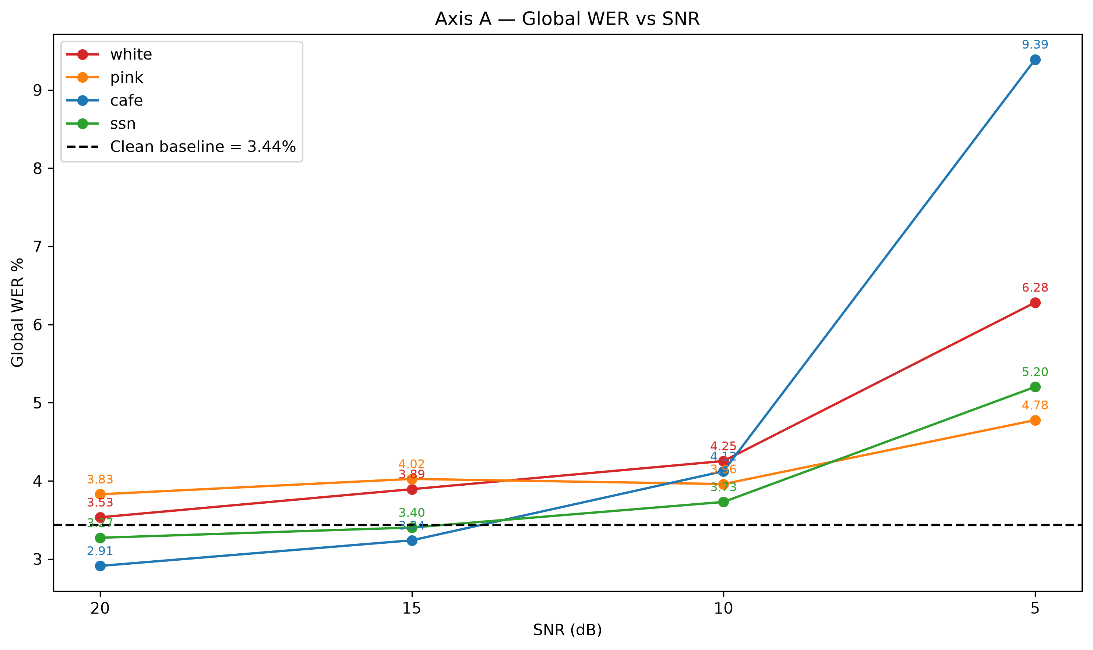
Results — Axis A Degradation Curves
Reading the curves
Severity increases left to right
Cafe starts below the baseline and ends worst
Pink stays flattest across the range
SSN tracks white but consistently below it
The cafe curve is non-linear, not a gradient
15

Slide 16
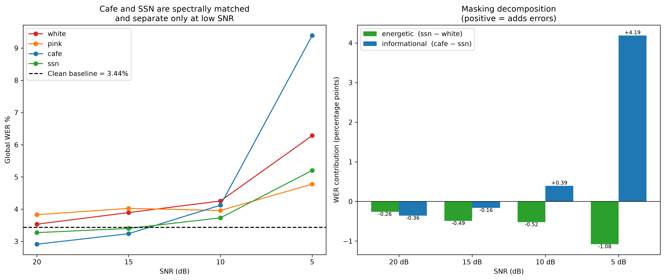
Results — Separating the Two Mechanisms
The central result of the project
SNR | Energetic | Informational
20 dB | -0.26 | -0.36
15 dB | -0.49 | -0.16
10 dB | -0.52 | +0.39
5 dB | -1.08 | +4.19
percentage points
Energetic term is negative — speech-shaped energy is less harmful than flat energy at the same SNR
Informational masking is zero at 20, 15 and 10 dB, then +4.19 points at 5 dB
Pooled over 600 paired cells: energetic -0.59 (p = 0.0008), informational +1.01 (p = 0.00002)
16
Notes:
Cafe and SSN share a spectrum to |dSII| = 0.0005, so the gap between them cannot be energetic.

Slide 17
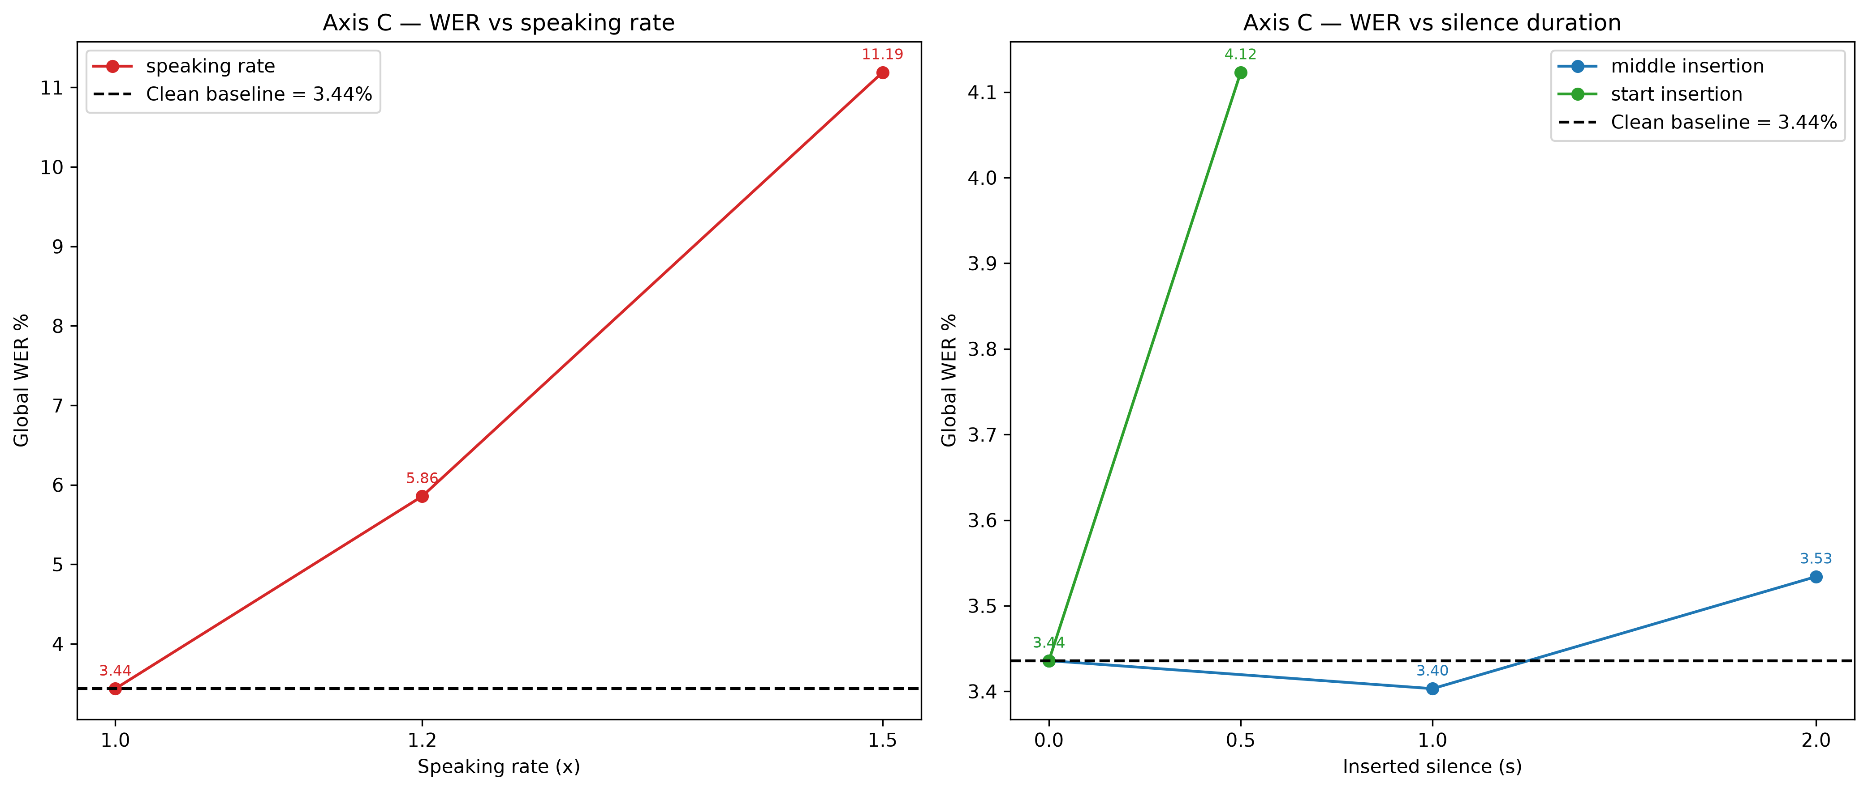
Results — Axis B (Channel) and Axis C (Temporal)
Axis B — channel
Telephonic 3.27% vs 3.44% clean
No measurable cost
Usable information sits inside 300-3400 Hz
Axis C — temporal
Rate 1.5x reaches 11.19%
Silence at the start hurts, mid-utterance does not
No noise added in either case
The largest single degradation in the study involves no added noise and no spectral change
That points at decoder alignment rather than the acoustic front end
17

Slide 18
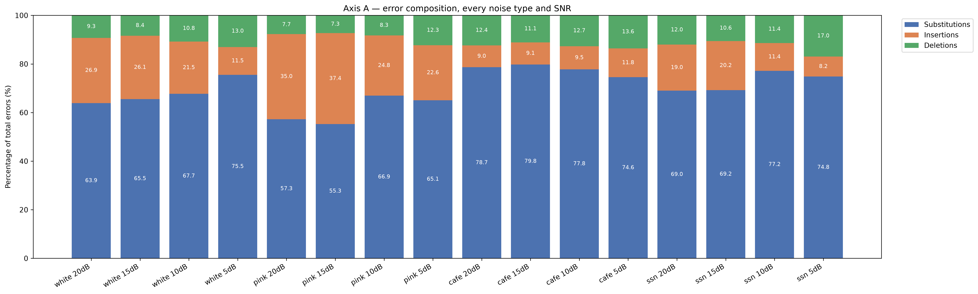
Results — Error Composition
Substitutions, insertions and deletions as a share of each condition's errors
Cafe damage is substitutions and deletions, not insertions — insertion share at 5 dB: white 11% pink 23% ssn 8% cafe 12%
Cafe's insertion share stays near 9-12% at every SNR while white's falls from 27% to 11%
Cafe is the only condition with zero trailing hallucination at all four SNR levels
The mid-term reading of this plot was the opposite and has been corrected
18

Slide 19
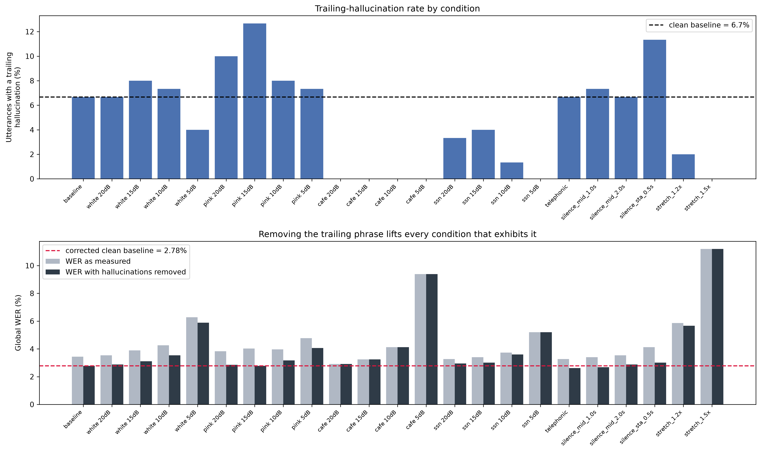
Results — End-of-Audio Hallucination
A condition-dependent confound, not a constant offset
What happens
Whisper appends "thank you" to quiet endings
6.7% of clean utterances affected
20 of the baseline's 32 insertions
Cafe suppresses it at every SNR
SSN only partly — so it is not purely spectral
Corrected clean baseline: 3.44% becomes 2.78%
Uncorrected, a mild condition can post a lower WER than clean audio while recognising slightly worse
Reported as a secondary metric only — corpus WER remains the headline number
19

Slide 20
Results — Does Spectral Distortion Predict Failure?
Condition | Mean MFCC MSE | WER
Telephonic | 831.8 | 3.27% | no measurable cost
White 5 dB | 244.9 | 6.28%
Pink 5 dB | 93.7 | 4.78%
SSN 5 dB | 49.7 | 5.20%
Cafe 5 dB | 33.5 | 9.39% | worst additive condition
The ordering inverts
Telephonic produces 25x cafe's MFCC deviation and costs nothing; cafe barely moves the features and is the most damaging.
Pooled Pearson finds nothing: MFCC r = 0.028 (p = 0.163), STE r = 0.008, ZCR r = 0.026
Spearman is significant for MFCC (p = 8.6e-05) and STE (p = 1.4e-12) — the link is monotonic, not linear
Within a fixed noise type it is positive: cafe r = 0.206, SSN r = 0.120
Between noise types it reverses — pooling cancels both, a Simpson's paradox
Spectral distance ranks severity inside a masker and misleads across maskers
20

Slide 21
Statistical Rigour and Verification
Statistics
Verification
Paired bootstrap
Acoustic verification
4,000 resamples per contrast, utterance-level pairing
3,750 checks re-derive SNR, bandwidth and duration from disk
Wilcoxon signed-rank
Independent method
Reported alongside; disagreement is labelled, not resolved
Verifier does not call the augmentation code it checks
Resolution limit
Reproducibility
About +/-0.6 points on 3,056 reference words
Full re-run on different hardware matched to 4 decimal places
Honest count
Unit tests
Only 9 of 22 conditions separate from clean at 95%
98 tests covering the DSP, metrics and control validity
21

Slide 22
Conclusion
Failure is not proportional to spectral distortion
1
Band-limiting discards most of the spectrum at no cost; babble barely moves the features and is the worst masker
Informational masking is real and threshold-like
2
Zero down to 10 dB, then +4.19 points at 5 dB against a spectrum-matched control
Concentrating noise in the speech bands helps
3
Energetic term is negative: speech-shaped noise is milder than flat noise at the same SNR
The worst degradation is temporal, not acoustic
4
Speaking rate 1.5x gives 11.19% on spectrally clean audio
Whisper is robust to acoustic perturbation and fragile to structural interference

Slide 23
Limitations and Future Work
Limitations
Future work
1
150 utterances resolve about +/-0.6 WER points, no finer
1
Sweep talker count to turn the 5 dB threshold into a curve
2
The cafe minus SSN term includes a small modulation component
2
Compound conditions to test whether the axes add
3
One talker count only — babble masks most at 2 to 4 talkers
3
Repeat on spontaneous and accented speech
4
Single model, single corpus, read speech, INT8 quantised
4
Extend the control design to reverberation
23

Slide 24
References (1 of 2)
IEEE style; every entry carries a resolvable DOI link
[1]
A. Radford et al., "Robust speech recognition via large-scale weak supervision," arXiv:2212.04356, 2022.
doi.org/10.48550/arXiv.2212.04356
[2]
V. Panayotov et al., "LibriSpeech: An ASR corpus based on public domain audio books," ICASSP, 2015.
doi.org/10.1109/ICASSP.2015.7178964
[3]
A. Vaswani et al., "Attention is all you need," NeurIPS, 2017.
doi.org/10.48550/arXiv.1706.03762
[4]
W. Chan et al., "Listen, attend and spell," ICASSP, pp. 4960-4964, 2016.
doi.org/10.1109/ICASSP.2016.7472621
[5]
A. Gulati et al., "Conformer: Convolution-augmented transformer for speech recognition," Interspeech, 2020.
doi.org/10.21437/Interspeech.2020-3015
[6]
Y. Gong et al., "Whisper-AT: Noise-robust ASR are also strong audio event taggers," Interspeech, 2023.
doi.org/10.21437/Interspeech.2023-2193
[7]
M. A. Shah et al., "Speech Robust Bench: A robustness benchmark for ASR," arXiv:2403.07937, 2024.
doi.org/10.48550/arXiv.2403.07937
[8]
S. Cornell et al., "The CHiME-7 DASR challenge," arXiv:2306.13734, 2023.
doi.org/10.48550/arXiv.2306.13734
[9]
J. Barker et al., "The third CHiME speech separation and recognition challenge," ASRU, 2015.
doi.org/10.1109/ASRU.2015.7404837
[10]
D. S. Park et al., "SpecAugment: A simple data augmentation method for ASR," Interspeech, 2019.
doi.org/10.21437/Interspeech.2019-2680
24

Slide 25
References (2 of 2)
IEEE style; every entry carries a resolvable DOI link
[11]
D. S. Brungart, "Informational and energetic masking effects in the perception of two simultaneous talkers," JASA, vol. 109, 2001.
doi.org/10.1121/1.1345696
[12]
M. Cooke, "A glimpsing model of speech perception in noise," JASA, vol. 119, 2006.
doi.org/10.1121/1.2166600
[13]
J. M. Festen and R. Plomp, "Effects of fluctuating noise and interfering speech on the speech-reception threshold," JASA, vol. 88, 1990.
doi.org/10.1121/1.400247
[14]
A. Varga and H. J. M. Steeneken, "Assessment for ASR: NOISEX-92," Speech Communication, vol. 12, 1993.
doi.org/10.1016/0167-6393(93)90095-3
[15]
D. Snyder et al., "MUSAN: A music, speech, and noise corpus," arXiv:1510.08484, 2015.
doi.org/10.48550/arXiv.1510.08484
[16]
S. Davis and P. Mermelstein, "Comparison of parametric representations for monosyllabic word recognition," IEEE TASSP, vol. 28, 1980.
doi.org/10.1109/TASSP.1980.1163420
[17]
J. Laroche and M. Dolson, "Improved phase vocoder time-scale modification of audio," IEEE TSAP, vol. 7, 1999.
doi.org/10.1109/89.759041
[18]
T. Ko et al., "A study on data augmentation of reverberant speech for robust speech recognition," ICASSP, 2017.
doi.org/10.1109/ICASSP.2017.7953152
[19]
A. Baevski et al., "wav2vec 2.0: A framework for self-supervised learning of speech representations," NeurIPS, 2020.
doi.org/10.48550/arXiv.2006.11477
25

